Slide 1
Concept study
GOME-2/AVHRR radiance inter-comparison
Ruediger Lang, Rose Munro, Yakov Livschitz, Joerg Ackermann
EUMETSAT
Barry Latter
NCEO/RAL

Slide 2
Outline
Motivation
Approach
Preliminary results by NCEO/RAL (Barry Latter, et al.)
Preliminary results by EUMETSAT
GOME-2/Metop-A
instrument and level 0 to 1B radiometric calibration team at EUMETSAT:
Rose Munro (Mission scientist, PRD/MET)
Ruediger Lang (Product expert, OPS/MOD)
Yakov Livschitz (Software engineer, OPS/MOD)
Antoine Lacan (Instrument engineer, LEO)
Richard Dyer (Instrument engineer, OPS/CCD)
AVHRR/Metop-A
Joerg Ackermann (Product expert, OPS/MOD)
NOEC/RAL:
Member of GOME-SAG (B. Kerridge, R. Siddans, Barry Latter, et al.)

Slide 3
Motivation
Radiometric accuracy:
  Day-one and instrument anomaly offset
  Long-term in-orbit changes (both nominal and non-nominal)
    Triggered by GOME-2 in-orbit throughput degradation
Instrument alignment and geo-location pointing:
  Identify miss-alignments or pointing errors.
    Triggered by RAL study results.
    Investigation by EUMETSAT started in April.

Slide 4
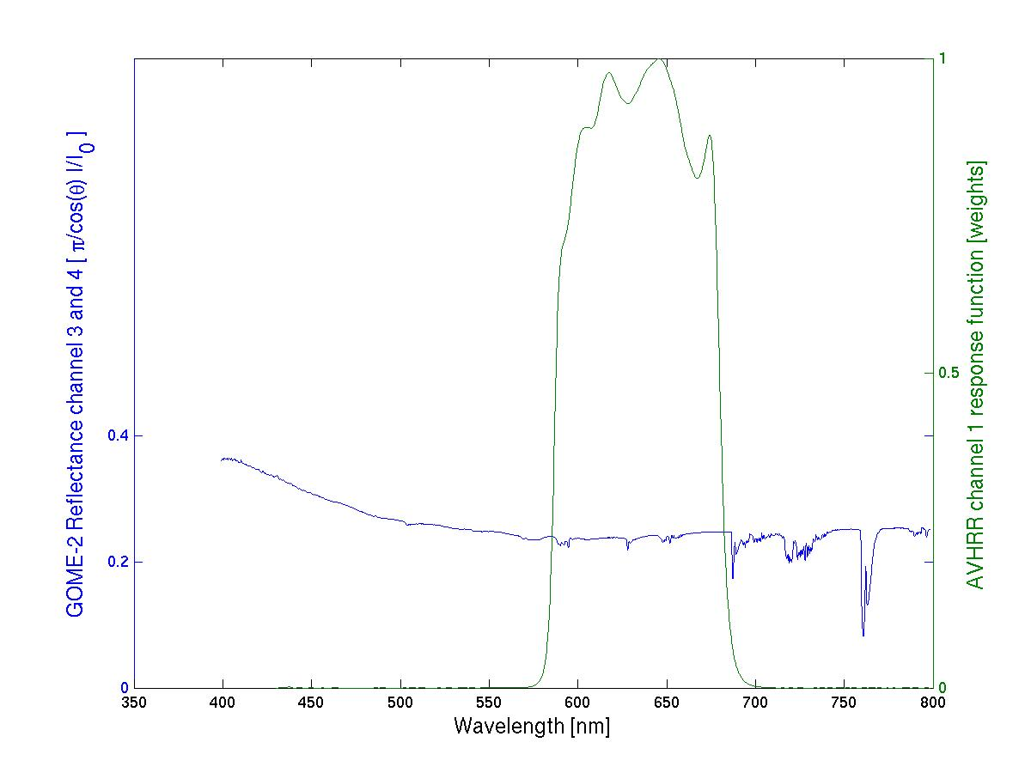
GOME-2 / AVHRR radiance co-location
GOME-2 channel 3 and 4 and AVHRR channel 1 data
AVHRR ch1
response function
GOME-2 Ch:4 (Band 6)
1024 measurements
GOME-2 Ch:3 (Band 5)
1024 measurements

Slide 5
GOME-2 / AVHRR radiance co-location
GOME-2 channel 3 and 4 and AVHRR channel 1 data
AVHRR ch1
response function
GOME-2 Ch:4 (Band 6)
1024 measurements
GOME-2 Ch:3 (Band 5)
1024 measurements
Detector pixel read-out sequence
direction GOME-2 channel 3
Detector pixel read-out sequence
direction GOME-2 channel 4
Read-out of all 1024 detector pixel takes 1024*45,78 μs = 46.875 ms introducing “spatial aliasing” (~2km across-track)

Slide 6


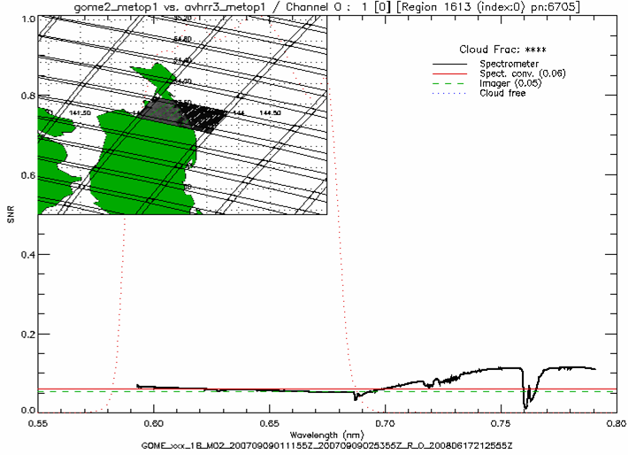
AVHRR/3 Validation using GOME-2
Co-located GOME-2 and AVHRR signals
Courtesy of Barry Latter et al. (2009)
AVHRR/3
geo-shifted
GOME-2
ground pixel
Wavelength (μm)

Slide 7
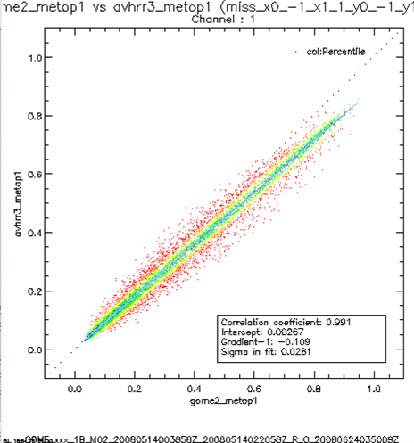
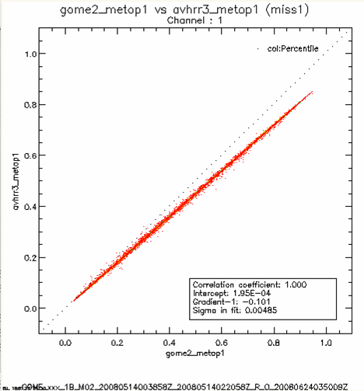
AVHRR/3 Validation using GOME-2
Scatter and offset before/after geo adjustment
Courtesy of Barry Latter et al. (2009)
Nominal co-location
Adjusted co-location
Across track: 20% FOV (~2 km)
Along track: 6% FOV (~ 2.2 km)
AVHRR/3 Target Reflectance
GOME-2 Target Reflectance
GOME-2 Target Reflectance
14th May 2008
Across Track shift is explained by GOME-2 read-out period (geo-location refers to start of the spectrum)
Along Track shift is very likely a real geo-location difference (investigations ongoing!)
GOME-2 convoluted target reflectancies are higher by about 10 % (relative value)

Slide 8
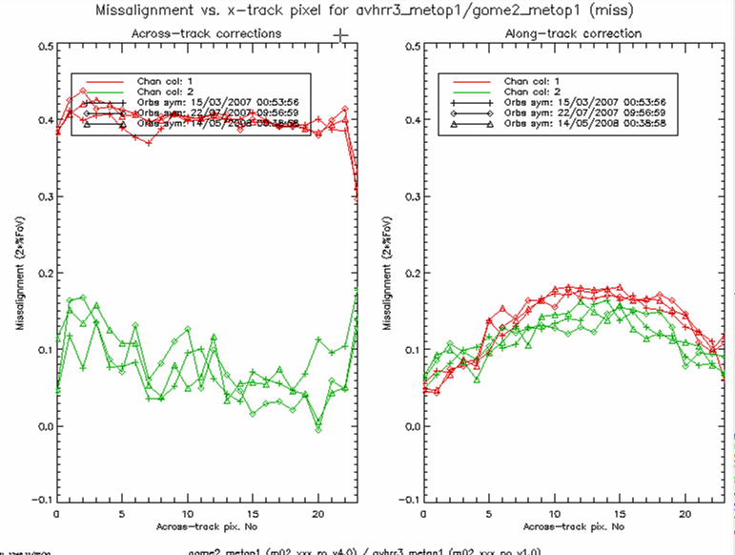
AVHRR/3 Validation using GOME-2
GOME-2 scanner position dependent geo-offset (in 2*%FOV)
Courtesy of Barry Latter et al. (2009)
AVHRR
channel1
14th May 2008
Across-track offset between GOME-2 and AVHRR can be explained by “spatial aliasing”
Along track offset however is not explained yet!
potential miss-pointing by GOME-2
AVHRR
Channel2
Only indicative because GOME ch4 covers only 20% of AVHRR ch2 plus significant water vapour contamination!!!
East
West
East
West

Slide 9
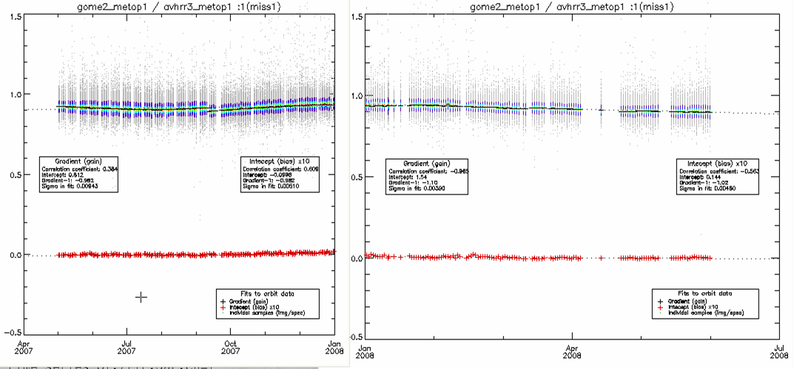
AVHRR/3 Validation using GOME-2
Long-term radiance inter-comparison
Courtesy of Barry Latter et al. (2009)

Slide 10
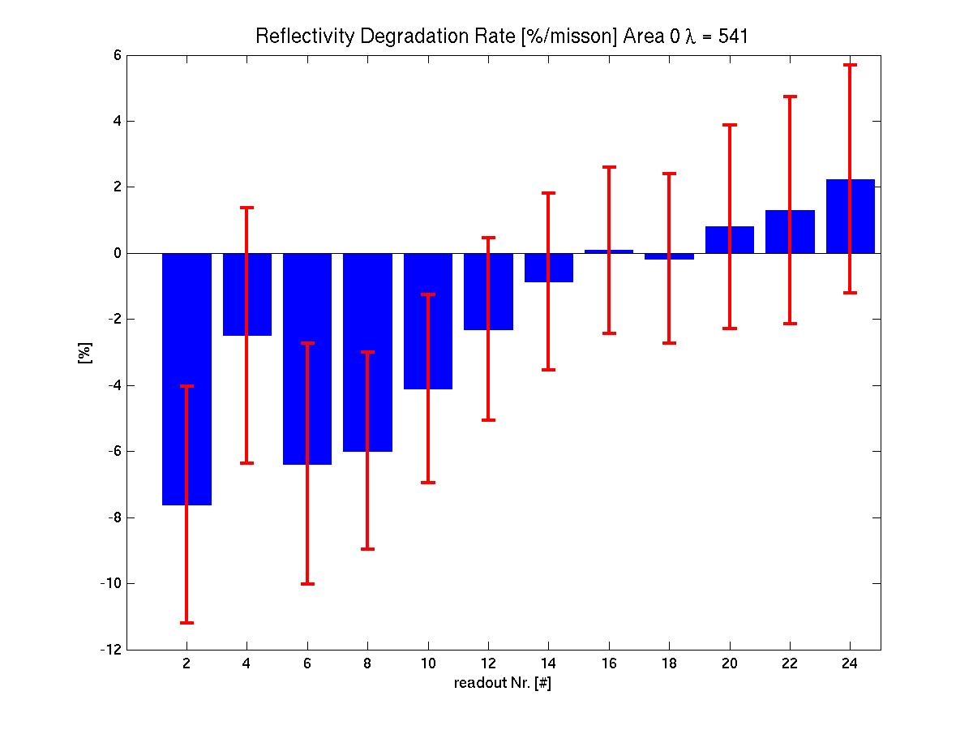
GOME-2 Reflectivity degradation rate
Sahara – 541nm – relative to mean of 2007
Reflectivity Sahara
Normalised to 2007
Every 2nd scanner angle position is shown
East
West

Slide 11
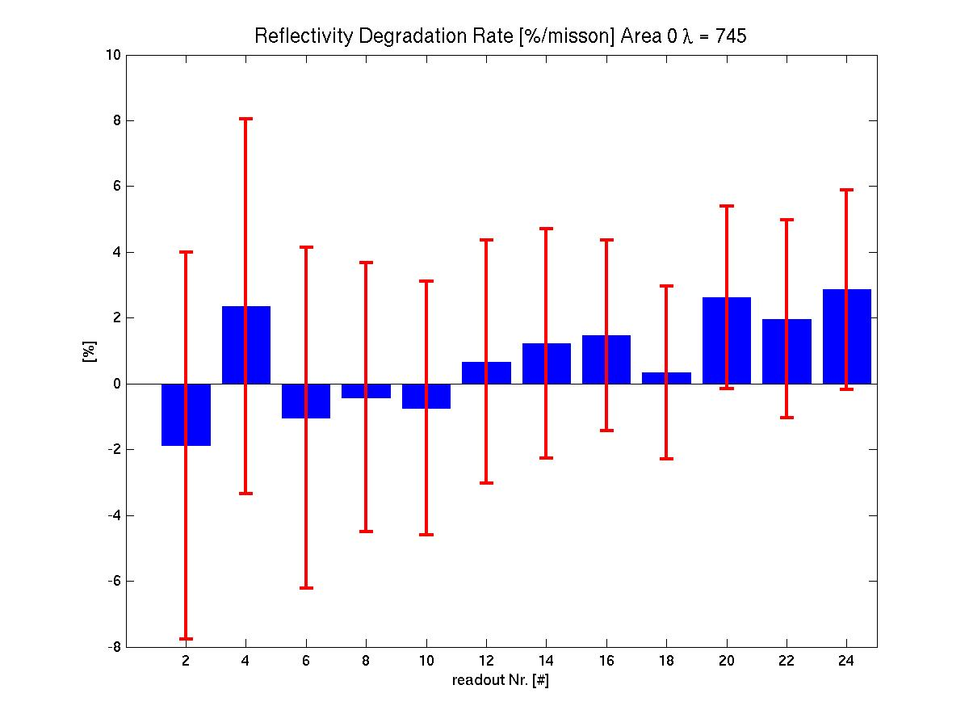
GOME-2 Reflectivity degradation rate
Sahara – 745nm – relative to mean of 2007
Reflectivity Sahara
Normalised to 2007
Every 2nd scanner angle position is shown
East
West

Slide 12
Open questions and conclusions
According to the RAL long-term results, there is no significant GOME-2 degradation in reflectivity for both AVHRR and GOME-2 in the AVHRRch1/GOMEch34 region visible yet
What is the initial (at launch) offset for both instruments?
According to the MODIS/AVHRR inter-comparison AVHRR (NOAA-16/17) experiences a dark bias of 9% (Cao, C., X. Xiong, A. Wu, and X. Wu, 2008, Assessing the consistency of AVHRR and MODIS L1B reflectance for generating fundamental climate data records, Journal of Geophysical Research, 1, 113, D09114, doi:10.1029/2007JD009363)
Consistent with RAL results for GOME-2/AVHRR, but EUM results show opposite bias of same magnitude (bug in EUM analysis!?).
For GOME-2 the initial offset in the solar mean reference has been estimated to be on the order of 1 to 3% in the AVHRRch1/GOMEch34 region (w.r.t. Wehrli 1985 SM0 reference spectrum).
Reflectivity long-term degradation in the 640 nm region for GOME-2 not yet quantified (only at 541 and 745 nm).

Slide 13
The End

Slide 14
GOME-2 Long-term throughput changes
Solar Mean Reference (SMR) spectrum
Reprocessed signals PPF 4.0 until February 2010
relative to February 2007

Slide 15
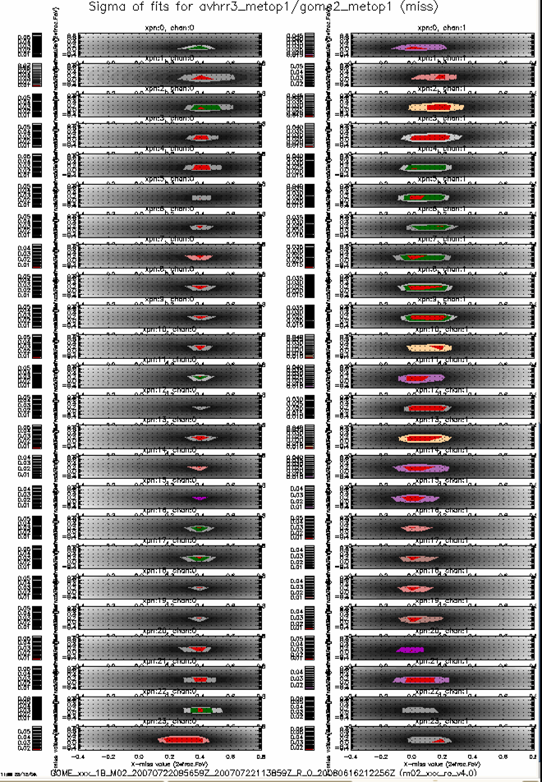
AVHRR/3 Validation using GOME-2
GOME-2 scanner position dependent geo-offset (in 2*%FOV)
Courtesy of Barry Latter et al. (2009)
AVHRR
channel 1
14th May 2008
Across-track
[2*%FOV_{GOME} ]
Along-track
[2*%FOV_{GOME} ]
East
GOME-2 scanner position
West

