Slide 1
NOAA GPRC Report
Fangfang Yu and Fred Wu
22 March 2011

Slide 2
Outline
Operation Status
GEO Imager vs. AIRS/IASI
Products
Bias monitoring Web
New Products
GOES sounder GEO-LEO inter-calibration
AVHRR vs. MODIS inter-calibration for the solar reflectance channels
MSU/AMSU
Emerging Capacity
GEO-GEO inter-calibration for GOES Imager and Sounder
Examples of Application
GOES-14/15 PLT
Evaluation of MBCC and Scan Mirror Emissivity
Stray Light
GEO Visible Channel Inter-Calibration (separate)

Slide 3
Operation Status
AIRS
IASI
Jan07 Jan08 Jan09 Jan10 Jan11
GOES-11
GOES-12
Jun/07
GOES-13
Meteosat-7/9
Aug/08
MTSAT-1R
MTSAT-2
Nov/09
FY-2C
FY-2D

Slide 4
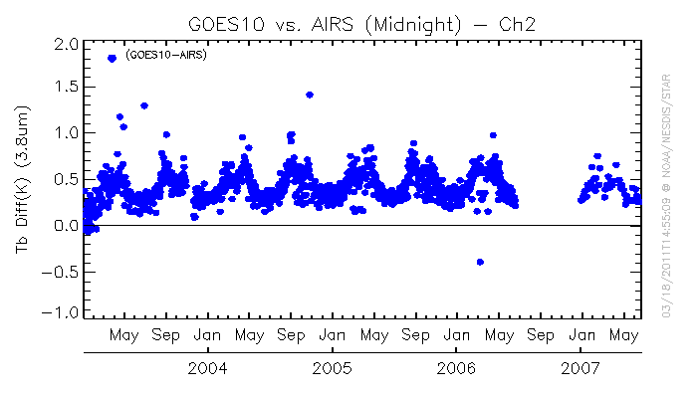
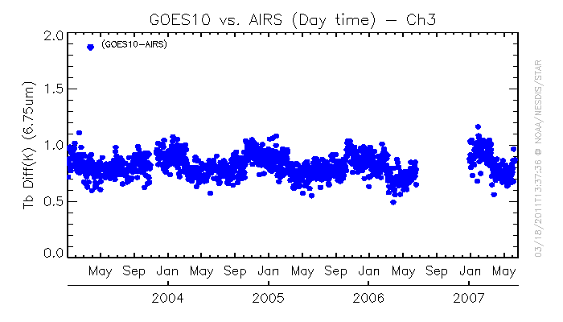
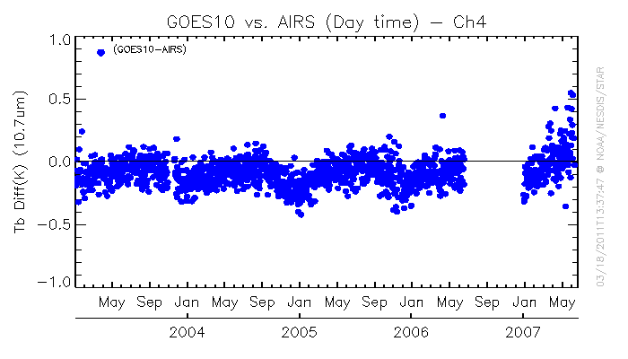
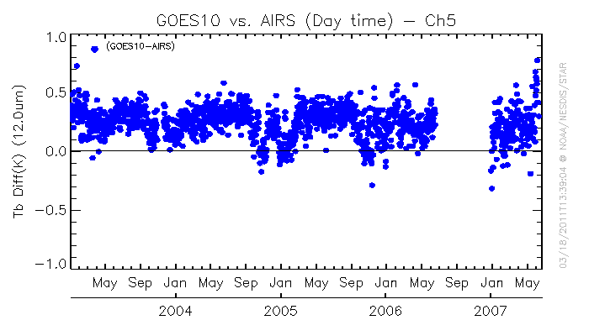
Back Process
AIRS
Jan03 Jan04 Jan05 Jan06 Jan07
GOES-10
UW/CIMSS

Slide 5
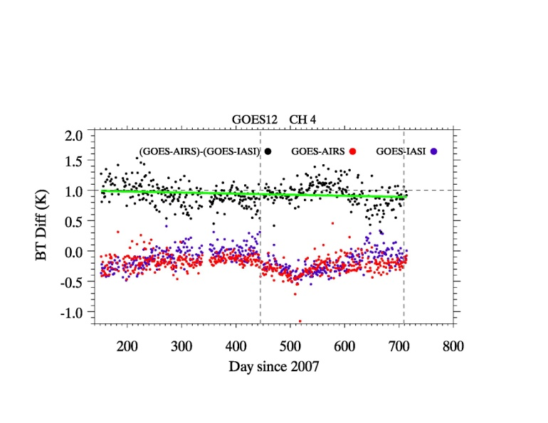
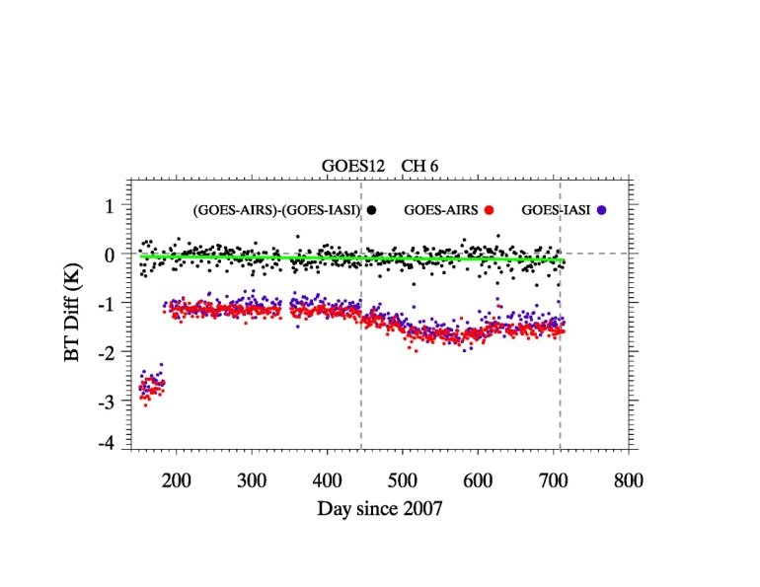
Presented at Tokyo

Slide 6
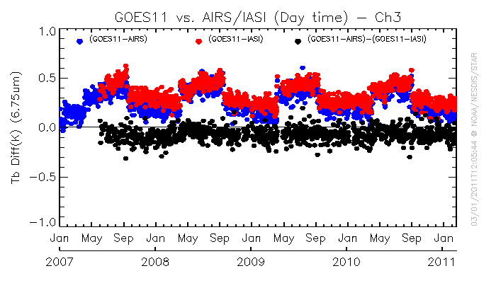

Slide 7
METEOSAT H₂O Contamination?
Growing (slower) warm bias in 10,7 μm Channel?

Slide 8
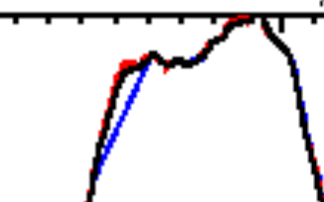
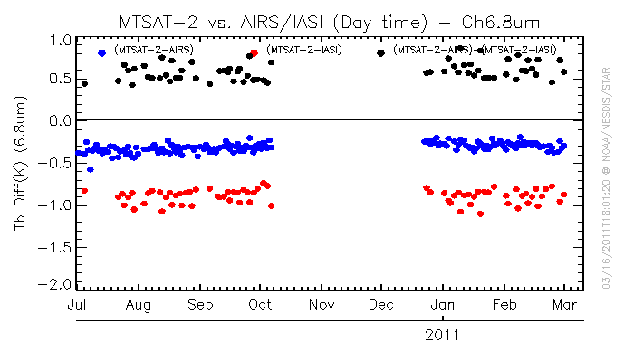
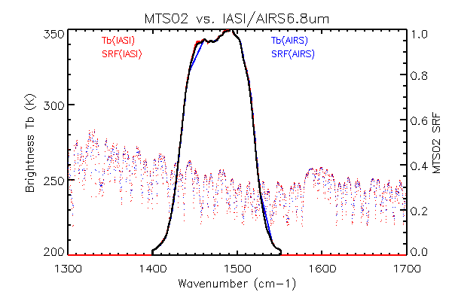
MTSAT-2 H₂O Channel SRF?
NOAA has two sets of MTSAT-2 water vapor channel SRF, one from the package which NOAA received about 5 years ago (plotted in black line
These two SRFS are not exactly the same. But it seems to me the original one (in black) looks more “real” data as the one in blue has straight line at the left shoulder position.
The different SRF causes about 0.5K difference at the homogeneous scenes

Slide 9
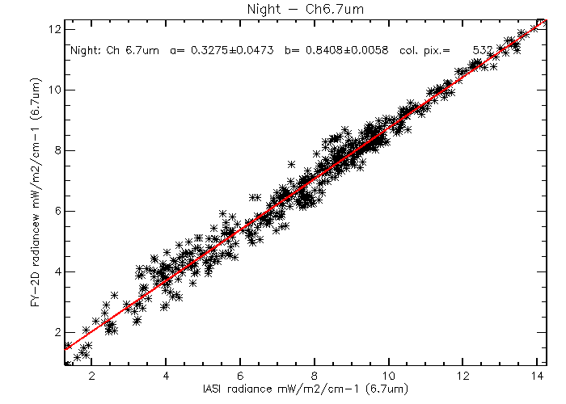
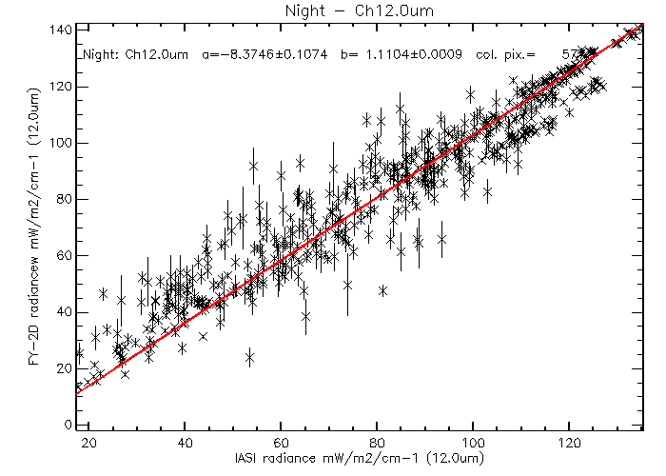
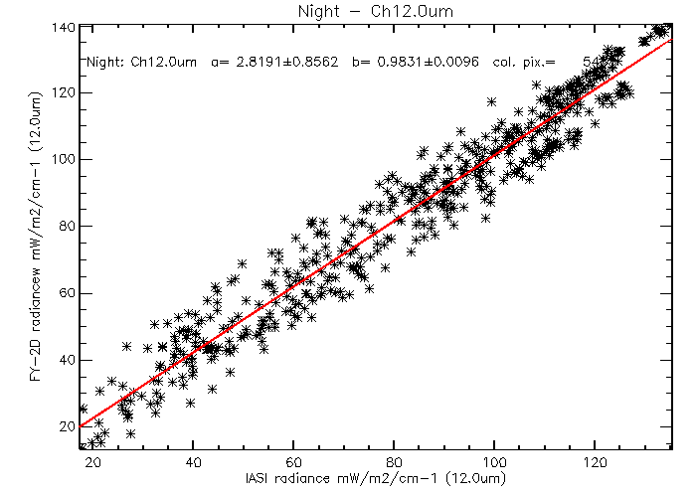
Fengyun-2D: Stray Light & H₂O Channel SRF?
Regression with weighting of FOV_STDV
Recursive removal of outliers
Non-linear issue?
?

Slide 10
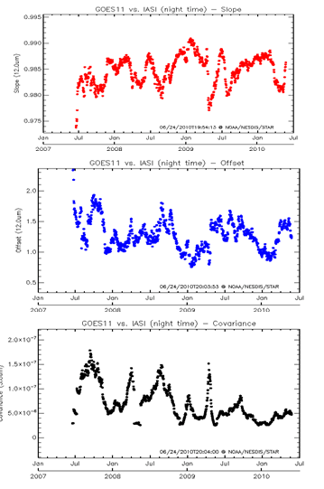
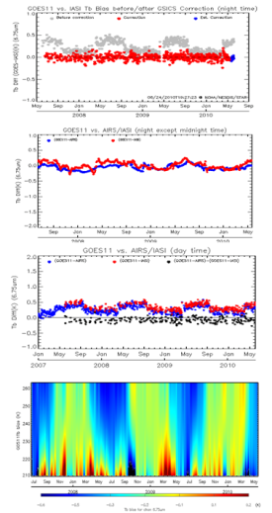
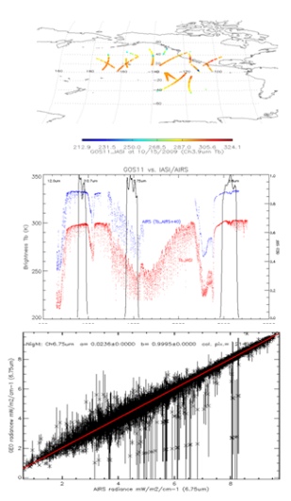
GEO-LEO Inter-Calibration Products
Products download server:
http://gsics.nesdis.noaa.gov:8080/thredds/catalog.html
Near Real-time Correction – update everyday
Re-analysis Correction – updated once per month
New product monitoring wiki-website:
https://gsics.nesdis.noaa.gov/wiki/GPRC/WebHome

Slide 11
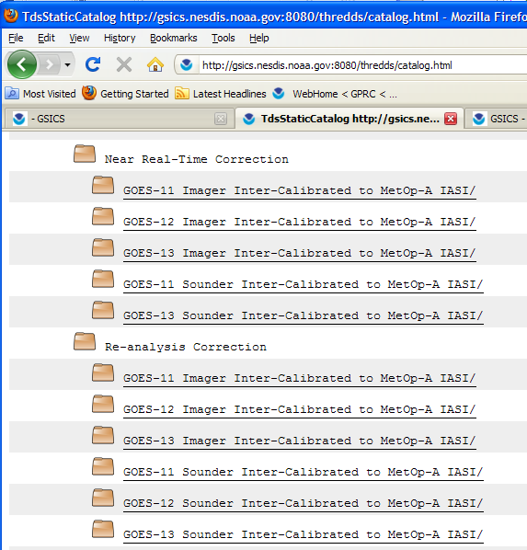
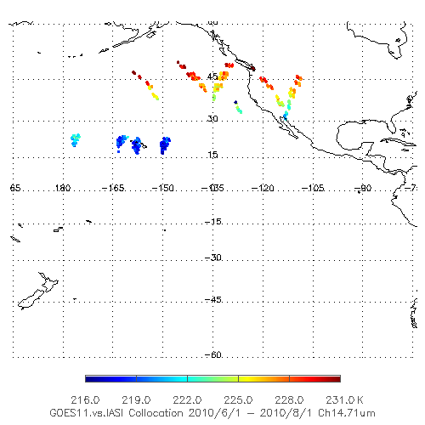
GOES Sounder Correction
GSICS GEO-LEO Operational Correction for GOES Sounder
Near real-time of daily correction
Re-analysis
Data available at NOAA GSICS server
http://gsics.nesdis.noaa.gov:8080/thredds/catalog.html
Bias monitoring available at
https://gsics.nesdis.noaa.gov/wiki/GPRC/GeoLeo
Spatial distribution of GOES-11 Sounder vs. IASI collocation

Slide 12
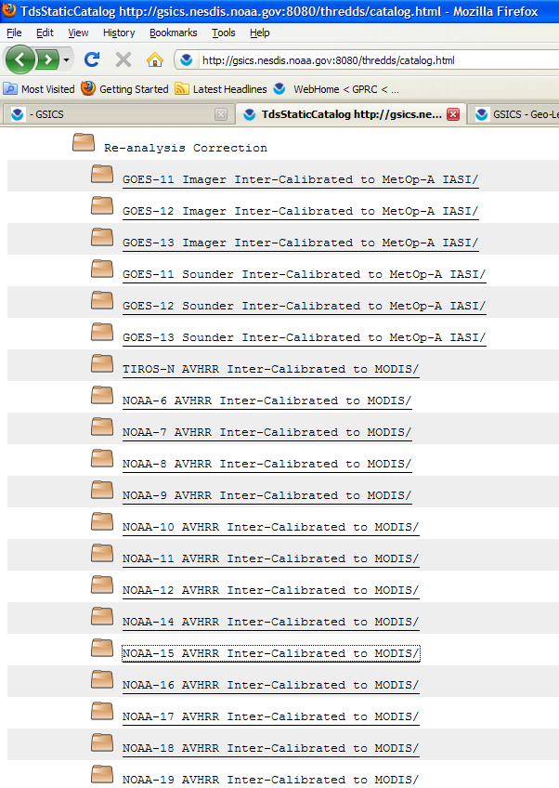
Re-analysis correction products for AVHRR
University of Wisconsin provided the ATBD and the re-analysis correction for the AVHRR solar reflectance channels
Inter-calibration with MODIS data
From TIROS-N to NOAA-19

Slide 13
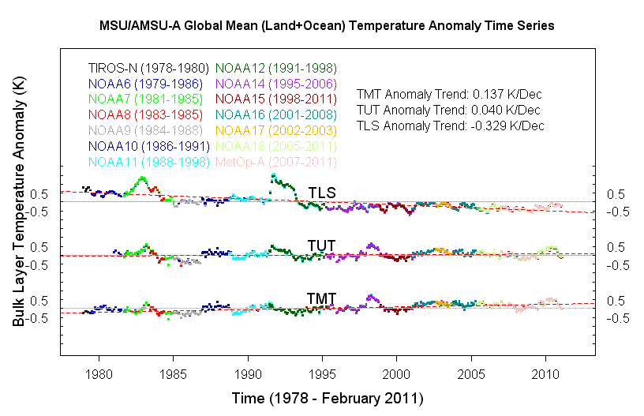
LEO-LEO inter-calibration for Microwave Sounding
http://www.star.nesdis.noaa.gov/smcd/emb/mscat/mscatmain.htm
Products:
Level-1B calibration coefficients
Corrected Level-1C radiance

Slide 14
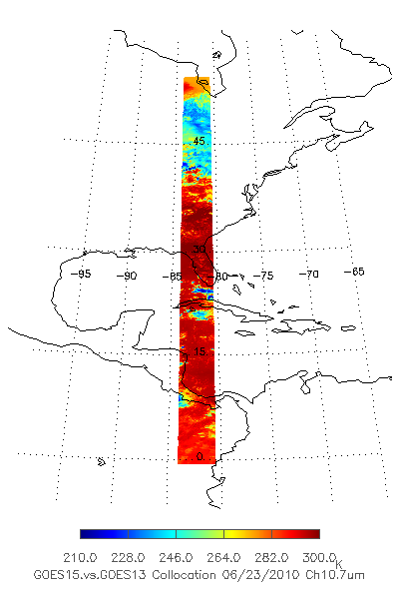
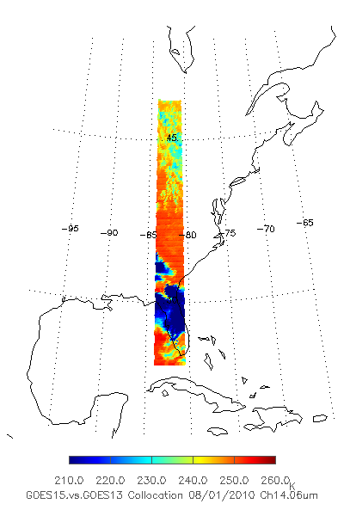
GEO-GEO Inter-Calibration
GEO-GEO inter-calibration for GOES Imager/Sounder
GOES 15 vs. GOES-13
GOES-11 vs. GOES-13
Regular inter-calibration frequency and location
Imager: twice/hour
Sounder: once/hour
Direct inter-comparison may exaggerate calibration anomaly
MBCC (different phase angle)
Spectral response function uncertainty
Opportunity to verify the GSICS GEO-LEO correction results
Imager (G15 vs. G13) Sounder (G15 vs. G13)
GEO-GEO Spatial distribution
GOES-15 – GOES13 Imager Ch6 (13.3um) GOES-15 vs. GOES-13 Sounder

Slide 15
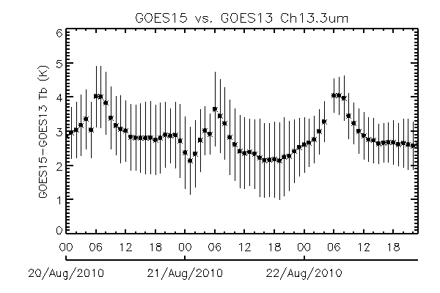
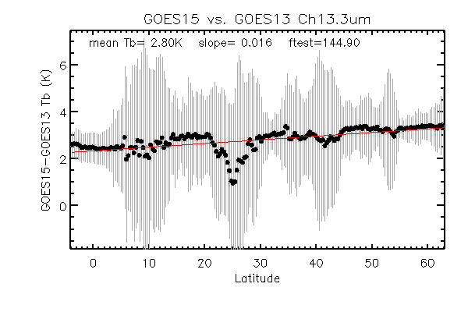
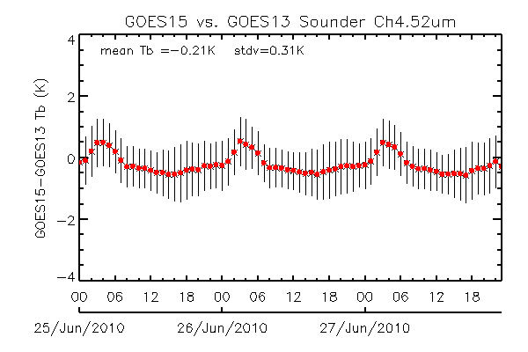
GEO-GEO Inter-Calibration
Latitudinal Tb bias (GOES15-GOES-13)
Diurnal Tb bias (GOES15-GOES-13)
GOES-15 – GOES13 Imager Ch6 (13.3um) GOES-15 vs. GOES-13 Sounder

Slide 16
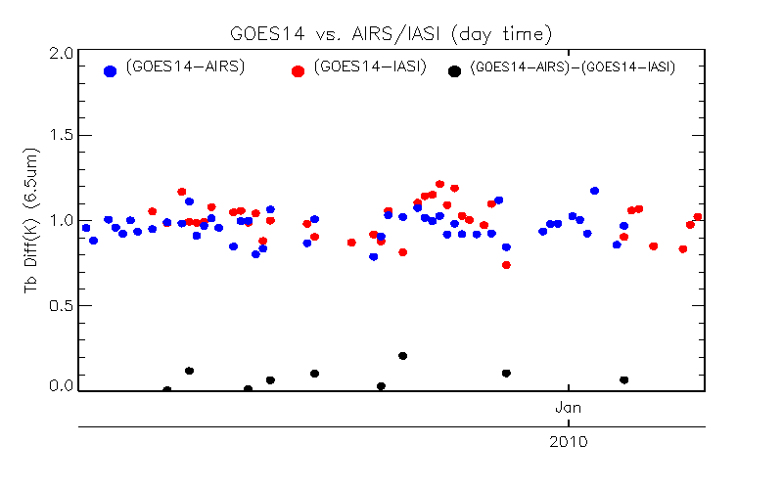
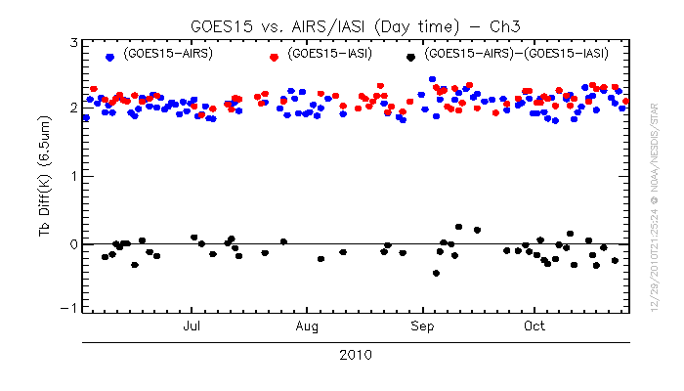
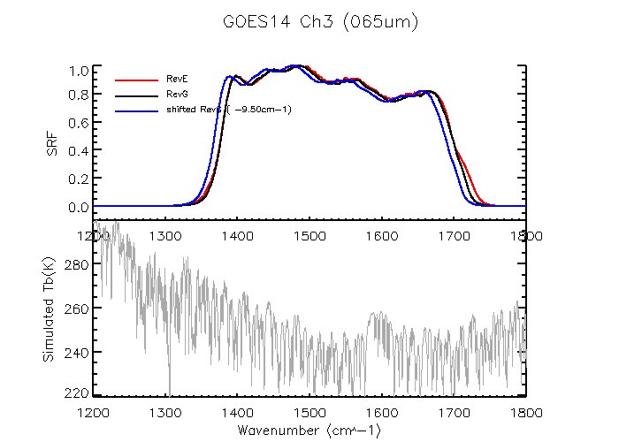
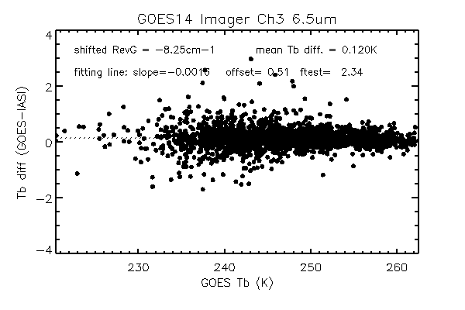
GOES-14/15 PLT Imager Ch3 & Ch 6 SRF
Large Tb biases was observed at GOES-14/15 Imager water vapor channels during the PLT test periods
0.99 K (±0.11) for GOES14 and 2.12K(±0.11) for GOES15
Instrument vendor re-analyzed the pre-flight data and provided a new version of SRF (RevG)
GOES Instrument performance monitoring data and the GSICS GEO-LEO collocation data used to evaluate the RevG SRF.
RevG improves the accuracy
GOES14: 0.99K to 0.97K
GOES15: 2.12K to 0.73K
NOAA is going to continue to shift the RevG SRF. The preliminary results:
GOES-14 Ch3: -8.25µm
GOES-15 Ch3: -5.75µm
GOES-15 Ch6: + 0.5µm
Time-series of Tb bias to AIRS/IASI for GOES-14 Ch3 (left) and GOES-15 Ch3 (right)
Tb bias to IASI with RevE SRF (black) and RevG SRF (red). Left: GOES-14, right: GOES-15

Slide 17
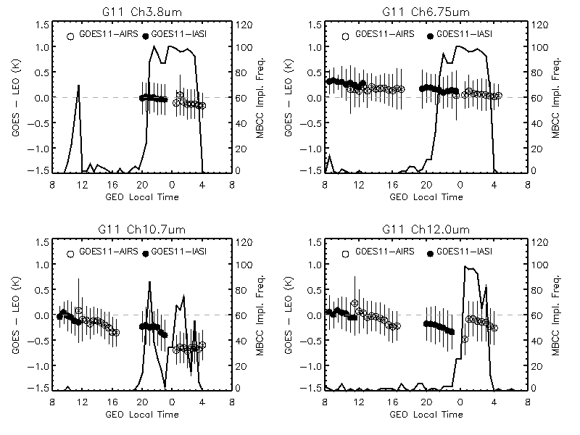
Mid-nigh Blackbody Calibration Correction (MBCC)
Use of the GSICS GEO-LEO collocation data and the GOES IPM data to assess the GOES midnight blackbody calibration correction (MBCC) calibration accuracy.
MBCC, if turned on, works efficiently to reduce the diurnal calibration variations for most GOES Imager IR channels except for Ch4 (10.7µm).
GOES-11/12 Imager has no significant scan-angle dependent calibration residual
Paper is ready to be submitted to IEEE on Geosciences and Remote Sensing.
Diurnal cal. Variation of GOES-11 Imager.
Channel name | GOES11 - AIRS |  | GOES12 -AIRS
 | Winter | Summer | Winter | Summer
Ch3 | 0.12 | 0.13 | - | -
Ch4 | - | 0.49 | - | 0.48
Ch5 | 0.13 | -
Ch6 |  |  | 0.04 | -0.11
Mean Tb bias to AIRS around satellite midnight time with MBCC correction (MBCC onset frequency larger than 80%)

Slide 18
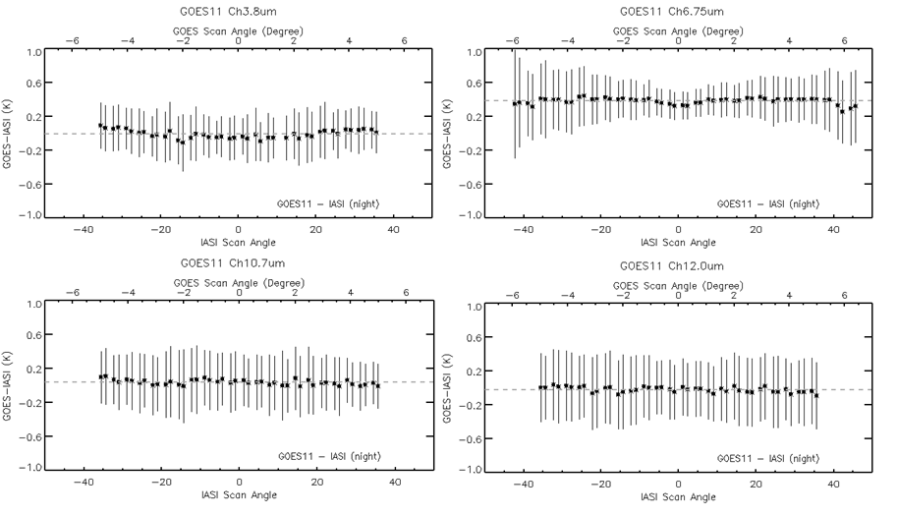
Angular Dependence of Scan Mirror Emissivity
Little scan-angle dependence of Tb bias for GOES-11

Slide 19
Stray Light

Slide 20
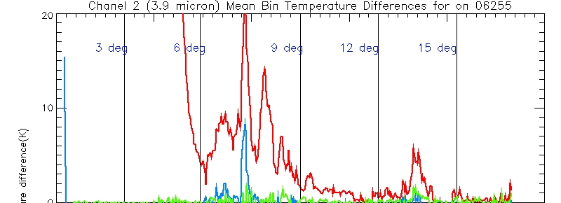
Stray Light

Slide 21
Stray Light

Slide 22
Stray Light

Slide 23
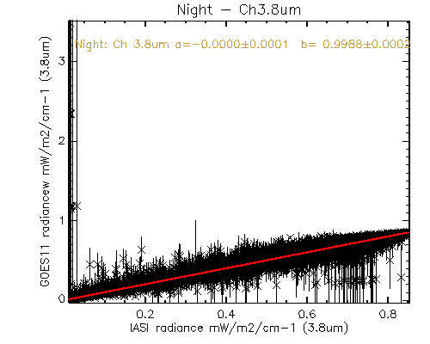
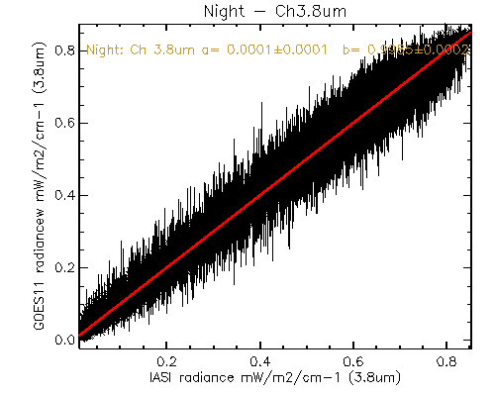
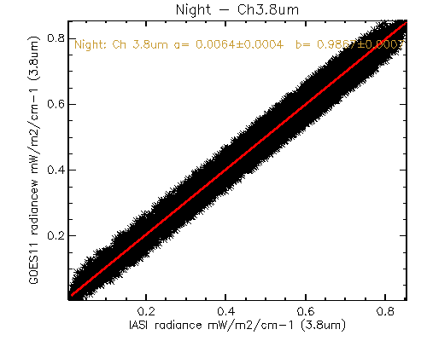
Baseline Regression vs. Recursive Filtering (RF) – GOES11 Ch2
Stray light
?
Baseline regression Recursive Filtering + FOV STD weighting Recursive Filtering
Tb(K) | GSICS Correction (T_{b}, mK) (Baseline) | GSICS Correction (T_{b}, mK) (RF + FOV STD weighting) | GSICS Correction (T_{b}, mK) (RF Only)
220 | 16 | -101 | -10,942
250 | 20 | 5 | -1,335
290 | 27 | 31 | -164
286.3 | 27 | 29 | -201
Mean homogeneous Tb bias (leo-geo) = 34 mK
Data: GOES vs. IASI collocation from 1/1/2011 – 1/30/2011

Slide 24
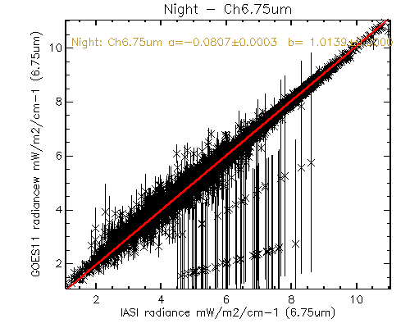
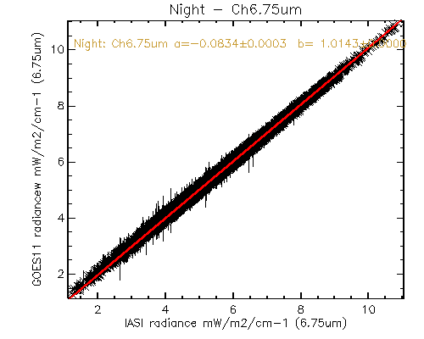
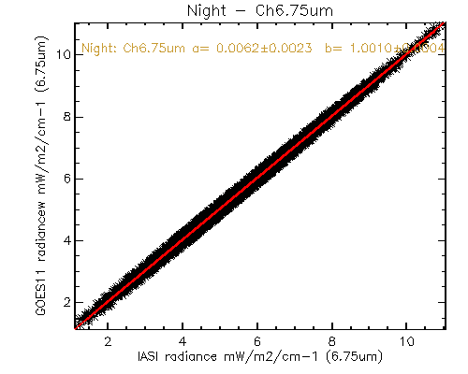
Baseline Regression vs. RF - GOES-11 Ch3
Baseline regression Recursive Filtering + FOV weighting Recursive Filtering
Tb(K) | GSICS correction (T_{b}, mK) (Baseline) | GSICS Correction (T_{b}, mK) (RF + FOV STD weighting) | GSICS Correction (T_{b}, mK) (RF Only)
220 | 488 | 449 | -81
250 | -100 | -101 | -53
290 | -417 | -429 | -49
245.9 | -52 | -52 | -55
Mean homogeneous Tb bias (leo-geo) = -61 mK
Data: GOES vs. IASI collocation from 1/1/2011 – 1/30/2011

Slide 25
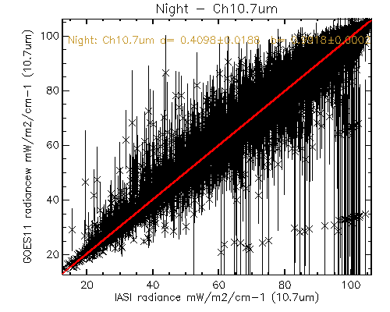
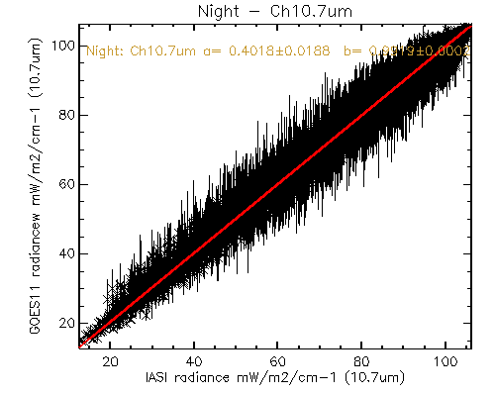
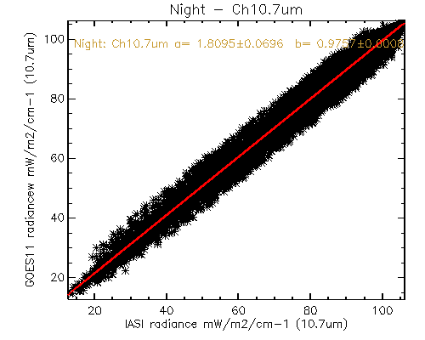
Baseline Regression vs. RF - GOES-11 Ch4
Baseline regression Recursive Filtering + FOV weighting Recursive Filtering
Tb(K) | GSICS Correction (T_{b}, mK) (Baseline) | GSICS Correction (T_{b}, mK) (RF + FOV STD weighting) | GSICS Correction (T_{b}, mK) (RF Only)
220 | -387 | -377 | -2,215
250 | -39 | -35 | -745
290 | 245 | 244 | 340
283.8 | 207 | 207 | 203
Mean homogeneous Tb bias (leo-geo) = 0.229K
Data: GOES vs. IASI collocation from 1/1/2011 – 1/30/2011

Slide 26
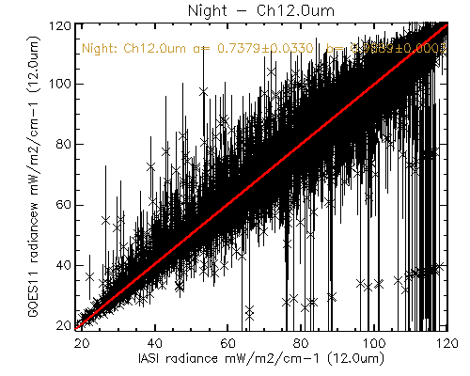
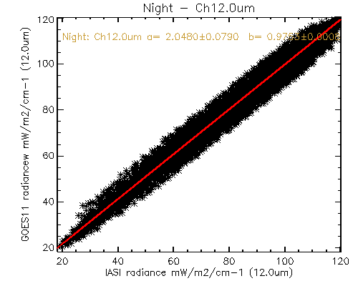
Baseline Regression vs. RF - GOES-11 Ch5
Baseline regression Recursive Filtering + FOV weighting Recursive Filtering
Tb(K) | GSICS Correction (T_{b}, mK) (Baseline) | GSICS Correction (T_{b}, mK) (RF + FOV STD weighting) | GSICS Correction (T_{b}, mK) (RF Only)
220 | -.559 | -219 | -1,845
250 | -91 | 58 | -582
290 | 315 | 314 | 455
282.0 | 244 | 268 | 277
Mean homogeneous Tb bias (leo-geo) = 0.284K
Data: GOES vs. IASI collocation from 1/1/2011 – 1/30/2011

Slide 27
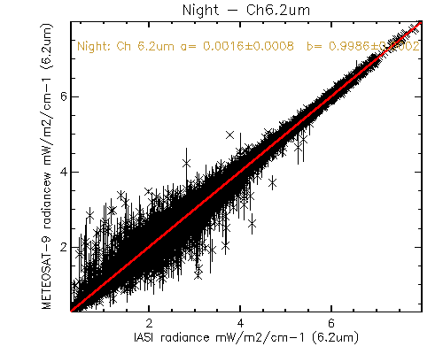
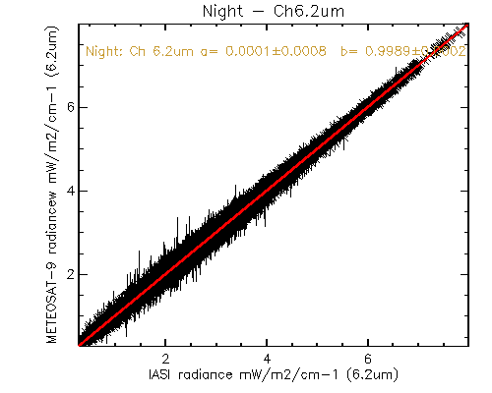
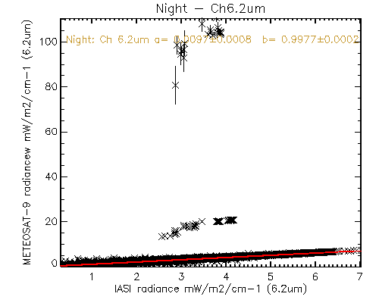
Outlier Removal with Recursive Filtering
b
a
Baseline regression (2/1/2011-3/1/2011)
With RF
c
d
The outliers should be the radiance from the other channels
Baseline regression (1/1/2011-1/31/2011)
RF removes the outliers

Slide 28
Reports to Actions
GSICS Product Acceptance Form
Submitted with GEO-LEO ATBD
Combining GEO-LEO solar channel calibration methods (GRWG05_02)
Moon calibration method review(GRWG-5_11)

Slide 29
Conclusions
GEO-LEO inter-calibration
NOAA GPRC continues the non-stop routinely monitoring of the operational GEO satellites
Almost complete the back-process of GOES-10 vs. AIRS inter-calibration
New GSICS correction Products
GEO-LEO: GOES Sounder GEO-LEO inter-calibration (Near real-time and re-analysis corrections)
LEO-LEO: AVHRR solar reflectance channels
New applications
GOES GEO-GEO inter-calibration
Evaluate the new version of SRF before implementation on the satellites
GOES Imager diurnal and scan-angle calibration evaluation
Recursive filtering can effectively remove the outliers – recommend for operational regression

