Slide 1
The GSICS Collaboration Servers, a Vehicle for the International Collaboration Status: 2012
Peter Miu (EUMETSAT)
CMA, EUMETSAT, JMA, KMA, NOAA/NESDIS, WMO

Slide 2
GSICS Collaboration Servers
What are the GSICS Collaboration Servers?
Individually, the servers are also known as Data and Product servers provide a set of services for the GSICS user community to support data exchange and access to relevant products to support the calibration of satellite data.
Who has implemented one of these servers?
EUMETSAT has a fully operational server receiving comparable satellite data sets from the EUMETSAT and JMA. Pre-operational GSICS products are sent daily to the server for validation by experts in the GSICS community. These should be finalised this year and the products shall be archived by the GPRC (EUMETSAT Data Centre Archive).
NOAA has implemented a GSICS server providing a redundancy node for the GSICS collaboration servers network. Currently the server pulls data and products from the EUMETSAT GSICS server.
CMA are in the process of implementing their own GSICS servers to be part of the GSICS collaboration servers network.

Slide 3
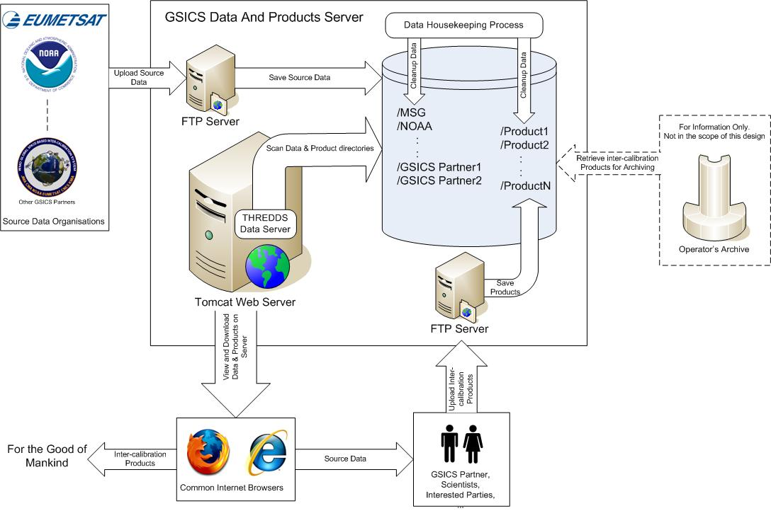
GSICS Data and Products Server: Design Overview
GEO-AIRS/IASI is one of many
GSICS supports inter-calibration on other orbits, for other instruments, in other spectral regions
All are similar in some ways
Each pair is unique in some ways
Instrument characteristics
Agency priority
Hierarchical Structure
General ATBD
Purpose, Options, Selection, Implementation
Details for individual pairs on http://www.star.nesdis.noaa.gov/smcd/spb/calibration/icvs/GSICS/index.php

Slide 4
What Data Sets are on the Servers
Source Data Sets from EUMETSAT:
MET7 MVIRI netCDF data sets (20 days rolling archive)
MSG1 SEVIRI netCDF data sets (20 days rolling archive)
MSG2 SEVIRI netCDF data sets (20 days rolling archive)
MetOp-A IASI netCDF data sets (20 days rolling archive)
The EUMETSAT server is currently being upgraded to expand the size of the rolling archive as well as the number of GSICS products that can be stored on it.
Intermediate Data Sets from JMA to support the comparisons:
MTSAT2 Imager – MetOpA IASI collocated netCDF data sets (Since 2010-09-09)
MTSAT2 Imager – Aqua AIRS collocated netCDF data sets (Since 2010-09-09)
Notes:
Why GEO-LEO has been the focus

Slide 5
What Products are on the Servers
NTRC and RAC Demo Products (Monitored Instrument – Reference Instrument):
MET7 MVIRI - MetOpA IASI NRTC demo product (since 2010-09-08).
MSG1 SEVIRI - MetOpA IASI NRTC demo product (since 2010-11-08).
MSG2 SEVIRI - MetOpA IASI NRTC demo product (since 2011-01-14).
MetOpA HIRS - MetOpA IASI NRTC demo product (since 2011-12-12).
MTSAT2 Imager - Aqua AIRS NRTC demo product (since 2012-02-15).
MTSAT2 Imager - Aqua AIRS - MetOpA IASI NRTC demo product (since 2012-02-15).
MTSAT2 Imager - MetOpA IASI NRTC demo product (since 2012-02-15).
MET7 MVIRI - MetOpA IASI RAC demo product (since 2008-06-01).
MSG1 SEVIRI - MetOpA IASI RAC demo product (since 2008-06-01).
MSG2 SEVIRI - MetOpA IASI RAC demo product (since 2008-06-01).
MetOp-A HIRS - MetOpA IASI RAC demo product (since 2009-05-13).
MTSAT2 Imager - Aqua AIRS RAC demo product (since 2011-10-04).
MTSAT2 Imager - Aqua AIRS - MetOpA IASI RAC demo product (since 2010-09-08).
MTSAT2 Imager - MetOpA IASI RAC demo product (since 2010-09-08).
NRTC – Near Real Time Correction.
RAC – Re-Analysis Correction.
Validation of these products is done according to the Product Acceptance Procedure. Work is needed in the definition and application of this validation process.

Slide 6
What GSICS Data and Products Servers Documentation is available ?
The following documents have been presented on the GSICS mailing lists (http://groups.google.com/group/gsics-data-wg?hl=en):
GSICS Data Management Server User Guide, Draft.
GSICS Data Management Server Operations Service Specification (and supporting documentation) Action GDWG 03_22, Draft.
EUMETSAT Archive NetCDF Format Proposal, Draft.
EUMETSAT netCDF format guide is available via the EUMETSAT website:
http://www.eumetsat.int/Home/Main/DataProducts/Resources/index.htm#formatGuides

Slide 7
Data and Products Servers: Planned Activities
Planned activities:
Collaboration Servers Data Exchange (products only; transfer mechanism? Push or Pull ?).
Development of a GSICS products’ plotting tool.
Satellite CF conventions specification for GSICS netCDF files.
Using ISO 19115 to register GSICS products with external database systems that following this catalogue inter-operability standard.

Slide 8
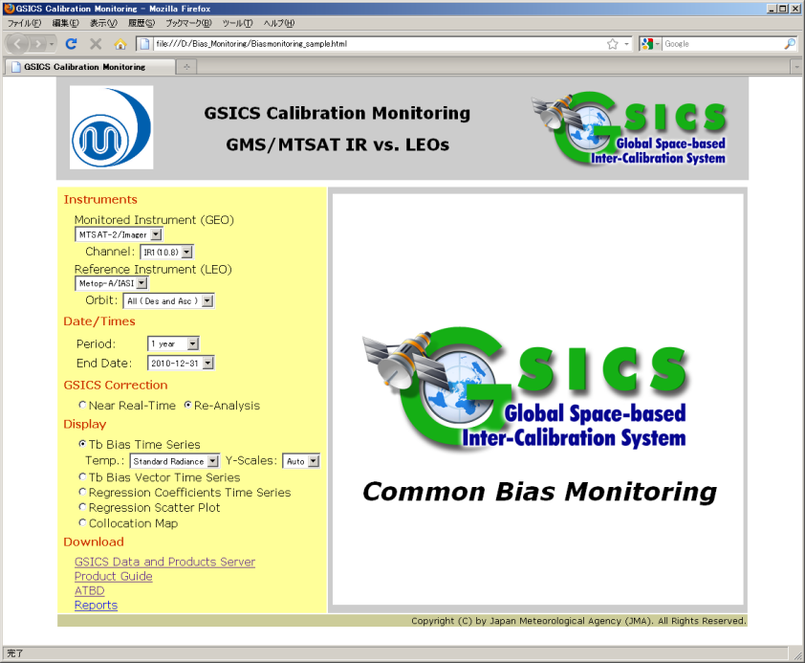
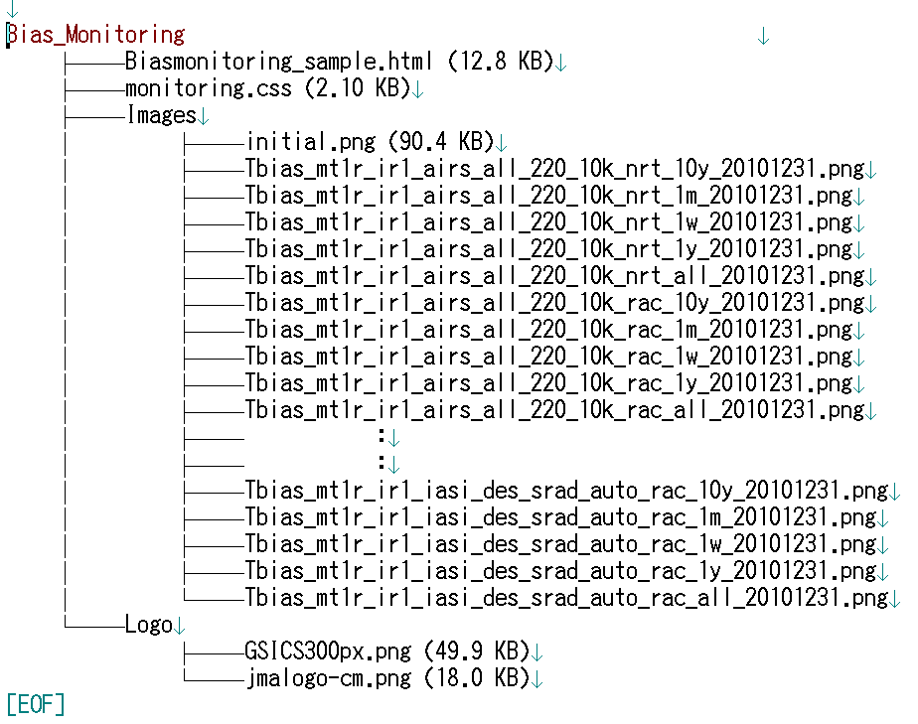
Products Plotting Tool(1)
Tentative requirements for plotting the GSICS GEO-LEO IR results in the netCDF products were discussed between GRWG and GDWG in a teleconference at the end of 2010.
JMA with support from the GSICS GCC developed a prototype for a unified web page to display these results. The prototype fulfil the tentative requirements discussed but could not be developed for operations as the method for displaying the plots was not operationally practical (over 7200 static images were required to be generated daily to display the different plot permutations).
7200 files per 1 day in case of 1 MTSAT !

Slide 9
Products Plotting Tool(2)
EUMETSAT has formalised the tentative requirements discussed into a GSICS document containing the following requirements categories:
Portability
Download and Installation
General Operation of the tool
General Plot Attributes
Time Series Plot Attributes
Documentation
Enhancements
This draft document was used to develop a proto-type based on the JMA and GCC proto-type but replacing the plot generation method with real-time generations of the plots using the data stored in the GSICS products.
The draft requirements document and the proto-type will be discussed in the GDWG breakout session. Since the plotting tool is the first ‘customer’ of the GSICS products, it was observed that their contents are required to be re-examined by the GRWG as additional information was needed for the plotting which was not contained in the product itself (e.g. Lookup tables for unit conversions).

Slide 10
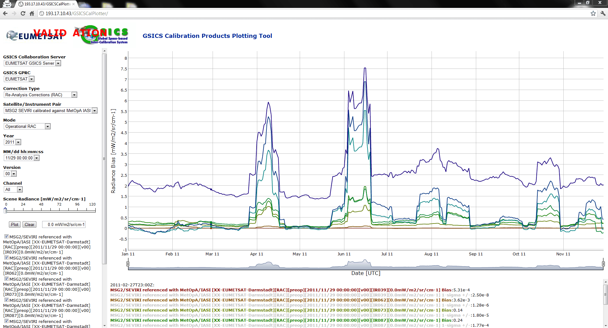
Products Plotting Tool(3)

Slide 11
Quick Demo of the Plotting Tool
The Plotting Tool is located on the EUMETSAT VALIDATION GSICS Data and Products Server:
http://193.17.10.43/GSICSCalPlotter/

Slide 12
Support is needed to resolve the following Concerns
Support outside of the GDWG is needed on the following:
Finalise the requirements definition for the Products’ Plotting Tool. GSICS products’ contents should be re-examined to ensure they contain the auxiliary data needed to improve usability.
Additional satellite source data sets are to be made available in netCDF for comparisons.
Additional intermediate data sets used during the comparable process (e.g. Collocation data sets) are to be made available in netCDF.
Roadmap for the release the first version(s) of GSICS products to the user community.
Agreements on what needs to be archived.
Defining where GSICS documentation is to be located; also GSICS documentation format/templates. This is needed for operations and to track future upgrades.
Specifying operational support for GSICS.

Slide 13
End of Presentation: Thank you for your attention
http://gsics.wmo.int
http://gsics.eumetsat.int
http://cs.star.nesdis.noaa.gov/thredds/catalog/gsics/
http://gsics.cma.gov.cn/

