Slide 1
Additional Metadata Requirements for GSICS Bias Monitor
Peter Miu (EUMETSAT)
CMA, EUMETSAT, JMA, KMA, NOAA/NESDIS, WMO

Slide 2
Products Plotting Tool(2)
EUMETSAT has formalised the tentative requirements discussed into a GSICS document containing the following requirements categories:
Portability
Download and Installation
General Operation of the tool
General Plot Attributes
Time Series Plot Attributes
Documentation
Enhancements
This draft document was used to develop a proto-type based on the JMA and GCC proto-type but replacing the plot generation method with real-time generations of the plots using the data stored in the GSICS products.
The draft requirements document and the proto-type will be discussed in the GDWG breakout session. Since the plotting tool is the first ‘customer’ of the GSICS products, it was observed that their contents are required to be re-examined by the GRWG as additional information was needed for the plotting which was not contained in the product itself (e.g. Lookup tables for unit conversions).

Slide 3
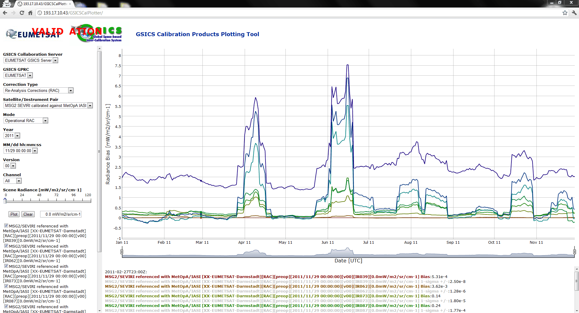
Products Plotting Tool(3)

Slide 4
Quick Demo of the Plotting Tool
The Plotting Tool is located on the EUMETSAT VALIDATION GSICS Data and Products Server:
http://193.17.10.43/GSICSCalPlotter/

Slide 5
So What is Wrong ??
The plots shown are technically correct but it is not so useful for the user community as the units change so much from one channel to another.
It would be better to plot radiance-brightness temperatures but this requires additional coefficients for the conversion process. These coefficients are NOT in the current GSICS product netCDF files.
So What, user can find these coefficients themselves and do the conversions themselves ...
To add value to the data, it should be in most popular units expected (defined by the target user community) or at least the netCDF file should provide all the information needed for the unit conversion process.

Slide 6
Proposed GSICS Products netCDF Requirements Update
There are 2 options from a Data Management point of view:
Change the data in the netCDF arrays to be in the expected units.
Target user community can immediately use the data.
Data sets are still in demo/pre-operational status thus the impact of this update should be low.
All existing netCDF file are required to be ‘reprocessed’ into the new format.
Some users may want keep the current units.
Update the netCDF file to include additional meta-data to support the conversion.
Should not affect existing users (if there are any other than the plotting tool) as software using the existing data sets are not affected.
Users have a choice of units to used.
No reprocessing is needed for the combined RAC product as it will be replaced with the new netCDF version.
All existing NRTC products are required to be ‘reprocessed’ into the new format.
Additional processing is required on the user side for unit conversions.

Slide 7
New Requirements ...
To be defined by the GRWG ....

Slide 8
End of Presentation: Thank you for your attention
http://gsics.wmo.int
http://gsics.eumetsat.int
http://cs.star.nesdis.noaa.gov/thredds/catalog/gsics/
http://gsics.cma.gov.cn/

