Slide 1


Using the Moon for Sensor Calibration Inter-comparisons
Xiaoxiong (Jack) Xiong
NASA Goddard Space Flight Center (GSFC)
Key Contributors: J. Sun and A. Angle
GSICS Joint Research and Data Working Group Meeting, NSMC, CMA, Beijing, China (March 5-8, 2012)

Slide 2
Outline
Introduction
MODIS Lunar Observations
Methodology and Applications
  Calibration Stability Monitoring
  Inter-comparisons
  Results and Discussions
Summary
“Using the Moon to Track MODIS Reflective Solar Bands Calibration Stability”
SPIE Remote Sensing, 19-22 September 2011, Prague, Czech Republic
Page 2

Slide 3
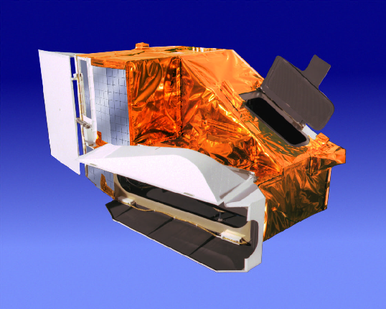
Introduction
MODIS On-board NASA EOS Terra and Aqua Spacecraft
36 spectral bands (490 detectors)
  0.41 – 14.4μm
4 focal plane assemblies (FPA)
  VIS, NIR, S/MWIR, and LWIR
3 spatial resolutions (nadir)
  250m, 500m, and 1km
< 2 days for a complete coverage of the Earth’s surface
~ 40 data products
  Land, oceans, and atmosphere
20 reflective solar bands (RSB): bands 1-19, and 26 from 0.41-2.2μm
16 thermal emissive bands (TEB): bands 20-25 and 27-36 from 3.5-14.4μm
Page 3
Notes:
Since it’s after general Aqua MODIS talk, only need to mention spectral bands (VIS, NIR)

Slide 4
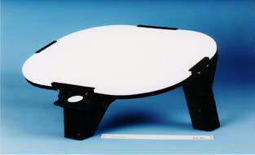
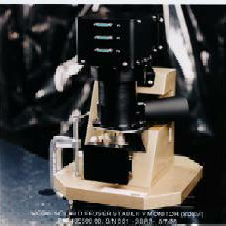
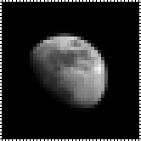
MODIS Reflective Solar On-orbit Calibration
RSB Calibration Requirements
±2% in reflectance and ±5% in radiance at Ltyp and scan angles within ±45º
An extra ±1% is applied for radiances from 0.3Ltyp to 0.9Lmax
Page 4

Slide 5
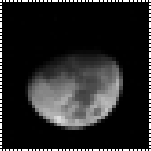
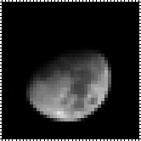
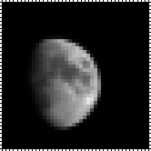

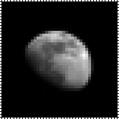
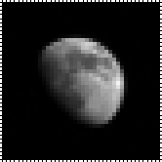

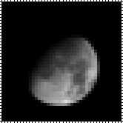
MODIS Lunar Observations
Aqua MODIS (band 1) Lunar Observations (Oct 04 – Jun 05)
Through SV port
Fixed phase angles (±55º)
Spacecraft roll maneuvers
Same approach and strategies applied to NPP VIIRS
Terra and Aqua MODIS Scheduled Lunar Observations
 | 2000 | 2001 | 2002 | 2003 | 2004 | 2005 | 2006 | 2007 | 2008 | 2009 | 2010 | 2011 | 2012
Terra | 9 | 10 | 10 | 9 | 10 | 8 | 9 | 9 | 10 | 8 | 9 | 8 | 2
Aqua |  |  | 5 | 8 | 10 | 9 | 9 | 6 | 9 | 11 | 10 | 8 | 2
Page 5
Notes:
RSB: VIS, NIR, SWIR
SWIR crosstalk but very stable

Slide 6
Methodologies and Applications
Methodologies
Applications
  Calibration Stability Monitoring
    Reflective Solar Bands
    Thermal Emissive Bands
  Calibration inter-comparison
  Electronic Crosstalk Characterization
  Optical Leak Characterization
  Spatial characterization
    Band-to-band registration (BBR)
    Modulation Transfer Function (MTF)
Calibration Stability and Inter-comparisons - Solar Reflective
Page 6
Notes:
RSB: VIS, NIR, SWIR
SWIR crosstalk but very stable

Slide 7
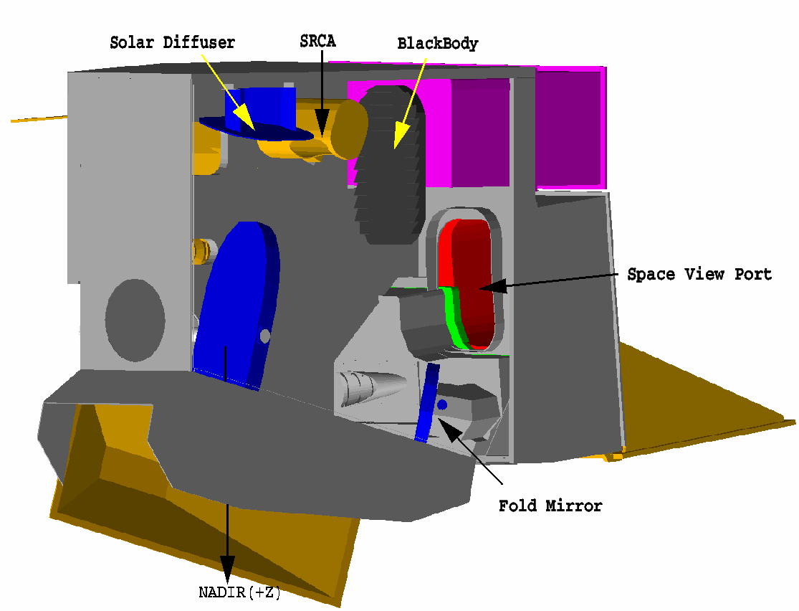
Stability Monitoring
gain ∝ 1/m₁
Geometric Factors
Δ_{SD}: SD degradation factor
Γ_{SD}: SD screen vignetting function
d: Earth-Sun distance
dn*: Corrected digital number
dc: Digital count of SDSM
Page 7

Slide 8
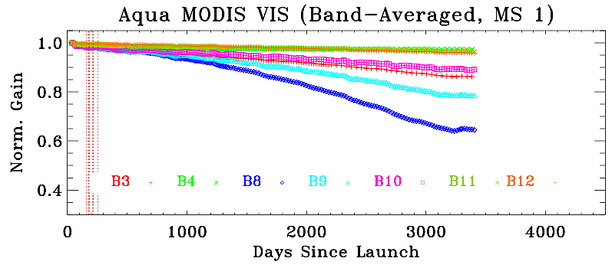
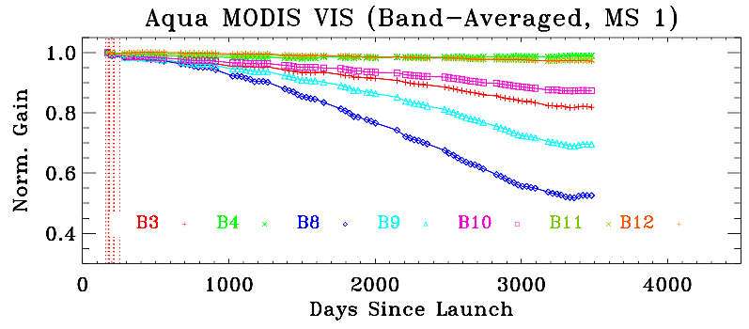
Stability Monitoring
λ
gain ∝ 1/m₁
Diffuser
AOI_{SD} = 50º
AOI_{Moon} = 11º
λ
Moon
Critical information to track sensor response versus scan angle (RVS)
Responses are time, wavelength, AOI, and mirror side dependent
Page 8

Slide 9
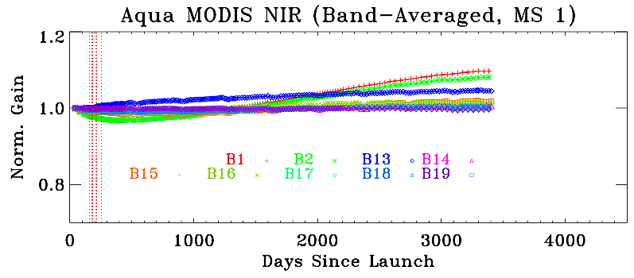
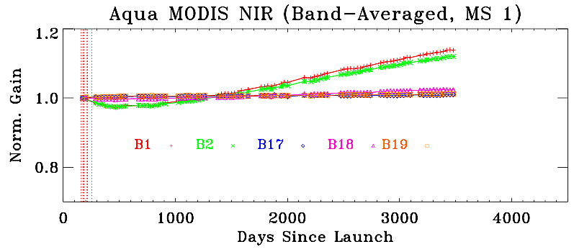
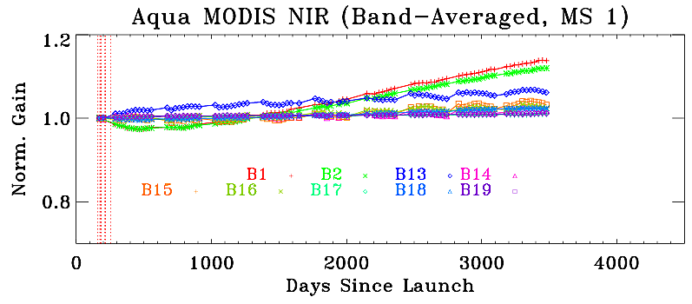
Stability Monitoring
Diffuser
Moon
Q: Bands 13-16 responses saturate when viewing the Moon
A: Normalizing non-saturated pixels in these bands to the matching pixels in the non-saturated spectral bands
Page 9

Slide 10
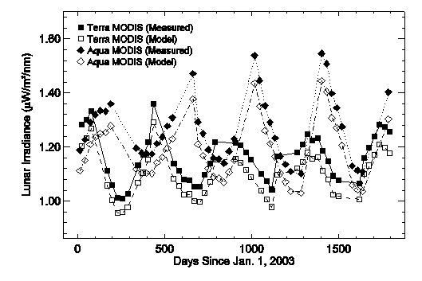
Inter-comparisons
Integrated Lunar Irradiances from Individual Sensors
  Calibration and solar spectral irradiance
Normalization to a Common Lunar Model (e.g. ROLO)
  Lunar viewing geometry difference
Advantages
Disadvantages
Future perspective
Xiong and Sun (GRSL 2009)
Page 10
Notes:
Corrected with integrated lunar irradiance from ROLO model.
Sum over all dn with over-sample correction applied.

Slide 11
Inter-comparisons
Terra and Aqua MODIS Calibration Inter-comparisons
Band 1
 | Band 1 |  | Band 2 |  | Band 3
 | Mean | Std.dev | Mean | Std.dev | Mean | Std.dev
Terra | 1.058 | 0.0052 | 1.080 | 0.0044 | 1.089 | 0.0051
Aqua | 1.065 | 0.0036 | 1.081 | 0.0035 | 1.075 | 0.0049
Ratio | 0.992 | 0.0063 | 0.998 | 0.0056 | 1.012 | 0.0070
Page 11
Notes:
This is the same for Terra MODIS

Slide 12
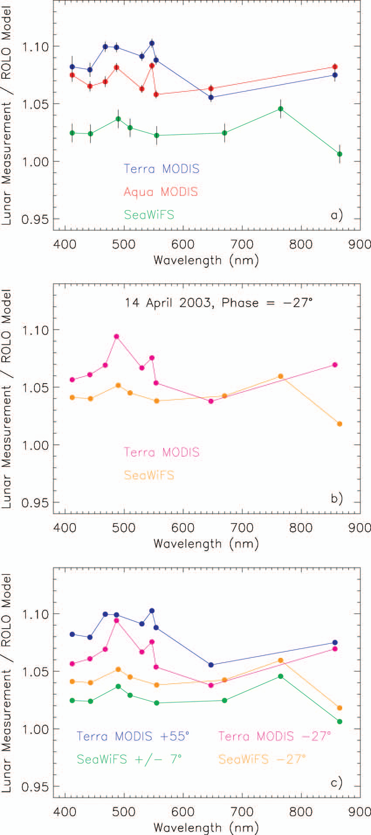
Inter-comparisons
Using the Moon for MODIS and SeaWiFS Calibration Inter-comparison
UL: Mission-long band averages
BL: SeaWiFS and Terra MODIS Lunar CAL
UR: SeaWiFS and Terra MODIS mission-long averages and Lunar CAL
(Eplee et al, Applied Optics, 2011)
Page 12
Notes:
This is the same for Terra MODIS

Slide 13
Inter-comparisons
Using the Moon for MODIS and VIIRS Calibration Inter-comparison
Three scheduled lunar observations made thus far for NPP VIIRS
  January to March, 2012
  Preliminary results derived to support sensor on-orbit calibration
Lessons and experience from MODIS applied for VIIRS
  Planning and scheduling
  Strategies and methodologies
  Data analysis tools
Future improvements
Page 13
Notes:
This is the same for Terra MODIS

Slide 14
References (MODIS)
Barnes WL, Xiong X, Eplee R, Sun J, and Lyu CH, “Use of the Moon for Calibration and Characterization of MODIS, SeaWiFS, and VIRS,” Earth Science Satellite Remote Sensing: Data, Computational Processing, and Tools, Vol. 2, Chapter 6, 98-119, Springer, 2006
Sun J, X. Xiong, W. Barnes, and B. Guenther, “MODIS Reflective Solar Bands On-orbit Lunar Calibration,” accepted for IEEE Transactions on Geoscience and Remote Sensing, Vol. 45, No. 7, 2383-2393, 2007
Xiong, X, J. Sun, and W. Barnes, “Inter-comparison of On-orbit Calibration Consistency between Terra and Aqua MODIS Reflective Solar Bands Using the Moon,” IEEE Geosci. Remote Sens. Let., 5(4), 778-782, 2008
Xiong X, C. Cao, and G. Chander, “An Overview of Sensor Calibration Inter-comparison and Applications,” Frontiers of Earth Science in China, 4(2): 237–252, (2010) [doi:10.1007/s11707-010-0002-z]
Eplee, RE Jr., J. Sun, G. Meister, F.S. Patt, X. Xiong, and C.R. McClain, “Cross calibration of SeaWiFS and MODIS using on-orbit observations of the Moon,” Appl. Opt. 50, 120-133, 2011 [doi:10.1364/AO.50.000120]
A number of SPIE Papers on MODIS Lunar Observations and Applications on: RSB and TEB stability monitoring, calibration inter-comparisons, spatial characterization, and optical leak and xtalk characterization
Page 14
Notes:
RSB: VIS, NIR, SWIR
SWIR crosstalk but very stable

Slide 15
Summary
MODIS lunar observations and applications
  Stability monitoring (independent of OBC, no source/target degradation)
  Calibration inter-comparisons
  Others
Methodologies
  Normalization to a lunar model
  Relative approach for bands with saturated pixels or partial views
Lunar inter-comparison results
  Terra and Aqua MODIS, MODIS and SeaWiFS
  MODIS and NPP VIIRS
Advantages and limitations
  Extremely stable (same target for all sensors)
  Satellite operation and/or sensor observation constraints
Page 15

