Slide 1
Mission/Measurement Overview
Mission Overview / Purpose
Provide a new level of accuracy to greatly improve a wide range of climate change observations including atmosphere, ocean, clouds, energy, land vegetation, snow and ice
Provide the first complete spectra of the earths outgoing energy to space: a new fingerprint to test climate change
The new accuracy and spectra will greatly improve tests of the accuracy of climate model predictions
Use all of the above to enable improved climate policy decisions
Observations
Full reflected solar (RS) spectrum 350 – 2300nm, 0.3% (95%)
Full infrared (IR) emitted spectrum 200 – 2000 cm⁻¹, 0.1K (99%)
GNSS – Radio Occultation
Climate change detection within 20% of perfect observations

Slide 2
CLARREO Mission Status
The CLARREO Project demonstrated readiness to begin Phase A at a fully successful Mission Concept Review in November, 2010
A mature mission architecture that met all science, technical, and cost criteria
The Science Definition Team (SDT) was selected in January 2011
In February 2010, the Administration’s FY12 budget removed $1.2B from the proposed NASA Climate Initiative in the years FY12-15
NASA was directed to not proceed to Phase A for CLARREO in FY11
CLARREO was placed in an “Extended Pre-Phase A” from FY12-FY16

Slide 3
Progress Against ESD Direction
Science Studies
Science Definition Team has made significant advances in CLARREO climate change science (11 journal publications, five in preparation – See Next Page)
Calibration Demonstration Systems
Infrared and Reflected Solar system designs completed; all major system hardware delivered or on order, and assembly is underway
On-plan for completion of I&T in spring of 2012
Alternative Mission Concept Studies
Studies encompass all mission cost drivers to find less expensive options
Simplified instruments (reduced spectral coverage, simplified cal/val systems)
Alternative platforms & orbits (e.g. ISS, FASTSat, international partners)
Alternative access to space (e.g. rideshare (ESPA), hosted payload (Iridium NEXT))
Have identified options that are cost-effective yet yield compelling science
Best option to date: ISS version of the CLARREO Minimum Mission: 1 IR spectrometer, 1 RS spectrometer, GNSS-RO

Slide 4
Science Studies - Accomplishments
Science Definition Team meetings in spring and fall 2011
Advances in climate model observing system simulation experiments
Development of combined reflected solar and infrared spectra OSSEs
100 year reflected solar IPCC scenario climate simulation (2 papers)
Advances in climate change simulations using current observations
Reflected solar simulations using 5 years of SCIAMACHY data (1 paper)
Infrared simulations using MODIS/CERES/CALIPSO/Cloudsat (1 paper)
Advances in climate change spectral fingerprints
Studies of retrievals of climate variables from infrared and reflected solar climate change spectral fingerprints: temperature, water vapor, cloud using SCIAMACHY, AIRS, and A-train data (2 papers)
Advances in using CLARREO as the intercalibration standard
Demonstration of methods for CLARREO to determine angle dependent polarization sensitivity of imagers: MODIS, VIIRS, and AVHRR (1 paper)
Sampling studies of a variety of orbits including the international space station (1 paper).
Comparisons of time series of matched spectral bandpass of SCIAMACHY to MODIS and CERES (1 paper)

Slide 5
Progress in Technology Development
Three Instrument Incubator projects have successfully demonstrated the readiness of key technologies for CLARREO
University of Wisconsin / Harvard University
A New Class of Advanced Accuracy Satellite Instrumentation (AASI) for the CLARREO Mission
University of Colorado - LASP
A Hyperspectral Imager to Meet CLARREO Goals of High Absolute Accuracy and On-Orbit SI Traceability
NASA Langley
Calibrated Observations of Radiance Spectra from the Atmosphere in the far-InfraRed – CORSAIR
The CLARREO team is continuing technological risk reduction for achieving on-orbit SI-traceability
IR Calibration Demonstration System (NASA Langley)
RS Calibration Demonstration System (NASA Goddard)

Slide 6
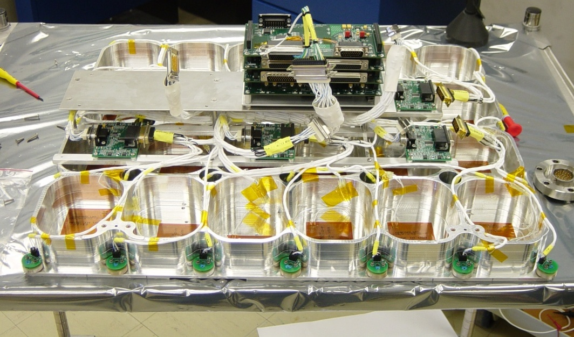
IR Calibration Demonstration System
Prototype Optical Bench (underside)
Assembled with thermal control electronics and tested in thermal vacuum chamber
Optical Bench Thermal Control Electronics
Thermistors and Heater Elements

Slide 7
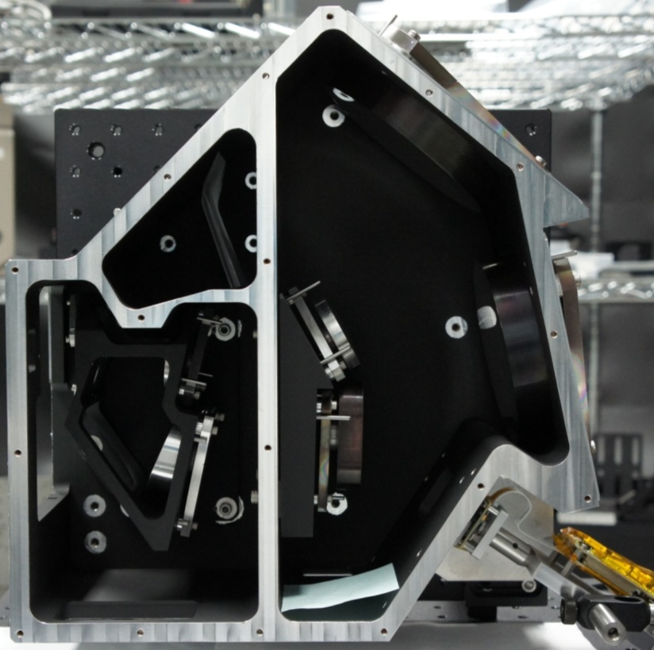
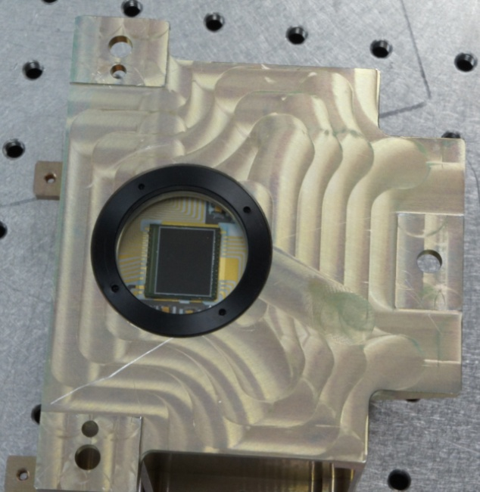
RS Calibration Demonstration System
Main Housing
Assembly completed
Achieved first light (with off-the-shelf detector)
Mid-visible SNR exceeding requirements by >10X
Spectrometer
Optics
Slit
Grating
GSFC-Developed Silicon Detector Array
Off-the-Shelf
Detector
Telescope
Optics

Slide 8
Evaluation of Hosting on Existing Platforms
Iridium NEXT
Has the advantage of numerous launch opportunities, but offers only small payload mass and volume allocations
Conclusion: Iridium NEXT is not a viable option for either of the CLARREO instruments (or reduced IR options) due to mass, volume, thermal constraints
Small Satellites: FASTSAT (MSFC)
Initial studies of the MSFC FASTSAT satellite bus indicate that the CLARREO infrared and reflected solar instruments are too large for this platform
Future studies will investigate other existing small satellite opportunities
Conclusion: FASTSAT is not a viable option for either of the CLARREO instruments (or reduced IR options) due to mass and volume constraints
ESPA (DoD)
Offers a well known interface for small spacecraft but poses some programmatic issues
International Space Station
Offers large payload mass and volume allocations
Logistics, access to space, and orbits have been considered
Conclusion: ISS meets CLARREO accuracy goals 50S to 50N for spectral fingerprinting of climate change
Conclusion: ISS meets the CLARREO "NIST in orbit" requirements

Slide 9
Opportunities for Collaboration
Partnerships & Collaboration
NIST continues to be a very active and formal partner
Active participation in Calibration Demonstration Systems at GSFC (reflected solar) and LaRC (infrared)
NIST continues to put their own financial resources into this activity to maintain progress (extending capabilities in near infrared and far infrared wavelengths)
UK international agreement
Imperial College, NPL, and Hadley Centre are active and formal partners
UK formal agreement being updated now
Working with Nigel Fox at NPL on a UK Space agency funded study of reflected solar science requirements for a potential TRUTHS demonstration mission
UK Space Agency representatives are coordinating with ESA for development of TRUTHS
Italy informal agreement
Italy, with international partners including NASA LaRC, has submitted a proposal to ESA for deploying a far-IR/IR spectrometer to fly on the ISS
NASA Competitive Opportunities
R&A Proposals: Intercalibration and AIST solicitations
EV-2 Proposals: FireX (Mlynczak), Echo (Pilewskie) and Zeus (Anderson)

Slide 10
CLARREO Critical Take-Aways
The CLARREO team is continuing to advance the goals of GSICS by assessing alternative means of achieving space-based reference calibration
Thank you for your continued support
Science analysis, simulation and modeling work is achieving substantial advances in CLARREO IR, RS and RO climate change science
Calibration Demonstration Systems are meeting the planned milestones in addressing the primary risks and uncertainties in the measurement and calibration approaches
Broadening of the Science Value framework and mission trade space is providing flexible options for mission implementation that achieve compelling science in a cost effective manner

