Slide 1
Midnight Calibration Error (MCE) Correction for SST products at MSC / JMA
Yukio Kurihara

Slide 2
SST algorithm for MTSAT-2 imageries
Cloud Screening
Cloud screening is made by applying threshold based tests using brightness temperatures from infrared channel 1 (BT1, 10.8 micron), 2 (BT2, 12 micron) and 4 (BT4, 3.8 micron) and reflectivity from visible channel.
SST calculation
SSTs are calculated from BT1, BT2 and empirically calculated atmospheric background conditions (atmospheric temperature and transmittance) by solving simplified infrared radiative transfer equation using 1DVAR method.

Slide 3
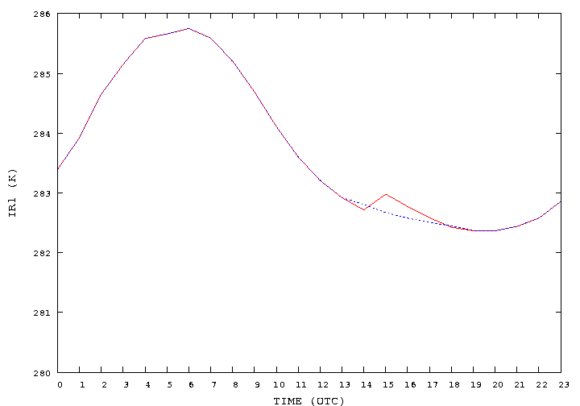
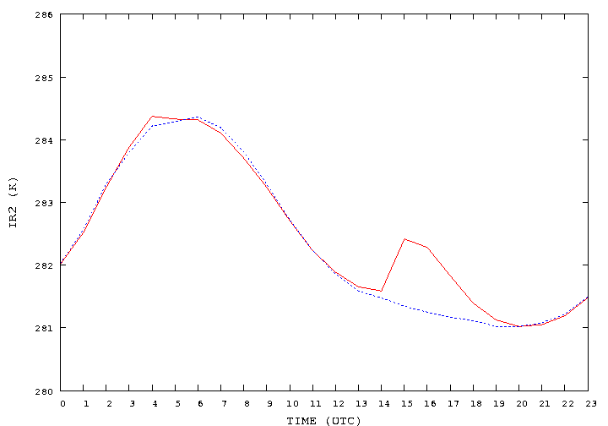
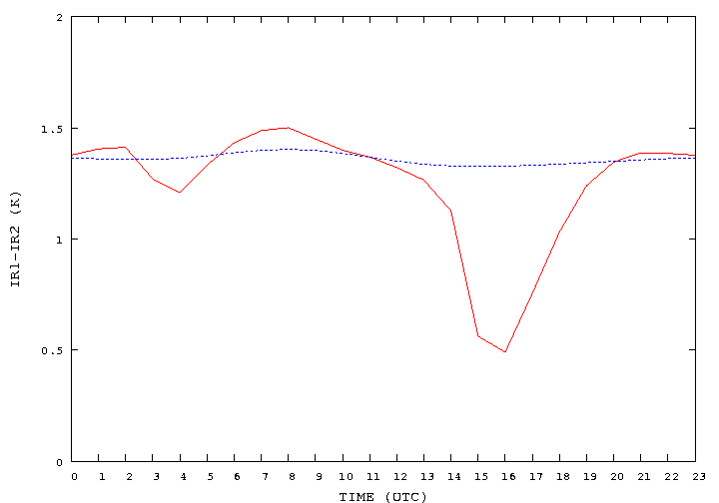
Diurnal Cycle of mean Brightness Temperature (BT) and MCE Correction
BT1 (10.8 micron)
BT2 (12 micron)
Mean BTs are calculated from all of BTs observed at the same time in the past 10 days.
Red shows the cycle of BT from MTSAT-2.
Blue shows the expected natural cycle.
Unnatural spikes in green circles are effected by MCE.
MCE correction is made by correcting difference between Red and Blue as a bias.
BT1-BT2

Slide 4
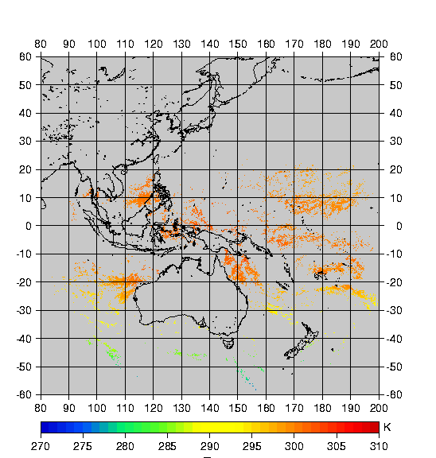
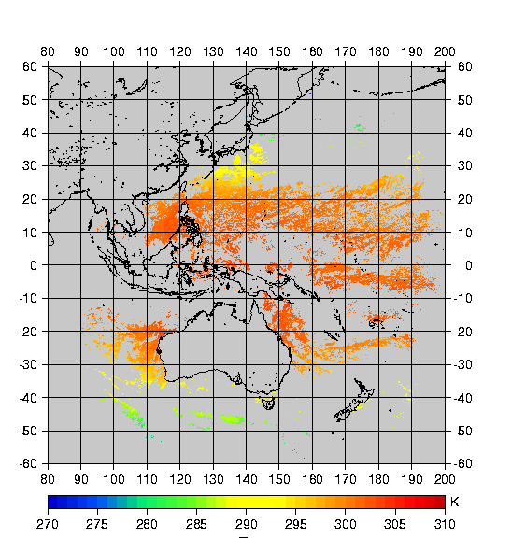
SSTs for 16UTC March 1st , 2012
SSTs retrieved from the original imageries (left) and those from MCE corrected imageries

Slide 5
Conclusion
Midnight calibration error (MCE) strongly contaminated SST products produced by MSC.
MCE could be corrected using diurnal cycle of mean BTs.
But this method is empirical and has no theoretical evidence.
If hourly inter calibration become available by GSICS, MCE will be corrected more effectively.

