Slide 1


CLARREO Advances in Reflected Solar Spectra Calibration Accuracy
K. Thome¹, N. Fox², G. Kopp³,
J. McCorkel¹, P. Pilewskie³
¹NASA/Goddard Space Flight Center
²National Physical Laboratory
³Laboratory for Atmospheric and Space Physics

Slide 2
Introduction
High level summary of calibration advances to achieve the CLARREO RS goals
Examples shown will be based on hardware and approaches developed for
  NPL’s TRUTHS
  LASP’s HySICS
  GSFC’s SOLARIS
Outline
  CLARREO RS and its calibration goals
  Current state of calibration for RS terrestrial imagers
  Approaches to achieve CLARREO-level accuracy

Slide 3
Accuracy Requirements – Climate applications
Instrument absolute accuracy requirements are derived with the goal of achieving measurements
  Within 20% of a perfect climate observing system
  Time to detect trends within 15% of perfect observing system
0.3% uncertainty (k=2) for the RS spectra
  Nadir reflectance
  Driven by natural variability of cloud radiative forcing, cloud fraction, cloud optical depth, particle size
SI traceable observations needed to survive short gaps in record
SNR requirements are driven by the verification approaches not the data itself

Slide 4
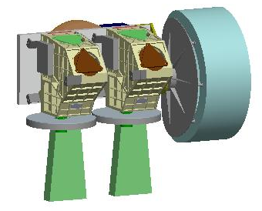
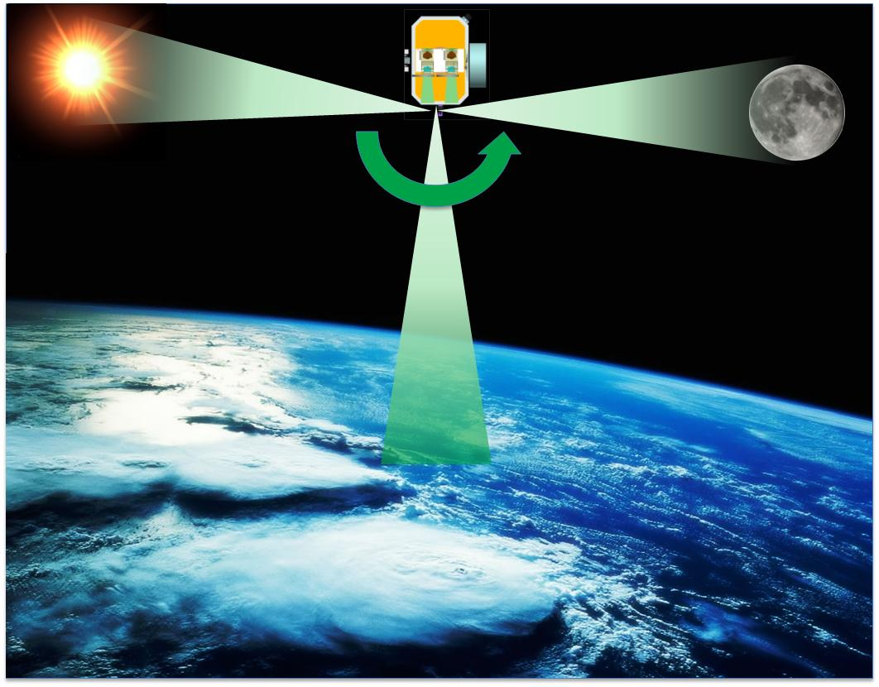
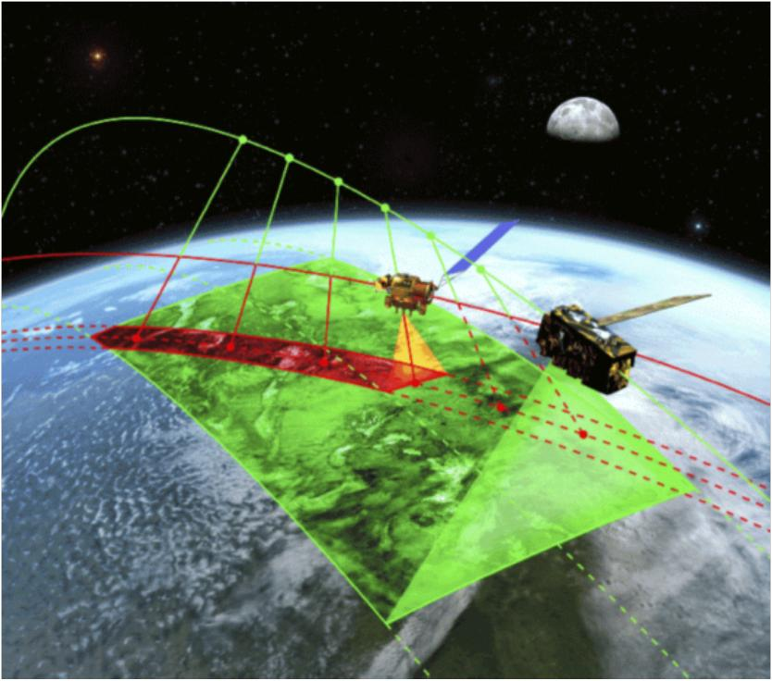
RS Instrument
Benchmark reflectance from ratio of earth view to measurements of irradiance while viewing the sun
Lunar data provide calibration verification
Offner system covering 320 to 2300 nm with 500-m GIFOV and 100-km swath width
Reflectance traceable to SI standards at an absolute uncertainty <0.3%
Benchmark reflectance from ratio of earth view to measurements of irradiance while viewing the sun

Slide 5
Calibration approach
Characterize sensor to SI-traceable, absolute radiometric quantities during prelaunch calibration
Component and system level data used to develop hi fidelity sensor model
Transfer to orbit through accurate prediction of sensor behavior while viewing known sources
Ensure prelaunch calibration simulates on-orbit sources

Slide 6

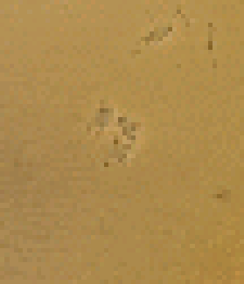
Current calibration approaches
RS part of the spectrum relies primarily on lamps, diffusers, and vicarious
Both pre-launch and post-launch
Attempt to monitor the source while on orbit
Absolute uncertainty in radiance is 4.2% (k=2)
3.6% (k=2)
Need far better for climate-quality measurements
0.2% (k=2)
relative
Intercomparisons 1.0% (k=2) relative

Slide 7
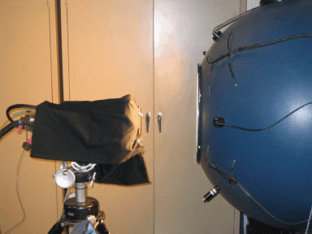
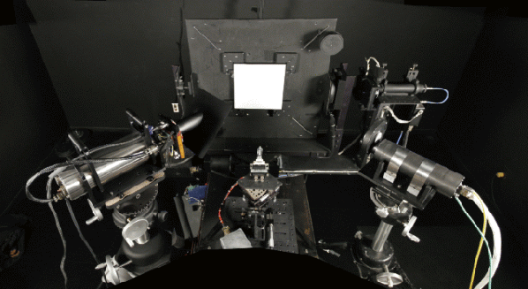
Current calibration approaches
Methods are traceable to source-based calibration standards
Accuracy of source-based methods is limited by broadband nature of the source and ability to characterize the source stability and spatial characteristics
Best case for absolute uncertainty of a broadband sphere source is 1% (k=2)

Slide 8
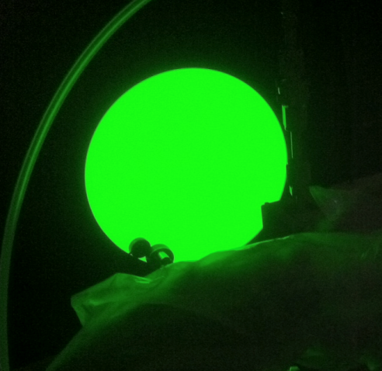
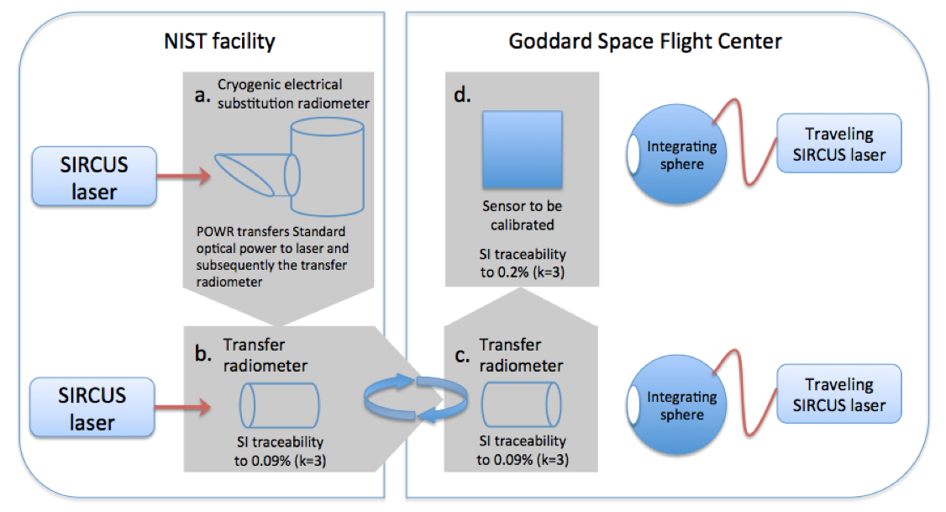
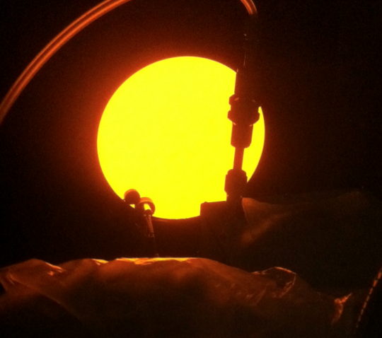
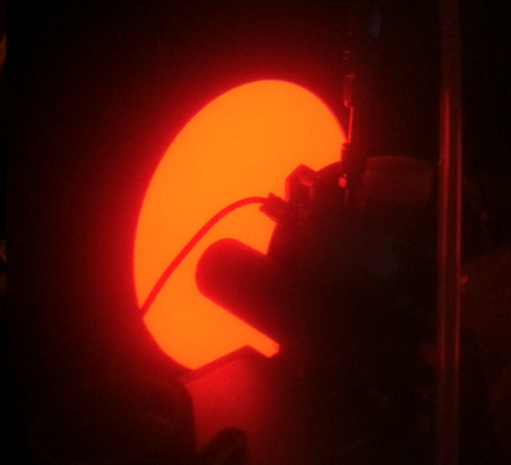
0.3% uncertainty (k=2) is feasible
Narrow band sphere output calibrations are achieving 0.09% (k=2)
Metrology facility
Vendor or other facility

Slide 9
TRUTHS
TRUTHS takes the laboratory to space
Primary reference is electric substitution cryogenic radiometer
Tunable monochromatic beam calibrates other TRUTHS instruments
Earth imager aperture illuminated by deployable diffuser
Measures incoming and reflected solar

Slide 10
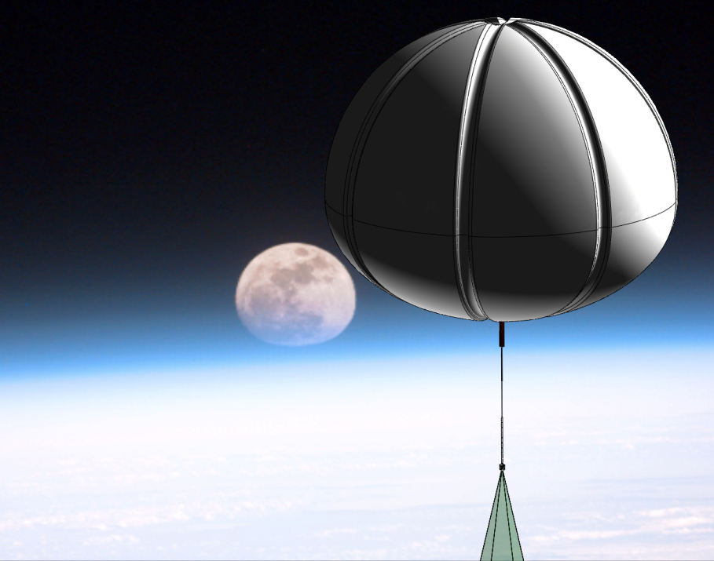
HySICS
Implements solar cross-calibration approaches to provide on-orbit radiometric accuracy and stability tracking
HyperSpectral Imager for Climate Science the follow-on to a breadboard instrument
Flight test a CLARREO-like hyperspectral imager
  <0.2% (k=1) radiometric uncertainty
  <0.13% (k=1) instrumental polarization sensitivity
Perform two high-altitude balloon flights to demonstrate solar cross-calibration approach and to acquire sample Earth and lunar radiances

Slide 11
HySICS provides CLARREO-like opportunities
Demonstrate feasibility of acquiring CLARREO reflected solar data with single spectrometer
Smaller, lower mass instrument
Solar cross-calibrations under realistic conditions
Builds on and improves needed ground test equipment
Environmental testing after initial instrument calibration
  Vibration tests
  TVAC testing
  Post I&T calibration to confirm instrument performance

Slide 12
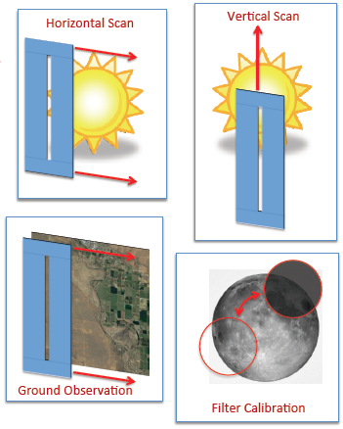
Solar cross-calibration
Ratio of earth radiance to solar irradiance limits effects of instrument instability
Balloon flights can test
  Flat-field calibrations
  Solar irradiance retrieval
  Filter calibrations
  Ground observations
High altitude removes much of atmospheric influences

Slide 13
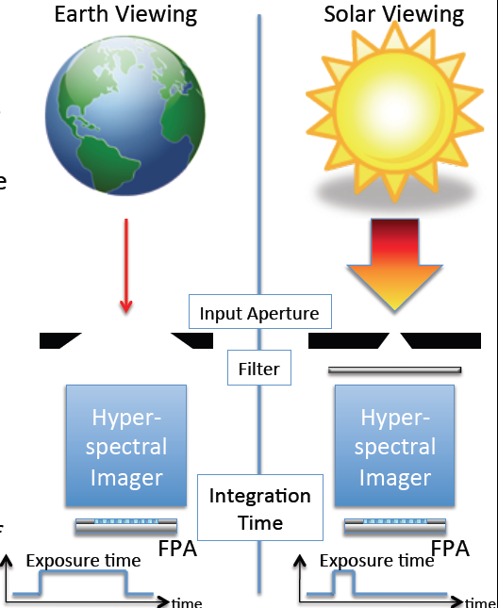
Solar cross-calibration
Showing retrieval of reflectance is key element of HySICS
Non-trivial measurement because
  Large difference between solar and terrestrial signals
  Size of source difference as well
Breadboard demonstrated feasibility

Slide 14
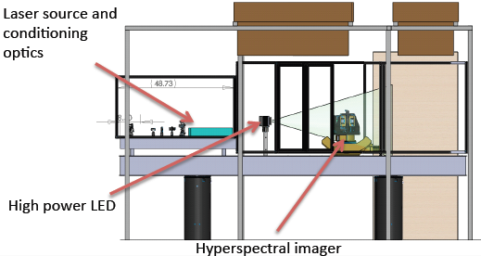
Laboratory improvements
Need to demonstrate that research-level efforts at metrology labs can be transferred to other facilities
LASP and GSFC both have NIST-supplied traveling SIRCUS and trap detector monitors calibrated by NIST over seven orders of magnitude
LASP has a cryogenic, electric substitution radiometer
Uniform, stable white light sources for broadband calibrations
LASP also has demonstrated a solar disk simulator High power laser adjusts intensity over >5 orders of magnitude

Slide 15
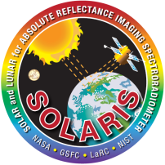
Calibration Demonstrator System
SOlar, Lunar for Absolute Reflectance Imaging Spectroradiometer (SOLARIS)
  Technology demonstration of
    Thermal control of attenuators and detector
    Design and production of optics
    Depolarizer technology
  Test prelaunch calibration methods
  Evaluate reflectance retrieval
  Demonstrate transfer-to-orbit error budget showing SI-traceability

Slide 16
SI traceability and transfer to orbit
Develop and check calibration protocols and methods
Path to SI traceability (source and detector standards)
Verifiable error budgets
Instrument model development and evaulation

Slide 17
Transfer to orbit
Key element of both HySICS and SOLARIS is to demonstrate a transfer to orbit
Traceability sun as calibration source is not at issue
Key issues for traceability are
  Proof of transfer to orbit
  Methods to evaluate attenuator behavior with time
  Stray light
Issues are tractable
  Absolute solar irradiance measurement
  Instrument modeling
  Lunar verification
Error budget demonstration

Slide 18
Summary
HySICS, SOLARIS, and TRUTHS play a key role demonstrating CLARREO-quality error budgets are feasible
Accuracies already being achieved in the laboratory
Collaborative efforts with metrology laboratories (NIST, NPL) continue to be critical
  “Operational” use of detector-based methods SIRCUS
  Extension to wavelengths >1 micrometer
  Broadband calibration approaches
  Laboratory calibration protocols
Peer review of error budgets is the critical step

