Slide 1
Multi-Instrument Intercalibration Framework GSICS Meeting March, 2013
Aron Bartle (Mechdyne)
James Gallagher (OPeNDAP), Dave Johnson (SSAI)
Constantine Lukashin, Dave Doelling (NASA)
Carlos Roithmayr, Chris Currey (NASA)

Slide 2
MIIC Framework
The Multi-Instrument Intercalibration Framework is a collection of software designed to work in a distributed collaborative environment to provide LEO-GEO and LEO-LEO intercalibration services. The MIIC Framework leverages the OPeNDAP network protocol and server-side functions to efficiently access IC event data from large volumes of distributed datasets housed within NASA’s collection of Earth science data systems.
Funded by ROSES-2011 Advancing Collaborative Connections for Earth System Science (ACCESS), two year effort
Spinoff of CLARREO Intercalibration Science Data System mission concept

Slide 3
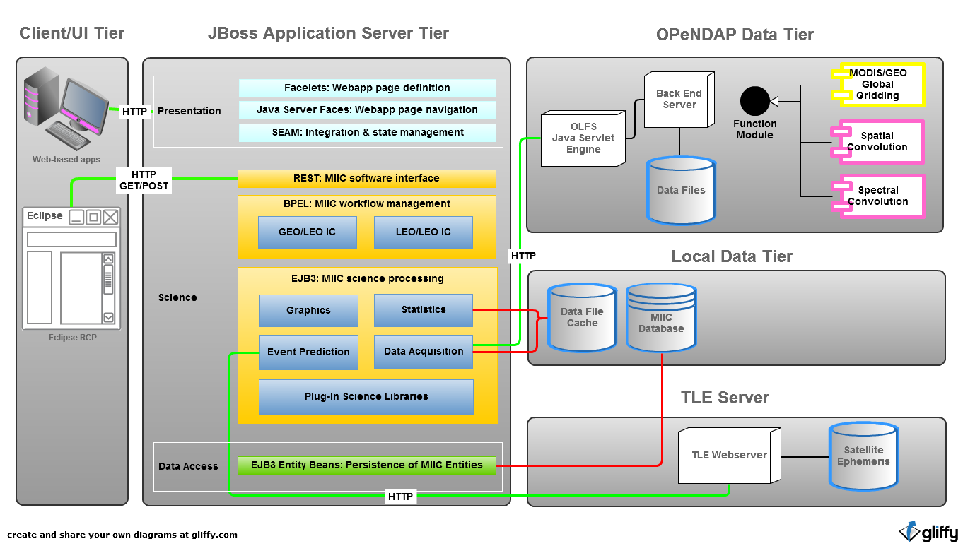
MIIC System Architecture

Slide 4
MIIC Framework Objectives
The MIIC Framework predicts near co-incident measurements with matched viewing geometries for instruments on separate spacecraft and efficiently acquires these data from remote data servers using OPeNDAP and server-side functions.
New OPeNDAP server-side functions complement those in place for format translation and subset selection to minimize the computation and network demands placed on instrument teams that perform multi-instrument intercalibration in the distributed and heterogeneous context of the NASA Earth Science data system infrastructure.

Slide 5
MIIC Framework Features
Intelligent Event Prediction software
Use SGP4 orbit propagator (Java version)
Predict matched viewing conditions from two spacecraft instruments
Geolocate arbitrary pointing vectors in sensor scan plane (+/- 50°) then calculating viewing angles relative to both spacecraft and sun
Identify data filenames and Lat-Lon bounding boxes to subset
Predict LEO-LEO and LEO-GEO IC events
Efficient access to remote data based on OPeNDAP
Achieve significant reduction in data volume transfer by smart selection and server-side processing (typically < 0.1 % total data volume required for IC)
Develop server-side functions (gridding, spectral and spatial convolution)
Currently using OPeNDAP Hyrax server, Freeform and HDF4 handlers
Supports netCDF

Slide 6
MIIC Framework Features
Client-side filtering and science algorithm processing
Web interface to allow users to specify selection criteria
Automatically execute intercalibration plans end-to-end (build IC plan, aquire and process events, calculate and persist calibration coefficients)
Caches matched event data on client-side for further processing
Extend science library for comparative analysis
Template for future distributed collaborative science data systems

Slide 7
Provide MIIC Web Services
RESTful Web Services
Allows software outside of application tier to access MIIC services
Use HTTP methods to acquire services, specify URL
Event Prediction Service to Acquire Data
Specify satellite instruments, time range, viewing geometry, etc.
Service creates IC Plan and returns data
Useful for users that what tool to acquire data, run own algorithms
Inter-Calibration Service
Create IC Plan, acquire and process data
User gets Calibration correction coefficients, plots, final results
Results saved in database

Slide 8
MIIC Framework Build Plan
1. MIIC Framework, Build 1 (2012):
Implement LEO-GEO orbital intercalibration Event Predictor
Develop equal angle server-side gridding functions (OPeNDAP Server)
Acquire IC events from remote servers, Filter and Merge
Perform Linear regression on monthly collection of IC events
Test performance on CLARREO and ASDC servers
2. MIIC Framework, Build 2 (2013):
Implement LEO-LEO orbital intercalibration Event Predictor
Develop spectral and spatial convolution functions (OPeNDAP Server)
Implement cookie-cutting sampling – MODIS pixels convolved on SCIAMACHY IFOVs
Develop MIIC web services interface
Persist calibration results in database
Improve user interface: control and graphics (web page)
Define plugin interface for Earth Science Data Analysis algorithms
Test performance on CLARREO and ASDC servers + recommend deployment architecture
3. MIIC Framework future plans:
Extend Framework for Comparative Data Analysis (observations and climate models)
Implement Histogram classes: 1D and 2D, both distributions and averages
Implement science work flow engine for HPC cluster
Eclipse UI with MIIC plugins

Slide 9
Build 1 - Intercal Cone (GEO vs. LEO)
When is LEO subsatellite point within GEO field of view?
Intercal can take place when angle between LEO and GEO S/C position vectors is ≤ half-angle of Earth-centered (teal) cone.
LEO S/C
to GEO
GEO FOV cone

Slide 10
Points to be Checked for Angle Matching
Viewing Angles
Viewing Zenith Angle (VZA)
Solar Zenith Angle (SZA)
Relative Azimuth Angle (RAZ)
At each instant t, for each target point, calculate viewing angles for
LEO S/C
GEO S/C
Then calculate viewing angle differences: D VZA, D RAZ
gridded instrument crosstrack swath
LEO S/C
swath target point

Slide 11
Intercalibration Event Prediction Results
• • Aqua ground track
Aqua swath
|Δ VZA| ≤ 10°
|Δ RAZ| ≤ 20°
|Δ VZA| ≤ 10° and |Δ RAZ| ≤ 20°

Slide 12
OPeNDAP Server w/ MIIC Server-side Functions
Java
C++
HDF4
MODIS
Freeform
GEO
Build 1 Functions
Build 2 Modules
MIIC client retrieves DAP2 objects (DataDDS) over network (http protocol)
MIIC client queries THREDDS for list of available files
Build 2 sever-side functions to be separate dynamic linkable modules
Build 1 tested with latest Hyrax 1.8.8

Slide 13
OPeNDAP Data Tier: B1 Server-side Functions
Server-side functions are HTTP query strings after data URL
Functions to grid files
http://…/MCIDAS.G-13.2011.01.01.2145.08K.bin.dods ← data URL ?eageogrid(.5, ← equal angle GEO grid, ½ degree GRID_VAR,TIME, ← scan time included in grid GRID_VAR, latitude, GRID_VAR, longitude, GRID_VAR, channel_data,"0", -99, ← channel 0, -99 is miss val FILTER_VAR, latitude,-35,10, ← include only lat from -35 to 10 FILTER_VAR, longitude, -133,-104)

Slide 14
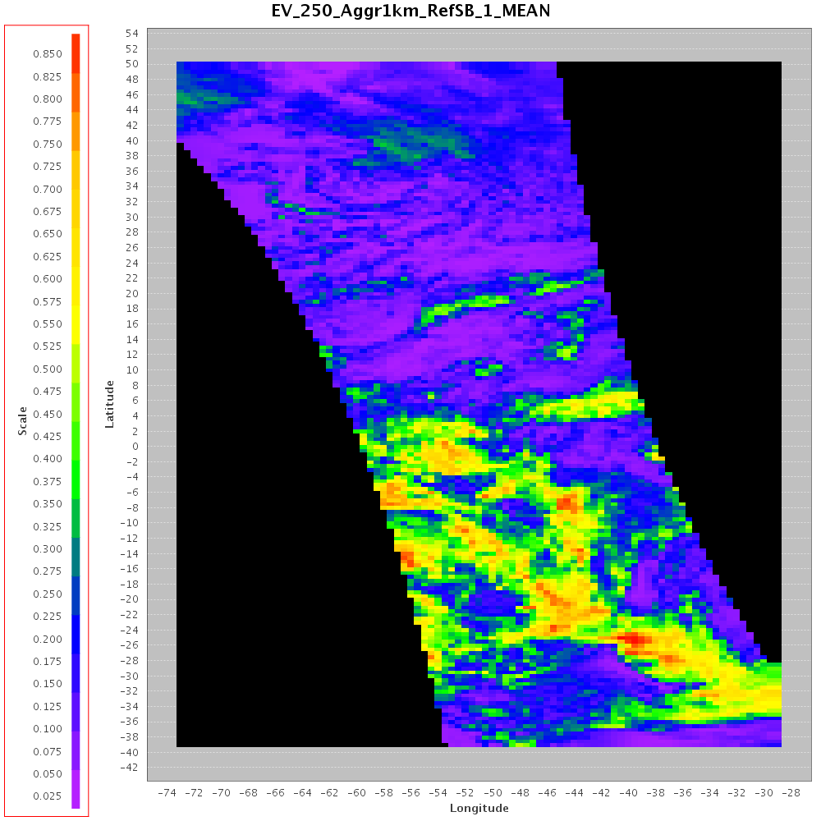
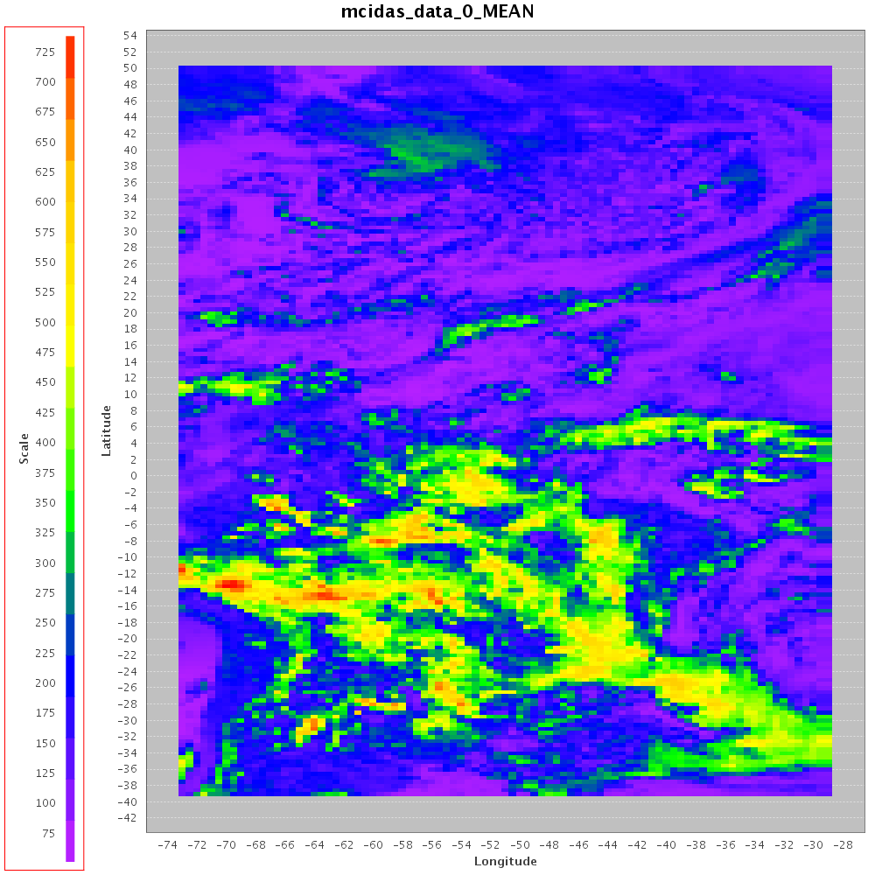
LEO/GEO Matched Event Sample
MODIS EV_250_Aggr1km_RefSB band 1 (620-670 nm), 2011-01-01 hour 16
GOES-13 0.65 um , GOES-13 time 1645

Slide 15
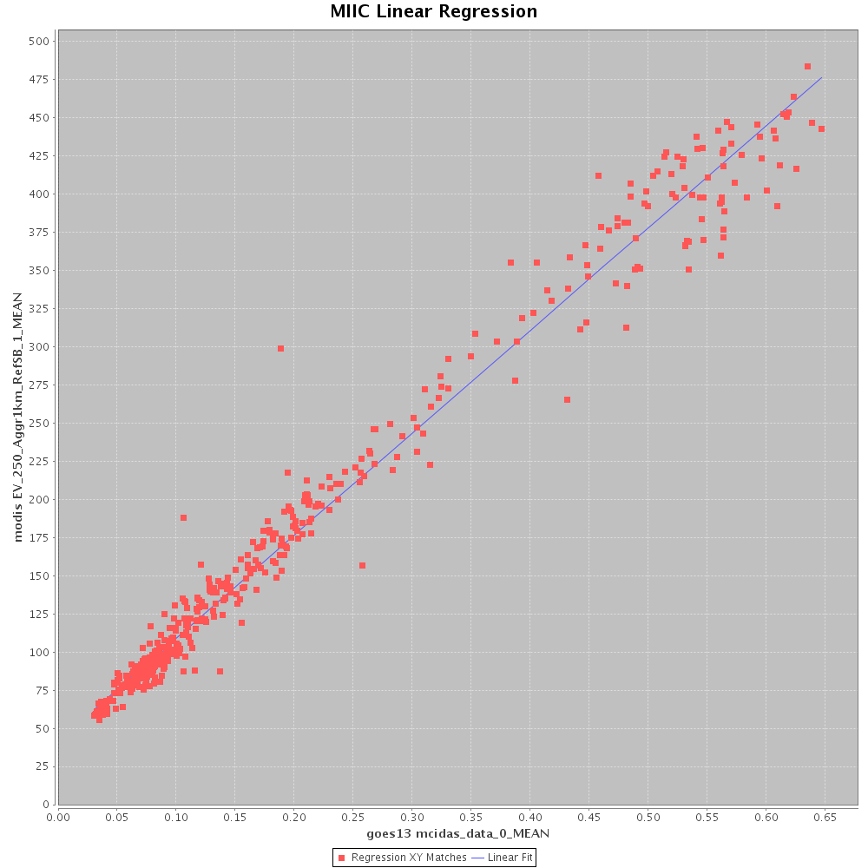
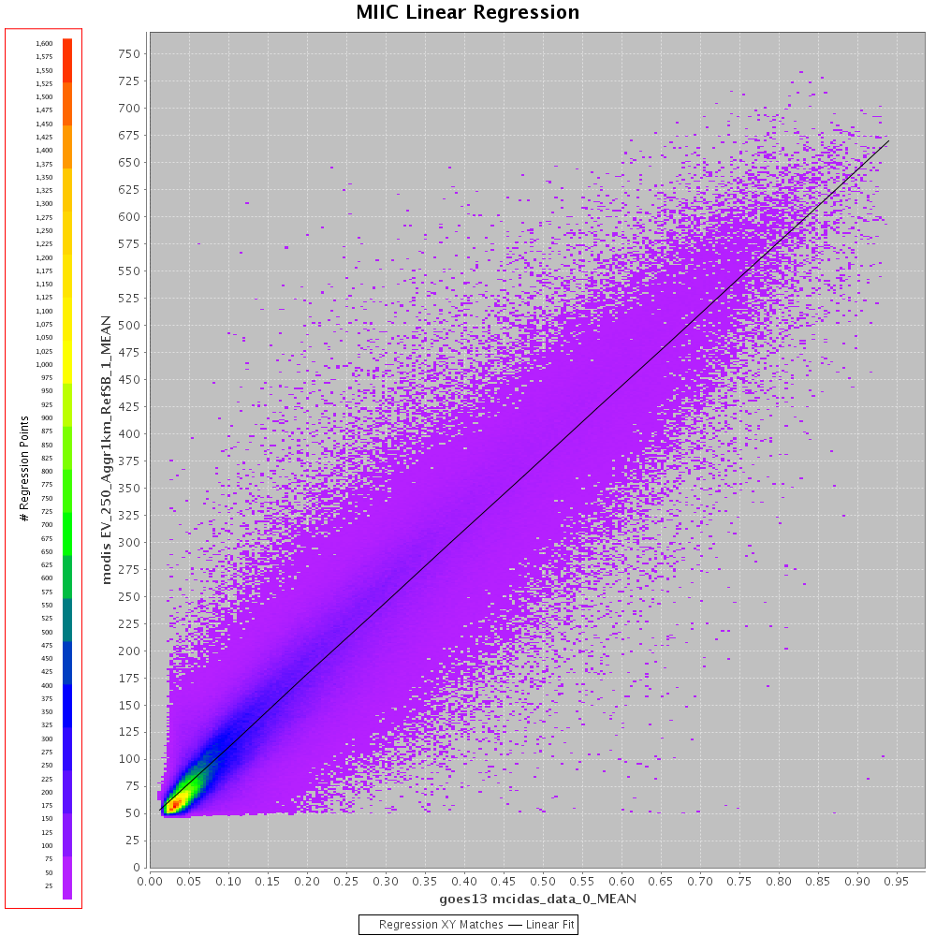
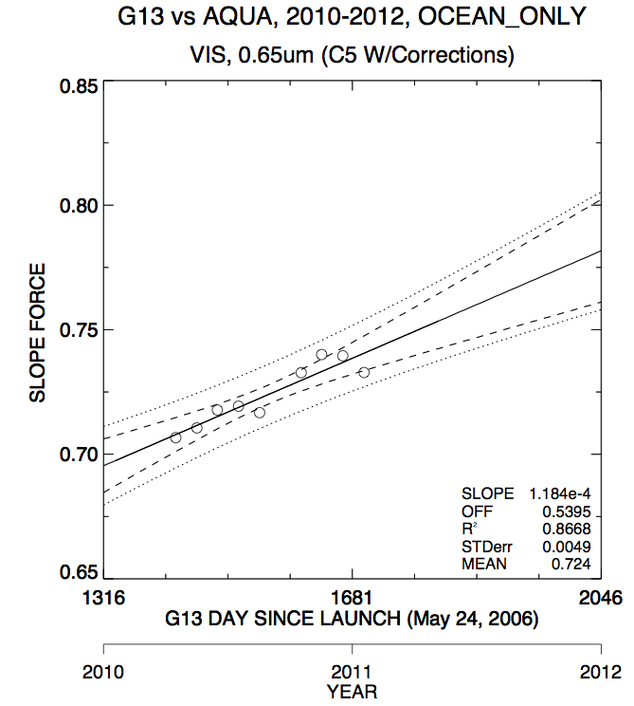
LEO/GEO Calibration Work in Progress
One Day Regression FILTERING:
Nsamples: 555
Filtering: -vza5 –raz15
R squared: 0.981
Parameter Estimate: 41.925
Parameter Estimate: 671.610
One Month Regression NO Filtering:
Nsamples: 941242
Filtering: disabled
R squared: 0.892
Parameter Estimate: 44.748
Parameter Estimate: 665.123
What we need! Trending of Monthly Calibration Coefficients + better filtering (ref. MIIC Proposal)

Slide 16
How Extendable is the MIIC Framework?
Added server-side function to grid CERES SSF hdf44
Event predictor works for CERES-Aqua and GOES-13
Performed one month of Aqua-CERES with GOES-13 IC
Added client-side Instrument class and runtime configuration file to select LEO and GEO instrument filtering and band
Can select any parameters within file and perform regression (CERES SW flux vs. GOES-13 imager 0.65 um )
Tested GERB (hdf), OSSE (hdf), MERRA (netCDF), ….

