Slide 1

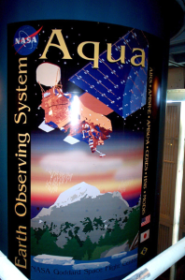
Aqua MODIS Reflective Solar Bands (RSB)
Calibration Improvements in Collection 6
Amit Angal, Junqiang Sun, Hongda Chen, and Jack Xiong
&
MODIS Characterization Support Team (MCST)
GRWG/GDWG Annual Meeting 2013-03-04/08
Page 1

Slide 2
Outline
Introduction
  Overview
  Reflective Solar Bands (RSB) calibration & Performance
  RSB LUT Timeline
Collection 6 (C6) Algorithm Formulation
  Sensor response (m1)
  Sensor response versus scan-angle (RVS)
C6 Performance
  C5-C6 Comparison
  Improvements to the L1B product (long-term drift, detector-detector striping)
Summary
Page 2

Slide 3

Overview
RSB EV Reflectance
Key Look-Up-Tables (LUT) for RSB
  m1: Inversely proportion to gain at the AOI of SD
  RVS: Sensor Response versus Scan angle (normalized to SD view AOI to the scan mirror)
  Uncertainty
Calibration Sources
  SD/SDSM calibration
  Lunar observation
  SRCA and EV mirror side (MS) ratios
  Selected EV targets
MODIS scan mirror
11.25
Angle of Incidence (AOI)
Page 3

Slide 4
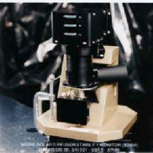
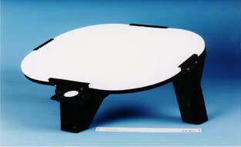
MODIS RSB Calibration Using SD/SDSM
Reflectance Factor
Sun
1.44% Screen
Optional 7.8% Screen
SDSM
Scan Mirror (MODIS)
Δ_{SD}: SD degradation factor;
Γ_{SD}: SD screen vignetting function
d: Earth-Sun distance
dn*: Corrected digital number; dc: Digital count of SDSM
SD

Slide 5
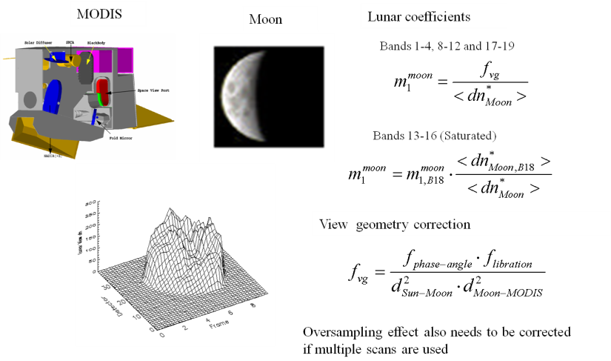
MODIS Lunar Calibration

Slide 6
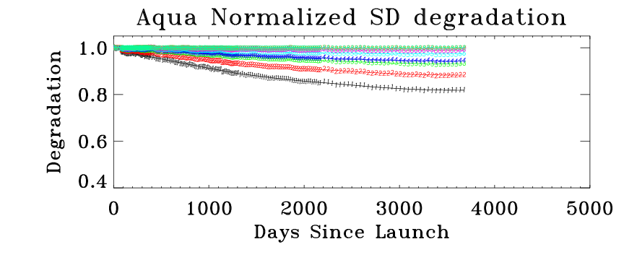
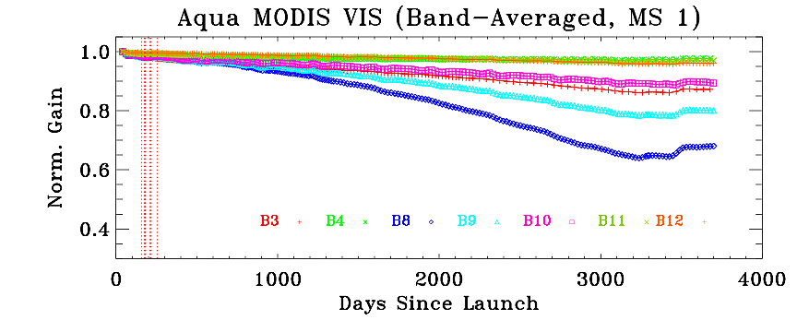
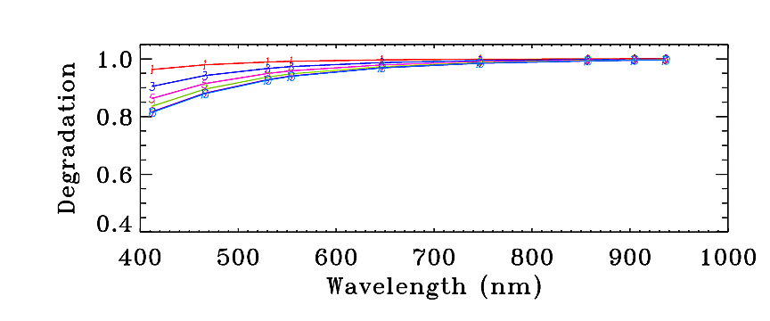
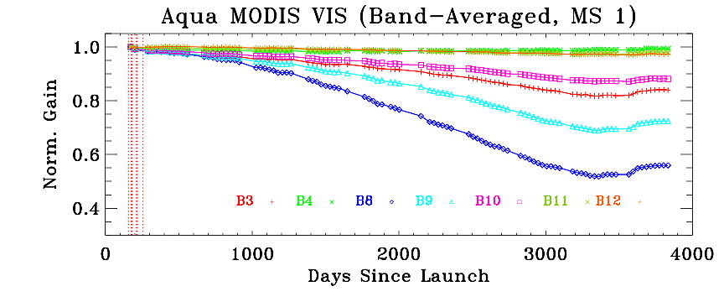
RSB Performance
λ
SD
Time
Lunar
Larger SD BRF degradation at shorter (VIS) wavelength
Changes in RSB responses are AOI dependent
Wavelength dependency for gain change

Slide 7
RSB LUT Timeline
m1 LUT History:
  Collection 2: Prelaunch calibration coefficients
  Collection 3-5 : Time-dependent m1 generated using SD/SDSM calibration
  Collection 6:
    m1 generated using SD/SDSM, lunar calibration and EV response trending for Terra bands 1-4,8 and 9 and Aqua bands 8,9
    m1 for all other RSB generated using the SD/SDSM calibration
RVS LUT History:
  Collection 2-3: Prelaunch RVS
  Collection 4: Time-dependent RVS based on SD, lunar and SRCA gains. Applied for bands 3,8 and 9
  Collection 5: Time-dependent RVS applied to all RSB (except SWIR) using SD, lunar and SRCA and EV mirror side differences
  Collection 6: C5 Approach applied for most RSB. EV response trending supplements on-board measurements for Terra bands 1-4,8 and 9 and Aqua bands 8 and 9
Page 7

Slide 8
Enhancements in Collection 6
SD degradation at 936 nm is applied
  Previous SD degradation is normalized at this wavelength
  A correction of 0.6% in Aqua over 11 years (also applied in C5)
Time dependent RVS applied to bands 13-16
  Approach developed to monitor bands 13-16 lunar calibration stability (some pixels saturate when viewing the Moon)
Detector dependent RVS
  Mainly applied to VIS bands (e.g. bands 8-12)
Some RSB calibration coefficients (m1) and RVS are derived at the same time using observations to the SD, Moon, and “pseudo-invariant” EV targets at different AOIs
  Mainly applied to VIS bands (e.g. bands 8-9)
Apply to both Terra and Aqua MODIS
Page 8

Slide 9
MODIS RSB RVS characterization
Bands with no on-orbit change in RVS (SWIR)
  Pre-launch RVS
Bands with small changes in RVS
  Use SD and lunar trending for mirror side 1 (MS1) RVS
  Use SD, lunar, and EV mirror side ratios for mirror side 2 (MS2) RVS
  Fit each response trending over time, normalize to SD response, and then fit over AOI
Bands with large changes in RVS (Aqua bands 8,9 and Terra bands 1-4, 8 and 9)
  Supplement the on-board lunar measurements with the trending from EV targets
  Detector dependent RVS applied for several VIS bands (B8-12)
Page 9

Slide 10
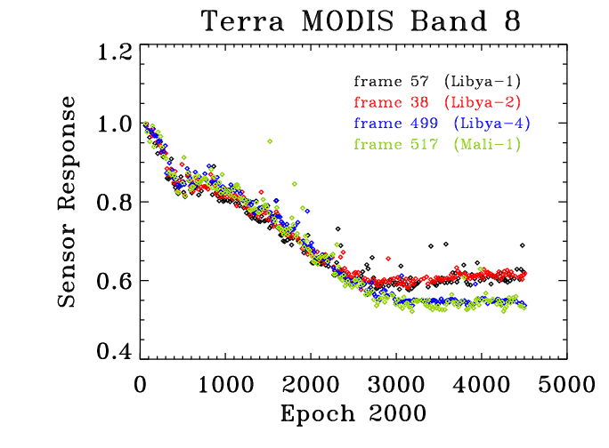
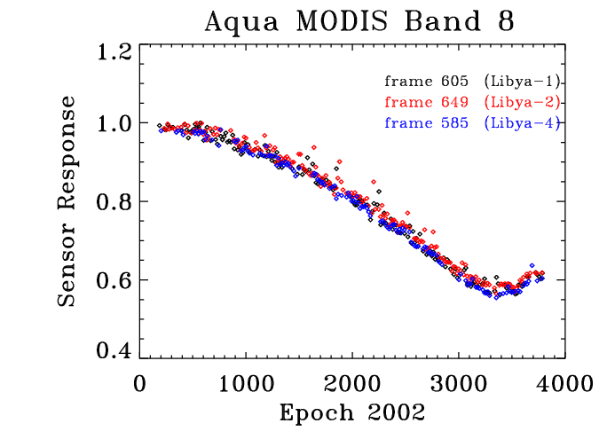
EV Response Trending for VIS bands
A linear approximation is used to estimate the gain change at AOI other than the SD (50.25°) and SV (11.25°)
A long-term bias is also evident for selected VIS bands at the SD AOI
In order to supplement the on-board SD and lunar measurements, EV response trending from pseudo-invariant desert targets was used to track the gain change at all AOI
  Libya-4, Libya-1 and Libya-2

Slide 11
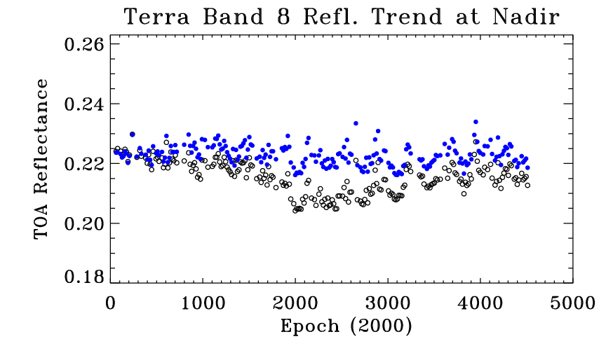
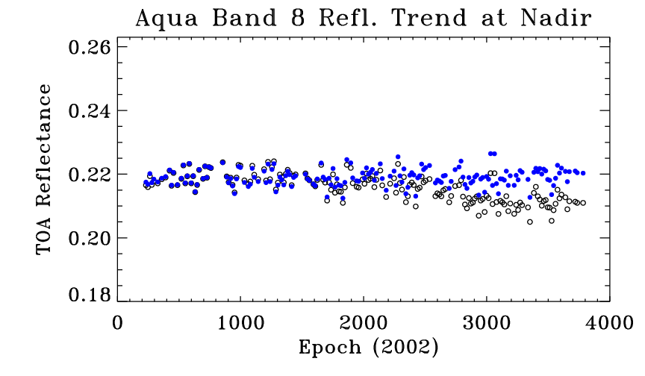
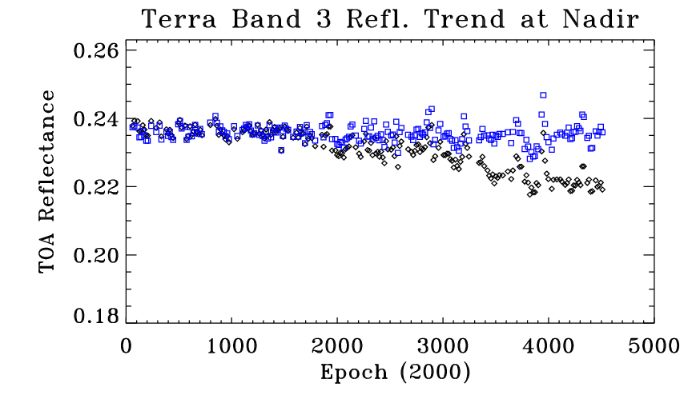
Results: C5- C6 Difference
C5 C6
C5 C6
Similar improvements observed at other AOI
Long-term bias reduced for all the bands using this approach (Terra bands 1-4, 8, 9 and Aqua bands 8 and 9)
C5 C6

Slide 12
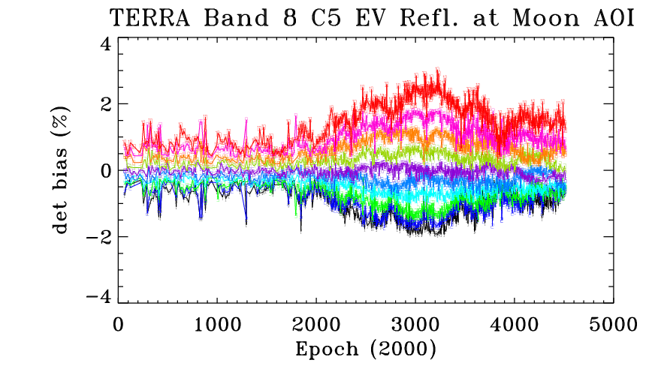
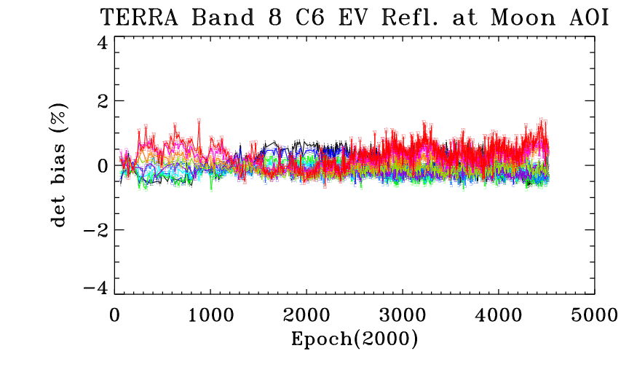
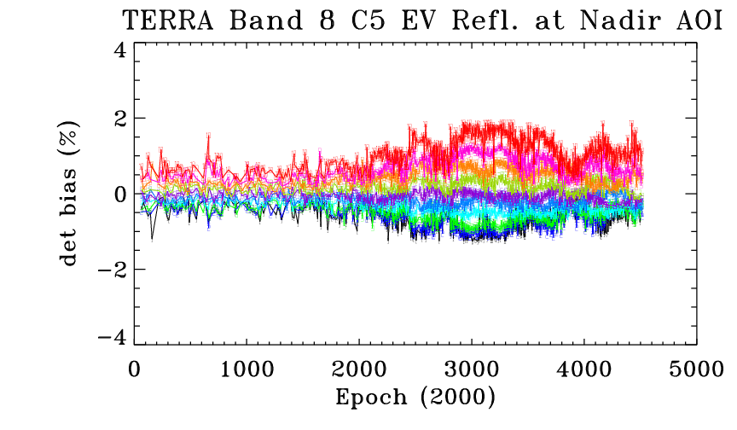
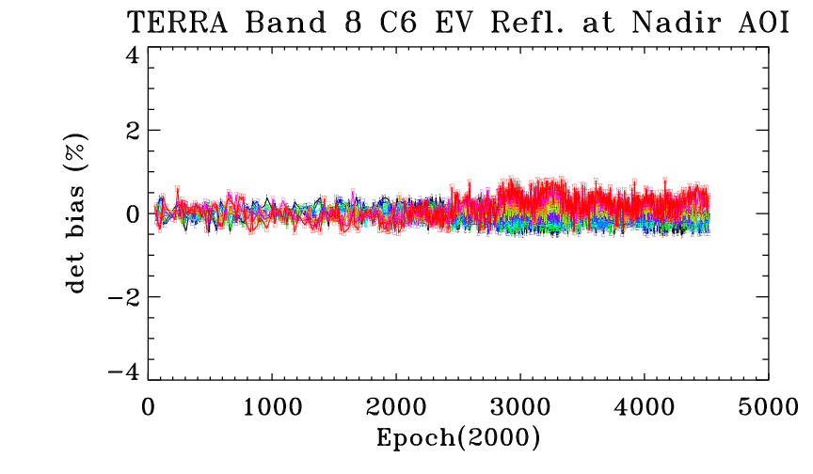
Results: C5- C6 Difference

Slide 13
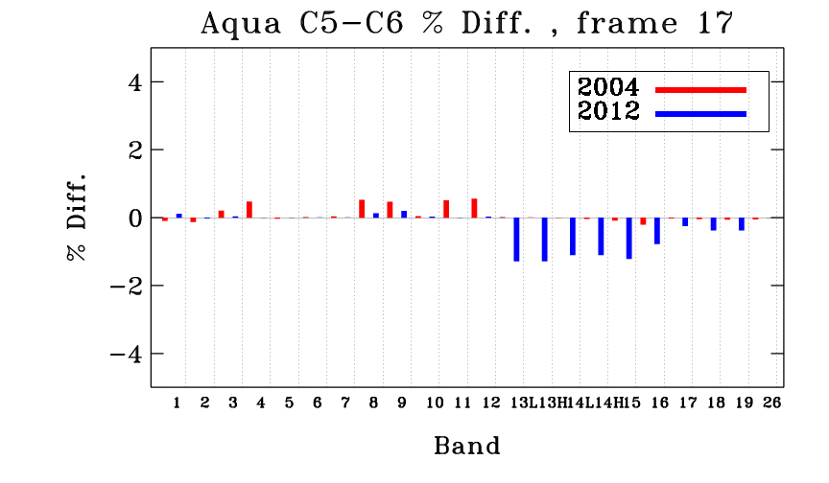
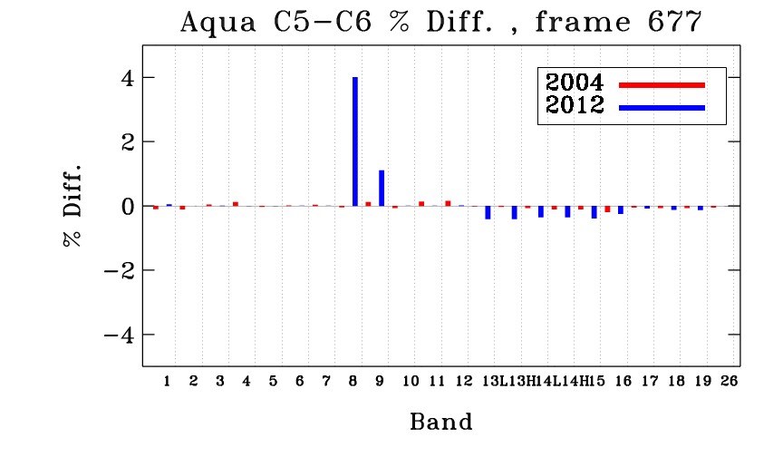
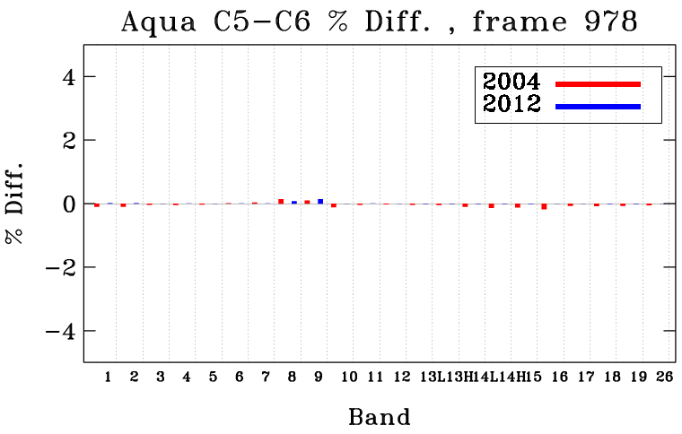
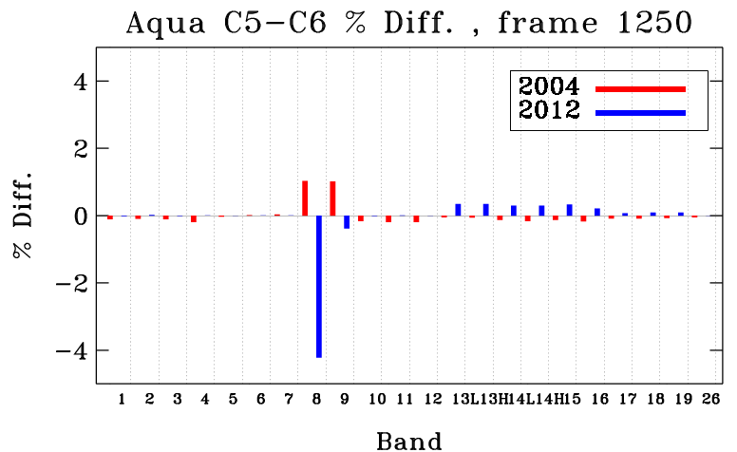
C5-C6 Difference

Slide 14
Summary
Collection 6 RSB m1 and RVS LUT have been developed for the MODIS L1B products
  Long-term drift observed in Terra bands 1-4, 8-9 and Aqua bands
  8-9 significantly reduced
  Time-dependent RVS applied to bands 13-16
  Detector-dependent RVS for Terra bands 3, 8-12 and Aqua bands 8-12
  C6 RSB uncertainty algorithm provides an improved characterization of the AOI and time-dependence of the RVS
Challenges
  Polarization
  Stability of the EV targets
  Aging instruments: Terra 13+ years and Aqua 11+ years

Slide 15
Backup Slides

Slide 16
RSB LUT Summary
Version/Bands | Bands 1-4 | Bands 5-7, 26 | Bands 8-12 | Bands 13-16 | Bands 17-19
C4 | m1/RVS^{pl} | m1/RVS^{pl} | m1/RVS*** | m1/RVS^{pl} | m1/RVS^{pl}
C5 | m1/RVS* | m1/RVS^{pl} | m1/RVS* | m1/RVS^{pl} | m1/RVS**
C6 | m1^{EV}/RVS^{EV} | m1/RVS^{pl} | m1^{EV}/RVS^{EV} (B8,9) m1/RVS* (B10-12) | m1/RVS* | m1/RVS**
Terra
Version/Bands | Bands 1-4 | Bands 5-7, 26 | Bands 8-12 | Bands 13-16 | Bands 17-19
C4 | m1/RVS^{pl} | m1/RVS^{pl} | m1/RVS** | m1/RVS^{pl} | m1/RVS^{pl}
C5 | m1/RVS** | m1/RVS^{pl} | m1/RVS** | m1/RVS^{pl} | m1/RVS**
C6 | m1*/RVS* | m1/RVS^{pl} | m1^{EV}/RVS^{EV} (B8,9) m1/RVS* (B10-12) | m1/RVS* | m1/RVS**
Aqua
RVS ^{pl} : Pre-launch RVS
RVS* : Time-dependent RVS using SD and Moon for MS#1. MS#2 RVS derived using MS#1 as a reference and using EV and SRCA mirror side ratios.
RVS**: Time-dependent RVS using SD and Moon for both MS#2 (2-point RVS). On-orbit RVS applied since 08/10/2010 in C5 and for entire mission in C6.
RVS***: Time-dependent RVS using SD, SRCA and Moon for MS#1. MS#2 RVS derived using MS#1 as a reference
RVS^{EV}: Time-dependent RVS using the Moon and earth-scene measurements from pseudo-invariant desert targets at various AOI.
Additional correction for the SDSM D9 degradation has been applied to all bands except SWIR starting 01/01/2009.
Detector-dependent RVS applied for Bands 8-12 starting C6.
Page 16

