Slide 1
Calibrating the METEOSAT SEVIRI solar channels using lunar observations
Sébastien Wagner (1)
Bartolomeo Viticchie (1), Tom Stone (2), Tim Hewison(1), Gary Fowler (1)
(1) EUMETSAT
(2) USGS

Slide 2
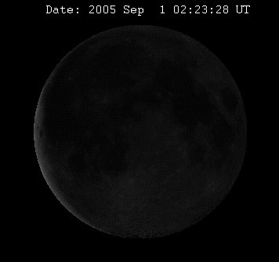
The Moon as a radiometric calibration source
INTRINSIC PROPERTIES:
Exceptionally stable
Non-uniform appearance, varying hemisphere seen
(lunar librations)
Non-Lambertian reflectance
Smooth reflectance spectrum
Continuous and periodic changes in apparent brightness
(e.g. phase) ➔ Can be characterized and modeled
UTILITY AS A CALIBRATION REFERENCE
Requires an analytic model with a continuous predictive capability
Stability of the Moon ⇒ Model valid for any time ⇒ Calibration reference = model
Source : PixHeaven.net / Wikipedia
To date, USGS has the only established lunar reference model, based on the ROLO observation program

Slide 3
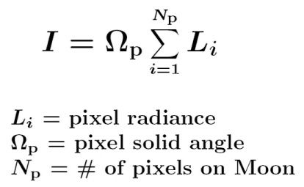
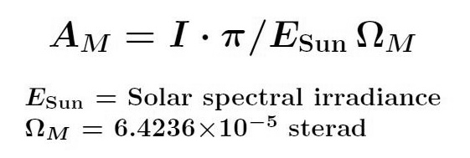
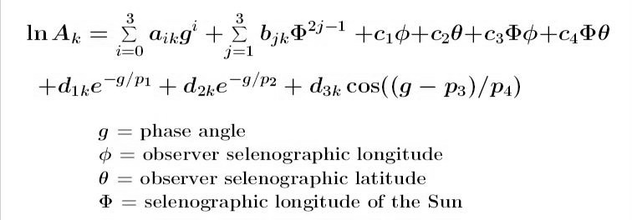
The USGS lunar irradiance model
➔ More than 8 years of observations done at the Robotic Lunar Observatory (ROLO) (350-2450nm range covered by a total of 32 bands)
➔ ROLO lunar images spatially integrated to irradiance and converted to disk reflectance:
Empirical reflectance model — a function of geometric variables only:
By fitting the observations, the model parameters are estimated
Estimated uncertainty:
  5-10% in absolute irradiance scale (due to measurement of Vega by the ROLO telescopes)
  ∼1% relative accuracy
ref: Astronomical Journal 129, 2887-2901 (2005)

Slide 4
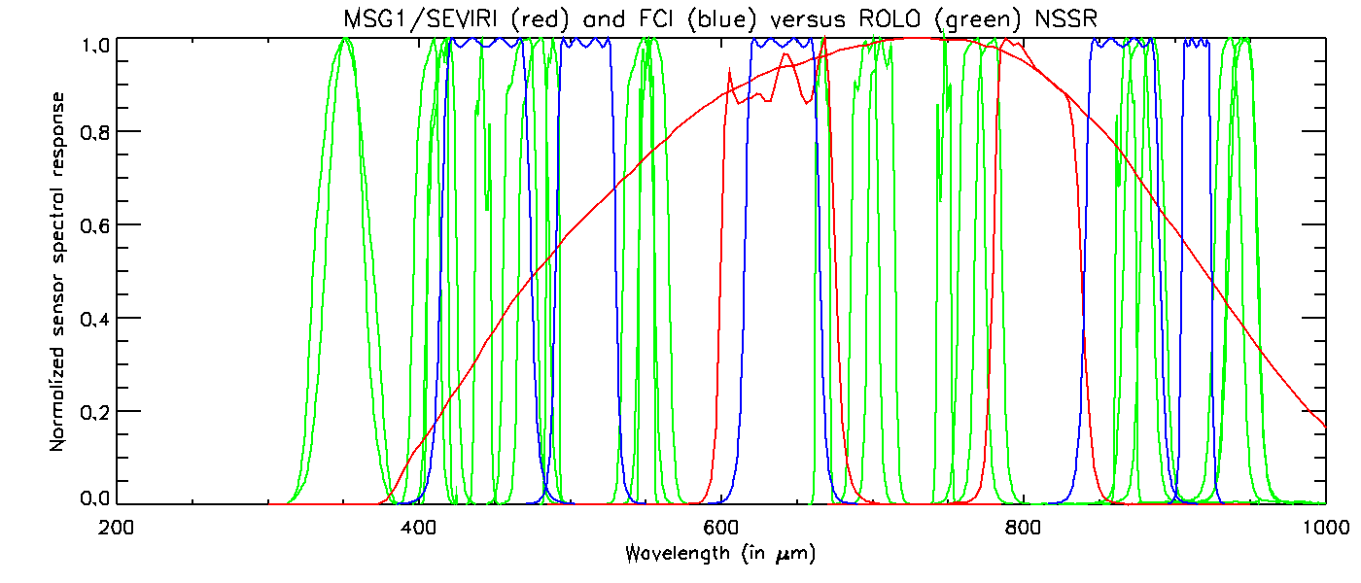
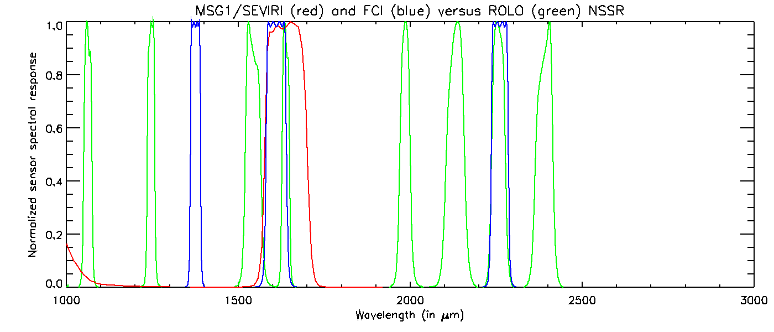
Sensor spectral responses...ROLO versus MSG1/SEVIRI and MTG/FCI (indicative)

Slide 5
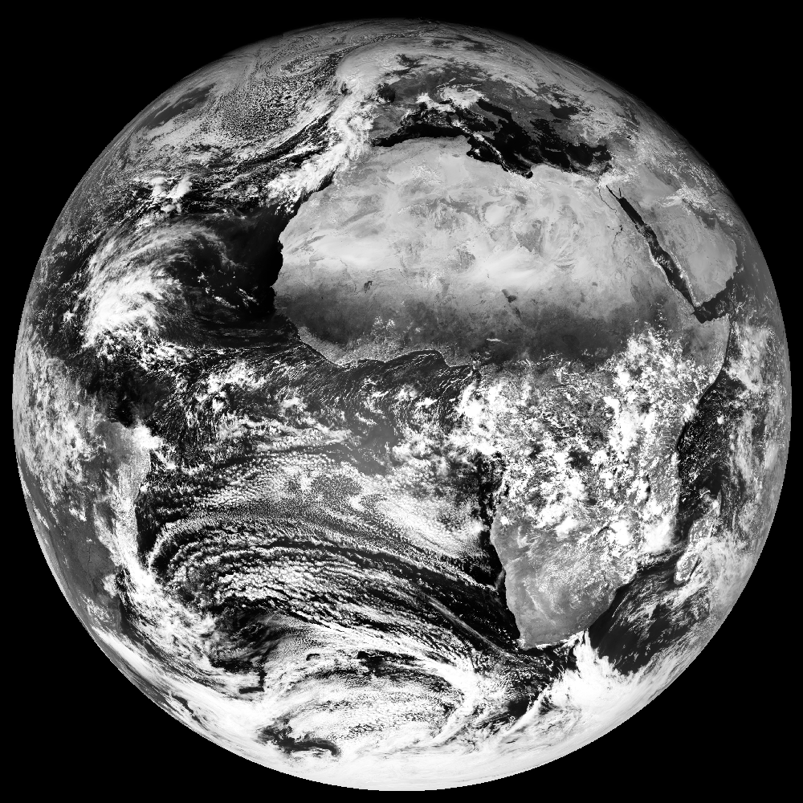
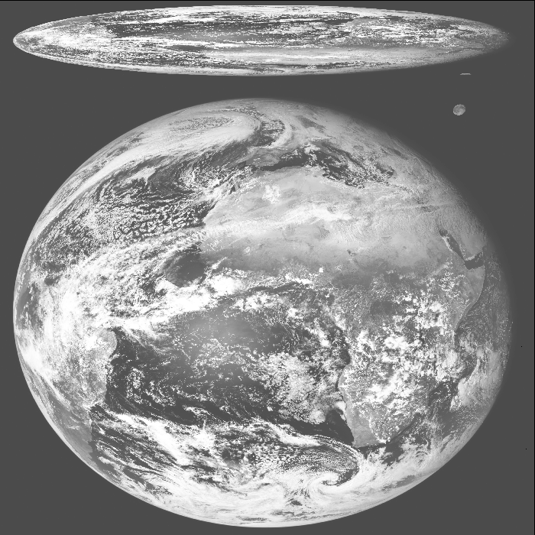
What about lunar observations with SEVIRI?
  Fields of regard for Low Resolution Channels:
  Level 1.0: raw measurement data + auxiliary data
    Visible Moon (up to 5 observations in a row)
    Field Of Regard covers a rectangle of ∼22° N/S and ∼18° E/W
  Level 1.5: data rectified to an uniform grid
    No visible Moon anymore
    FOR = Earth disk
    But: info on the Moon kept available in header + trailer:
      Flag to indicate if the Moon is in the FOR
      Statistics on the Moon counts (min/max/mean/std dev)
    Lunar observations available in the 4 image corners
    (more than 100 potential observations / year)
SEVIRI Level 1.0 image (forward and backward scan)
SEVIRI Level 1.5 image

Slide 6
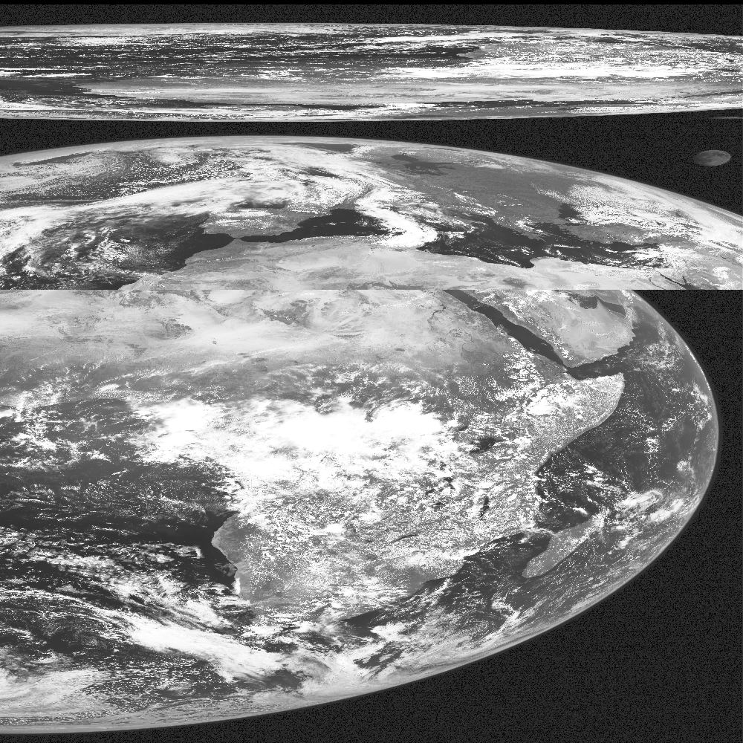
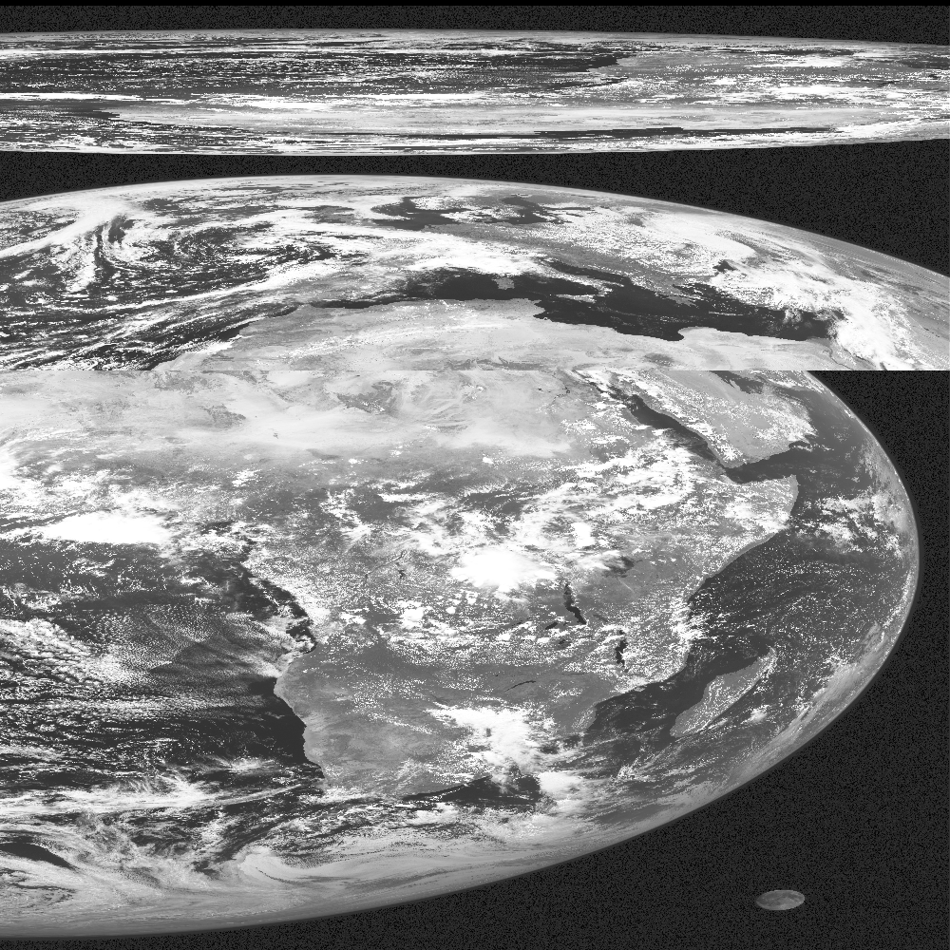
What about the HRVIS band?
SEVIRI Level 1.0 image (forward and backward scan)

Slide 7
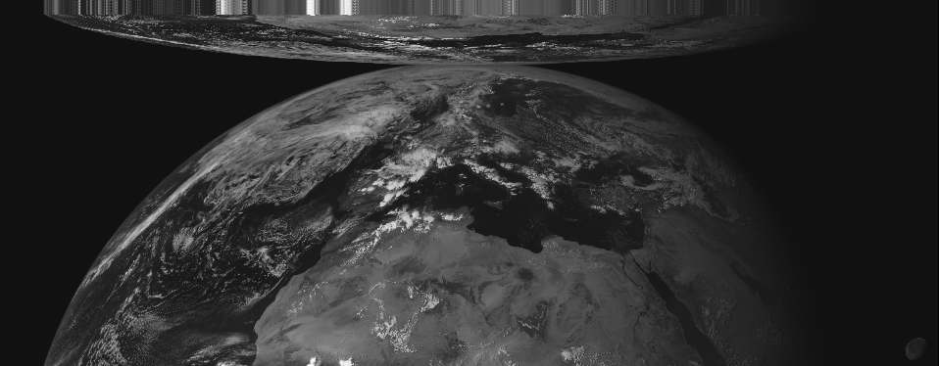
What about the Rapid Scan Service?
SEVIRI Level 1.0 image (forward and backward scan)

Slide 8
Extraction of the Moon imagette
Knowing the relative position of the channels on the focal plane one can use the information obtained in the IR8.7 to spot the Moon in the Solar Channels (VIS06, VIS08, NIR1.6 and HRVIS)

Slide 9
Extraction of the Moon imagette
Knowing the relative position of the channels on the focal plane one can use the information obtained in the IR8.7 to spot the Moon in the Solar Channels (VIS06, VIS08, NIR1.6 and HRVIS)

Slide 10
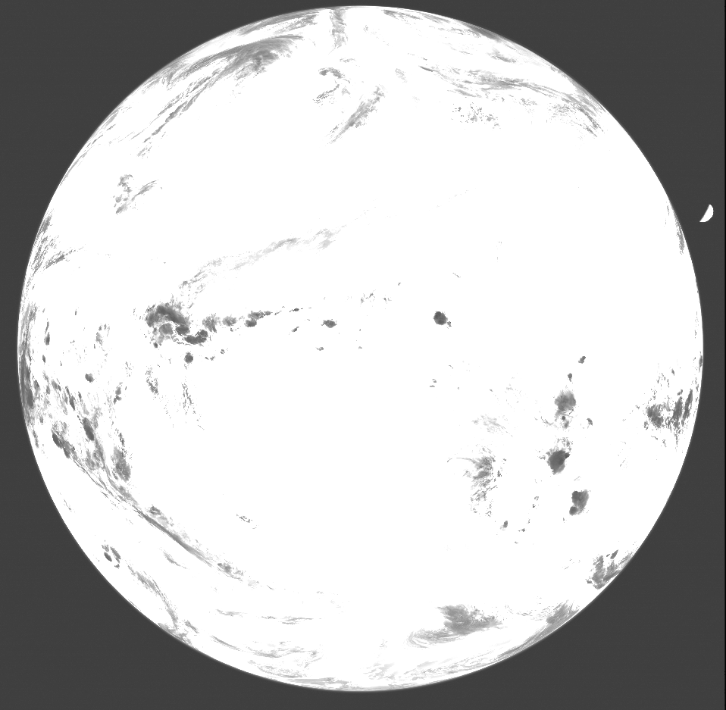
Extraction of the Moon imagette
  Why the IR8.7 channel?
  Earth and Moon = nearly saturated “patches” for all illumination conditions
  ➔ Procedure based on patch detection (fast and simple)

Slide 11
How to extract the lunar observations from the SEVIRI L1.0 images?
Location of the Moon within the SEVIRI Level 1.0 image
  Realignment of the Earth image
  Patch detection to trace the Moon in the IR8.7 band ➔ detection in the other bands from focal plane geometry.
  Estimate of the Earth sub-satellite point in the IR8.7 + relative position of the Moon centre w.r.t. the SSP.
  Realignment of the Moon image (to correct for the apparent motion of the Moon)
Extraction of the Moon imagettes
From centre of the Moon ⇒ estimated radius of the Moon extraction circle (Moon radius + margin)
Scaling of the Level 1.0 counts to equivalent Level 1.5 radiances
  Calculation of the equivalent Level 1.5 counts (correction for small potential instrument non-linearities)
  Conversion from the equivalent Level 1.5 counts to radiance, using calibration coefficients from the Level 1.5 headers

Slide 12
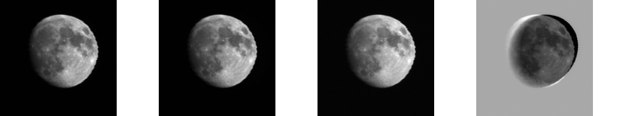
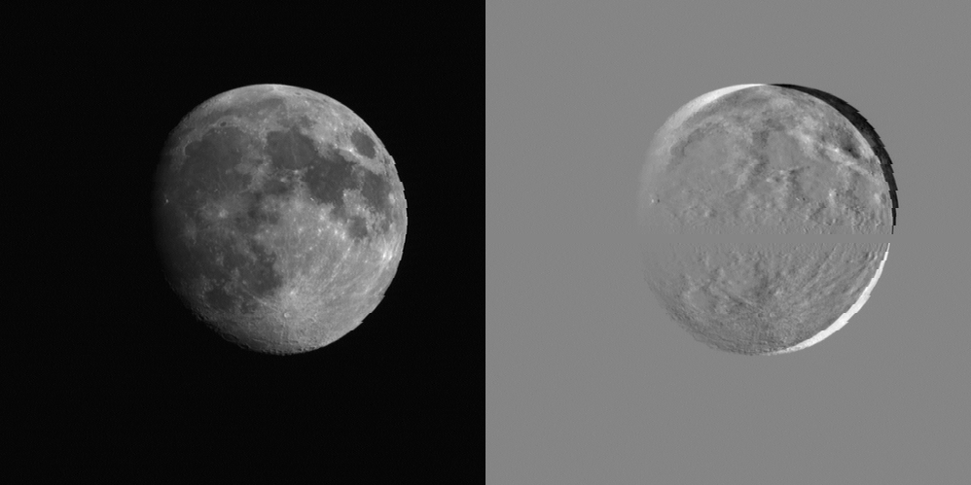
Extraction of the Moon imagette
Correction for lunar motion
VIS0.6
VIS0.8
NIR1.6
HRVIS
Correction for lunar motion

Slide 13
Current available datasets
    Consolidation of the existing lunar observations database for MSG1, MSG2 and MSG3:
  MSG1: end 2003 – 2009 (Full Disk + RSS) complete (part of the commissioning + all the operational data). Validation data still missing (1 year of data between May 2007 and May 2008).
  MSG2: 2006- June 2012 complete.
  MSG3: after 01/01/2013 complete.
  Automatic saving of lunar observations after 01/01/2013 by the Image Processing Facility.
  For comparison: initially about 30 potential lunar observations for MSG1. Now more than 170 observations available.
    Full range of phase angles covered.
    Collaboration with USGS ➔ inter-band calibration using the ROLO model as a reference (~1% relative error)

Slide 14
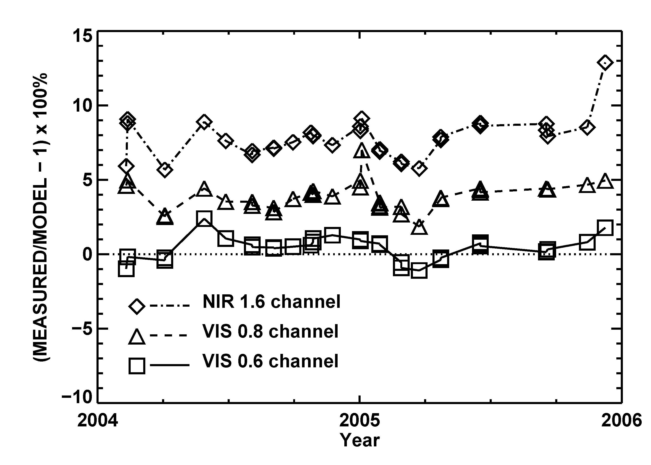
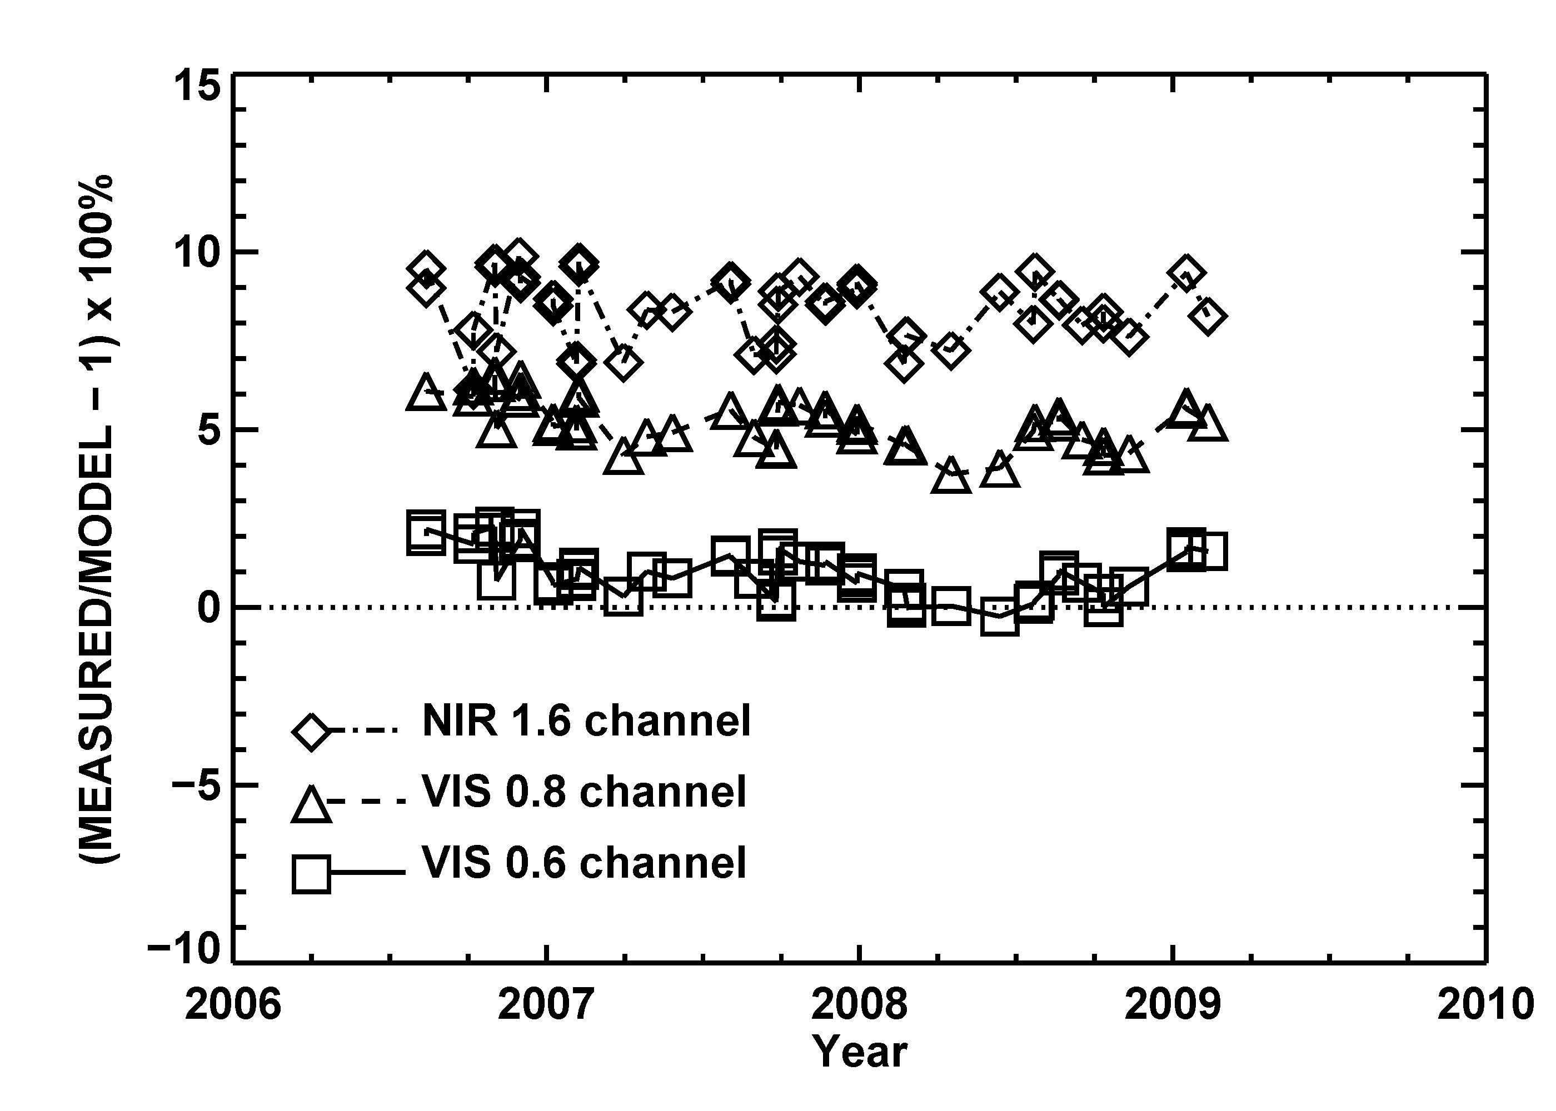
First comparison with the ROLO model (MSG1 + MSG2 FD low-res)
SEVIRI – Meteosat 8
SEVIRI – Meteosat 9
Note: End at the end of 2006 after the start of Rapid Scan Service
Courtesy T. Stone, USGS

Slide 15
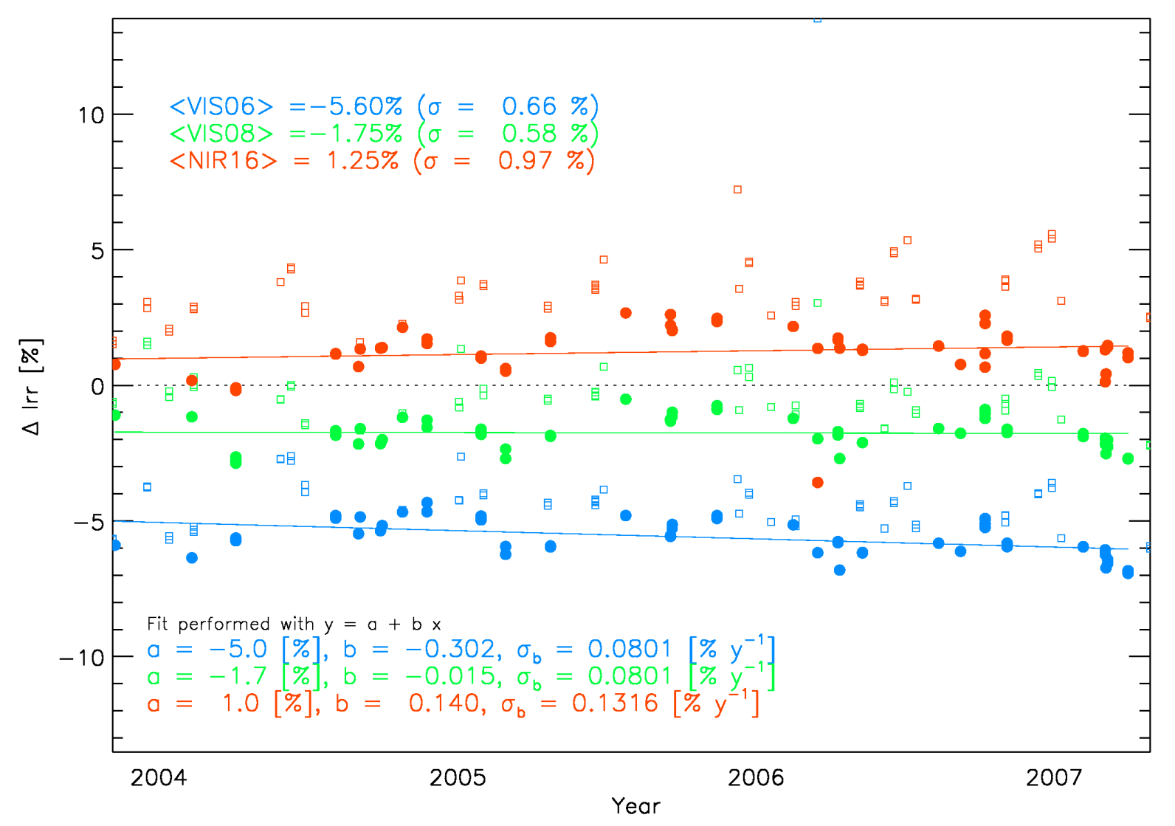
Comparison with the ROLO model (MSG1 FD low-res channels)
Stability below 1% over more than 3 years
LATEST RESULTS
  Results to be used only for inter-band calibration and drift monitoring
  Lunar calibration method and instrument are stable.
  SD <1% - consistent with expected performance of ROLO
  ⇒ BUT is it affected by seasonality?
  Relative difference between channels = consistent with current findings in terms of absolute calibration.

Slide 16
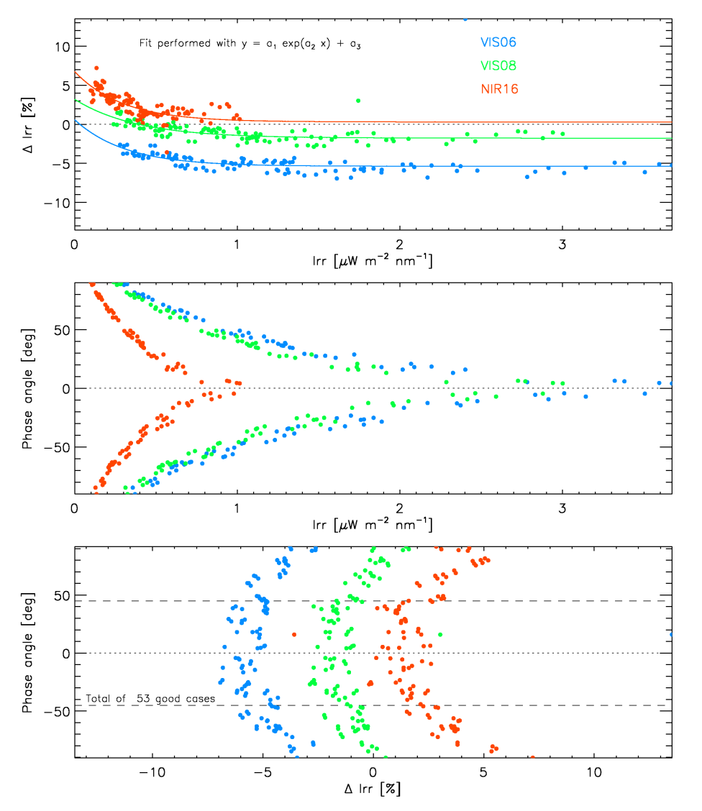
Comparison with the ROLO model (MSG1 low-res channels)
Irr = total irradiance from the Moon disk of SEVIRI observations
ΔIrr = difference between ROLO-Irr and Irr in percentage
ΔIrr vs. Irr : systematic deviation between ROLO and SEVIRI
Phase Angle vs. ΔIrr : systematic deviation between ROLO and SEVIRI
Selection according to the phase angle [-45 deg, 45 deg]

Slide 17
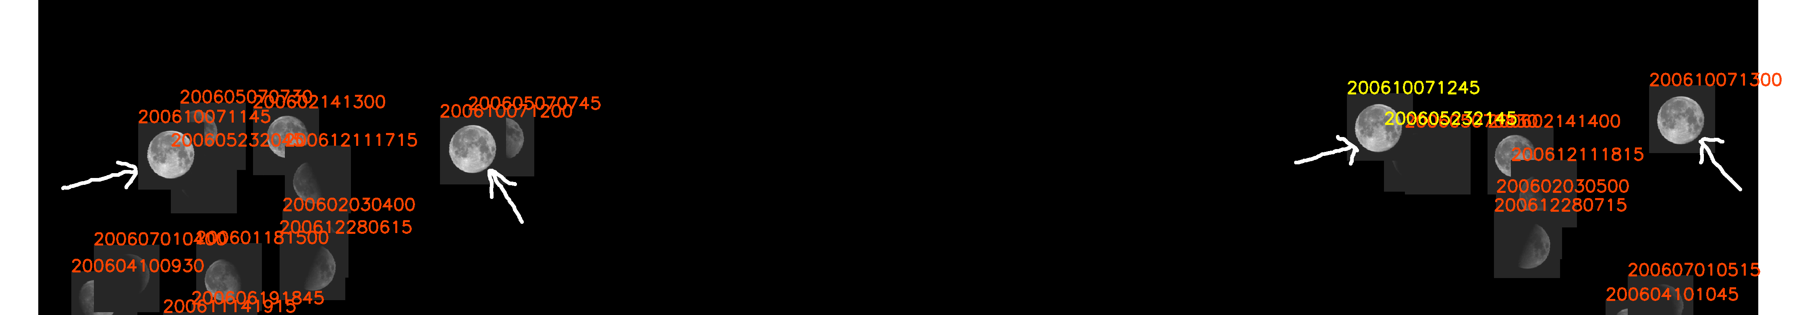
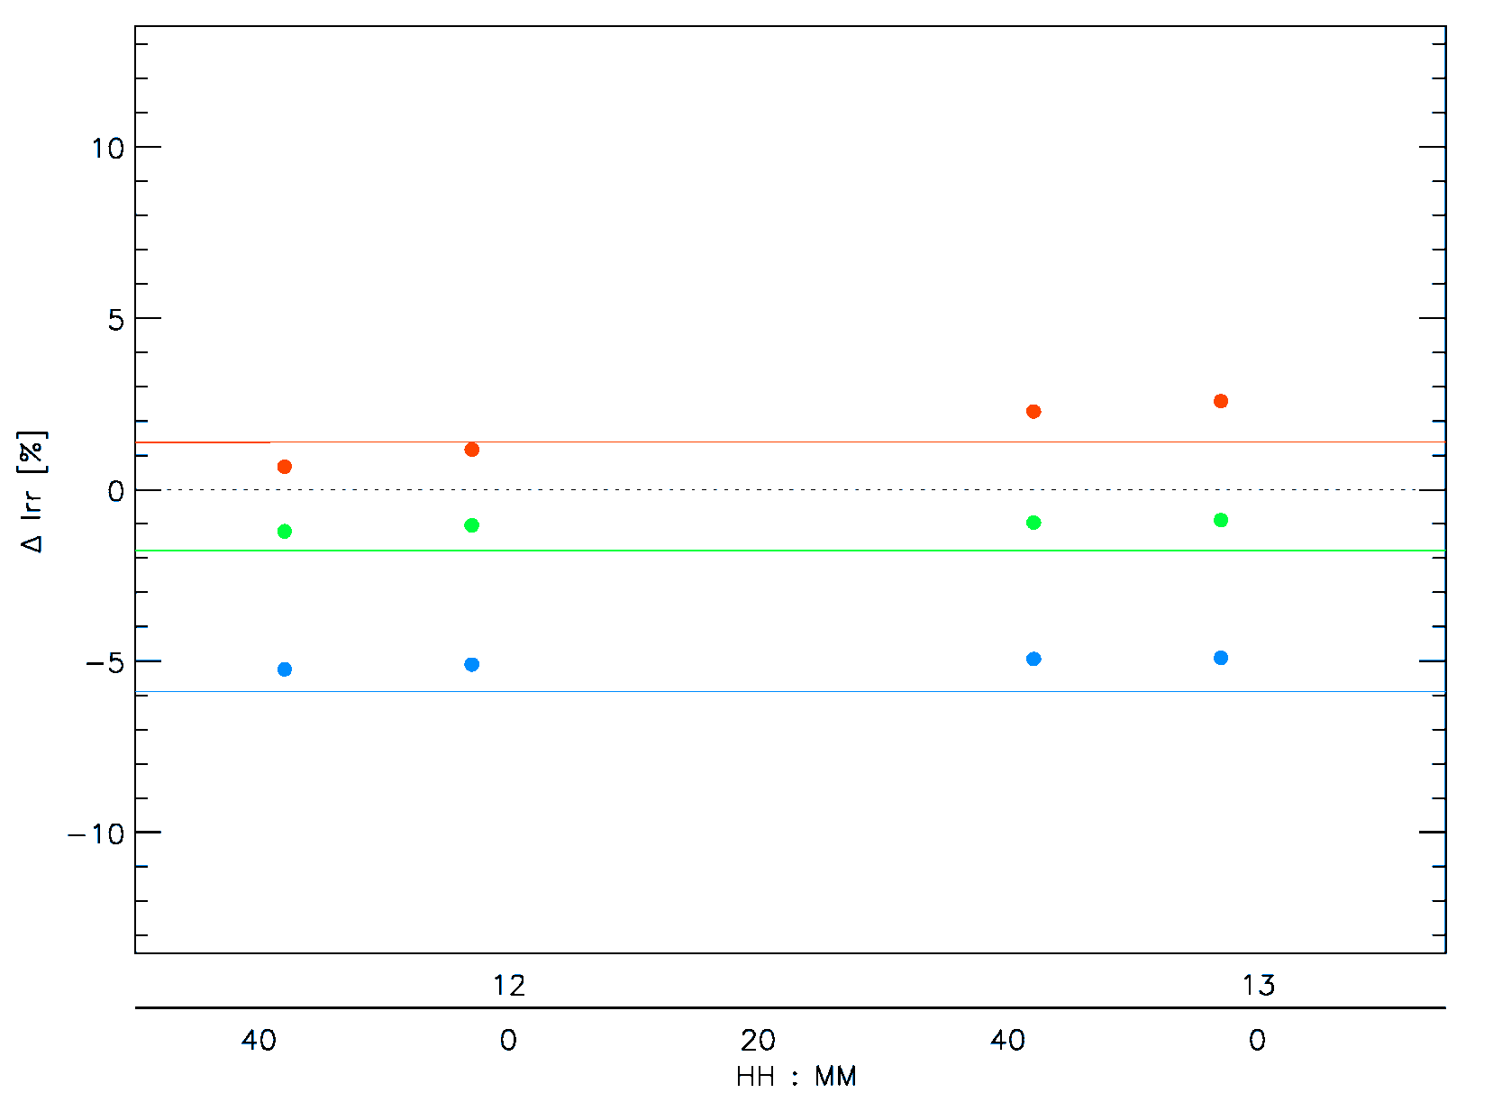
Following up the results shown in NOAA GPRC report (Fangfang)
Scan angle dependency...
MSG1 – 07/10/2006

Slide 18
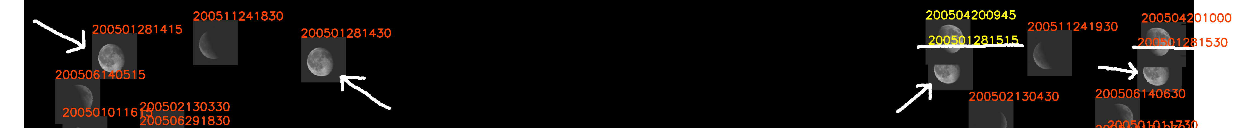
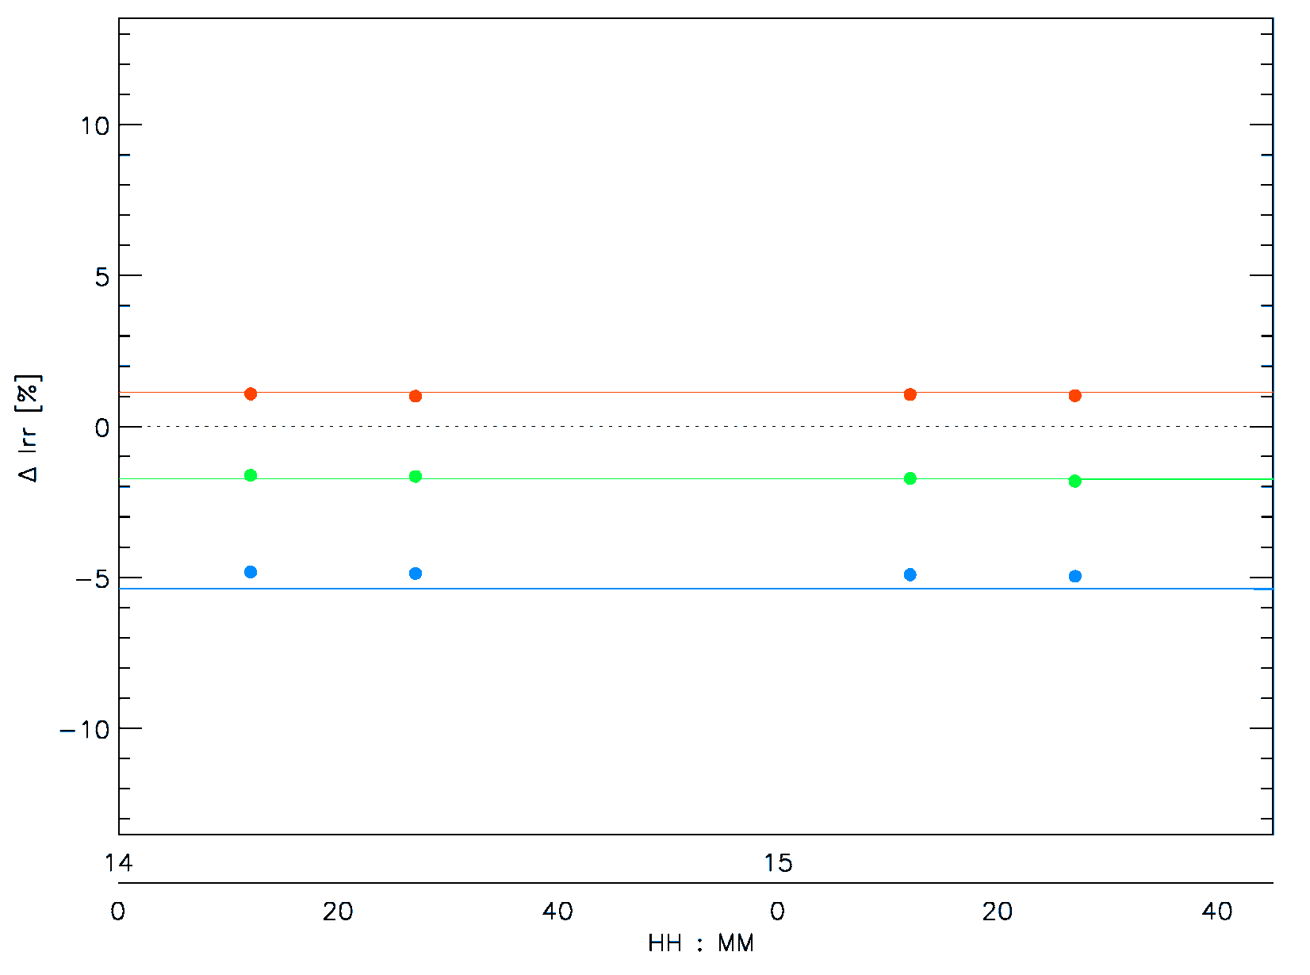
Following up the results shown in NOAA GPRC report (Fangfang)
Scan angle dependency...
MSG1 – 28/01/2006

Slide 19
Files stored in the process
DATA DOWNLOAD & STORAGE
(Level 1.5 Headers & Trailers +
Level 1.0 native)
EXTRACTION OF MOON OBSERVATIONS
(images + IDL save files)
PRODUCTION OF THE BINARY FILES FOR ROLO
to ROLO
File | Size
.dat files with H&T | about 807 KB each
.nat files with the row data | up to 323 MB each (standard mode)
.txt files containing the time-stamps used for the download | -
File | Size
.sav files | about 3.1 MB (HRVIS) about 868 KB (low-res)
.gif files | about 546 KB
File | Size
binary files | about 2 MB (HRVIS) about 171 KB (low-res)
.txt file containing a report on the files rejected | -
.ps file with figure | about 5.3 MB
.sav file about one year | about 140 KB
Possibility to save intermediate data in order to build-up a validation database for lunar calibration
available to other GSICS partners for validation purposes
Reprocessing purposes
323000 + 807 + [3100 + (868 x 3) + 546] + [2000 + (171 x 3) + 5300 + 140] = 338010 KB 150 Moon observations per year (average), i.e. up to 338010 KB x 150 = 51 GB per year

Slide 20
Summary
Development of a procedure to extract lunar observations from Level 1.0 MSG/SEVIRI data in all scanning configurations (FD, HRVIS and RSS)
Consolidated database of lunar observations is being built-up for all MSG missions (MSG1, 2 and 3) between 2003 and 2012.
Comparison against ROLO for MSG1 and MSG2 SEVIRI low-res channels: stability below 1% over three years for the consolidated dataset.
Future activities:
Comparison of the complete archive with the ROLO model ➔ all MSGs + all scanning configurations: LRES and HRVIS in nominal scan mode or Rapid Scan
Understanding of the differences for low illumination (high phase angles) between ROLO and MSG/SEVIRI
Mechanism to monitor regularly MSGs/SEVIRI solar reflective bands
Feasibility of performing lunar calibration with MFG/MVIRI observations.
Feasibility of analysing detector performance (e.g. for MTG/FCI).

Slide 21
Thank you for your attention

Slide 22
Back-up slides

Slide 23
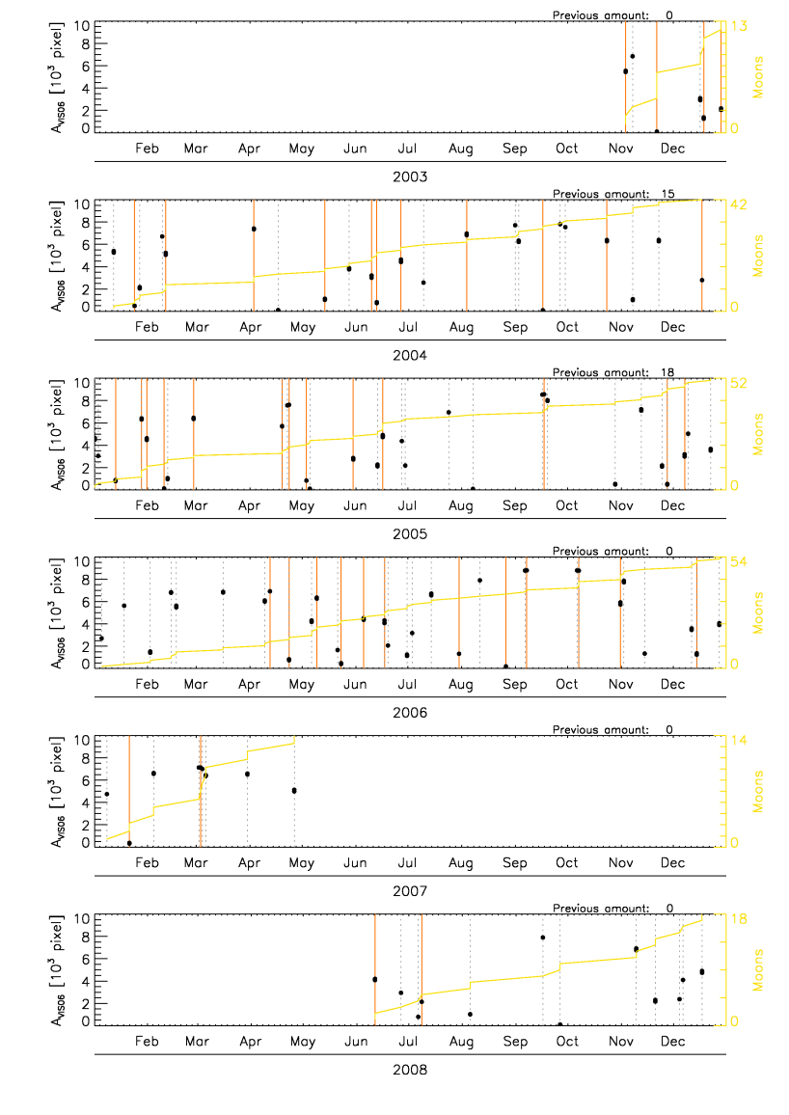
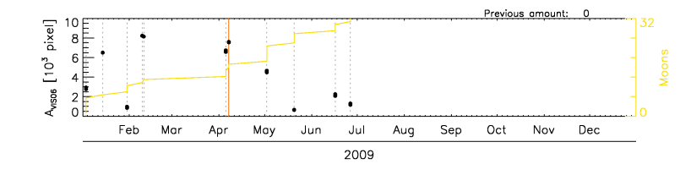
Extraction of the Moon imagette
Moon observations from MSG1:
successful extraction from both standard data
and RSS data (2008 and 2009 in the plot)

Slide 24
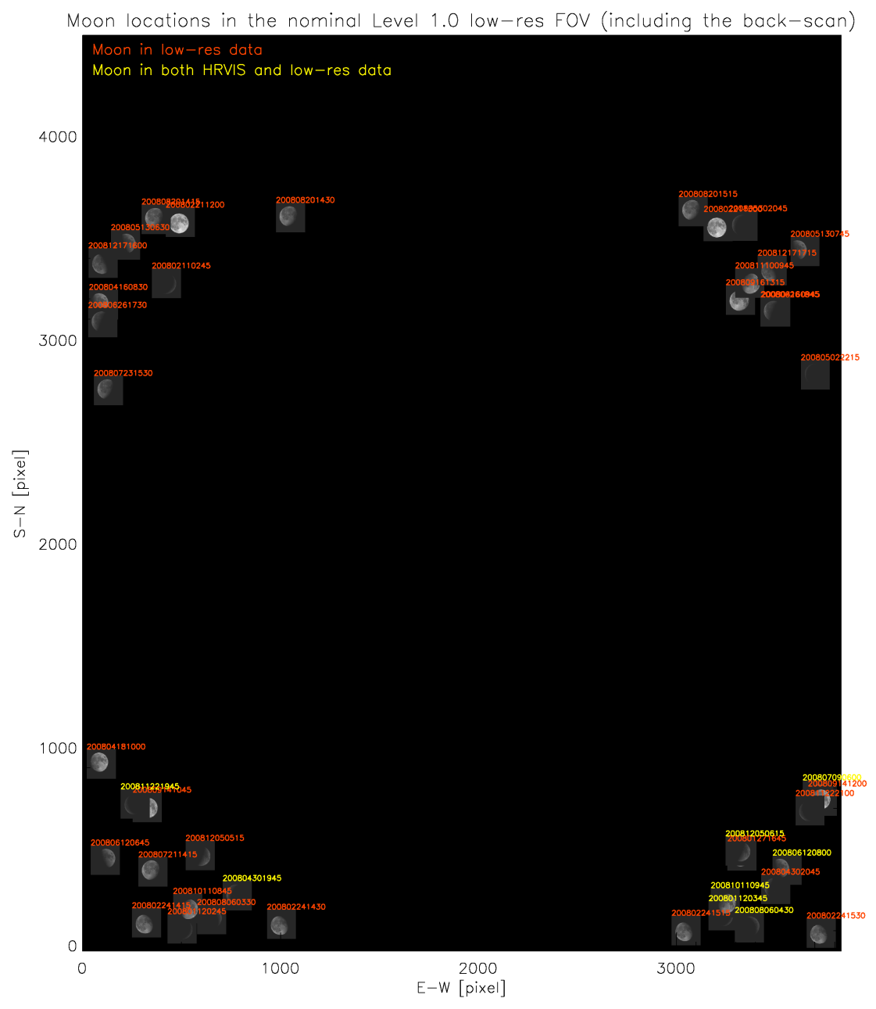
Extraction of the Moon imagette
MSG2 2008
43 Observations
(8 HRVIS cases)

Slide 25
Extraction of the Moon imagette
MSG2 2008
43 Observations
(8 HRVIS cases)
1h 30min

Slide 26
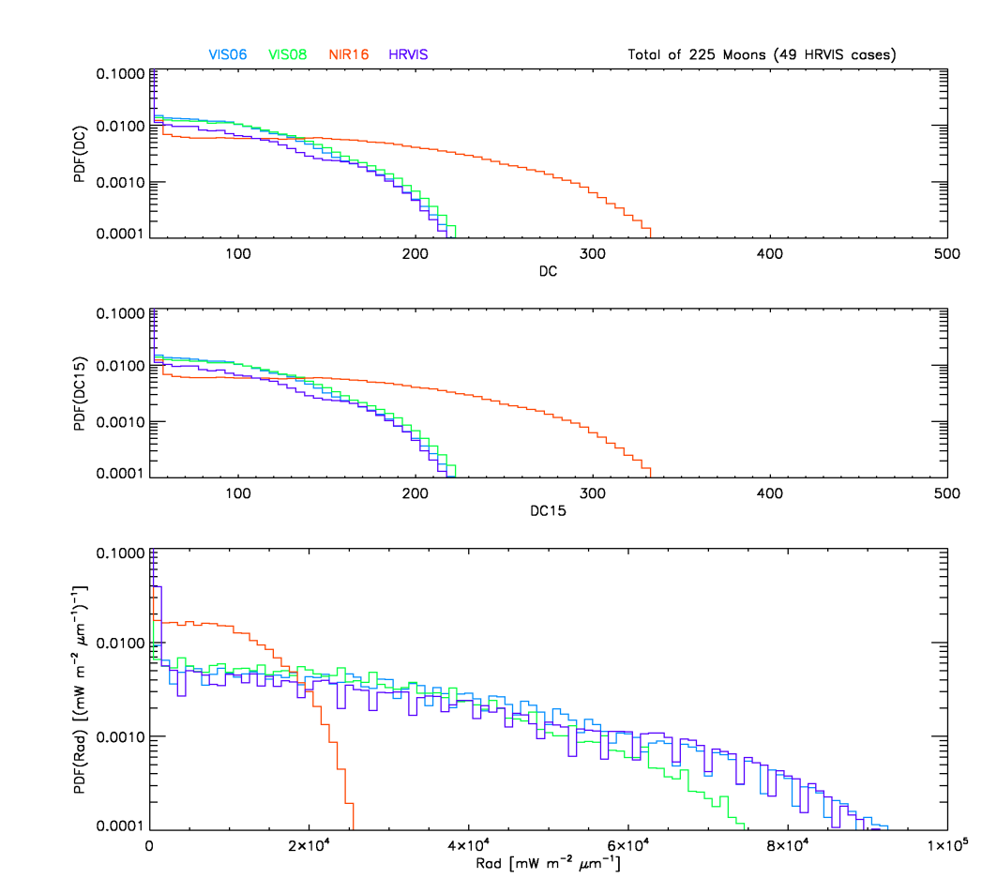
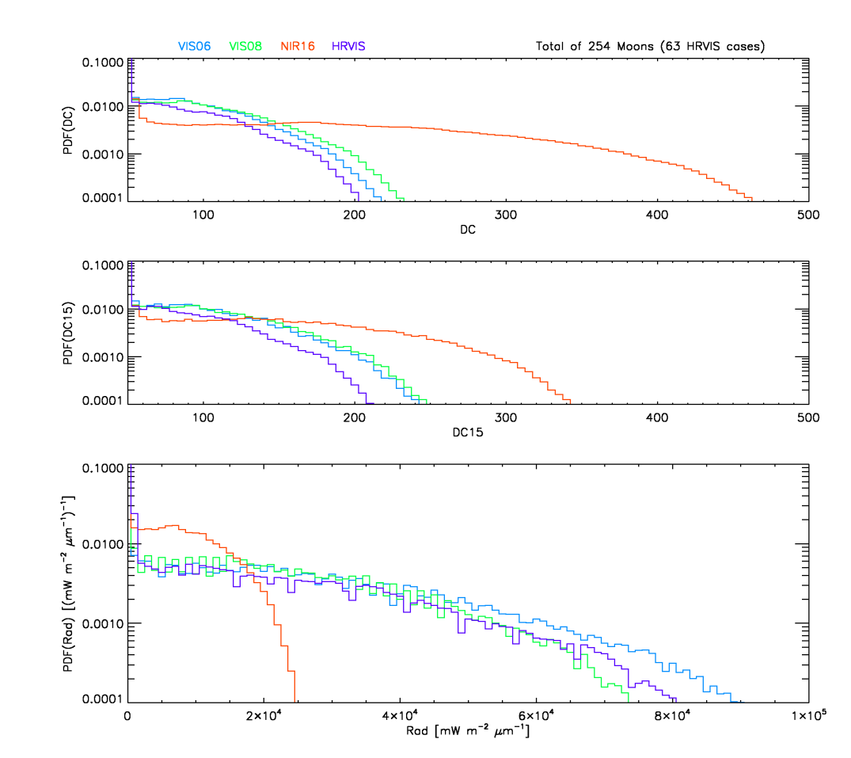
Extraction of the Moon imagette
Statistics on the Moon observations from MSG1
Statistics on the Moon observations from MSG2

