Slide 1
Lunar Calibration for GOES-10 Imager Visible Channel – Ongoing Effort on the Uncertainty Assessment
Fangfang Yu, Xiangqian Wu and Tom Stone
- Based on the presentations in SPIE’06 and Calcon’06
2013 GSICS Annual Meeting
Williamsburg, VA
March 4-8, 2013

Slide 2
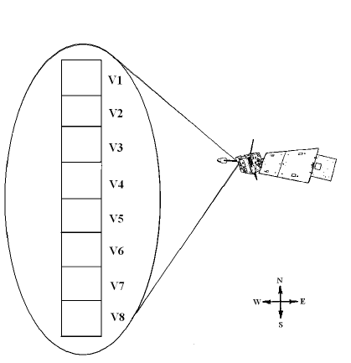
GOES Imager Visible Channel
Linear array of 8 detectors
IGFOV = 28 µrad
Only one calibration source: space clamp
Scan the field of regard (FOV) back and forth
Multiple scan modes

Slide 3
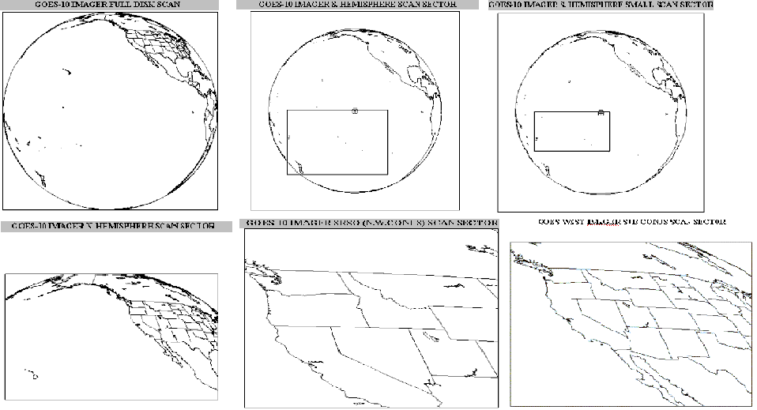
GOES-10 (GOES West) Scan Modes

Slide 4
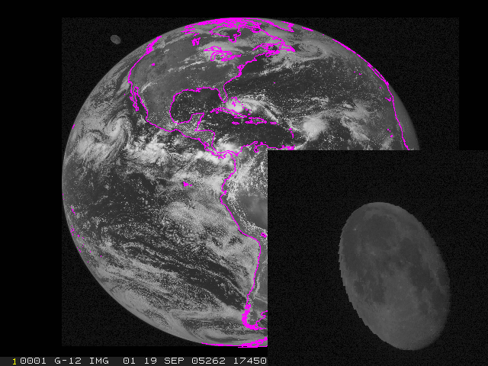
Good Data

Slide 5
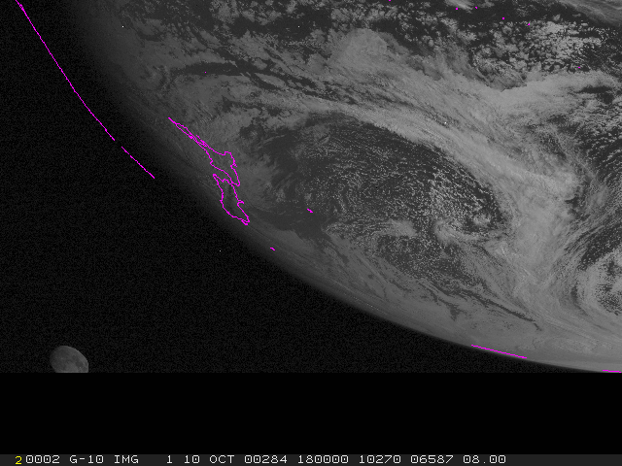
Clipped by edge
Challenging to know the fraction and orientation of the unclipped part

Slide 6
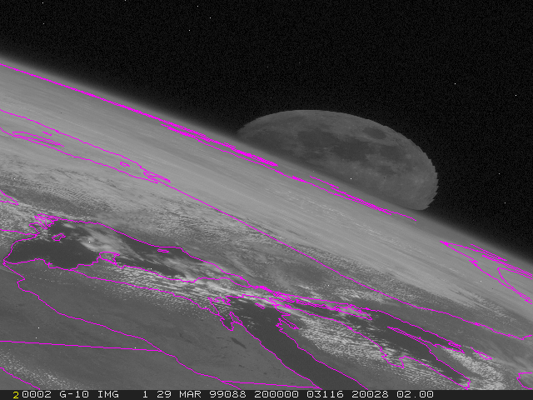
Clipped by the Earth
Little hope to derive lunar irradiance

Slide 7
Unscheduled Data Collection
Predicted gibbous Moon appearance within the GOES FOR (about three times a month on average)
Found 21 suitable observations for GOES-10 in 7.5 years between July 1998 to December 2005.
Five of the 21 cases have a second lunar image within ~ one hour

Slide 8
Scheduled Data Collection
Began in November 2005
One or two scheduled gibbous lunar image every month for each GOES
  Used ~one minute of star view time with negligible impact on navigation

Slide 9
y(t) = a + b*t +c*t²
y(t) is the least-squares fit of R(t)

Slide 10
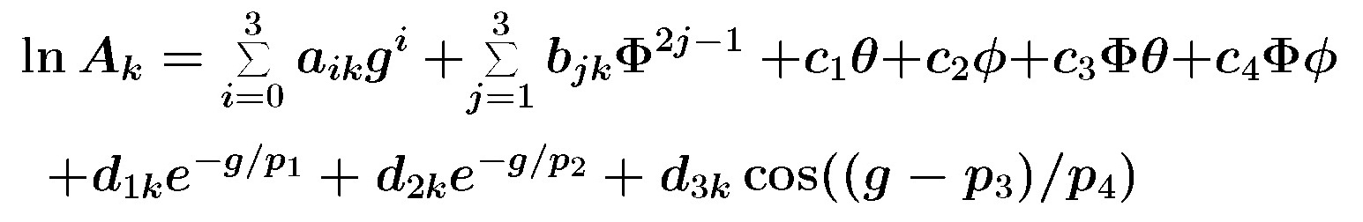
ROLO Irradiance Model
E_{Model} = A Ω_{M} E_{S} / π
E_{Model}: Modeled lunar irradiance

Slide 11
Measured Lunar Irradiance
i: Index of Moon pixel
R_{i}: Radiance from pixel i
ω_{i}: Solid angle subtended by pixel i
Since
So
E_{GOES} = ωS∑_{i}(C^{i}_{R} – C_{S})

Slide 12
Moon Location
Baseline – 400 X 700 pixels containing the Moon
Alternative – fit to ellipse
  Finding the edge
  Least squares fit
  Further adjustment
    Growing
    Fixed mask of ten extra pixels – works best so far

Slide 13
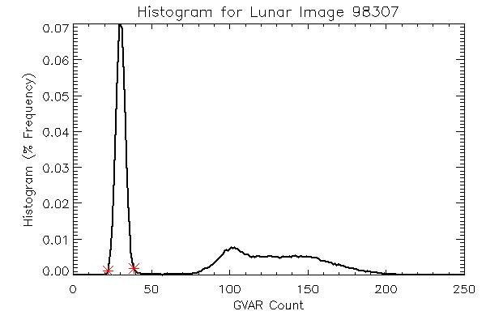
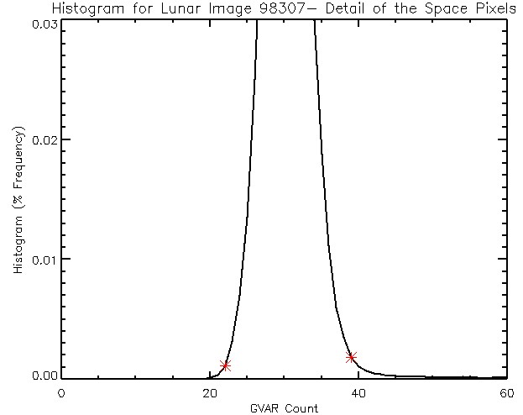
Identification of Space Pixel

Slide 14
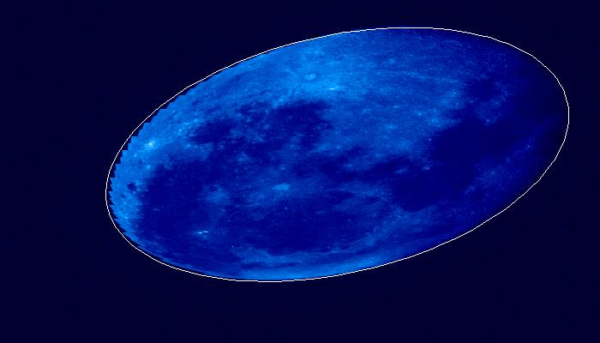
1998_221_210021

Slide 15
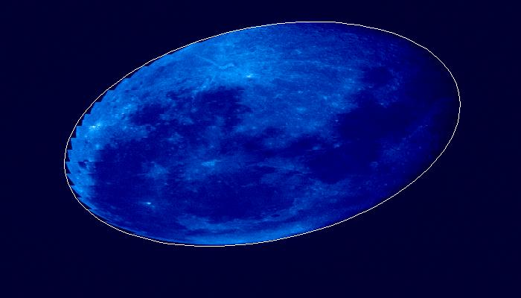
1998_221_220035

Slide 16
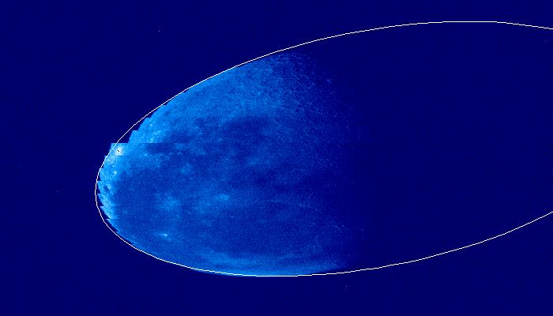
2005_208_013551

Slide 17
Results – Wu et al. SPIE (2008)
 |  | Constant | Mode | Selected Mean
All Pixels | A | 1.081 | 1.010 | 1.029
 | β | -0.048 | -0.045 | -0.049
 | SE | 0.038 | 0.042 | 0.030
Growing Moon | A | 1.064 | 1.030 | 1.038
 | β | -0.048 | -0.046 | -0.048
 | SE | 0.033 | 0.033 | 0.030
Masking Moon | A | 1.0494 | 1.0255 | 1.031
 | β | -0.050 | -0.048 | -0.049
 | SE | 0.029 | 0.030 | 0.029

Slide 18
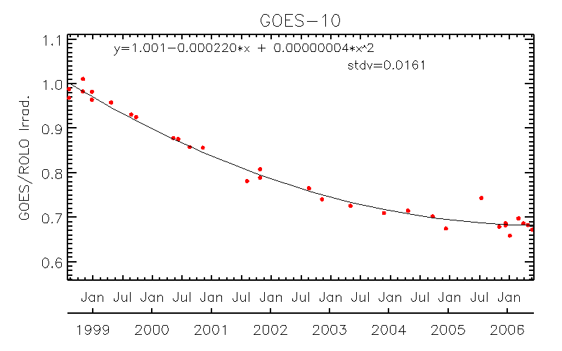
GOES-10 Imager Visible Channel Degradation
Scheduled moon obs

Slide 19
Paired Images
?
3-4% difference in ratio

Slide 20
Uncertainty Components
Assumes that ROLO model is perfect (<1% relative accuracy over all the phase angles, according to T. Stone)
Uncertainty components
  Re-sampling
    E-W: not an issue
    N-S: space clamp while the moon is moving
  Space count value
    Detector background noise
    Space count truncation
    Drift between clamps
  Moon edge
    Stray light
    Sub-pixel moon
  Incident-angle dependent scan-mirror reflectance
  Others?

Slide 21
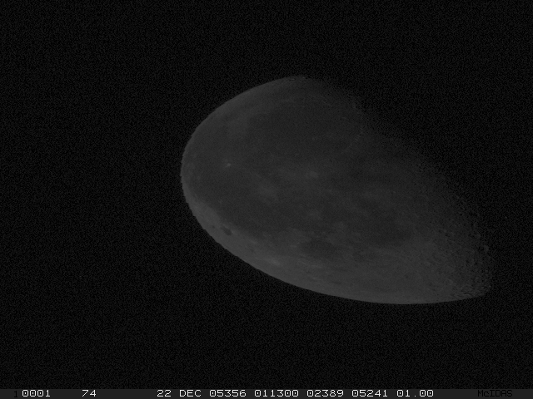
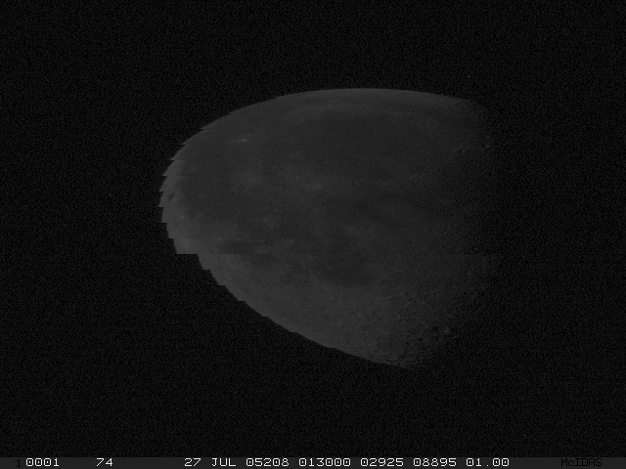
Moon orbit?
Impact of space clamp event

Slide 22
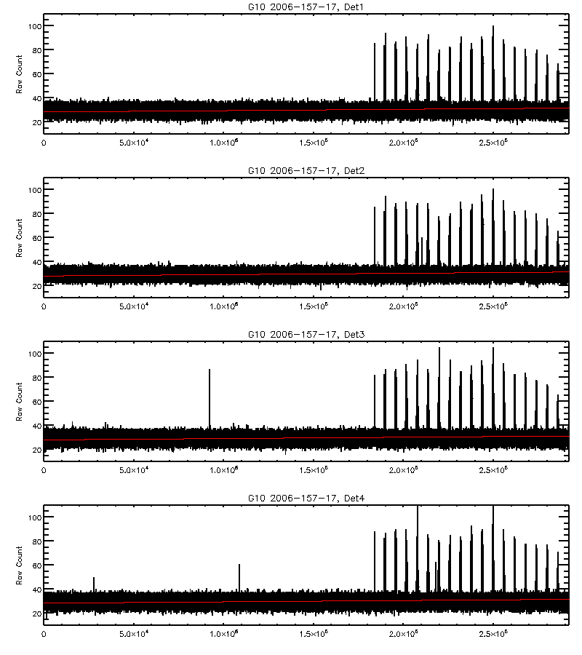
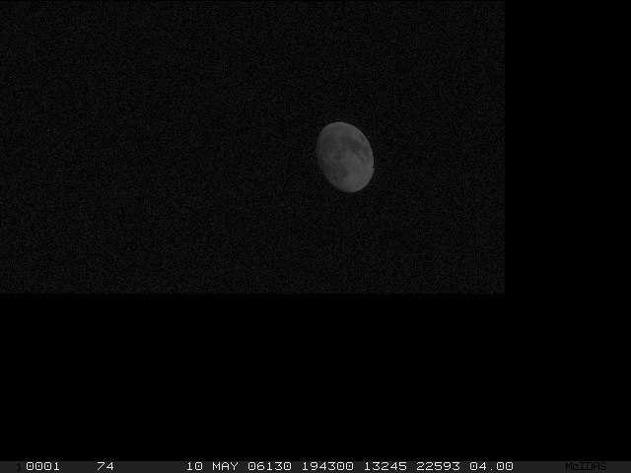
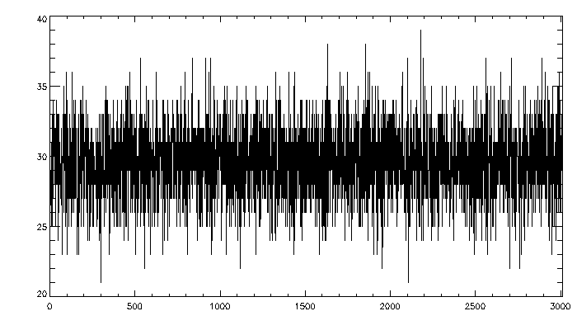
Space View Noise/Count Truncation
Det#4
Stdev = 2-3 count
Moon date | Phase Angle | Mean irrad (mW/m2cmSr | Max-Min Irrad | Stdv Irrad
2006-06-06 | -58.8 | 0.8420 | 0.0032 (0.38%) | 0.0011 (0.13%)

Slide 23
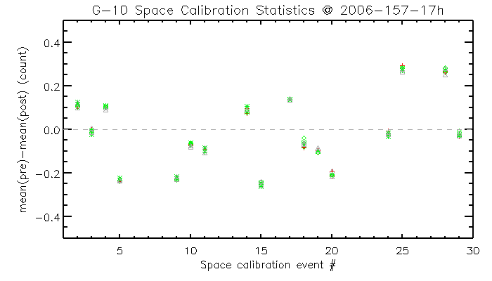
Drift between Clamps
The visible detector should not have short-term drift

Slide 24
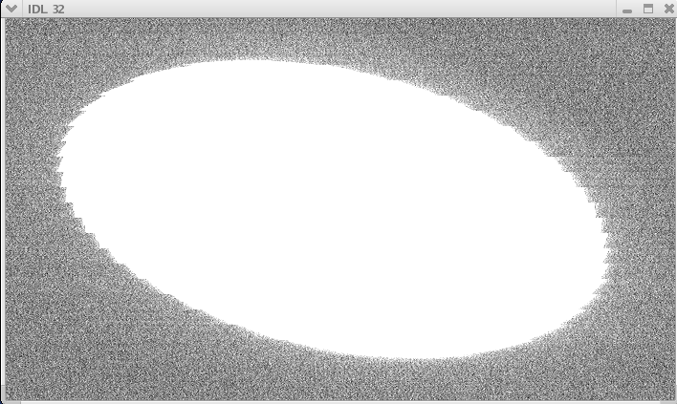
Fussy Moon Edge

Slide 25
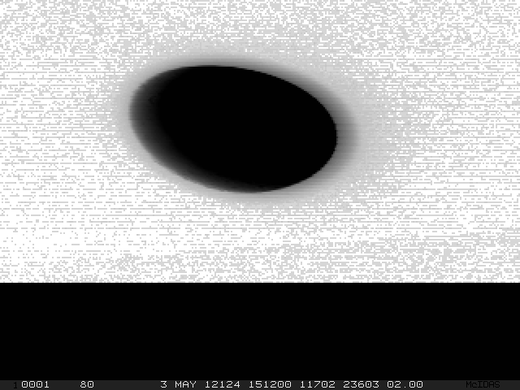
Moon image at Ch2 (3.9um)
Stray-light
Expanding the moon mask area increases the uncertainty caused by space count
Where is moon edge? Should the stay-light be accounted as moon irradiance?

Slide 26
Scan Angle Effect
Comparison with Miller-Turner model results confirm the impact of incident angle reflectance
  Reported yesterday
~2.2% based on MIT Lincoln Lab
  Yet we cannot simply implement ground measurements to the space
Extensive observations of the Moon were obtained at various scan angles during the GOES-14 an 15 PLT periods.
  Preliminary result displayed the G14 and G15 angle-dependent reflectance patterns are different
  Need more effort to understand it

Slide 27
Conclusion
Case study shows the impact of background noise and count truncation is small
  Need more study, especially at large phase angle
Continue the lunar calibration error budget analysis
  Stray-light effect
More effect is needed to characterize the angular dependent scan mirror reflectance

