Slide 1
KMAKorea Meteorological Administration
NMSC National Meteorological satellite center
GSICS WebMeeting, 14 August 2013
DCC BRDF
produced by SBDART model
for COMS visible calibration
Minjin CHOI
National Meteorological Satellite Center / Korea Meteorological Administration
Korea

Slide 2
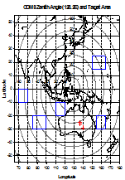
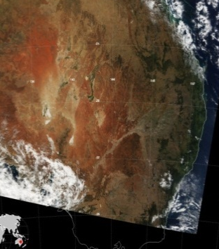
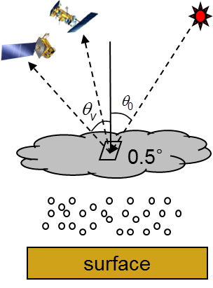
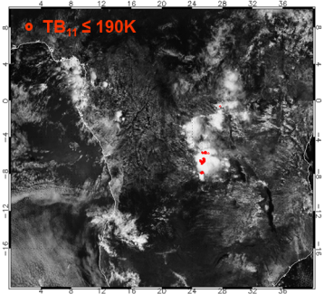
GSICS Activity of KMA for visible channel
KMA Installed vicarious calibration system for visible channel using 5 targets. ocean, desert, water cloud, deep convective cloud (DCC), moon
We have tested with these target data since 2011.
Target | Ocean | Desert | Water cloud | Deep convective cloud | Moon
Period | Sep. 2011 ~ Present
Source | Regular observation |  |  |  | Special obs. (twice a month)
Obs. | - Pacific Ocean - Indian Ocean | - Simpson Desert in Australia | - Over ocean regions - Overcast clouds | - High reaching overcast clouds | - moon

Slide 3
GSICS Activity of KMA for visible channel
Result from DCC target is consistent with other target data, making linear regression line with high correlation.
The degradation are about 4.36% (2.75%/year) from the moon and 3.28% (2.07%/year) from the other 4 targets from Sep. 2011 to Apr. 2013.
Result of GSICS will be displayed on KMA’s homepage by the end of 2013.

Slide 4
vicarious calibration algorithm using DCC
Satellite data
Sohn et al. 2009, Ham and Sohn2010
Visible band (0.67 μm)
Same FOV
Well-calibrated
IR band (10.8 μm)
TB₁₁
1
Threshold conditions
No
3
Yes
Assumption of input parameters
COT=200, r_{e} = 20 μm,
Cloud height = 1~15km
Tropical profiles
Selected DCC pixels
2
Cloud Radiative transfer modeling
Observed visible radiances
Simulated visible radiances
Vicarious calibration

Slide 5
part 1: Selection of DCC targets
Threshold conditions to select the overshooting DCCs
convective clouds whose tops extended from 14 to 19 km with extremely high reflectivity
Solar geometry |  | SZA ≤ 40º
Viewing geometry |  | VZA ≤ 40º
 | - geometry criteria: to minimize navigation errors and 3-D radiative effects
Surface type |  | No restriction
 | - no restriction of surface type: less influence on reflectance of DCC targets
Cloud conditions (1) |  | target pixel: TB₁₁ ≤ 190 K
 | - only temperature criterion: overshooting DCCs represent cloud top temperature lower than the TTL temperature (~190 K)
Cloud conditions (2) |  | environmental pixel: STD(TB₁₁) ≤ 1K
 |  | environmental pixel: STD(R_{0.6})/Mean(R_{0.6}) ≤0.03
 | - two types of homogeneity checks: to avoid selection of cloud edge or small-scale plumes
target pixel
STD,
STD/Mean
9 x 9
environmental pixels
TB₁₁: brightness temperature at 10.8 μm, R_{0.6}: reflectance at 0.67 μm, STD: standard deviation in environmental (9x9) pixels

Slide 6
part 2: cloud RTM description (1/2)
SBDART (Santa Barbara Disort Radiative Transfer) model (Ricchiazzi et al. 1998) - based on DISORT (Discrete Ordinates Radiative Transfer) model - capable up to 32 streams - relatively accurate and efficient RTM for cloudy atmosphere
KMA used some options as follows:
phase function: delta-fit method (Hu et al. 2000) - bulk phase function: strong forward peak and thousands of Legendre polynomials - needed to truncate method for the phase function in the forward direction - to reduce the computational burden without degrading accuracy
gases absorption: correlated-k-distribution (CKD) method (Kratz 1995; Kratz and Rose 1999) - gaseous absorption associated with Rayleigh scattering
sfc. info.: oceanic surface properties for any surface type
DISORT model

Slide 7
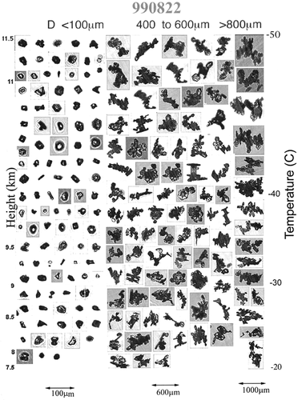
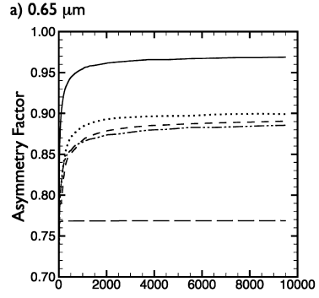
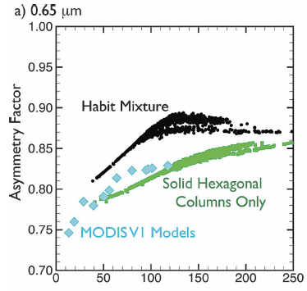
part 2: cloud RTM description (2/2)
Scattering properties: Baum model Baum et al. (2005a and 2005b) for non-spherical ice particles
- based on in-situ measurements to obtain habit fractions (Heymsfield et al., 2002) - use single scattering properties of droxtals, hexagonal plates, hollow columns, solid columns, bullet rosettes, and aggregates
(Yang and Liou, 1996a and 1996b; Yang et al., 2003a and 2003b) - band averaged scattering properties with respect to r_{e} by integration of single scattering properties
Q_{ext} (extinction efficiency), ω₀ (Single scattering albedo),
g (asymmetry factor), P(Θ) (phase function), f_{d} (delta transmitted energy)
DISORT model

Slide 8
part 2: RTM inputs
RTM input parameters for COMS calibration using DCC target
# of streams | 20 | Cloud conditions | Ice phase (use Baum scattering model)
Simulation wavelength | 0.57488 μm – 0.77992 μm |  | COT = 200
 | (interval: 0.04101μm) |  | Effective radius = 20 μm
Filter function | rectangular filter |  | Cloud top-height = 15 km
Geometry | SZA, VZA, SAA, VAA (Observed pixels information) |  | Cloud depth = 14 km
surface type (BRDF) | Ocean
atmosphere | Tropical standard profile
uncertainty ranges
in Appendix of Sohn et al. (2009)
Input |  | Sfc. | Atmos. | AOT | Cloud
Parameters |  | albedo | profiles | At 0.55 μm | COT | re | Zc | Zc
Reference value |  | Oceanic | TRO | 0 | 200 | 20 μm | 15 km | 14 km
Input range |  | 0 – 0.4 | MLS | 0 – 3 | 100 – 400 | 10 – 30 | 12 – 18 | 10 – 14
Maximum uncertainty | SZA = 0º | 0.09% | 1.29% | 0.14% | 4.79% | 1.64% | 0.15% | 0.24%
 | SZA = 10º | 0.09% | 1.29% | 0.14% | 4.79% | 1.96% | 0.16% | 0.24%
 | SZA = 20º | 0.09% | 1.29% | 0.14% | 4.74% | 2.35% | 0.18% | 0.24%
 | SZA = 30º | 0.09% | 1.30% | 0.14% | 4.60% | 3.02% | 0.21% | 0.24%
 | SZA = 40º | 0.08% | 1.30% | 0.13% | 4.41% | 3.02% | 0.21% | 0.24%

Slide 9
part 3: Methodology for DCC BRDF test
BRDF structure
Test plan
- geometry (degree)
- SZA = [10, 20, 30, 40]
- VZA = [0, 5, 10, … 55, 60]
- RAA = [5, 15, 20, … 170, 175]
tangential axis
RAA
270º
radial axis
VZA
60º
40º
20º
RAA: relative azimuth angle between SAA and VAA
(0 ≤ RAA <180)
0º
180º
- cloud parameter
- COT = [50, 75, 100, 200, 400]
- Re = [10, 20, 30, 40] (μm) - cloud top height = 15 km - cloud base height =1 km
incident radiation
SZA
90º
- other inputs
- COMS ch.1 (0.675 μm), MODIS ch.1, 2, 3, 4
- tropical standard profile

Slide 10
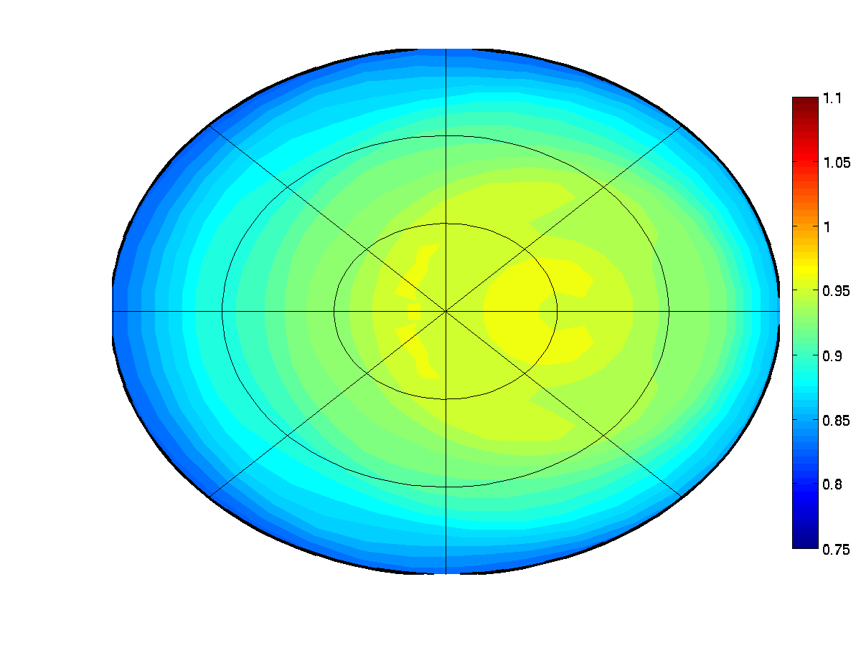
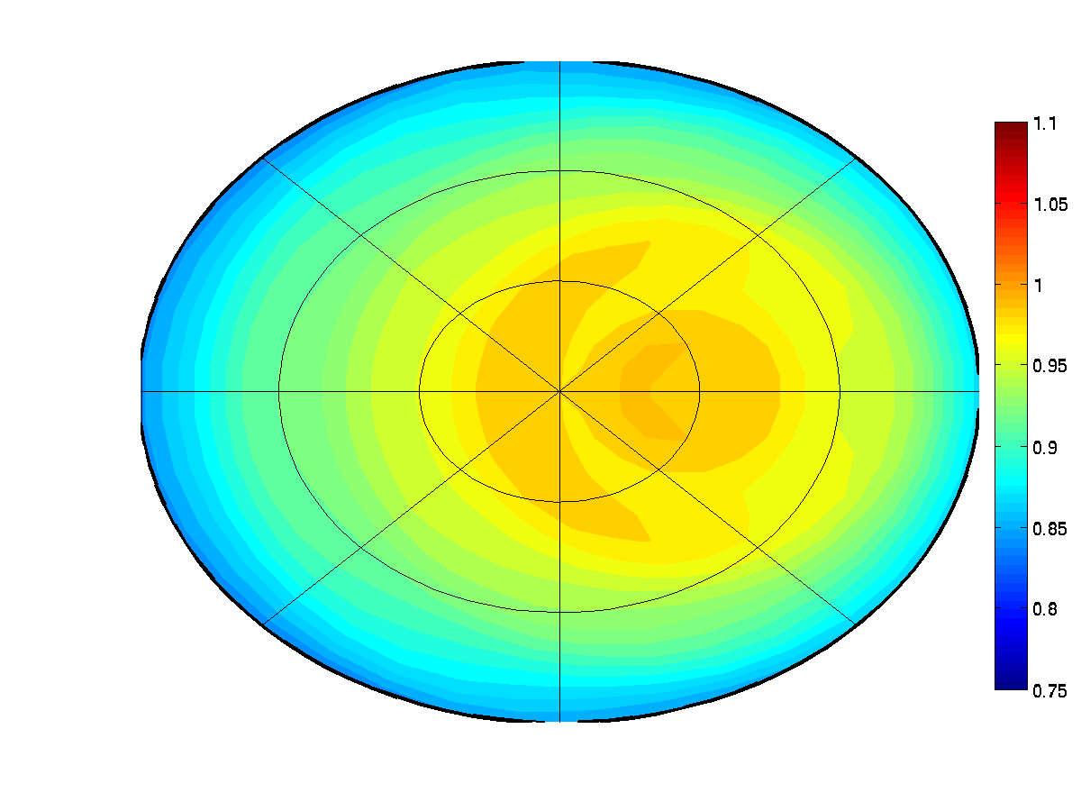
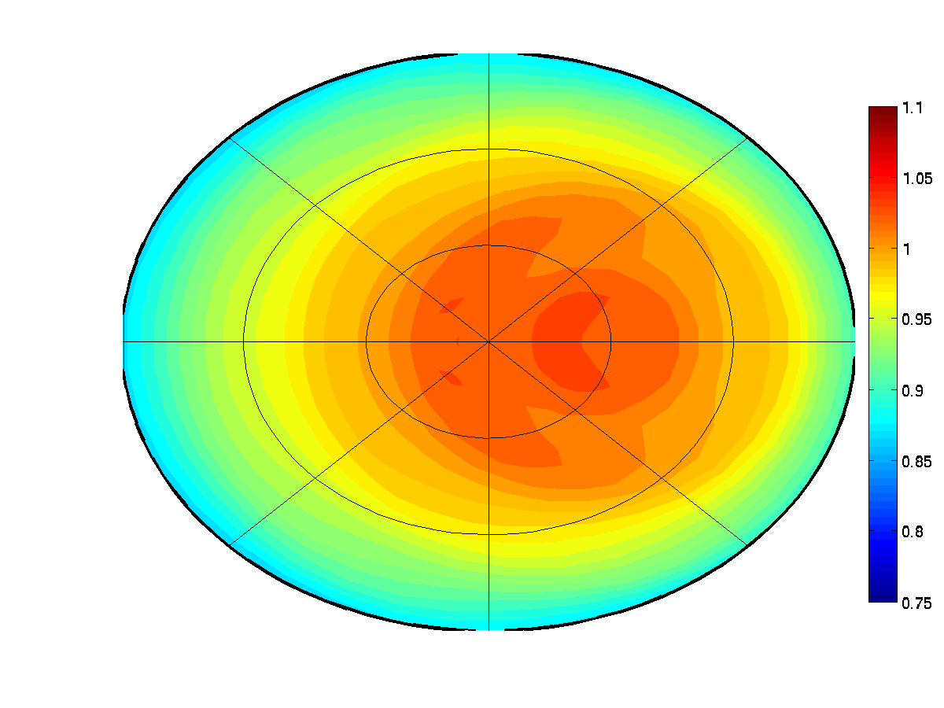
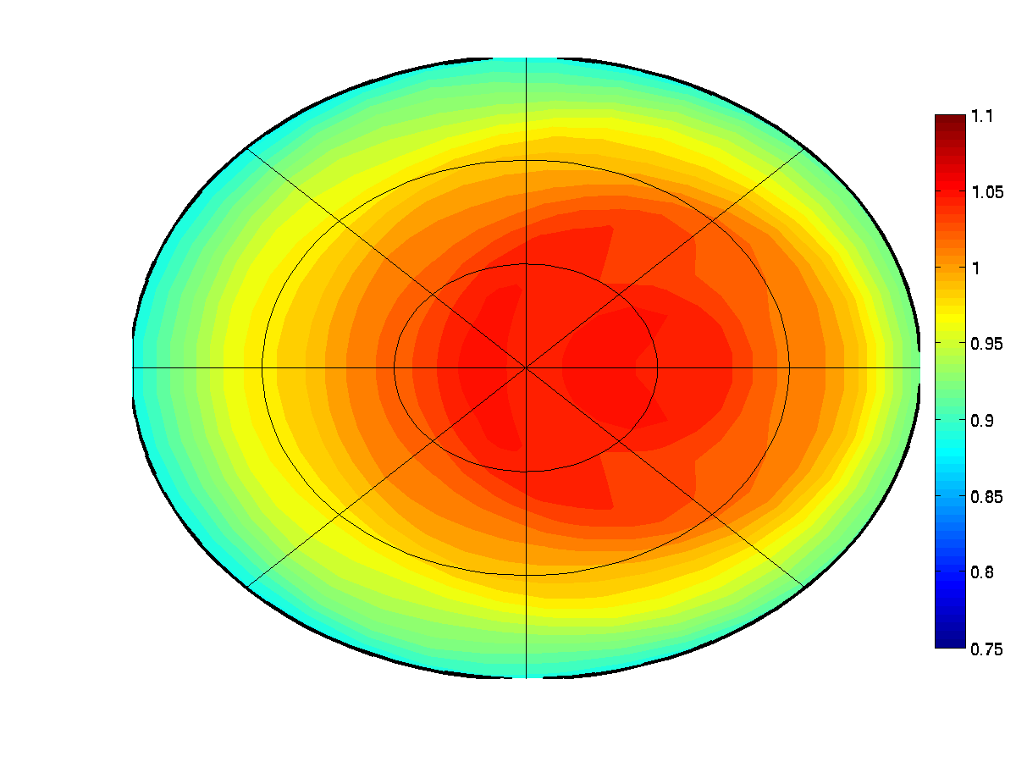
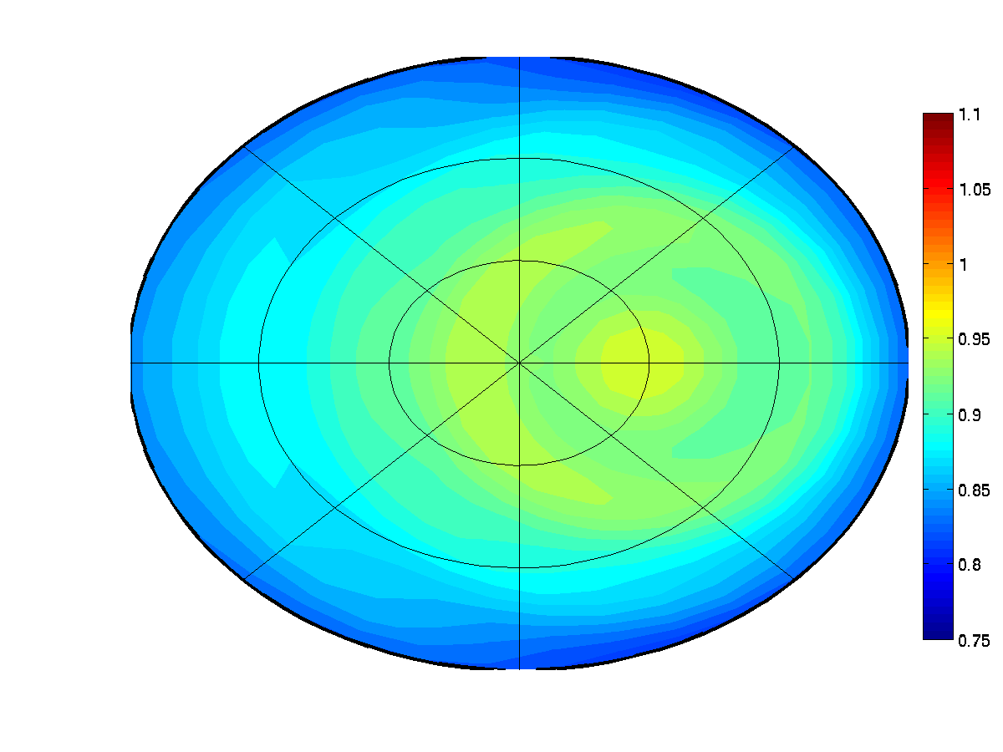
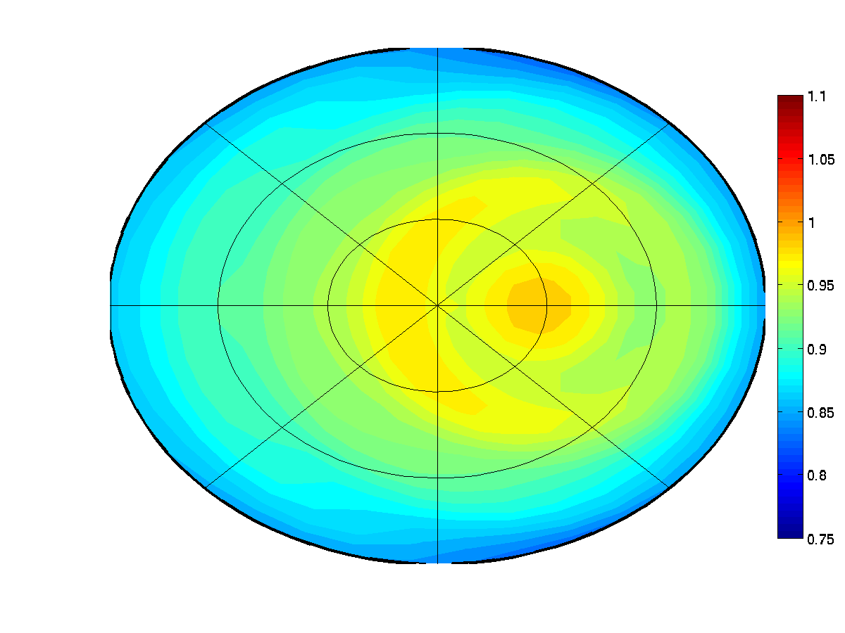
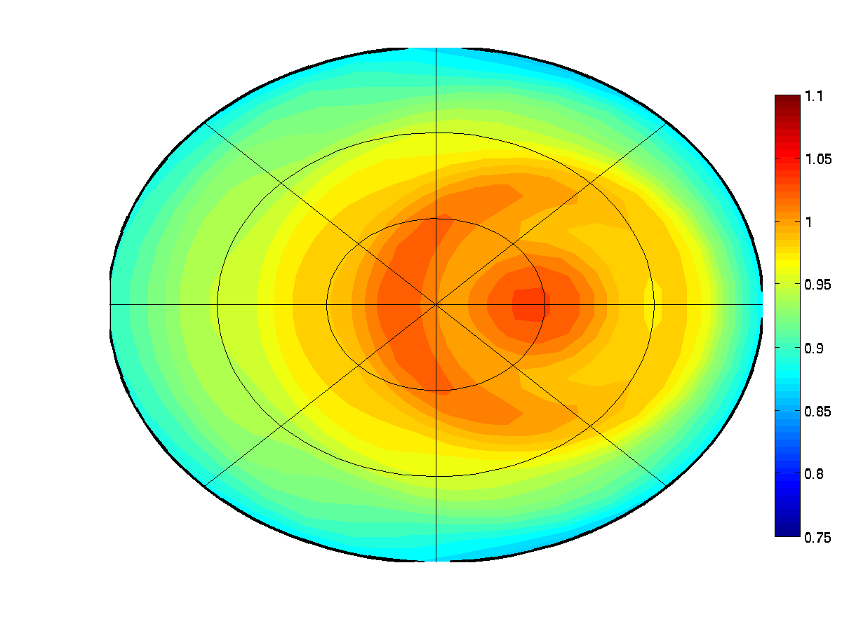
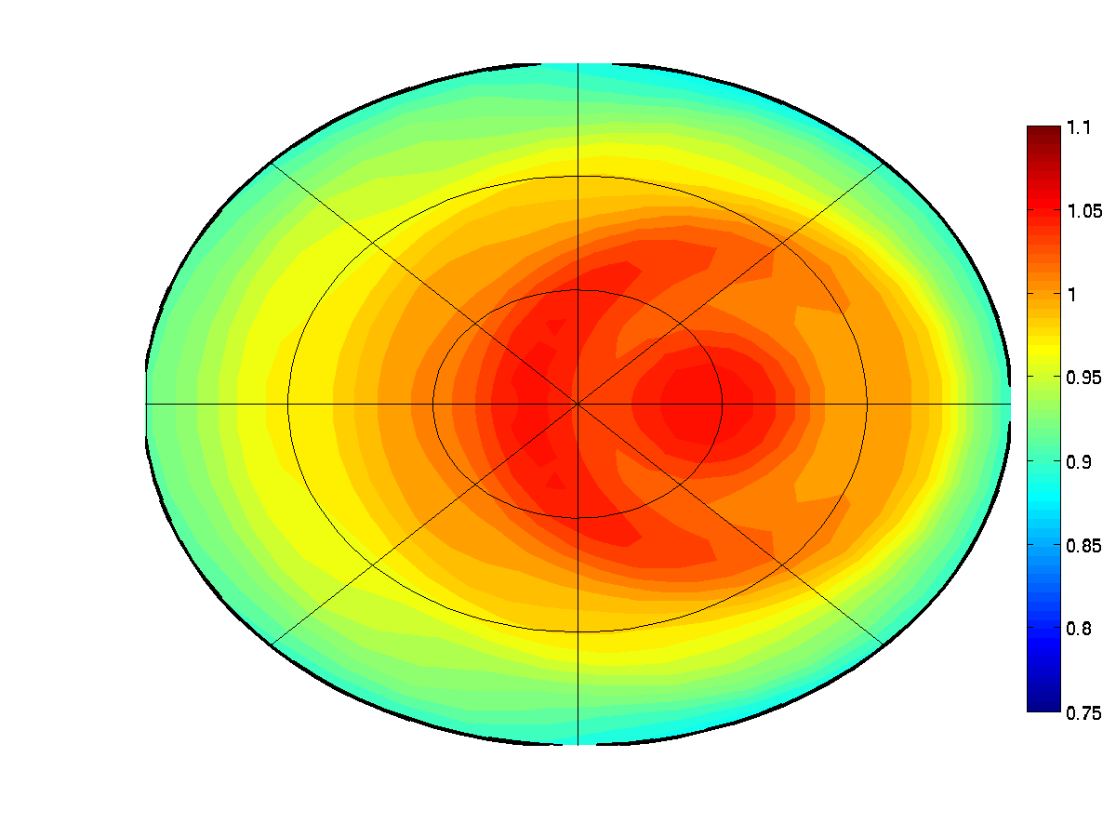
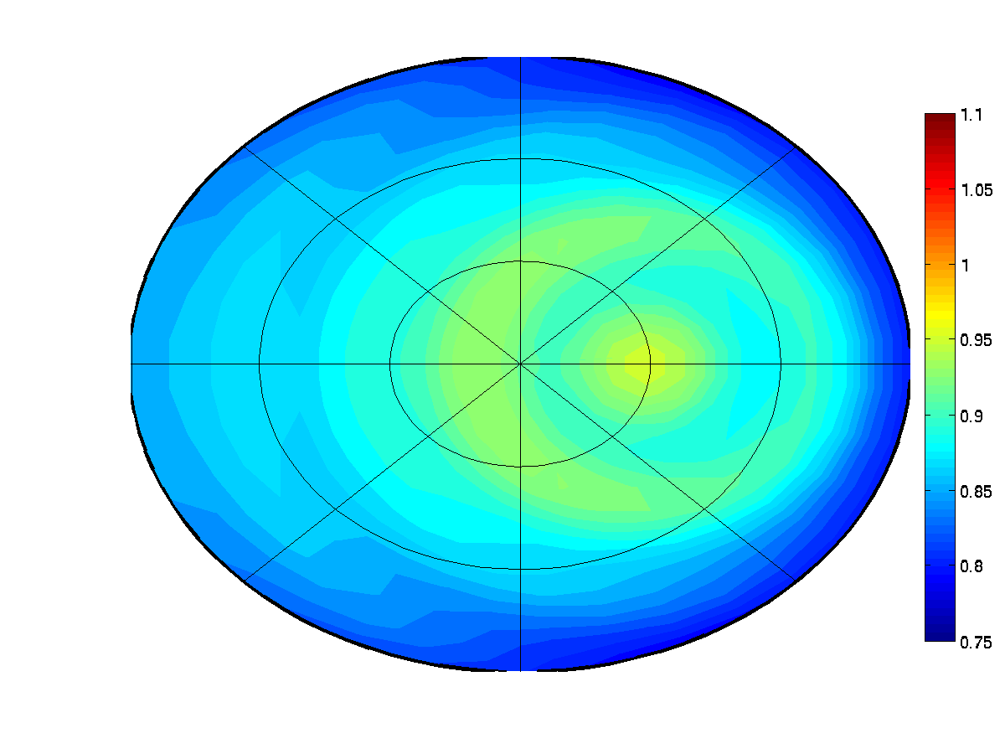
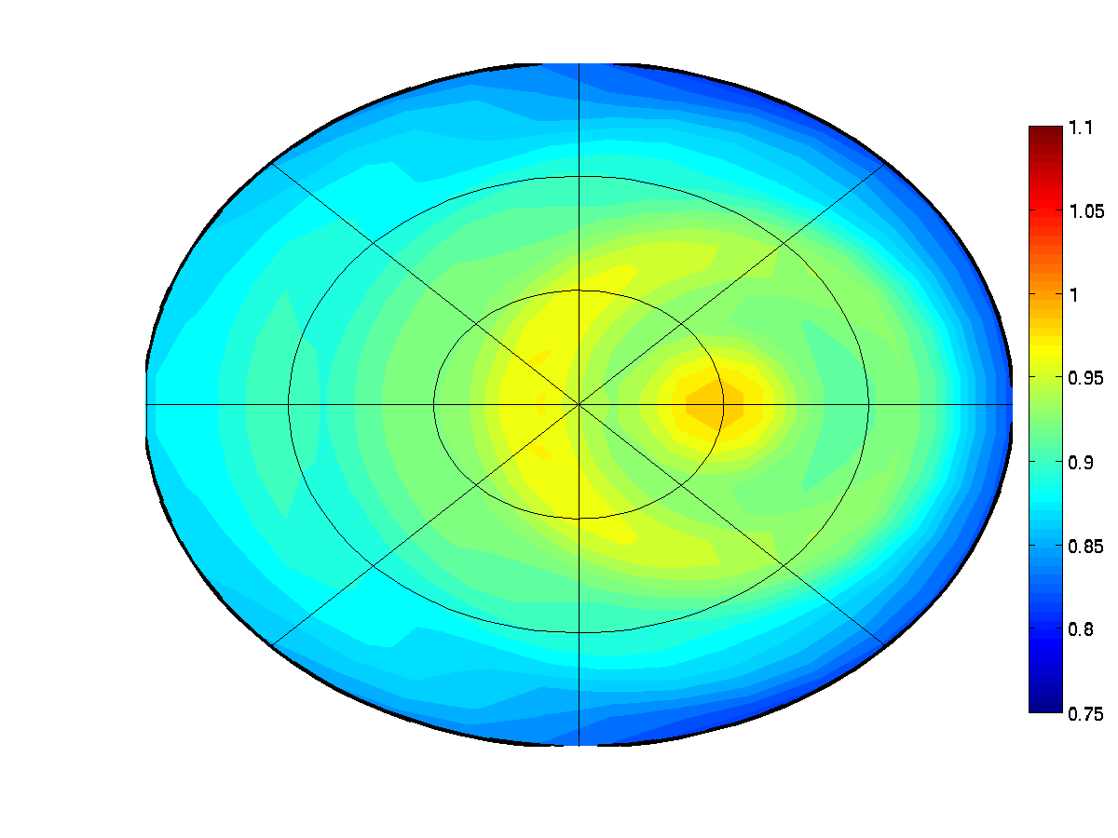
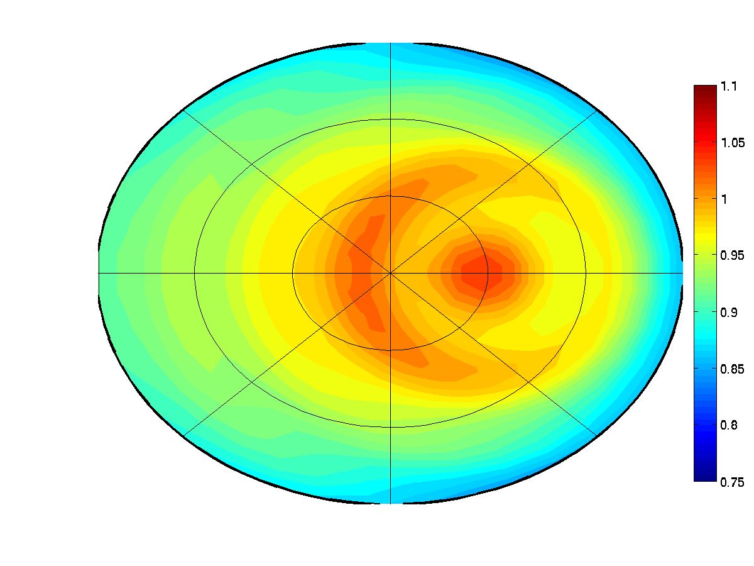
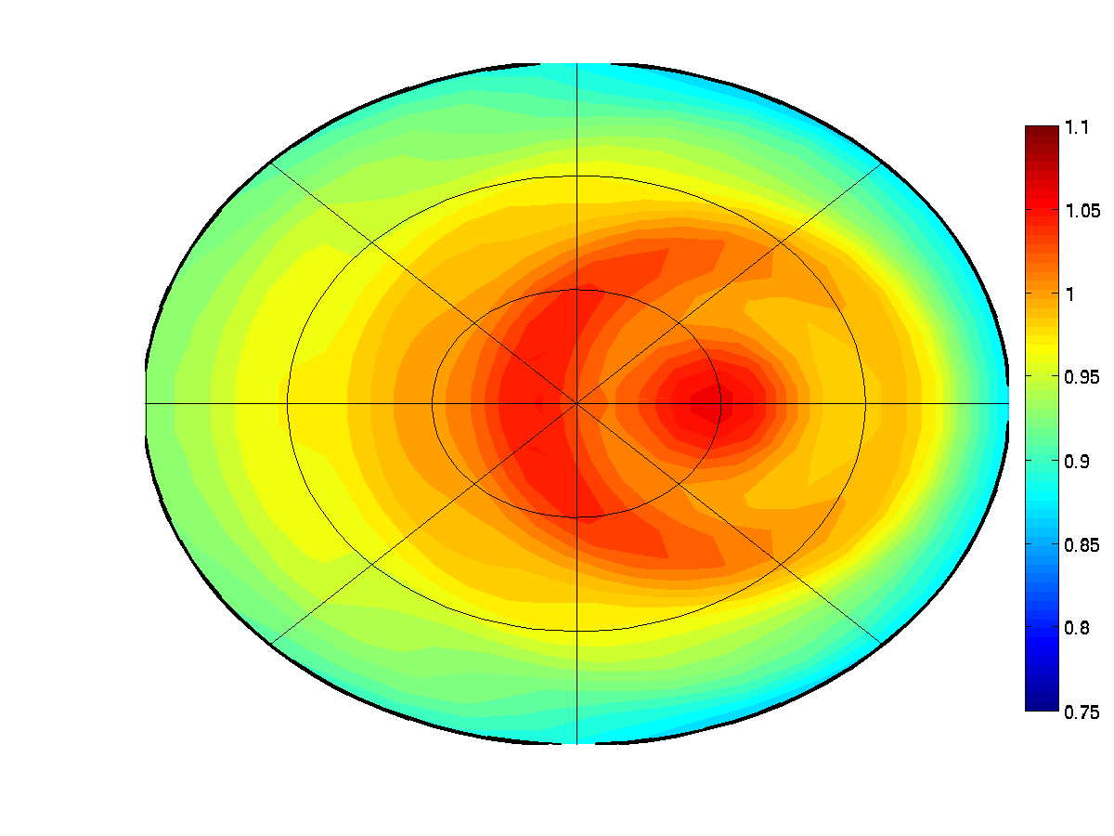
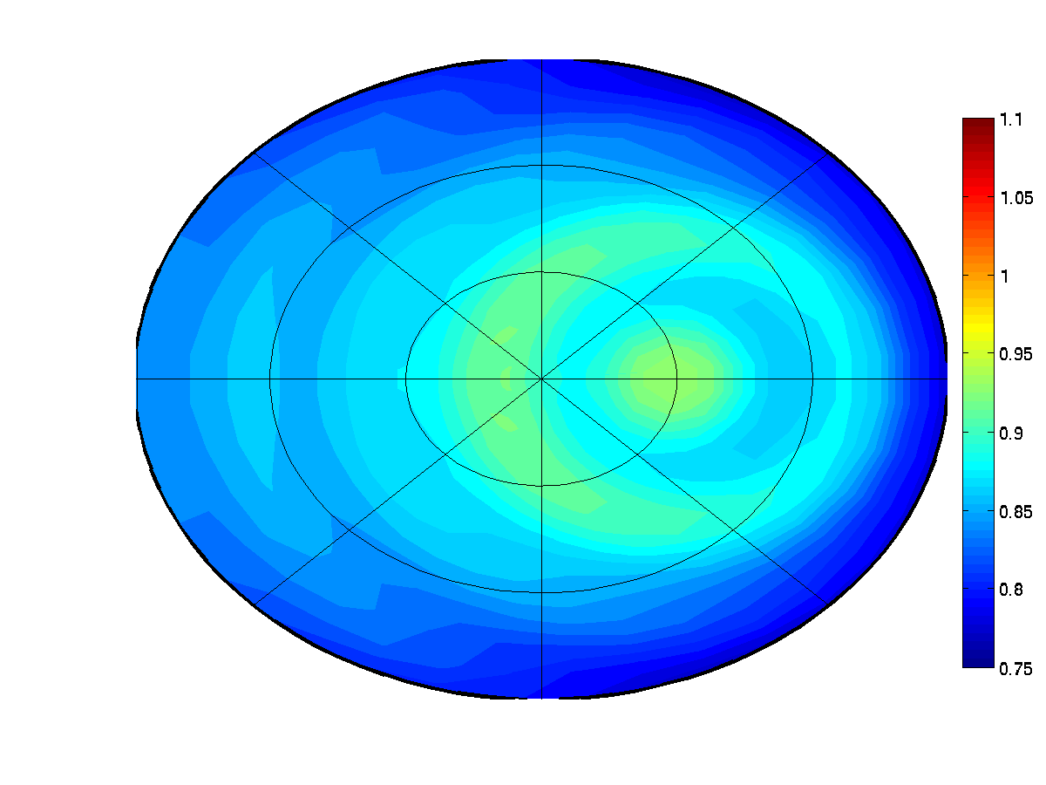
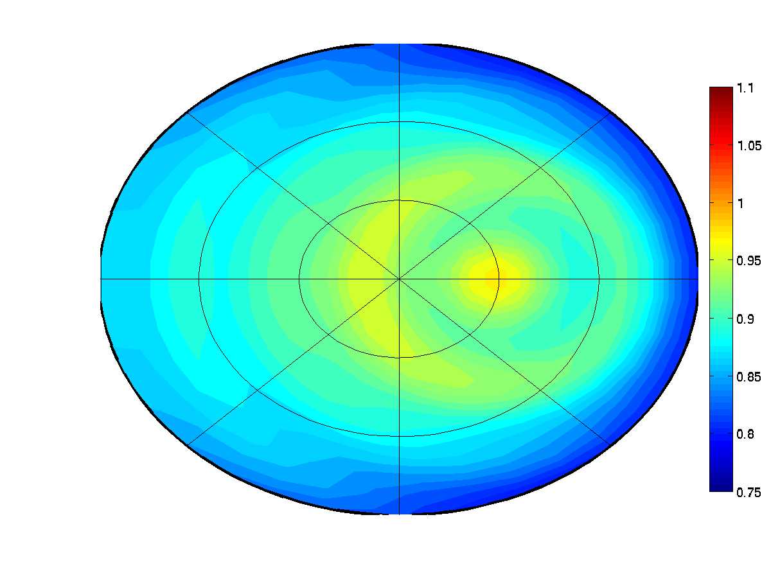
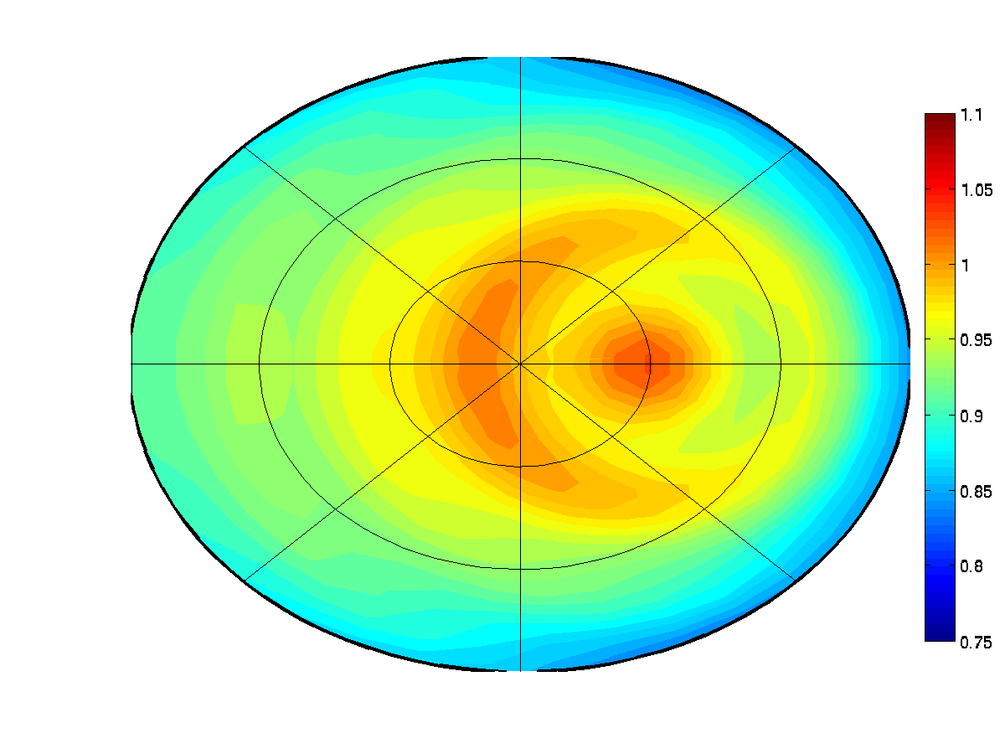
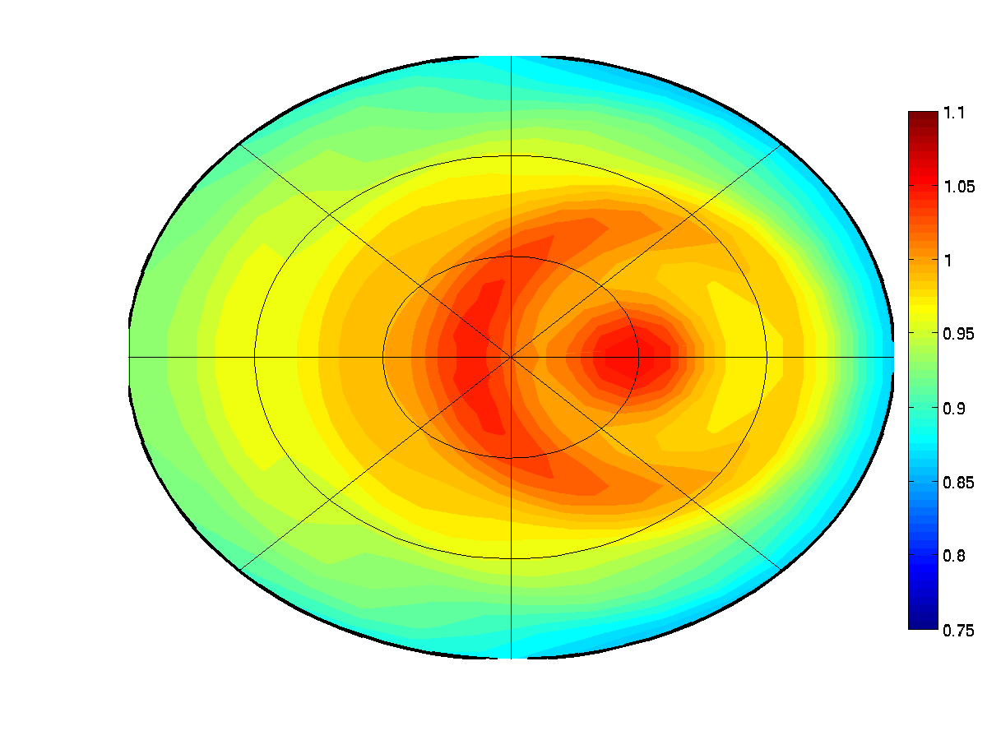
part 3: Results 1
(SZA = 20º)
75
100
200
400
10 μm
270º
60º
40º
20 μm
20º
0º
180º
90º
30 μm
40 μm

Slide 11
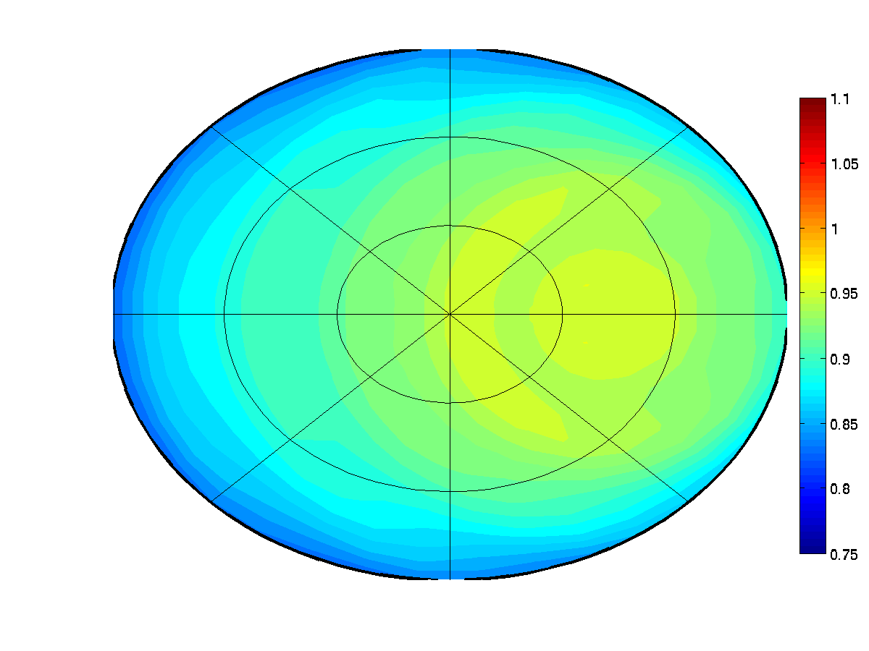
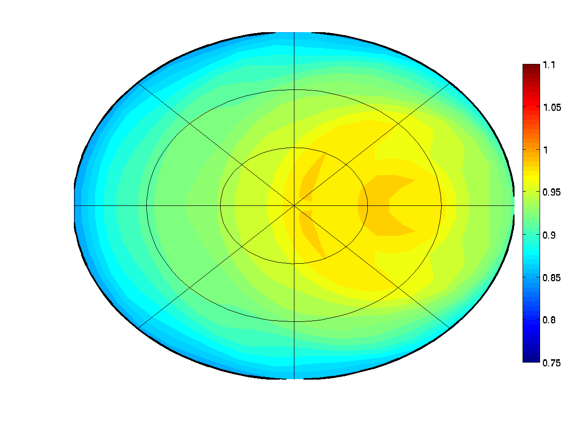
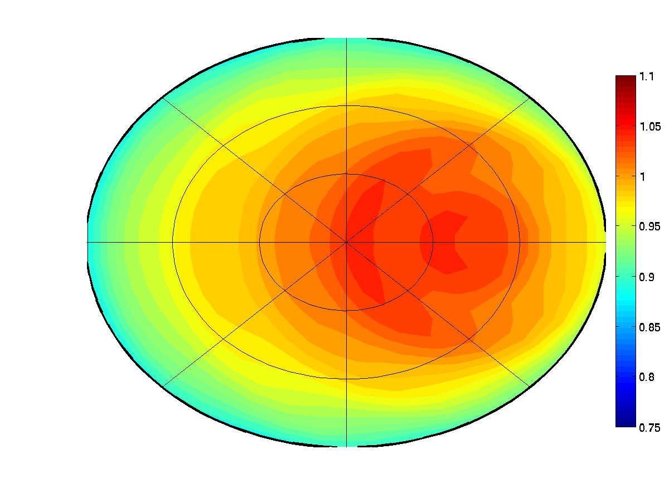
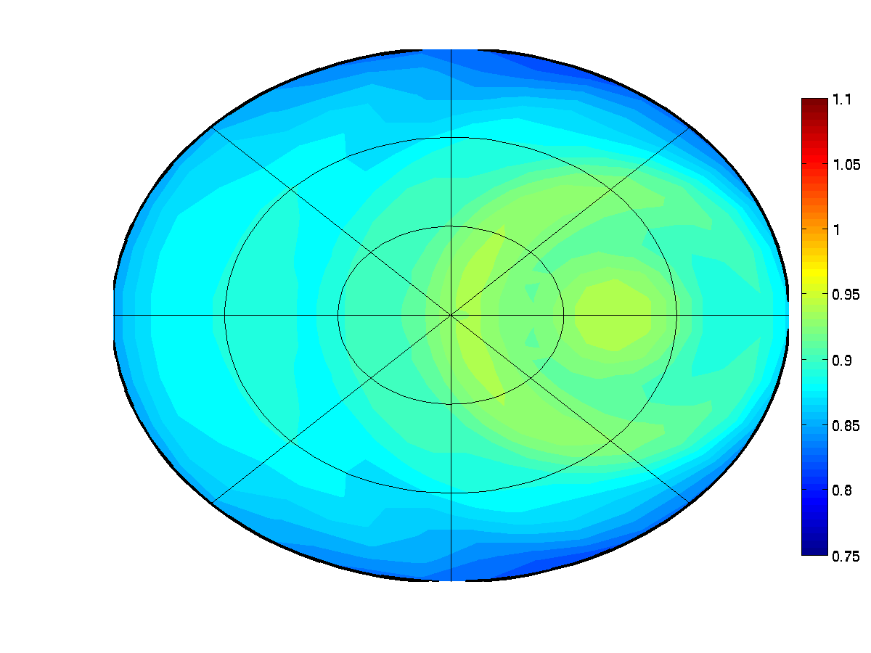
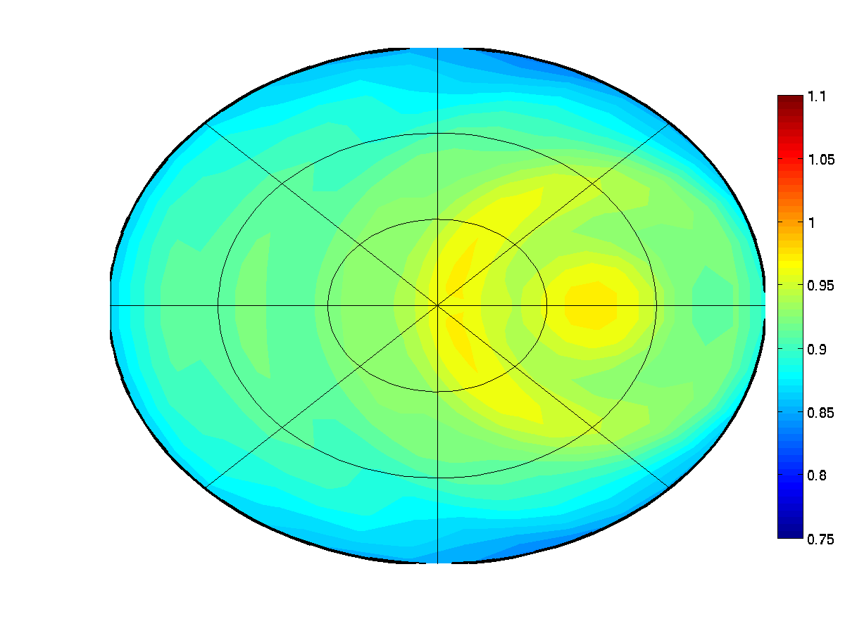
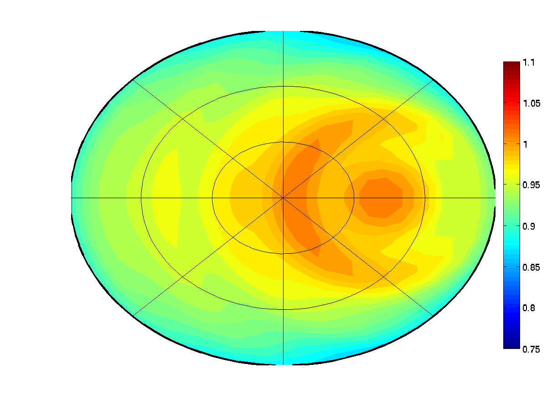
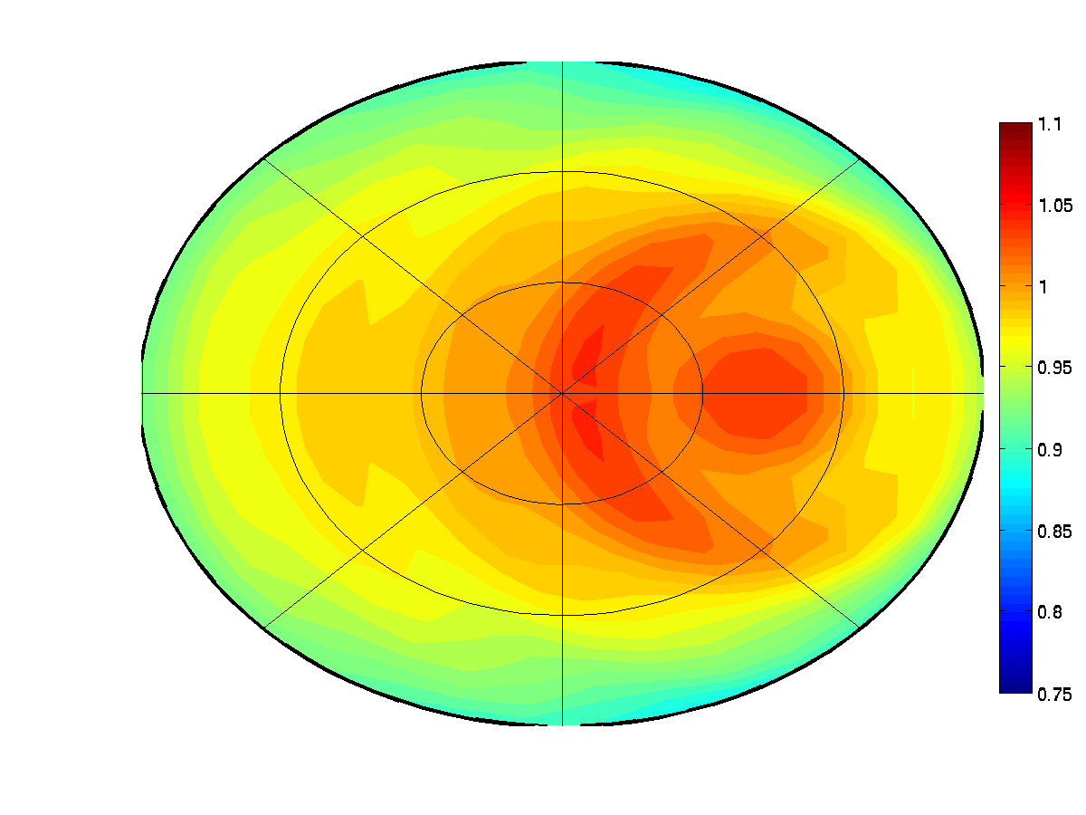
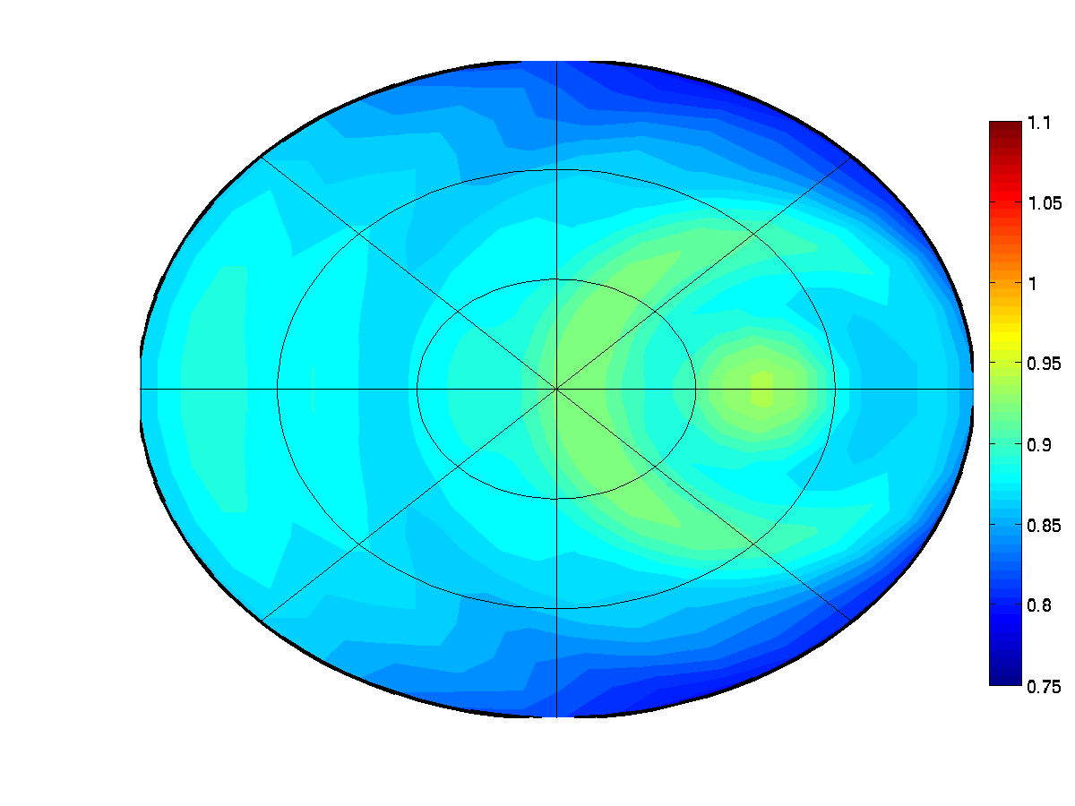
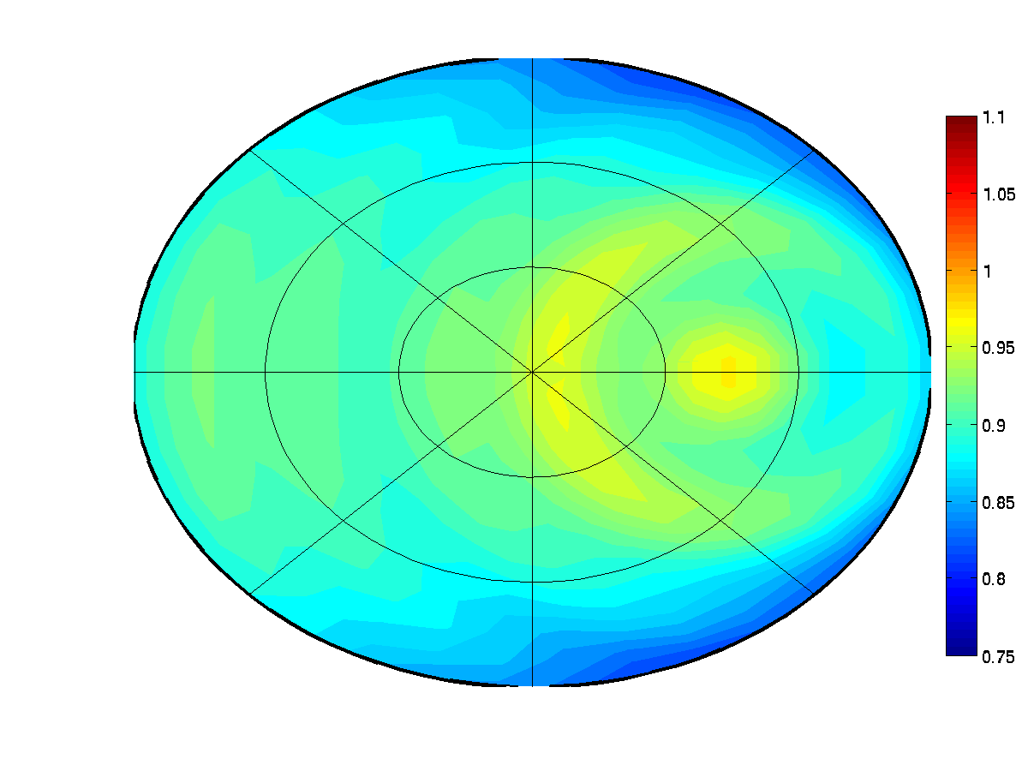
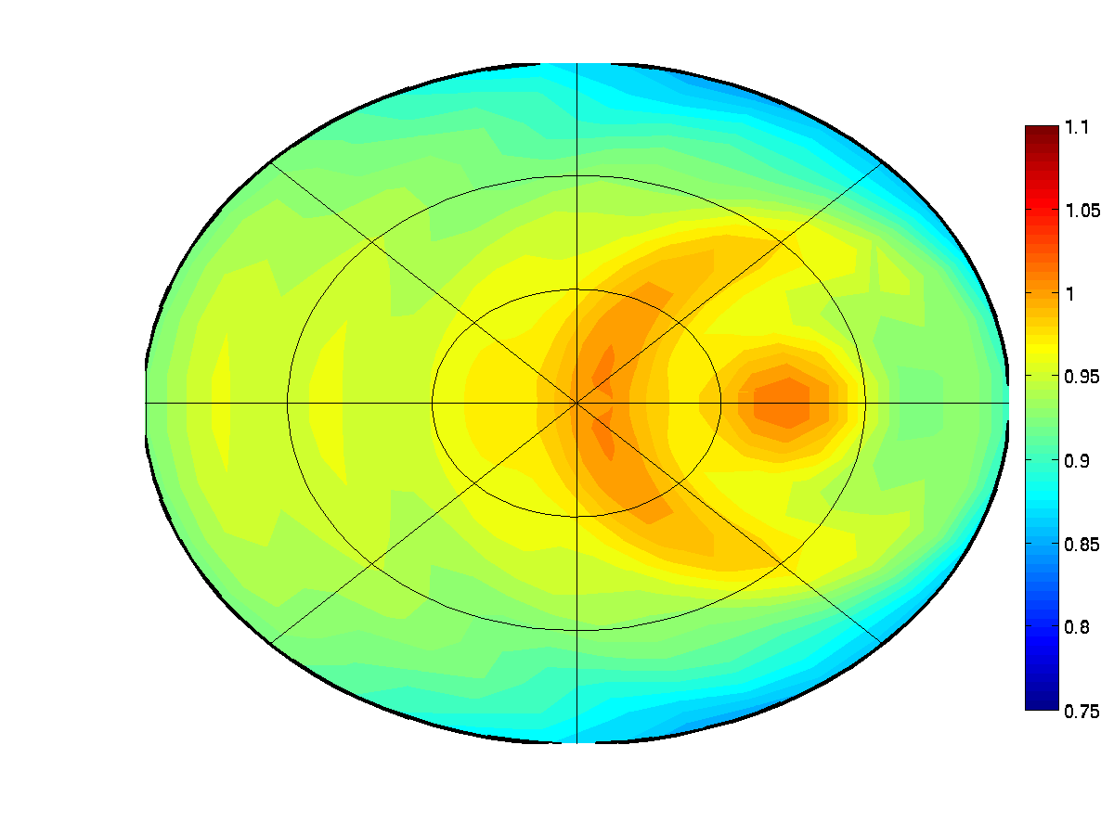
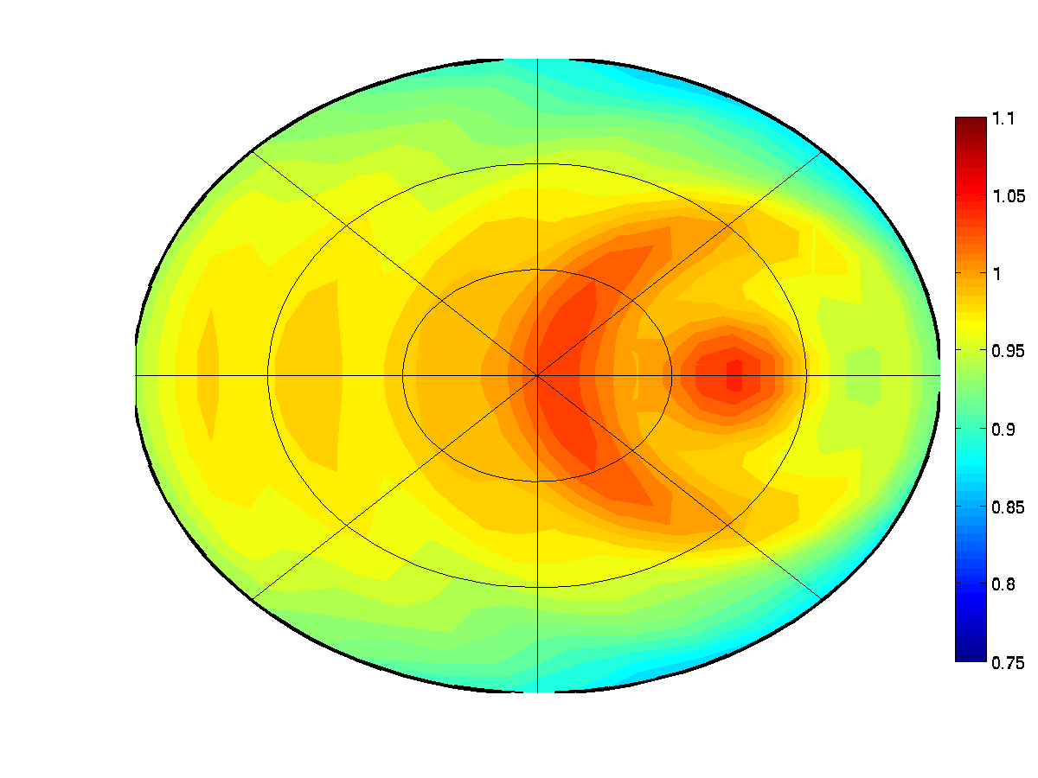
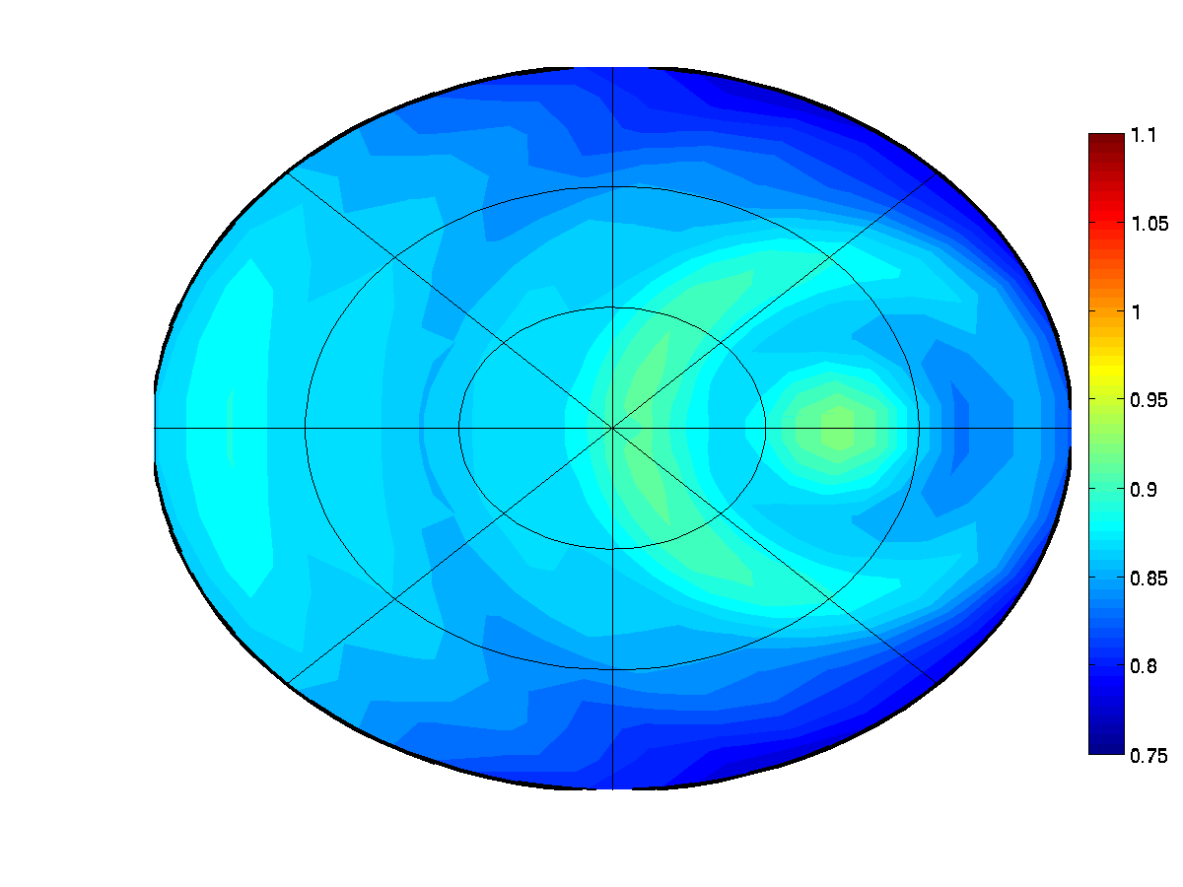
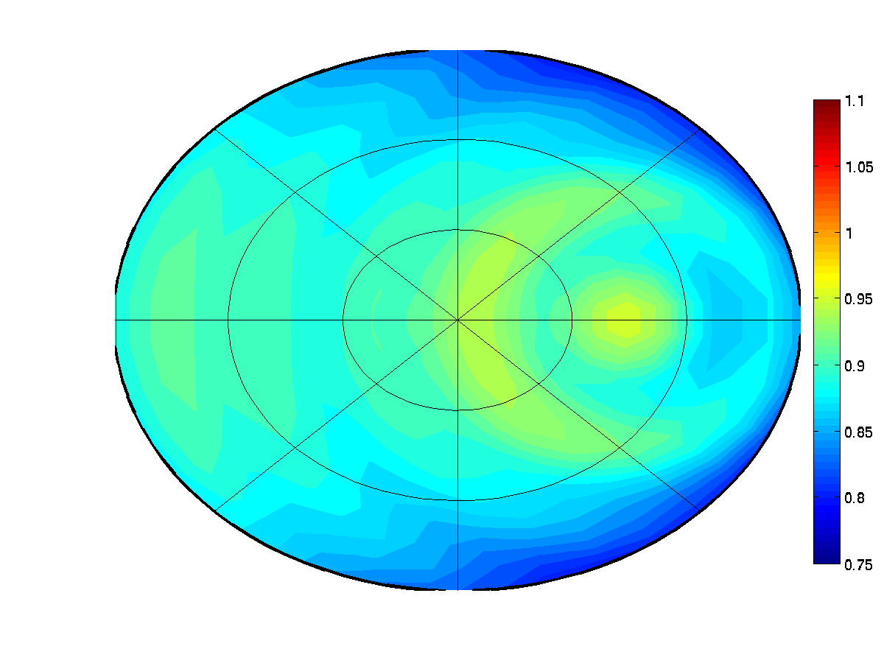
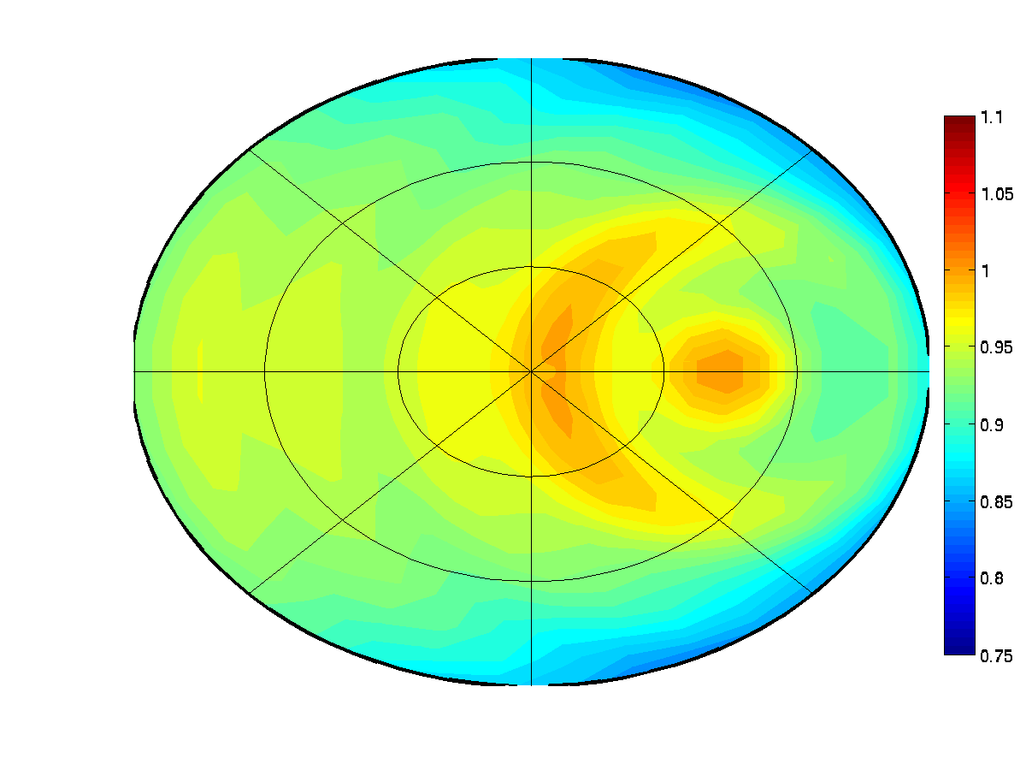
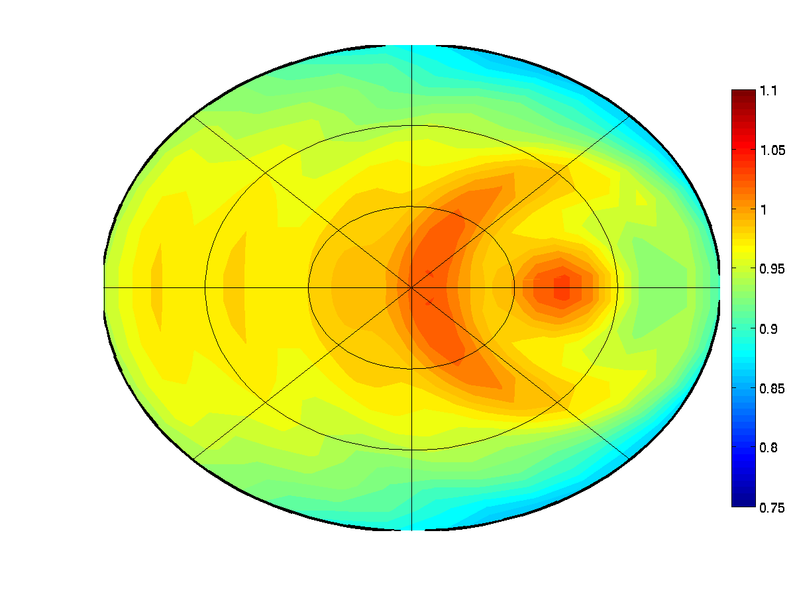
part 3: Results 2
(SZA = 30º)
75
100
200
400
10 μm
270º
60º
40º
20 μm
20º
0º
180º
90º
30 μm
40 μm

Slide 12
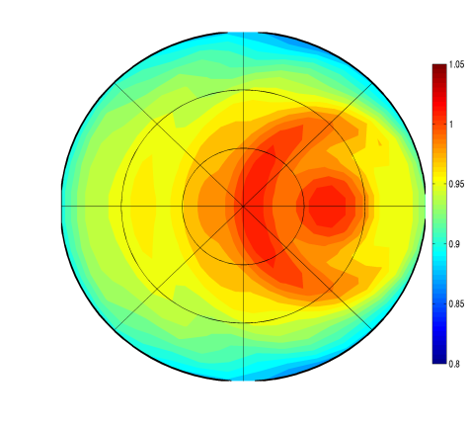
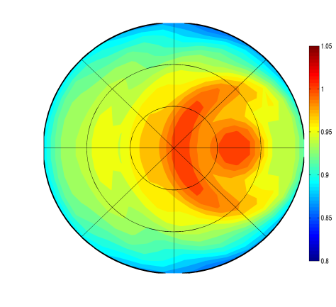
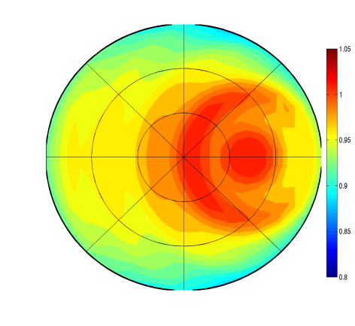
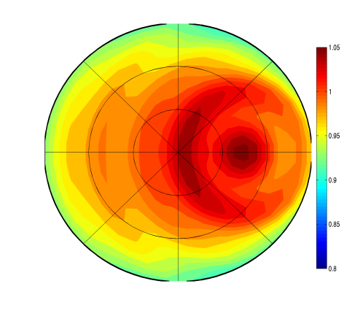
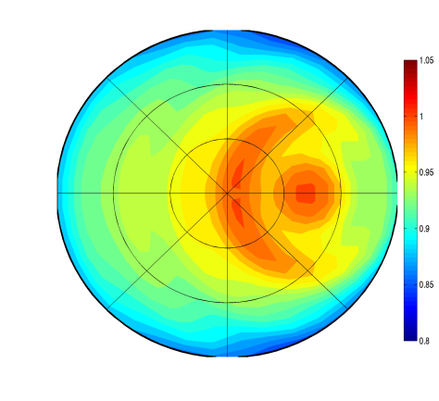
part3: Result 3
SZA = 20º, COT = 200, Re = 20 μm
0.94 – 1.00
270º
270º
270º
270º
270º
60º
60º
60º
60º
60º
40º
40º
40º
40º
40º
20º
20º
20º
20º
20º
0º
180º
0º
180º
180º
180º
0º
0º
0º
180º
90º
90º
90º
90º
90º
COMS ch.1
(0.675 μm)
MODIS ch.1
(0.645 μm)
MODIS ch.2
(0.847 μm)
MODIS ch.3
(0.466 μm)
MODIS ch.4
(0.554 μm)
Q_{ext} | 2.0022 | 2.0019 | 1.9963 | 2.0038 | 1.9942
ω₀ | 1.0000 | 1.0000 | 0.9999 | 1.0000 | 1.0000
g | 0.8118 | 0.8118 | 0.8124 | 0.8100 | 0.8105

Slide 13
Summary
SBDART model could be constructed bi-directional reflectance distribution structure above cloud layer with respect to various input parameters and wavelength of channels, not implying Lambertian surface.
simulated reflectance using SBDART for COMS vicarious calibration is ranging from 0.93 to 1.02.
DCC BRDF is highly dependent on scattering parameterization of RT model.
Vicarious calibration for COMS using DCC target has been conducted well in spite of dependency on the result of RT model simulation.
Result from DCC target is consistent with other target data and the degradation are about 3.28% (2.07%/year) from Sep. 2011 to Apr. 2013.

Slide 14
Back-up slides

Slide 15
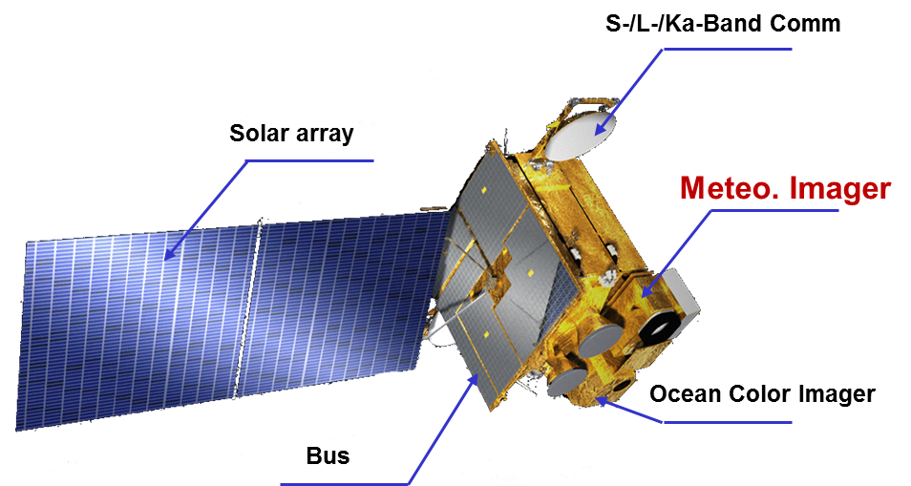
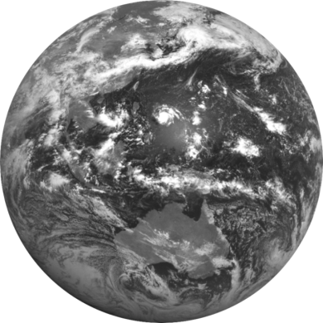
COMS
Communication, Ocean, and Meteorological Satellite(COMS)
Location : 128.2°E
Operational : April 1st, 2011~
Design life time : 7 years(2011~2018)
Payload : MI(Meteorological Imager)
GOCI(Geostationary Ocean Color Imager)
Transponder for communication
The first visible image of COMS
(2010. 7. 12 11:15 KST)

Slide 16
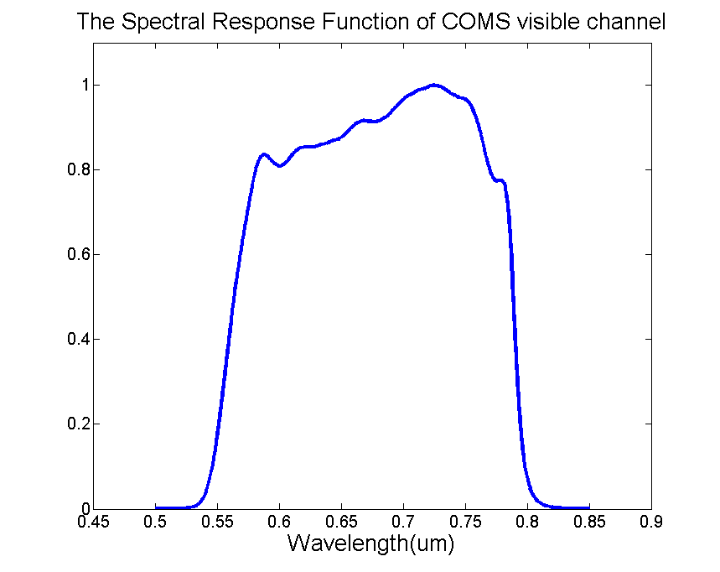
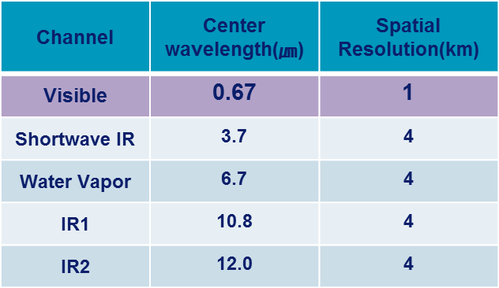
Visible channel radiometric model
Radiance: R = m∙X + b ( )
where m = linear calibration coefficient, i.e. the slope (pre-launch determined)
X = digital counts
b = intercept (measured by the count values of spacelook data)
No on-board calibration for slope m
⇒ Ground calibration must be needed!!

Slide 17
Results (Scatter Plot)
Date | Slope | Intercept | Date | Slope | Intercept
2011.09 | 0.866794 | 0.030549 | 2012.07 | 0.847942 | 0.039423
2011.10 | 0.883913 | 0.015551 | 2012.08 | 0.871089 | 0.024997
2011.11 | 0.865026 | 0.033198 | 2012.09 | 0.870726 | 0.023313
2011.12 | 0.869005 | 0.020513 | 2012.10 | 0.859446 | 0.025622
2012.01 | 0.873601 | 0.018751 | 2012.11 | 0.873348 | 0.016775
2012.02 | 0.871341 | 0.025278 | 2012.12 | 0.859193 | 0.022906
2012.03 | 0.860161 | 0.026934 | 2013.01 | 0.856222 | 0.021422
2012.04 | 0.878237 | 0.024862 | 2013.02 | 0.864552 | 0.014774
2012.05 | 0.881722 | 0.025316 | 2013.03 | 0.854285 | 0.018082
2012.06 | 0.870585 | 0.027393 | 2013.04 | 0.856494 | 0.02709
Scatter plot by using ocean/desert/WC/DCC
- slope= 0.864972
- intercept= 0.024749

Slide 18
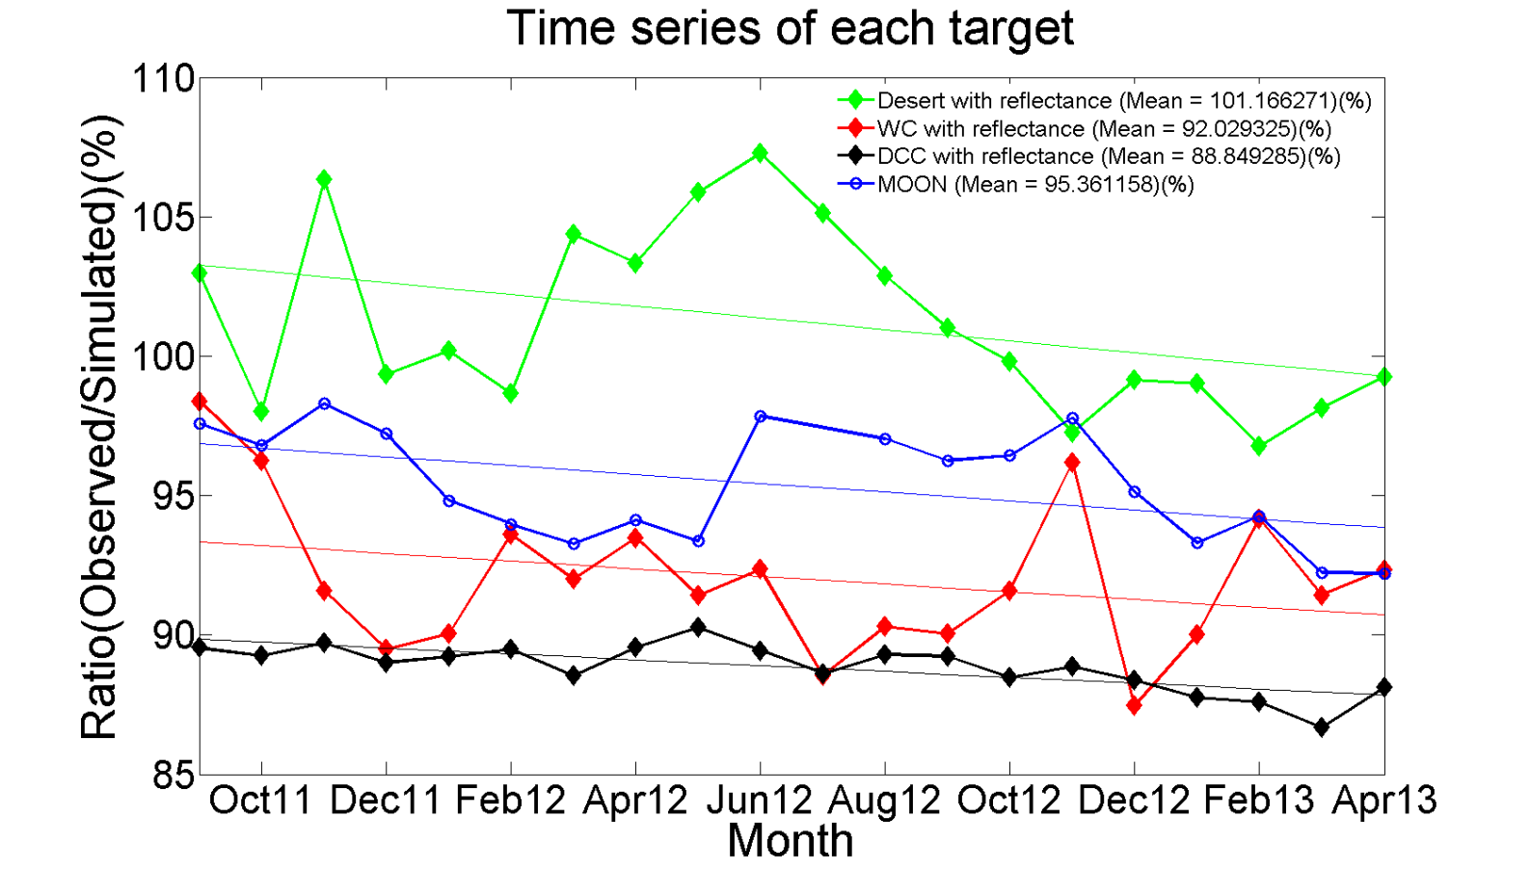
Results (Time Series)
Slopes and intercepts of regression lines for each target
 | Slope | Intercept | Change of means(%/year)
Desert | -0.2093 | 103.2595 | -2.5116
Moon | -0.1588 | 96.8657 | -1.9056
WC | -0.1384 | 93.3438 | -1.6608
DCC | -0.1050 | 89.8470 | -1.26
The mean values of ratio for each target are between -2.5~ -1.2%/year from September 2011 to April 2013.
All methods for respective targets are different from each other. But, all targets have the similar trend with negative slope.

Slide 19
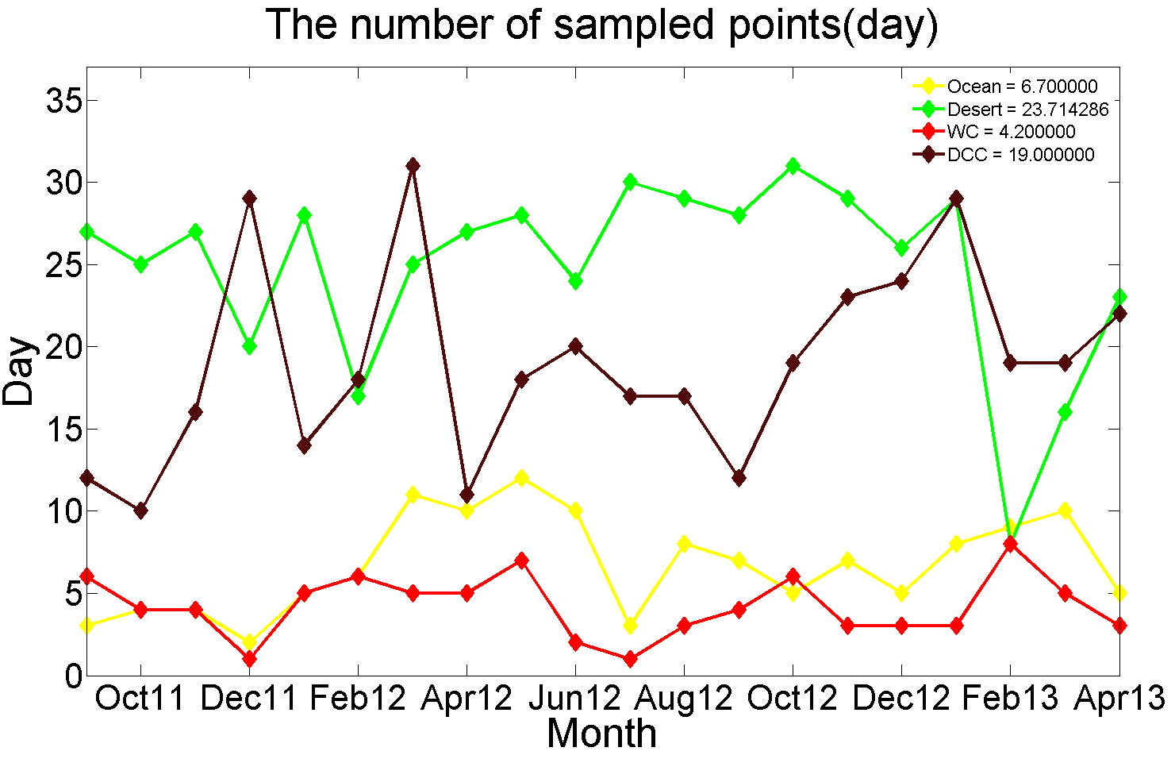
The number of sampled points
The mean of sampled days of desert and DCC are over 15 days. On the other sides, These values related about ocean and WC are under 15.

Slide 20
Results (Degradation)
The degradation are about 4.36%(2.75%/year) from the moon and 3.28%(2.07%/year) from the other 4 targets from September 2011 to April 2013.

Slide 21
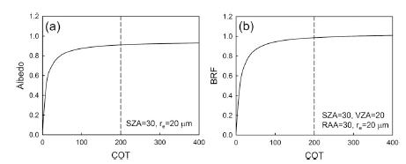
MODIS-derived cloud properties for cold clouds (TB ≤ 190K)
Criteria: TB₁₁ ≤ 190K, STD_{9×9} of TB₁₁ ≤ 1K
Sohn et al. 2009
Observation of MODIS
More than 85% pixels show COT=100 which means that real COT could be greater than 100.
65.3%
simulation result
20.4%
14.3%
About 65% of pixels show COT > 150.

Slide 22
Simulation of MODIS reflectance
(by assuming r_{e}=20 μm, COT=200 )
Sohn et al. 2009
1) Pixel-based value
2) error histogram
3) on daily basis

Slide 23
comparison of scattering properties
Ham et al. 2009
Cloud BRDF
(SZA=30º, COT=40, 6 kinds of re)
applied Mie phase function
applied Baum scattering model

Slide 24
SZA=10º
10 μm
75
100
200
400
20 μm
30 μm
40 μm

Slide 25
SZA=20º
10 μm
75
100
200
400
20 μm
30 μm
40 μm

Slide 26
SZA=30º
10 μm
75
100
200
400
20 μm
30 μm
40 μm

Slide 27
SZA=40º
10 μm
75
100
200
400
20 μm
30 μm
40 μm

