Slide 1
Introduction Manik Bali

Slide 2
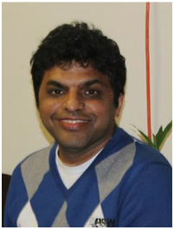
Name: Manik Bali
Title : Deputy Director of GSICS Co-Ordination Center
Affiliation: NOAA, College Park
( ESSIC, University of Maryland,MD,USA )
Work closely with Larry Flynn (GCC Dir.), Tim Hewison(GRWG Chair.),
Fred Wu( GRWG Vice Chair), and GSICS EP( Jerome, Mitch ..)
to support GSICS activities.
Editor for GSICS Quarterly Newsletter.

Slide 3
Experience:
AVHRR, AATSR, AIRS inter-calibration.
Radiative Transfer Modeling, NWP, L1B CAL/VAL.
Data Assimilation.
Sentinel-2 Level 2A data processing.

Slide 4
Objective(s) for Participating GRWG UV Group.
Support the UV subgroup members in connecting
Support creation, review and operationalization of UV products.
Support creation of UV calibration data base.
Participate in UV Calibration activities

Slide 5
Recommendation(s) to the UV Group.
New member countries be introduced to GSICS.
( Tom McElroy Environment Canada already invited, will join future meetings)
Enable connection of UV group with the future group modelling group in GSICS.
( UV CRTM )
Make GSICS processes transparent, ISO certified.

