Slide 1
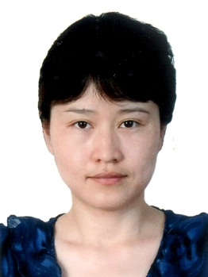
Self introduction
Yuan Li,(Lillian, Li) female, associate professor.
born in 1978,obtained the Ph.D. degree in March, 2006 from Beijing Institute of Technology(BIT), majoring in optical engineering.
National Satellite Meteorological Center(NSMC/CMA).
mainly engaged in the study of in orbit radiometric calibration of remote sensor and remote products retrieval. (solar bands for 7 years, UV bands for 6 months)
the responsibility scientist of the land surface reflectance product of FY-3C.
the CMA GPRC Points of contacts for operational matters of WMO / GSICS.

