Slide 1
Aqua-MODIS and VIIRS DCC calibration
David Doelling, Rajendra Bhatt
Jan 8, 2014

Slide 2
Objectives
Aqua-MODIS Collection 6 long-term calibration stability based on DCC
NPP-VIIRS calibration stability based on DCC
  The official NOAA VIIRS product provides only forward processing calibration
  CERES uses the NASA Land PEATE product (provided by Jack Xiong), which has recalibrated the VIIRS record from launch
  GSICS to transfer the Aqua-MODIS calibration reference to NPP-VIIRS
What is the time record needed to accurately predict a calibration trend?

Slide 3
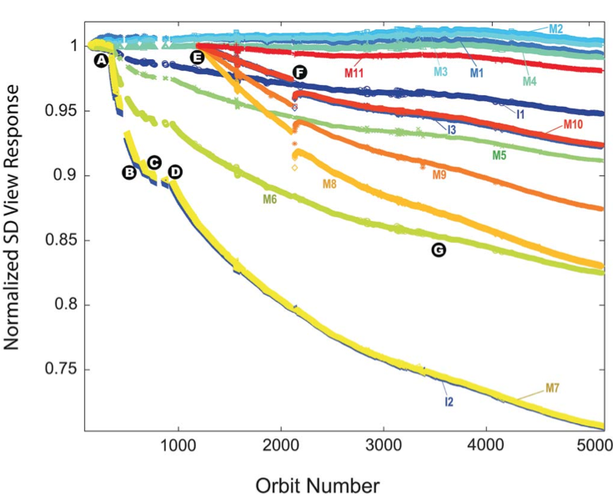
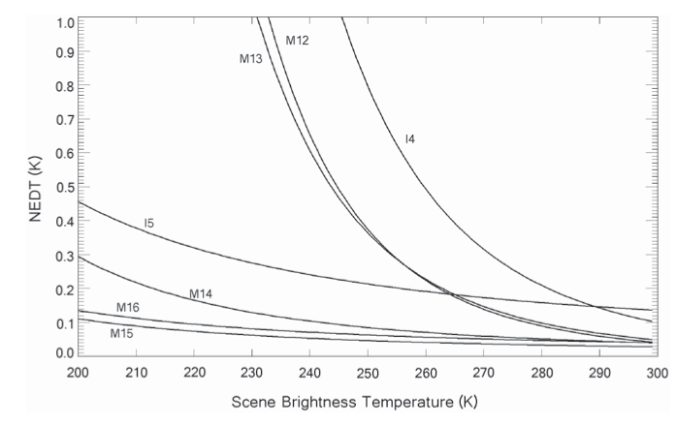
NPP-VIIRS on orbit calibration
M15 (10.8µm) noise equivalent change in temperature (NEdT). The noise at 205°K is ~0.1°K
M5 (0.65µm) known sensor degradation
M7 (0.86µm) tungsten contamination
Cao et al. 2013 TGRS

Slide 4
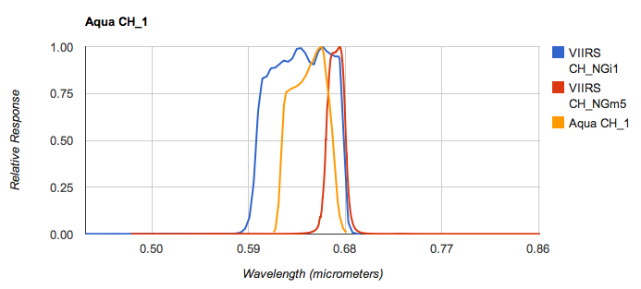
Aqua-MODIS and NPP-VIIRS 0.65µm spectral response functions

Slide 5
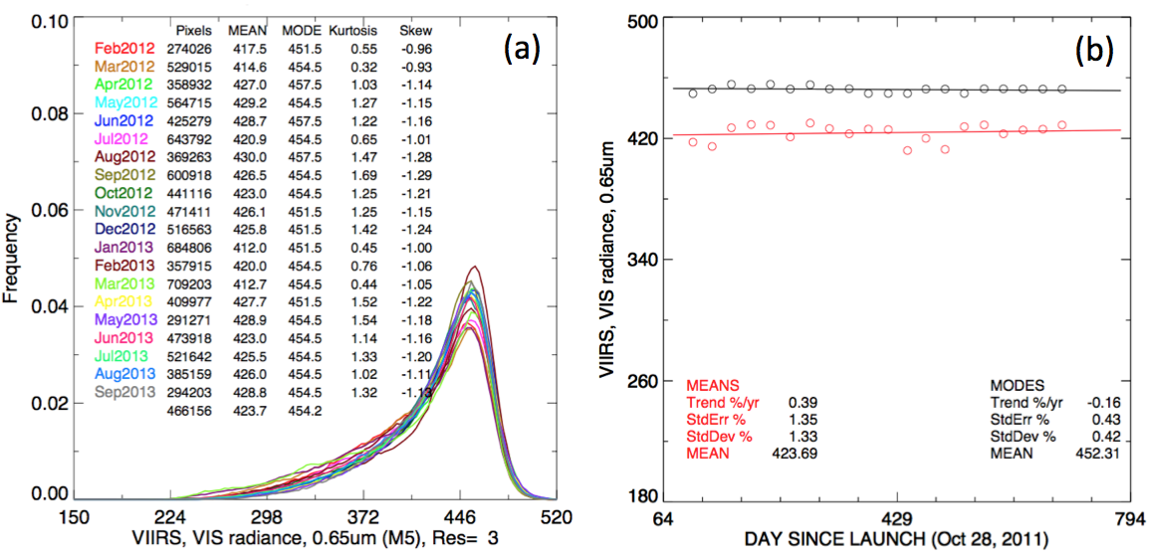
VIIRS M5 DCC calibration
• Used only the TWP spatial domain
• VIIRS extrapolated long term is -1.6%/decade

Slide 6
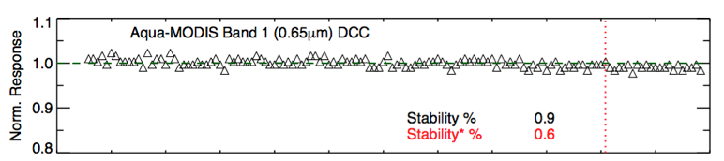
Aqua-MODIS DCC calibration
• Used only the TWP spatial domain,
• note the decrease in standard deviation over time
• Note the downward trend of the Aqua-MODIS 0.65µm Collection 6 calibration, consistent with VIIRS (-1% over its lifetime)
• Jack states that the Aqua-MODIS calibration stability is instrument (solar diffuser, instrument) based, whereas Terra-MODIS is desert based

Slide 7
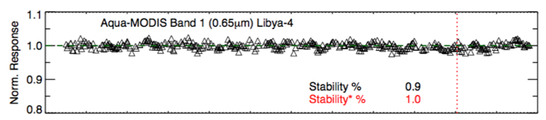
Aqua-MODIS Libya-4 calibration
• The downward trend is also observed with Libya-4, except for a brightening event in 2014
• The sensor calibration signal is embedded in the natural variability of the invariant target and the algorithm noise, which is based on the instrument characteristics

Slide 8
Aqua-MODIS DCC calibration
2002-2012
GEO domain | Mean 10-year Rad | %/decade
GOES-W | 467.3 (+1.3%) | -0.92
GOES-E | 465.0 (+0.8%) | -1.57
Met 0° | 467.4 (+1.3%) | -1.15
Met 60° | 464.8 (+0.8%) | -1.32
MTSAT | 461.2 (reference) | -1.21
• VIIRS DCC calibration is -1.6%/decade
• DCC GEO domain trend range ~0.6%/decade
• It is highly unlikely that DCC natural variability exceeds ±0.6%/decade, since the DCC trends in the GEO domains are similar

Slide 9
DCC calibration linear trend standard error
DCC linear trend standard error
Aqua-MODIS observations |  | NPP-VIIRS observations (2 years)
Full record (12 years) | VIIRS time frame
0.9% | 0.6% | 0.42% (M5), 0.52% (I1)
• The VIIRS sensor characteristics are an improvement over MODIS
• The VIIRS sensor does not have the magnitude of sensor striping differences that MODIS has. (Cao et al. 2013) (Each MODIS scan is based on 10 detectors)

Slide 10
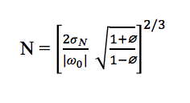
Trend significance
N = time to detect trend
ω₀ = magnitude of trend
σ_{N} = standard deviation of the time-series
∅ = autocorrelation of the time-series
• This is the time needed to confidently predict a trend of a given magnitude based on the natural variability and autocorrelation of the measurements
• 2 is the factor to compute N at the 95% confidence level with a 50% probability, 3.3 is the factor for 95% confidence and 90% probability (1.4x)
• This assumes that all natural oscillations and time scales are known
• Weatherhead, E. C., et al. (1998), “Factors affecting the detection of trends: Statistical considerations and applications to environmental data” J. Geophys. Res., 103(D14), 17149–17161, doi:10.1029/98JD00995.
• Weatherhead, E. C., et al. (2000), “Detecting the recovery of total column ozone”, J. Geophys. Res., 105(D17), 22201–22210, doi:10.1029/2000JD900063.

Slide 11
VIIRS minimum detectable trend
VIIRS band | Observed DCC trend | Minimum trend
M5 | -0.16%/year | ±0.54%/year
I1 | -0.42%/year | ±0.52%/year
• Neither observed trend exceeded the natural variability over 2-years of VIIRS observations
• Libya-4 the minimum detectable trend is ~±1.3%/year

Slide 12
Predicted time to detect trend
VIIRS band | Trend ±(%/decade) | Years to detect trend
M5 | 0.42 | 9
I1 | 0.52 | 7
• The DCC natural variability or standard deviation of monthly gains is 0.42% and 0.52% for M5 and I1 respectively
• Assume that the natural variability of VIIRS DCC does not change over time
• Table shows the standard deviation divided by a decade trend and the number of years to detect that trend
• VIIRS calibration drifts greater than 1%/decade can be confidently detected in ~5 years and 11 years using Libya-4

Slide 13
Conclusions
The NPP-VIIRS onboard calibration is as good as Aqua-MODIS if not better
  Tungsten issue has been resolved
  VIIRS detector striping is an improvement over MODIS
The 2-year record NPP-VIIRS calibration stability is within ±0.5%/decade based on the DCC natural variability
~5 years are needed to confidently detect a trend greater than ±1%/decade based on DCC natural variability

