Slide 1
FY-3C/MERSI characterization evaluation based on CMA GISCS platform on early orbit
Xiuqing(Scott) Hu, Na Xu, Ronghua Wu, Ling Sun, Lin Chen, Hanlie Xu, Ling Wang
National Satellite Meteorological Center, CMA
2014.03.24

Slide 2
Outline
Background
MERSI instrument Performance evaluation
Calibration assessment
Conclusion

Slide 3
Background
FY-3C launched on 23 September 2013 with the third Medium Resolution Imaging Spectrom­eter (MERSI).
FY-3C initiated the operational running era of China’s second generation of polar-orbiting meteorological satel­lites FY-3 serials after two experimental satellites FY-3A and FY-3B.
MERSI was turned on September 30, 2013 and open its solar reflective bands and then it’s IR bands started to work on October 17, 2013.
FY-3C/MERSI has some remarkable improvements with respect to the MERSI onboard on FY-3A and FY-3B.
  SNR Improvement in these bands 1~4 (250m spatial resolution)
  Enhance the consistency of the spectral response function (SRF) in different detectors within one band, especially for the thermal Infrared band (band 5).
  Extended the field of viewing for space view (SV) for the lunar calibration .
  Radiometric response stability of solar bands is better than FY-3A and FY-3B which have great degradation in short wavelength bands (λ<500nm).

Slide 4
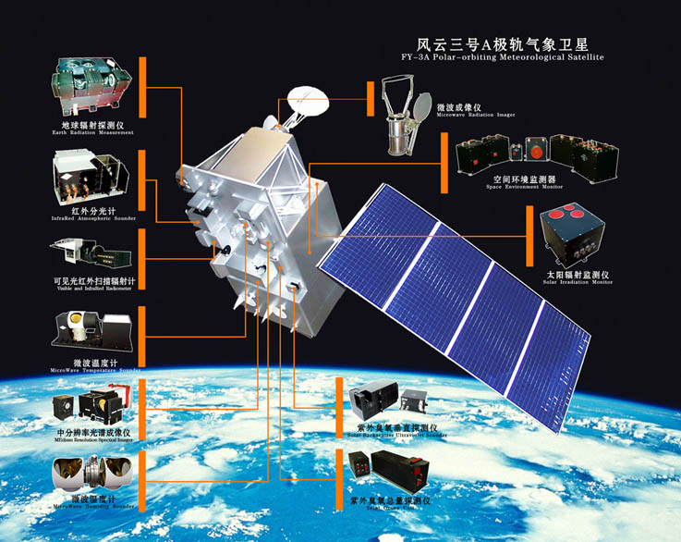
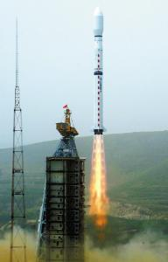
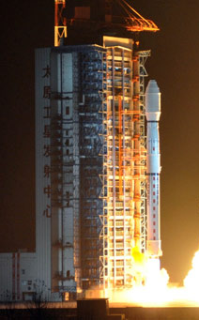
Background
FengYun-3:
FY-3A
Launched on 5/27/08
local equator-crossing time: 10:30 AM (descending southward)
First light on 6/4/08
FY-3B
Launched on 11/05/10
local equator-crossing time: 1:30 PM (ascending northward)
First light on 11/12/20
Near-sun-synchronous polar orbit
Nominal altitude: 836 km
Data website: http://fy3.satellite.cma.gov.cn
Notes:
4
Fengyun-3 (FY-3) series is the second generation of polar-orbiting meteorological satellites in China.
FY-3A was launched on May 27, 2008. It is operated in a sun-synchronous morning orbit with a local equator-crossing time of 10:30 AM in descending node. FY-3B was launched on November 5, 2010 in an afternoon orbit with an equator-crossing time of 1:30 PM in ascending node.
NSMC is responsible for the data receiving, processing, archiving and dissemination.

Slide 5
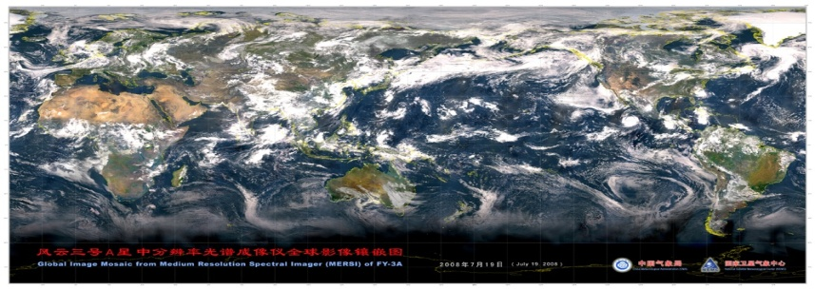
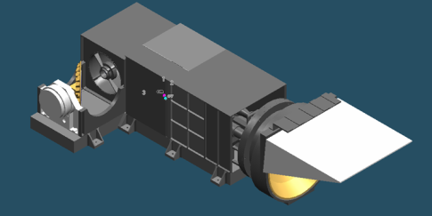
Medium Resolution Spectral Imager
(MERSI)
20 spectral bands with a total of 350 detectors located on 4 focal plane assemblies (FPA).
  19 reflective solar bands (RSB): bands 1-19, 0.4~2.1um
  1 thermal emissive bands (TEB): band 5, 10-12.5 um
Two spatial resolutions (nadir): 250 m(1-5), and 1 km(6-20)
Scan angle: ±55° (from nadir)
  A swath of 10 km (along-track) by 2900 km (nadir along-scan)
  Global coverage in 1 day
One-sided 45° scan mirror with one K- mirror (de-rotation)
  1.5 second each scan
A broad range of applications
  Near 20 science data products for studies of the Earth’s land, ocean, and atmosphere properties.
Made by Shanghai Institute of Technology and Physics (SITP), Chinese Academy of Sciences (CAS)
(Hu, X, IEEE, 2012)
Notes:
5
The MERSI was manufactured by Shanghai Institute of Technology and Physics, Chinese Academy of Sciences.
MEdium Resolution Spectral Imager (MERSI) is a keystone payload onboard FY-3.
The first MERSI (MERSI-1) onboard the three FY-3 satellites has 20 spectral bands: 19 reflective solar bands covering the wavelength range from 0.4–2.1 μm and one thermal emissive band covering 10–12.5 μm. MERSI will be further enhanced in the fourth satellite in FY-3 series.
MERSI is a cross-track scanning radiometer and makes earth view observations over a scan angle range of ±55° about nadir via a 45° scan mirror and a de-rotated K mirror. It collects data at 2 nadir spatial resolutions: 250 m (5 bands) and 1000 m (15 bands). It covers a swath of 2900 km cross track by 10 km (at nadir) along track for each scan with multiple detectors (10 or 40), enabling complete global coverage in one day. In total, there are 350 along-track detectors: 40 detectors per band for the channels with a 250-m pixel resolution, and 10 detectors per band for the channels with a 1-km pixel resolution.
FY-3 MERSI is capable of making continuous global observations for a broad range of scientific studies of the Earth’s system and there are approximately 20 science data products.

Slide 6
MERSI continuity and Evolution
Band | FY-1A/B MVISR-1 | FY-1C/D MVISR-2 | FY-3A/B/C VIRR | FY-3A/B/C MERSI-1 | FY-3D/E/F MERSI-II
1 | 0.58-0.68 | 0.63 | 0.63 | 0.470 | 0.470
2 | 0.725-1.1 | 0.865 | 0.865 | 0.550 | 0.550
3 |  | 3.75 | 3.75 | 0.650 | 0.650
4 |  | 10.8 | 10.8 | 0.865 | 0.865
5 | 10.5-12.5 | 12.0 | 12.0 | 11.25 | 1.03
6 |  | 1.61 | 1.61 | 1.640 | 1.64
7 |  | 0.455 | 0.455 | 2.130 | 2.13
8 | 0.48-0.53 | 0.49 | 0.49 | 0.412 | 0.412
9 | 0.53-0.58 | 0.55 | 0.55 | 0.443 | 0.443
10 |  | 0.94 | 1.36 | 0.490 | 0.490
11 |  |  |  | 0.520 | 0.555
12 |  |  |  | 0.565 | 0.670
13 |  |  |  | 0.650 | 0.709
14 |  |  |  | 0.685 | 0.746
15 |  |  |  | 0.765 | 0.865
16 |  |  |  | 0.865 | 0.905
17 |  |  |  | 0.905 | 0.936
18 |  |  |  | 0.940 | 0.940
19 |  |  |  | 0.980 | 1.38
20 |  |  |  | 1.030 | 3.8
21 |  |  |  |  | 4.05
22 |  |  |  |  | 7.2
23 |  |  |  |  | 8.550
24 |  |  |  |  | 10.8
25 |  |  |  |  | 12.0
Futural MERSI-2
Five more IR bands
Circurrus Clould Band 1.38um
Has two IR split windows with 250m spatial resolution
Cover all bands in VIRR and MERSI-1
Higher accuracy from onboard calibration
Has Lunar Calibration

Slide 7
FY-3C MERSI Event log on orbit
Date | Event Log | Description
2013.09.30 | Open and get first image | Successfully image collection
2013.10.01 | Take off the cooler baffle | For IR band working
2013.10.01 | Turn on VOC（AB,A,B) | Check the initial response change
2013.10.09~11 | Turn on VOC（AB,A,B) | Monitor the degradation
2013.10.17 | Open IR band (b5） | IR image is good and has weak stripping
2013.10.23 | First SV moon observation | Get moon disk for lunar calibration
2013.10.25~27 | Turn on VOC（AB,A,B) | Monitor the degradation
2013.11.01 | Close the onboard normalized processing | Downlink the raw image data and the stripping is heavier （5,6,7,8,18,20)
2013.11.05~07 | Turn on VOC（AB,A,B) | Monitor the degradation
2013.11.08 | Update the new normalized LUT in DPPS | L1 Image stripping is better
2013.11.19~21 | Turn on VOC（AB,A,B) | Monitor the degradation
2013.11.21 | SV moon observation | Get moon disk for lunar calibration
2013.12.14~16 | Turn on VOC（AB,A,B) | Monitor the degradation
2013.12.20 | SV moon observation | Get moon disk for lunar calibration
2014.01.10~12 | Turn on VOC（AB,A,B) | Monitor the degradation

Slide 8
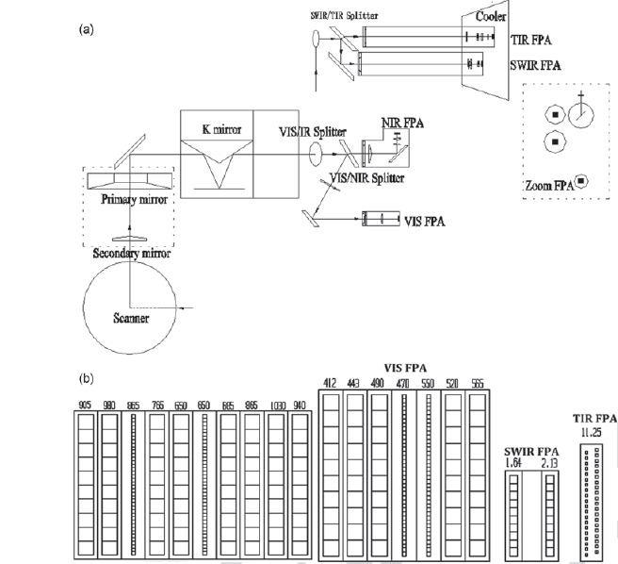
FY-3A MERSI’s de-rotation K mirror stop working and its SWIR bands 6 and 7 are influenced by anomalous electronic gain jumps, possibly induced by electrostatic discharge.
For FY-3B MERSI, the baffle of radiative cooler was not successfully opened. Thus, bands 5, 6 and 7 are operated in anomalous working conditions without temperature control since Jan. 21, 2011, and band 5 is inoperable.
FY-3C MERSI is working perfectly by now.
Notes:
Real instrument Photo of MERSI two modules. The left is the visible on-board calibrator (VOC) seeing from the front; The right is the instrument main optical- mechanical component.
Instrument optical design sketch map of MERSI main optical- mechanical module . (a) Interior optical configuration of MERSI and light passing; (b) Detector layout of each band in the focal planes.
Scene radiant flux reflects from the beryllium scan mirror which is continuously rotating at 40 rpm. The scan mirror is oval shaped and nickel plated and coated with silver for high reflectance and low scatter over the broad spectral range of the sensor. Energy is reflected from the scan mirror and then strikes the primary mirror (the entrance pupil), goes through a field stop and then onto the secondary mirror. Radiance reflected from the secondary mirror is transmitted to K mirror which is used to remove the rotation of the image due to the rotation by 45° scanner and multi-detector parallel. The K mirror rotates at exactly half the rate of the scanner and uses alternating mirror sides on successive telescope scans. The similar function of K mirror is the half-angle mirror in SeaWiFS.
visible (VIS) (412 to 565 nm), near infrared (NIR) (650 to 1030nm), short wavelength infrared (SWIR) (1640 to 2130nm), and thermal infrared (TIR) (12250nm). The SWIR and TIR focal plane assemblies (FPA’s) should be cooled to approximately 90 K by a passive radiant cooler.

Slide 9
Performance evaluation
In-orbit verification (IOV) of the instrument performance specification of FY-3C/MERSI started to be conducted in middle October, 2013.
Some representative performances were derived, including
  signal noise ratio (SNR),
  dynamic range
  saturation restore function.
  modulation transfer function (MTF),
  band-to band registration,
  calibration accuracy
  consistency of the multiple detector,
  instrument stability

Slide 10
FY-3C/MERSI SRF: Better consistency of multi-detector in Infrared band
3A_IR5
3C_IR5
MERSI spectral response function (SRF) of each detectors of band 5 in FY-3A (left) and FY-3C(right)

Slide 11
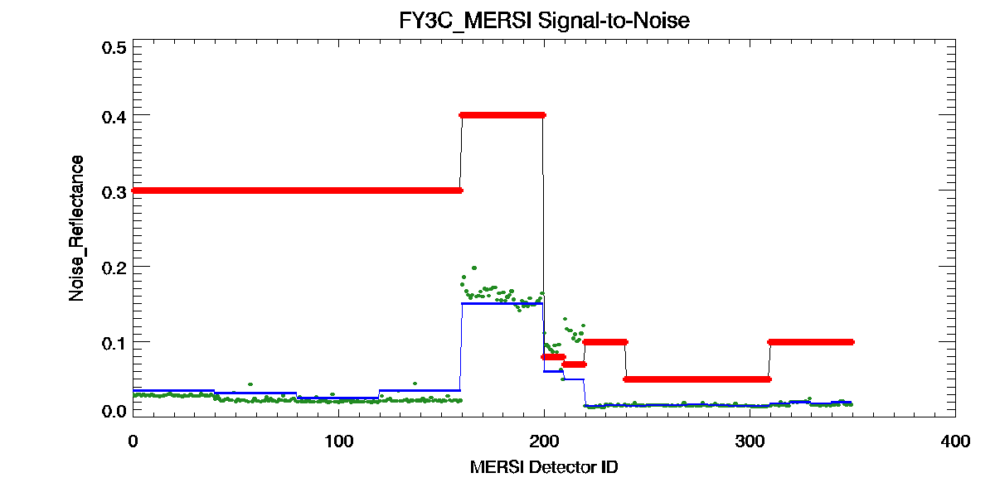
SNR: Noise equivalent reflectance (NEΔρ) or
Noise equivalent temperature (NEdT)
Red：Specification
Blue：Preflight
Green：inflight
1 2 3 4 6,7 8,9 10~16 17~20
Noise equivalent reflectance (NEΔρ) or Noise equivalent temperature (NEdT) of each detector of FY-3A MERSI solar reflective bands on-orbit calculated using the space view data during the commissioning phase. The at the solar bands (Bands 1–4 and 6-20) was largely beyond the specifications except for some detectors at band 6 and 7 as shown in above Figure.

Slide 12
MERSI SNR Comparison in FY-3A/B/C
Band | Wavelength | Specification | 3A SNR | 3B SNR | 3C SNR | 3C inflight
1 | 0.47 | 0.3 | 0.246 | 0.146 | 0.035 | 0.029
2 | 0.55 | 0.3 | 0.177 | 0.101 | 0.032 | 0.024
3 | 0.65 | 0.3 | 0.200 | 0.103 | 0.025 | 0.022
4 | 0.865 | 0.3 | 0.154 | 0.136 | 0.035 | 0.024
5 | 11.25 | 0.4 K | 0.20 | 0.18 | 0.15 | 0.15
6 | 1.64 | 0.05 | 0.046 | 0.131 | 0.06 | 0.065
7 | 2.13 | 0.05 | 0.071 | 0.148 | 0.05 | 0.065
8 | 0.412 | 0.1 | 0.036 | 0.025 | 0.015 | 0.014
9 | 0.443 | 0.1 | 0.029 | 0.021 | 0.016 | 0.016
10 | 0.49 | 0.05 | 0.040 | 0.020 | 0.015 | 0.016
11 | 0.52 | 0.05 | 0.077 | 0.020 | 0.016 | 0.016
12 | 0.565 | 0.05 | 0.034 | 0.022 | 0.016 | 0.016
13 | 0.65 | 0.05 | 0.037 | 0.019 | 0.017 | 0.016
14 | 0.685 | 0.05 | 0.030 | 0.016 | 0.016 | 0.016
15 | 0.765 | 0.05 | 0.031 | 0.018 | 0.015 | 0.016
16 | 0.865 | 0.05 | 0.034 | 0.018 | 0.015 | 0.015
17 | 0.905 | 0.1 | 0.028 | 0.015 | 0.018 | 0.017
18 | 0.94 | 0.1 | 0.026 | 0.012 | 0.020 | 0.021
19 | 0.98 | 0.1 | 0.028 | 0.017 | 0.018 | 0.016
20 | 1.03 | 0.1 | 0.036 | 0.019 | 0.020 | 0.018
Great SNR improvement

Slide 13
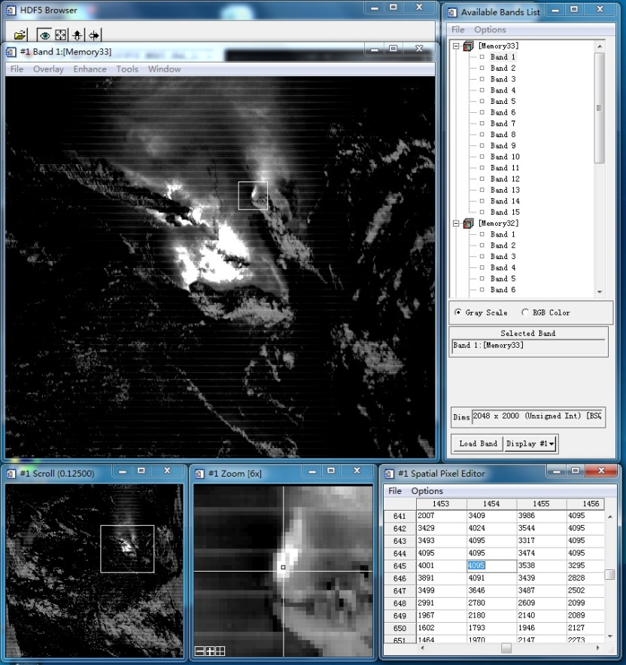
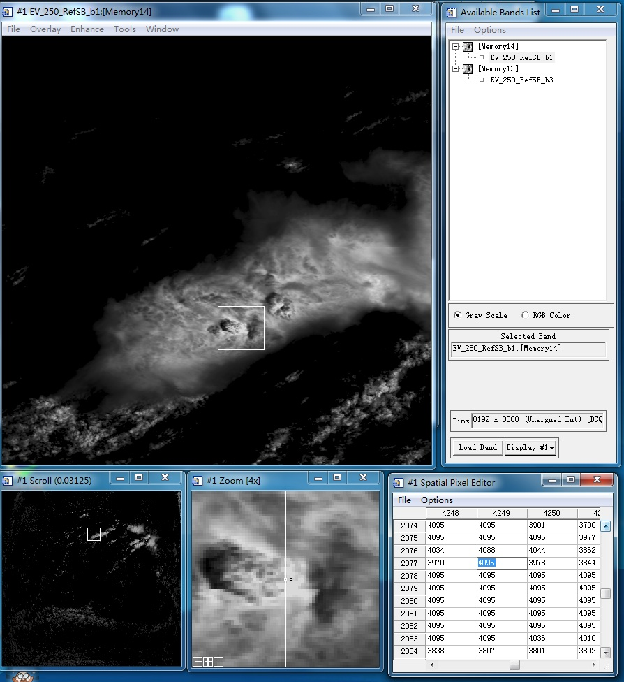
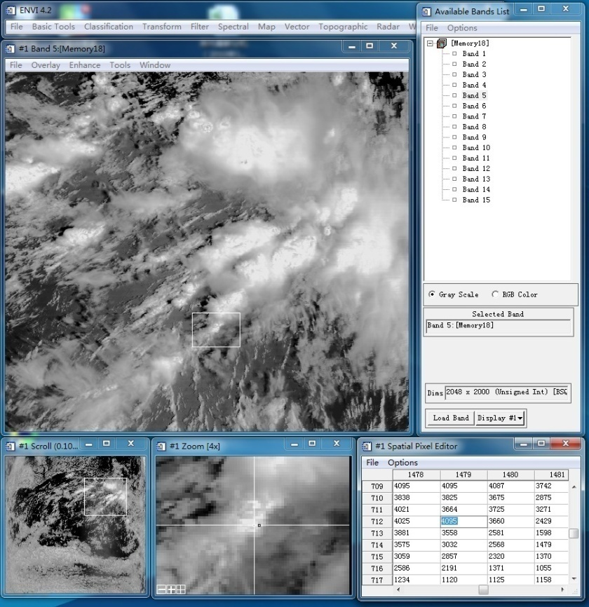
Saturation Restore

Slide 14
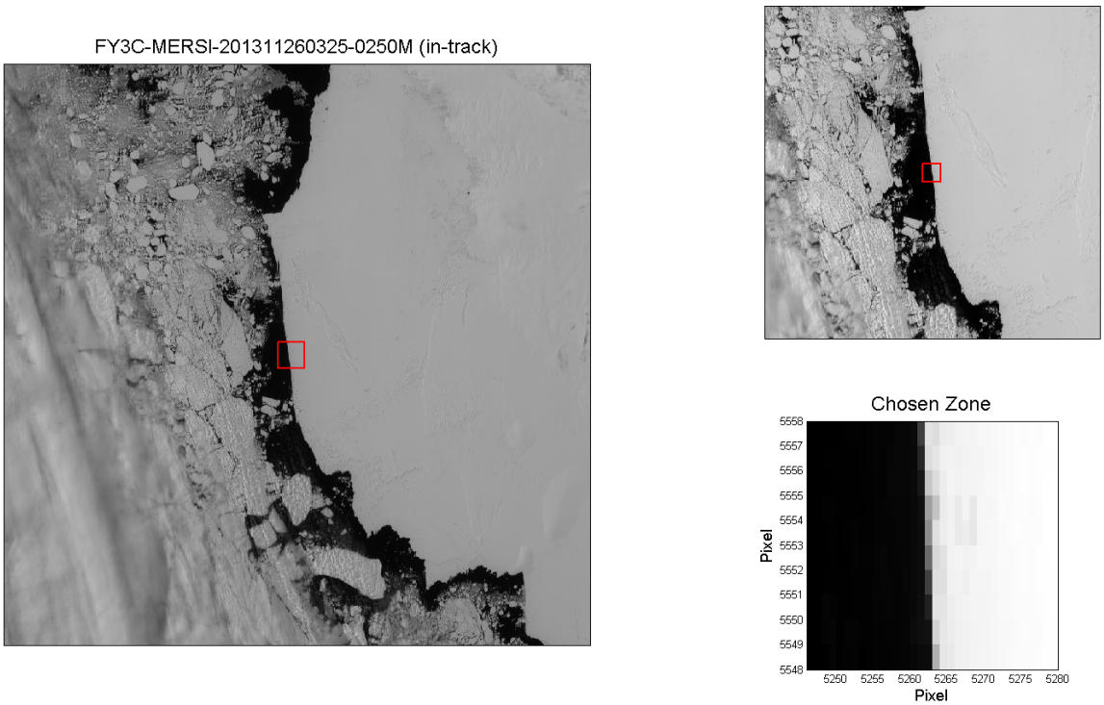
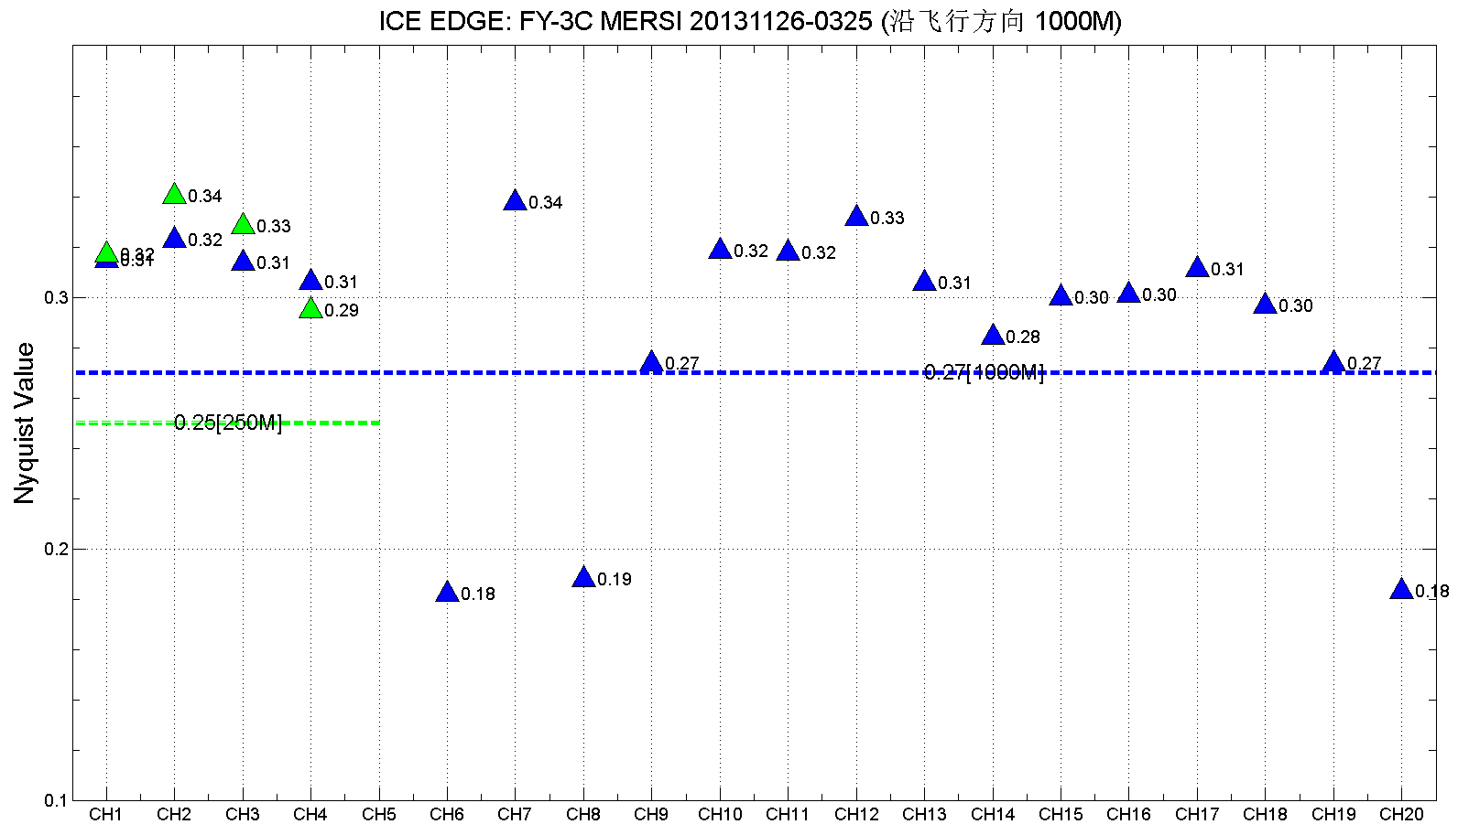
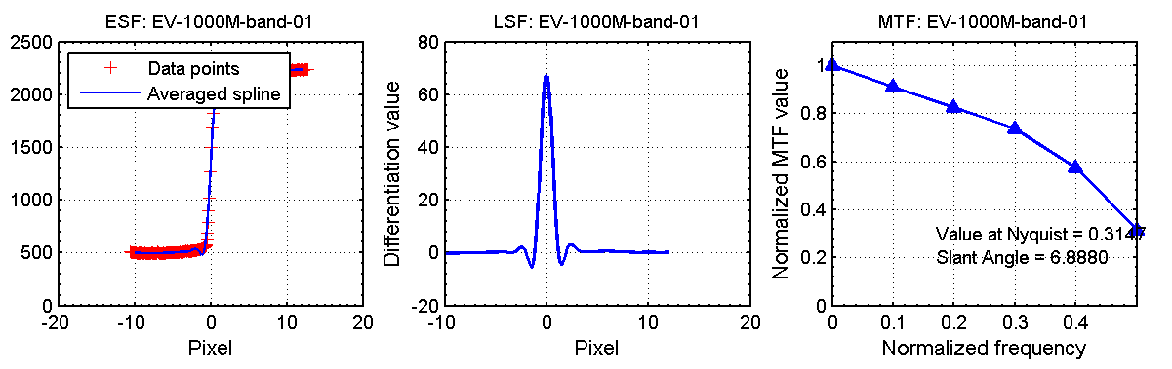
MTF (along track)

Slide 15
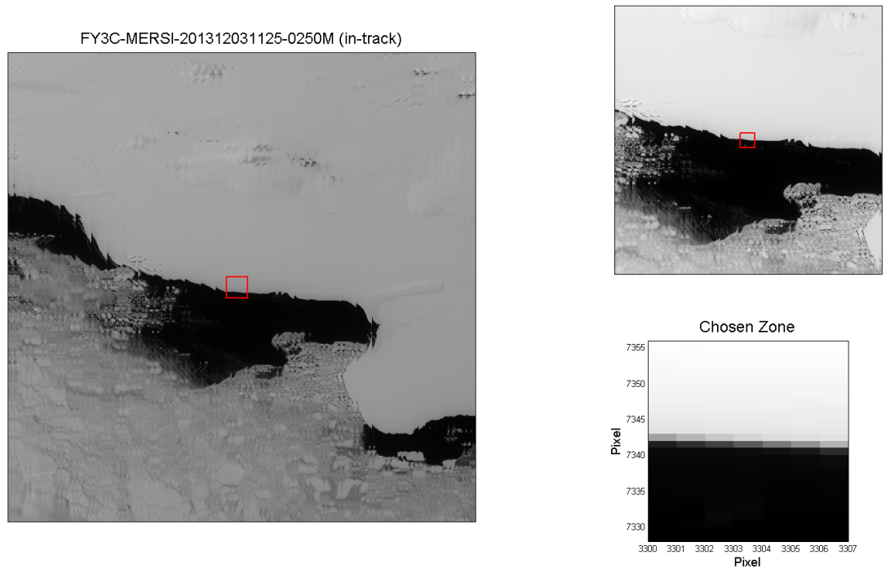
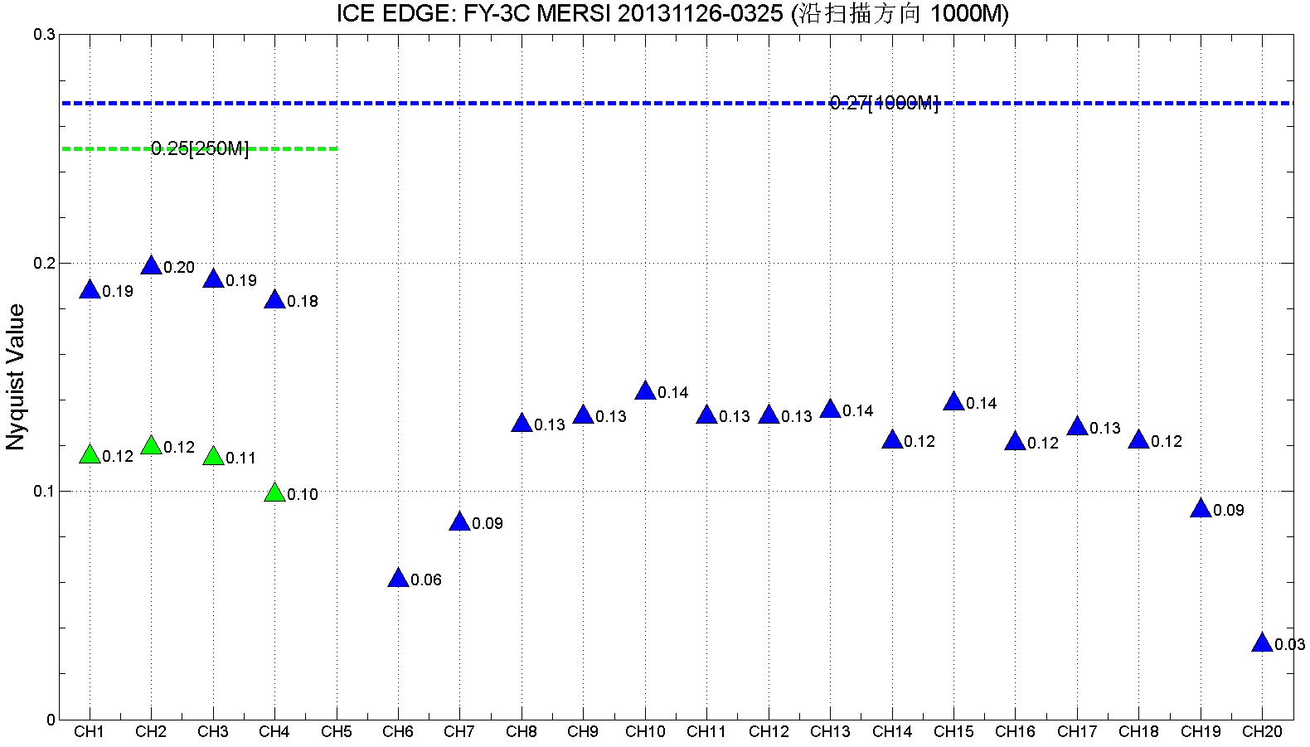
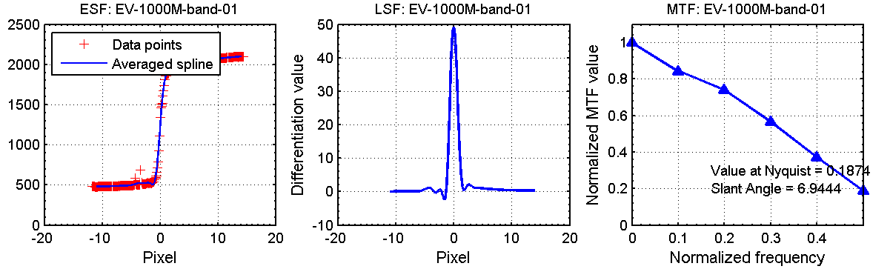
MTF (along scanning)

Slide 16


De-overlap processing
MERSI has 27% overlap along scanning
Image is better after de-overlap processing
20140101 250m MERSI before and after de-overlap in two scenes

Slide 17
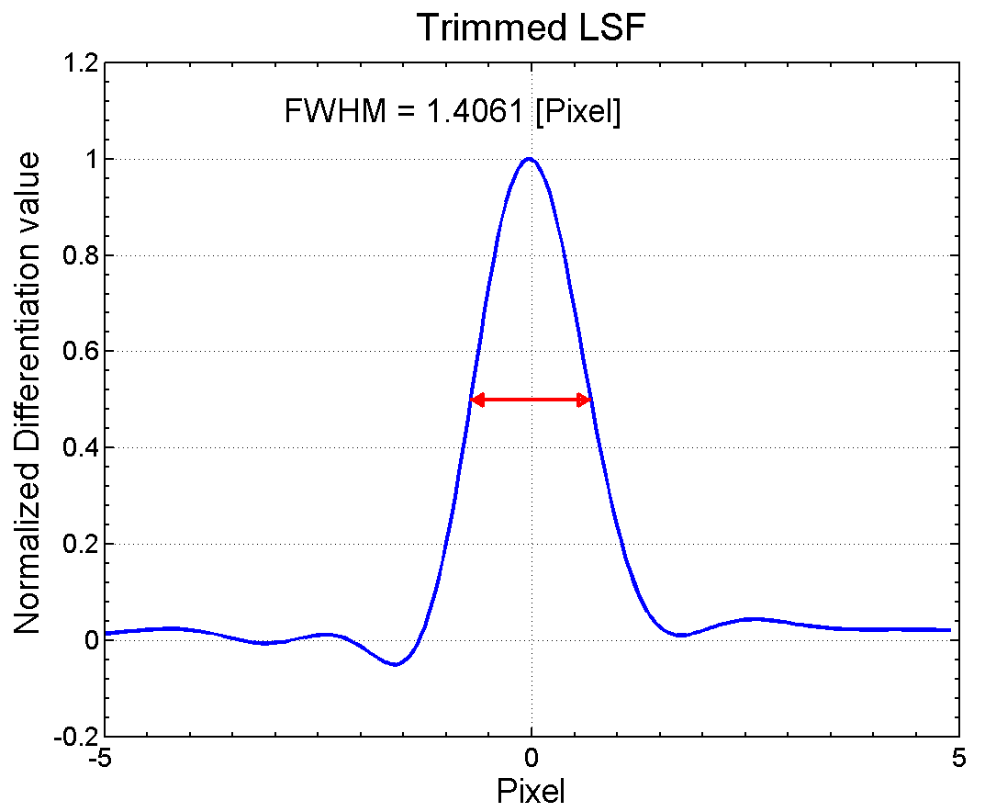
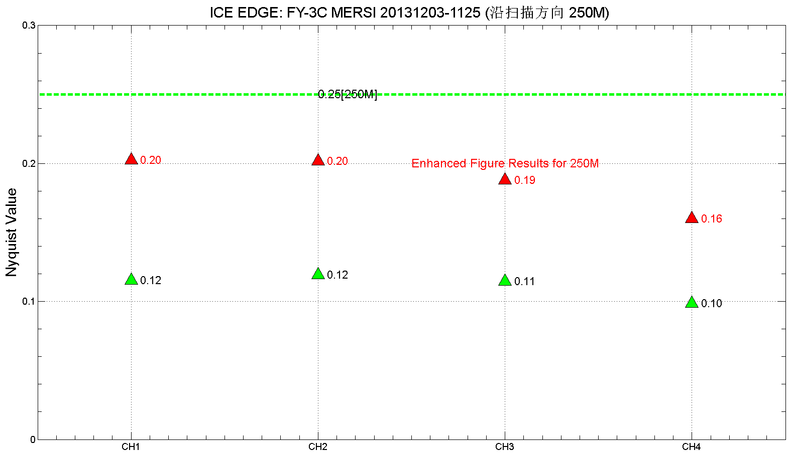
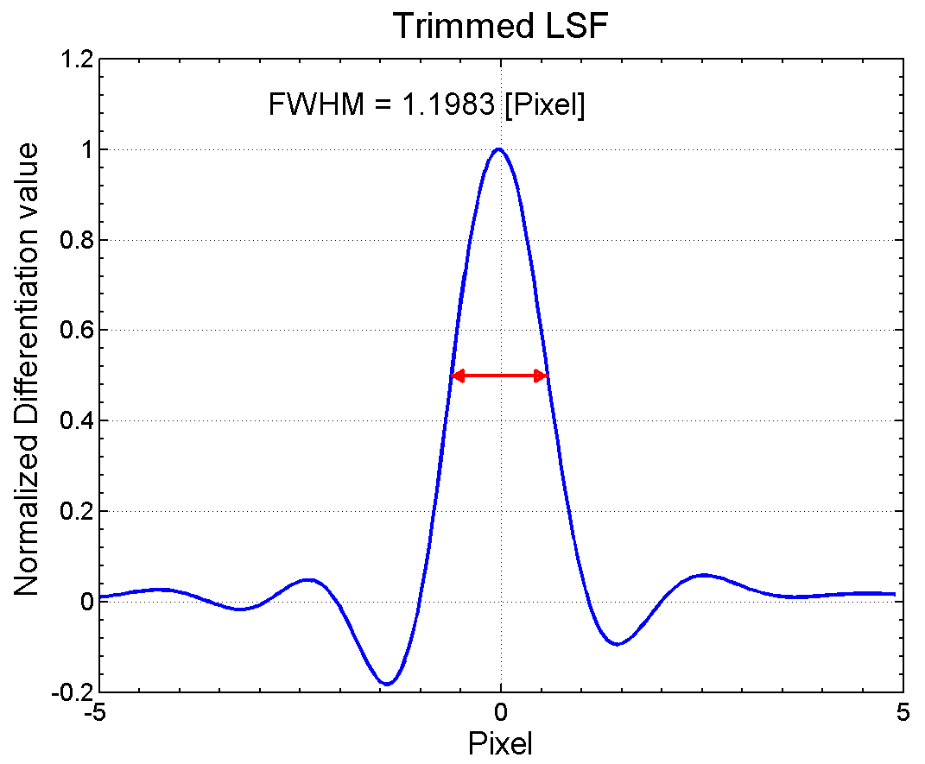
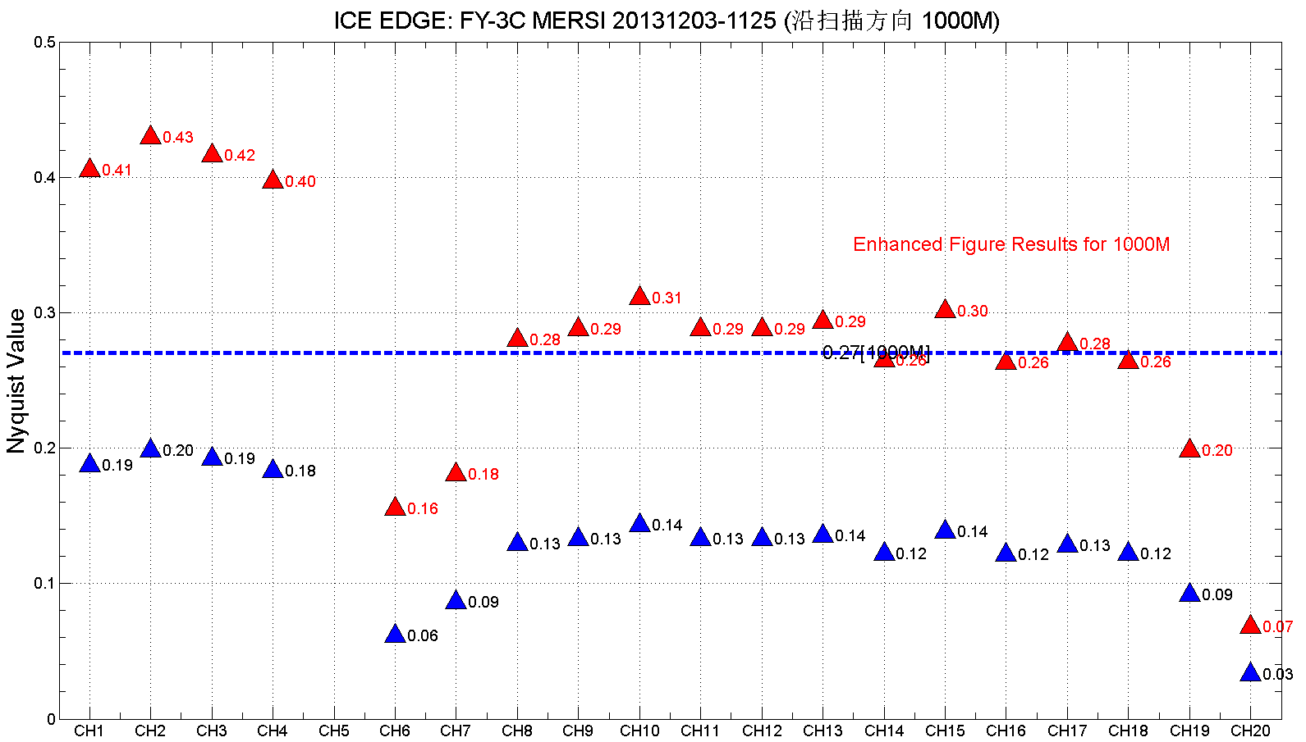
MTF after de-overlap

Slide 18
Calibration verification and evaluation
Onboard calibration
  Visible onboard calibrator√,
  Space view lunar calibration√
Inter-calibration
  SNO: IASI √ CrIS √ /MODIS √ /GOME-2√/VIIRS √
  Cross calibration using PICS Δ
  Itself Inter-comparison within FY-3A/3B/3C Δ
  Comparison between different sensor with same bands Δ
Test Site calibration
  Multi-sites√ 、CRCS（Summer, 2014）
Global Stable sites monitoring
  Desert√ 、snow、DCC √ 、sunglint

Slide 19
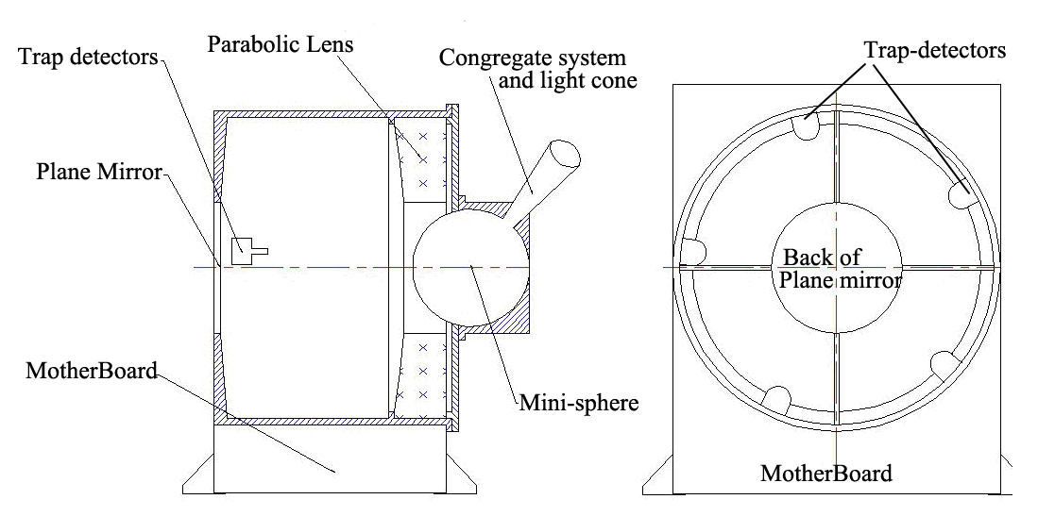
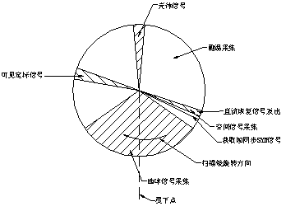
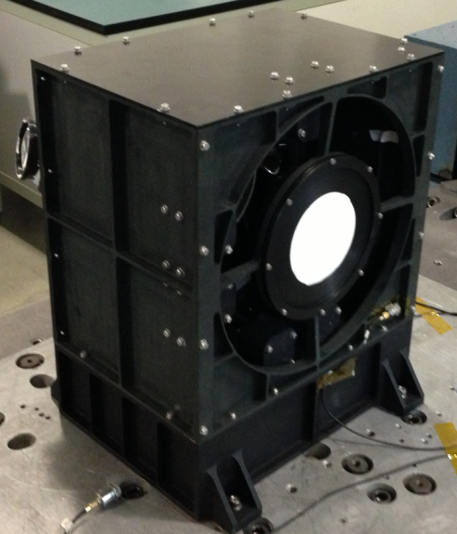
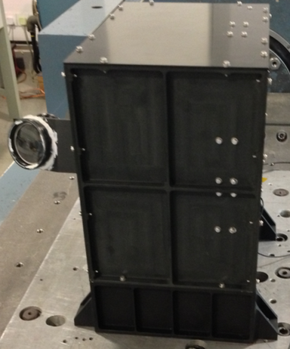
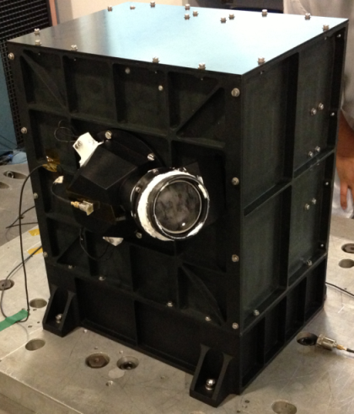
FY-3/MERSI VOC
Solar cone
Two Internal lamps
Mini interaged sphere
扩束准直系统
Trap detector monitoring

Slide 20
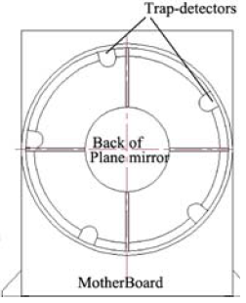
VOC monitoring
First onboard visible calibration prototype device for FY series.
The VOC’s output is a parallel light source from the beam expanding system. Although the radiance can’t be calculated exactly, it is relatively stable and monitored by trap detectors.
When lamps are turned on or the sun enters the light cone, it can be used to monitor the temporal radiometric response changes.
(Hu, X, IEEE, 2012)
Notes:
The VOC is the first onboard visible calibration prototype device for FY series.
Schematic of the VOC. The left is the vertical section sketch map. The MERSI will scan the radiance from parabolic lens. The right is front seeing and also faces to the scanner of MERSI.
It is composed of a 6-cm diameter integrating sphere with two halogen-tungsten interior lamps and a sunlight import cone, an export beam expanding system with a flat mirror and a parabola to create a quasi-Gaussian beam, and absolute radiance trap detectors (4 detectors with the same filter designs as MERSI bands 1 to 4 with central wavelengths at 470 nm, 550 nm, 650 nm and 865 nm, and one panchromatic detector with no filter). The light source from the internal lamps or exterior sunlight (when the satellite passes over the South Pole) are collected and uniformed by the integrating mini-sphere, and then collimated into parallel light by beam expanding system.
VOC is only used for tracking the instrument radiometric degradation for research purposes because of its non-regular operation and inability to be traced.

Slide 21
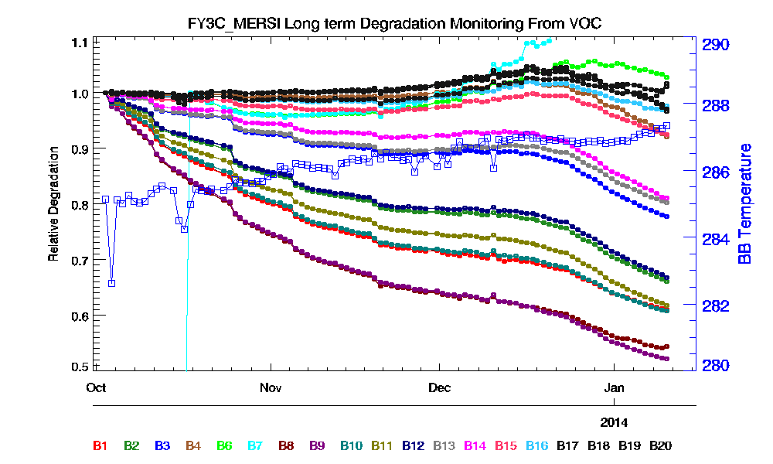
VOC solar signal normalization

Slide 22
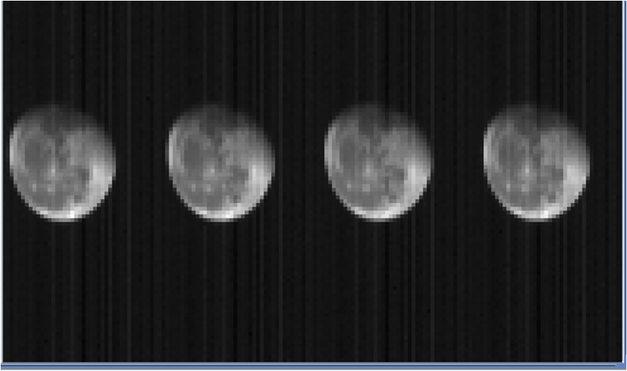
Lunar calibration for MERSI
Moon images in FY-3C/MERS’s space viewing for four times on December 20, 2013

Slide 23
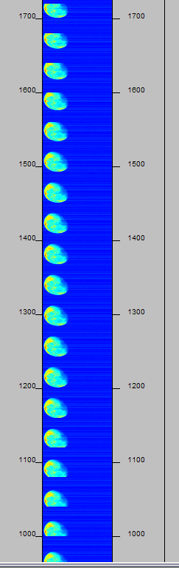

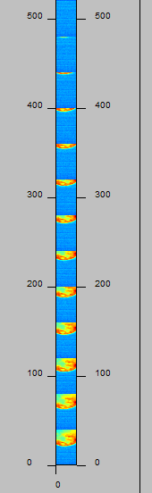

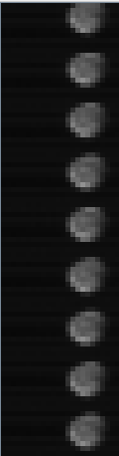


SV lunar Observe
250m SV image
FY3C 20131121 20:05
1km SV image
FY3C 20131023 07:15
FY3B 20131014 07:05

Slide 24
First result of
Lunar calibration
Band | WL/nm | Preflight | 2013-10-23 05:30 | 2013-10-23 07:15 | 2013-11-21 20:05 | 2013-12-21 10:30
1 | 476.22 | 0.0286 | 0.0349 | 0.0343 | 0.03546 | 0.03478
2 | 552.01 | 0.0285 | 0.0357 | 0.0350 | 0.03628 | 0.03559
3 | 650.77 | 0.0288 | 0.0368 | 0.0359 | 0.03725 | 0.03672
4 | 861.39 | 0.0283 | 0.0411 |  | 0.04178 | 0.04127
6 | 1641.25 | 0.0190 | 0.0233 | 0.0233 | 0.02467 | 0.02384
7 | 2129.25 | 0.0185 | 0.0226 | 0.0204 | 0.02296 | 0.0226
8 | 413.29 | 0.0165 |  | 0.0219 | 0.02271 | 0.02274
9 | 443.64 | 0.0206 |  | 0.0266 | 0.0277 | 0.02755
10 | 491.84 | 0.0226 | 0.029 | 0.0276 | 0.02834 | 0.02816
11 | 520.03 | 0.0227 | 0.0298 | 0.0327 | 0.03014 | 0.02983
12 | 564.68 | 0.0223 | 0.0292 |  | 0.02954 | 0.02914
13 | 649.45 | 0.0225 | 0.0317 | 0.0311 | 0.03197 | 0.03174
14 | 684.27 | 0.0234 | 0.0332 | 0.0315 | 0.03231 | 0.03218
15 | 763.79 | 0.0226 | 0.0265 | 0.0288 | 0.0268 | 0.02654
16 | 863.77 | 0.0224 |  | 0.0325 | 0.03333 | 0.03313
17 | 903.24 | 0.0255 | 0.0381 |  | 0.03959 | 0.03942
18 | 939.43 | 0.0327 |  | 0.0373 | 0.03992 | 0.03825
19 | 978.31 | 0.0254 | 0.0454 |  | 0.04617 | 0.04695
20 | 1029.71 | 0.0251 |  | 0.0657 | 0.06904 | 0.06939

Slide 25
Inter-calibration for FY-3C/MERSI
The cross-calibration became the most important approach for the evaluation of FY-3C/MERSI calibration accuracy.
We conducted the calibration evaluation for the solar bands using LEO-LEO SNO data from EOS/MODIS, NPP/VIIRS and Metop-A/GOME-2. It was found that the difference from different calibration methods and need further analysis to provide the calibration coefficient update based on the integration of these methods.
GSICS LEO-LEO IR method was used to MERSI band 5 based on Metop/IASI and NPP/CrIS. Figure 3 shows the bias of MERSI IR band is keeping within 0.5K with respect to CrIS.

Slide 26
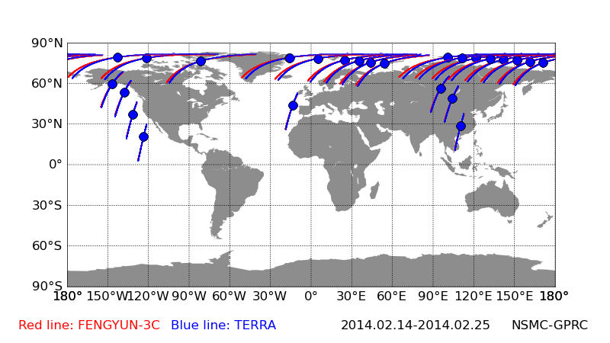
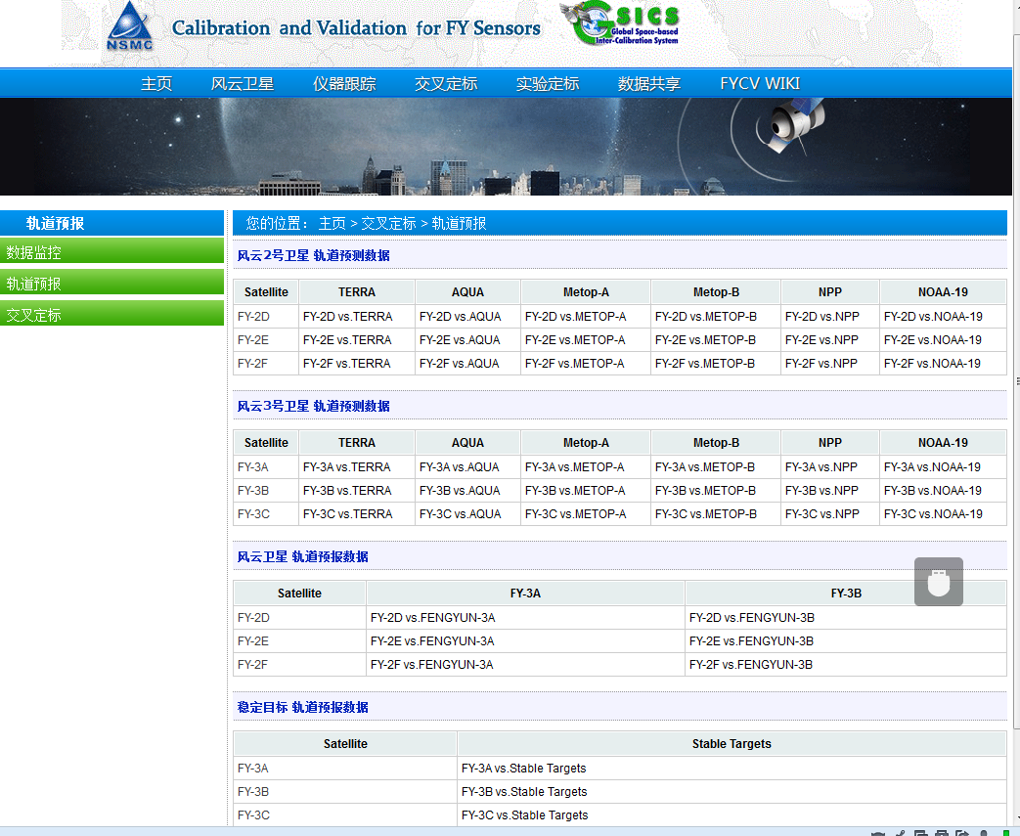
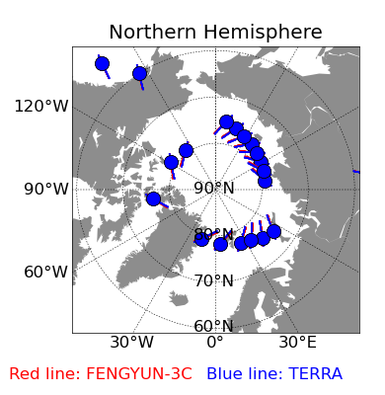
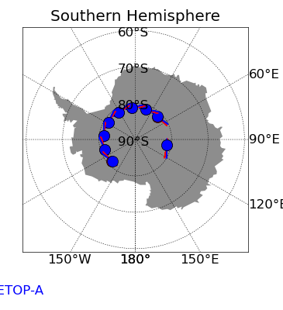
GSICS Public Platform http://gsics.nsmc.cma.gov.cn
(Hu, X, IEEE, 2013)

Slide 27
FY-3C/MERSI/VIRR IR using IASI
FY-3C/MERSI-METOP-A/IASI
Mean Bias
0.57±0.29K
FY-3C/VIRR-METOP-A/IASI
Mean Bias
CH4：-1.01±0.47K
CH5：-0.95±0.38K
(Xu, N, Remote Sensing, 2014)

Slide 28
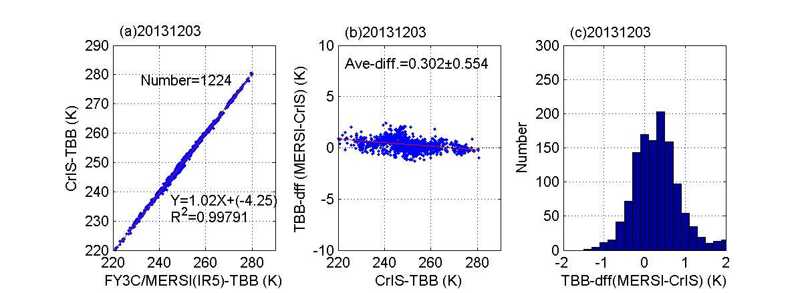
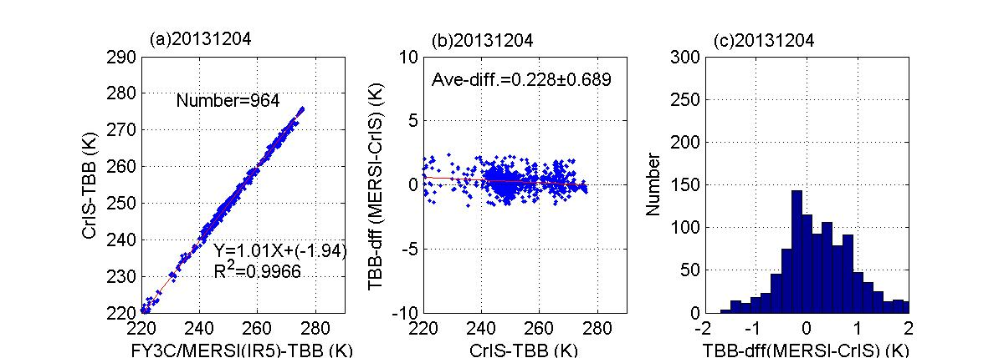
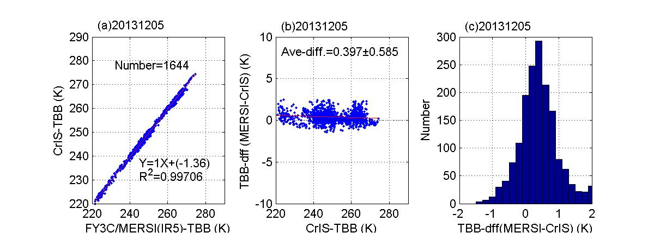
FY-3C/MERSI using CrIS
FY3C/MERSI has good consistency with NPP/CrIS
Bias is less than 0.5 K and higher than CrIS
Bias has no large temperature dependence

Slide 29
MERSI IR Bias Trend: stable
Calibration bias trend and standard deviation of MERSI band 5 using NPP/CrIS during December , 2013 based on the CMA GSICS platform

Slide 30
Xcal using MODIS

Slide 31
MERSI with Terra/MODIS

Slide 32
MERSI with Terra/MODIS

Slide 33
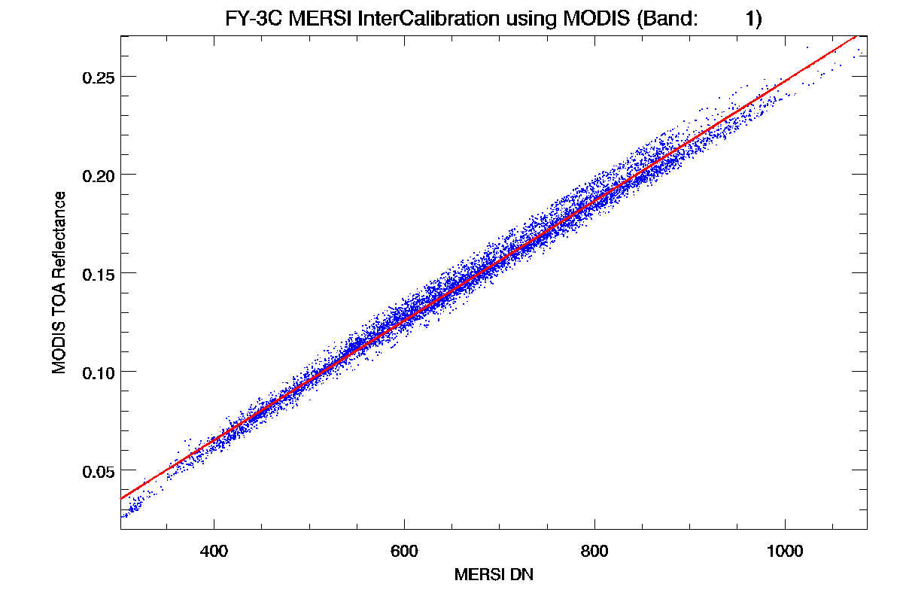
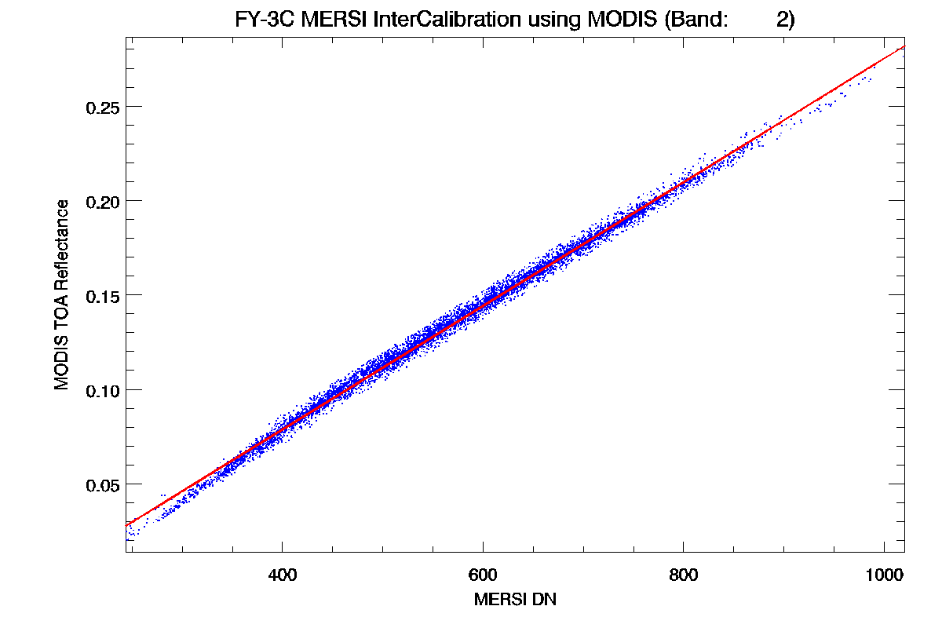
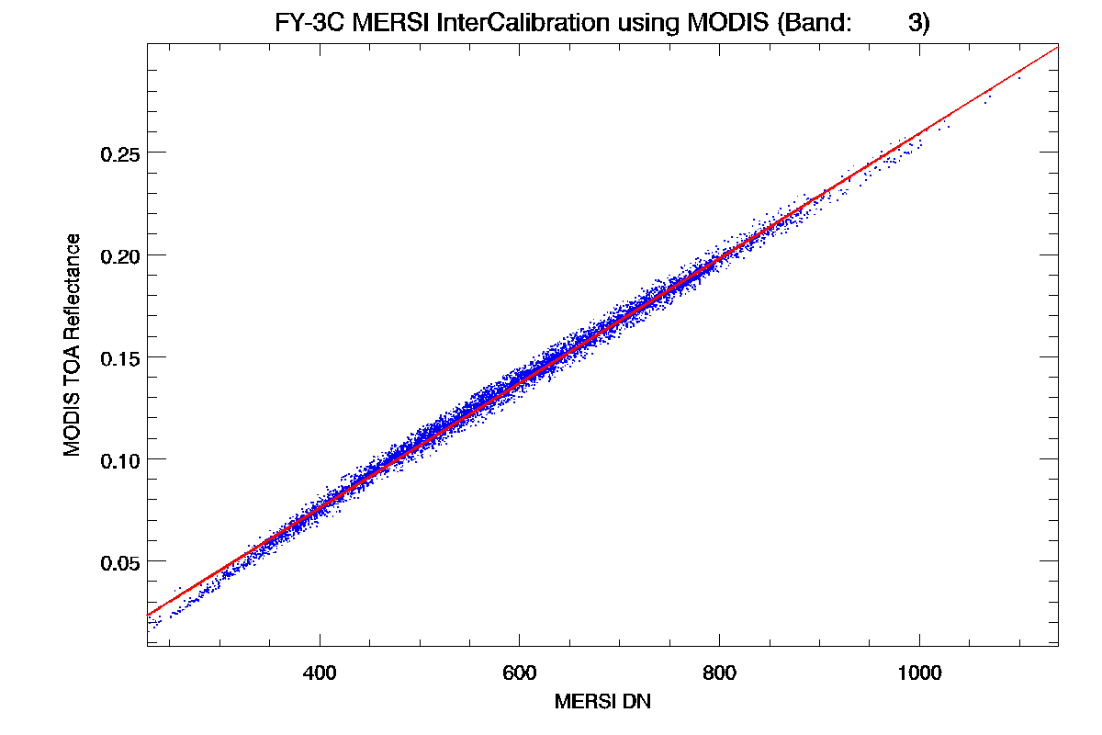
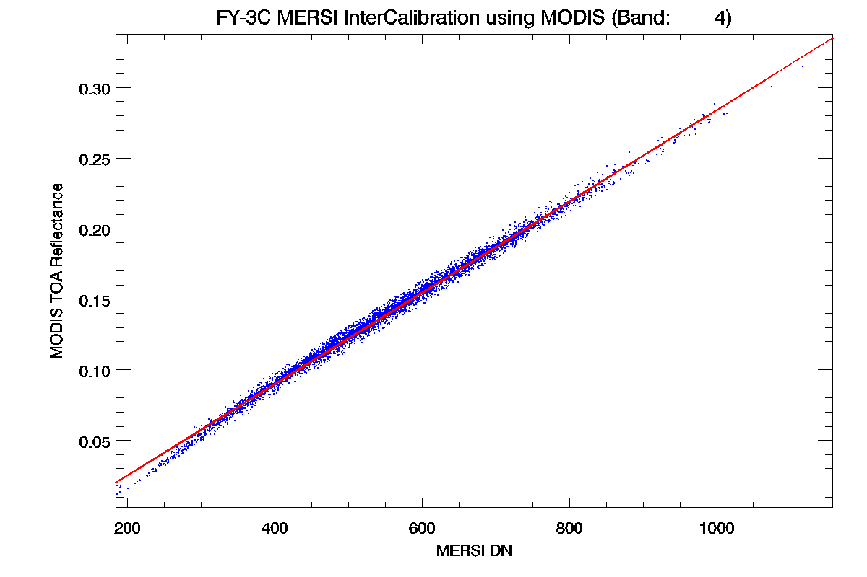
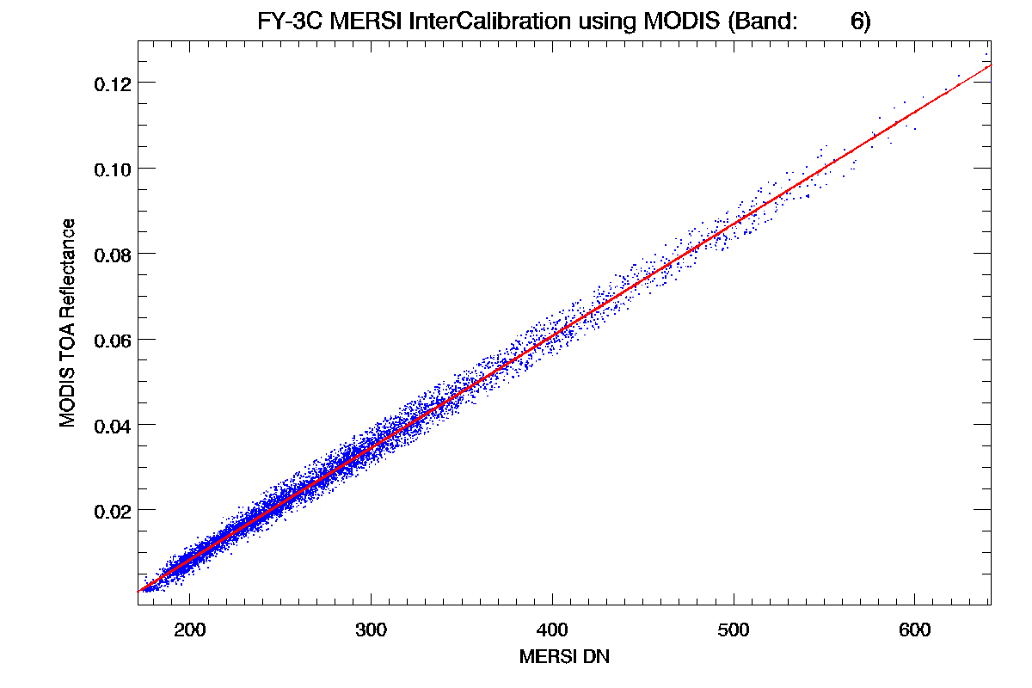
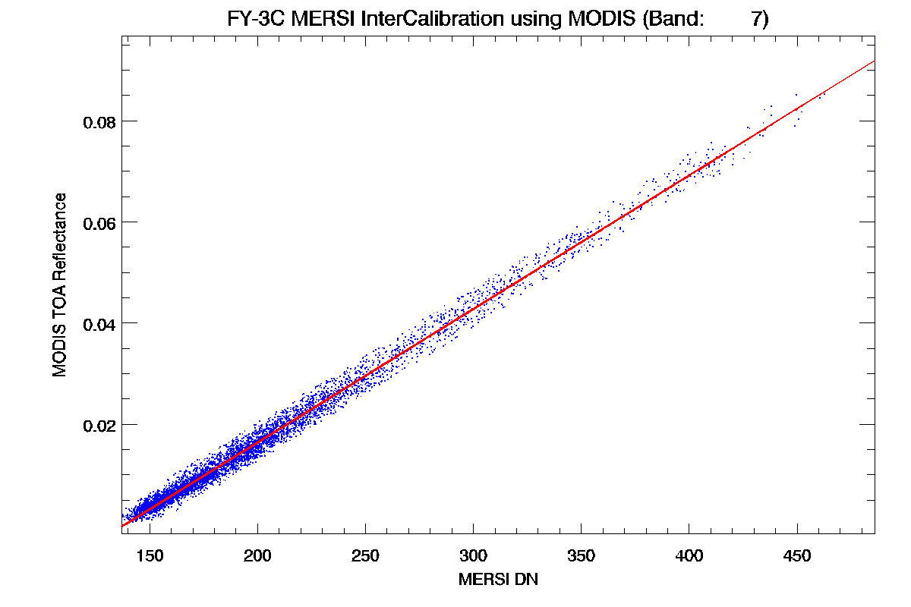
MERSI with Terra/MODIS

Slide 34
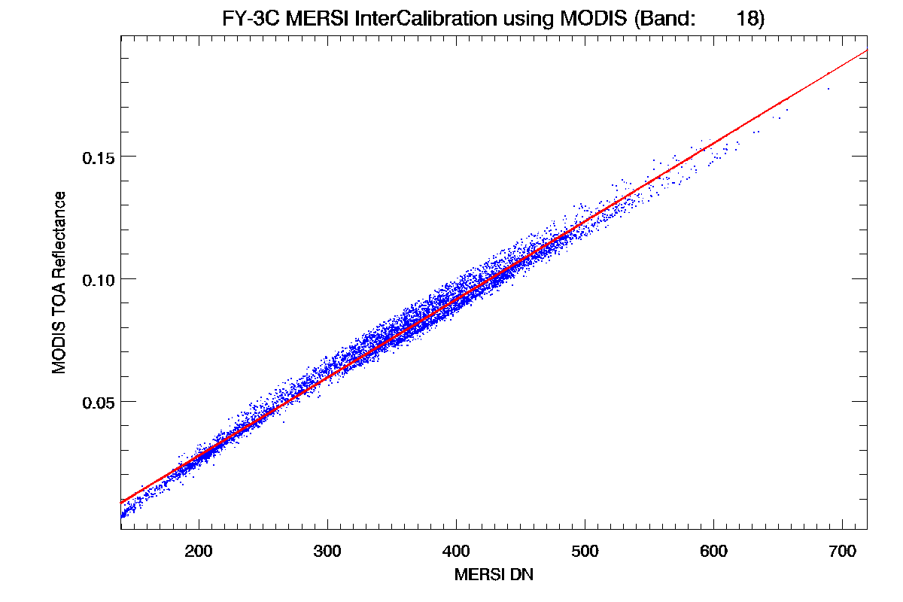
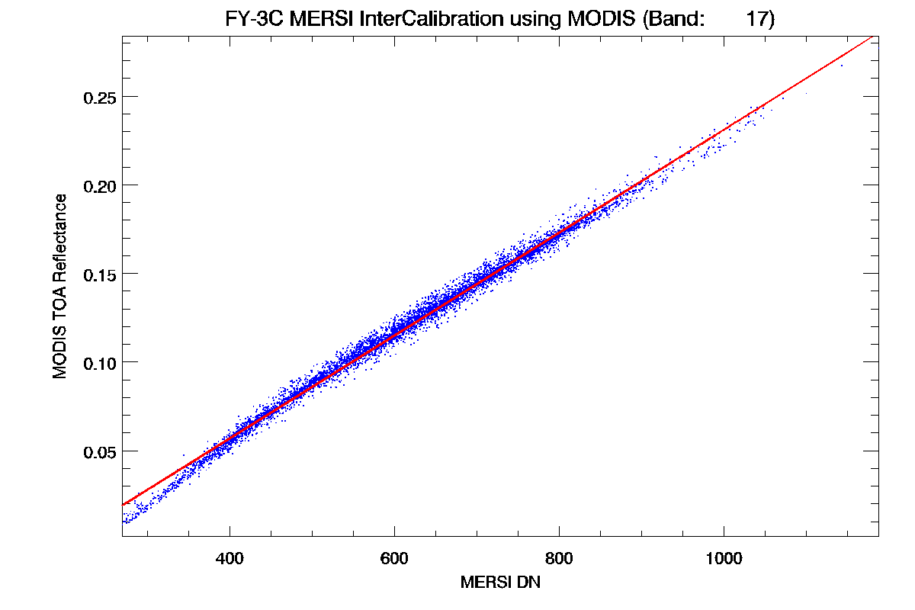
MERSI with Terra/MODIS

Slide 35
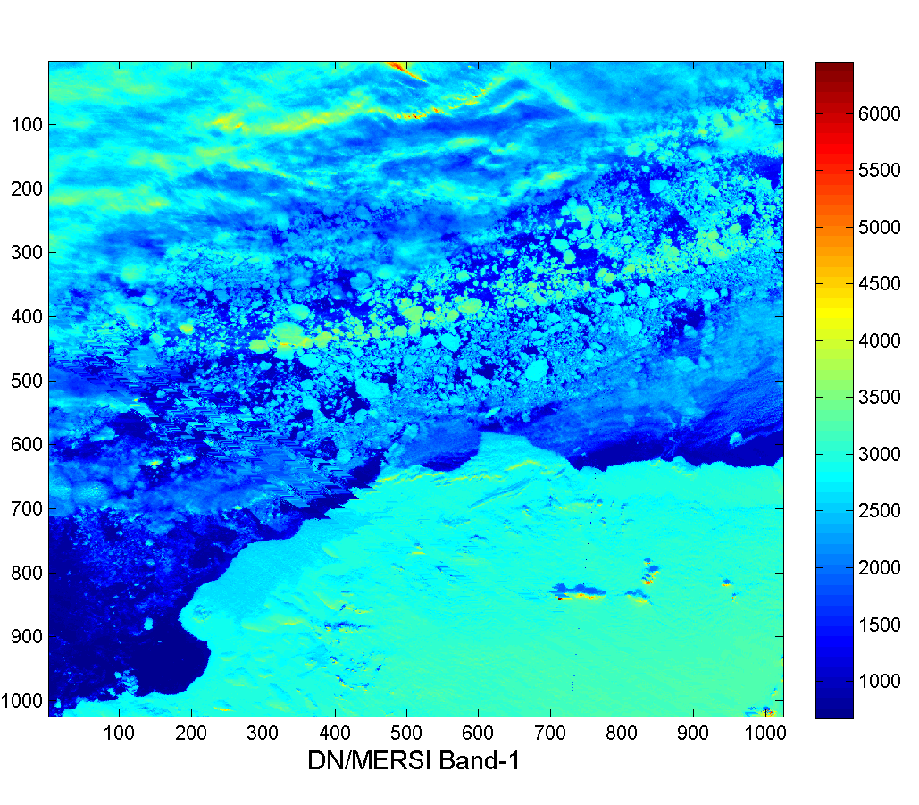
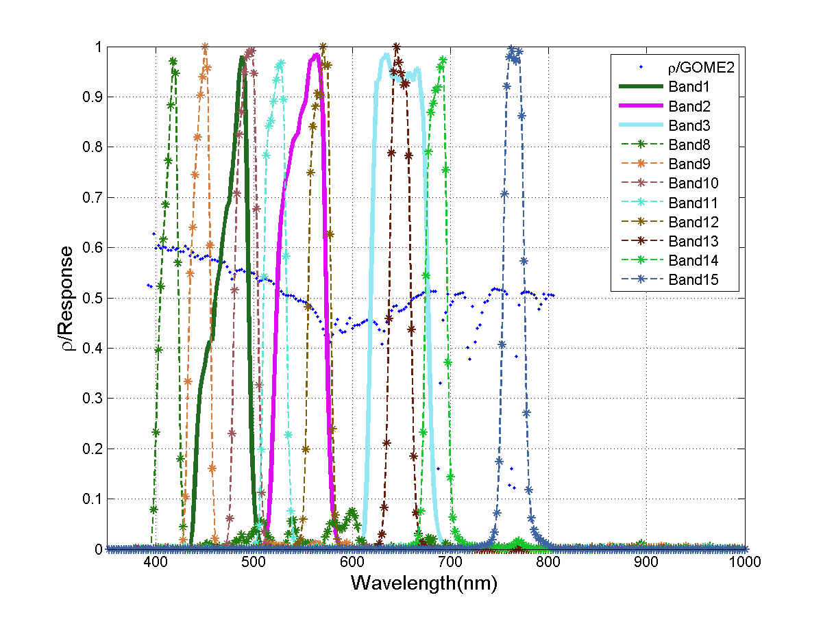
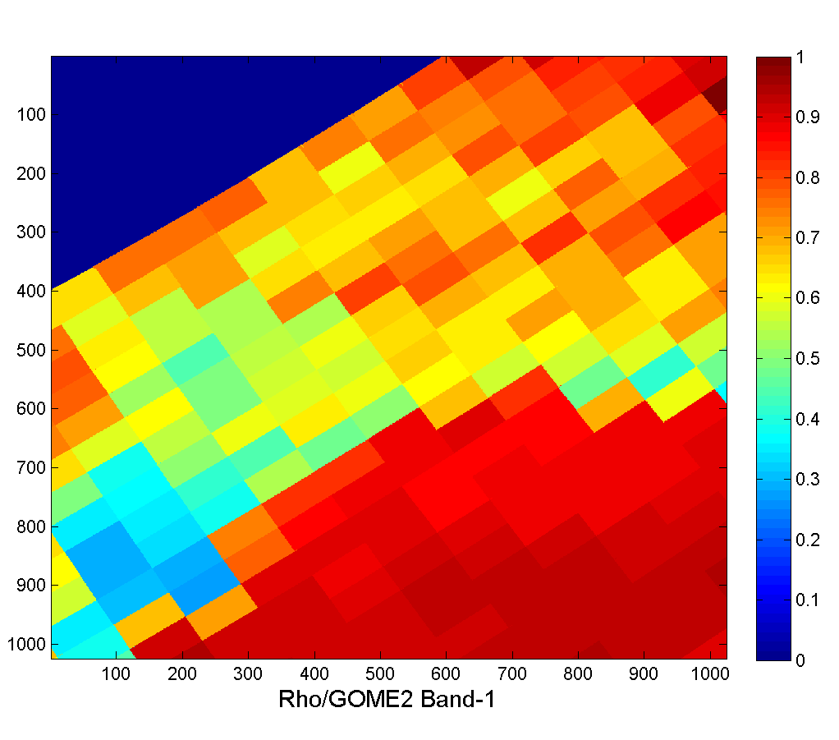
MERSI with GOME-2

Slide 36
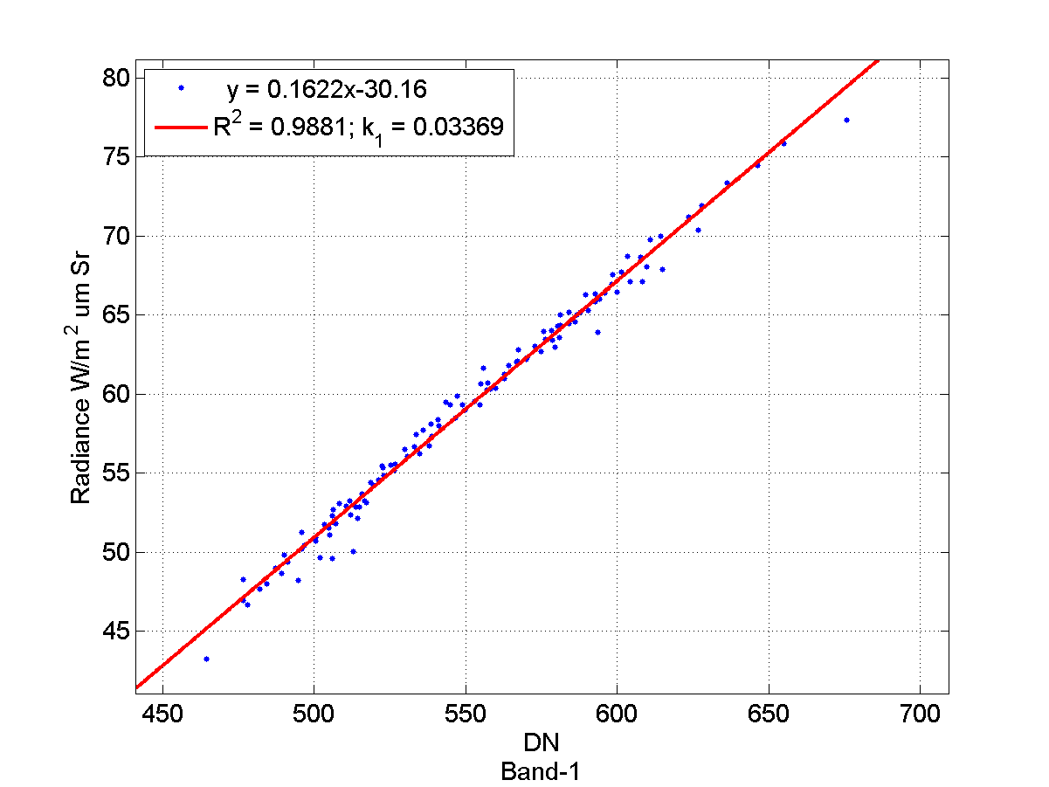





MERSI using Metop-A/GOME-2

Slide 37

MERSI comparison with NPP/VIIRS
band | Wl (um) | width (nm) | VIIRS
1 | 470 | 50 | M3
2 | 550 | 50 | M4
3 | 650 | 50 | I1/M5
4 | 865 | 50 | I2/M7
5 | 11250 | 2500 | I5/M15
6 | 1640 | 50 | M10
7 | 2130 | 50 | M11
8 | 412 | 20 | M1
9 | 443 | 20 | M2
10 | 490 | 20 | M3
11 | 520 | 20 | --
12 | 565 | 20 | M4
13 | 650 | 20 | M5
14 | 685 | 20 | M5
15 | 765 | 20 | M6
16 | 865 | 20 | M7
17 | 905 | 20 | --
18 | 940 | 20 | --
19 | 980 | 20 | --
20 | 1030 | 20 | M8

Slide 38





Multisite calibration tracking
Gobi and desert targets: Dunhuang, Libya1, Libya4 and Arabia2; ocean site: Lanai (MOBY).
TOA radiation calculation similar as CRCS VC, but without in-situ measurements.
Dunhuang (40.138°N, 94.32°E)
Libya1 (24.42°N, 13.35°E)
Libya4 (28.55°N, 23.39°E)
Arab2 (20.13°N, 50.96°E)
Lanai (20.49°N, -157.11°E)
Notes:
Annual CRCS VC is not enough to monitor the radiometric degradation for timely in-flight calibration updates.
Although the CRCS synchronous-measurement-based VC meets the calibration accuracy of approximately 3% for VIS and NIR window bands with respect to Aqua MODIS, the limited frequency of once a year is not enough for timely monitoring of sensor response degradation and stable on-orbit calibration coefficient updating. To increase the post-launch calibration frequency, a multi-site calibration tracking method has been developed to monitor the RSB radiometric response variation and fulfill the operational calibration of MERSI
This method relies on radiative transfer modeling over stable sites without synchronous in-situ measurements. Multiple sites with uniform and stable surface properties have been chosen. Radiative transfer simulated radiation over these stable targets is used as the calibration reference.

Slide 39
Multi-site Cal
(Sun, L, IEEE, 2012)

Slide 40
Degradation rate based on Multi-sites Cal
Band | k1 | k0 | 2σ/Mean(%) | Annual DegradationRate(%)
1 | 2.45E-06 | 3.71E-02 | 3.09 | 2.37
2 | -1.33E-06 | 3.86E-02 | 1.69 | -1.22
3 | -4.19E-06 | 3.49E-02 | 2.16 | -4.35
4 | -3.30E-06 | 3.46E-02 | 2.88 | -3.50
6 | 1.48E-06 | 2.53E-02 | 2.31 | 2.17
7 | 1.02E-07 | 2.56E-02 | 3.37 | -0.11
8 | 4.24E-06 | 2.17E-02 | 8.07 | 6.27
9 | 4.12E-06 | 2.73E-02 | 4.86 | 5.31
10 | 6.01E-06 | 3.02E-02 | 2.51 | 7.12
11 | 5.21E-06 | 3.12E-02 | 2.64 | 6.03
12 | 4.60E-07 | 3.03E-02 | 2.13 | 0.68
13 | -3.96E-06 | 2.86E-02 | 2.59 | -5.05
14 | -1.46E-06 | 3.00E-02 | 3.03 | -1.62
15 | 5.70E-06 | 2.83E-02 | 2.94 | 7.41
16 | 2.12E-06 | 2.79E-02 | 2.94 | 2.93
17 | -2.99E-05 | 3.36E-02 | 6.92 | -38.38
18 | -1.27E-04 | 4.42E-02 | 18.94 | -174.00
19 | -3.79E-05 | 3.71E-02 | 7.07 | -45.00
20 | 1.10E-05 | 3.45E-02 | 1.38 | 0.52

Slide 41
Cal results using several methods
Cal Method | Preflight | Lunar | Multi-sites |  |  | Xcal using MODIS
date |  | 2013/12/21 | 2013/10/5 | 2013/12/15 | 2013/12/20 | 2013/12/23 | 2013/12/28
1 | 2.86E-02 | 3.48E-02 | 3.49E-02 | 3.65E-02 | 2.95E-02 | 2.96E-02 | 2.97E-02
2 | 2.85E-02 | 3.56E-02 | 3.64E-02 | 3.83E-02 | 3.23E-02 | 3.22E-02 | 3.21E-02
3 | 2.88E-02 | 3.67E-02 | 3.33E-02 | 3.50E-02 | 3.04E-02 | 3.01E-02 | 3.02E-02
4 | 2.83E-02 | 4.13E-02 | 3.35E-02 | 3.50E-02 | 3.14E-02 | 3.14E-02 | 3.17E-02
6 | 1.90E-02 | 2.38E-02 | 2.29E-02 | 2.54E-02 | 2.55E-02 | 2.64E-02 | 2.62E-02
7 | 1.85E-02 | 2.26E-02 | 2.35E-02 | 2.60E-02 | 0.00E+00 | 0.00E+00 | 0.00E+00
8 | 1.65E-02 | 2.27E-02 | 1.82E-02 | 2.07E-02 | 1.83E-02 | 1.72E-02 | 1.71E-02
9 | 2.06E-02 | 2.76E-02 | 2.50E-02 | 2.66E-02 | 2.21E-02 | 2.16E-02 | 2.15E-02
10 | 2.26E-02 | 2.82E-02 | 2.86E-02 | 3.00E-02 | 2.46E-02 | 2.42E-02 | 2.41E-02
11 | 2.27E-02 | 2.98E-02 | 2.94E-02 | 3.09E-02 | 2.63E-02 | 2.58E-02 | 2.59E-02
12 | 2.23E-02 | 2.91E-02 | 2.86E-02 | 3.03E-02 | 3.15E-02 | 3.12E-02 | 2.97E-02
13 | 2.25E-02 | 3.17E-02 | 2.75E-02 | 2.87E-02 | 3.38E-02 | 0.00E+00 | 0.00E+00
14 | 2.34E-02 | 3.22E-02 | 2.81E-02 | 3.02E-02 | 3.83E-02 | 0.00E+00 | 0.00E+00
15 | 2.26E-02 | 2.65E-02 | 2.69E-02 | 2.88E-02 | 4.05E-02 | 0.00E+00 | 0.00E+00
16 | 2.24E-02 | 3.31E-02 | 2.67E-02 | 2.83E-02 | 3.83E-02 | 0.00E+00 | 0.00E+00
17 | 2.55E-02 | 3.94E-02 | 3.36E-02 | 3.38E-02 | 2.63E-02 | 2.76E-02 | 2.77E-02
18 | 3.27E-02 | 3.83E-02 | 4.63E-02 | 4.38E-02 | 2.97E-02 | 3.15E-02 | 3.08E-02
19 | 2.54E-02 | 4.70E-02 | 3.76E-02 | 3.74E-02
20 | 2.51E-02 | 6.94E-02 | 3.43E-02 | 3.60E-02
We are finding the reason of this kind of large difference from the results of different methods. Maybe the large no-linearity lead to the different results because they worked in different dynamic range in different method.

Slide 42
Instrument Stability monitoring
The instrument performance monitoring (IPM) system for FY-3C/MERSI is also being developed using the telemetry and engineering data of the instrument
Radiometric stability is monitored by the earth viewing data of global PICS (deserts, salt lakes, snow and DCC). The current most information show the relatively stable status of the instrument operational running and there is no obvious degradation of FY-3C MERSI instrument radiometric response.
The long term stability monitoring using 4 deserts of Pseudo Invariant Calibration Sites (PICS) during the first three months from Oct. to Dec, 2013. The results indicate that FY-3C/MERSI is more stable than the previous instruments.

Slide 43
MERSI Instrument Performance Monitoring using OBC files
Parameter | Description | Dimension | Usage
MERSI_imagery | MERSI Quick View imagery of the global Earth View | RGB(3,2,1) | Check EV data integrity and quality
Earth Invariant Targets | Invariant targets EV data of all MERSI bands, DCC | 20 bands, 4 GeoAngles and LatLon | Ev monitoring using Desert, snow
Telemetry temperatures | BB, RTA, cavity, HAM, FPA, cooler, Mainframe, Circuit Card Assembly | 21 temps | Instrument Healthy status
Health and Status Telemetry | Motor current, DC store current, |  | Instrument operation status
VOC_Counts | MERSI observation DN of Solar diffuser for band I1~I3, M1~M11, DNB over band average | 19 bands | Degradation trending
VOC NEdDN | Noise NEdN for VOC signal of solar bands | 19 bands | SNR trending
VOC_Counts by detectors | MERSI observation DN of Solar diffuser I1~I3, M1~M11, DNB over detector average | 19bands *40(10)det | degradation for Detector uniform
VOCSM signal | VOCSM signal of VOC and Sun in every orbit | 8 bands | VOC trending
SV_Counts | MERSI observation Space view DN for 20 bands | 20bands | Background signal trending
SV NEdDN | Dark Noise NEdN for Space view signal | 20bands | Dark noise signal
BB_Counts | MERSI observation Blackbody DN for 20 bands | 20 bands | IR gain derivation
BB NEdDN | Noise NEdN for black body signal | 20bands | IR bands noise
F factors and H factors | Degradation of Solar bands based on VOC signal and VOCSM, solar incident angles to VOC and VOCSM | 19 bands | Solar bands degradation
SNR | Signal to noise ratio for 19 solar bands | 19 VIS bands | solar bands noise
NEDT | Noise equivalent temperature for 7 IR bands I4, I5, M12-M16 | IR bands | IR bands noise
IR Calibration Gain | Calibration gains for IR bands M4, M5, M12-M16 | IR bands | IR calibration trending
Lunar Calibration | Lunar observation data collection and Analysis | 19 bands | Solar bands degradation

Slide 44


Instrument status is stable

Slide 45








Global Stable Site monitoring
Libya1
Libya4
Arabia2
Uyuni_salt
Algeria3
Algeria5
Sonora

Slide 46
TOA reflectance trend:
No apparent degradation
FY-3C/MERSI Long term stability monitoring using 4 deserts of PICS during the first three months from Oct. to Dec, 2013

Slide 47
Conclusion
FY-3C/MERSI overcame the several problems existed in FY-3A and FY-3B and is better than the previous.
It has significant improvement in some performances as following：
  Better SNR
  Better consistency of the SRF in different detectors within IR band
  Provide the possibility SV lunar calibration .
  Better Radiometric response stability of solar bands(λ<500nm).
These good performances are important for its long term operation and quantitative application.

Slide 48
The End
Thanks for your attention

