Slide 1
Ocean Colour Instrument Calibration
RSP
Ewa J. Kwiatkowska

Slide 2
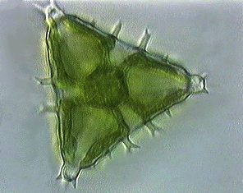
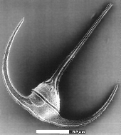

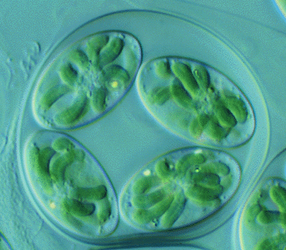

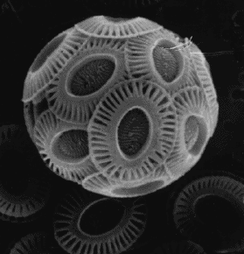

What is ocean colour?
Ocean colour
monitoring of oceanic, coastal and inland waters in the visible range of the spectrum
Primary products
water-leaving radiance or reflectance
concentrations of water constituents: marine phytoplankton (chlorophyll pigment), sediments, coloured dissolved matter, water transparency
Climate and seasonal forecasting
coupled ocean-atmosphere physical-biogeochemical models
air-sea CO₂ exchange – carbon flux, phytoplankton produce half of the oxygen we breath
air-sea heat exchange – phytoplankton absorption of light and water optical turbidity
Coastal and marine environment
good environmental status of marine environment (EC Marine Strategy Framework Directive)
water quality
harmful algal blooms, natural disasters, human activities
Marine resources management and forecasting
good ecological and chemical status (EC Water Framework Directive)
fisheries, aquaculture
water resources

Slide 3
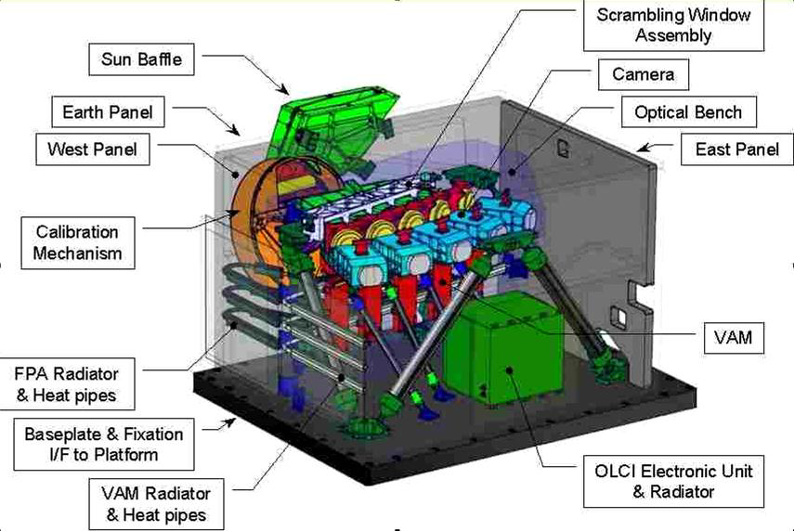

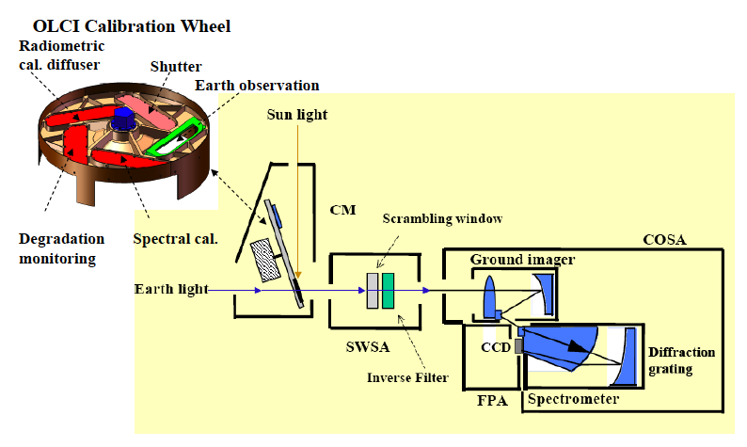
Sentinel-3 OLCI
OLCI configuration
OLCI - programmable imaging spectrometer
5 Camera Optical Sub Assemblies (COSA)
5 Focal Plane Assemblies (FPA)
5 Video Acquisition Modules (VAM)
1 Scrambling Window Assembly
1 Calibration Assembly allowing radiometric and spectral calibrations
1 OLCI Electronic Unit (OEU) managing all the instrument functions
 | OLCI bands | λ center | λ width
1 | aerosol, in-water properties | 400 | 15
2 | yellow substance, detritus | 412.5 | 10
3 | chlorophyll absorption max | 442.5 | 10
4 | chlorophyll and other pigments | 490 | 10
5 | suspended sediments, red tide | 510 | 10
6 | chlorophyll absorption min | 560 | 10
7 | suspended sediments | 620 | 10
8 | chlorophyll absorption and fluorescence | 665 | 10
9 | fluorescence | 673.75 | 7.5
10 | chlorophyll fluorescence peak | 681.25 | 7.5
11 | chlorophyll fluorescence ref, atmospheric correction | 708.75 | 10
12 | vegetation, clouds | 753.75 | 7.5
13 | O₂ R-branch absorption | 761.25 | 2.5
14 | atmospheric parameters, O₂A cloud top pressure | 764.375 | 3.75
15 | cloud top pressure | 767.5 | 2.5
16 | O₂ P-branch absorption | 778.75 | 15
17 | atmospheric correction | 865 | 20
18 | vegetation, water vapour reference | 885 | 10
19 | water vapour, land | 900 | 10
20 | atmospheric correction, H₂O absorption | 940 | 20
21 | atmospheric correction, aerosols | 1020 | 40
5 cameras
~68.5° FoV
across-
track-tilt
OLCI optical layout

Slide 4
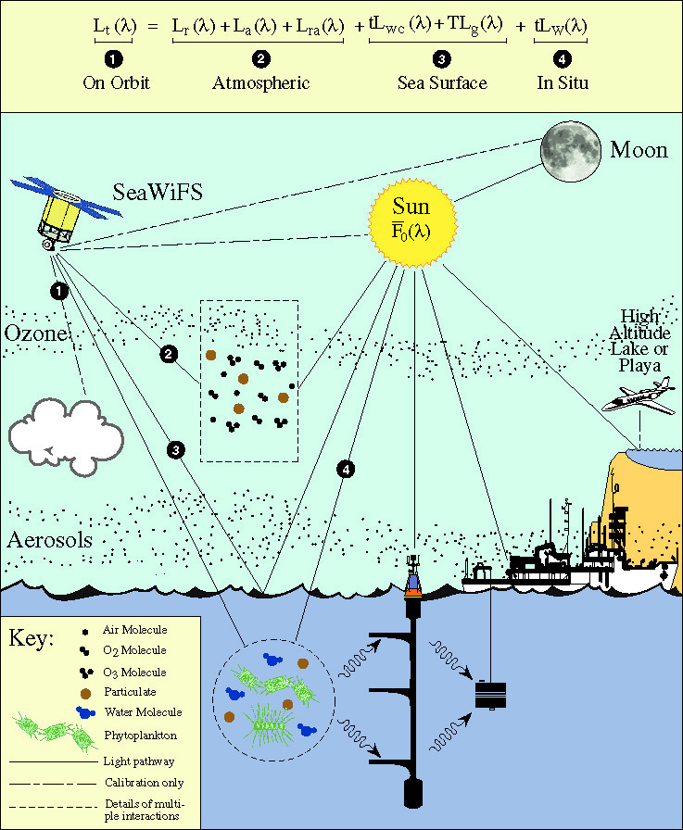
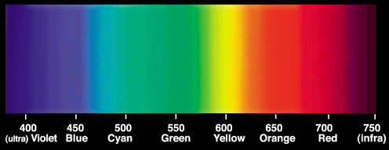
(
) ∙ t_{g}
Ocean colour observation conditions
satellite observes both oceans and the atmosphere
atmosphere must be accurately modeled and removed
  absorption from gases, O₃, H₂O, O₂, NO₂, CO₂
  scattering from air molecules
  scattering and absorption from aerosols
OC Sensor
unknown: L_{a} and L_{w}
L_{t} – total top-of-the-atmosphere (TOA) radiance
L_{r} – radiance from molecular (Rayleigh) scattering, tabulated for sensor wavelengths, geometries, dependent on pressure, wind speed
L_{a} – radiance originated from aerosol scattering
L_{ra} – interaction of molecular and aerosol scattering
L_{wc} – white cap radiance at the surface, approximated using wind speed
L_{g} – sunglint radiance, estimated using wind-ruffled sea surface model
L_{w} – water-leaving radiance
transmittances:
t – atmospheric diffuse transmittance, tabulated for aerosol models
T – direct transmittance of the atmosphere
    t_{g} – gaseous t., estimated using gas concentrations and absorption spectra

Slide 5
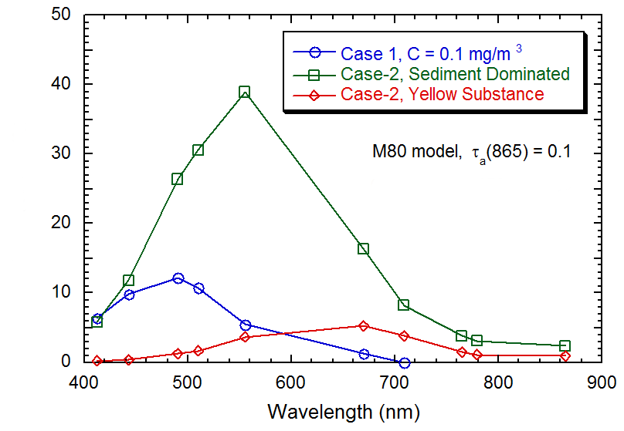
Ocean colour signal magnitude
50%
Case 1 – open ocean waters dominated by phytoplankton and their byproducts,
great majority of the global ocean
40%
30%
Percentage of L_{w}(λ) in L_{t}(λ)
20%
10%
0%
atmosphere contributes approximately 90% of the measured signal
1% error in instrument calibration
10% error in water-leaving radiances, L_{w}

Slide 6
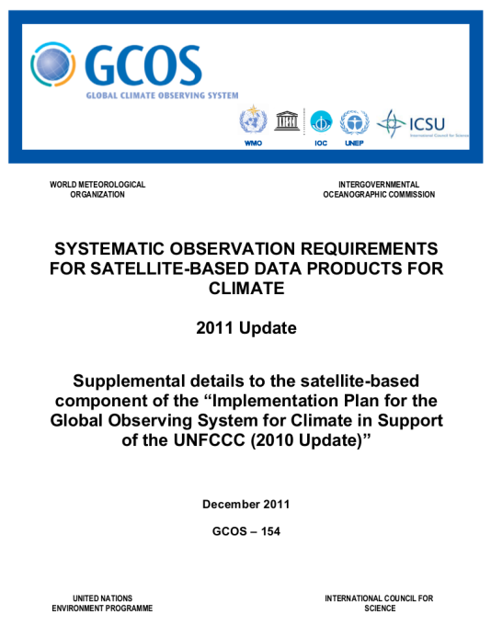
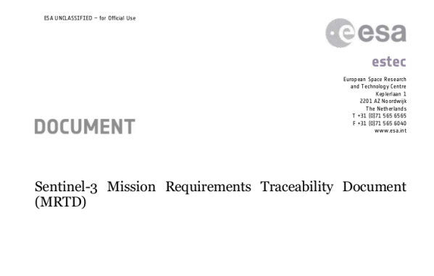
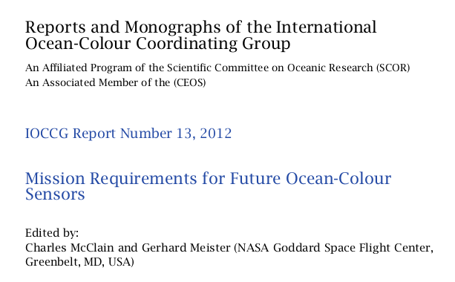
Ocean colour accuracy requirements
Measurement requirements
water-leaving radiances, L_{w}
5% absolute uncertainty in blue/green (all docs)
0.5% stability per decade (GCOS)
chlorophyll concentration, C_{a}
30% absolute uncertainty (in case 1)
3% stability over a decade (GCOS)
uncertainties are present in processing algorithms, including atmospheric correction
to meet the measurement requirements, L_{t} need to have uncertainties better than 0.5%
characterization of components (straylight, polarization, diffuser BRDF, detectors...) about 0.2%

Slide 7
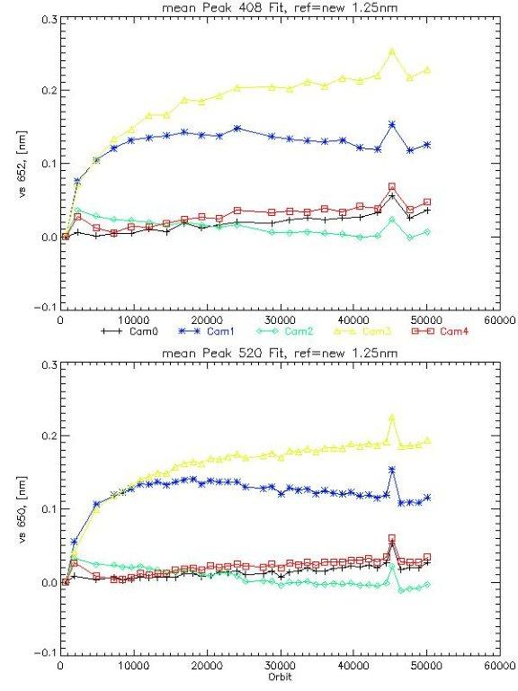
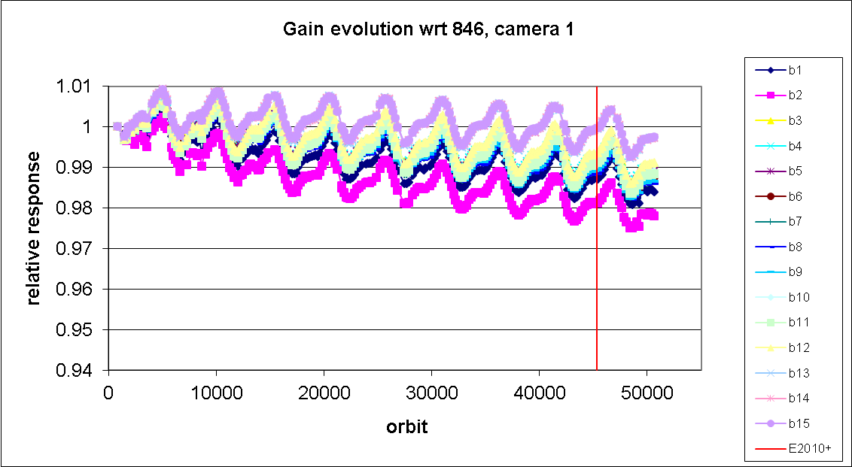
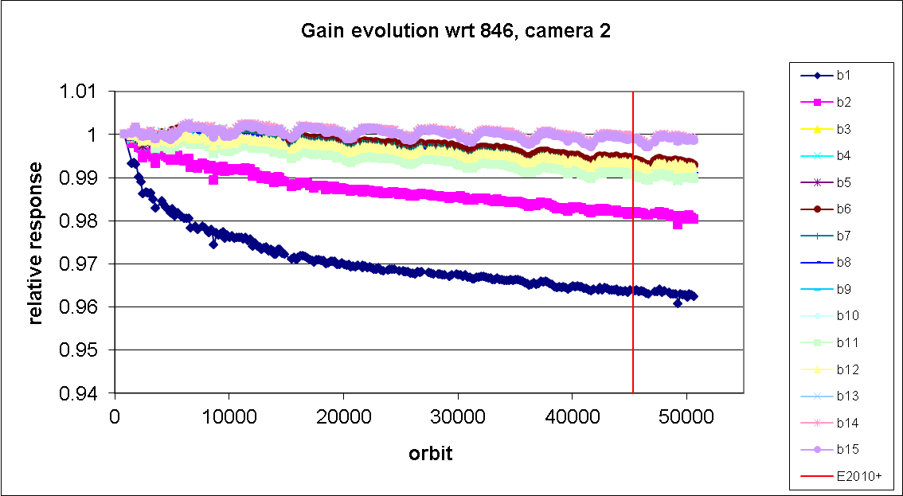
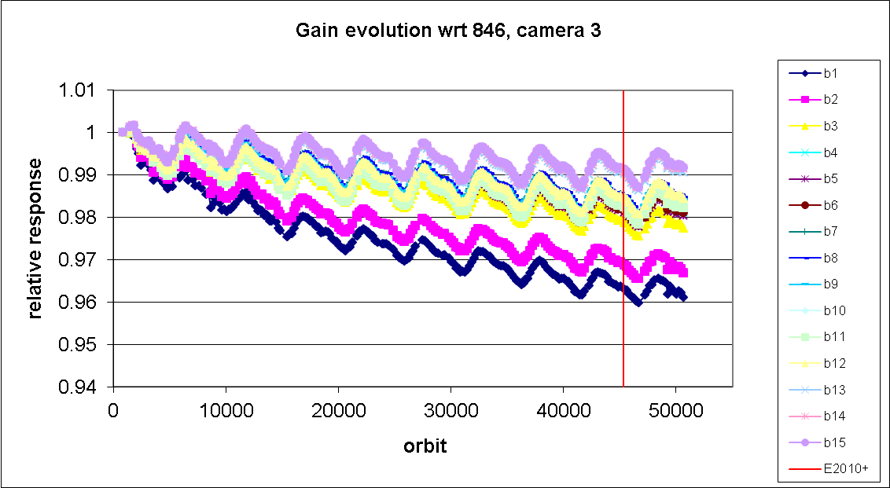
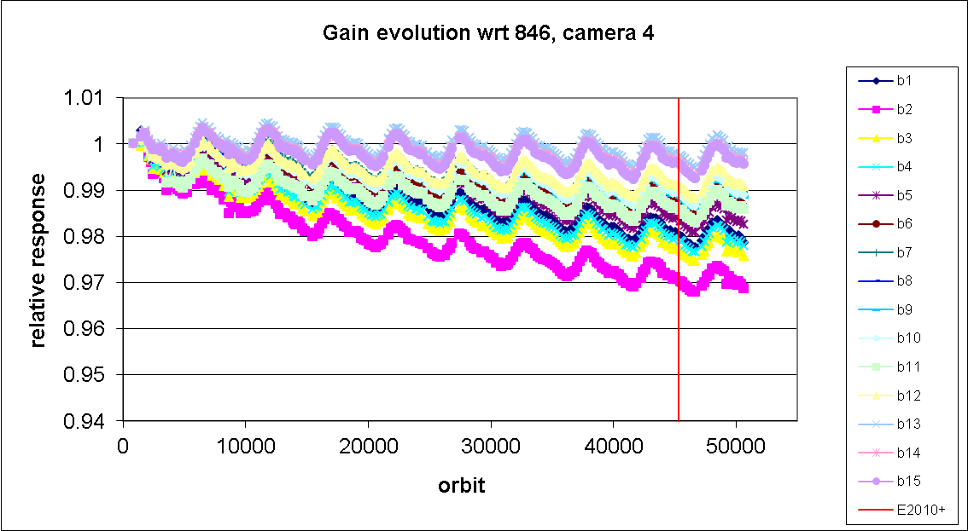
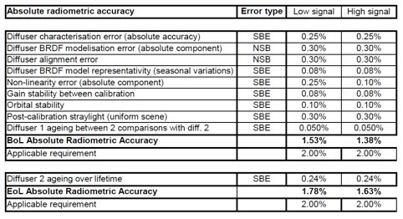
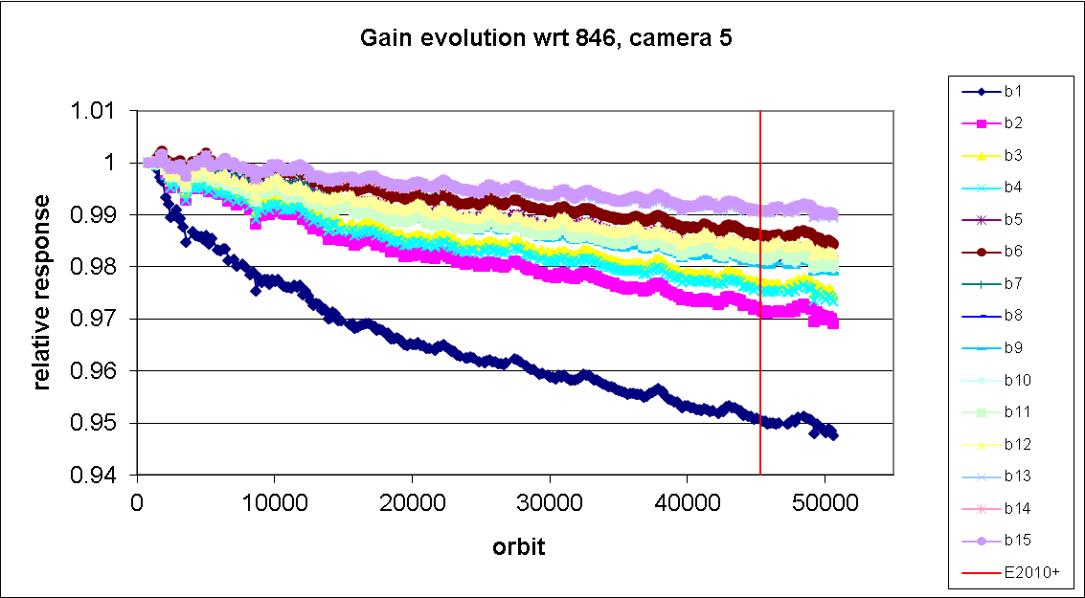

Direct instrument calibration
MERIS
camera 1
camera 2
Erbium peak 408nm
OLCI calibration requirements
absolute radiometric uncertainty 2% (≤ 900nm)
inter-band radiometric uncertainty 1%
no long-term stability requirement
spectral evolution 5cameras
camera 3
Erbium peak 520nm
camera 4
MERIS
camera 5
radiometric evolution
Pre-launch – sensor is characterized in a laboratory
On-orbit – regular radiometric and spectral calibrations track temporal changes in sensor response
      OLCI / MERIS
radiometric calibration
solar diffuser-1 every 15 days
solar diffuser-2 every 3 months
erbium diffuser every 3 or 6 months
Fraunhofer lines (for validation)
O₂ A-band (for validation)
spectral calibration

Slide 8
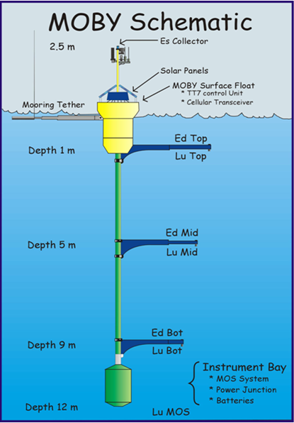

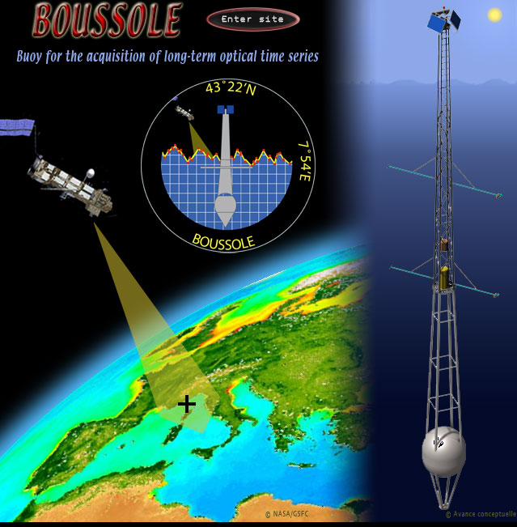
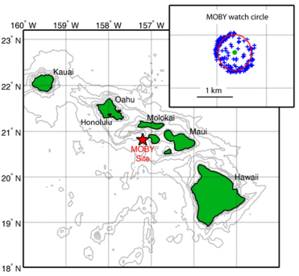
Vicarious instrument calibration
Direct calibration
Pre-launch – laboratory
On-orbit – on-board calibrators
Measurement requirements
water-leaving radiances, L_{w}
5% absolute uncertainty in blue/green
2% uncertainty
<< 0.5% uncertainty
System Vicarious Calibration
Earth-view – comparison against an independent source; single gain per band
Calibration of the combined instrument-algorithm system
MERIS / OLCI
NIR calibration
oceanic gyres, e.g. South Pacific Gyre
VIS calibration
in situ SI-calibrated source, << 5% L_{w} uncertainty

Slide 9
GSICS vicarious calibration methods
OLCI calibration requirements
absolute radiometric uncertainty 2%
inter-band radiometric uncertainty 1%
Calibration verification methods
  Absolute calibration over Rayleigh – uncertainty ~ 3.5%
  Inter-band calibration over sunglint – uncertainty ~ 2%
  Inter-band calibration over DCC – uncertainty ~2%
  Cross-calibration over desert – uncertainty ~ 3-4%
  Cross-calibration over Antarctica – uncertainty ~ 2%
Calibration methods
  Moon radiometric degradation trending (long-term stability) – uncertainty ~ 0.1% per mission in SeaWiFS, lunar measurements used in MODISes and VIIRS
  Modified System Vicarious Calibration for polarization and RVS degradation modelling in MODIS-Terra and Aqua – uncertainty < 1%
  Detector radiometric equalization at TOA radiances for MERIS cameras over Dome Concordia site in Antarctica and for MODIS detectors per mirror side over oligotrophic waters

Slide 10
Ocean colour validation
product validation,
quick response to
degradation,
systematic
development
satellite data
frequent internal
reprocessings to
test cal/char/alg
revisions
calibration labs
for in situ
instrumentation,
inter-calibration
round robins
      bio-optical and atmospheric products
      instrument calibration and characterization
      spatial and temporal stability of algorithms
      instrument processing chain
      science algorithm development
satellite L3
trending, anomalies,
mission
inter-comparisons
validation
bio-optical
field measurement
protocols
satellite L1/L2
data extractions,
matchups with
in situ, trending
validation sites,
field campaigns,
new instruments
and validation
concepts
databases of
in situ validation
measurements

Slide 11


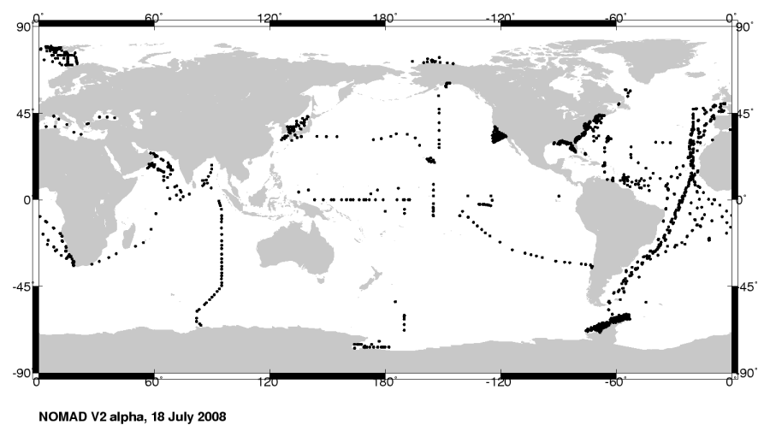

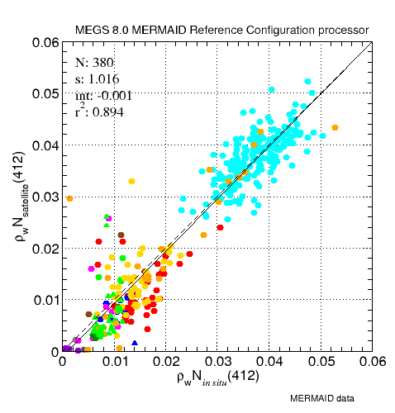
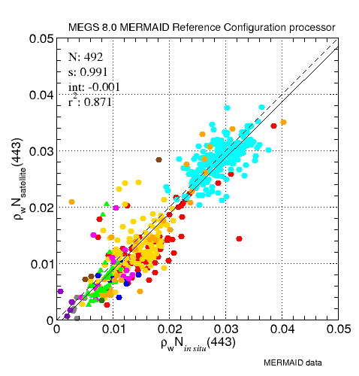
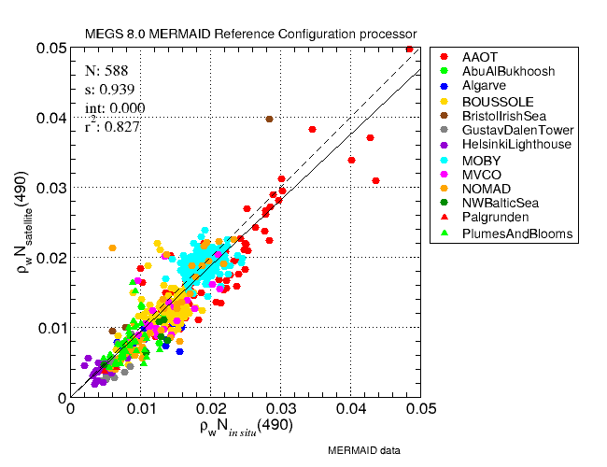
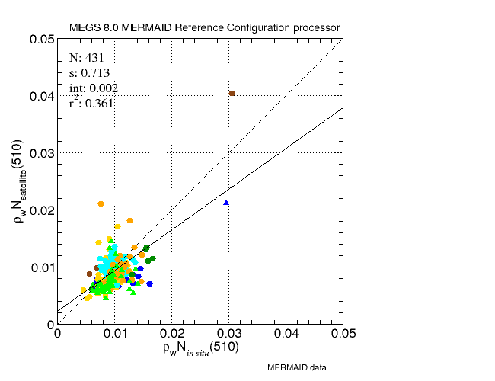
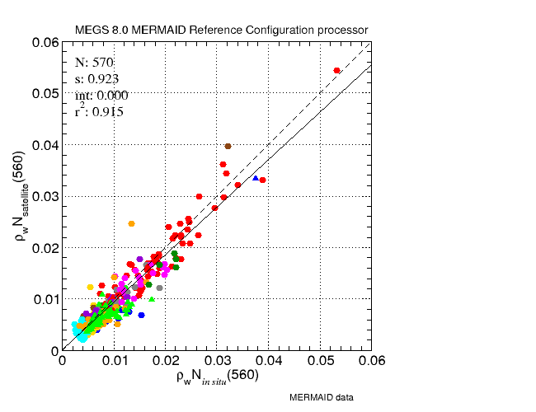
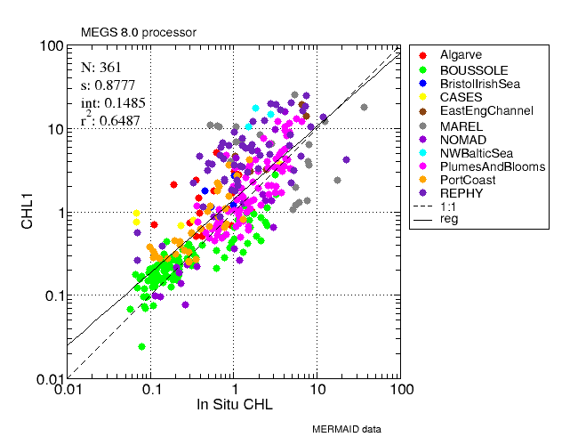
G. Zibordi (AAOT, Abu Al Bukhoosh, Gustav Dalen Tower, Helsinki Lighthouse)
J. Icely (Algarve) V. Brando (LJCO)
D. Antoine (BOUSSOLE) K. Ruddick (MUMMTriOS)
D. McKee (BristolIrishSea) H. Feng & H. Sosik (MVCO)
M. Kahru (California Current) J. Werdell & NOMAD’s PIs
S. Belanger (CASES) S. Kratzer (NWBalticSea, Palgrunden)
G . Schuster & B. Holben (CoveSEAPRISM) P-Y. Deschamps (SIMBADA)
H. Loisel (EastEngChannel, FrenchGuyana) D. Siegel (PlumesAndBlooms)
S. Ahmed & A. Gilerson (LISCO) K. Voss (MOBY)
A. Hommerson (WaddenSea) B. Gibson & A. Weidemann (WaveCIS)
mission-long matchups with in situ
a few hundred points
uncertainties
15 to 20%
and higher
MERIS
π∙R_{rs} (412 nm)
π∙R_{rs} (443 nm)
π∙R_{rs} (490 nm)
in situ
high variance precludes stable accuracy assessment
π∙R_{rs} (510 nm)
π∙R_{rs} (560 nm)
C_{a}

Slide 12
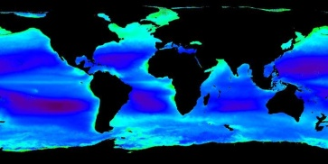
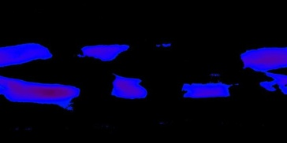
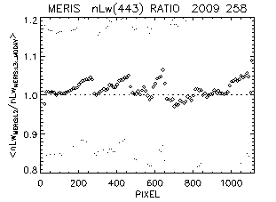
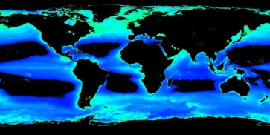
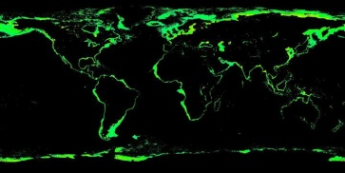
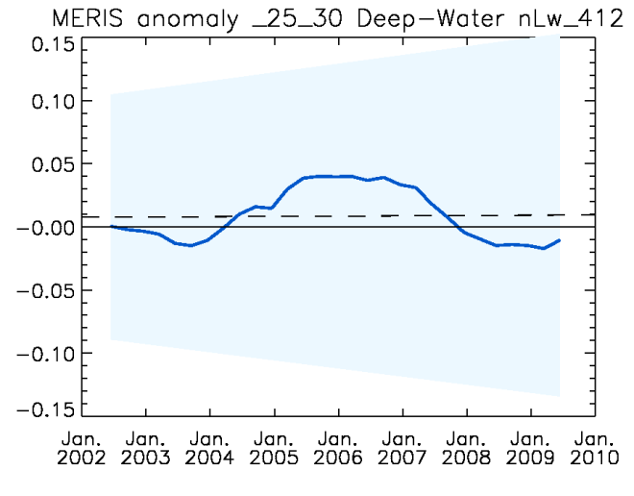
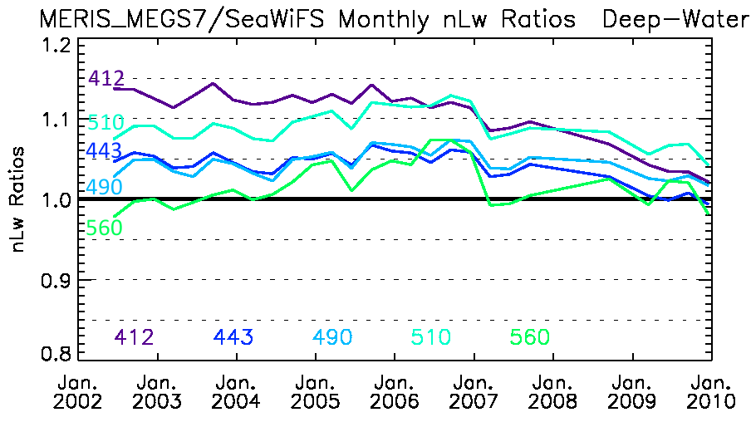
Level-3 analyses
Deep-Water (depth > 1000m)
Oligotrophic (Chlorophyll < 0.1)
Region ID | Minimum Latitude | Maximum Latitude | Minimum Longitude | Maximum Longitude
AtlN55 | 50.0 | 60.0 | -50.0 | -20.0
PacN45 | 40.0 | 50.0 | -179.0 | -140.0
PacN35 | 30.0 | 40.0 | -179.0 | -140.0
PacN25 | 20.0 | 30.0 | -179.0 | -140.0
PacN15 | 10.0 | 20.0 | -179.0 | -140.0
PacEqu | -10.0 | 10.0 | -179.0 | -140.0
PacS15 | -20.0 | -10.0 | -179.0 | -140.0
PacS25 | -30.0 | -20.0 | -179.0 | -140.0
PacS35 | -40.0 | -30.0 | -179.0 | -140.0
PacS45 | -50.0 | -40.0 | -179.0 | -140.0
AtlS55 | -60.0 | -50.0 | -20.0 | 10.0
Hawaii | 15.0 | 25.0 | -163.0 | -153.0
SIO | -35.0 | -25.0 | 75.0 | 85.0
SPG | -32.0 | -22.0 | -139.0 | -129.0
AtlNE | 36.0 | 40.0 | -74.0 | -70.0
instrument and algorithm L3 evaluations over spatial and temporal domains
tens of thousands of points
uncertainties
1 to 4%
MERIS r.3, nL_{w} 443 nm
camera-to-camera trends
Mesotrophic (0.1<Chlorophyll<1)
Eutrophic (1<Chlorophyll<10)
2-3%
MERIS reprocessing 3
nL_{w} 412 nm anomalies
MERIS reprocessing 2
MERIS reprocessing 3
reprocessing
2011
low variance supports stable accuracy assessment

Slide 13
Ocean colour calibration highlights
ocean colour is extra sensitive | low signal impacted by instrument degradation and algorithms
get the L1B right | below 0.5% absolute uncertainty
vicariously calibrate | hyperspectral, Si-calibrated source, << 5% L_{w} uncertainty
get water-leaving radiance (or reflectance) right | primary Level-2 product
revise and test calibration (and algorithms) | frequent internal reprocessings to evaluate spatial and temporal accuracy and stability of evolving instrument calibration models
in situ validation measurements are inadequate on their own | overall statistical accuracy of the mission but sparse data with high variance
use Level-3 global and regional time-series | low variance, stable accuracy assessment
full mission reprocessings | routine reprocessings to incorporate new instrument knowledge and assure consistent time series

