Slide 1
JMA GPRC Report
Masaya Takahashi
Meteorological Satellite Center / Japan Meteorological Agency
(visiting scientist at EUMETSAT from Mar. 2014 to Feb. 2015)

Slide 2
Contents
Update of JMA GSICS members
Progress of the MTSAT calibration system on GSICS
Infrared channel
Visible channel inter-calibration/vicarious calibration
Contribution to SCOPE-CM phase2 projects
Towards Himawari-8/AHI inter-calibration
VIS/NIR vicarious calibration using Metosat-9/SEVIRI as proxy data
Observation quality monitoring
Summary and future plans

Slide 3
2014 JMA GSICS members
Executive Panel (EP)
(new) Kotaro BESSHO (Mr)
GSICS Research Working Group (GRWG)
(new) Keita HOSAKA (Dr)
Masaya TAKAHASHI (Mr)
Kenji DATE (Mr)
GSICS Data management Working Group (GDWG)
(new) Masaya TAKAHASHI (Mr), vice chair
GPRC points of contacts for operational matters
Masaya TAKAHASHI (Mr)
Great appreciation for Dr. Manik Bali’s acceptation of the interim GDWG chair!

Slide 4
Contents
Update of JMA GSICS members
Progress of the MTSAT calibration system on GSICS
Infrared channel
Visible channel inter-calibration/vicarious calibration
Contribution to SCOPE-CM phase2 projects
Towards Himawari-8/AHI inter-calibration
VIS/NIR vicarious calibration using Metosat-9/SEVIRI as proxy data
Observation quality monitoring
Summary and future plans

Slide 5
Progress of the MTSAT IR calibration system on GSICS
Current status of MTSAT-1R/-2 IR GSICS Correction
Demonstration phase, started in July 2010
Reference sensor: Metop-A/IASI and Aqua/AIRS
Toward the Pre-Operational phase
Additions and modifications to the netCDF conventions, merge of RAC (Re-Analysis Correction) files
To meet the requirement of EUMETSAT bias plotting tool, completed in July 2013
Uncertainty evaluation
ongoing, will be completed during my stay in EUMETSAT

Slide 6
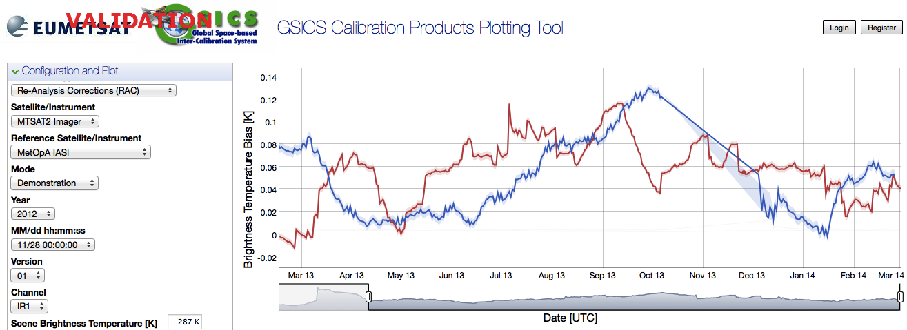
Comparison of TB bias on the EUMETSAT bias plotting tool
Requirements for the visualization on the bias plotting tool
RAC data are only supported (all information should be contained in one file)
Function enhancement will be discussed in the GDWG breakout session
We modified MTSAT-2 vs. AIRS/IASI IR RAC format in July 2013
Easy comparison of GSICS Corrections are realized!
Time series of 11μm channel TB difference against Metop-A/IASI
on http://vgsics.eumetsat.int/plotter/
MTSAT-2 10.8 um
Meteosat-10 10.8 um
Many thanks for supports and comments of EUMETSAT and NOAA

Slide 7
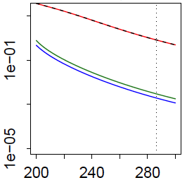
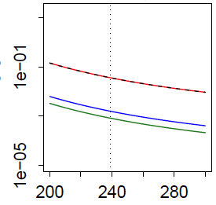
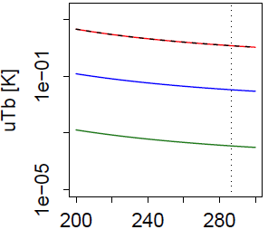
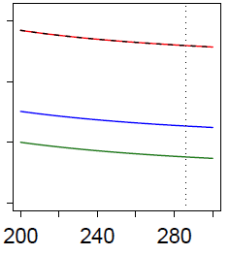
Uncertainty evaluation of MTSAT vs. IASI IR correction
in collaboration with Dr. Tim Hewison
WG_13.10 : JMA to complete Uncertainty analysis for MTSAT-IASI products by analyzing random errors contribution from spatial and temporal variability at least …
Open
Method: Hewison (2013), already evaluated for MSG/SEVIRI and GOES/Imager
Progress of MTSAT-2/Imager:
Systematic errors have been calculated (but not for full error sources)
Random error evaluation is underway (will be finished in 2014)
Contribution on each source of systematic error to the standard uncertainty of TB
Uncertainty of TB [K]
3.8 [μm] 6.8 [μm] 10.8 [μm] ch 12.0 [μm]
[K]
Total systematic uncertainty Temporal mismatch Longitudinal mismatch Latitudinal mismatch

Slide 8
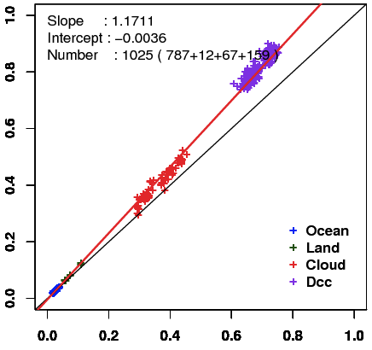
Progress of the MTSAT VIS calibration system on GSICS
A) Vicarious calibration using radiative transfer calculation
in collaboration with the University of Tokyo
Method: Comparison of observed and simulated radiance for particular targets
Target: Wide range of radiances
Cloud-free ocean/land, Liquid water cloud, Deep Convective Cloud (DCC)
Radiative transfer calculation:
RSTAR (Nakajima and Tanaka [1986,1988])
Input data: Independent of GEO data
JMA Re-Analysis atmos. profiles, MODIS L1B, BRDF, Aura/OMI total column ozone, …
Aerosol/Cloud optical parameters (e.g., optical thickness) are retrieved from MODIS L1B data
Result of MTSAT-2 in Feb. 2011
Simulated reflectivity
Observed reflectivity

Slide 9
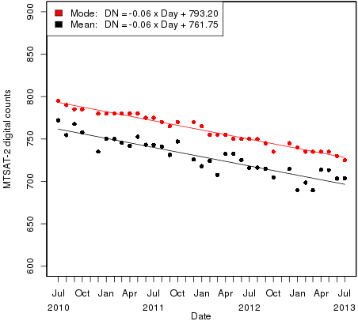
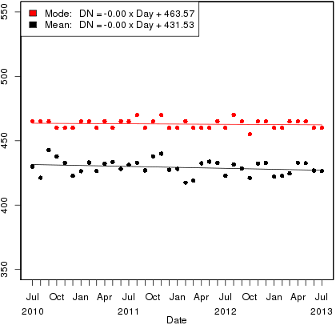
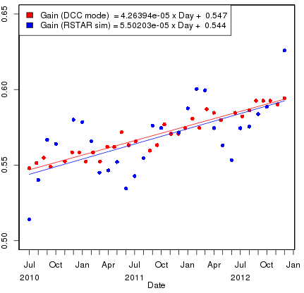
Progress of the MTSAT VIS calibration system on GSICS
B) Inter-calibration of NASA’s method using DCC
In collaboration with Dr. Sebastien Wagner
DCC session
tomorrow: 3b
Good agreements with the ATBD and other GPRC results
Monthly MODIS statistics (central) are used to derive gain (right)
Comparison of DCC method with RT simulation method
Similar trends, whereas large seasonal variation in the vicarious method
Time series of monthly DCC pixel statistics and MTSAT-2 visible channel gain
NASA DCC method
Vicarious method using RTM
mode
mode
mean
mean
MTSAT-2/Imager DN
Aqua/MODIS Radiance [W/m^2/sr/um]
MTSAT-2 VIS Gain [(W/m^2/sr/um)/DN]

Slide 10
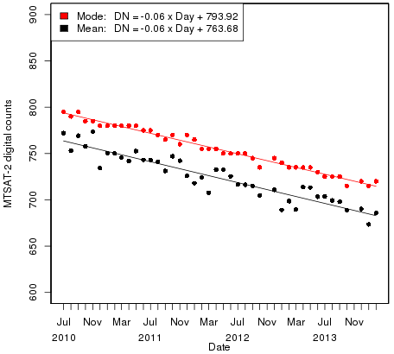
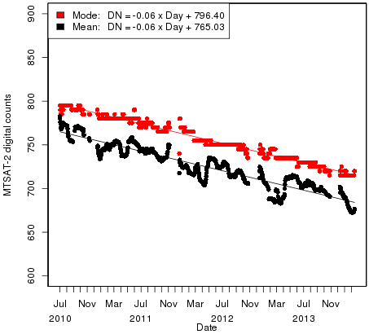
Towards demonstration-phase …
GSICS Correction (NetCDF) filename/contents
Will be proposed in the Wednesday’s GRWG VIS session by Sebastien and will be checked in the GDWG breakout session
Product type:
E.g., Re-Analysis Correction (RAC) and Near Real Time Correction (NRTC) for GEO-LEO IR product
Should we produce the same kinds of products as the IR correction?
Time series of MTSAT-2 DCC digital counts statistics (mode/mean)
30-day rolling average on a daily basis
Monthly average

Slide 11
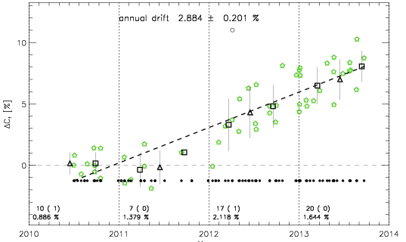
Progress of the MTSAT VIS calibration system on GSICS
C) Lunar calibration using the ROLO model
In collaboration with Dr. Bartolomeo Viticchie
Applicable to JMA GEO satellites except for MTSAT-1R (due to its scanning pattern)
Experience of GMS-5 lunar calibration with the support of Dr. Tom Stone
We got started with MTSAT-2 lunar calibration in this March w/ Dr. Viticchie
In the near future, this method will be applied to Himawari-8/AHI VIS/NIR bands
Preliminary result of MTSAT-2 lunar calibration using the ROLO model (time series of calibration slope against the ROLO model)

Slide 12
Contents
Update of JMA GSICS members
Progress of the MTSAT calibration system on GSICS
Infrared channel
Visible channel inter-calibration/vicarious calibration
Contribution to SCOPE-CM phase2 projects
Towards Himawari-8/AHI inter-calibration
VIS/NIR vicarious calibration using Metosat-9/SEVIRI as proxy data
Observation quality monitoring
Summary and future plans

Slide 13
Contribution to SCOPE-CM phase2 projects
JMA has contributed to SCOPE-CM since the initiative’s establishment
IOGEO project w/ Rob Roebeling
Joined kick off web meeting in February 2014
LAGS project w/ Mr. Alessio Lattanzio
In 2014, we will re-calibrate 2001 GMS-5 visible channel data using DCC method
Vicarious calibration using RT simulation will be helpful for the re-calibration
SCOPE-CM Phase 2 projects with JMA involvement, starting in January 2014
Name | Leader | SCOPE-CM partners
Land surface albedo from geostationary satellites (LAGS) | Alessio Lattanzio (EUMETSAT) | JMA, NOAA
Inter-calibration of passive imager observations from time-series of geo stationary satellites (IOGEO) | Rob Roebeling (EUMETSAT) | CMA, DWD, JMA, NOAA
Sustained production of International Satellite Cloud Climatology Project (ISCCP) cloud products | Kenneth Knapp (NOAA) | CMA, EUMETSAT, INPE, JMA, City College New York
Atmospheric Motion Vectors and Clear/All Sky Radiances from historical meteorological satellites in geostationary and polar orbit | Kotaro Bessho (JMA) | EUMETSAT, NOAA

Slide 14
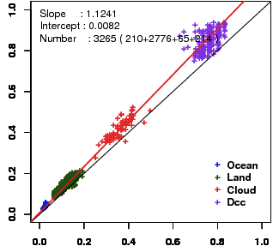
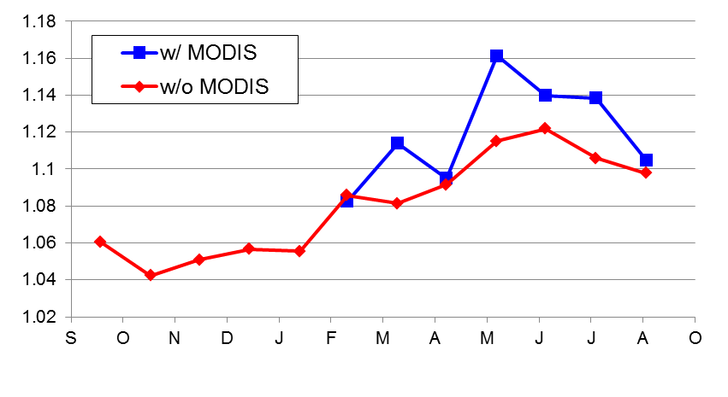
Re-calibration of historical satellites:
GMS-5 visible channel re-calibration before 2000
GMS-5: operated from June 1995 to May 2003
Developed vicarious calibration technique cannot be directly applied before 2000 due to a lack of MODIS data
Solution: Use of constant/climatological value for optical parameters
Preliminary results
Similar tendency, but difference of slope magnitude and some spikes
Can be useful for comparison with other re-calibration methods
w/o MODIS,
w/ climatological aerosol
Time series of regression coefficient: slope
(monthly mean for detector-2)
w/ MODIS
y = 1.0885 x – 0.0039
y = 1.241 x – 0.0082
Sep. 2000
Detector-2
Sep. 2000
Detector-2
Simulated reflectivity
DCC
Cloud
Land
Sea
DCC
Sea
Observed reflectivity
Observed reflectivity
1999 2000

Slide 15
Contents
Update of JMA GSICS members
Progress of the MTSAT calibration system on GSICS
Infrared channel
Visible channel inter-calibration/vicarious calibration
Contribution to SCOPE-CM phase2 projects
Towards Himawari-8/AHI inter-calibration
VIS/NIR vicarious calibration using Metosat-9/SEVIRI as proxy data
Observation quality monitoring
Summary and future plans

Slide 16
Himawari-8/9: Next generation JMA’s GEO satellites
Information can be found on: http://mscweb.kishou.go.jp/
Advanced Himawari Imager (AHI)
Band | Central Wavelength [μm] | Spatial Resolution
1 | 0.43 - 0.48 | 1Km
2 | 0.50 - 0.52 | 1Km
3 | 0.63 - 0.66 | 0.5Km
4 | 0.85 - 0.87 | 1Km
5 | 1.60 - 1.62 | 2Km
6 | 2.25 - 2.27 | 2Km
7 | 3.74 - 3.96 | 2Km
8 | 6.06 - 6.43 | 2Km
9 | 6.89 - 7.01 | 2Km
10 | 7.26 - 7.43 | 2Km
11 | 8.44 - 8.76 | 2Km
12 | 9.54 - 9.72 | 2Km
13 | 10.3 - 10.6 | 2Km
14 | 11.1- 11.3 | 2Km
15 | 12.2 - 12.5 | 2Km
16 | 13.2 - 13.4 | 2Km
“Himawari”: a nickname of JMA’s GEO satellites, meaning sunflower in Japanese
JMA will launch Himawari-8 in summer 2014 and begin its operation in 2015. The launch of Himawari-9 is also planned in 2016.
AHI (Advanced Himawari Imager) has 16 bands
10 minutes for full disk observation, 2.5 minutes around Japan
●
●
●
●
●
●
as of MTSAT-1R/2
●
Band | Central Wavelength [μm] | Spatial Resolution
1 | 0.55 – 0.90 | 1Km
2 | 3.50 – 4.00 | 4Km
3 | 6.50- 7.00 | 4Km
4 | 10.3 – 11.3 | 4Km
5 | 11.5 – 12.5 | 4Km
●
●
●
●: MSG
●

Slide 17
A Sequence of Himawari-8/9 AHI Observation in 10 minutes Time Frame
This super-rapidscan (every 30 seconds) mode will also be used for the lunar observations
___
Full Disk Observation
in every 10 min.
Over Japan (1)
every 2.5 min.
Over Japan (2)
every 2.5 min.
Typhoon monitoring
every 2.5 min.
Land-mark
extraction (1)
every 30 sec.
Land-mark
extraction (2)
every 30 sec.
A combination of one "Full Disk" and "small sectored” scans in 10 minutes

Slide 18
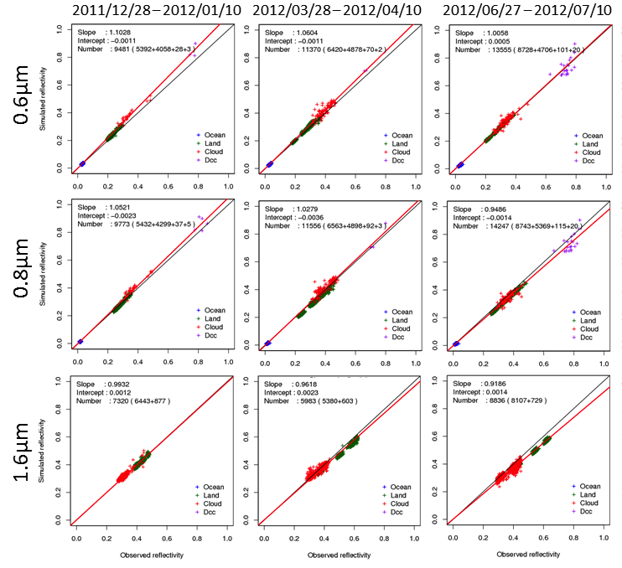
VIS/NIR vicarious calibration using Metosat-9/SEVIRI as proxy data
Comparison of reflectivity between Metosat-9/SEVIRI and our vicarious calibration using RT simulation
Research for the preparation of Himawari-8/AHI vicarious calibration
Same method for MTSAT, in good agreement with GMS/MTSAT results
Issue: the way to carry out this method for other AHI VIS/NIR bands ( 0.46, 0.51, 2.26 μm) before the launch of Himawari-8
SEVIRI L1.5 data are provided in the collaboration framework between EUMETSAT and JMA.

Slide 19
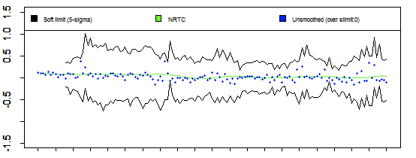
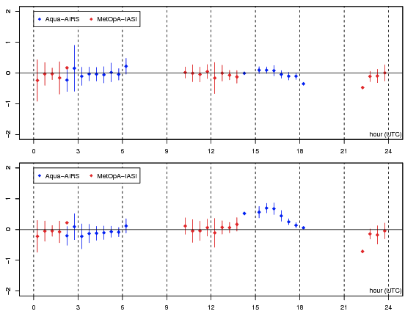
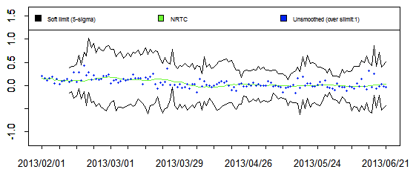
Observation quality monitoring
in collaboration with Mr. Peter Miu
Calibration change alert discussed in the June 2013 web meeting
Diurnal variation of TB biases discussed in the paste F2F/web meetings
Bias monitoring using global/regional NWP is under development
GEO-GEO inter-comparison will also be carried out, if data are available in JMA
Prototype of calibration change alert derived from MTSAT-2 vs. IASI NRTC Correction
Diurnal variation of TB biases derived from GEO-LEO IR collocation data
MTSAT-2 against Metop-A/IASI Aqua/AIRS
10.8 [μm]
Soft limit
10.8 [μm]
ΔTB [K] ΔTB [K]
ΔTB [K] ΔTB [K]
MTSAT-2 against Metop-A/IASI Aqua/AIRS
12.0 [μm]
12.0 [μm]

Slide 20
Summary and future plans
We would like to proceed cooperatively with the GSICS colleagues!
MTSAT calibration system on GSICS
IR: uncertainty evaluation will be finished in 2014
VIS:
GSICS correction using DCC: will enter the demonstration phase
Lunar calibration: will implement to the JMA calibration system
Vicarious calibration: continue collaboration research w/ the Univ. of Tokyo
SCOPE-CM phase2 projects
Join discussions and re-calibrate GEO data for IOGEO, LAGS and ISCCP projects
Himawari-8/9
Preparation for operational inter/vicarious calibration system
Information of GSICS correction will be included in NRT distribution

Slide 21
Backup Slides

Slide 22
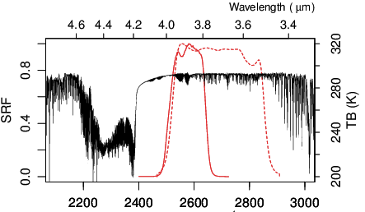
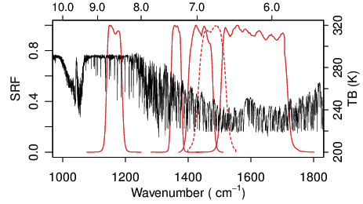
Predicted SRFs (Spectral Response Function) of AHI
VIS
SWIR
NIR
MWIR
LWIR
Himawari-8
MTSAT-2
Available on http://mscweb.kishou.go.jp/himawari89/space_segment/srf_201206/AHI_SpectralResponsivity.zip

Slide 23
NRT (Near Real Time) distribution with GSICS Information
Action EP-12.05: “Each GPRC to consider implementing the near real time
distribution of both the operational calibration information and the
corrected calibration information, as part of the L1 data formats”
For MTSAT:
Difficult to include it due to big impacts on users
For Himawari-8/-9:
Now under consideration (will be announced in a few month)
Tentative plan of calibration information included in Himawari-8/-9 NRT data
(The information will be valid when GSICS Correction enters Operational-phase)
Correction coefficients against one reference sensor
Window period to be used in a regression
Ancillary information (text block)
Calibration method, reference sensor name, …

