Slide 1
Using the Moon as a Radiometric Reference for Cross–Calibration
Thomas C. Stone
U.S. Geological Survey, Flagstaff, AZ USA
GSICS Research Working Group Meeting
EUMETSAT
24−28 March 2014

Slide 2
The Moon as a calibration light source for reflected solar wavelengths
The Moon can be regarded as a solar diffuser whose reflectance has stabilized over ~10⁹ years.
External, spatially extended source
Always available to Earth-orbiting instruments
To use the reflected light from the Moon for calibration:
Instruments must view the Moon
A reference for the lunar brightness must be provided
The lunar reference must predict the brightness variations due to:
the lunar phases, and the effects of non-uniform surface albedo
non-Lambertian reflectance (scattering phase function)

Slide 3
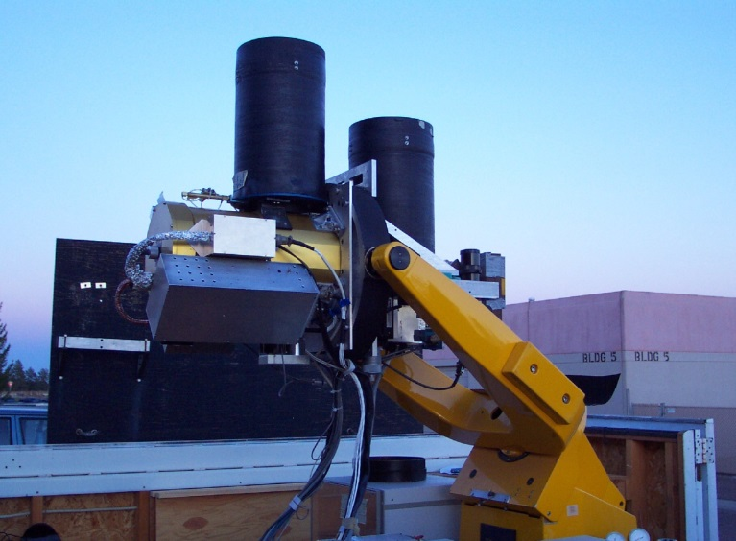
Lunar radiometric reference — irradiance
Experience with calibrating against the Moon has shown the practical quantity to use is spatially integrated irradiance.
Simplifies specification of the lunar reference
Increases signal-to-noise of measurements from images
Avoids the need for spatial registration of images
The lunar irradiance reference is provided by computations of a numerical model.
Developed by fitting an extensive set of measurements from the Robotic Lunar Observatory (ROLO)
Results effectively normalize the lunar brightness for different views of the Moon

Slide 4
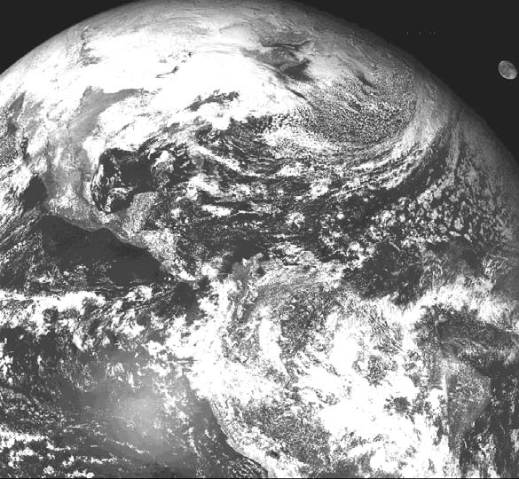
Lunar irradiance comparisons
A time series of measured-to-reference lunar irradiance ratios shows a sensor’s response change with time.
Example: GOES Visible channel imagers
• Moon images found in archives of meteorological data (e.g. CLASS)
GOES−13 Northern Hemisphere
28 January 2013 18:45

Slide 5
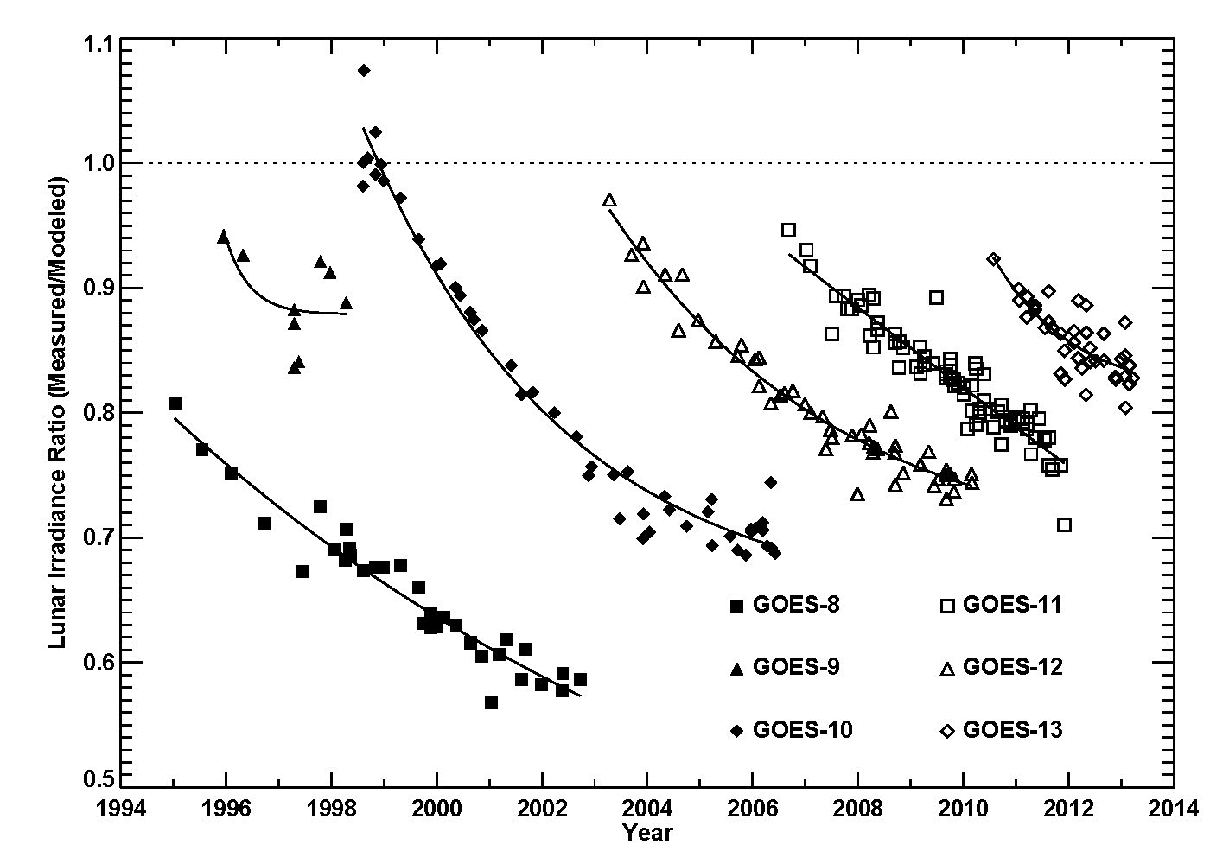
Lunar irradiance comparisons
A time series of measured-to-reference lunar irradiance ratios shows a sensor’s response change with time.
Example: GOES Visible channel imagers
• Raw pixel counts converted to radiance using constant (pre-launch) coefficients

Slide 6
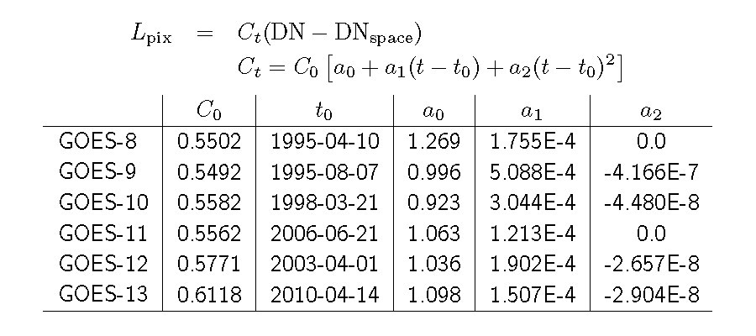
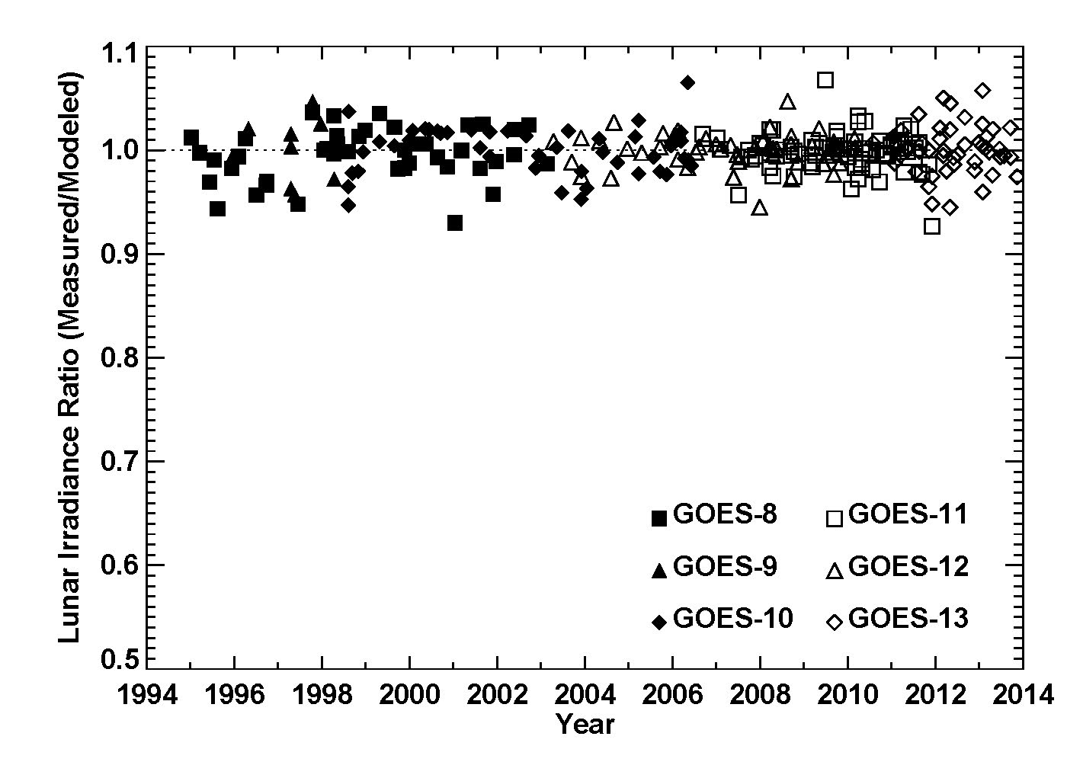
Time-dependent calibration equations were developed for GOES−8 through 13 from fitting these lunar response trends.
• pixel radiance L_{pix} in
Watts/(m² sr μm)
• (t‒t₀) in days since t₀
Applying these radiance conversions to the GOES Vis imager data removes the trends and places the sensors on the same radiometric scale.
This development should be checked against other vicarious calibration techniques.

Slide 7
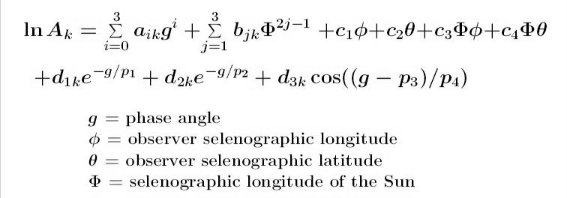
Some technical details of the ROLO lunar model
Model development and operation are done in terms of lunar disk-equivalent reflectance A, for the 32 ROLO bands (k):
328 coefficients, determined by fitting ROLO measurement dataset
driver for this model form was minimizing the fit residuals
mean absolute residual is 0.0096 in lnA, ~1% in irradiance

Slide 8
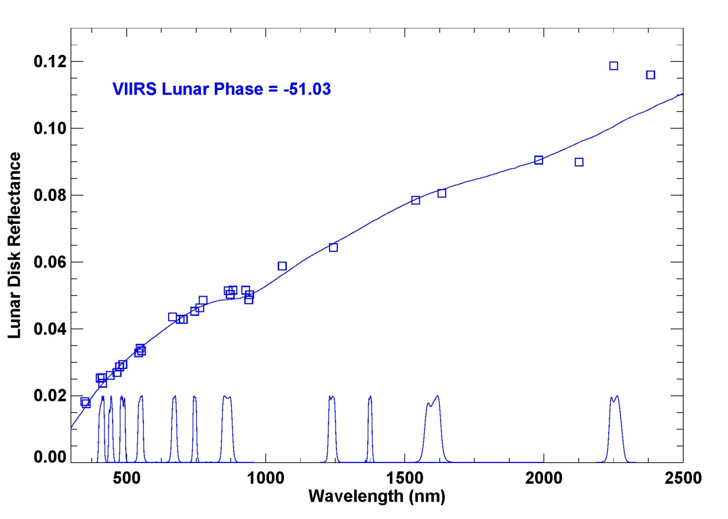
An example: NPP−VIIRS observation of the Moon acquired 10 February 2014
□ symbols are A_{k}
from the lunar model equation
Solid line is a reference lunar reflectance spectrum, fitted to the A_{k} values.
The fitted spectrum is convolved with the instrument band relative spectral response functions and solar spectrum to give irradiances.

Slide 9
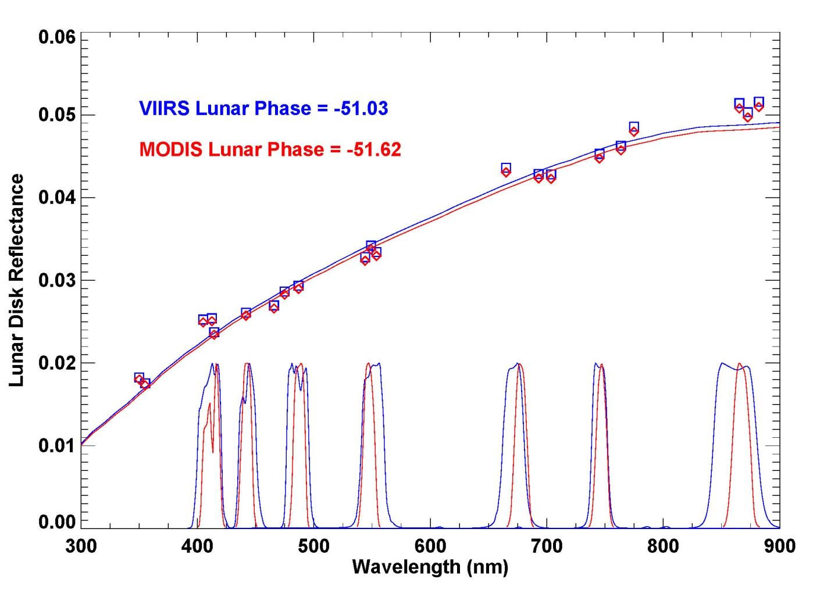
A second example: MODIS−Aqua lunar observation acquired 16 October 2002
Seven MODIS ocean color bands coincide with VIIRS bands M1–M7.
The similar geometry of the observations means the lunar disk reflectance spectra are nearly the same.

Slide 10
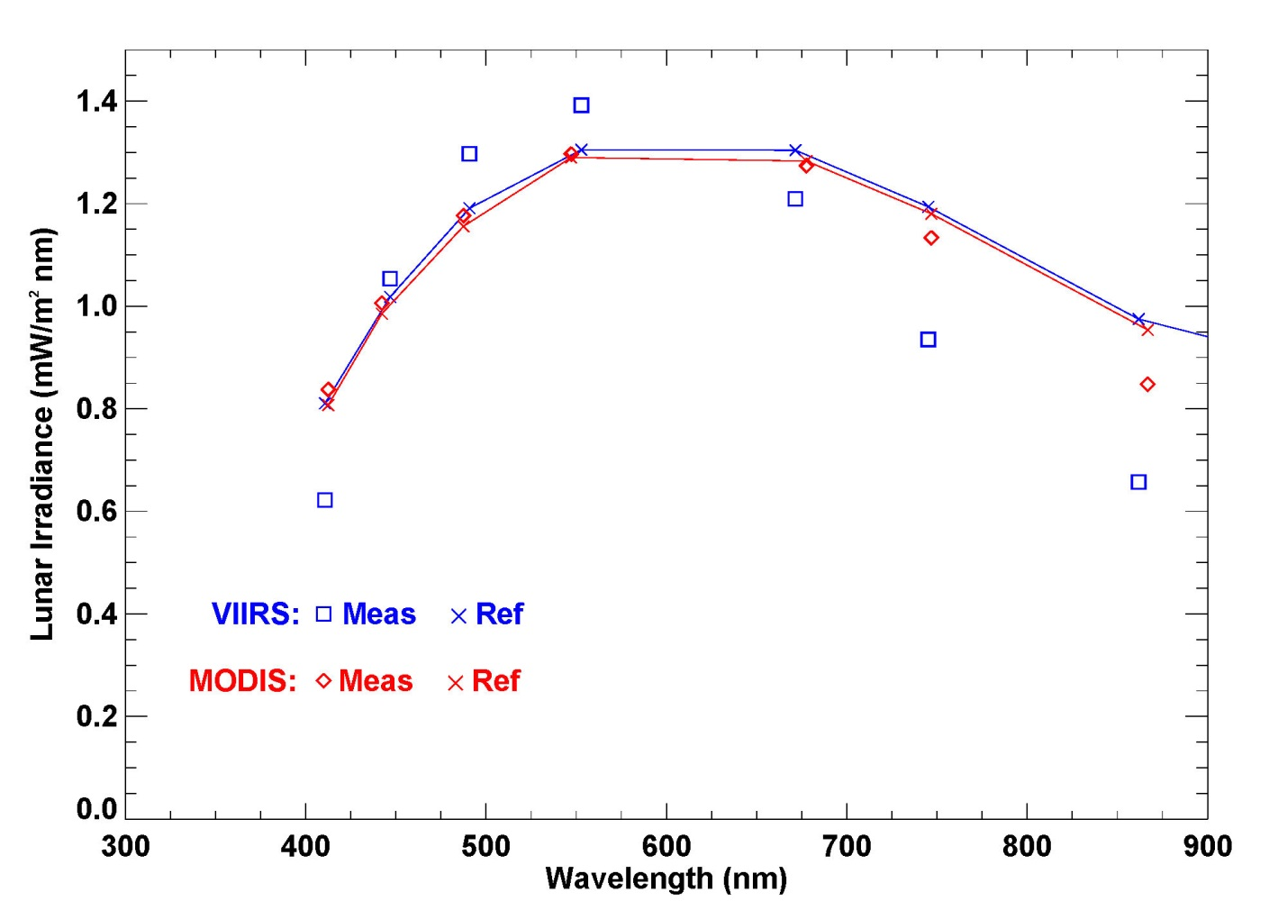
Spectral convolution and corrections for Sun–Moon and Moon–spacecraft distances typically lead to different lunar irradiance predictions, but these two cases come very close to each other.
□ and ◊ symbols are lunar irradiance measurements from VIIRS and MODIS images.
The reference lunar irradiance is nearly the same for both instruments.
There are notable differences in sensor response to the similar lunar source.

Slide 11
Conclusions
The given example of VIIRS and MODIS lunar observations demonstrates the capability for cross-calibration using the Moon as an external reference, observed by both instruments under similar conditions but at different times.
The lunar calibration system can support cross-comparisons such as these for any lunar observation geometry within the valid range of the irradiance model.
The accuracy of these comparisons is governed by the relative precision of the lunar irradiance model, ~1%.
The collection of Moon observations from the GOES imagers demonstrates the capability to correct sensor response trends, and place the series of instruments on the same radiometric scale, referenced to the lunar calibration system.

