Slide 1
GOES Imager/Sounder IR Diurnal Variations
Fangfang Yu and Xiangqian Wu
NOAA/NESDIS/STAR

Slide 2
Outline
GOES IR midnight Calibration Issue
Midnight calibration anomaly
Remedy algorithm – midnight blackbody calibration correction (MBCC) for Imager only
Characterization of the Diurnal Calibration variation
GEO-LEO
GEO-GEO

Slide 3
GOES IR Midnight Calibration Issue
Midnight calibration anomaly
Last 6-8 hours
Around the satellite midnight
The radiance in general are well calibrated beyond the midnight effect period using the standard calibration algorithm

Slide 4
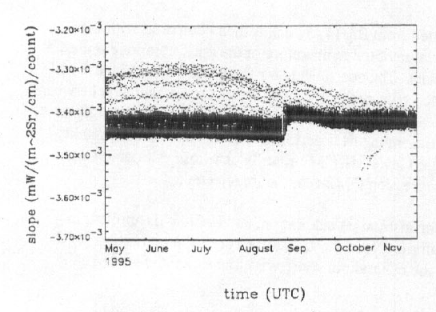
Midnight Calibration Anomaly
Causes of Midnight calibration anomaly (Johnson and Weinreb 1996)
Extra radiation reflected by the non-unity emissivity of BB to the detectors, when the instrument is viewing the BB.
Scattered solar radiation contamination at space view
Most pronounced at pre-eclipse and post-eclipse around the equinox.
The issue exists at all the current 3-axis stabilized Geo satellites
non-perfect BB effect
Contaminated SPLK effect, mainly at pre- and post- eclipse season around equinox periods
Original calibration slopes of GOES-8 Imager Ch2 (from Johnson and Weinreb, 1996)

Slide 5
Midnight Blackbody Calibration Correction (MBCC)
Current operational remedy: midnight blackbody calibration correction (MBCC) (Johnson and Weinreb1996, Weinreb and Han 2003)
MBCC is based on the regression of the calibration slope against the instrument temperature beyond the midnight effect window
Expected to work better at shortwave channels than at the long-wave channels

Slide 6
Characterization of Diurnal Calibration Variation
GEO-LEO Inter-calibration
Reference stable instruments: AIRS and IASI
Different collocation time period
Difference between AIRS and IASI radiometric calibration is very small and stable (Wang et al., 2012)
GEO-GEO inter-comparison/inter-calibration
Frequent collocation over the overlapped area
Challenge for the SRF correction

Slide 7
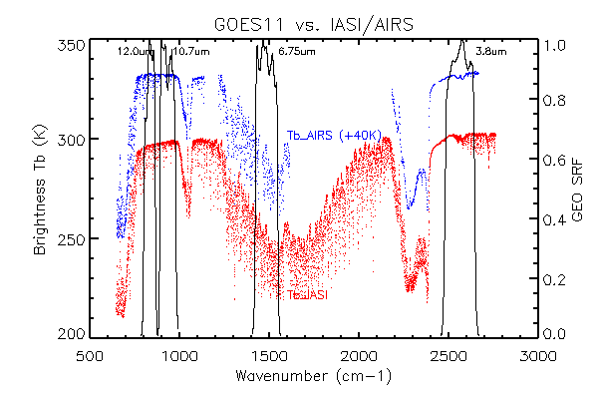
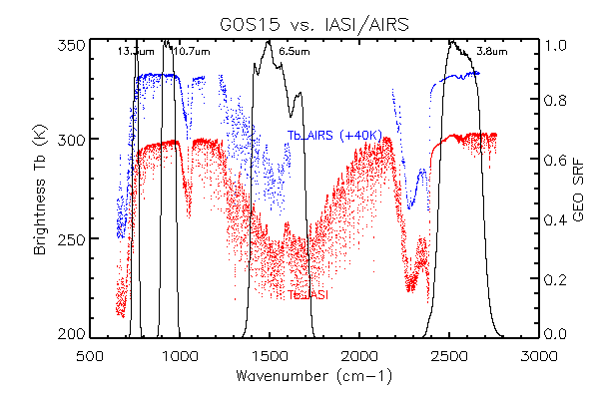
GOES Imager IR channels
Satellite | IR Channel | Central Wavelength (um)
G08-15 | Ch2 | 3.9
G08-11 | Ch3 | 6.75
G12-15 |  | 6.5
G08-15 | Ch4 | 10.7
G08-11 | Ch5 | 12.0
G12-15 | Ch6 | 13.3

Slide 8
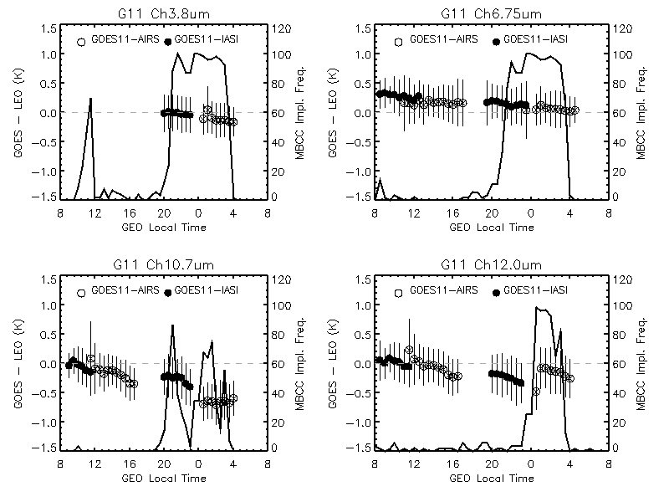
Diurnal Cal. Variation and MBCC Performance Evaluation
assuming
MBCC correction was not always turned on around the midnight time at different channels
Yu et al. 2013, TGRS

Slide 9
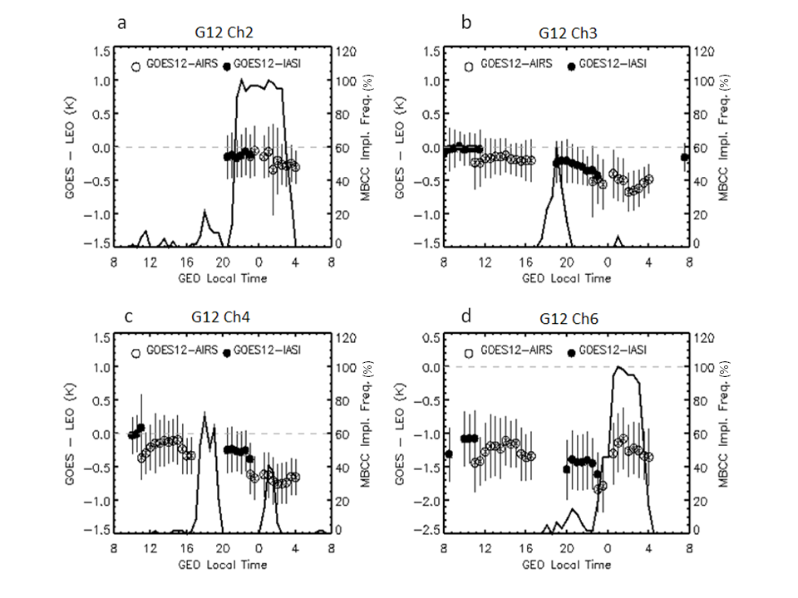
Diurnal Cal. Variation and MBCC Performance Evaluation

Slide 10
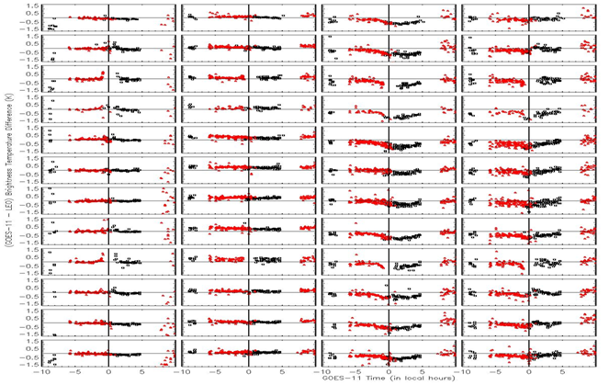
MBCC Performance Evaluation – GOES-11 Imager IR Channels
Ch2 Ch3 Ch4 Ch5
Jan
Feb
Mar
Apr
May
Jun
Jul
Aug
Sep
Oct
Nov
Dec
Jan
Feb
Mar
Apr
May
Jun
Jul
Aug
Sep
Oct
Nov
Dec
Diurnal variation varies at different channel and different season
provided by Rama Mundakkara

Slide 11
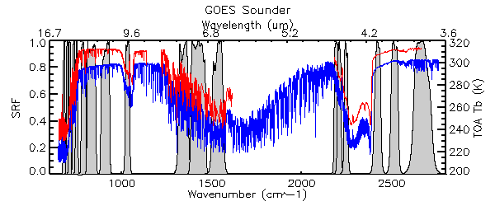
GOES Sounder IR instrument characterization
Detector | Channel number | wavelength (µm) | Purpose | Temperature Range (K)
LW (HgCdTe) | 1 | 14.71 | Temperature Sounding | Space - 260
 | 2 | 14.37 | Temperature Sounding | Space - 260
 | 3 | 14.06 | Temperature Sounding | Space - 270
 | 4 | 13.64 | Temperature Sounding | Space - 290
 | 5 | 13.37 | Temperature Sounding | Space - 300
 | 6 | 12.66 | Temperature Sounding | Space - 315
 | 7 | 12.02 | Surface Temperature | Space - 330
MW (HgCdTe) | 8 | 11.03 | Surface Temperature | Space - 335
 | 9 | 9.71 | Total Ozone | Space - 310
 | 10 | 7.43 | Water Vapor | Space - 300
 | 11 | 7.02 | Sounding | Space - 285
 | 12 | 6.51 | Sounding | Space - 265
SW (Insb) | 13 | 4.57 | Temperature Sounding | Space – 310
 | 14 | 4.52 | Temperature Sounding | Space - 295
 | 15 | 4.45 | Temperature Sounding | Space - 275
 | 16 | 4.13 | Temperature Sounding | Space - 330
 | 17 | 3.98 | Surface Temperature | Space - 335
 | 18 | 3.74 | Surface Temperature | Space - 335

Slide 12
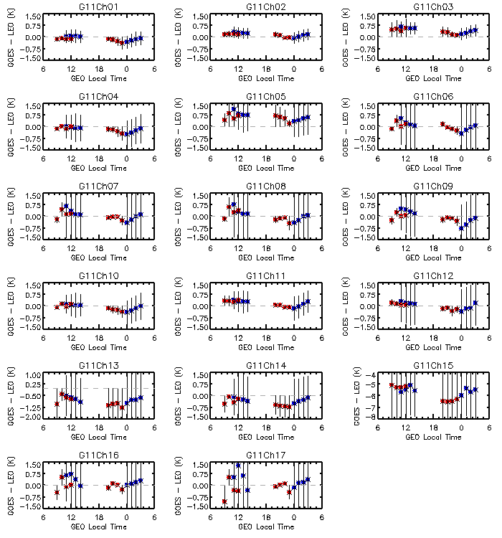
No MBCC applied to the Sounder IR channels
Impact of the midnight calibration anomaly for GOES-11 Sounder IR channel 1 through Ch17. ΔTb_{4:00am,0:00am} = ΔTb_{4:00am} - ΔTb_{0:00am}
Channel | ΔTb_{4:00am,0:00am} (K) | Channel | ΔTb_{4:00am,0:00am} (K) | Channel | ΔTb_{4:00am,0:00am} (K)
Ch1 | +0.25 | Ch7 | +0.54 | Ch13 | +0.33
Ch2 | +0.22 | Ch8 | +0.49 | Ch14 | +0.38
Ch3 | +0.25 | Ch9 | +0.67 | Ch15 | +0.61
Ch4 | +0.37 | Ch10 | +0.39 | Ch16 | +0.28
Ch5 | +0.24 | Ch11 | +0.44 | Ch17 | +0.51
Ch6 | +0.51 | Ch12 | +0.53
Yu and Wu, 2013 TGRS

Slide 13
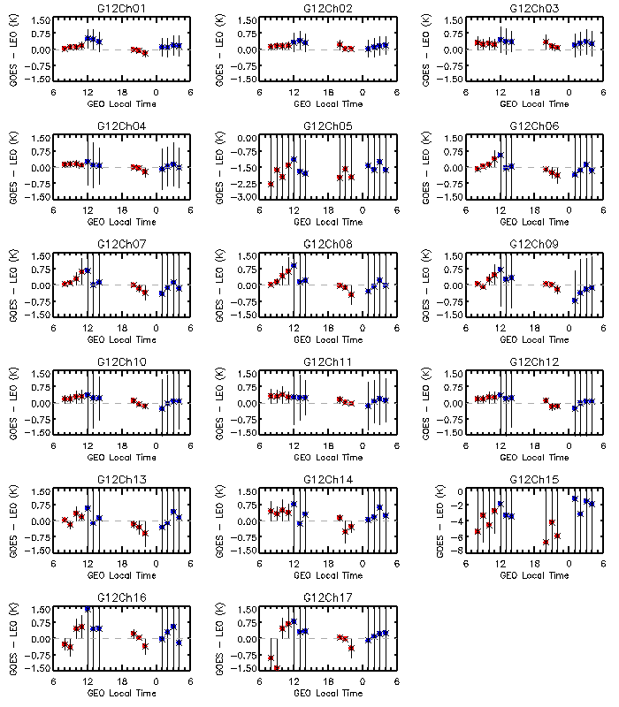
Impact of the midnight calibration anomaly for theGOES-12 Sounder IR LW and SW (Ch1-12), calculated as the max(ΔTb to AIRS) – min(ΔTb to AIRS) for the night-time collocation data.
Channel | max(ΔTb to AIRS) – min(ΔTb to AIRS) (K) | Channel | max(ΔTb to AIRS) – min(ΔTb to AIRS) (K)
Ch1 | +0.10 | Ch7 | +0.51
Ch2 | +0.16 | Ch8 | +0.51
Ch3 | +0.16 | Ch9 | +0.60
Ch4 | +0.22 | Ch10 | +0.36
Ch5 | - | Ch11 | +0.33
Ch6 | +0.46 | Ch12 | +0.35

Slide 14
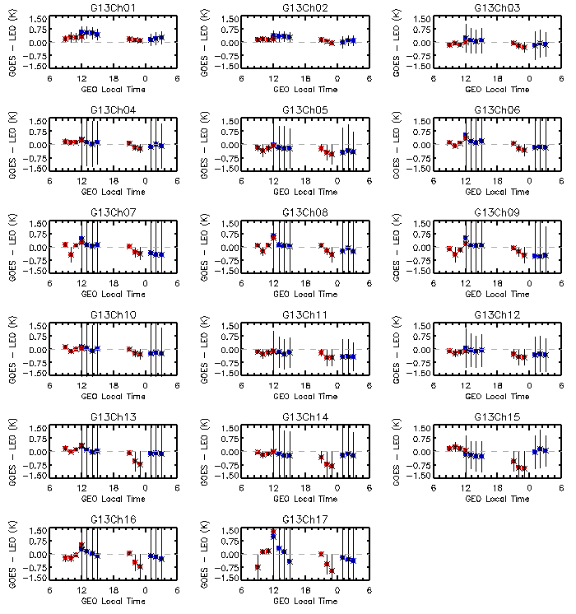
Tb bias difference between AIRS and IASI around satellite midnight at the SW channels of the GOES-13 Sounder. ΔTb_{11:00pm,1:00am =} ΔTb_{11:00pm -} ΔTb_{1:00am}
SW Channels | Ch13 | Ch14 | Ch15 | Ch16 | Ch17
Tb difference (K) | +0.60 | +0.63 | +0.91 | +0.60 | +0.76

Slide 15
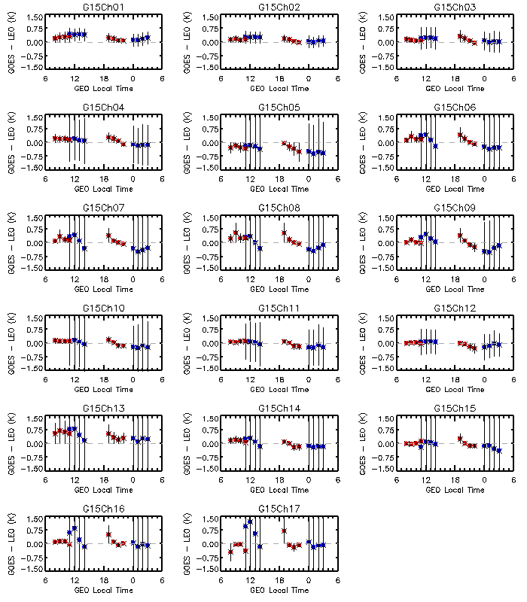
Diurnal calibration variations of GOES-15 Sounder IR channel 1 through Ch12. ΔTb_{8:00pm,1:00am} = ΔTb_{8:00pm} - ΔTb_{1:00am}
Channel | ΔTb_{8:00pm,1:00am} (K) | Channel | ΔTb_{8:00am,1:00am} (K)
Ch1 | +0.06 | Ch7 | +0.50
Ch2 | +0.13 | Ch8 | +0.55
Ch3 | +0.20 | Ch9 | +0.56
Ch4 | +0.34 | Ch10 | +0.25
Ch5 | +0.36 | Ch11 | +0.23
Ch6 | +0.48 | Ch12 | +0.10

Slide 16
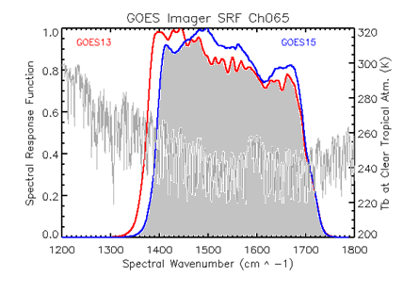
GEO-GEO IR Inter-Calibration
1)
- D. Tobin et al. 2005 JGR
2)
This algorithm can be applied to Sounder IR data. However, due to the application of MBCC calibration slope and smoothing of the radiance, it is challenging to apply to Imager IR channels
New SRF
3)
Where and are the simulated GEO1 and GEO2 radiances using various atmospheric profiles. Could have large uncertainty at the sounding channels

Slide 17
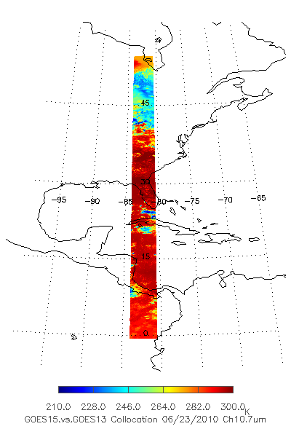
GEO-GEO Direct Inter-Comparison during GOES-15 PLT Period
GEO-GEO collocation
Spatial collocation
Temporal difference: < 5 minutes
Geometric alignment: viewing zenith angle difference < 1%
GOES 13: -75º
GOES-15: -89.5º

Slide 18
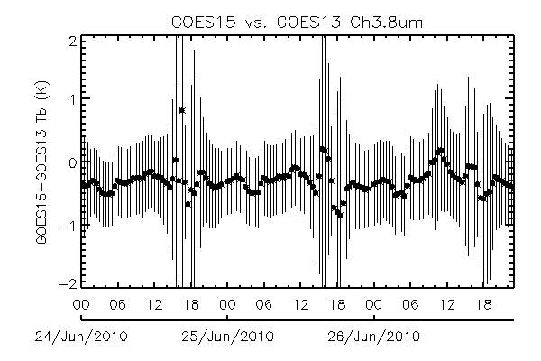
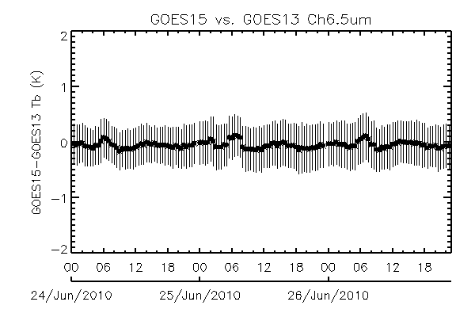
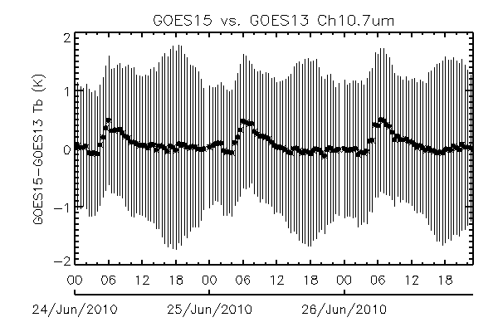
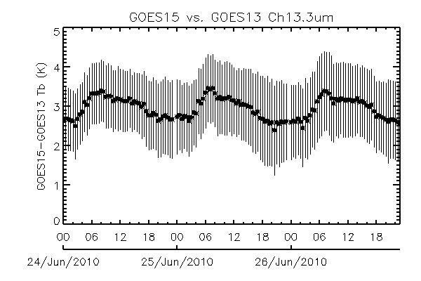
Direct GEO-GEO IR inter-comparison
No correction was made for SRF difference
Midnight
Midnight
BRDF
Midnight
Midnight
Note: the GEO-GEO inter-comparison was conducted before the SRF shifts for G15 Ch3 and Ch6

Slide 19
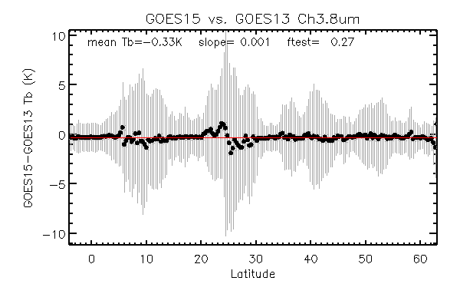
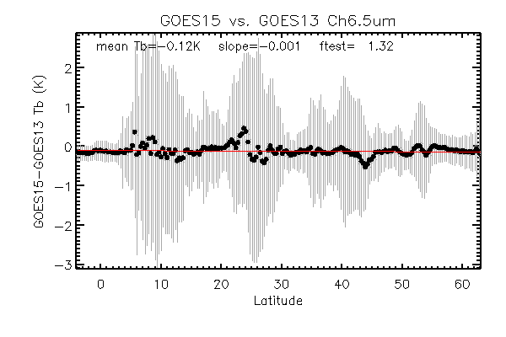
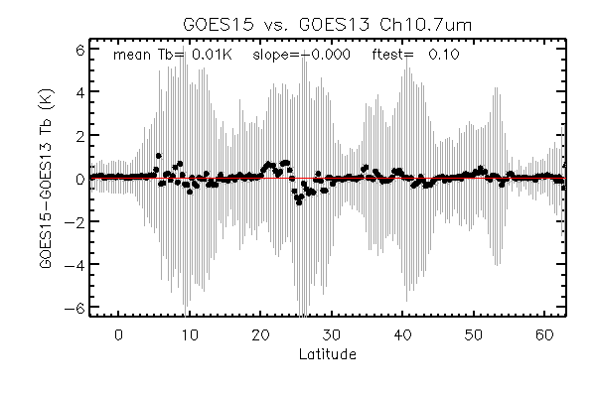
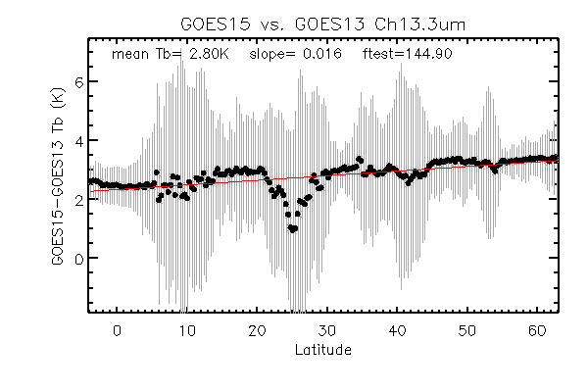
Latitudinal distributions of the mean GEO-GEO Tb difference
No correction was made for SRF difference
Significant trending!
Note: the GEO-GEO inter-comparison was conducted before the SRF shifts for G15 Ch3 and Ch6

Slide 20
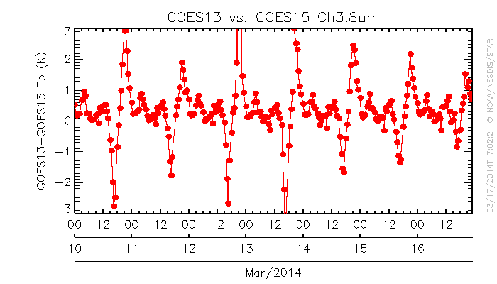
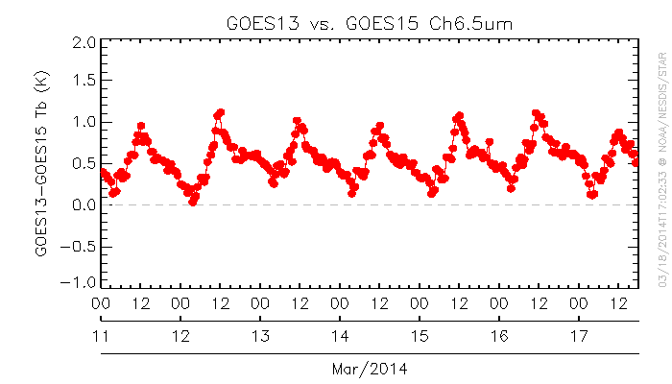
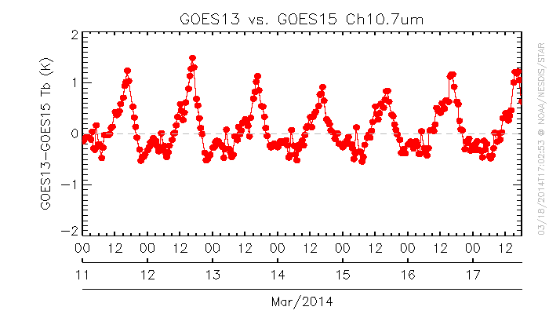
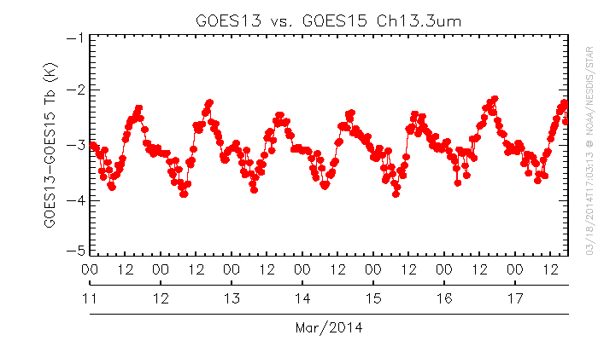
Direct GEO-GEO Inter-Comparison – radiance quality monitoring

Slide 21
Conclusions
GOES Imager/Sounder IR radiometric calibration is very stable beyond the midnight calibration anomalous period
Reliable GSICS GEO-LEO IR products to correct the GOES IR radiance.
NOAA applied an empirical calibration algorithm, MBCC method, to correct the erroneous midnight calibration coefficients for the Imager IR channels.
The MBCC slope was not always triggered on for all the IR channels around the midnight time
May result in relative larger uncertainty for the midnight IR radiance correction than the day-time data.
Challenges of GEO-GEO product
Different SRFs
Bias could be latitudinal dependent.
The duration of detectable midnight calibration variation may vary at different IR channels. Need to ensure that at least one of the GEO instrument is beyond the midnight impact for an accurate GEO-GEO correction.
Direct GEO-GEO inter-comparison (without SRF correction) is useful for the radiance quality monitoring

Slide 22
backup

Slide 23
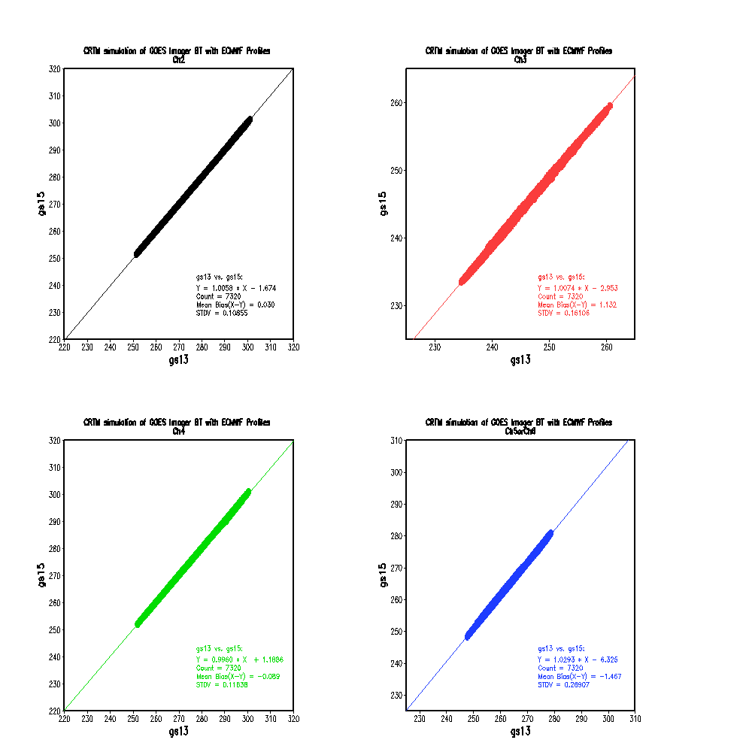
Scatter-plots of CRTM Simulated G13 vs. G15 Tb values
ECMWF: TB
Courtesy of H. Qian
Notes:
Two RTM models with two types of atmospheric profiles used for this study. CRTM model with ECMWF profiles over the collocated region (80W-90W;0-60N), Sampling profiles: 1x1°, 6hr, 3day (Sept. 24-26, 2010), totally around 61x10x4x3=7300 profiles.
LBLRM with 9 profiles.

Slide 24
Scatter-plots of LBLRM Simulated G13 vs. G15 Tb values
Nine atm. Profiles:
Clear Tropical
Cloud Tropical 700Pa
Cloud Tropical 500Pa
Clear US standard
Cloud Tropical 200Pa
Cloud US standard 500pa
Clear mid. Latitude Summer
Clear mid. Latitude winter

Slide 25
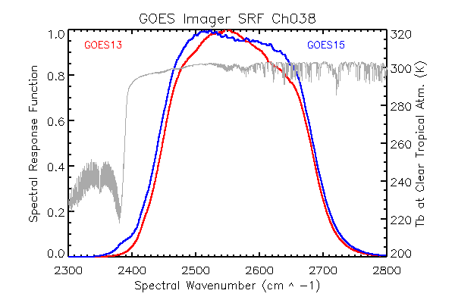
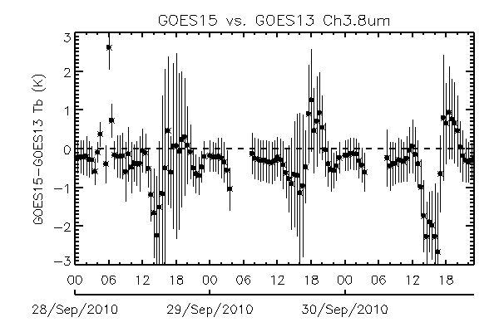
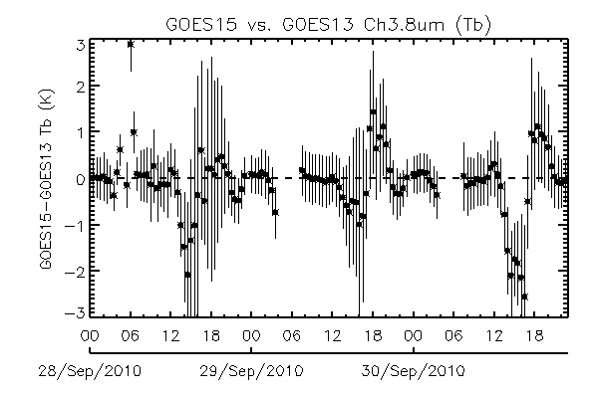
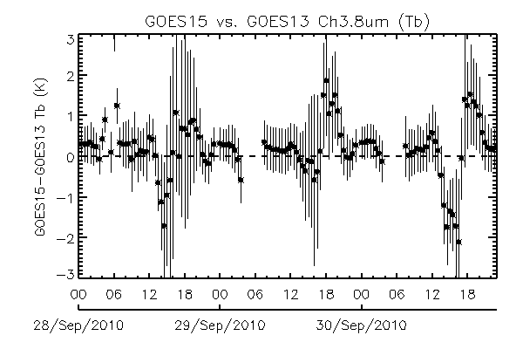
G13 vs. G15 Imager Ch2 (3.9µm)
G13 vs. G15 SRF
Direct inter-comparison
Corrected G13 vs. SRF transformed G15 Tb diff. (CRTM/ECMWF)
Corrected G13 vs. SRF transformed G15 Tb diff. (LBLRM/9 atm.)
Mean Tb at night yet beyond the midnight effect: -0.04 (0.17)K
Mean Tb at night yet beyond the midnight effect: 0.21K
Yu et al. SPIE 2012

Slide 26
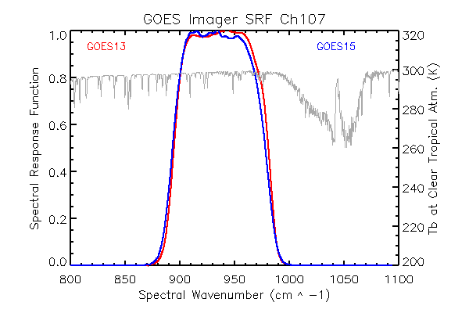
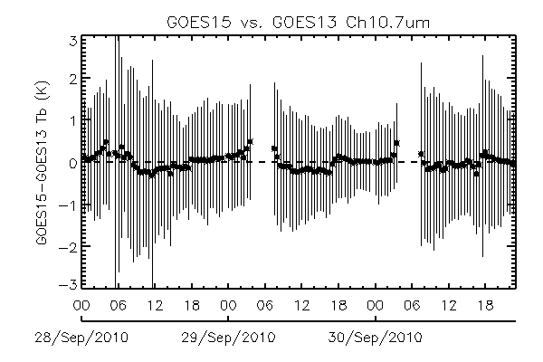
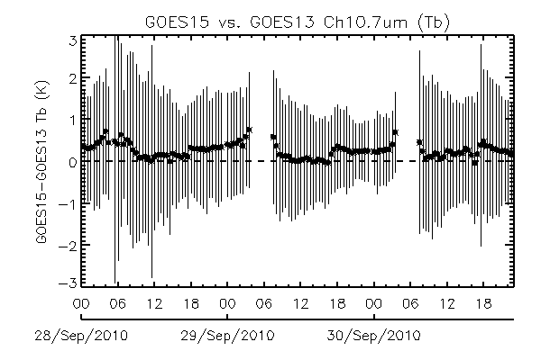
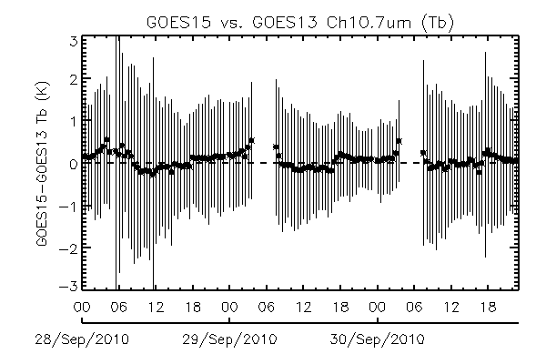
G13 vs. G15 Imager Ch4 (10.7µm)
G13 vs. G15 SRF
Direct inter-comparison
Corrected G13 vs. SRF transformed G15 Tb diff. (CRTM/ECMWF)
Corrected G13 vs. SRF transformed G15 Tb diff. (LBLRM/9 atm.)
Mean Tb (day-time, 13:00-20:00UTC) : 0.02(0.14)K
Mean Tb (day-time, 13:00-20:00UTC) : 0.08K

Slide 27
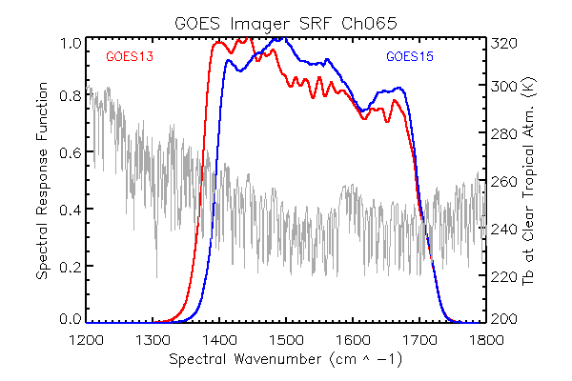
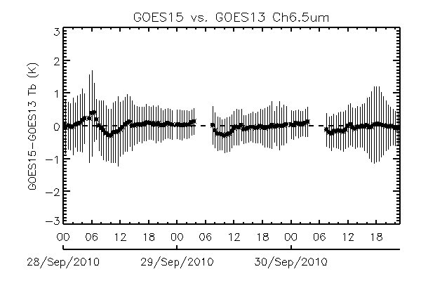
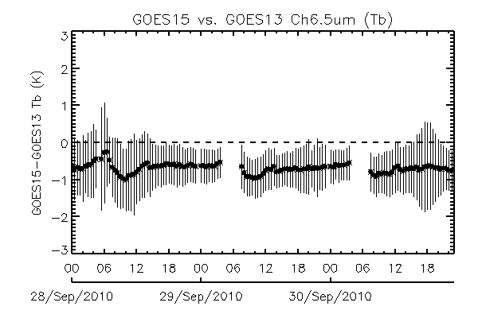
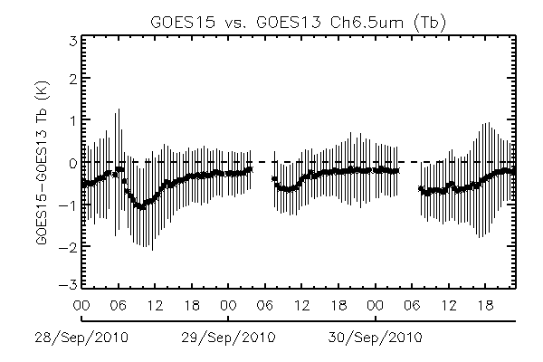
G13 vs. G15 Imager Ch3 (6.5µm)
G13 vs. G15 SRF
Direct inter-comparison
Corrected G13 vs. SRF transformed G15 Tb diff. (CRTM/ECMWF)
Corrected G13 vs. SRF transformed G15 Tb diff. (LBLRM/9 atm.)
Mean Tb (daytime): -0.65(0.06)K
Mean Tb (day-time) : -0.41K
Yu et al. SPIE 2012

Slide 28
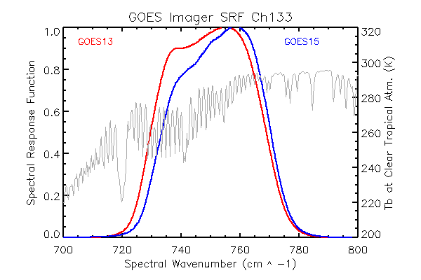
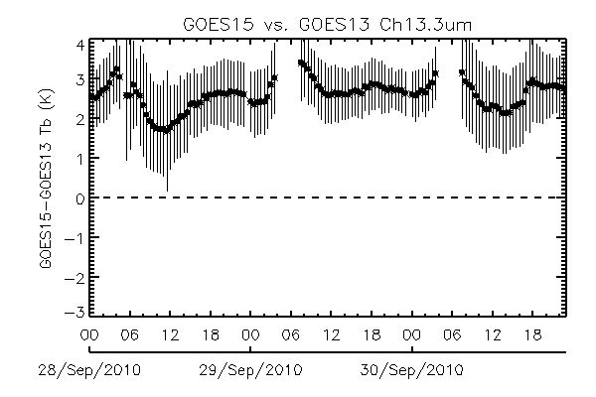
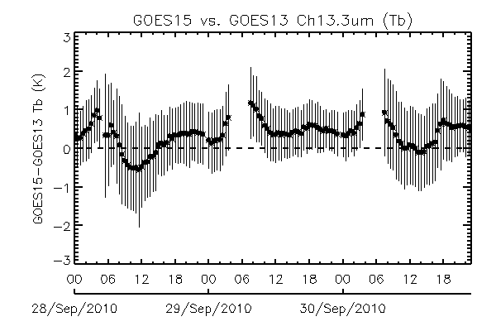
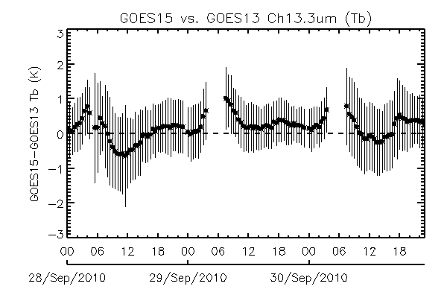
G13 vs. G15 Imager Ch6 (13.3µm)
G13 vs. G15 SRF
Direct inter-comparison
Corrected G13 vs. SRF transformed G15 Tb diff. (CRTM/ECMWF)
Corrected G13 vs. SRF transformed G15 Tb diff. (LBLRM/9 atm.)
Mean Tb (day-time, 13:00-20:00UTC) : 0.32 (0.26)K
Mean Tb (day-time, 13:00-20:00UTC) : 0.04K

