Slide 1
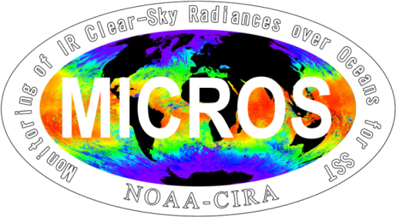
Recent Progress with MICROS
Monitoring of SST Radiances
in NOAA MICROS System
www.star.nesdis.noaa.gov/sod/sst/micros/
Xingming Liang^{1,2} and Sasha Ignatov¹
¹NOAA/NESDIS/STAR, ²CSU/CIRA
GSICS 2014 annual meeting, March 24-28, 2014, EUMETSAT, Darmstadt, Germany
Slide 1 of 18

Slide 2
Acknowledgements
ACSPO SST Team
J. Stroup, X. Zhou, K. Saha, B. Petrenko, Y. Kihai, J. Sapper
Calibration Community
T. Hewison, T. Chang, F. Wu, F. Yu, L. Wang, F. Weng, C. Cao, M. Goldberg – GSICS Team
A. Wu, J. Xiong– MODIS Calibration Support Team (MCST)
NOAA Community Radiative Transfer (CRTM) Team
Y. Chen, Q. Liu, Y. Han, F. Weng
NOAA Soundings Team
Y. Song, W. Wolf
GSICS 2014 annual meeting, March 24-28, 2014, EUMETSAT, Darmstadt, Germany
Slide 2 of 18

Slide 3
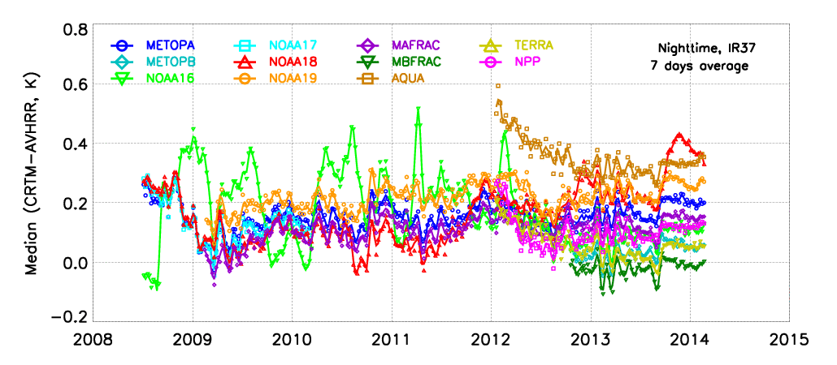
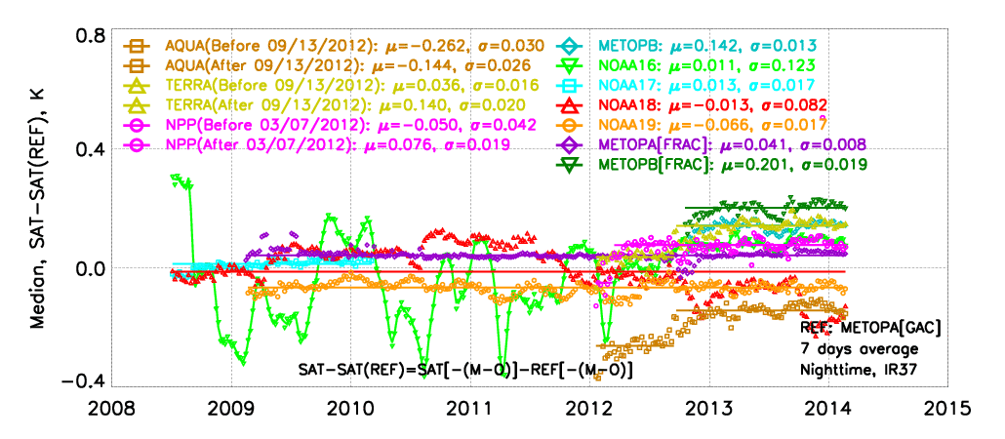
MICROS Summary
-- evaluation of sensor stability and cross-consistency--
Monitor M-O Biases
M (Model) = Community Radiative Transfer Model (CRTM) simulated TOA Brightness Temperatures (w/ first-guess SST, atmo. profiles as input)
O (Observation) = Clear-Sky sensor (AVHRR, MODIS, VIIRS) BTs
Double Differences (“DD”) for Cross-Platform Consistency
“M” used as a “Transfer Standard”
DDs cancel out/minimize effect of systematic errors & instabilities in BTs
GSICS 2014 annual meeting, March 24-28, 2014, EUMETSAT, Darmstadt, Germany
Slide 3 of 18
Notes:
3

Slide 4
Outline
Progress with MICROS since GSICS’2013
Sustained near-real time monitoring of AVHRR GAC (NOAA-16, -18, -19; Metop-A, -B), FRAC (Metop-A, -B), MODIS (Terra, Aqua), and VIIRS (S-NPP). Near-Real Time MICROS now covers period from July 2008 ̶ present
Added 12 years of reprocessed AVHRR GAC data (2002 ̶ 2014, ACSPO-RAN1) from NOAA-15, -16, -17, -18, -19, Metop-A and –B
Tested ECMWF vs. GFS profiles as input into fast CRTM, to minimize M-O biases and improve DDs
Conclusion and Future Work
GSICS 2014 annual meeting, March 24-28, 2014, EUMETSAT, Darmstadt, Germany
Slide 4 of 18

Slide 5
Sustained Monitoring of 5 AVHRRs, 2 MODISs, 1 VIIRS
Nighttime DD’s @3.7 µm (Ref = Metop-A GAC)
……
ACSPO ver 1.0
CRTM r577
Reynolds SST
ACSPO ver 2.3
CRTM ver 2.1
CMC SST
5+ years of data available from Jul’2008 – present
AVHRRs on Metop-A, -B; N-17, -19; MODIS &VIIRS are more stable; N-16, -18 less stable
Cross-platform inconsistencies are in part of due to
Sensor characterization (Working with MCST, AVHRR CAL Teams to resolve)
Overpass times from 9:30pm to 5:00 am (Diurnal effect)
Inconsistent CRTM coefficients
Part of temporal variability is due to ACSPO & CRTM updates -- Reanalysis underway
GSICS 2014 annual meeting, March 24-28, 2014, EUMETSAT, Darmstadt, Germany
Slide 5 of 18

Slide 6
AVHRR GAC Reanalysis: 2002-Present (ACSPO-RAN1)
Included in Reanalysis are data from 7 AVHRRs (N-15, -16, -17, -18, -19 and Metop-A, -B) – GAC only
ACSPO V2.2 & CRTM V2.1 with Reynolds V2.0 Daily SST and GFS 1⁰x 26 levels consistently used
Only nighttime data are used in this presentation (Daytime data are also available in MICROS but they are not used here)
GSICS 2014 annual meeting, March 24-28, 2014, EUMETSAT, Darmstadt, Germany
Slide 6 of 18

Slide 7
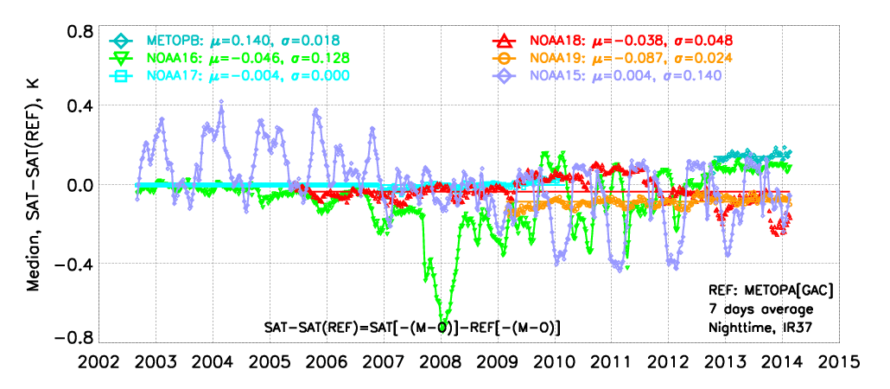
NIGHT Double Differences BT@3.7µm (Ref = N-17/Metop-A)
Stability (Best > ..> Worst): Metop-A > N-17 > Metop-B > N-19 > N-18 > N-16 > N-15
Most stable Metop-A & N-17 used as references
Stability for longwave IR11&12 (not shown) is similar to IR37
Least stable are N-15, -16 (after 2006), and -18 (after 2011)
GSICS 2014 annual meeting, March 24-28, 2014, EUMETSAT, Darmstadt, Germany
Slide 7 of 18

Slide 8
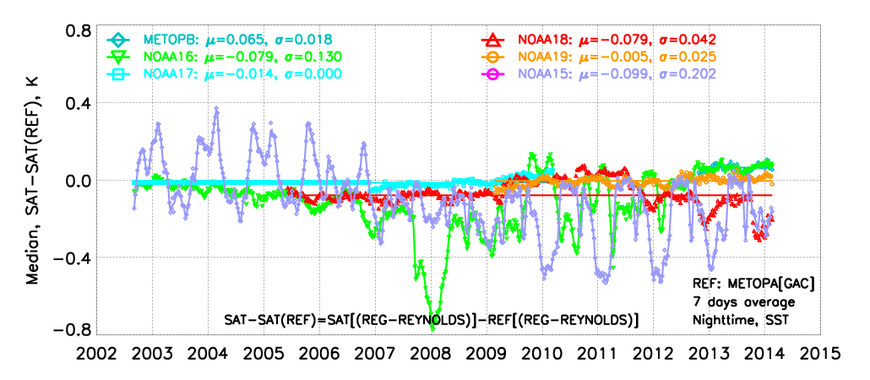
NIGHT Double Differences SST (Ref = N-17/Metop-A)
Artifacts in SSTs are strongly linked to instabilities in BTs
Most stable are Metop-A, -B, N-17, -19
Least stable are N-15, -16 (after 2006), -18 (after 2011)
Need help of Calibration community to fix AVHRR Fundamental CDR!
GSICS 2014 annual meeting, March 24-28, 2014, EUMETSAT, Darmstadt, Germany
Slide 8 of 18
Notes:
8

Slide 9
Testing ECMWF vs. GFS profiles as CRTM input
Based on prior sensitivity analyses (Saha et al, JGR 2012), first-guess daily SST in CRTM was updated from Reynolds to CMC in June 2013
As a result, time series of mean M-O biases and DDs became more stable, and STDs of M-O biases reduced
Next step is to optimize the atmospheric profiles input to CRTM
Here, we test ECMWF vs. current implementation - NCEP GFS (both real-time products)
Use 1 month of global data from NOAA-16 -18, -19 AVHRRs; Terra and Aqua MODISs; and S-NPP VIIRS from 18 Jan – 17 Feb 2014
Analyses based on MICROS functionality (Histogram, map, dependences, time series, and DD as well)
GSICS 2014 annual meeting, March 24-28, 2014, EUMETSAT, Darmstadt, Germany
Slide 9 of 18

Slide 10
ECMWF vs. GFS
 | GFS | ECMWF
Horizontal | 1° | 0.25°
Vertical | 26 Levels | 97 Levels
Highest Level | 10 mb | 0.1 mb
Time Interval | 6 hr | 6 hr
Forecast | 12 hr | 0 hr
Operational | Yes | Yes
Available | 2004~ | 2002~
GSICS 2014 annual meeting, March 24-28, 2014, EUMETSAT, Darmstadt, Germany
Slide 10 of 18

Slide 11
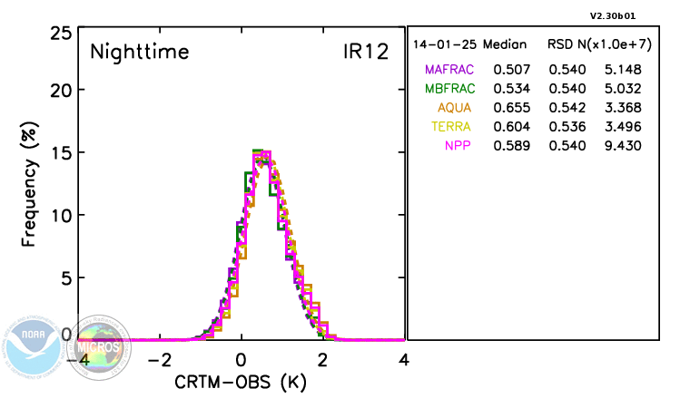
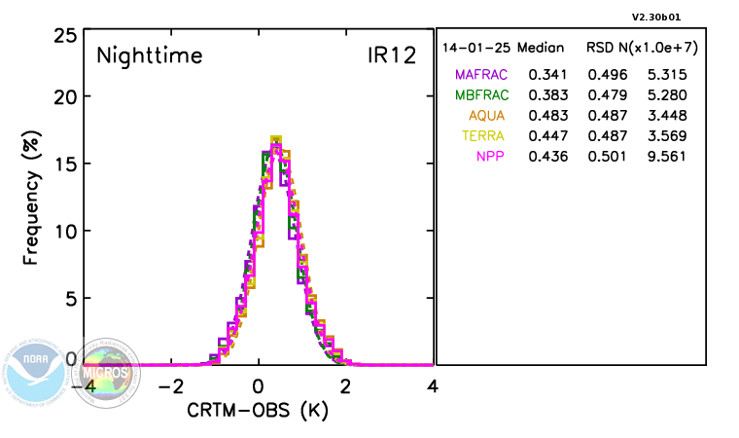
Histograms
Effect of using ECMWF vs GFS
GFS
Number of clear-sky pixels increases by ~3% (positive effect on ACSPO cloud mask)
Histograms are slimmer (Global standard deviations of M-O biases smaller)
Unusually warm M-O biases in longwave IR11 &IR12 become closer to 0
IR11 is affected less than IR12
IR37 is affected only minimally
ECMWF
GSICS 2014 annual meeting, March 24-28, 2014, EUMETSAT, Darmstadt, Germany
Slide 11 of 18

Slide 12
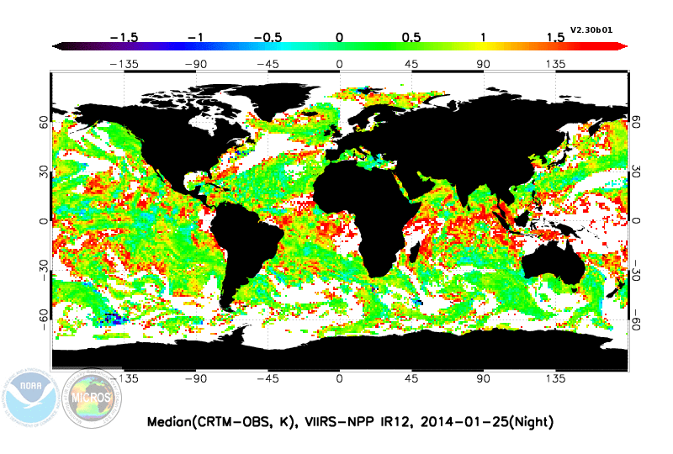
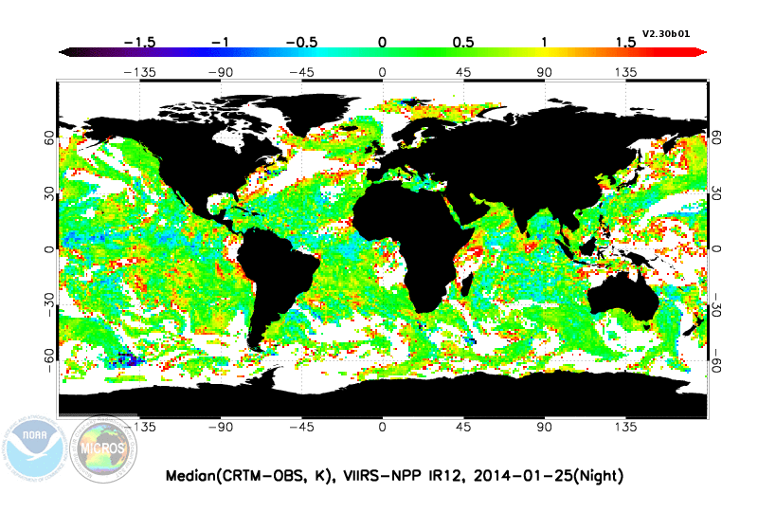
Example Global Map of M-O biases in IR12
GFS
Elevated M-O biases in the tropics may suggest that TPW in GFS is underestimated
Biases are significantly reduced and more spatially flat when ECMWF is used
Smaller cold spots appear in ECMWF implementation, suggesting that ECMWF TPW may be (slightly) overestimated
ECMWF
GSICS 2014 annual meeting, March 24-28, 2014, EUMETSAT, Darmstadt, Germany
Slide 12 of 18

Slide 13
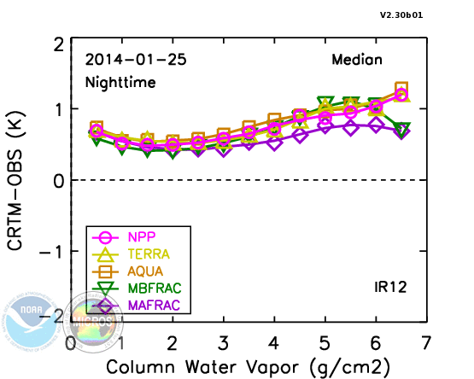
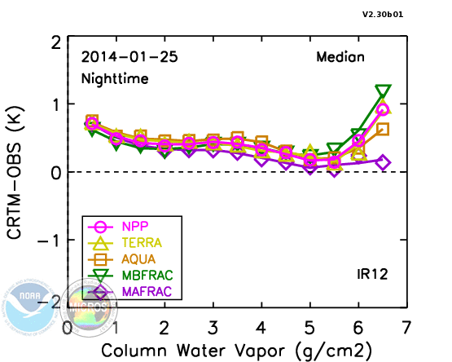
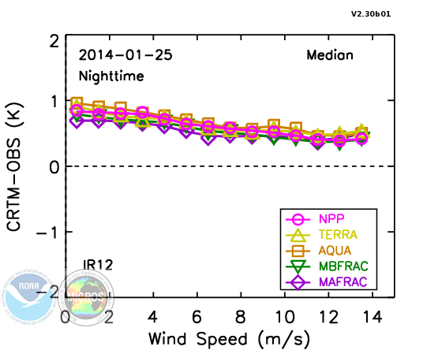
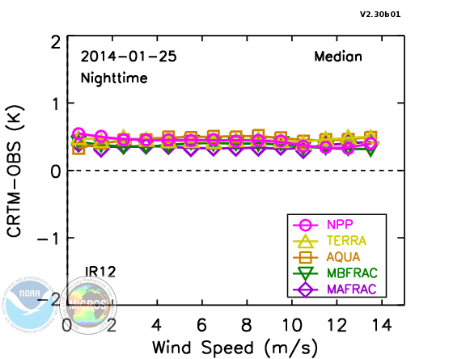
Wind Speed & TPW Dependencies of M-O Biases
GFS
ECMWF
High TPW and Wind Speed Dependencies significantly improved when ECMWF is used
GSICS 2014 annual meeting, March 24-28, 2014, EUMETSAT, Darmstadt, Germany
Slide 13 of 18

Slide 14
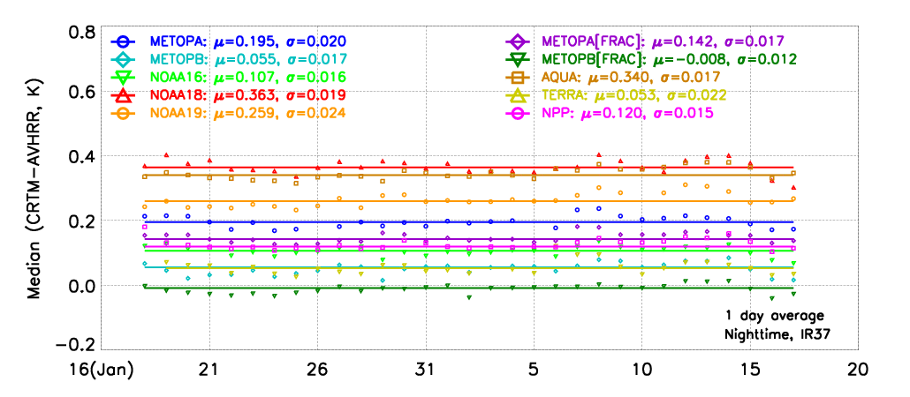
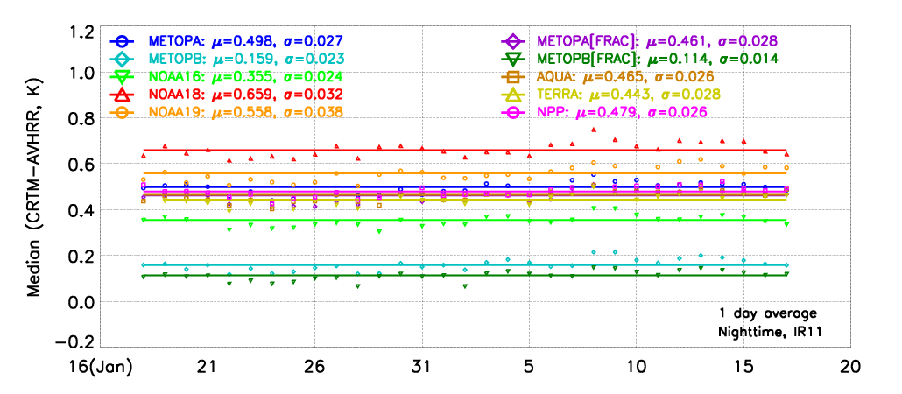
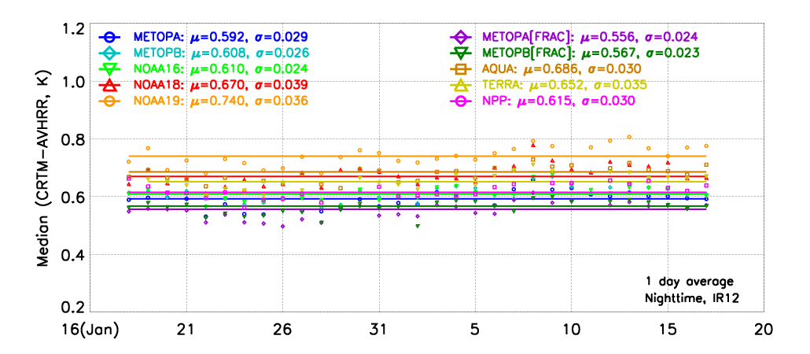
Time Series of M-O Biases Using GFS
Typical M-O biases in IR37 are ~0.2K
IR37
~0.2K
IR11
Typical M-O biases in IR11 & IR12 are ~0.5-0.6K
~0.5K
IR12
GFS
~0.6K
GSICS 2014 annual meeting, March 24-28, 2014, EUMETSAT, Darmstadt, Germany
Slide 14 of 18

Slide 15
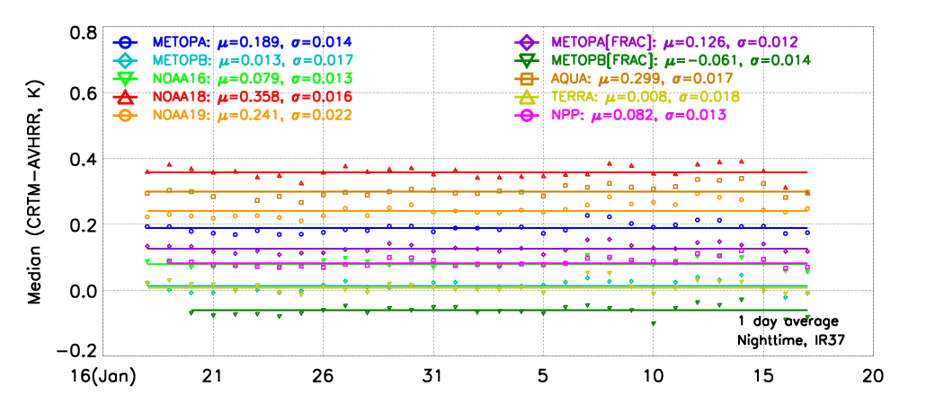
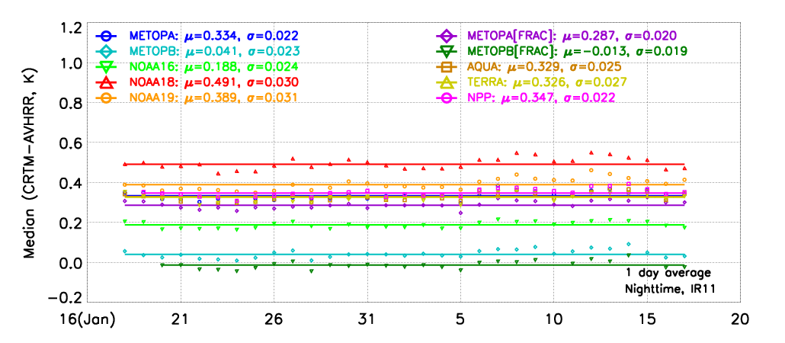
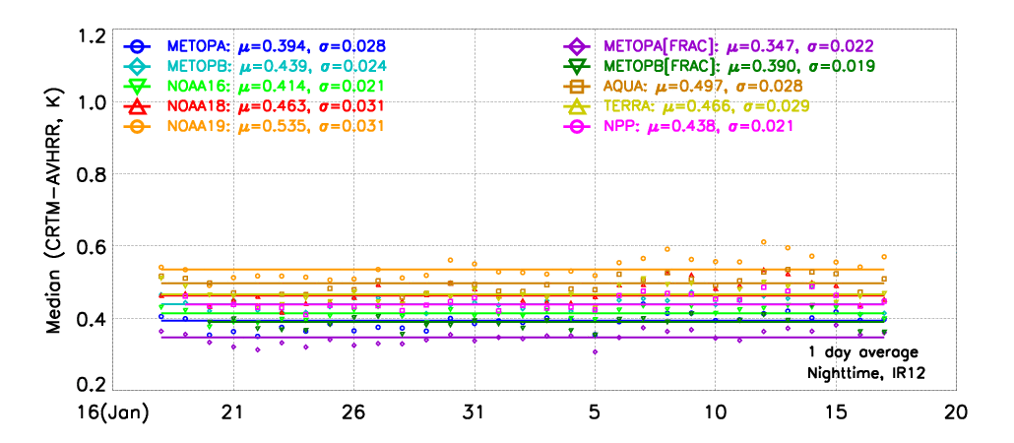
Time Series of M-O Biases Using ECMWF
M-O biases in IR37 change very little, as expected
IR37
~0.2K
IR11
M-O biases in IR11 & IR12 reduce by ~0.2K
~0.3K
IR12
ECMWF
~0.4K
GSICS 2014 annual meeting, March 24-28, 2014, EUMETSAT, Darmstadt, Germany
Slide 15 of 18

Slide 16
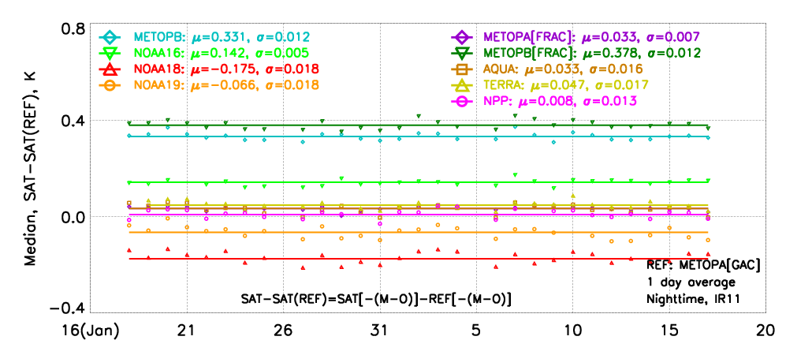
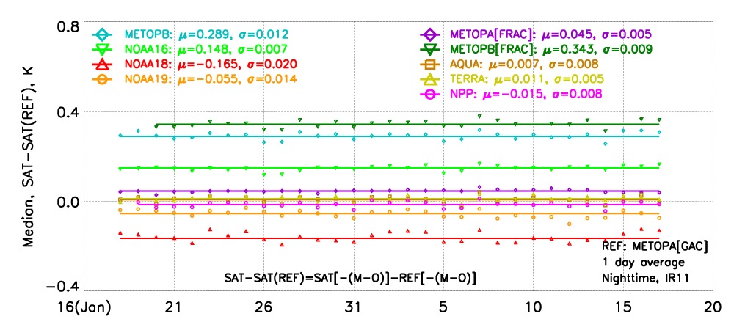
Double difference (IR11)
GFS and ECMWF DDs are within several 0.01K
GFS
However, for ECMWF they seem to cluster a little closer to the desired “0” line
Also, the stability (measured by STDs) are somewhat better for ECMWF
ECMWF
GSICS 2014 annual meeting, March 24-28, 2014, EUMETSAT, Darmstadt, Germany
Slide 16 of 18

Slide 17
Conclusion and Future work
Conclusion and Future Work
GSICS 2014 annual meeting, March 24-28, 2014, EUMETSAT, Darmstadt, Germany
Slide 17 of 18

Slide 18
Conclusion
NRT monitoring of 5 AVHRRs, 2 MODISs and VIIRS in MICROS sustained
5+ years of data are now available (2008-2014)
AVHRRs on Metop-A, -B, N-17, -19, and MODIS & VIIRS are stable
AVHRRs on N-16 and -18 are less stable
Documented in Liang and Ignatov, JGR, 2013
12+ years (2002-pr) of 7 AVHRRs GAC reanalyzed & displayed in MICROS
Use consistent versions of ACSPO & CRTM, and Reynolds/GFS input data
Ranked stability: Metop-A > N-17 > Metop-B > N-19 > N-18 > N-16 > N-15
ECMWF tested as CRTM input as alternative to current GFS
More clear-sky ocean pixels (positive effect of cloud mask)
STDs of M-O biases are smaller for IR11 & 12; Unchanged for IR37
Warm M-O bias in IR11&12 become closer to 0
Stability slightly improved for all bands and SST
GSICS 2014 annual meeting, March 24-28, 2014, EUMETSAT, Darmstadt, Germany
Slide 18 of 18

Slide 19
Future Work
Extend AVHRR GAC ACSPO-RAN back to ~1992 & Display in MICROS. Need help from sensor CAL community to Improve AVHRR Sensor Radiances (Calibration, Spectral Responses)
Extend ECMWF vs. GFS comparisons. Additionally analyze ERA-Interim & MERRA profiles
Analyze & Improve daytime M-O biases and DDs
Complete and document consistent CRTM coefficients analyses
Add GEO (MSG/SEVIRI, Himawari/AHI, GOES-R/ABI) and LEO (ESA/AATSR) in MICROS
Extend MICROS to Include Reflectance Bands (use CRTM in conjunction with GOCART/NAAPS aerosol data)
Work with CAL/GSICS community, to explore adding hyper-spectral (AIRS/IASI) transfer standard, in addition to CRTM
GSICS 2014 annual meeting, March 24-28, 2014, EUMETSAT, Darmstadt, Germany
Slide 19 of 18

