Slide 1
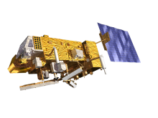
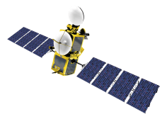
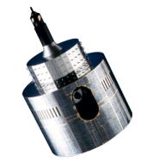
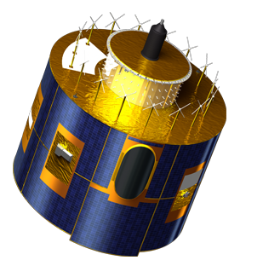
Lunar Calibration Workshop
Status of the preparation
Sébastien Wagner (EUMETSAT)
In collaboration with
Tom Stone (USGS)
Sophie Lachérade, Bertrand Fougnie (CNES)
Jack Xiong (NASA)
Notes:
EUM/STG-SWG/36/14/VWG/15

Slide 2
Workshop preparation
In June, web meeting to kick off the activity ➔ series of presentations to explain:
The objectives of the workshop and the expectations
The time line
The preparation of the data
The GIRO application
Organizers deliver the GSICS Implementation of the ROLO (GIRO) application to participants (initially as an executable) ➔ same tool for all teams
In order to 1) attend the workshop and 2) to maximize the outcome of the workshop ➔ Participants should prepare their own data + process them with the GIRO application + iterate with the organizers before the workshop

Slide 3
Draft time line – as presented in June
Time line | Organizers | Participants
24/06/2014 | Kick-off lunar calibration workshop web meeting
July – August | Development / Finalization of the GIRO application Documentation on GSICS / Lunar Calibration Wiki | Participants to prepare input data (extraction / reformatting)
End August / Early September | Provide the GIRO application
 |  | Feedback / Output
September / October | Updates / Support
November | Output screening / Feedback to participants | Re-processing if needed
01/12/2014 - 04/12/2014 | Lunar calibration workshop at EUMETSAT Darmstadt, Germany

Slide 4
Draft time line – as presented in June
Time line | Organizers | Participants
24/06/2014 | Kick-off lunar calibration workshop web meeting
July – August | Development / Finalization of the GIRO application Documentation on GSICS / Lunar Calibration Wiki | Participants to prepare input data (extraction / reformatting)
End August / Early September | Provide the GIRO application
 |  | Feedback / Output
September / October | Updates / Support
November | Output screening / Feedback to participants | Re-processing if needed
01/12/2014 - 04/12/2014 | Lunar calibration workshop at EUMETSAT Darmstadt, Germany
WE ARE HERE NOW

Slide 5
What was done and current status
First version of the GIRO provided in July to participants in order to test it on their architectures. Version with I/O handling only.
➔ We had some participant feedbacks and some minor issues were corrected
➔ Support was also provided on preparing the input data (SRFs, Lunar observations)
The ROLO model was ported into the GIRO following EUMETSAT’s IDL implementation
Updated GIRO application fully tested and compared with USGS’s version (see presentation by Tom and Bart)
Set-up of a dedicated wiki page to gather information related to the Lunar Calibration Workshop and to GSICS activities on lunar calibration
https://gsics.nesdis.noaa.gov/wiki/Development/LunarWorkArea

Slide 6
Next steps
Week 38: distribution of the full GIRO application to the participants
Between now and end of October:
Continue preparing the input data for the participating instruments
Support to the participants if required
Feedbacks on the GIRO application
Starting in November (or as soon as GIRO outputs start being produced): results screening. Participants are asked to send their results (as available) for a pre-check. Purpose: limit pitfalls in the data preparation to have a last iteration before the workshop where results will be discussed.
Finally, Lunar Calibration Workshop – Four-day meeting in December (01/12/2014 – 04/12/2014)

Slide 7
Next steps
In order to prepare the workshop, need to collect information from the participants: as stated at the K-O, one of the main objectives of the workshop is to build a data set of lunar observations and make it available to the calibration/inter-calibration community (GSICS, CEOS IVOS, etc.)
SRFs converted into GSICS NetCDF format (support can be provided by M. Takahashi – JMA / GSICS Data WG)
➔ Currently we have a limited set of SRFs already available on the GSICS wiki
Input files for the GIRO
If there are issues in provided SRFs or input data, please let us know

Slide 8
In case of delays...
Potential other dates:
08/12/2014 – 12/12/2014
January 2015 at the latest
➔ Gives time to participants to work on their data before the GSICS Research and Data Working Group Annual Meeting
(16/03/2015 – 20/03/2015, hosted by the India Meteorological Department in Delhi - India)
➔ IF ANY SERIOUS ISSUE: date will be discussed at the progress meeting
Final decision relies on:
Amount of participating teams with data ready to be processed by the GIRO application
Would it help participants to have an extra few weeks (Workshop in January)?

Slide 9
Analysis tools
Still needs to be discussed between organizers and within GSICS Research WG.
EUMETSAT will not provide an official tool to visualize / analyse the results
Tools to navigate + analyse the results ➔ responsibility of each participant
HOWEVER:
EUMETSAT has its own needs for visualizing / analysing results and data
IDL ad hoc routines for internal purposes
Could be provided WITHOUT SUPPORT to participants to make the development faster to prepare the workshop.

Slide 10
Draft agenda of lunar calibration workshop
Day 1
Introduction to the workshop: goals, expectations, practicalities.
General presentation(s) on lunar calibration: description of the lunar reference, uncertainties, current limitations, common identified pitfalls when analysing the data.
Description of the lunar calibration system as provided to the attendees.
Establishing a lunar calibration reference data set for the calibration community.
Recommendations on how to derive the observed irradiance from the available imagery.
Beyond the workshop: a framework for using a common referenced and validated calibration and inter-calibration reference.
Starting presentations by each group on their datasets. Presentations will address separately GEO and LEO platforms as these two types of orbits raise specific issues.

Slide 11
Draft agenda of lunar calibration workshop
Day 2
Continuation of the presentations by each group about their data sets
Preliminary results obtained in preparation for the workshop.
Day 3
Discussion on the results presented by each group to identify potential deficiencies in the data preparation
Discussion on the use of the GIRO.
Sensitivity analysis to be performed on the data brought by each participant (practical work performed on the EUMETSAT Technical Computer Environment).
Day 4
Guidance and recommendations on:
How to prepare the data.
How to interpret the results.
Wrap-up and way forward.
Expectation from the GIRO users (needs, requirements)

Slide 12
Conclusion
We are on track with respect to the initial plan
Target still remains to have the workshop organized in December.
But this depends on how ready are the potential participants (see presentation and discussion on the data sets preparation)

