Slide 1
Planning GCC Topics for
Annual Meeting
Manik Bali, Larry Flynn
NOAA/STAR

Slide 2
Possible Topics we can cover
GCC Operations during the year 2014.
GPPA:
Timeliness
What are GSICS Products?
GSICS Roster, Do we need update the roster ?
GSICS Newsletter
Future Editions, Ideas for Special Issues

Slide 3
Possible Topics we can cover
GSICS Product Promotion
What could be the bar for promoting Pre-Op products to Op products.
Introduction of GSICS-affiliated products
Status of upcoming products [Can be covered in the plenary ].
Traceability document for VIS products.
Plan for product acceptance and promotion for VIS, KMA, CMA, ISRO [GCC Role]
GCC User Interaction
Engaging users-GPPA

Slide 4
Planning for GSICS Data Working Group

Slide 5
Topics
Establish GSICS standards for datasets ( VIS- JMA, MW-NOAA)
Repository for archiving datasets (e.g. SRFs) ( NOAA )
Repository for sharing codes (Github), (NOAA )
Repository for sharing tools (e.g. SBAF), ... ( JMA )
netCDF formats for combined products (NOAA, JMA )
Plotting Tool - Enhancement for CMA IR products ( EUMETSAT )
Plotting Tool - Extension to DCC & Lunar results (EUMETSAT, JMA )
Role of GSICS Coordination Center (NOAA )
Event logging (Rob) ( EUMETSAT, NOAA )
GPPA automation (Pete) (EUMETSAT )
GSICS Server - THREDDS configuration, directory restructuring and upgrades ( ALL )
Notification of product updates - through GSICS User Messaging Service ( NOAA, Discuss)
DOIs for products (raise in plenary first) ( NOAA )
GSICS File Conventions - Review process for updates ( NOAA, To be connected with GPPA on a separate thread )
Combining VIS/NIR+IR products - one product per instrument! (Joint with GRWG) ( EUMETSAT ALL )
Requirements for L1 source data to be shared on GSICS Servers ( Discussion and consensus, ALL )
Requirements for cropping L1 source data for LEO-LEO (Discussion )
Requirements for L1 source data from other GPRCs (Discussion )
Report from GPRC’s
Support to IMD Data Center and ISRO, CMA KMA
OSCAR WMO Landing Pages ( EUMETSAT , NOAA )
Action Items

Slide 6
Proposed GDWG Sessions
Slots Available
Wednesday 3 half sessions can be organized
Thursday 3 half session
Friday GDWG/GRWG Wrapup

Slide 7
Proposed GDWG Sessions
GDWG Activities KMA, CMA, ISRO, IMD, NOAA, EUMETSAT, JMA
File naming Meta Data standardizations.
Event logging, calibration chain alerts
Data/code Sharing ( Wiki, Github, etc )
Plotting tools and thredds server
GDWG Action Items & Preparation for 2015 UW and Roadmap

Slide 8
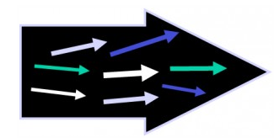
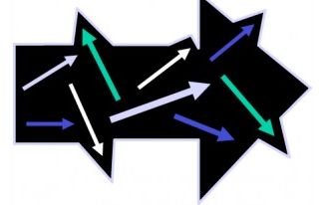
Resources/Contributions & Proposed Solutions
Option 1
Asking agencies to strictly follow GSICS
Good but unrealistic scenario
Option 2
Option adhered to in GDWG
Pete and Simon requested to chair GDWG meetings only
Masaya and I contributed towards products.
GSICS respects the goals of the agency
Get shared resources
Avoids delays in product submission
Align GSICS goals with agencies
Will changing the chair of a group or subgroup bring in resources ??

Slide 9
THANK YOU

