Slide 1
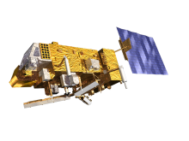
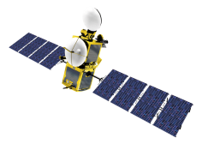
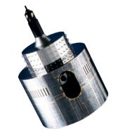
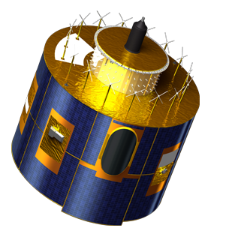
EUMETSAT Agency Report
2014/15 GSICS activities
J. Ackermann, S. Elliott, T. Hewison, K. Holmlund, V. John, R. Munro, P. Miu, A. O’Carroll, R. Roebeling, H. Rothfuss, B. Viticchiè, S. Wagner

Slide 2
Overview
Team
Satellite Status
Status of outstanding GSICS actions on EUMETSAT
Achievements and on-going work:
IR sub-group
VIS/NIR sub-group
MW sub-group
UV sub-group
Data working group
Instrument Calibration Event Logs & Information

Slide 3
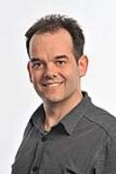
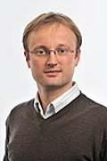
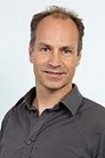
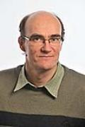
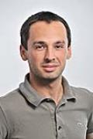
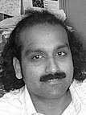
EUMETSAT GSICS Personnel Changes
Executive Panel
Ken Holmlund | EUMETSAT representative
Data Working Group
Peter Miu | Co-chair + Data management expert
Simon Elliott | Formats Expert
Research Working Group
Tim Hewison | Chair + Infra-Red (sub-group chair)
Sébastien Wagner | VIS/NIR + Lunar calibration
Rob Roebeling | Archive re-calibration
Rosemary Munro | Chair UV sub-group
Joerg Ackermann | Microwave
Supported by
Bartolomeo Viticchiè | VIS/NIR + Lunar calibration
Viju John | Infra-red (Meteosat - HIRS)
Anne O’ Carroll | Infra-red (AVHRR - IASI)
Point of Contact for Operational Matters
Harald Rothfuss

Slide 4
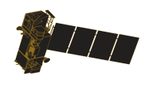
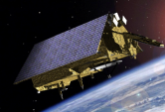
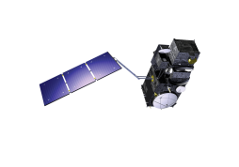
EUMETSAT commitment to long term continuity...
YEAR...
03
04
05
06
07
08
09
10
11
12
13
14
15
16
17
18
19
20
21
22
23
24
25
26
27
28
29
30
31
32
33
34
35
36
37
38
39
40
METEOSAT FIRST GENERATION
METEOSAT-7
METEOSAT SECOND GENERATION
METEOSAT-8
METEOSAT-9
MSG-3/METEOSAT-10
MSG-4/METEOSAT-11*
METEOSAT THIRD GENERATION
MTG-I-1 : IMAGERY
Mandatory Programmes
MTG-S-1: SOUNDING
MTG-I-2: IMAGERY
MTG-I-3: IMAGERY
EUMETSAT POLAR SYSTEM (EPS)
MTG-S-2: SOUNDING
METOP-A
MTG-I-4: IMAGERY
METOP-B
METOP-C
EPS-SECOND GENERATION (EPS-SG)
METOP-SG: SOUNDING AND IMAGERY
METOP-SG: MICROWAVE IMAGERY
Optional Programmes
JASON
JASON-2
JASON-3
SENTINEL 6 (JASON-CS)
Third Party Programmes
COPERNICUS
SENTINEL-3
SENTINEL-4 ON MTG-S
SENTINEL-5 ON EPS-SG
YEAR...
03
04
05
06
07
08
09
10
11
12
13
14
15
16
17
18
19
20
21
22
23
24
25
26
27
28
29
30
31
32
33
34
35
36
37
38
39
40

Slide 5
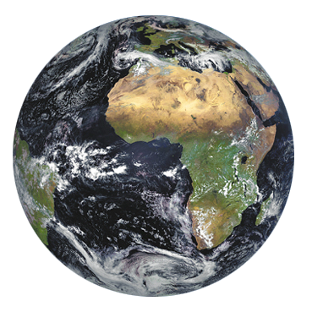
Current EUMETSAT satellites
METOP A-B
(LOW-EARTH, SUN – SYNCHRONOUS ORBIT)
EUMETSAT POLAR SYSTEM/INITIAL JOINT POLAR SYSTEM
JASON-2
(LOW-EARTH, 63° INCL. NON SYNCHRONOUS ORBIT)
OCEAN SURFACE TOPOGRAPHY MISSION
METEOSAT – 7 (1st GENERATION)
(GEOSTATIONARY ORBIT)
INDIAN OCEAN DATA COVERAGE MISSION AT 57°5 E
(UNTILL END 2016)
METEOSAT 8-9-10-11 (2nd GENERATION)
(GEOSTATIONARY ORBIT)
TWO-SATELLITE SYSTEM:
METEOSAT - 10: FULL DISK IMAGERY MISSION AT 0° (15 MN)
METEOSAT - 9: RAPID SCAN SERVICE OVER EUROPE AT 9.5°E (5 MN)
METEOSAT - 8: BACK UP AT 3.5°E
METEOSAT - 11: STORAGE

Slide 6
Meteosat-8 to 40°E after MSG-4 launch
2015
2016
2017
2018
2019
2020
2021
N
D
J
F
M
A
M
J
J
A
S
O
N
D
J
F
M
A
M
J
J
A
S
O
N
D
J
F
M
A
M
J
J
A
S
O
N
D
J
F
M
A
M
J
J
A
S
O
N
D
J
F
M
A
M
J
J
A
S
O
N
D
J
F
M
A
M
J
J
A
S
O
N
D
J F M A M J J A S O N D
MSG-4 Commissioning
Met-11 IOS (Duration TBD)
MTG-I1 Commissioning
Met-12 drift start
3.4ºW
MSG-4 Launch
Met-11 drift start
MTG-I1 Launch
MTG-S1 Launch
Met-11 drift stop
Met-12 drift stop
MTG-S1 Commissioning
Met-10 drift start
Met-11 drift start
0º
Met-10
Met-8 drift to IODC
Met-12
Met-8
Met-9 drift to 3.5ºE
Met-11
3.5ºE
Met-9
Met-9
9.5ºE
Met-9 RSS stop
Met-12 in parallel to Met-11
Met-10 RSS and Met-9 backup
Met-10
Met-10 RSS start
40ºE
57.5ºE
Met-7
Met-8 disposal
63ºE
Met-8 takes over IODC
Met-7 disposal
67.5ºE
MSG operations for IODC (or other) is TBD by Council
Duration of MSG-4 in orbit storage is TBD by Council
N
D
J
F
M
A
M
J
J
A
S
O
N
D
J
F
M
A
M
J
J
A
S
O
N
D
J
F
M
A
M
J
J
A
S
O
N
D
J
F
M
A
M
J
J
A
S
O
N
D
J
F
M
A
M
J
J
A
S
O
N
D
J
F
M
A
M
J
J
A
S
O
N
D
J F M A M J J A S O N D
2015
2016
2017
2018
2019
2020
2021

Slide 7
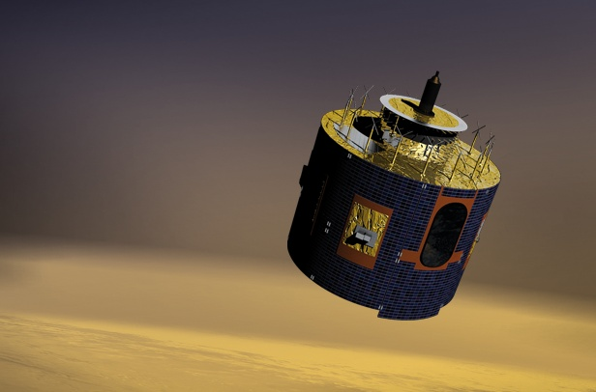
Geostationary satellites
Meteosat Second Generation (MSG)
4 geostationary weather satellites, operations at least until 2020 (end of MTG-I commissioning)
Full disk imagery: Imaging European weather, every 15 minutes with 12 spectral bands (currently Meteosat-10)
Rapid Scan Service (RSS) every 5 minutes (currently Meteosat-9): detection of rapid, local development of convective systems
Data collection for environmental monitoring
Plans to move Meteosat-8 to 40° to provide IODC – subject to final Council approval

Slide 8
EUMETSAT’s geostationary satellite coverage
60 N
Meteosat-10 (0° Longitude)
Meteosat-9 (9.5° E) (RSS)
Meteosat-8 (3.5 ° E) (Back-up)
0
Meteosat-7 (57.5° E)
80
60 S
160
140
120
100
80
60
40
20
0
20
40
60
100
120
140
160
180

Slide 9
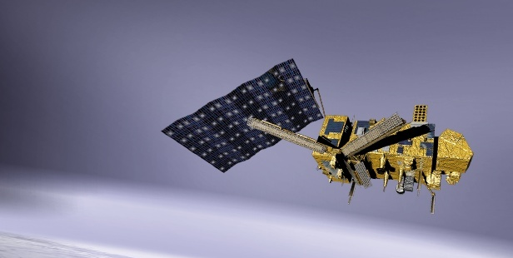
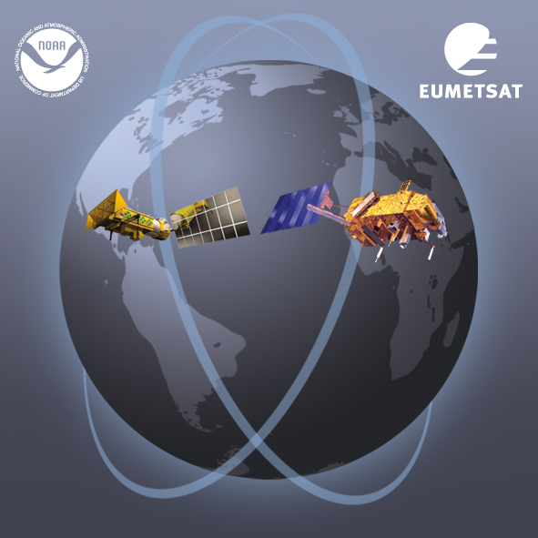
Current Polar-orbiting satellites: EUMETSAT Polar System
Dual operation of Metop-A and Metop-B
Metop-A launched in 2006: 21:30 Asc
Metop-B launched in 2012: +48 min
Metop-B prime satellite since April 2013
Metop-C launch planned for 2018
Part of Initial Joint Polar System shared with NOAA
Missions and Payload
Imagery (VIS, IR), sounding (IR, MW, UV, GPS occultation), radar (ASCAT)
direct broadcasting and data collection capabilities
Applications
Numerical Weather Prediction and Nowcasting at high latitudes
Marine meteorology and oceanography
Air quality, atmospheric chemistry

Slide 10
Status of Outstanding Actions on EUMETSAT

Slide 11
Governance/ Progress meetings, reporting and action tracking
No pending actions
Enhancing Outreach and User Interaction – Inform GSICS community & beyond and seek feedback
Action Ref. | Description | Assigned to | Due date | State
GRWG06_17 | Find out time overlaps between geostationary satellites (commissioning and operational periods), find out about the availability of such data and publish this information on the GSICIS Wiki | AllGPRCs | 01 Dec 2011

Slide 12
Actions on EUMETSAT Closed during 2014/15
Action Ref | Description | Assigned to | Due Date | State
GRWG_14.5 | S. Wagner to share strawman netCDF file for DCC products for review at web meeting. | S. Wagner | 1 May 2015 | Closed web meeting
GRWG_14.6 | EUMETSAT and JMA to prepare a list of requirements to participate in a lunar calibration workshop, applying a common version of the ROLO model and report on timing and feasibility of hosting such an event in time for workshop at a web meeting in May/June 2014. | T. Hewison, M. Takahashi | 1 May 2015 | Closed web meeting.
GRWG_14.11 | Tim Hewison to send CNES example GSICS Corrections with embedded delta corrections for further analysis. | T. Hewison | 1 May 2015 | Closed by email
GRWG_14.12 | EUMETSAT to implement the delta corrections in GSICS products using MetOp-B/IASI. | EUMETSAT | 1 May 2015 | Closed web meeting
GRWG_14.34 | EUMETSAT to provide feedback at web meeting on how to handle DCC seasonality by Oct 2014. | EUMETSAT | 1 May 2015 | Closed web meeting
GRWG_14.37 | Lunar calibration workshop organizers to provide one page summary on how the diffusion of lunar calibration expertise is intended to be done (as an example for best practise). To be also published in the GSICS Quarterly. | S. Wagner | 1 May 2015 | Closed

Slide 13
Status of Outstanding Actions on EUMETSAT
Action Ref | Description | Assigned to | Due Date | State
GRWG05_08 | Investigate the possibility to supply GEO data over desert sites to the SADE database | EUMETSAT | 01 Mar 2011 | Open
Several | Actions related to Instrument Events Logs will be reported by Rob
GWG_13.14 | EUMETSAT to propose solution based on modification of plotting tool and server structure and content to allow daily results to be displayed by 1 Sept 2013. | T. Hewison | 01 Sep 2013 | Late
GWG_13.37 | EUMETSAT (lead) + GDWG members to work with EUMETSAT to use their bias plotting tool for GPRC product monitoring plots. | T. Hewison | 01 Mar 2014 | Late
GWG_13.25 | Each GPRC provides angular data available in the May web meeting and present the result to decide ADM model in another web meeting in summer; July-Nov for threshold sensitivity analysis. | GPRC | 1 May 2014 | Close?
GWG_13.30 | All GPRCs to provide GCC with links to the official SRFs for all instruments for which GSICS Products are being developed for publication on GCC website. - Links to SRFs from NASA/NOAA/EUMETSAT/CMA/JMA are now available on the GCC website [TimHewison, 2015-01-23] | GPRC | 1 Jul 2014 | Close?

Slide 14
Status of Outstanding Actions on EUMETSAT – cont.
Action Ref | Description | Assigned to | Due Date | State
GRWG_14.13 | CNES and EUMETSAT to investigate differences in their IASI-A, -B and CrIS? comparison methods and results, and report these by the next annual GRWG meeting. | CNES + EUMETSAT | 1 May 2015 | ongoing analysis, to be included in new “Traceability Statement”.
GRWG_14.17 | EUMETSAT to report the AVHRR-IASI inter-calibration work in next meeting. | EUMETSAT | 1 May 2015 | Not on!?
GWG_13.12 | NOAA & EUMETSAT to analyse GEO-GEO difference after applying the GEO-LEO correction to quantify the diurnal calibration uncertainty before promotion to Operational status. | EUMETSAT | 01 Sep 2014 | See Thurs am 5l
GWG_13.16 | Tim Hewison to draft example of netCDF file incorporating the delta correction to convert from MetopB/IASI to MetopA/IASI and distribute to GRWG+GDWG. | T. Hewison | 01 Mar 2014 | Done See Thurs am 5h

Slide 15
Status of Outstanding Actions on EUMETSAT – cont.
Action Ref | Description | Assigned to | Due Date | State
GRWG_14.27 | All GPRCs to review their GSICS websites to take into account of the new developments in GSICS as these websites will be reviewed in the next joint meeting. | All GPRCs | 1 May 2015 | On GDWG agenda
GRWG_14.30 | EUMETSAT to support the creation of a GitHub? account for uploading the GSICS related codes for collaboration development. | All GPRCs | 1 May 2015 | On GDWG agenda
GRWG_14.31 | EUMETSAT to prepare a proposal for automating the GPPA and demonstrate this in a Webex meeting. | EUMETSAT | 1 May 2015 | Pete’s ppt
GRWG_14.21 | EUMETSAT shall provide a method to formalise this (GPPA) process in an automated way (if possible). | EUMETSAT | 1 May 2015 | Pete’s ppt
GRWG_14.33 | EUMETSAT to share with IMD plans for reprocessing of the archive data (re-calibration) | EUMETSAT | 1 May 2015 | Rob to follow-up
GRWG_14.35 | EUMETSAT/NOAA/NASA/JMA to perform analysis to evaluate the optimal temporal resolution for a DCC product. GPRCs are invited to report at the next web-meeting on the DCC method. | EUMETSAT, NOAA, NASA, JMA | 1 May 2015 | Wed session
GRWG_14.38 | Tim Hewison to provide a one-page summary GEO/LEO IR products for QA4EO best practices showcase. | TimHewison | 1 May 2015 | Open
GRWG_14.40 | Rob Roebeling and Dave Doelling to communicate on possibility of collaborations on inter-calibration / re-calibration in support to SCOPE-CM activities and report. | Rob Roebeling Dave Doelling | 1 May 2015 | Rob to follow-up here

Slide 16
Lunar Calibration Workshop – See Wed pm 3k
☑
GLCWS_14.3 | EUMETSAT, NASA (VIIRS + Landsat teams) and USGS to interact and investigate the discrepancies observed in the 2.2 microns band. | 01 Dec 2015
GLCWS_14.5 | All participants to provide lunar irradiances from the missing instruments to the common lunar calibration data set. | 01 Dec 2015
GLCWS_14.6 | EUMETSAT to circulate a draft for a data sharing and GIRO usage policy to the workshop participants. This should include the requirements for newcomers to join the community and get access to the data and the GIRO. | 01 Dec 2015
GLCWS_14.8 | All participants to report any restrictions on the use of their datasets in relation to the proposed data sharing policy. | 18 Mar 2015
GLCWS_14.9 | Establish a proposal for the way forward on a comparison of instruments with similar SRFs and phase angles. EUMETSAT will circulate a proposal to the Lunar Calibration Workshop participants by mid January. | 01 Dec 2015
GLCWS_14.11 | EUMETSAT should implement a systematic bias on the irradiance in the GIRO PERT. | 18 Mar 2015
GLCWS_14.12 | EUMETSAT should implement the proposed formulation for the calculation of the effective wavelength (see the minutes of the Lunar Calibration Workshop). | 18 Mar 2015
GLCWS_14.13 | EUMETSAT to revisit the change of the SRF shape in order to be more realistic. | 18 Mar 2015

☑

☑
☒
☑
☑

Slide 17
EUMETSAT achievements – IR subgroup
Status of Current products
Meteosat-9,-10/SEVIRI-Metop-A/IASI Pre-Op – See 5c
Progress to Operational
Meteosat-8/SEVIRI-Metop-A/IASI Demo
Limited capacity on processing system
Expected to promote to Operational in 2015
Meteosat-7/MVIRI-Metop-A/IASI Demo
Algorithm implemented for Reprocessing – See 1e
Development of New products
Prime GSICS Corrections – See 5h
Combines results from IASI/Metop-A & -B
Ready to submit as Demo GSICS product
AVHRR-IASI to prepare for Sentinel-3/SLSTR – See GSICS 2014 Annual Meeting 1h
Support for EU Horizon2020 FIDUCEO project
Maybe future GSICS product?
For past instruments:
Recalibration of MFG archive for IR/WV channels (FCDR available by end 2015) ➔ See 1e + 2s
Generation of FCDRs with HIRS and AVHRR to serve as references (FIDUCEO project)

Slide 18
EUMETSAT achievements – VIS/NIR subgroup
Lunar Calibration Workshop (in collaboration with CEOS/IVOS) – See 3k
Development of GSICS Implementation of ROLO
First iteration on the GSICS Lunar Observation Dataset
Support to visiting scientists from JMA and CMA with MTSAT2, Himawari-8/AHI & FY2E – See 3n and 3l
Deep Convective Clouds – See 3g
Accounting for seasonal variations
Support to visiting scientists from JMA and CMA with MTSAT2 & FY2E
EUMETSAT’s ATBD ready
Preparing the demo product (expected in 2015)
Support to SCOPE-CM: DCC time series for Meteosat-7
On-going implementation of the GIRO in operation to monitor Meteosat-7, -8, -9, -10 and soon -11
Incrementing our monitoring capabilities (integrated multi-mission approach) + method combination to derive robust calibration information

Slide 19
EUMETSAT achievements – MW subgroup
Planned activity for past instruments:
FCDR of microwave humidity sounders L1 data (SSM/T2, AMSU-B, MHS) (FIDUCEO project)

Slide 20
EUMETSAT achievements – UV subgroup
Formation of UV Sub-Group
➔ New Chair: Rosemary Munro
Within the framework of Atmospheric Composition Group activities:
CEOS WGCV: Support to the preparation of a workshop on sensor on-ground and in-orbit (no-vicarious) calibration. Proposal to be presented to WGCV in May (still in planning stage)
Contribution to the inter-comparison between the OMPS and GOME-2 Sensor Data Record/L1b by Wu et al. (presented at the 2014 EUM User Conference)
Prototyping of an inter-calibration procedure for GOME-2/MSG (VIS06) and GOME-2/AVHRR channel 1.
Preparing for routine AVHRR-GOME-2 and IASI sensor inter-calibration within the operational PMAp EPS multi-mission sensor co-location and co-registration framework ➔ Potential for producing time series of AVHRR Ch1(2)/GOME-2 and AVHRR T4/5/IASI inter-calibration coefficients.
Potential for new GSICS products?

Slide 21
EUMETSAT achievements – Data Working Group
Improvement of the GSICS plotting tool performances.
Support to NOAA to ensure compatibility of their pre-operational GSICS RAC products with the GSICS plotting tool.
CMA technical expert hosted for 3 months at EUMETSAT HQ. Main activities:
Configuration of CMA GSICS collaboration server
Support to the validation of a GSICS product development framework developed by EUMETSAT
Familiarisation with on-going GSICS tasks
Event logging
Product notification and distribution
Data product contents wrt guidelines + conventions + standards
Familiarisation with Data Centre operational environment + archiving of data
See GDWG report ➔ 2c

Slide 22
EUMETSAT achievements – Event logging
Collection of the landing pages from the GRPCs started and is ongoing
WMO OSCAR is being modified to host our landing pages
A calibration events Task Team with members from the GRPCs has been established.
Discussions on mandatory information at the landing pages to be started
Discussion on using common nomenclature for calibration events and monitoring to be started

Slide 23
EUMETSAT GSICS Products Development Timeline
Planned activities
?

Slide 24
Summary
Calibration is key to ensuring EUMETSAT achieves its objectives:
1. To establish, maintain and exploit European systems of operational meteorological satellites
2. To contribute to the operational monitoring of the climate & the detection of global climatic changes
3. Furthermore, other environment monitoring issues are considered when interactions with the atmosphere or the ocean are involved
EUMETSAT continues to develop new calibration capabilities
For real-time operations
Support of climate reanalysis
Support to future programs (MTG + EPS/SG) + third party programs (S3)
In international cooperation, including:
Global Space-based Inter-Calibration System
CEOS WGCV

Slide 25
Thank you

