Slide 1
JMA Agency Report
Arata Okuyama, Masaya Takahashi, Hidehiko Murata, Ryoko Yoshino, Keita Hosaka, Tasuku Tabata
Meteorological Satellite Center,
Japan Meteorological Agency

Slide 2
Contents
Update of JMA GSICS members
Summary of JMA action status
Uncertainty evaluation of MTSAT-2 vs. IASI/AIRS GSICS Correction
GEO-GEO-IR comparison
Temporal resolution of the DCC inter-calibration
Event logging - landing page for the JMA GEO
2014 achievements / 2015 work plan
MTSAT-2 lunar calibration using the GIRO
Investigation of seasonality on the DCC inter-calibration method
JMA SCOPE-CM activities
Summary and future plans

Slide 3
JMA GSICS members
EP
Arata Okuyama
GRWG
Arata Okuyama
Masaya Takahashi
Hidehiko Murata
Ryoko Yoshino
GDWG
Masaya Takahashi
Keita Hosaka
New
Come back to the GRWG!
New
New
Co-chair Feb 2015~
GPAT member: Arata
Point of operational contact: Arata
New
Member | GRWG | GDWG | GEO-LEO-IR | DCC | Moon | Vicarious method (RTM) | Ray matching | GEO-GEO | On-board
Masaya Takahashi (Mr.) | Y | Y | Y | Y | Y | (Y)
Arata Okuyama (Mr.) | Y |  |  |  | Y | Y
Ryoko Yoshino (Dr.) | Y |  | Y |  |  |  | Y
Keita Hosaka (Dr.) |  | Y |  |  |  |  |  |  | Y
Hidehiko Murata (Mr.) | Y |  |  |  |  |  |  | Y

Slide 4
Status of GRWG actions assigned to JMA
Action Ref | Description | Assigned to | Due Date | State
GWG_13.10 | JMA to complete Uncertainty analysis for MTSAT-IASI products by analyzing random errors contribution from spatial and temporal variability at least and combine these with the currently analysed systematic uncertainty. That will be sufficient for promotion to pre-operational status. | JMA (M. Takahashi) | 01 Mar 2015 | Closed (Report Thurs am)
GRWG_14.8 | CMA and JMA to present their analysis on GEO-GEO IR products at the next meeting. | CMA/JMA | 01 May 2015 | Report Thurs pm
GRWG_14.35 | EUMETSAT/NOAA/NASA/JMA to perform analysis to evaluate the optimal temporal resolution for a DCC product. GPRCs are invited to report at the next web-meeting on the DCC method. | EUMETSAT/NOAA/NASA/JMA | 01 May 2015 | Open
*GLCWS_14.8 | All participants to report any restrictions on the use of their datasets in relation to the proposed data sharing policy. | All | 01 Mar 2015 | Closed
*JMA can share GMS/MTSAT/Himawari lunar observation netCDFs within the lunar calibration community!

Slide 5
Status of GDWG actions assigned to JMA
Action Ref | Description | Assigned to | Due Date | State
GDWG_14.2 | GDWG to investigate methods to structure the order the global attributes within the netCDF file - e.g. between attributes related to the method and the application. | JMA (M.Takahashi) | 01 Mar 2015 | Will be discussed
GDWG_14.3 | GDWG to investigate how to include algorithm type in filename | All | 01 May 2015 | Will be discussed
GDWG_14.8 | Masaya Takahashi (JMA) to check for a document regarding minimum content for GPRC GSICS webpage. If this document does not exist, then he shall author one and upload it to the Wiki. | JMA (M.Takahashi) | 01 Mar 2015 | Closed
GDWG_14.10 | All GPRCs to provide satellite instrument specific links to calibration events to WMO-OSCAR. | All | 01 May 2015 | Closed
GDWG_14.11 | All GPRC to seek consensus on common naming conventions for calibration events at the level of Main-Categories/Sub-Categories/Event Types. | All | 01 May 2015 | Will be discussed
GDWG_14.12 | EUMETSAT/NOAA/NASA/JMA to define a calibration events database design, and if needed, discuss this in a future webex meeting. | All | 01 May 2015 | Will be discussed
GDWG_14.14 | All GPRCs to review their GSICS websites to take into account of the new developments in GSICS as these websites will be reviewed in the next joint meeting. | All | 01 May 2015 | Will be discussed
GLCWS_14.7 | GSICS Data Working Group to identify a suitable mechanism for sharing the lunar calibration dataset. | GDWG (M.Takahshi) | 01 Dec 2015 | Will be discussed
GLCWS_14.9 | The GSICS Data Working Group is asked to develop a procedure for verifying users’ implementation of GIRO. | GDWG (M.Takahashi) | 24 Mar 2014 | Will be discussed

Slide 6
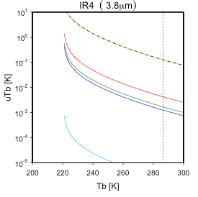
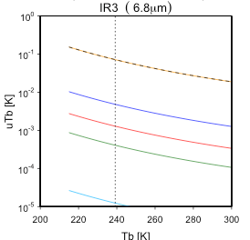
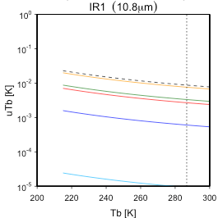
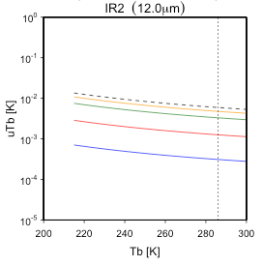
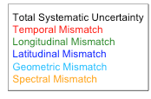
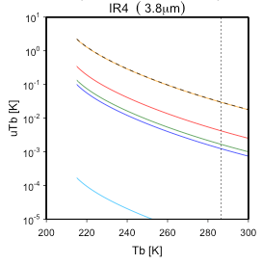
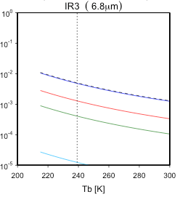
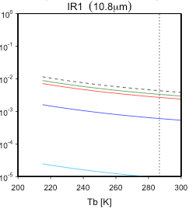
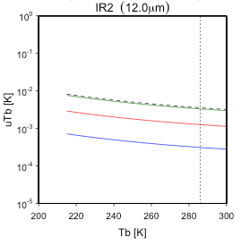
GWG_13.10, Thursday am (5a)
Uncertainty evaluation of MTSAT-2 vs. IASI/AIRS GSICS Correction
Systematic uncertainty
Spectral mismatch is dominant for all the channels
Promotion to be pre-operational phase
Almost ready to submit GPAF to the GPPA
Total systematic uncertainty at standard scene (TB@dotted line)
AIRS
0.13K 0.071K 0.0088K 0.0060K
IASI
0.030K 0.0050K 0.0043K 0.0036K

Slide 7
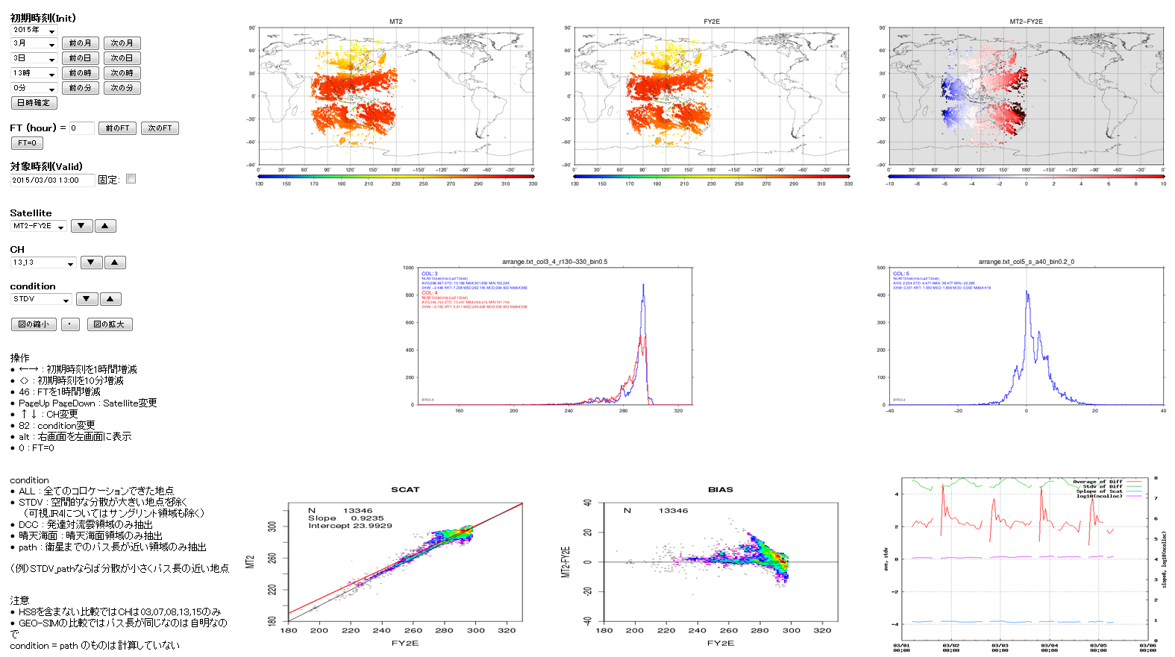
GRWG_14.8
Thursday pm (5l)
GEO-GEO-IR comparison
MTSAT-2 Tb
FY-2E Tb
Tb difference MTSAT-2 – FY-2E
Histogram of
Tb difference
Histogram of Tb
Scatter plot
Tb difference/Tb
Time series of statistics
Scatter plot Tb/Tb
MTSAT-2
MTSAT-2 – FY-2E
FY-2E
FY-2E
date
Operation panel
Averaged difference
(daily repeat of similar curve!)

Slide 8
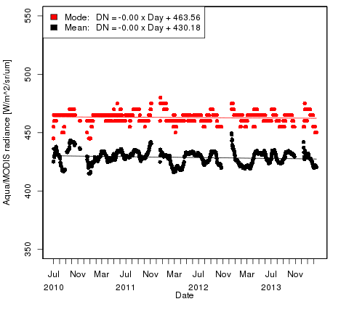
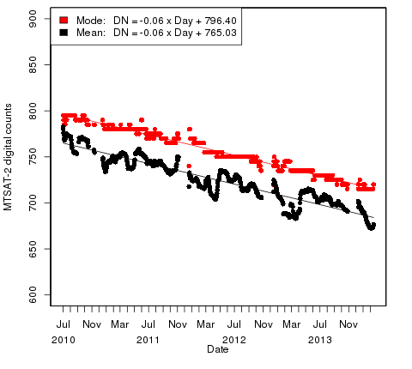
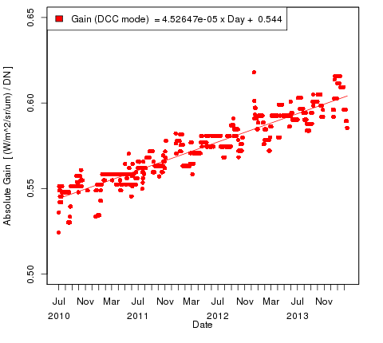
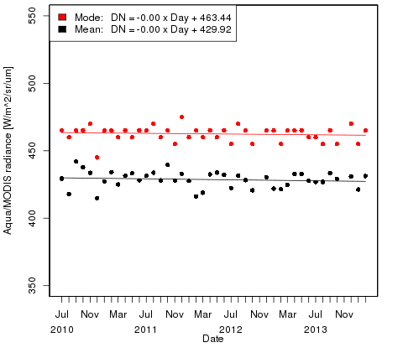
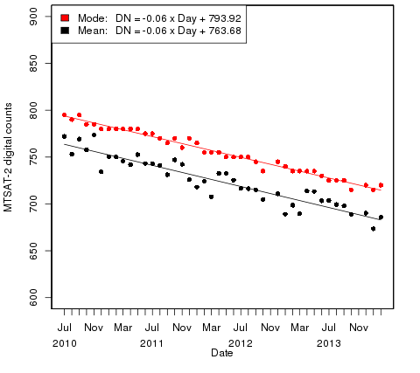
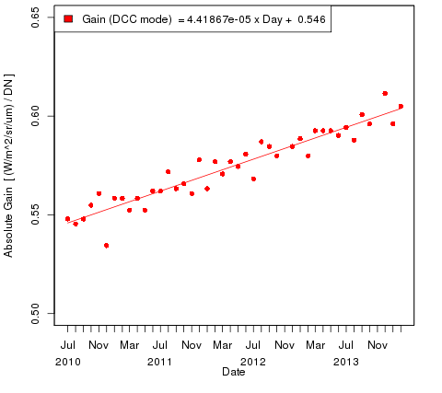
GRWG_14.35
Temporal resolution of the DCC inter-calibration
To be investigated further for demonstration products
30-day Rolling Ave.
AQUA/MODIS MTSAT-2/Imager MTSAT-2 Gain vs. MODIS
Monthly Ave.
8

Slide 9
Event logging - landing page for the JMA GEO
GDWG_14.10
http://www.data.jma.go.jp/mscweb/en/operation/calibration_portal.html
Will be linked from the WMO OCSAR!

Slide 10
2014 achievements / 2015 work plan
Lunar calibration of the MTSAT-2/Imager
Himawari-8/AHI radiometric calibration (in collaboration with NOAA and EUMETSAT)
Lunar calibration
DCC inter-calibration
Feasibility study for all VIS/NIR bands, Investigation on the seasonality
GEO-LEO-IR products
AHI-CrIS inter-calibration including the uncertainty evaluation
Ray-matching, RTM vicarious calibration, analysis of the solar diffuser calibration, etc.
SCOPE-CM calibration-related activities
Re-processing of surface albedo retrieval (LAGS)
Implementation of the DCC inter-calibration to GMS satellites
Inter-calibration of GMS WV/IR channels using HIRS (IOGEO)

Slide 11
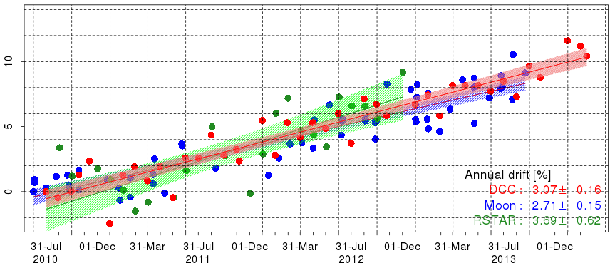
calibration slope vs. the ROLO (on the relative scale) - A way to monitor the instrument drift and compare with other calibration results
MTSAT-2 lunar calibration using the GIRO
Great collaboration with EUMETSAT and lunar calibration community!
Lunar calibration results
Good agreements with RTM and DCC, the smallest uncertainty of a regression line
F_{PIX} : Oversampling factor
Ω_{PIX} : Pixel solid angle [sr⁻¹]
Dc_{i} : Digital count of the Moon pixel
Off_{DC} : Averaged deep space DC
N_{PIX} : Number of the Moon pixels
[W m⁻² µm⁻¹ DC⁻¹]
Time series of MTSAT-2/Imager calibration slope difference (each method is rescaled at the first calibration result)
Hatch: 95% confidence interval of a linear regression line
Δslope [%]
Annual drift [%/yr]
DCC: 3.07 ± 0.16
Moon: 2.71 ± 0.15
RTM: 3.69 ± 0.62
11

Slide 12
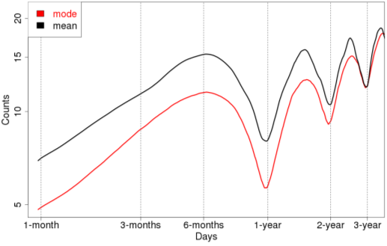
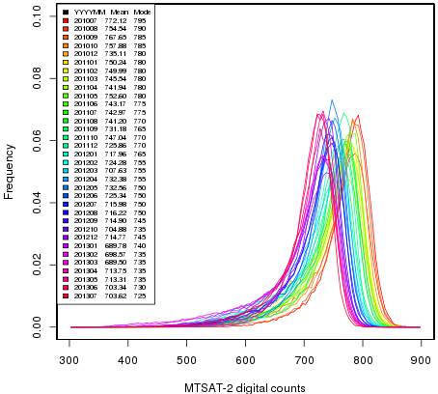
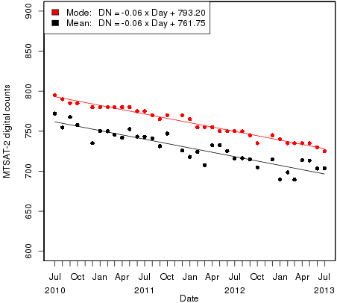
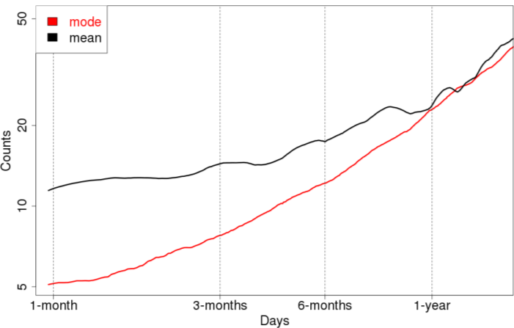
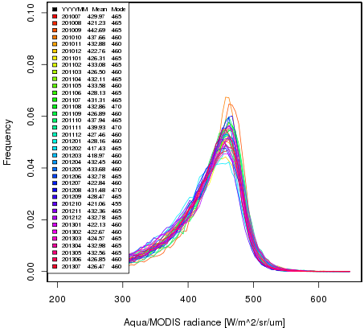
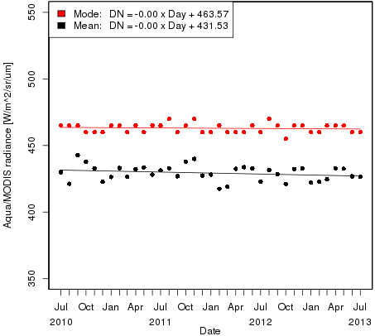
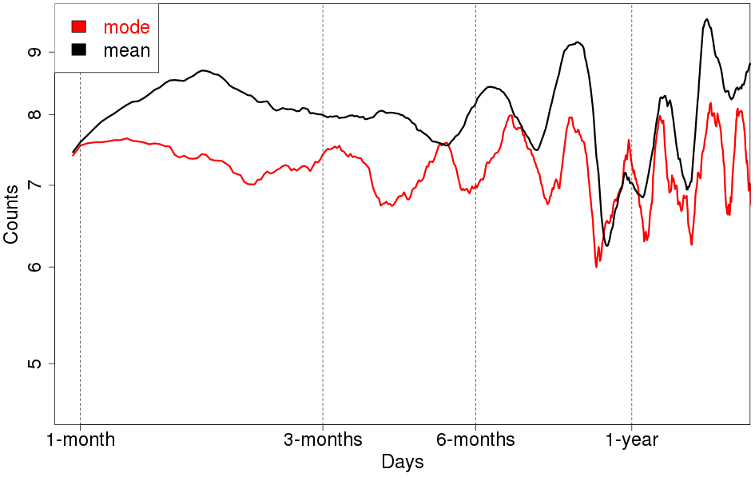
Investigation of seasonality on the DCC inter-calibration method
MSG2/SEVIRI VIS06
Monthly PDFs
time series of PDFs’ mode/mean
Variogram (RMSD of digital count at two different time)
mode
mean
Aqua/MODIS MTSAT-2/Imager

Slide 13
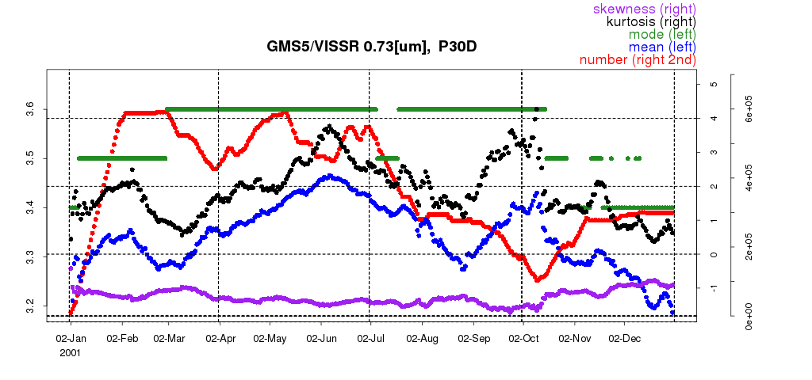
JMA SCOPE-CM activities
Member | LAGS | IOGEO | AMV/CSR | ISCCP
Masaya Takahashi | Y | Y
Arata Okuyama |  |  | Lead
Keita Hosaka |  |  |  | Y
LAGS (Land surface Albedo from GEO satellites)
Re-process using DCC inter-calibration results
Updates of source codes to the latest version
Change of input NWP data from JRA-25 to ERA-Interim
Re-process using DCC inter-calibration results: will be started in 2015
IOGEO (Inter-calibration of GEO imagers)
Understanding of computation method of spectral band adjustment factors
Reception of HIRS netCDF data
Re-process of GMS WV/IR channels: will be started in 2015
Time series of GMS-5 VIS DCC statistics in 2001
Instrument voltage [V]

Slide 14
Summary and future plans
MTSAT GSICS products
IR: uncertainty evaluation: almost finished, promotion to pre-op/op phase
VIS: promotion of DCC method to demo phase
Himawari-8/9 radiometric calibration
Implementation of operational inter/vicarious calibration system
IR: addition of S-NPP/VIIRS, GEO-GEO inter-comparison
VIS: feasibility study of DCC method for all the VIS/NIR bands, lunar calibration, investigation of inter-band calibration, etc.
Information of GSICS correction (and/or GSICS calibration coefficients) will be included in NRT distribution L1 data
SCOPE-CM projects
Start re-calibration of GEO data for IOGEO and LAGS projects

Slide 15
Backup Slides

Slide 16
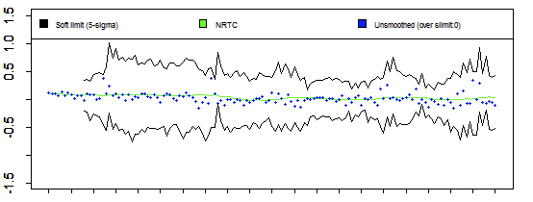
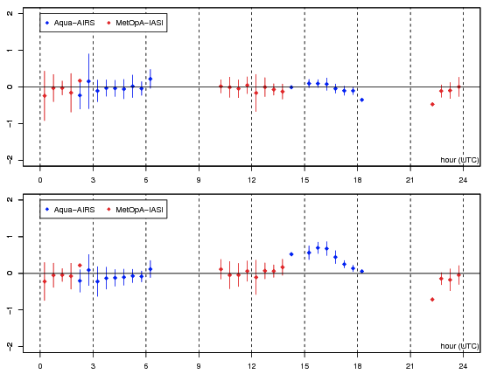
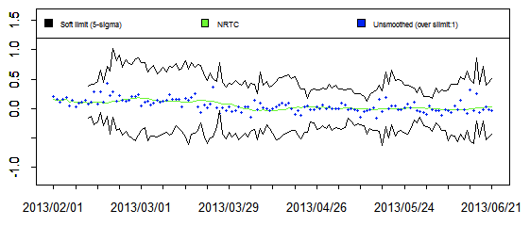
Observation quality monitoring
Calibration change alert discussed in the June 2013 web meeting
Diurnal variation of TB biases discussed in the paste F2F/web meetings
Bias monitoring using global/regional NWP is under development
GEO-GEO inter-comparison will also be carried out, if data are available in JMA
Prototype of calibration change alert derived from MTSAT-2 vs. IASI NRTC Correction
Diurnal variation of TB biases derived from GEO-LEO IR collocation data
MTSAT-2 against Metop-A/IASI Aqua/AIRS
10.8 [μm]
Soft limit
10.8 [μm]
ΔTB [K] ΔTB [K]
ΔTB [K] ΔTB [K]
MTSAT-2 against Metop-A/IASI Aqua/AIRS
12.0 [μm]
12.0 [μm]

Slide 17
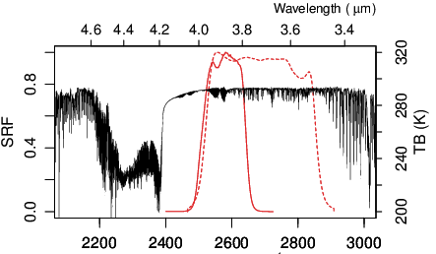
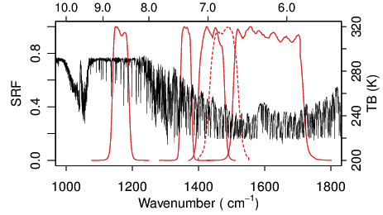
Predicted SRFs (Spectral Response Function) of AHI
VIS
SWIR
NIR
MWIR
LWIR
Himawari-8
MTSAT-2
Available on http://mscweb.kishou.go.jp/himawari89/space_segment/srf_201206/AHI_SpectralResponsivity.zip

