Slide 1

MODIS Response versus Scan-angle (RVS) and Lunar Calibration Reference
Xiaoxiong (Jack) Xiong
NASA/GSFC, Greenbelt, MD 20771, USA
Acknowledgements:
MODIS Characterization Support Team (MCST)
VIIRS Characterization Support Team (VCST)
GSICS Joint Meeting on Research and Data Working Groups, 16-20 March 2015, Delhi, India

Slide 2
Outline
MODIS Instrument
  Response versus Scan-Angle (RVS)
Solar and Lunar Calibration
On-orbit RVS Characterization
Lunar Calibration Reference
Take-home Message
2

Slide 3
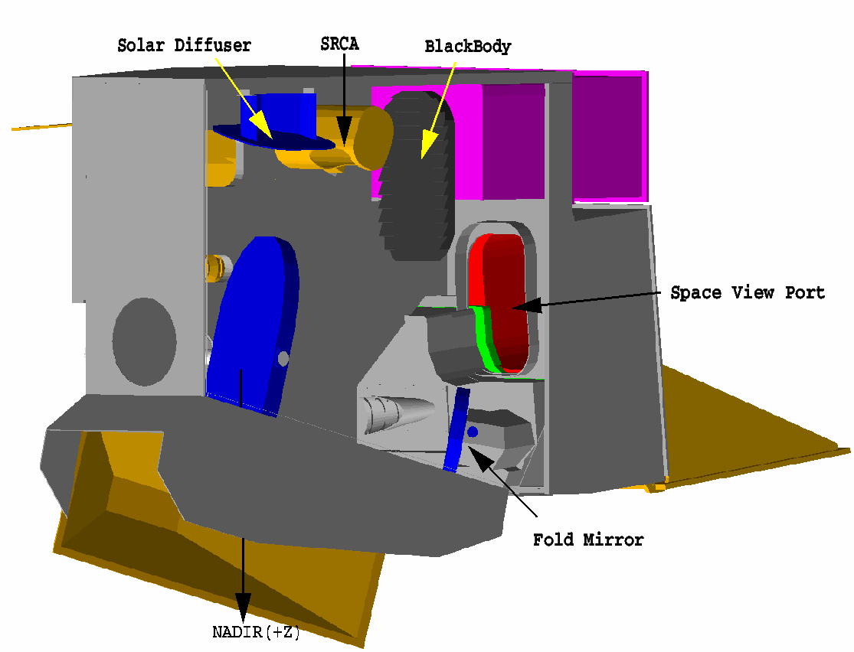
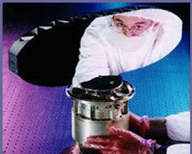
MODIS Instruments
MODIS: on NASA EOS Terra and Aqua missions launched in 1999 and 2002, respectively
2-sided scan mirror
Spectral range: 36 bands between 0.4 µm and 14.5 µm
  20 RSB and 16 thermal emissive bands (TEB)
Focal plane assemblies (FPA): VIS, NIR, SMIR, and LWIR
Spatial resolution: 250, 500, 1000 m
Swath Width: 2230 km
On-board Calibrators: SD, SDSM, BB, SV, and SRCA
Follow-on instrument: VIIRS on SNPP and future JPSS missions
3

Slide 4
MODIS Mirror Scan Angles and AOIs
Principal Scan Angles
(Earth View: -55˚ to 55˚)
Angles of Incidence
(Earth View: 10.5˚ to 65.5˚)
On_Board
BB
-129.4˚
Earth Scan Start 10.5˚
SV Port -11.2˚
On_Board BB -26.7˚
Normal
SV Port
-98.5˚
NADIR 38˚
Earth Scan Stop 65.5˚
Earth Scan
Stop (East)
55˚
Earth Scan
Start (West)
-55˚
NADIR
0˚
SCAN MIRROR
Pre-launch measurements to characterize sensor response versus scan-angle
4

Slide 5
Solar and Lunar Calibration (Aqua MODIS)
SD and SDSM Calibration
  Regularly scheduled with calibration frequency gradually decreased as mission continues to operate beyond its design lifetime (6 years)
  A SD door is close when no calibration is performed (different for Terra MODIS and SNPP VIIRS)
  More than 535 SD/SDSM calibrations performed since launch
Lunar Calibration
  Regularly scheduled via S/C roll maneuvers (8-10 times / year)
  Performed at nearly the same phase angles (-55⁰)
  More than 120 lunar calibrations performed since launch (additional free Moon events)
5

Slide 6
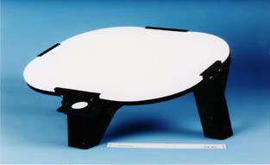

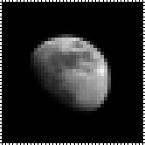
Solar and Lunar Calibration Methodology
Reflectance factor is computed via a SD calibration coefficient m₁
gain ∝ 1/m₁
Geometric Factors
MODIS SD and lunar observations are made at different AOIs
6

Slide 7
On-orbit RVS Characterization
Track on-orbit changes in sensor response for each band (λ), mirror side (MS) and at different angle of incidence (AOI)
Prior to C6
  SD and lunar trends at 2 different AOIs are used
  Linear interpolation/extrapolation is applied for other AOIs
  EV mirror side ratios are used for some bands (C5) for mirror side 2
Current C6
  Calibration reference traceable to on-board SD
  Relative calibration normalized to lunar calibration
  Changes in sensor response tracked at multiple AOIs, including the use of EV targets (for a few select bands)
7

Slide 8
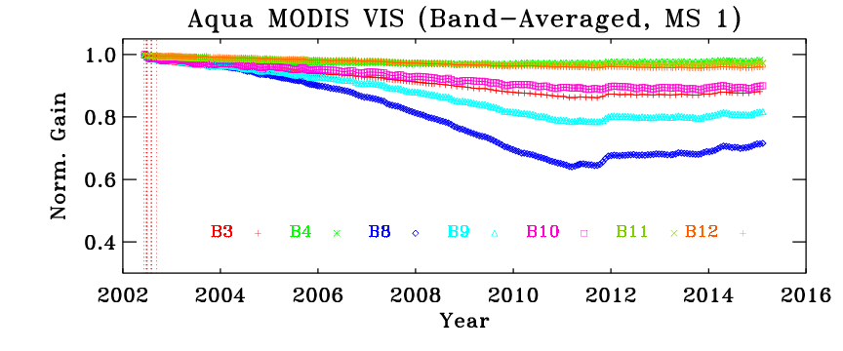
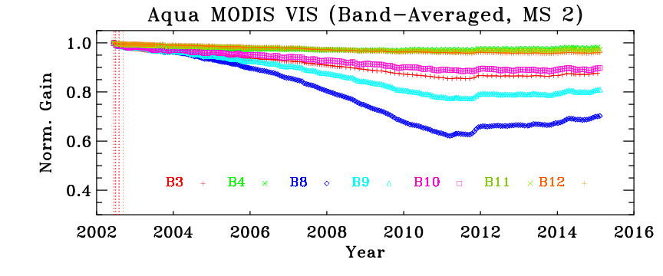
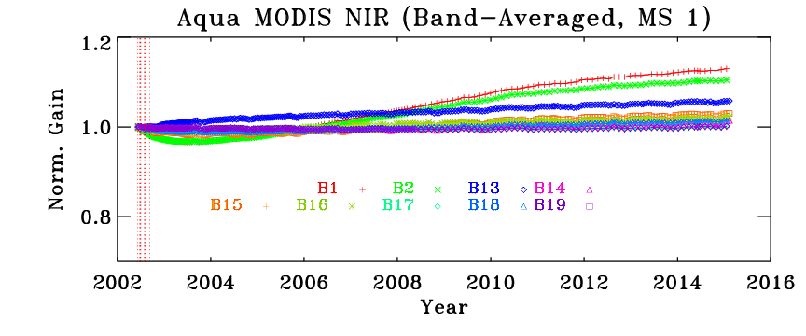
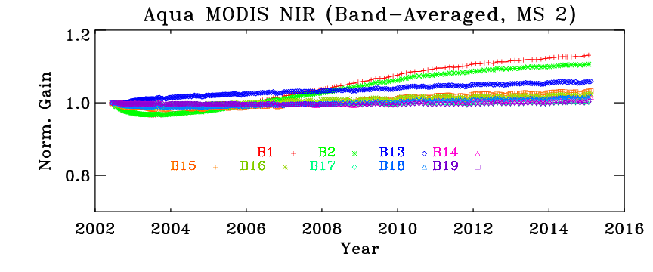
Aqua MODIS Radiometric Responses (VIS/NIR)
SD Calibration (MS1)
SD Calibration (MS2)
Terra MODIS MS differences are much larger in VIS/NIR
8

Slide 9
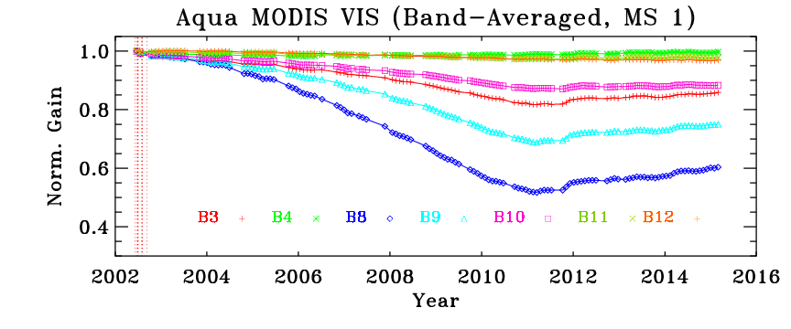
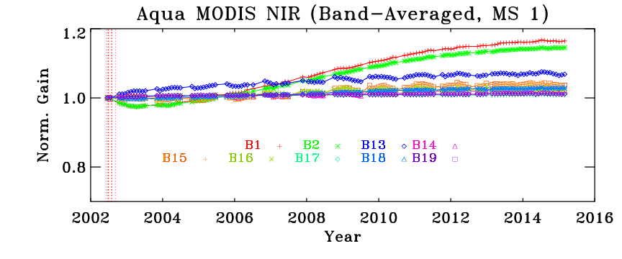
Aqua MODIS Radiometric Responses (VIS/NIR)
SD AOI
Lunar AOI
9

Slide 10
Collection-5 MODIS Band-1 EV Reflectance Trends at Various Frames (AOI)
10

Slide 11
Collection-5 MODIS Band-3 EV Reflectance Trends at Various Frames (AOI)
11

Slide 12
Collection-5 MODIS Band-9 EV Reflectance Trends at Various Frames (AOI)
12

Slide 13
Collection-6 MODIS Band-1 EV Reflectance Trends at Various Frames (AOI)
(under science testing)
13

Slide 14
Collection-6 MODIS Band-3 EV Reflectance Trends at Various Frames (AOI)
(under science testing)
14

Slide 15
Collection-6 MODIS Band-3 EV Reflectance Trends at Various Frames (AOI)
(already implemented)
15

Slide 16
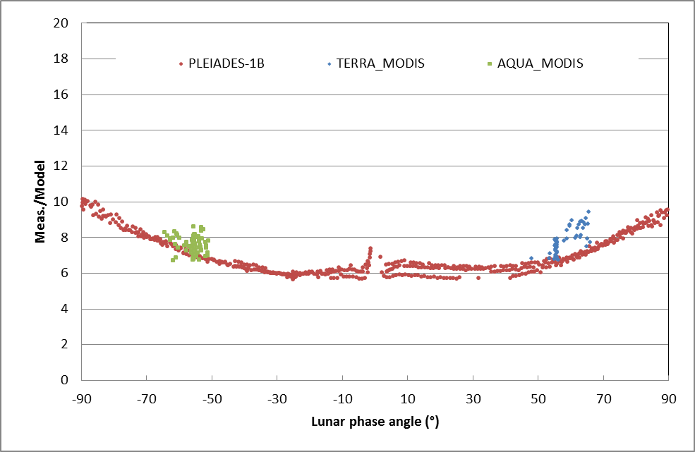
Lunar Calibration Reference
Phase angle dependence of the ROLO model (blue bands)
Comparisons of MODIS and PLEIADES lunar observations with ROLO (unscheduled + scheduled Moon for MODIS)
15
16

Slide 17
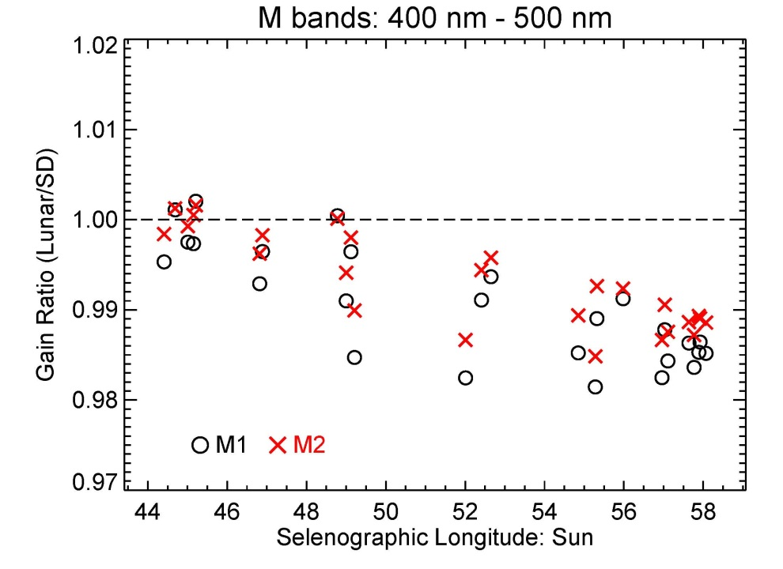
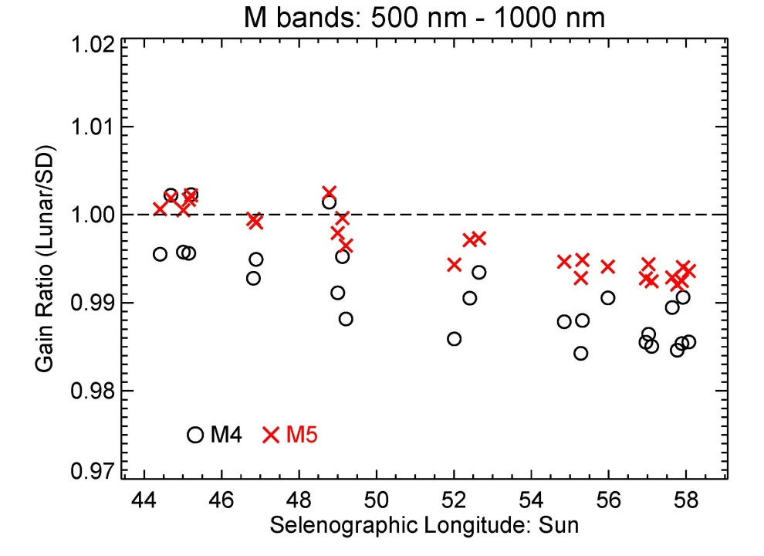
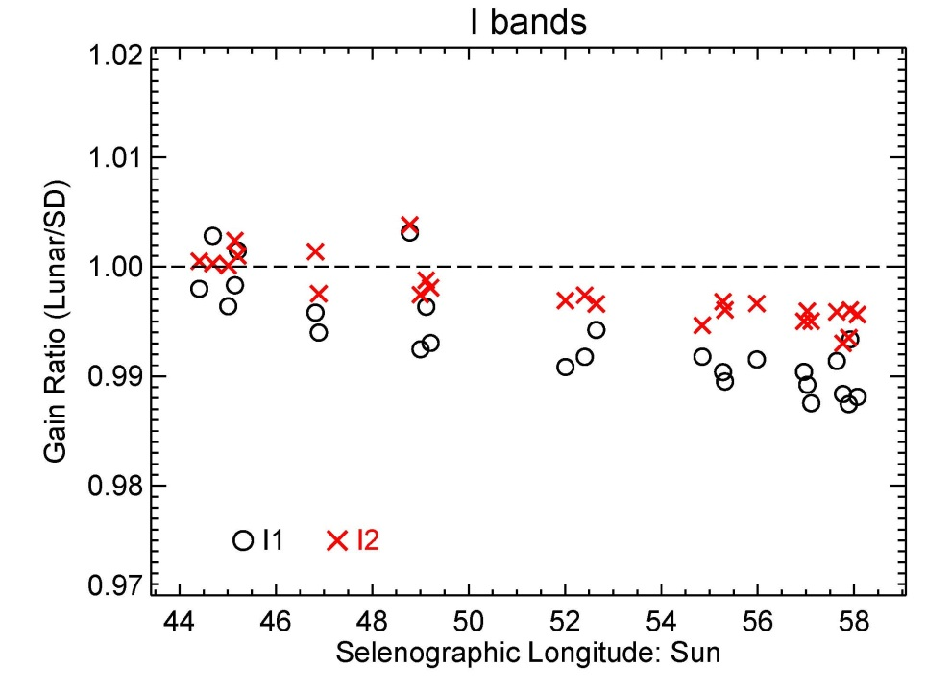
Lunar Calibration Reference
17

Slide 18
Summary
Both Terra and Aqua MODIS instruments continue to operate normally
All on-board calibrators remain capable of their design functions
Dedicated effort for on-orbit RVS characterization is as important as regular SD and lunar calibration (at fixed AOIs)
Overall Aqua MODIS on-orbit performance is better than its predecessor – Terra MODIS
Constant improvements and regular LUT updates are critical to maintaining sensor performance and data quality
Lunar calibration reference (impact due to phase and liberation angle difference)
18

