Slide 1
Application of GIRO to INSAT-3D (VIS channel)
Yogdeep Desai
IAQD/SPDCG/SIPA
Space Applications Centre-Ahmedabad (India)
Indian Space Research Organization

Slide 2
-INSAT3D Imager- General description of the VIS channel
Spectral Range = 0.52-0.77 micrometer
Quantization = 10bits
IGFOV =28 microrad
Sampling interval =1.75samples/IFOV
Scan rate =28deg/sec +0.2 s turnaround
Nominal Altitude =36000km (GEO)

Slide 3
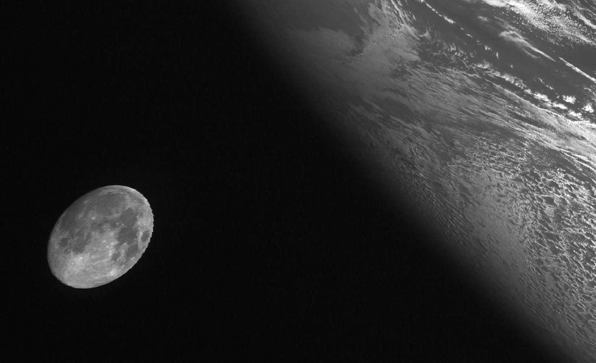
Description of the Moon acquisition
No manoeuvre
Moon acquired in sensor’s Field of regard (FOR)
An example of moon sighting in the VIS channel of INSAT3D

Slide 4
Satellite position: Assumptions and Considerations
Orbital vector (State Vector) is available for Water vapour (WV channel) lines
Each WV line corresponds to 8 VIS lines
To keep the IR detectors temperature within operable limits, half-yearly yaw rotation, N-S side flip, occurs between the period of vernal equinox and autumnal equinox (March 21 to Sep 23). During yaw-flipped position, the ground projection of visible and IR detectors swap physical positions relative to ‘normal’ orientation of the spacecraft.

Slide 5
Identifying Lunar pixels
Input: L1B (radiance corrected) product
Apply DN2L Look up table: this converts all deep-space counts to zero
Sum all non-zero pixels to give radiance in mW/cm2/um/sr
Convert radiance to Irradiance as E=L*Omega
Convert from mW/cm2/um to W/m2/um (factor of *10)

Slide 6
Sample Input file for GIRO
x
y
z
dDate (seconds since 1970-01-01T00:00:00Z)
sDate_File (yyyymmddhhmmssZ)
dOvrsamp_Fa
dPix_Solid_Ang[iCh]
dIrr_Obs[iCh]
39057.52301
-15868.66113
60.61241028
1423123358.0
20150205080238
1.751876381 (Over sampling factor)
0.000000000351858 (sr)
0.000506219 (W m⁻² μm⁻¹)
Repeated for
No. Of channels

Slide 7
Date and time of Lunar intrusion
Date (yyyymmdd) | Time (hhmm) | % illumination (Ref: Orbitron)
20140908 | 0500 | 99
20141202 | 0200 | 79
20141230 | 0100 | 62
20141230 | 0200 | 63
20150109 | 0900 | 85
20150113 | 1130 | 53
20150113 | 1230 | 52
20150205 | 0700 | 99
20150205 | 0800 | 99

Slide 8
Lunar Radiance (mW/cm2/microm/sr) to Irradiance (W/m2/microm)
Over sampling Factor: SamplingRate/ScanRate
Sampling Rate=21840 samples/s
ScanRate=12466.63306 /s
OSF=1.752 (approx)
Detector Solid Angle (Omega) =pi*14microrad*8microrad
=3.52*10⁻¹⁰ sr
Obs Irr in (W/m2/microm) = ∑L_{i} *Omega*10

Slide 9
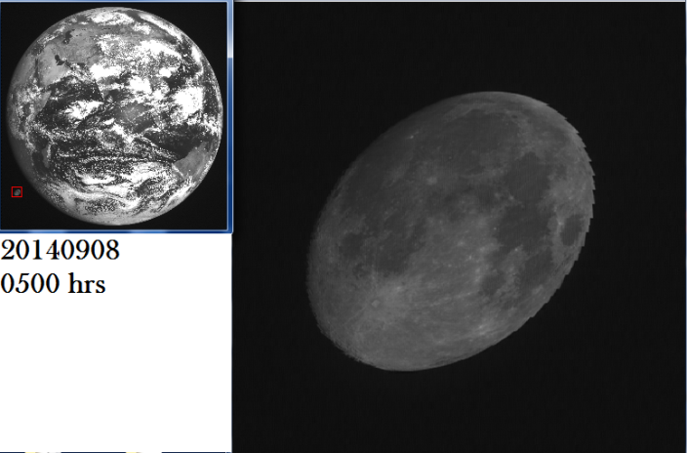
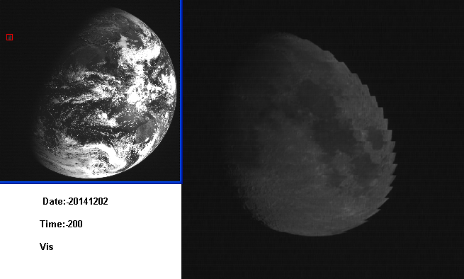
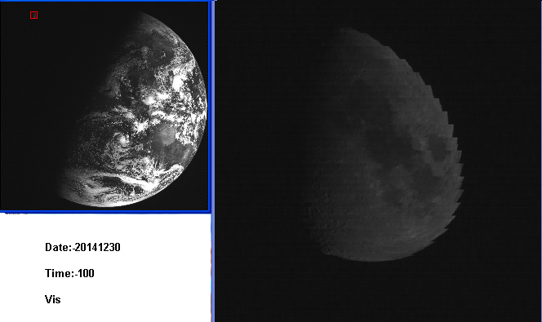
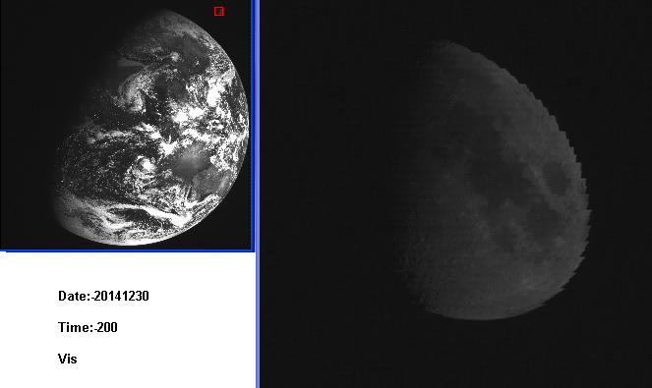
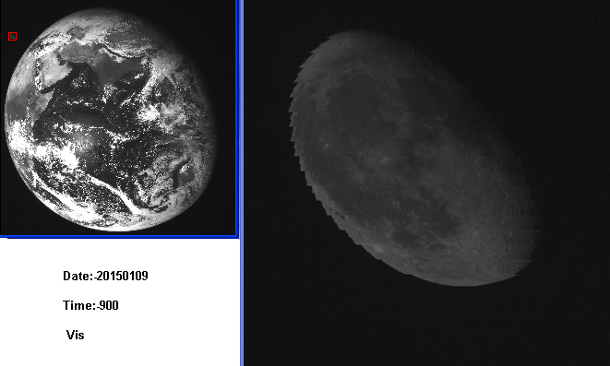
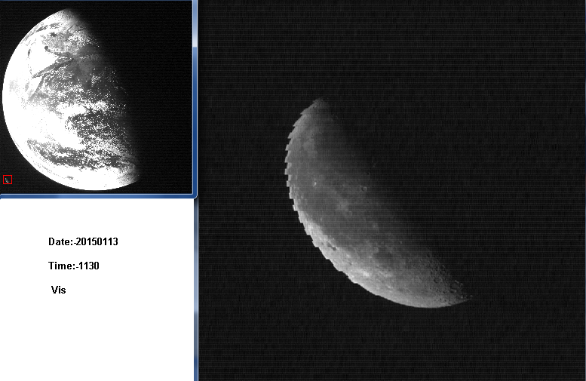
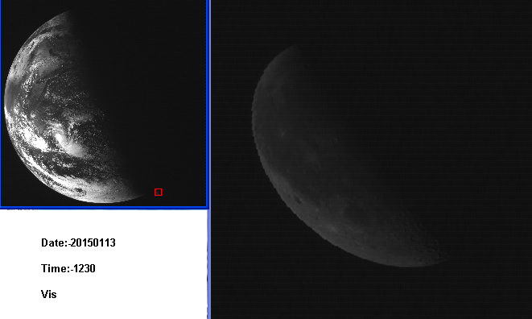
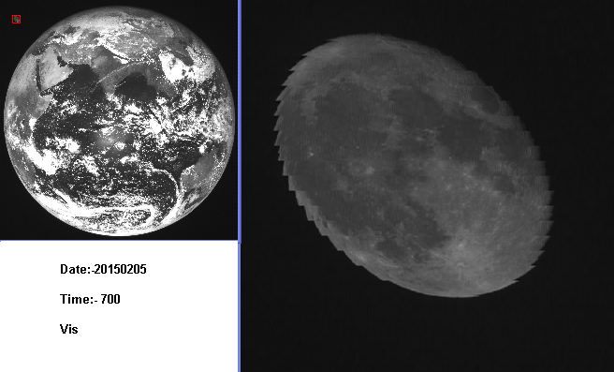
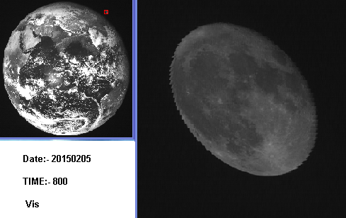

Slide 10
Time-series of irr_rolo and irr_obs
Observation: The difference between the observed irradiance and ROLO irradiance is proportional to % illumination of lunar disc

Slide 11
To be continued...
To add future lunar intrusions
To include imagette in computation...
for Lunar calibration for future missions, including for high resolution sensors
?
Utility to predict lunar intrusion for archived data

Slide 12
Thank you all

