Slide 1
2015 GSICS Annual Meeting (23-27 Mar 2015) @New Delhi, India
COMS
visible channel calibration
- issue for moon target -
Tae-Hyeong OH, Dohyeong KIM, Hyesook Lee and Minju GU
National Meteorological Satellite Center
Korea Meteorological Administration

Slide 2
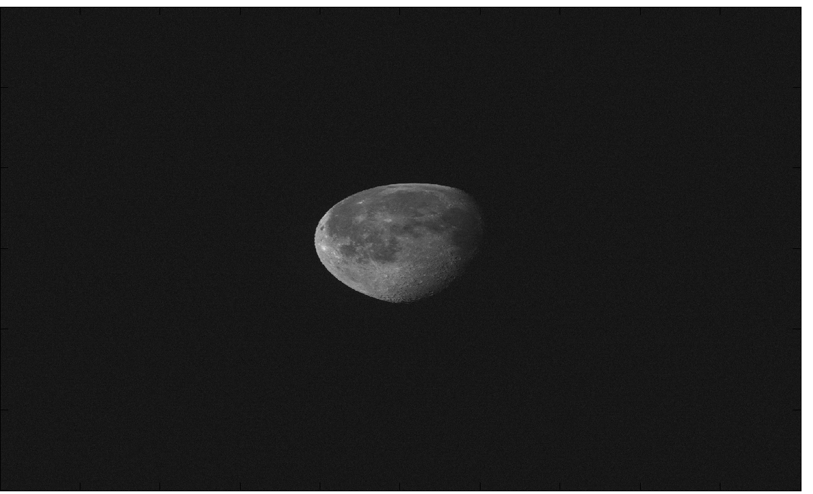
Lunar Calibration(IMPS)
COMS Moon observation L1A data
L1A Moon data (1200*2080)
Moon observation time
ROLO model of USGS(ver.311g)
COMS ephemerides data
- absolute phase angle
- Selenographic longitude of the sun
- Selenographic longitude of COMS
- Selenographic latitude of COMS
(b) IMPS moon area
Moon irradiance as measured by the COMS/MI
where
N_{P}: the total number of pixels in the lunar disk image
R_{P} : an individual radiance measurement(i.e. pixel) on the Moon
Ω: the solid angle of a pixel (sr), corresponding to one visible detector, i.e. 28 µrad
16/28: the over-sampling rate of MI along E-W axis
Moon irradiance computed from the ROLO
where
D_{m-v}: the moon-viewer distance in km i.e. Moon-satellite
D_{m-s}: the moon-sun distance in AU
Calculate a imager response the observed irradiance and ROLO irradiance
$$P= \frac{I_{Instrument}}{I_{Ref}}$$

Slide 3
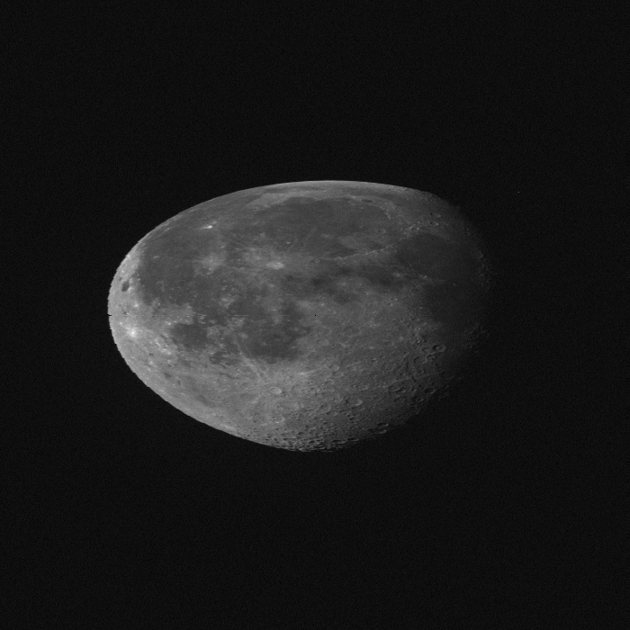
Lunar Calibration(GIRO)
Observed Moon data (2016-06-17 07:43:13)
(a) L1A Moon data (699*699)
(b) GIRO moon pixel (699*699)
threshold : 900 counts
L1A Moon data (1200*2080)
Re-make a Moon data
(count and radiance, 699*699) from level 1 data
Figure (a)
Select moon pixels above a threshold (900 count)
Figure (b)
Calculate (sanity check)
the observed irradiance
the integrated DC signal
the DC offset
the number of pixels
Calculate a imager response with the observed irradiance and ROLO irradiance from the GIRO_secondrelease
$$P= \frac{I_{observed}}{I_{ROLO}}$$

Slide 4
Dataset
Prepare the dataset to compare the result of IMPS and GIRO_fourthrelease
Satellite | Time Coverage | Observations | channel | Phase-angle range [deg] | Useful Observation for ROLO calibration
COMS | April 2011 ~ September 2014 | 81 | 1 | -92 ~ 92 | 79
79 COMS MI - VIS observations available
Instrument | Channel | SRF in GIRO NetCDF format
COMS MI | VIS06 | Yes

Slide 5
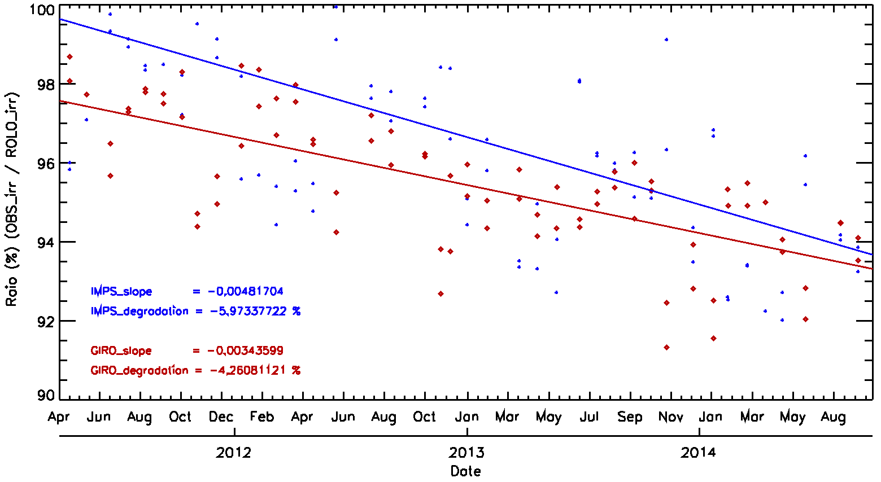
Results: IMPS vs GIRO
Compare the ratio using the result of IMPS and GIRO_fourthrelease
${OBS}_{irr}$/${ROLO}_{irr}$(IMPS): degradation = -5.97 % (-1.41 %/year)
${OBS}_{irr}$/${ROLO}_{irr}$(GIRO): degradation = -4.26 % (-0.98 %/year)
IMPS_slope = -0.0048
IMPS_degradation = -5.97 (1.41%/yr)
GIRO_slope = -0.0034
GIRO_degradation = -4.26 (0.98%/yr)
Moon area size :(699*699)

Slide 6
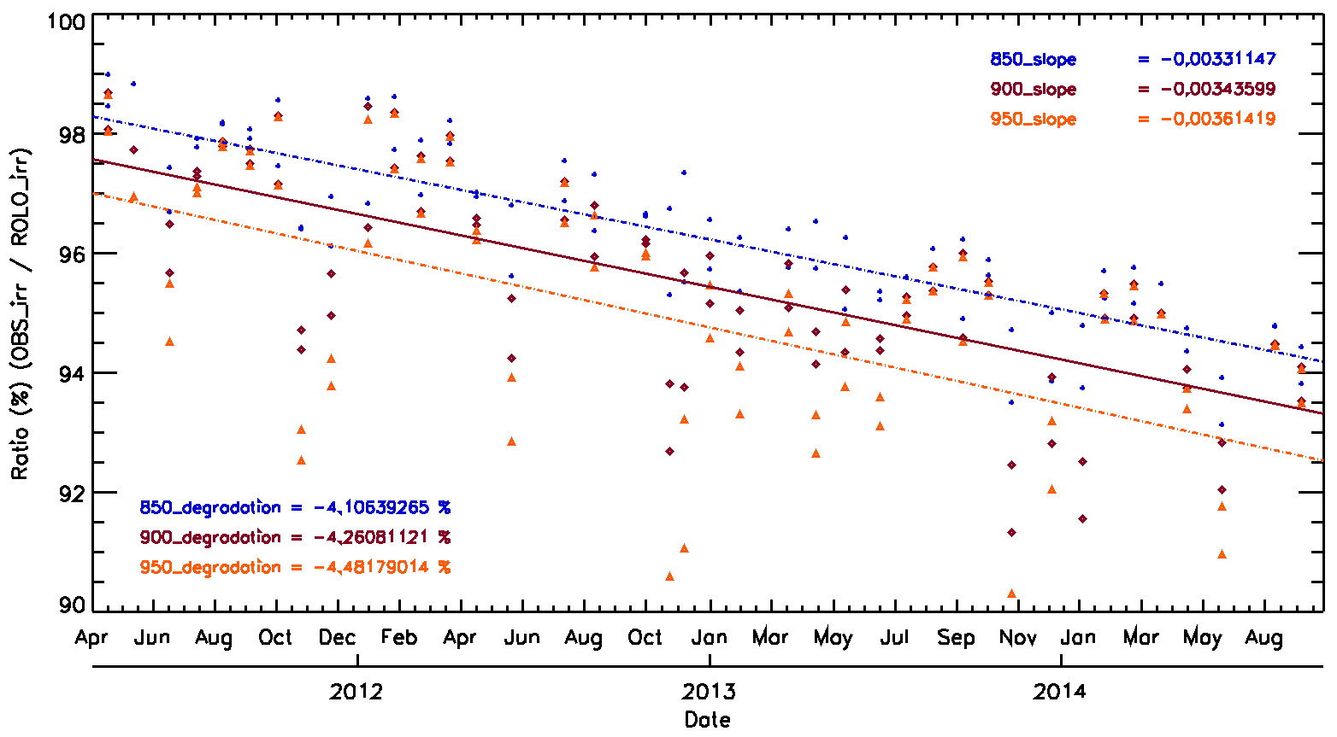
Sensitivity Test : threshold
Calculate observed irradiance through the threshold(850, 900, 950) to define the moon pixel
850_slope = -0.0033
900_slope = -0.0034
950_slope = -0.0036
850_degradation = -4.11 %(0.95%/yr)
900_degradation = -4.26 %(0.98%/yr)
950_degradation = -4.48 %(1.03%/yr)
Moon area size :(699*699)

Slide 7
Sensitivity Test : threshold
Calculate observed irradiance through the threshold(850, 900, 950) to define the moon pixel
Threshold : 850 count
slope : -0.0033 / degradation : -4.11% (-0.95%/year)
Correlation coefficient : -0.864
Threshold : 900 count
slope : -0.0034 / degradation : -4.26% (-0.98%/year)
Correlation coefficient : -0.731
Threshold : 950 count
slope : -0.0036 / degradation : -4.48% (-1.03%/year)
Correlation coefficient : -0.554

Slide 8
Moon area size test
Compare the ratio(Obs_irr/GIRO_ROLO_irr) with moon area ratio
Size of Moon area
699*699 / 599*699 / 499*699 / 349*599 / 319*549 / 319*554
To define moon area similar with IMPS moon area
319*554 : 176726 pixels
Mean Moon pixels of IMPS : 176675
Calculate the ratio (Obs_irr / ROLO_irr) of total pixel for each moon area
699*699 : -3.76897 % / slope : -0.00304
499*699 : -3.91396 % / slope : -0.00316
349*599 : -4.02183 % / slope : -0.00324
319*554 : -4.04176 % / slope : -0.00326
Ocean

Slide 9
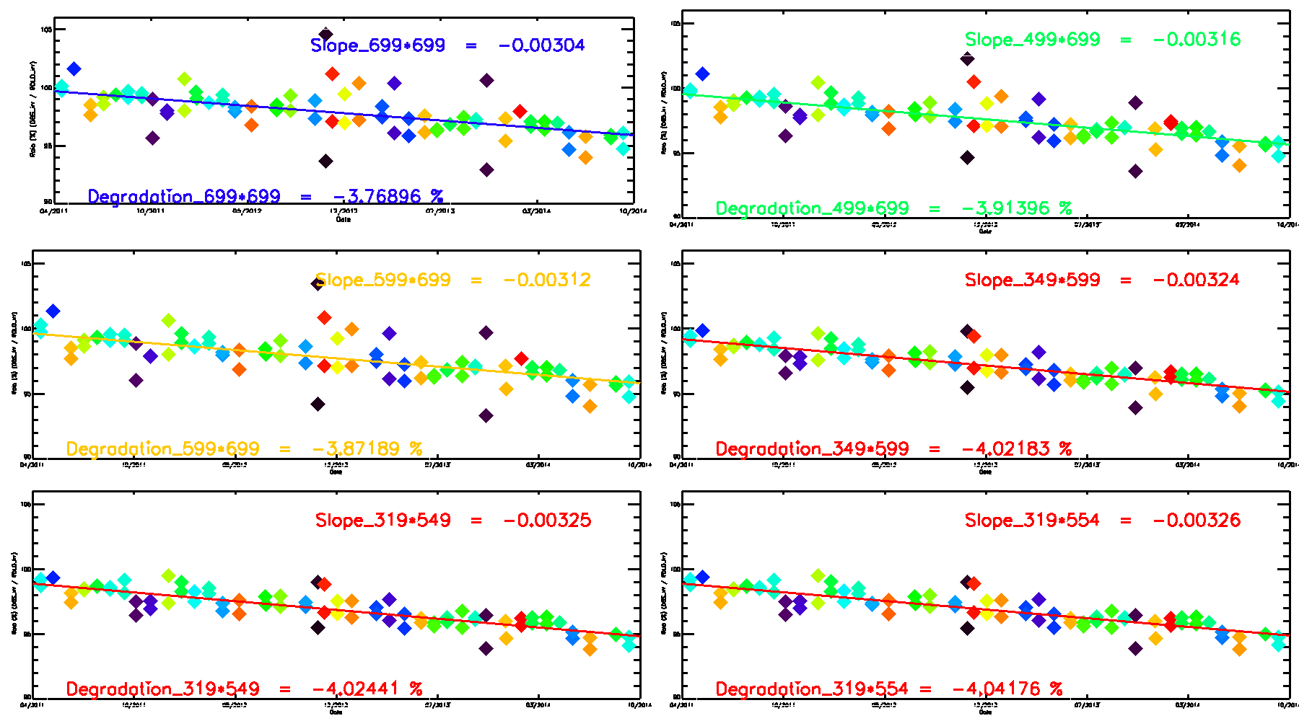
Moon area size test

Slide 10
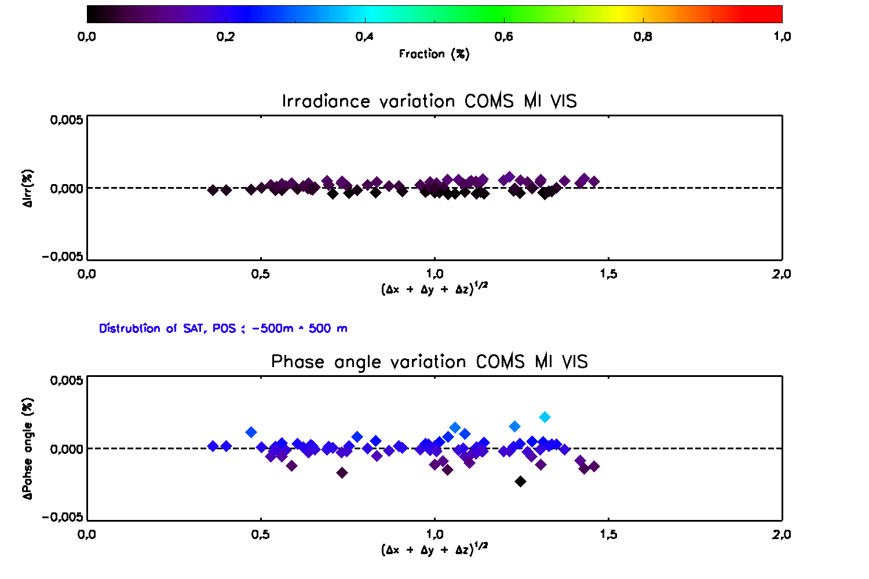
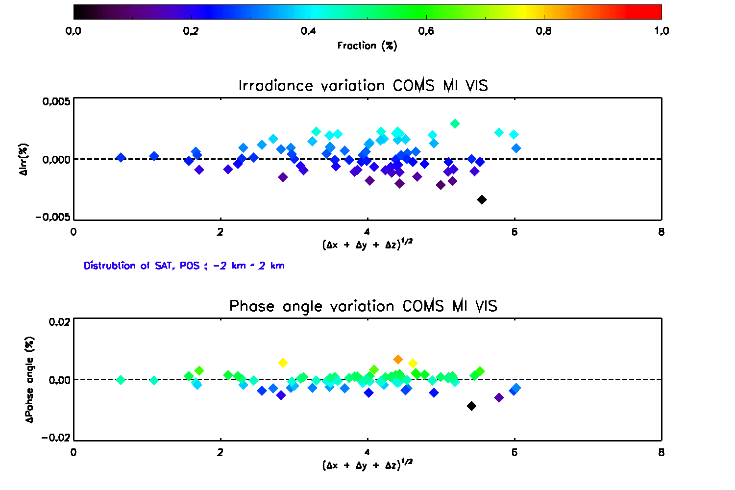
Perturbation Test (using GIRO_PERT)
Variation of GIRO ROLO Irradiance through change of satellite position
GIRO ROLO irradiance is very stable within ±0.01% when satellite position are change random with 0.5km~2km
Phase angle of moon change with in ±0.02% through satellite position’s variation
13

Slide 11
Summary & Issues
by Moon target
In 79 cases of COMS lunar observation
Compare the result of IMPS and GIRO_fourthrealese
Degradation(IMPS) is about -5.97%(-1.41%/year) and GIRO is about -4.26%(-0.98%/year)
Issues
Vary the ratio of observed irradiance and ROLO irradiance with threshold
And also change the ratio through Moon area size
Need more test to define the Moon pixel and Moon area size

Slide 12
Action Items (GSICS Lunar Workshop)
Lunar Calibration Workshop(1~4 Dec. 2014) Summary
GLCWS_14.8 Data Sharing
All participants to report any restrictions on the use of their datasets in relation to the proposed data sharing policy
KMA will share the lunar compulsory data
Lunar Irradiance Model Developments
to investigate possibility of their agency participating in funding the establishment of a new lunar observation facility
interest in contributing but no existing mechanism for such an international funding. Further investigations needed

Slide 13
Thank you ☺

