Slide 1
GSICS Quarterly Special Issues and Editors
Manik Bali and Larry Flynn
GSICS Coordination Center, NOAA
GSICS Annual Meeting 2015, New Delhi

Slide 2
Outline
Introduction
New features GSICS Newsletter
Format
DOI
Navigation
Article Review Process
Newsletter Phases
Acceptable research articles in the GSICS Newsletter.
New experiments
Editorial Board
Future Needs
Live Demo of Newsletter
Conclusion

Slide 3
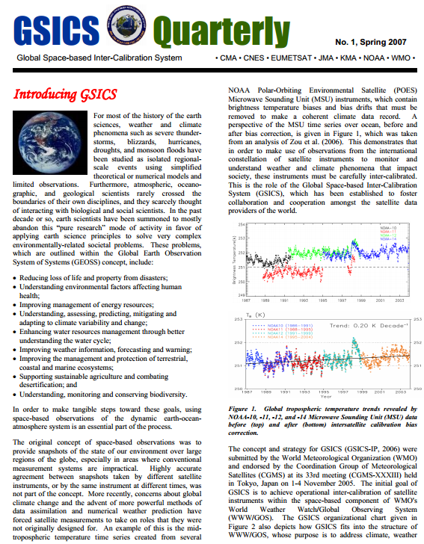
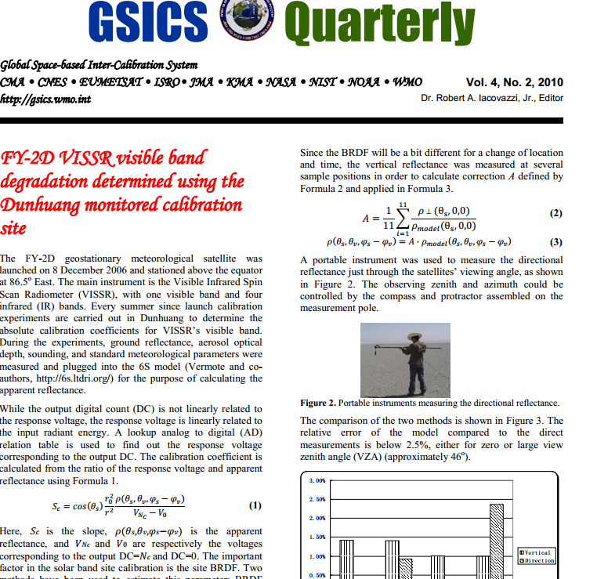
Introduction
GSICS Quarterly Newsletter is issued by the GSCICS Coordination Center
The first issue came out in April 2007
The Newsletter has also been used to carry announcements, news-items ( relevant to GSICS and connected communities such as CEOS GPM-X, Interactions with GRUAN)
The GSICS Newsletter proved to be an effective tool to bring the GSICS community together and inform scientific community about key developments made by GSICS ( such as GEO-LEO IR base line algorithm, Status of GSICS reference instruments)
By 2010 the Newsletter effectively began carrying articles on basic concepts of GSICS cross calibration and GSICS acceptable products.

Slide 4
Introduction
In 2013 Newsletter completed 6 years of continuous publication each quarterly ( Edited by Bob Iacovazzi, George Ohring and Fangfang Yu).
In these years the GSICS community had developed advanced algorithms to monitor in-orbit instruments that were peer reviewed and accepted in the community. New challenges of the Newsletter that needed to be addressed now include
The aspirations of the researcher and the expectation of the readers had significantly changed/enhanced during these years
Researchers across agencies were using these algo. and demonstrating exciting results. They needed an interactive , published platform that could connect them directly to the calibration community in order to communicate their calibration results.
GSICS community had grown, developed linkages with contemporary groups in CEOS, GRUAN, GPM-X and widened member of the WMO satellite community.
Critical need of meeting the needs of authors, 3G community and readers of the Newsletter within the WMO Framework

Slide 5
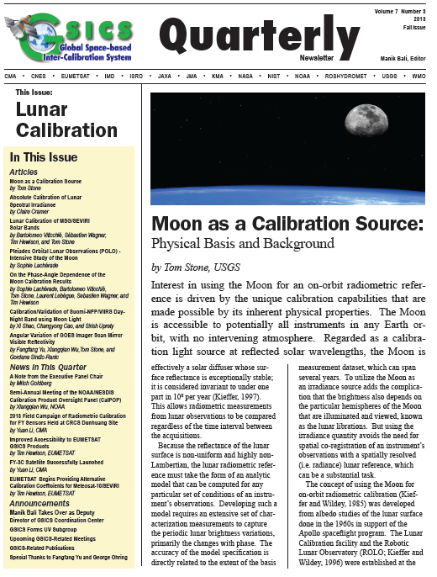
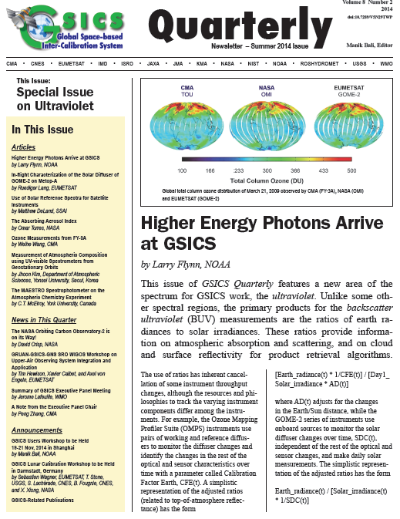
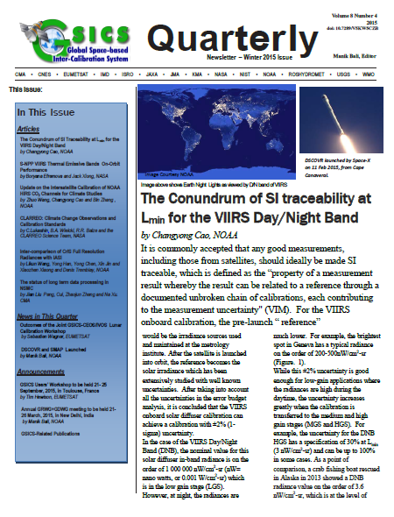
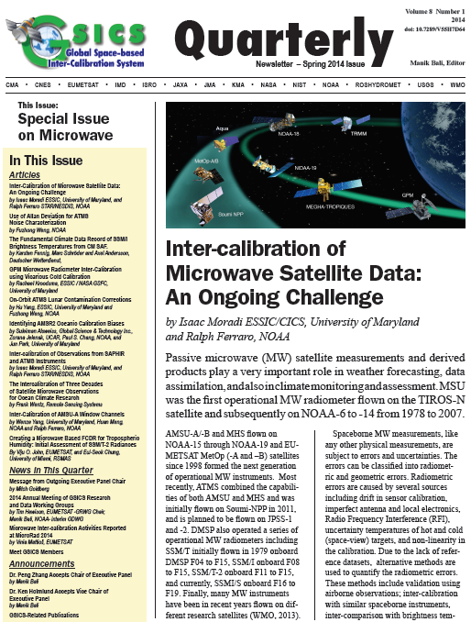
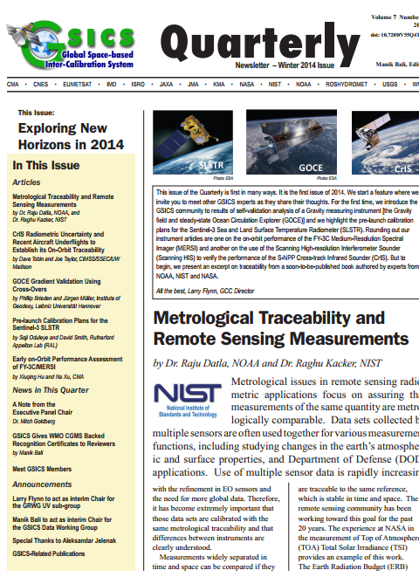
New Features
Since Fall 2013, brand new format .
A robust review process.
Since Winter 2014, the Newsletter has a doi.
Accepts articles on topics related to calibration (Pre and Post launch).
New Landing page on the GCC website.
Rate and Comment section: readers and authors can interact.
Articles are reviewed by subject experts
Help available to non native English speaking contributors.
Since Fall 2014, new navigation features added to the Cover Letter.

Slide 6
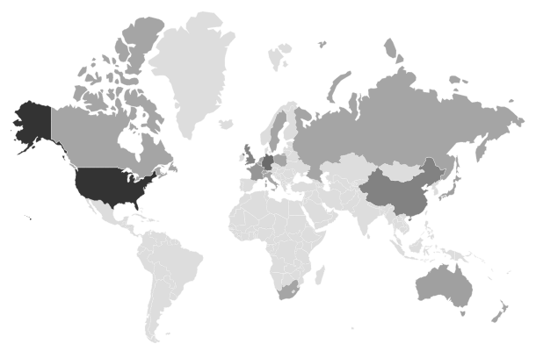
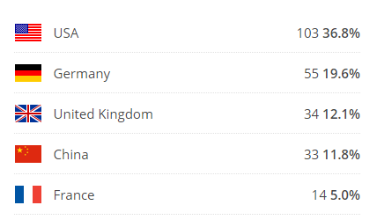
Newsletter Readers across the world
Newsletter getting noticed
Journal of Physics and Chemistry of Earth invited Authors of GSICS Microwave issue to submit articles based on their submission to GSICS Newsletter .

Slide 7
Newsletter Article Review process
Author
Reviewer
Editor
Editor has a preliminary look at the article and checks.
If the article falls within the scope of GSICS/WMO/CGMS /GPM-X or scope of its partners including the 3G
Article falls within the 700-800 word limit with 2 Figures and 1 table.
If the article is a lead article it fulfils lead article criterion
Articles are solicited round the year however call is sent out every quarter via the GSICS Dev.
Articles are sent to the Newsletter Editor directly or via GSICS Correspondents or Chairs of GSICS Groups/Subgroups.
Newsletter review
Guiding Principal
If the editor decides to publish the article, the article is sent to a proof reader or/and a subject expert reviewer.
Editor may decide to send the article directly to a reviewer or via a proof reader.
Editor procures doi number from NOAA library and pastes it into the Newsletter and gives the final copy of the newsletter to the technical expert for release via mailcimp. The technical expert releases I and also makes a web version of the lead article.
Editor forwards the Comments from the reviewer to the author who makes changes and re-submits the article to the editor who forwards them back to the reviewer for his final go ahead.
Editor facilities communication between Author and Reviewer to get GSICS/peer reviewed article.

Slide 8
Newsletter Phases
Newsletter is prepared in the following phases
Submission Phase (normal pace)
Review Phase ( increases rapidly as we go towards release date goes upto 24 reviews at the same time)
Formatting Phase (intense work, done by the editor)
Assigning of doi and release Phase. ( intense for editor as any )
Post release phase.( not relatively intense)
Reviewers
Reviewers are experts on topics related to GSICS.
Reviewer given credit --names mentioned in the Newsletter.
Details of review process here.

Slide 9
Types of articles acceptable in the Newsletter
Experimented with several types of articles.
Article on brand new work , not peer reviewed earlier (GCC does not have the resources to review such work accurately)
Articles based on already published work (replication of text and key result figures need to be avoided)
Easy to accept articles that are review of published work , do not replicate results but give ideas about the way forward.

Slide 10
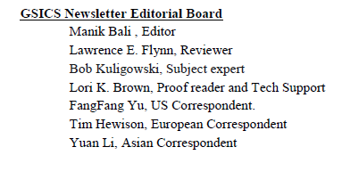
New Experiments---Editorial Board
In order to give due credit to regular contributors ( proof readers, reviewers, technical support ) , the GCC.

Slide 11
Future Needs--Feedbacks
Future needs planned as per feedback from users.
Blessing from WMO-(We already have a WMO logo on the release email any additional blessing would add interest)
Invite Guest Editors
Invite well known members to be members of the Editorial Board ( invited Jerome Lafeuille to be on editorial board). George Ohring, Bob Iacovazzi , suggest more candidates)

Slide 12
Conclusions
The GSICS Newsletter has evolved into an effective tool for sharing GSICS research with global scientific community.
Past year doi, navigation features, new format has been added.
Editorial board has been formed. ( recommendations invited for member)
Propose to have guest editor for special issues.
New features to be added in the coming time.

Slide 13
THANK YOU

