Slide 1
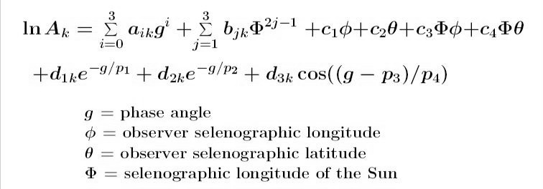
Accounting for Sensor Spectral Response Functions in the ROLO Lunar Calibration System
For ROLO lunar calibrations, the instrument measurement and the radiometric reference are both irradiance values
spatially integrated over the disk of the Moon
single values for each instrument band, corresponding to the particular conditions of a Moon observation
the lunar reference is not a radiance field, such as used for vicarious calibration with desert sites or deep convective clouds
The reference values are generated by computing the ROLO model for the observation geometry, i.e. phase angle (g) and librations (φ,θ,Φ):

Slide 2
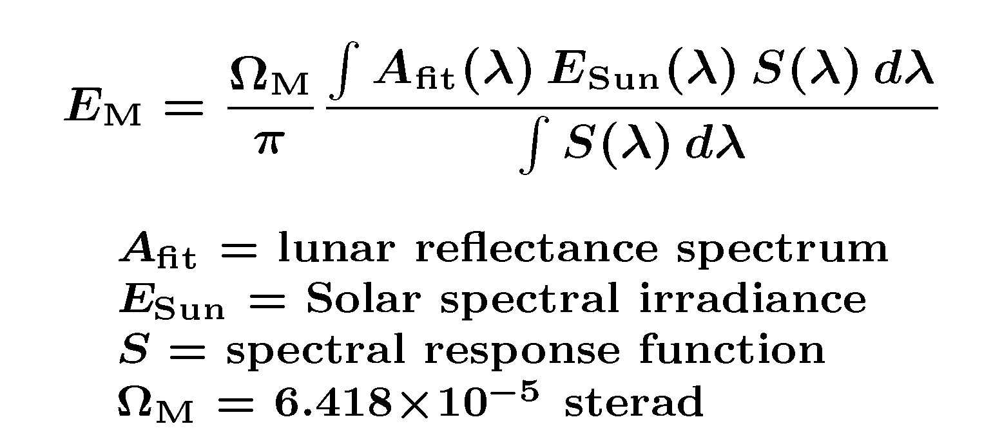
The disk reflectance model outputs (A_{k}) at 32 ROLO bands are fitted with a lunar reflectance spectrum, which is convolved with the sensor band spectral response functions and the solar spectrum to give the lunar irradiance (E_{M}) at the band wavelengths:
With this convolution, the lunar calibration system intrinsically accounts for sensor band spectral responses.
the convolution is necessary to produce a single reference irradiance value for each band, to compare with the corresponding instrument measurements to realize a lunar calibration

Slide 3
To compare two instruments’ views of the Moon made at different times (and therefore different geometries) requires normalizing the sensor irradiance measurements using the model-generated reference values.
the model results have accounted for the different SRFs, therefore SBAFs cannot be derived from comparisons of different instruments’ observations of the Moon that have been normalized in this way
► One could de-construct the lunar model and generate the spectrally resolved irradiance, but then how to normalize the measurements ?
► One could generate dummy reference irradiance values for different instruments for a specific lunar view geometry, and compare the results for overlapping bands of different instruments
this will reflect the differences in the pre-determined SRFs, but convolved with the lunar reflectance and solar irradiance spectra
the outcome will depend on the choice of view geometry, since the lunar reflectance changes with phase angle (next slide)

Slide 4
