Slide 1
GSICS Web Meeting: Best Practice for Defining SBAFs
September 8, 2015

Slide 2
VIS and SWIR Online SBAF Tool [UPDATE]
Ben Scarino, Dave Doelling, Arun Gopalan, Thad Chee, Patrick Minnis, Raj Bhatt, Conor Haney

Slide 3
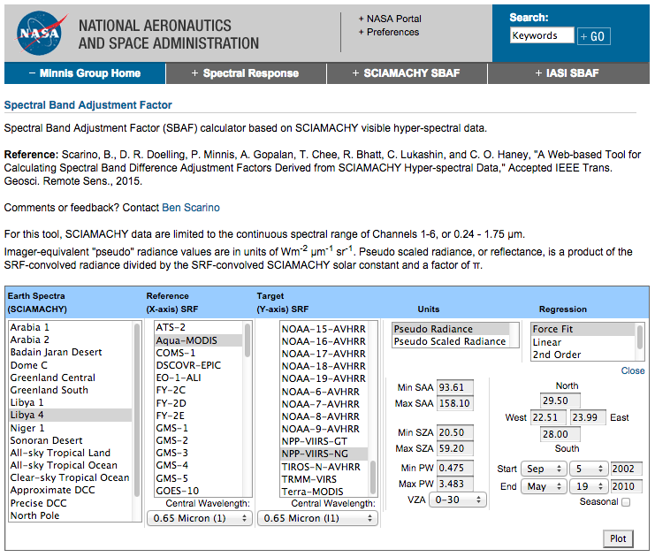
SCIAMACHY SBAF Tool
http://cloudsgate2.larc.nasa.gov/SBAF
backup: http://www-angler.larc.nasa.gov/SBAF

Slide 4
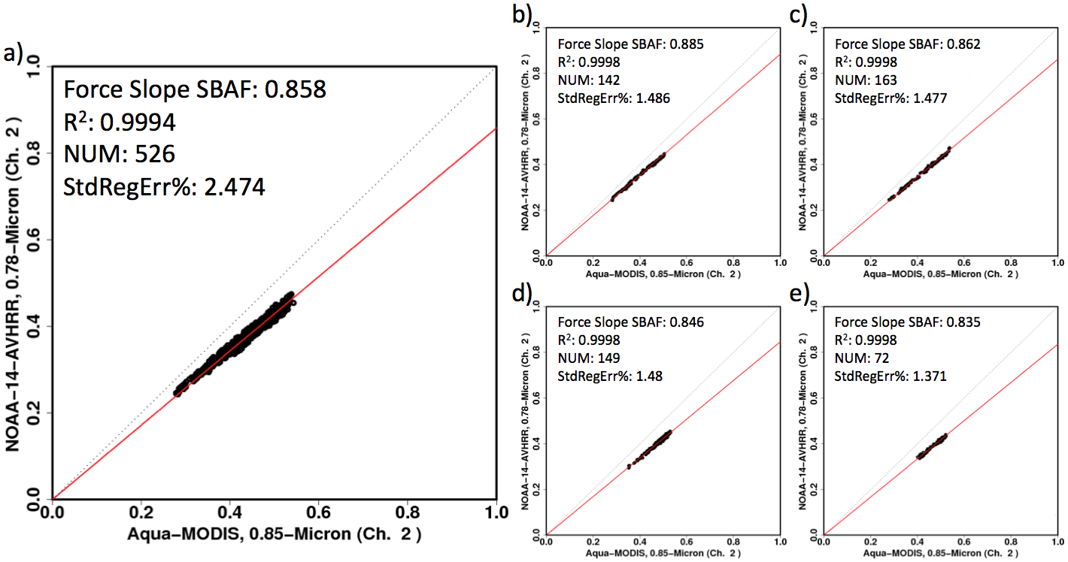
SCIAMACHY SBAF Tool
[recap]
0.0 < PW < 0.75 g cm⁻³
0.75 < PW < 1.5 g cm⁻³
0.0 < PW < 3.0 g cm⁻³
1.5 < PW < 2.0 g cm⁻³
2.0 < PW < 3.0 g cm⁻³
Proper subsetting, e.g., by precipitable water (PW), can reduce standard error
SBAF changes systematically relative to PW amount

Slide 5
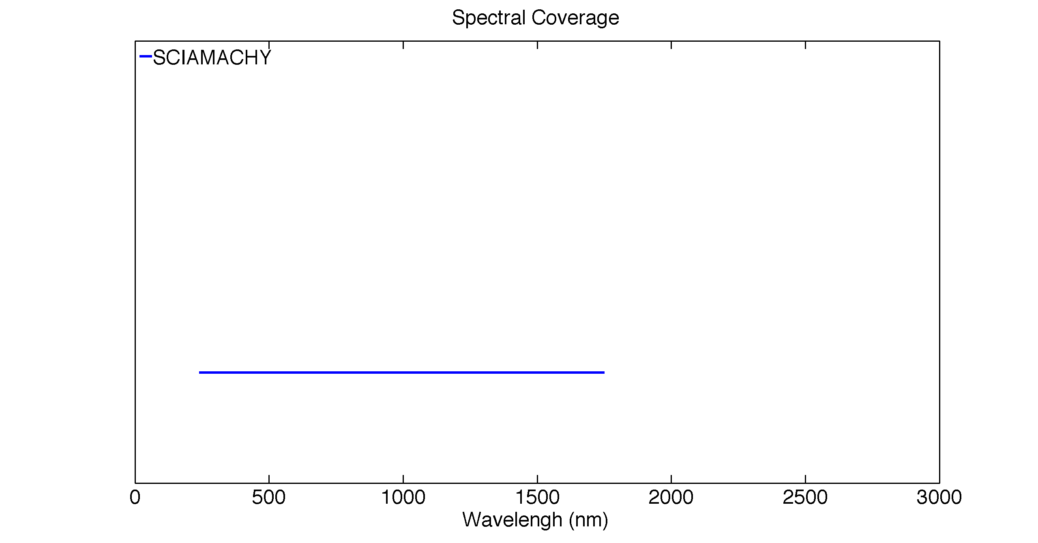
240 – 1750 nm
SCIAMACHY-based SBAFs limited to Ch. 1-6, or 0.24-1.75 μm
Channels 7 and 8 (1.75-2.38 μm) plagued by detector issues and poor calibration

Slide 6
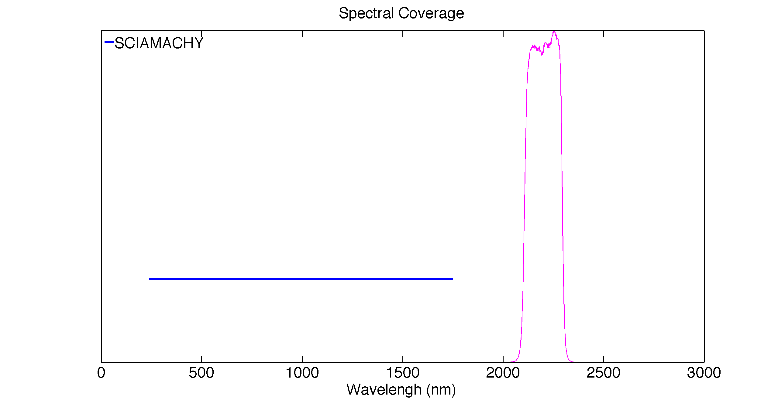
Landsat-8-OLI SWIR2 SRF
240 – 1750 nm
Thus SCIAMACHY is insufficient for SWIR-channel SBAFs

Slide 7
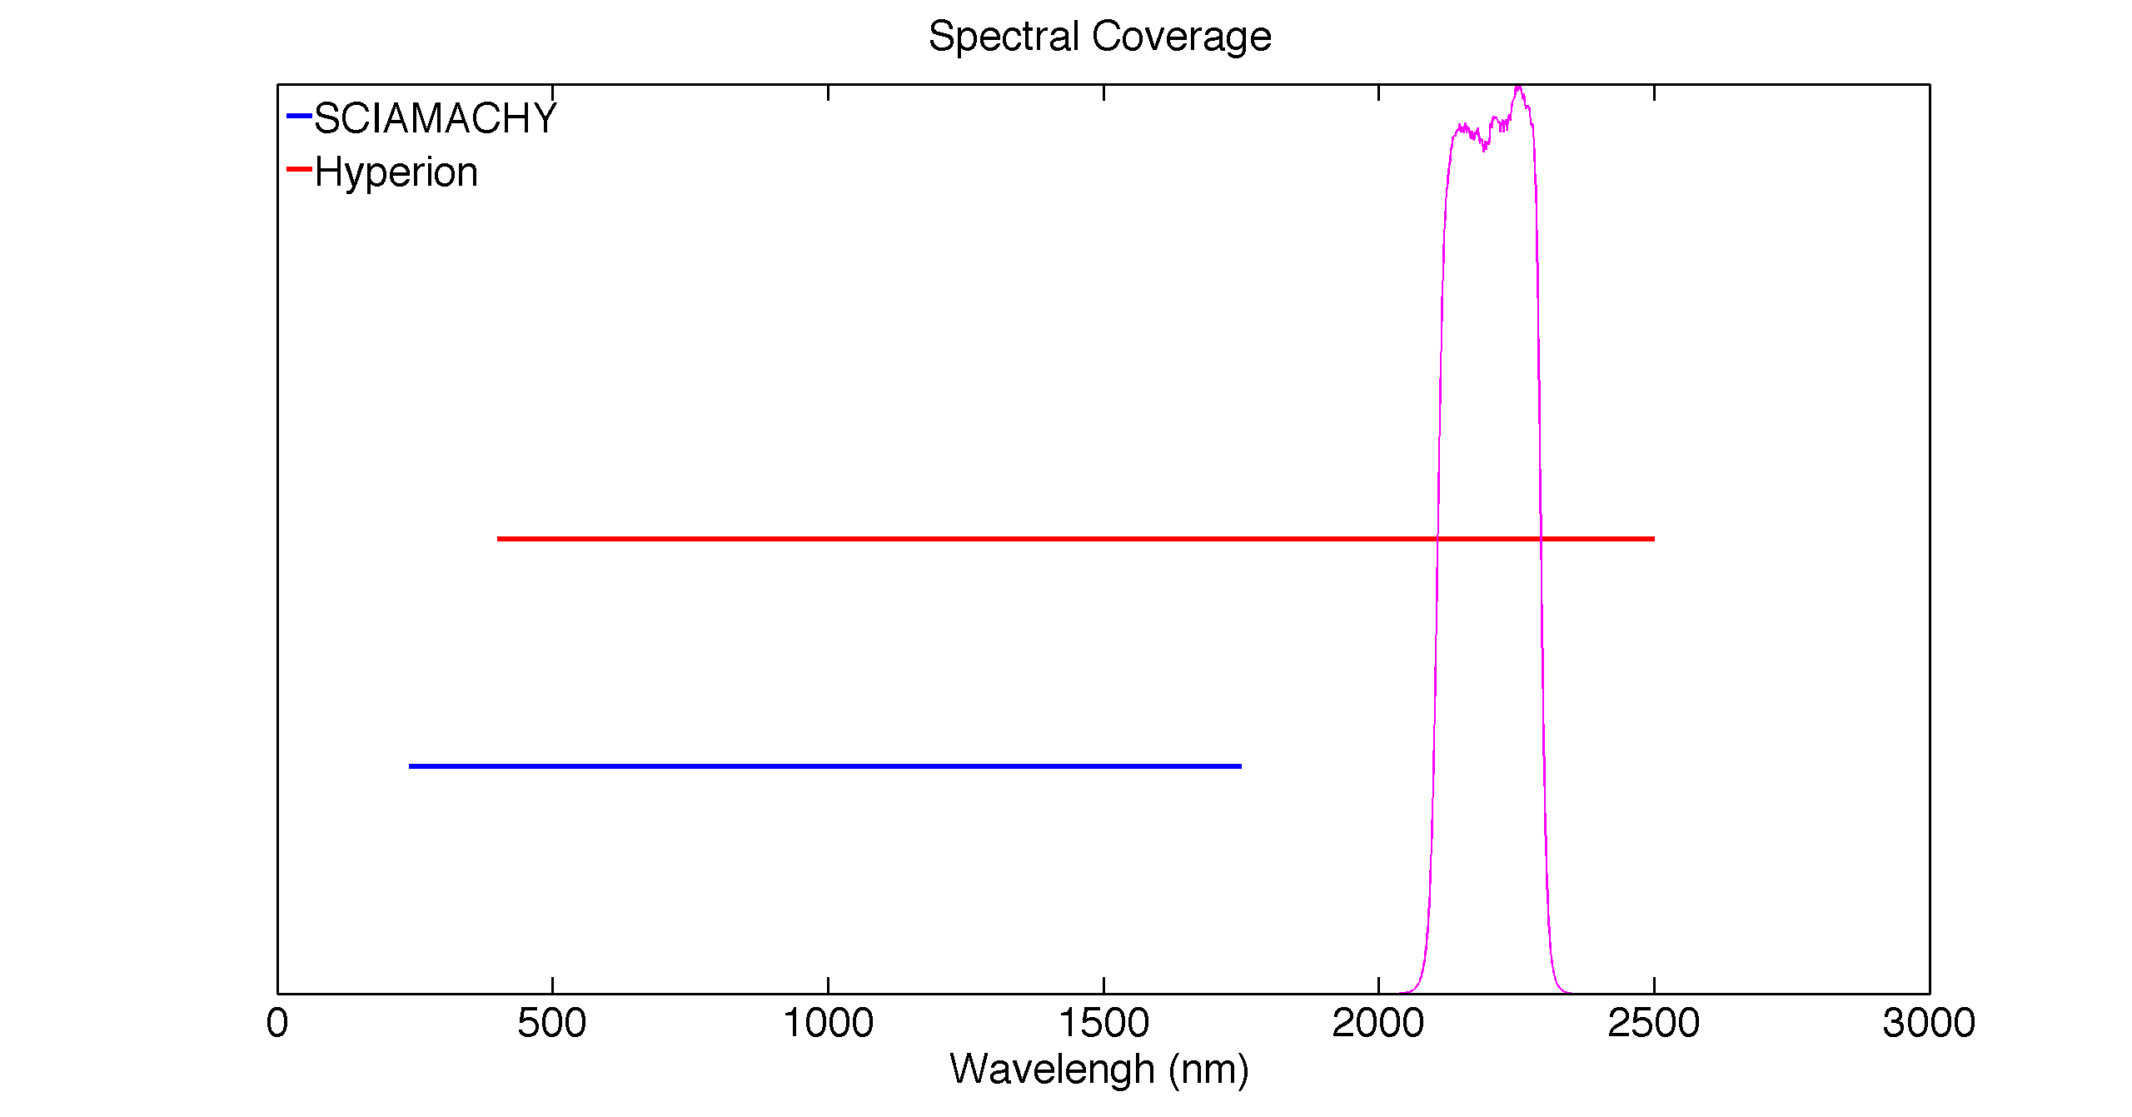
Landsat-8-OLI SWIR2 SRF
400 – 2500 nm
DSCOVR-EPIC O₃ Bands
240 – 1750 nm
Solution: Use Hyperion to fill the missing spectra

Slide 8
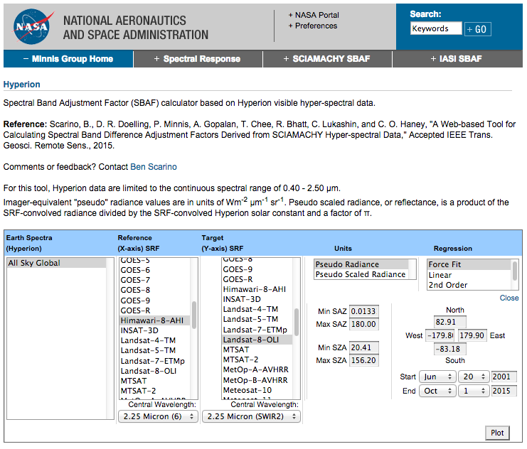
Hyperion SBAF Tool
[pre-release] http://cloudsgate2.larc.nasa.gov/cgi-bin/site/showdoc?mnemonic=HYPERION&mode=HYP#

Slide 9
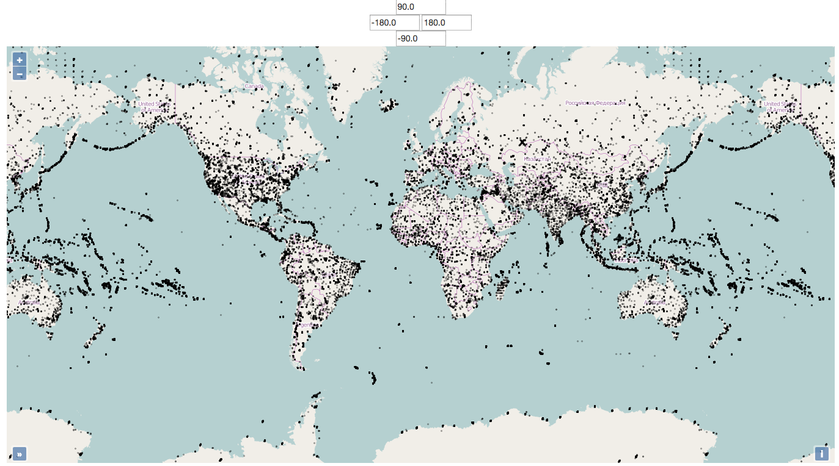
Hyperion SBAF Tool: Scan Selector [COMING SOON]
Hyperion is a tasked instrument, thus coverage only available for select locations
Certain targets are routinely scanned

Slide 10
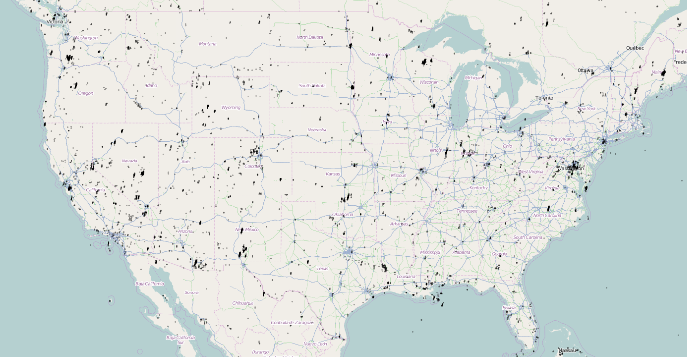
Hyperion SBAF Tool: Scan Selector [COMING SOON]
Users can be as general or precise in their region/scan selection as they desire

Slide 11
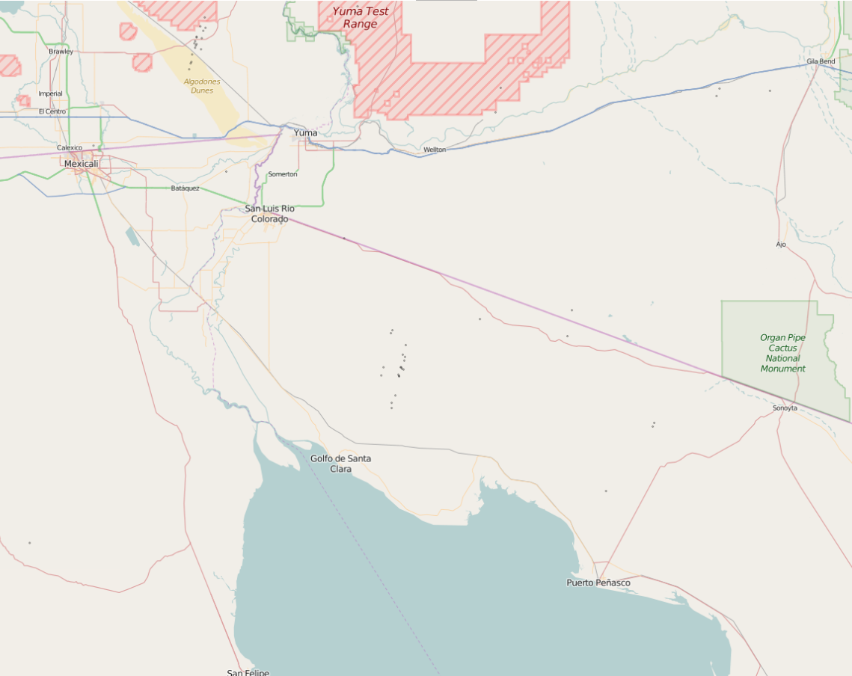

Slide 12
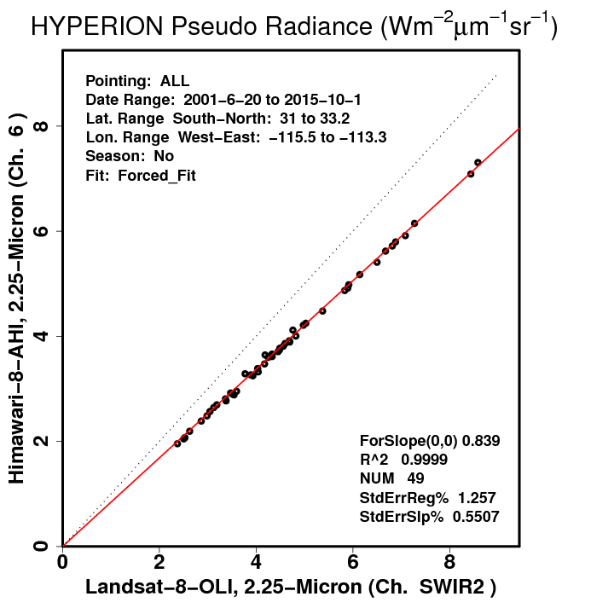
Hyperion SBAF Tool
[pre-release] http://cloudsgate2.larc.nasa.gov/cgi-bin/site/showdoc?mnemonic=HYPERION&mode=HYP#

Slide 13
Conclusions
SCIAMACHY SBAF:http://cloudsgate2.larc.nasa.gov/SBAF
Backup: http://www-angler.larc.nasa.gov/SBAF
Proper subsetting is effective for reducing uncertainty and honing the correction
Hyperion SBAF: http://cloudsgate2.larc.nasa.gov/cgi-bin/site/showdoc?mnemonic=HYPERION&mode=HYP#
Still in testing phases
Supplements SCIAMACHY SBAF with SWIR coverage
Scan selector map allows precise control of target selection

Slide 14
Using IASI to Define SBAFs for IR Channels
Ben Scarino, Dave Doelling, Arun Gopalan, Conor Haney, Thad Chee, Patrick Minnis, Raj Bhatt

Slide 15
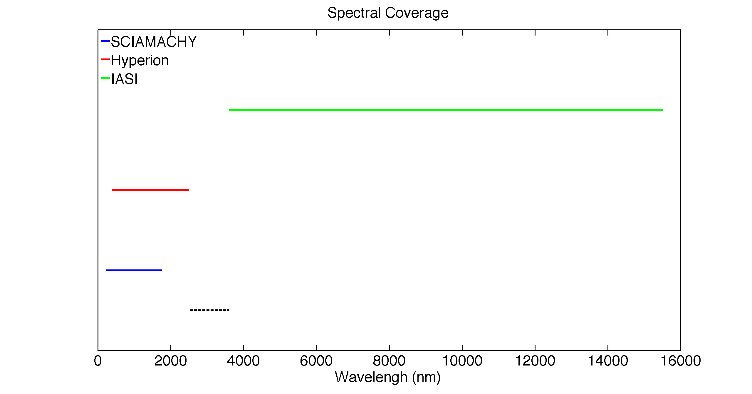
3600 – 15500 nm
400 – 2500 nm
240 – 1750 nm
2500 – 3600-nm gap
SBAF calculation possible from 0.24 – 15.5 μm, excepting a 2.5 – 3.6-μm gap

Slide 16
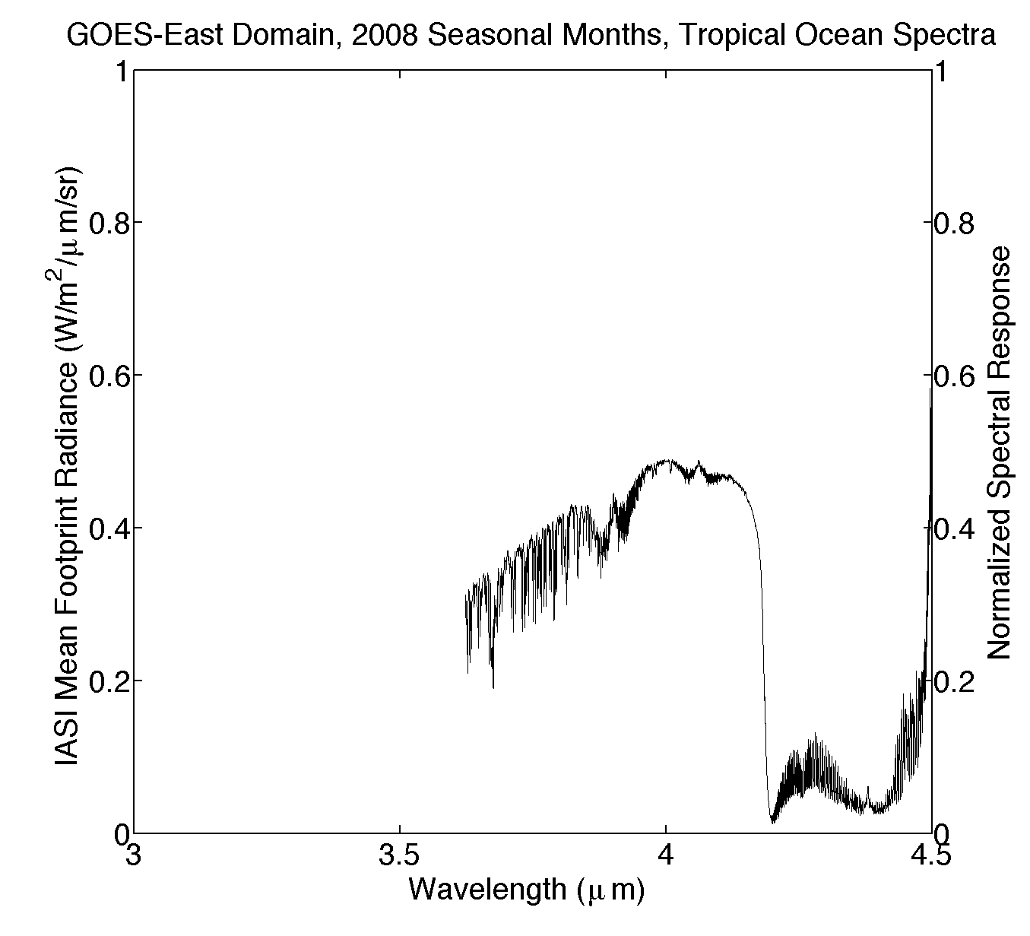
IASI ends abruptly at 3.6 μm…

Slide 17
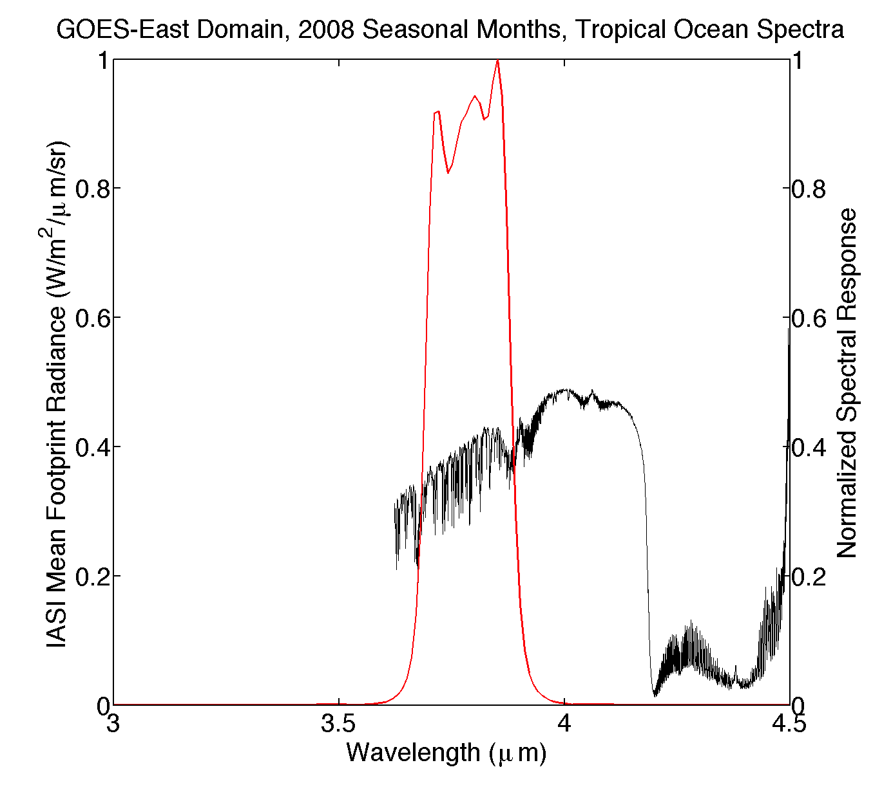
Terra-MODIS.20
…which is sufficient for some instruments

Slide 18
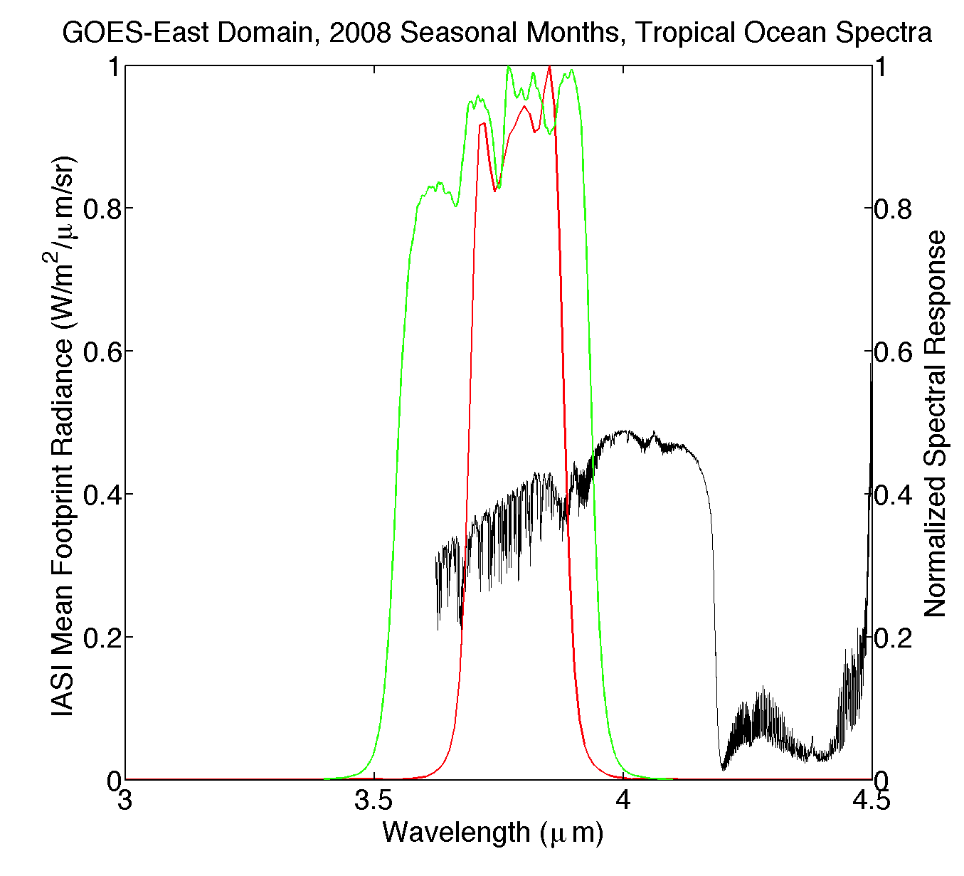
Terra-MODIS.20
NPP-VIIRS-NG.I4
However, NPP-VIIRS I4-Band SRF extends beyond IASI range

Slide 19
Terra-MODIS.20
NPP-VIIRS-NG.I4
Thus we assume Planck extrapolation to fill the missing spectra

Slide 20
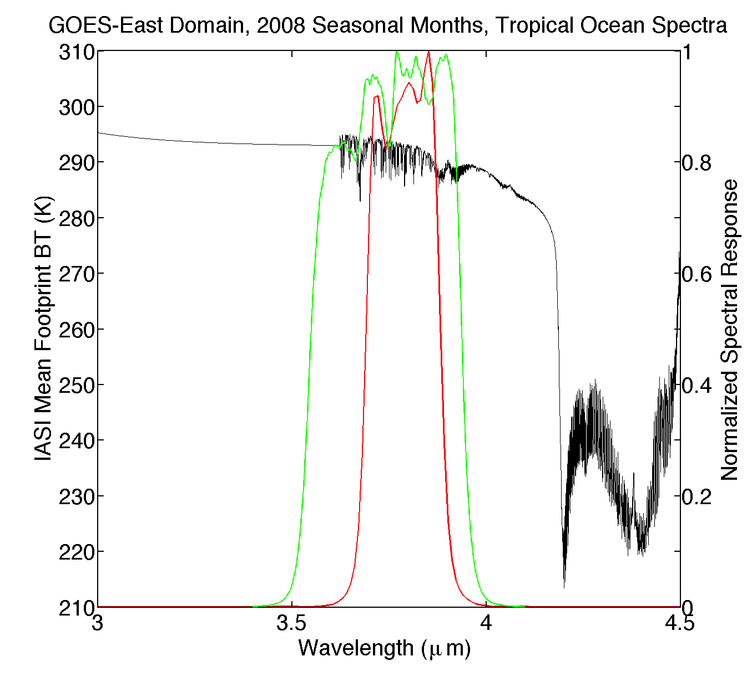
Terra-MODIS.20
NPP-VIIRS-NG.I4
Equivalent BT

Slide 21
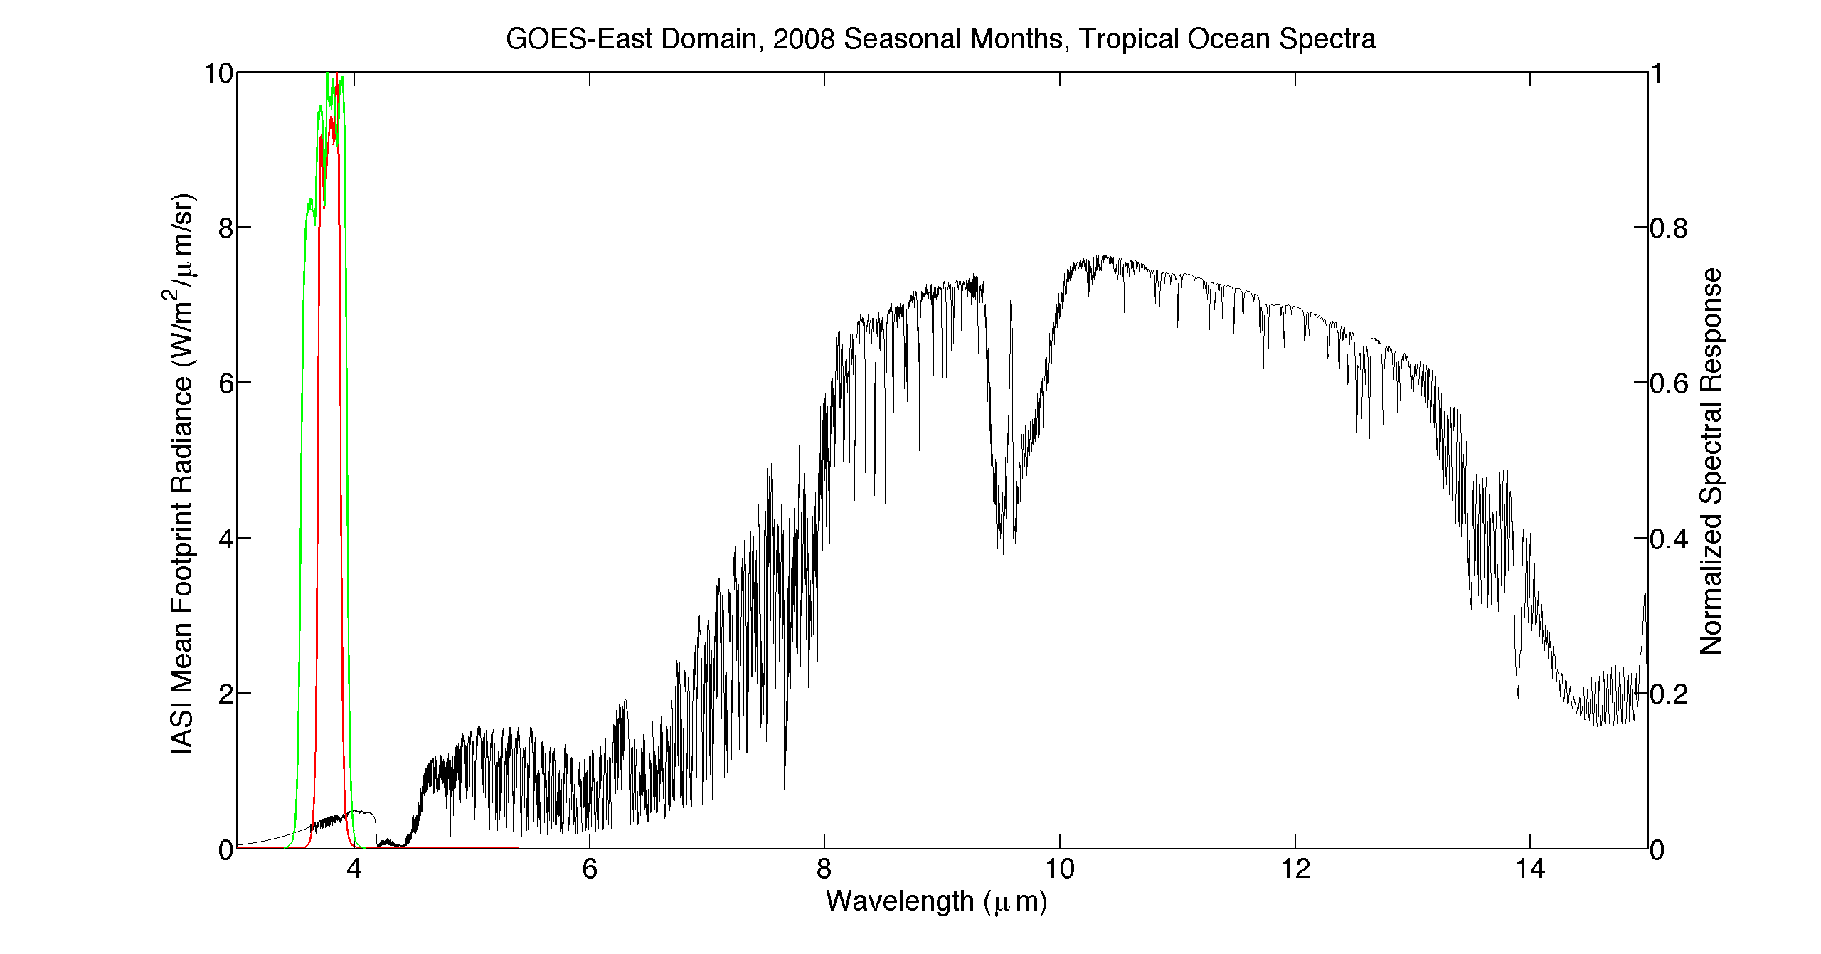
Terra-MODIS.20
NPP-VIIRS-NG.I4
Complete IASI radiance spectrum

Slide 22
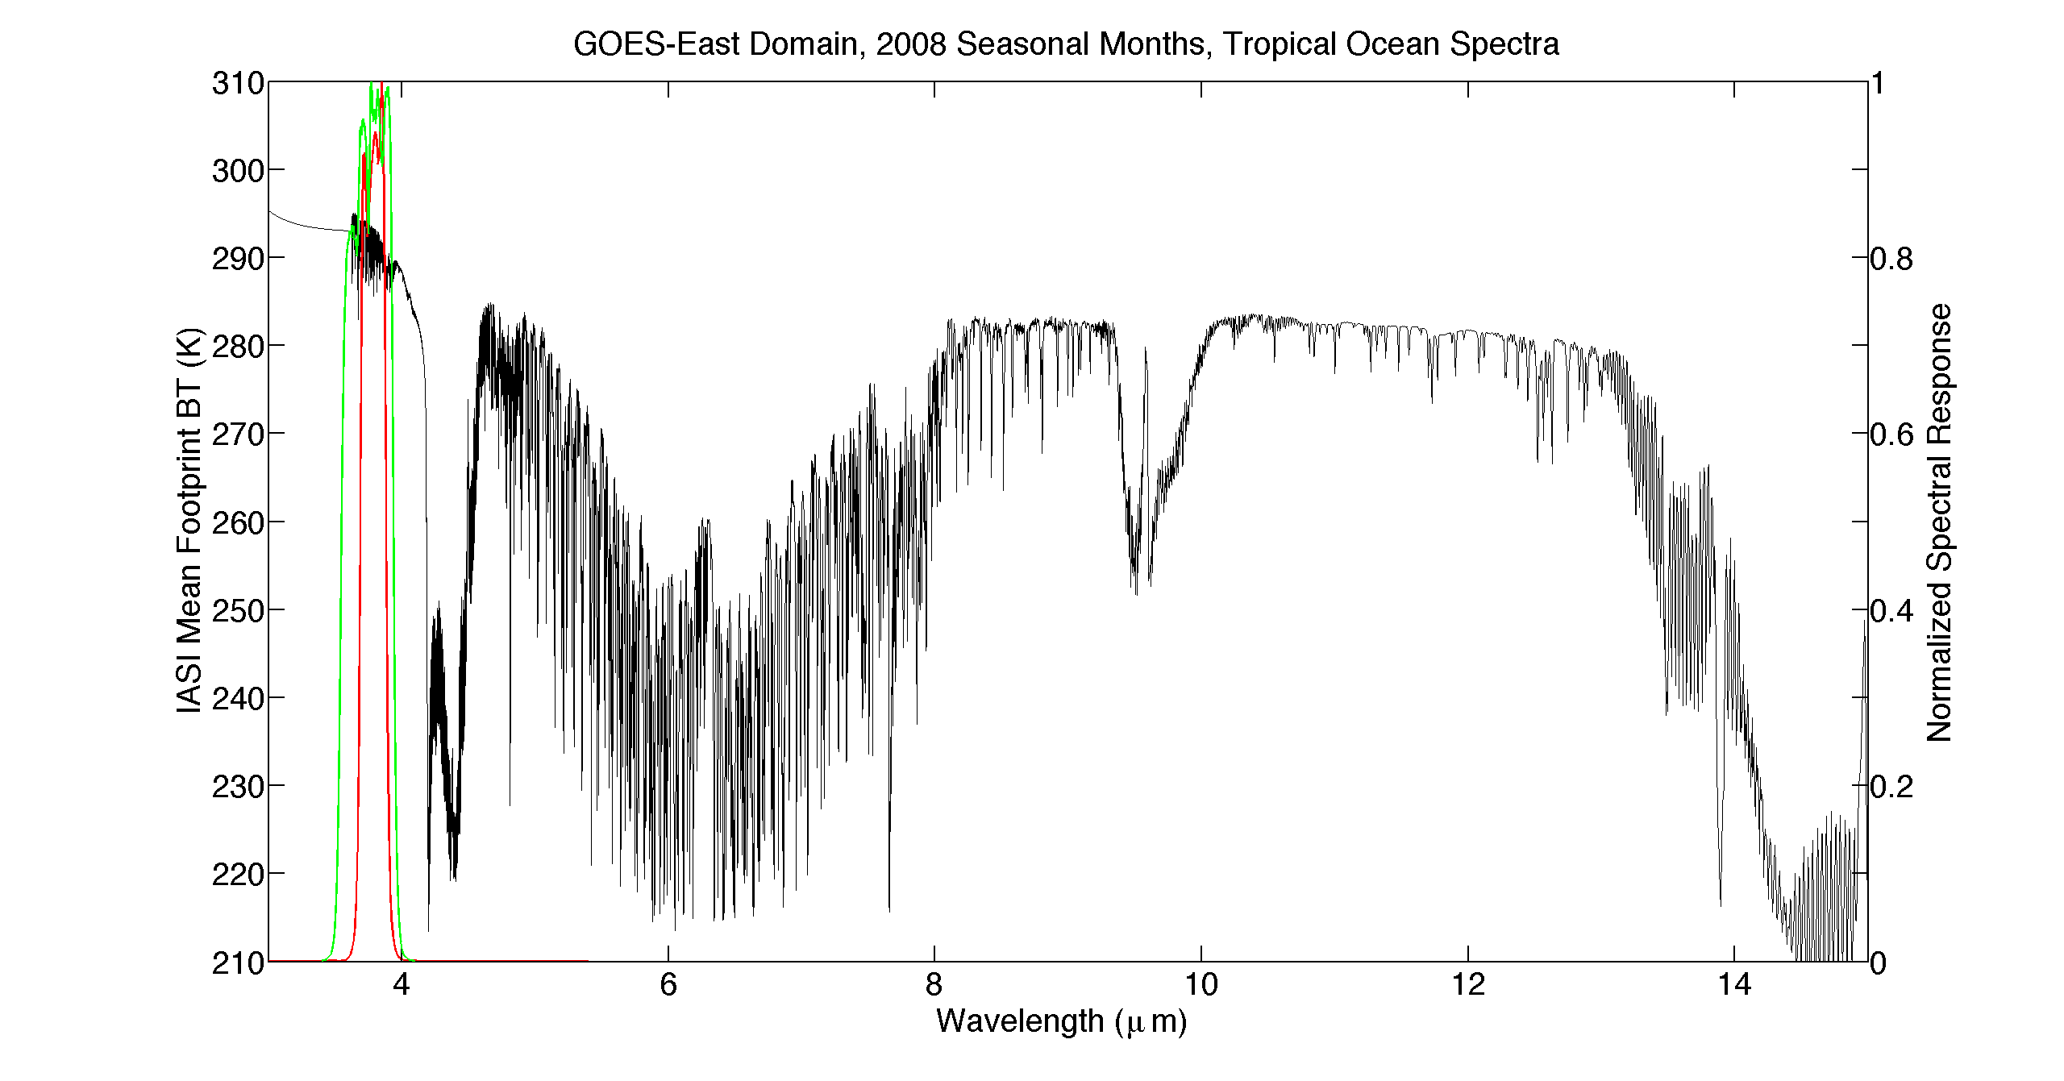
Terra-MODIS.20
NPP-VIIRS-NG.I4
Complete IASI BT spectrum

Slide 23
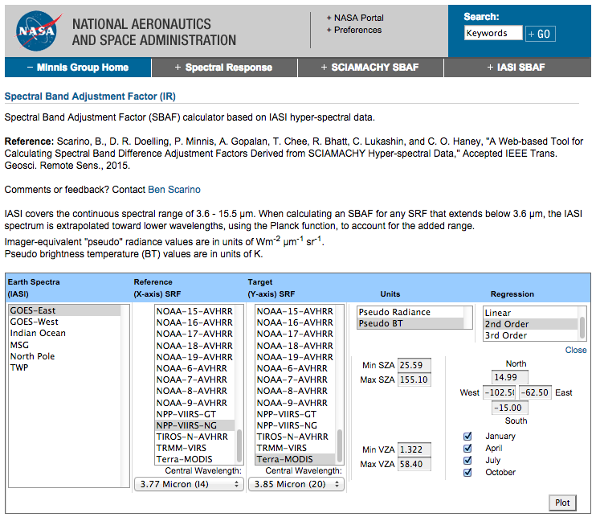
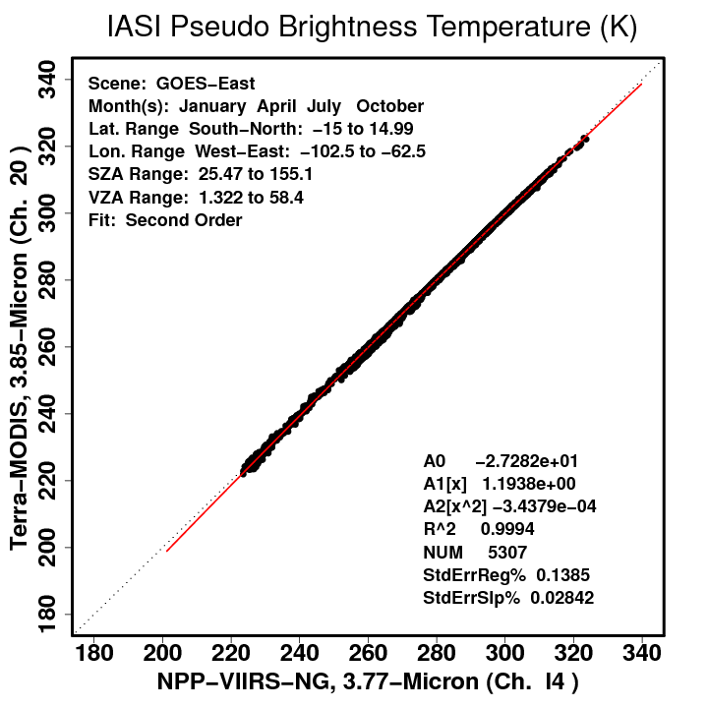

Slide 24
Examples

Slide 25
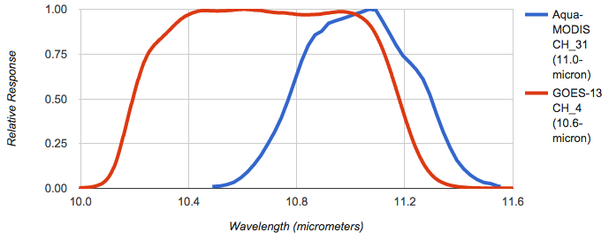
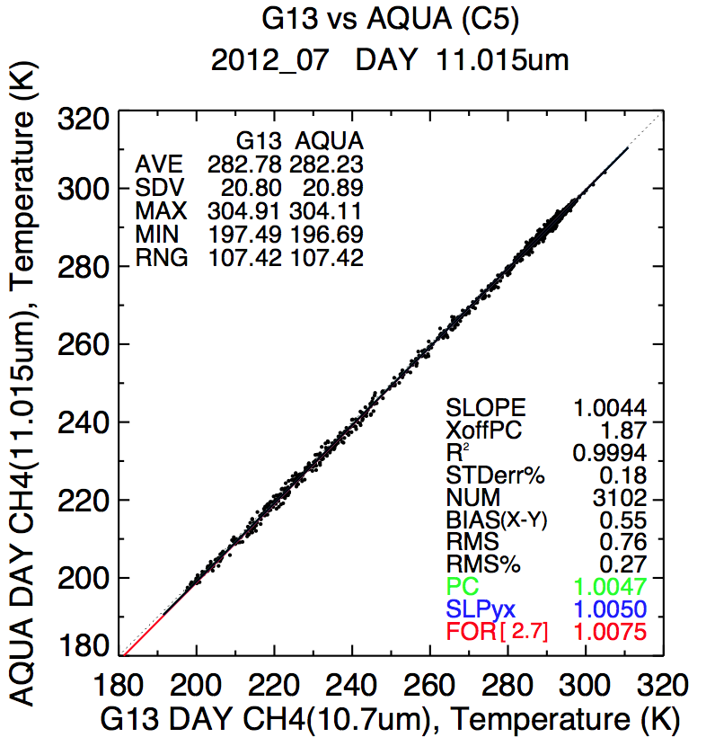
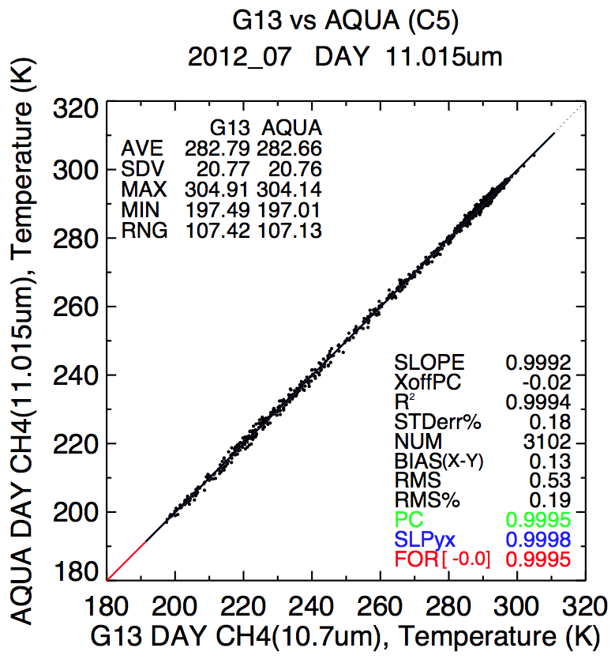
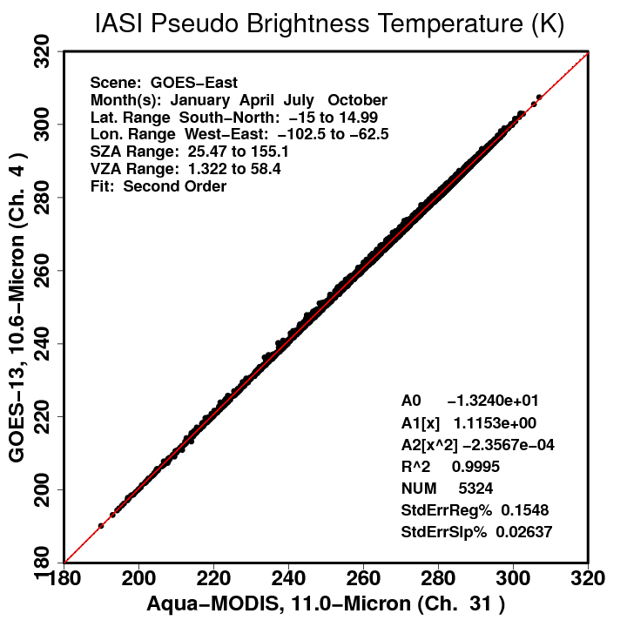
GOES-13 vs. Aqua-MODIS: WN Channel
Before SBAF
2nd-order Adjustment
After SBAF

Slide 26
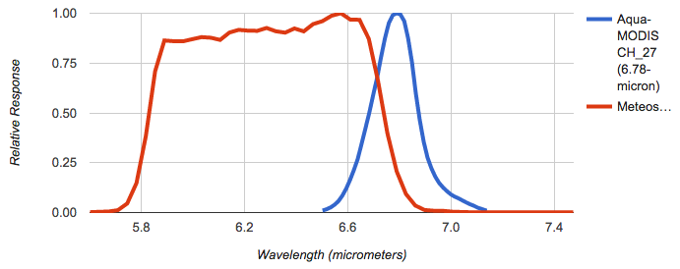
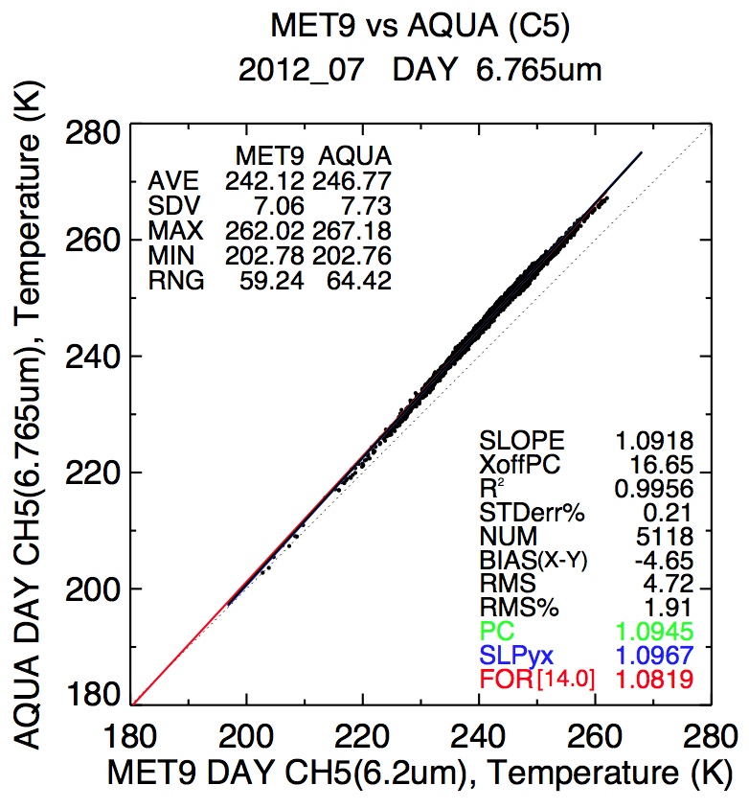
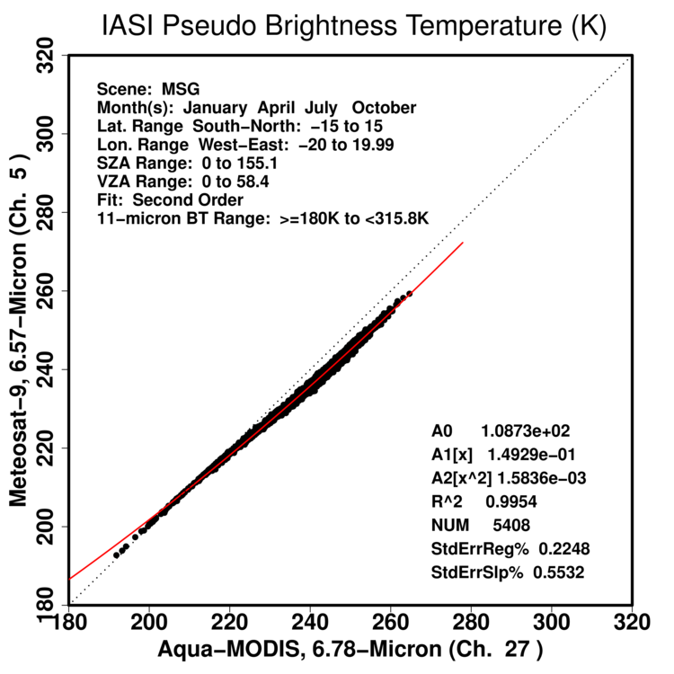
Meteosat-9 vs. Aqua-MODIS: WV Channel
Met-9 CH_5
Slight “S” curve in both ray-matched data and IASI-based pseudo data
2nd-order SBAF cannot perfectly capture the nonlinearity
Need either 3rd-order or piece-wise SBAF to reduce ray-matched nonlinearity
Before SBAF
2nd-order Adjustment

Slide 27
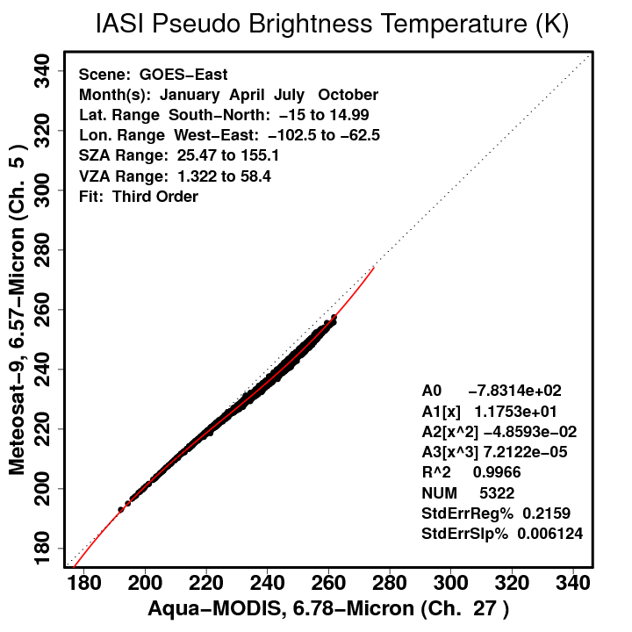
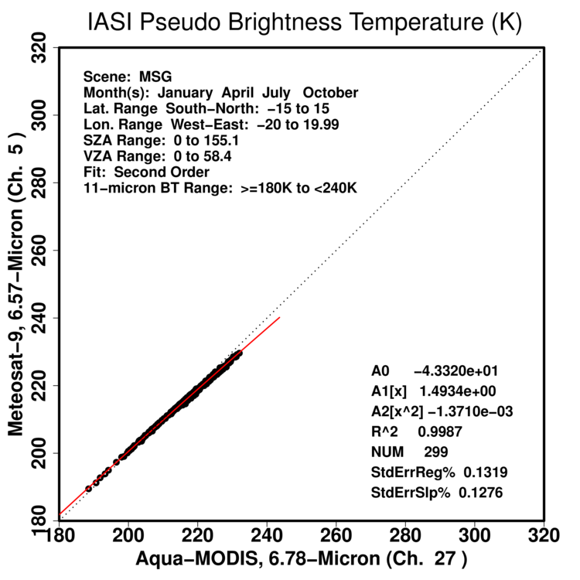
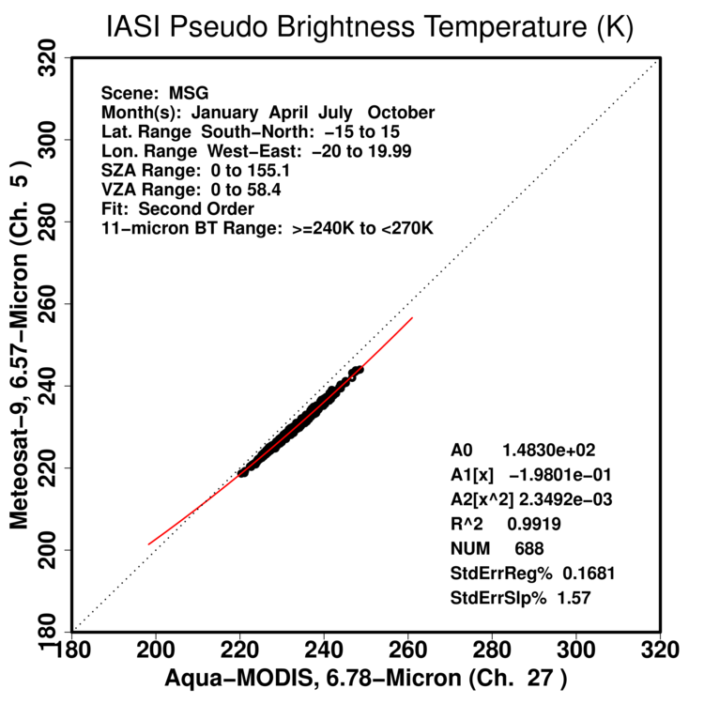
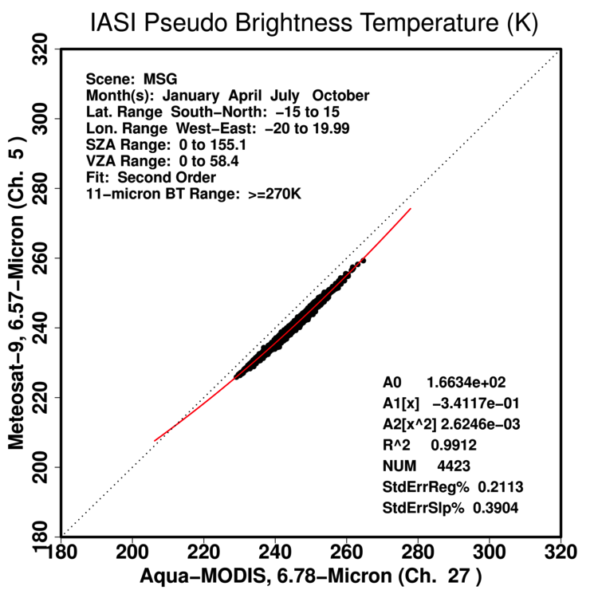
Meteosat-9 vs. Aqua-MODIS: WV Channel
3rd-order and piecewise SBAFs
3rd-order SBAF
180 K <= 11-μm BT < 240 K
240 K <= 11-μm BT < 270 K
11-μm BT >= 270 K

Slide 28
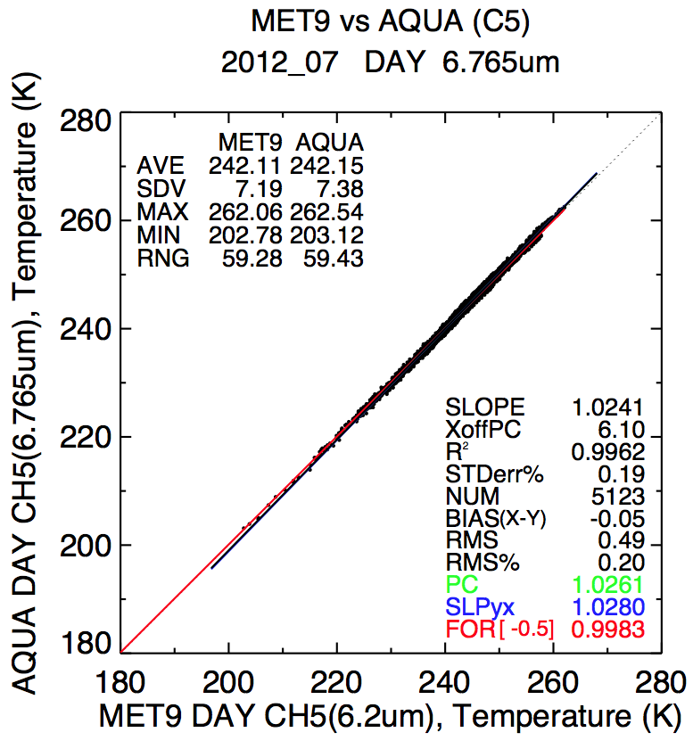
Meteosat-9 vs. Aqua-MODIS: WV Channel
Met-9 CH_5
Before SBAF
3rd-order or Piecewise Adjustment
(results are similar regardless of which is used)
After SBAF

Slide 29
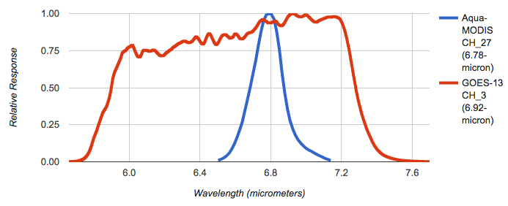
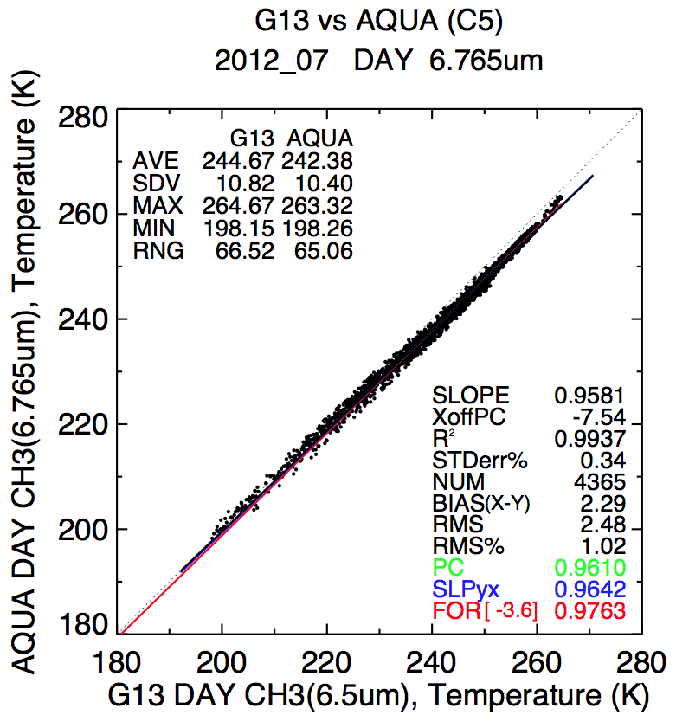
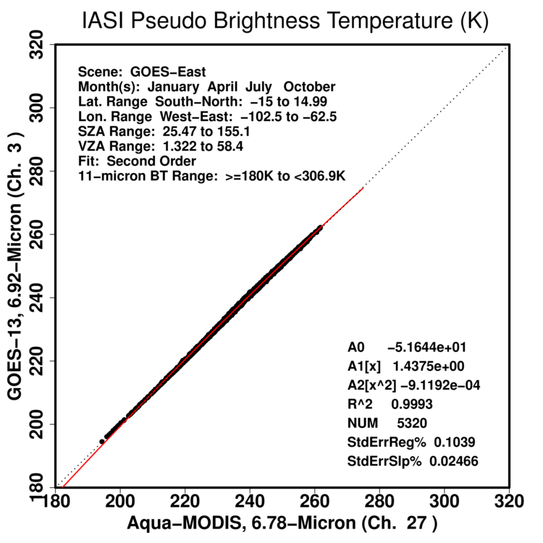
GOES-13 vs. Aqua-MODIS: WV Channel
Before SBAF
2nd-order Adjustment

Slide 30
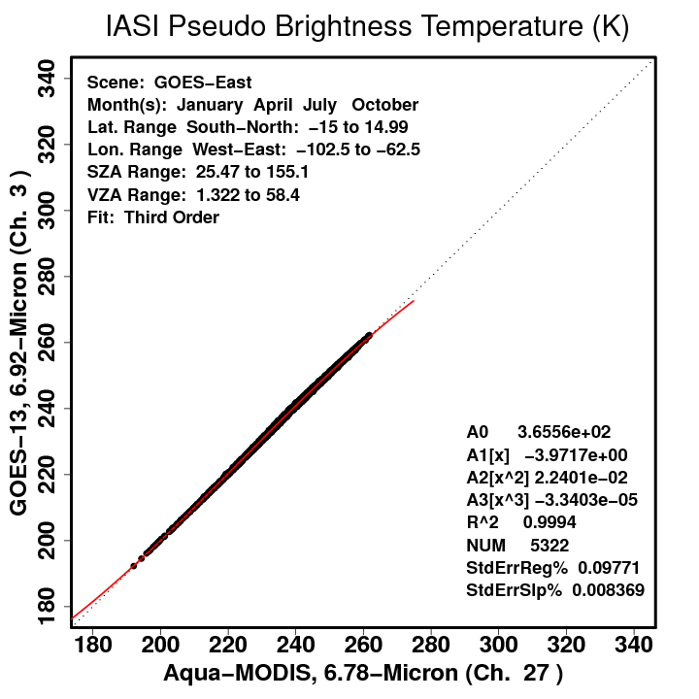
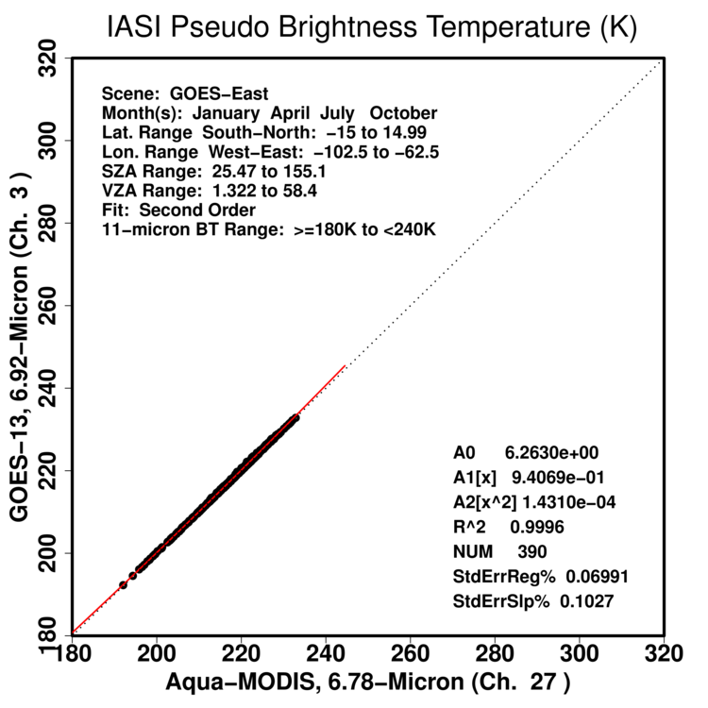
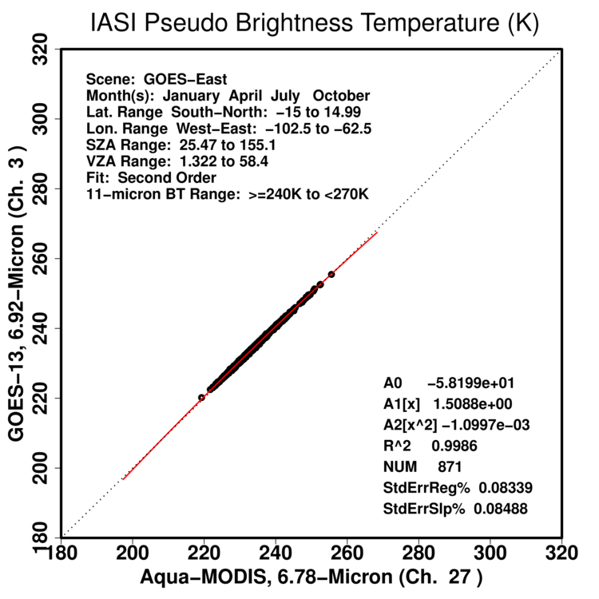
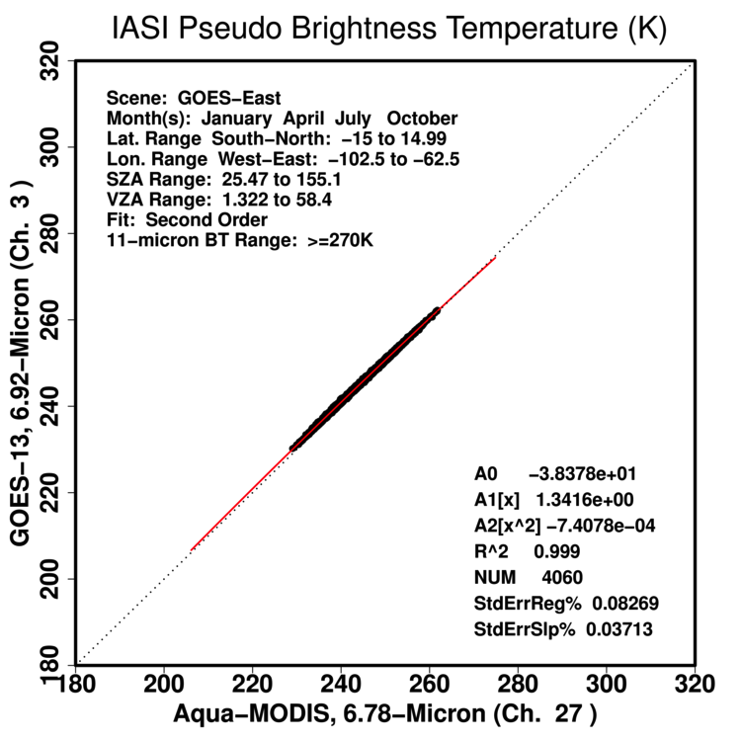
GOES-13 vs. Aqua-MODIS: WV Channel
3rd-order and piecewise SBAFs
3rd-order SBAF
180 K <= 11-μm BT < 240 K
240 K <= 11-μm BT < 270 K
11-μm BT >= 270 K

Slide 31
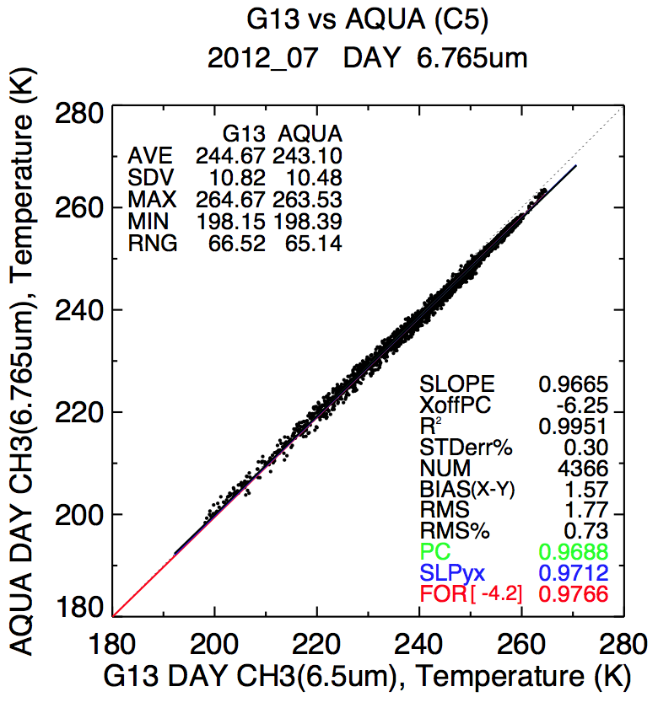
GOES-13 vs. Aqua-MODIS: WV Channel
Before SBAF
3rd-order or Piecewise Adjustment
(results are similar regardless of which is used)
After SBAF

Slide 32
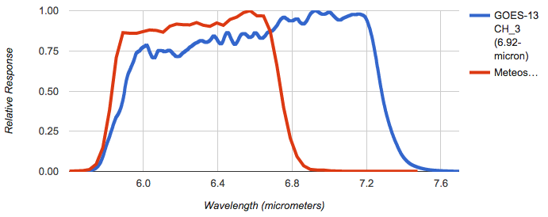
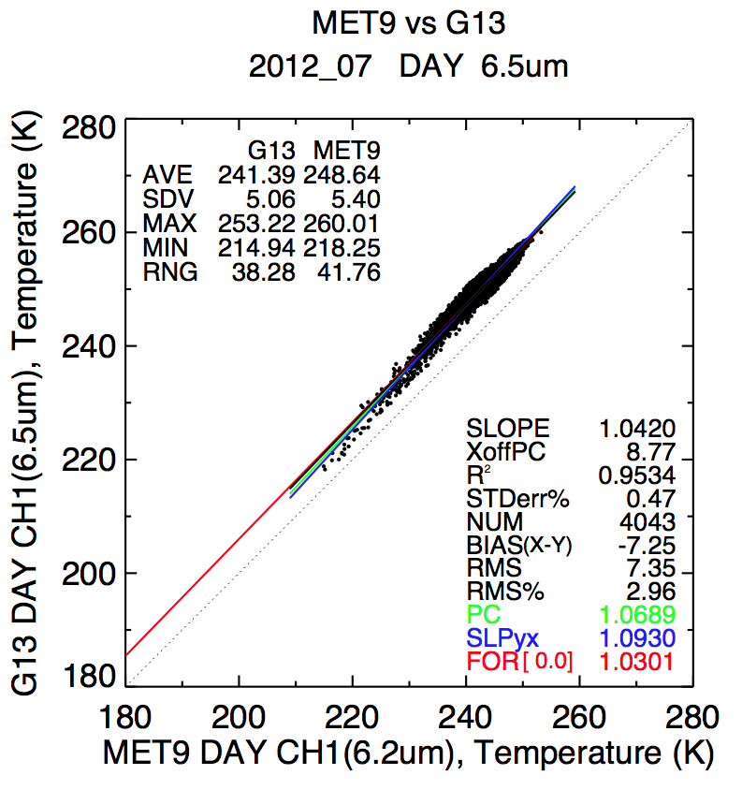
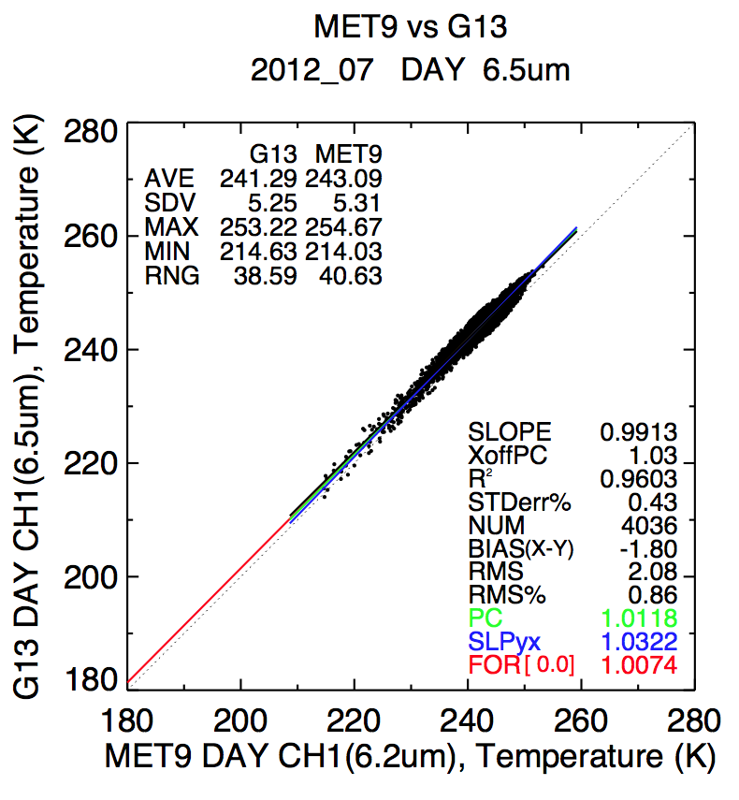
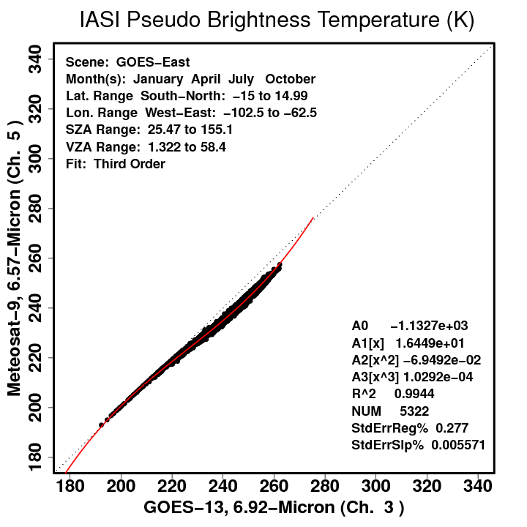
Meteosat-9 vs. GOES-13: WV Channel
Met-9 CH_5
Before SBAF
3rd-order or Piecewise Adjustment
(results are similar regardless of which is used)
After SBAF

Slide 33
Conclusions
Between SCIAMACHY, Hyperion, and IASI, SBAFs can be determined empirically in the almost-continuous spectral range of 0.24-15.5 μm
Demonstrated subtle improvement in the WN channel
Corrected rather significant non-linearities in the WV channel
Effectively reduces ray-matched offset, standard error, and bias

