Slide 1
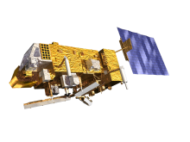

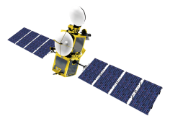
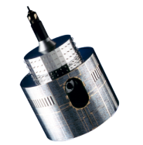
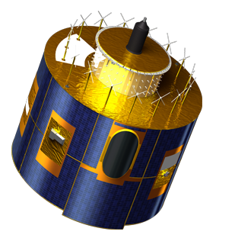
GOME-2 instrument
calibration
using on-board and external
validation sources
Ruediger Lang, Gabriele Poli, Christian Retscher, Rasmus Lindstrot, Roger Huckle, Antoine Lacan, Ed Trollope and Rosemary Munro

Slide 2
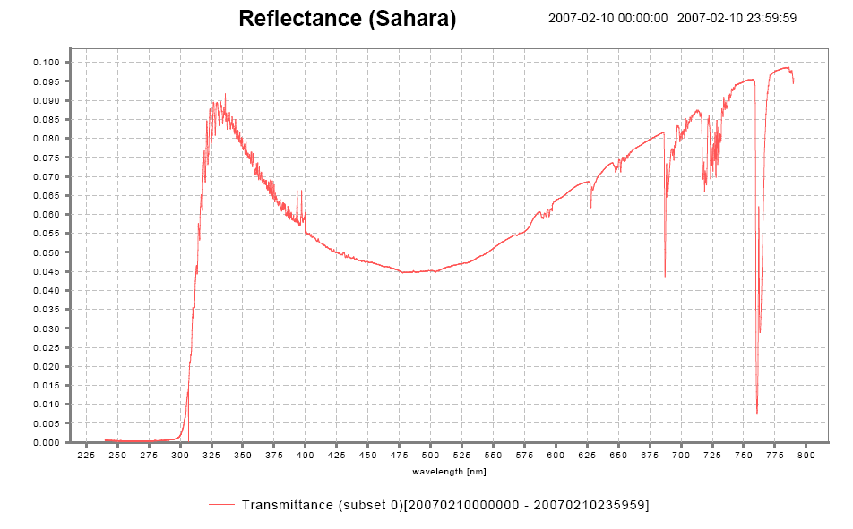
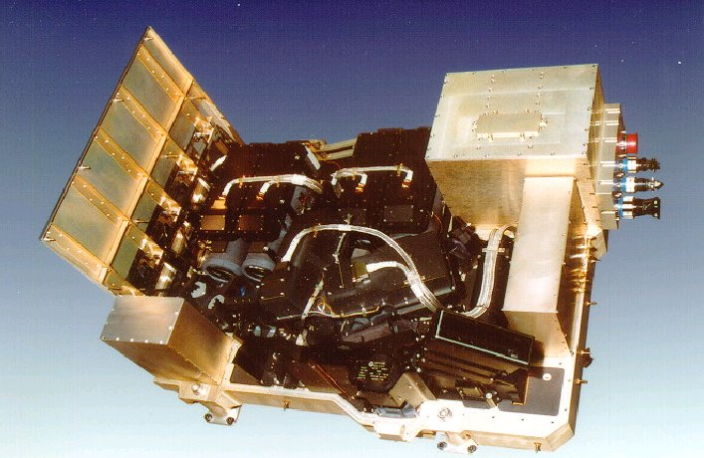
The GOME-2 UVN instrument on Metop
Measuring atmospheric composition
GOME-2 main channel transmittance
GOME-2:
series of 3 instruments on Metop (Metop A launched in 10/2006)
sun-synchronous orbit, 09:30
412 orbits (29 days) repeat cycle
Global coverage 1.5 days
240 nm to 800 nm
0.25 to 0. 5 nm spectral resolution (FWHM)
4 channels with 4098 energy measurements of polarisation corrected radiances (40 x 80 km²)
2 channels with 512 energy measurements of linear polarised light in perpendicular direction (S/P) (40 x 10 km²)
HCHO
Aerosol
SO₂
NO₂
O₃
BrO
I/I₀
H₂O
O₃
(O₂)₂
OClO
O₂
240
790
Wavelength [nm]
Orbit file sizes
GOME-2 L1B ~ 1GB
IASI L1C ~ 2GB

Slide 3
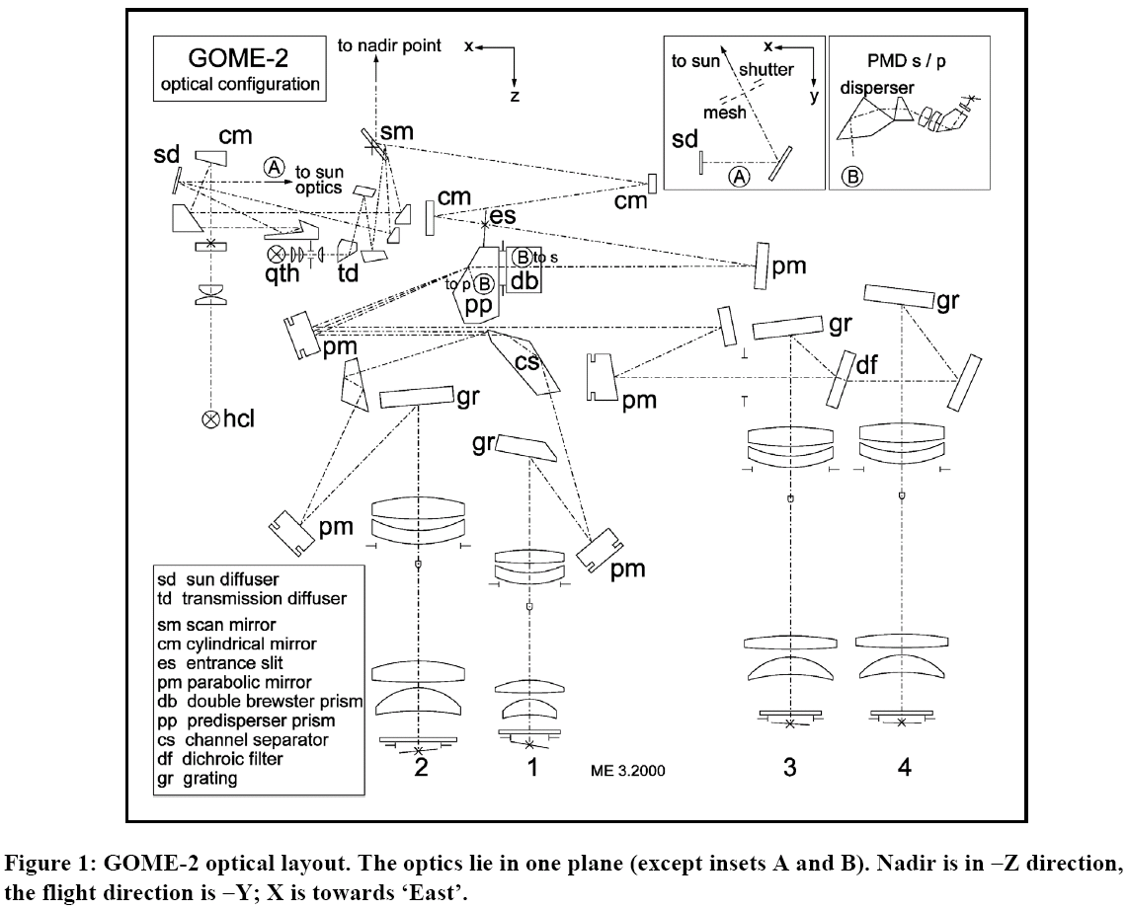
GOME-2 optical layout
Scanning grating spectrometer with a random-access linear silicon photodiode array
Earthshine
Sun (daily)
Scan Mirror
Solar diffuser
White Light Source
WLS (daily)
Calibration
Unit
Spectral Light Source
SLS (daily)
Common (Earth/Solar/Cal) path

Slide 4
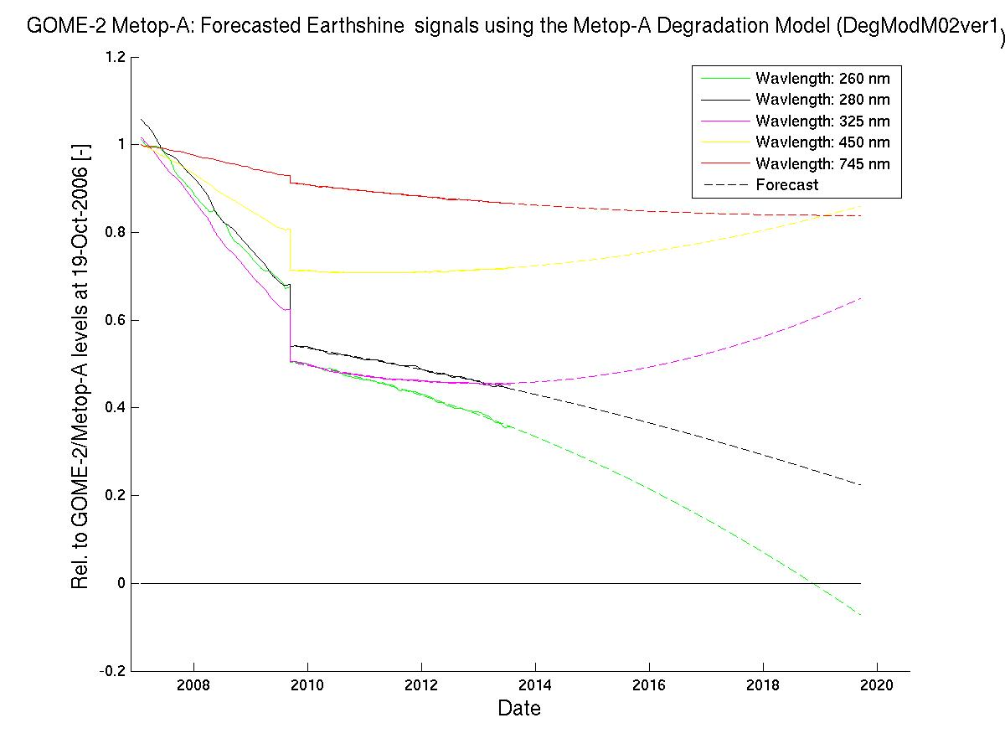
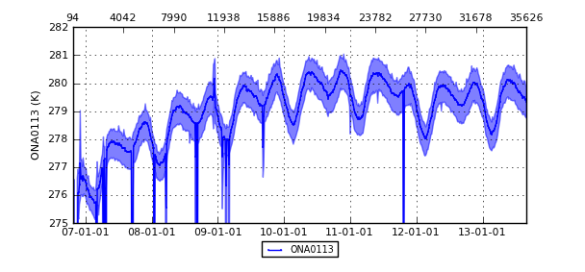
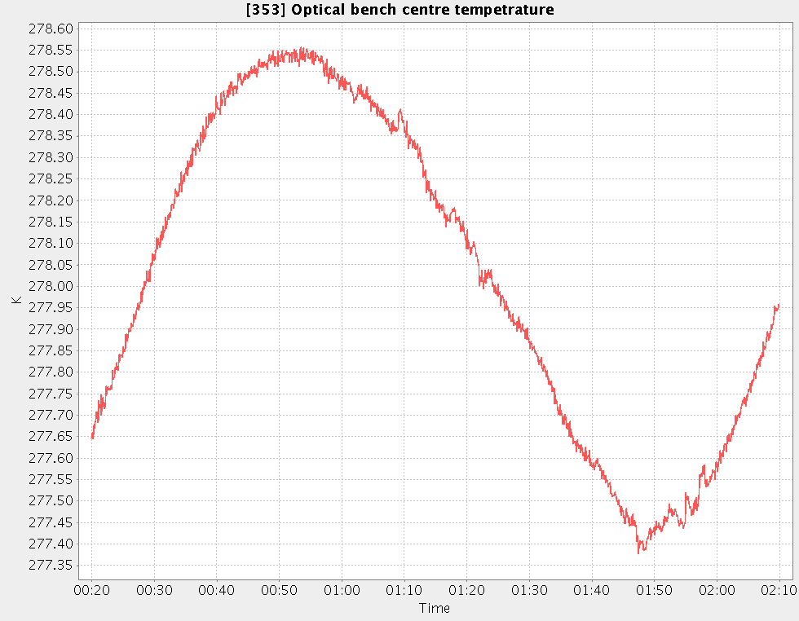
Instrument design aspects
Thermal control and degradation
GOME-2 Optical bench temperature
Earthshine Trend/Forecast
282 K





Spectra stability
(long-term and orbital)
Spectral resolution
(long-term and orbital)
Quality on-ground calibration measurements
On-ground to in-orbit changes
The correction/control over contamination and its dynamic
ΔT=3K
275 K
278.6 K
100 min
The thermally uncontrolled optical bench
and the degradation in the optical path through degradation and contamination of optical surfaces dominate large parts of the observed in-orbit continuous calibration aspects.
277.4 K

Slide 5
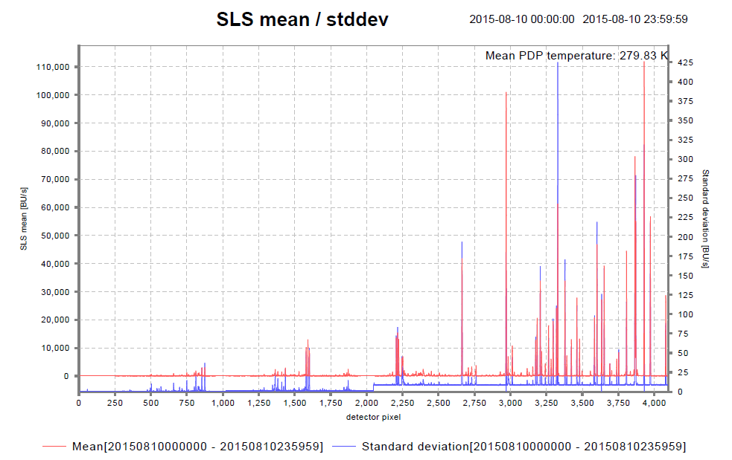
On-board calibration (daily)
Spectral line source daily measurement
GOME-2 FM3 Metop-A

Slide 6
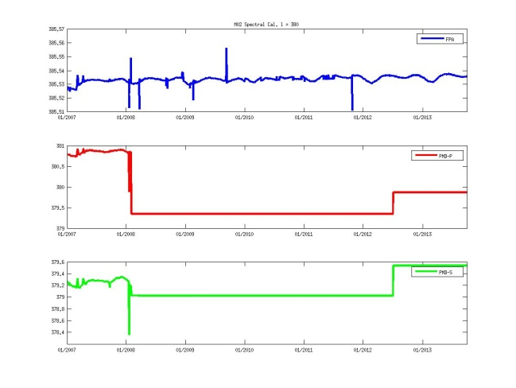
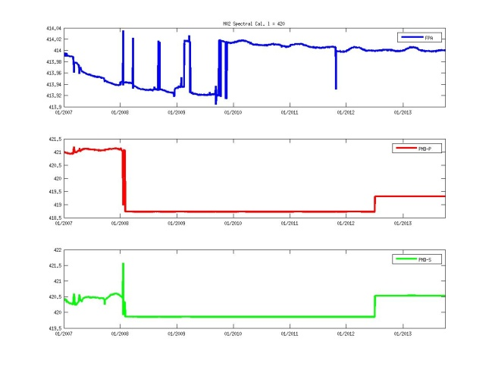
On-board calibration (daily)
Spectral line source daily measurement
GOME-2 FM3 Metop-A
Channel 2
Channel 3
385.57 nm
414.04 nm
385.51 nm
413.90 nm
381.00 nm
421.50 nm
379.00 nm
418.50 nm
379.60 nm
422.00 nm
378.20 nm
419.50 nm
R2 campaign
Jan 2007 – Jan 2012
OPS phase (same PPF 5.3)
Jan 2012 – Oct 2013

Slide 7
On-board calibration (daily)
Spectral line source daily measurement
GOME-2 FM3 Metop-A
Channel 3
414.04 nm
OB temperature
413.90 nm
421.50 nm
Jumps of 0.1 nm (0.5 pixel; ~20% FWHM) observed in channel 3 related to different dispersion polynomial fitting regimes.
The different regimes are most likely triggered by the change in OB temperature.
418.50 nm
422.00 nm
419.50 nm
R2 campaign
Jan 2007 – Jan 2012
OPS phase (same PPF 5.3)
Jan 2012 – Oct 2013

Slide 8
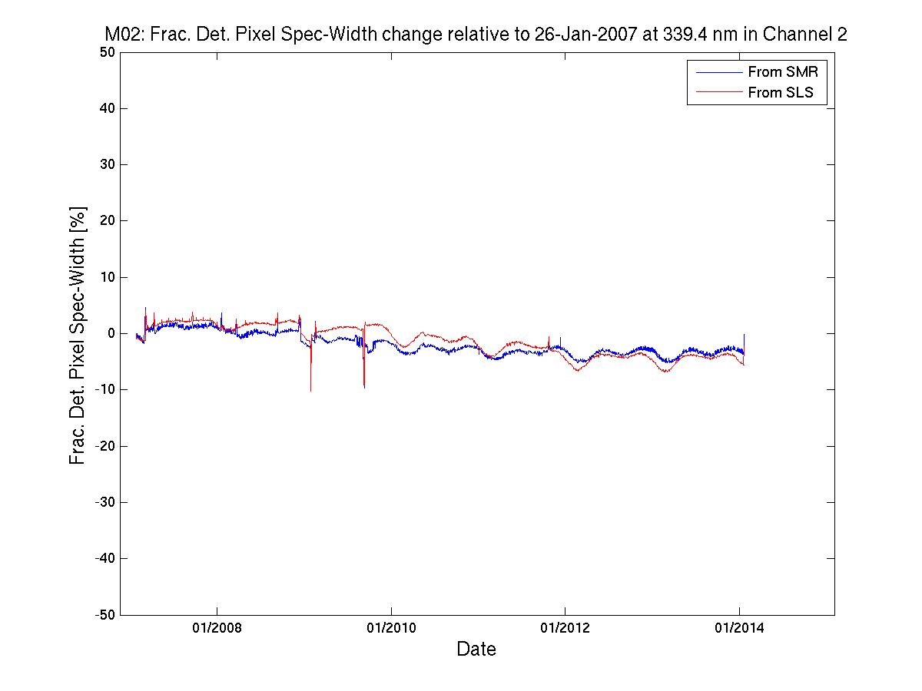
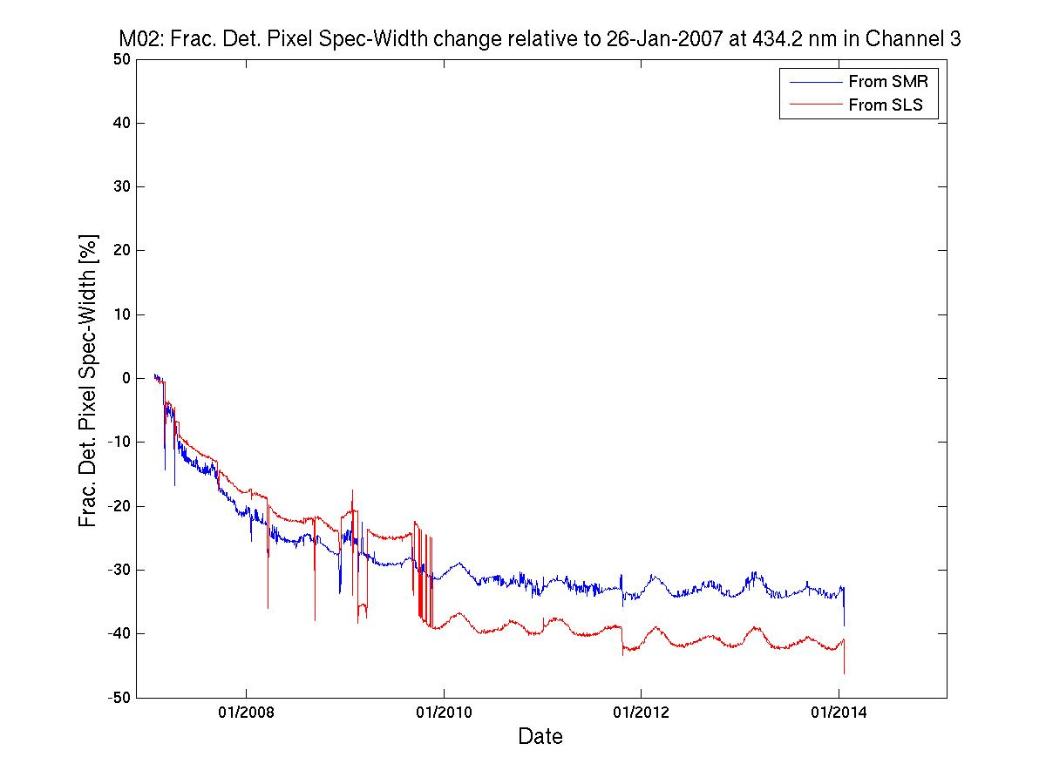
On-board calibration (daily)
SLS spectral calibration VS solar spectral calibration
GOME-2 FM3 Metop-A
Initiated by on-board anomaly of the Spectral Line Source on Metop-A at 25/12/2014
indication of lamp aging
introduction of “back-up” spectral calibration algorithm using the solar spectrum
Channel 2
Channel 3
Operational spectral calibration from HCL lamp
New Solar spectrum Fraunhofer line fitting
Solar reference spectrum fitting results slightly more noisy, but more stable!

Slide 9
On-board calibration (daily)
White light source daily measurement
GOME-2 FM3 Metop-A

Slide 10
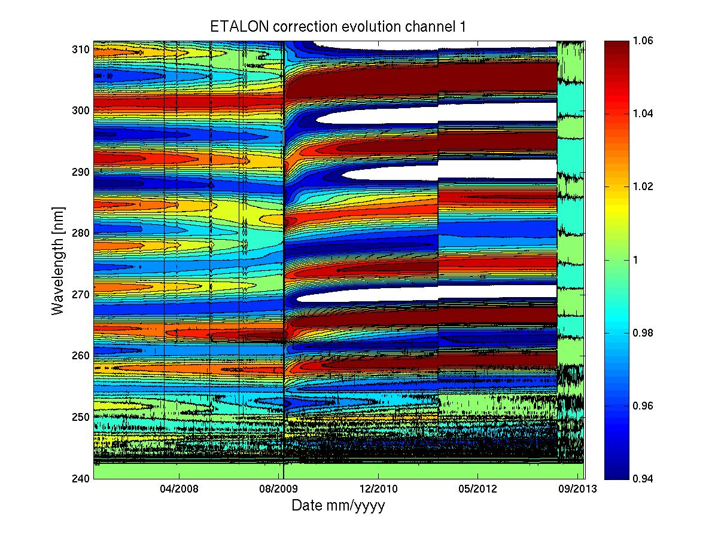
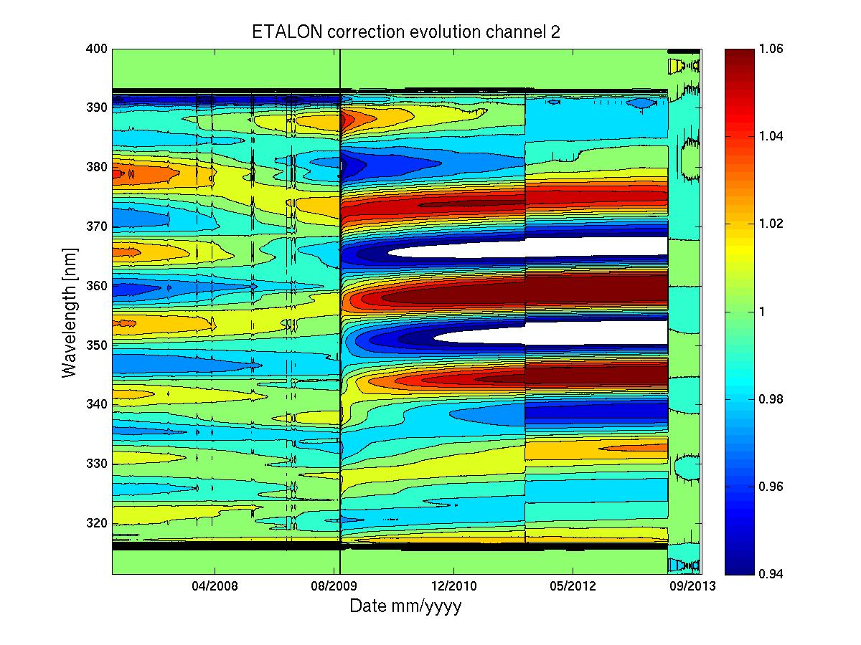
GOME-2 Metop-A Long-term throughput changes
On-board calibration ETALON (FPA)
GOME-2 FM3 Metop-A
R2 campaign
Jan 2007 – Jan 2012
OPS phase (same PPF 5.3)
Jan 2012 – Oct 2013

Slide 11
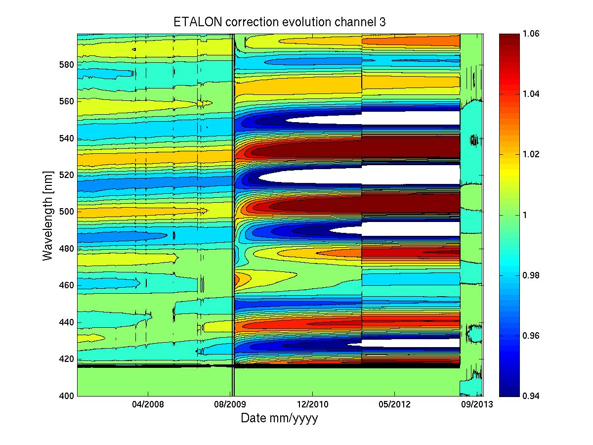
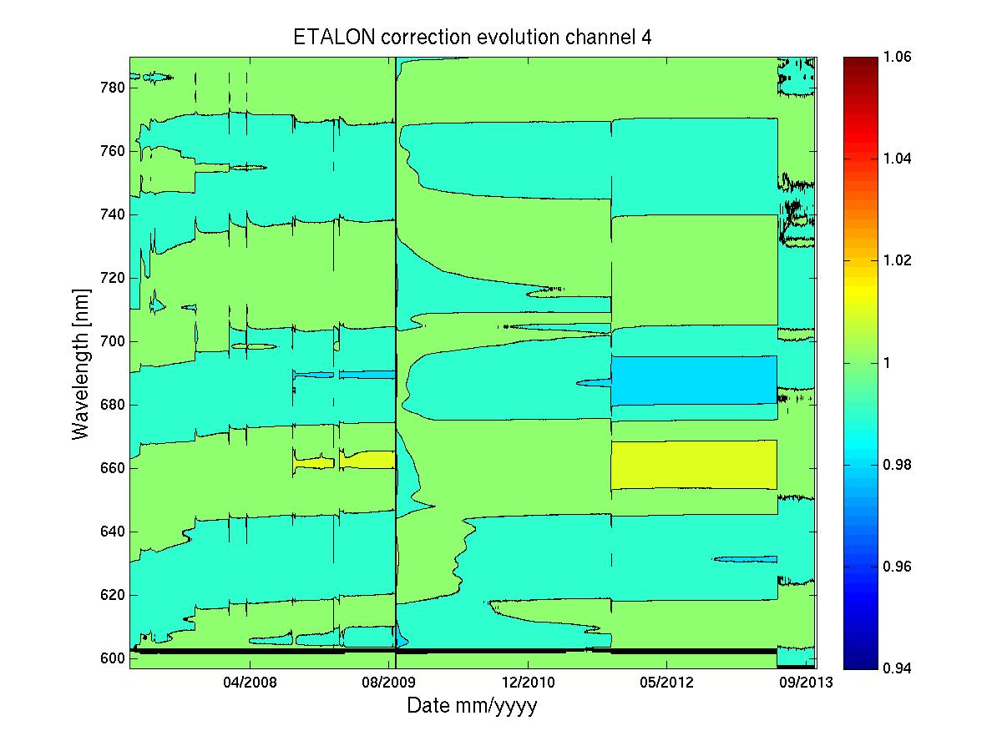
GOME-2 Metop-A Long-term throughput changes
On-board calibration ETALON (FPA)
GOME-2 FM3 Metop-A
R2 campaign
Jan 2007 – Jan 2012
OPS phase (same PPF 5.3)
Jan 2012 – Oct 2013

Slide 12
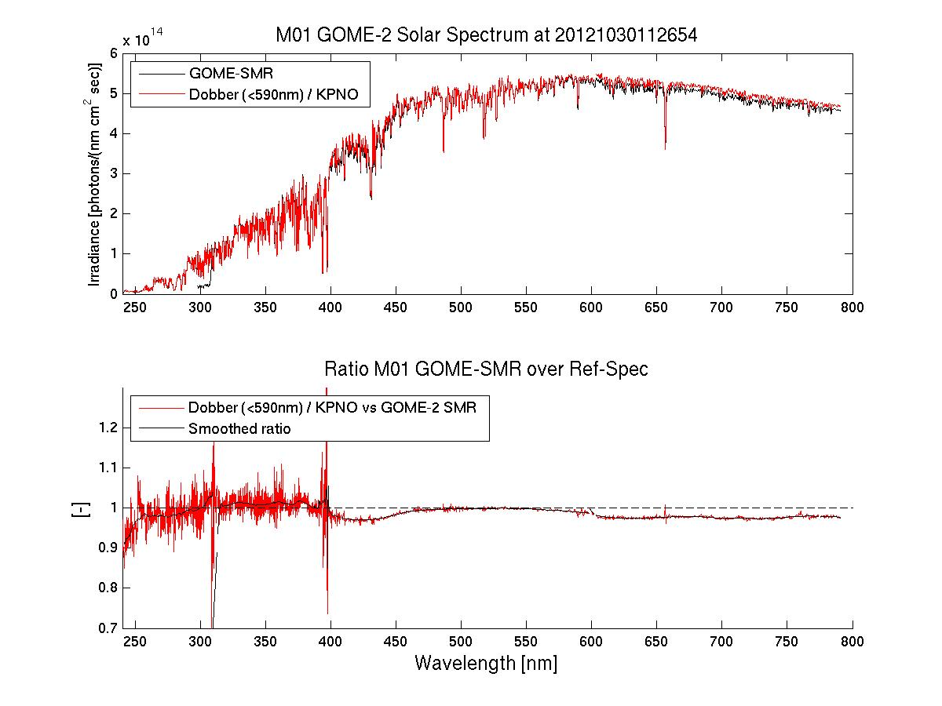
Metop-B / FM2 solar measurement
With adjustment channel-overlap incl. etalon
GOME-2 FM2 Metop-B
First Solar Measurement
30 October 2012

Slide 13
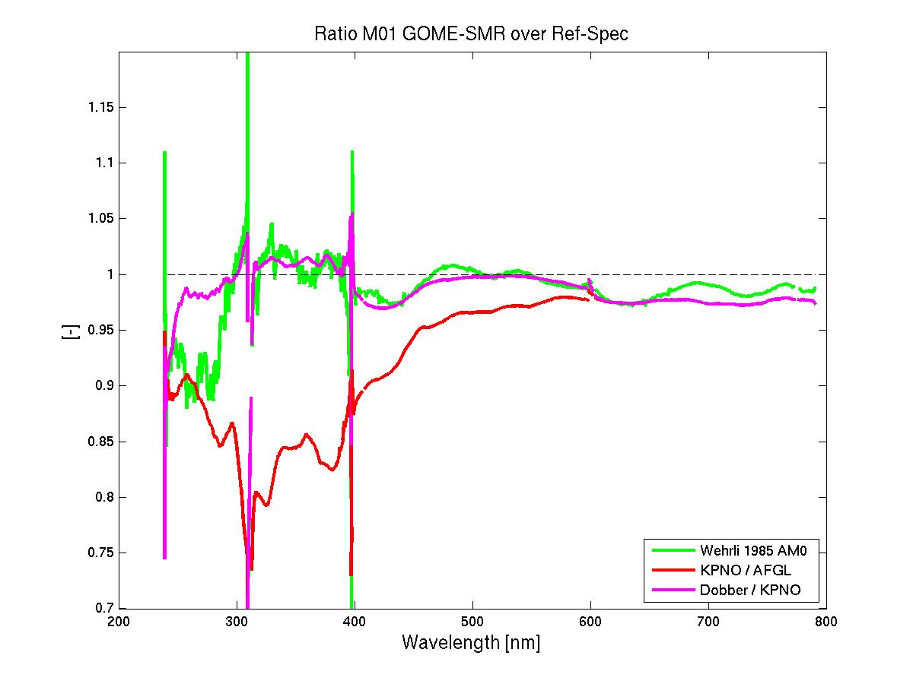
Metop-B / FM2 solar measurement
With adjustment channel-overlap incl. etalon
GOME-2 FM2 Metop-B
First Solar Measurement
30 October 2012

Slide 14
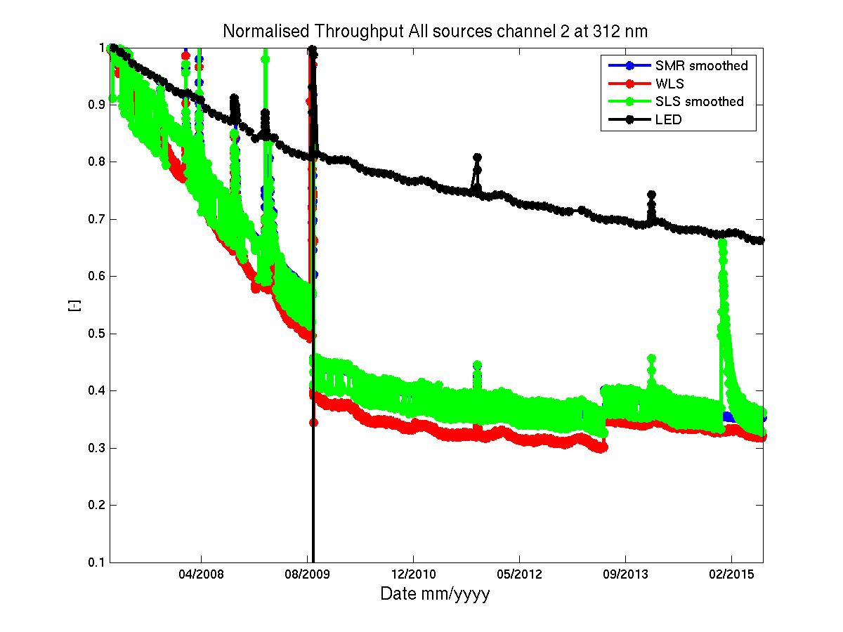
GOME-2 Metop-A Long-term throughput changes
All sources at 312 nm (FPA)
GOME-2 FM3 Metop-A

Slide 15
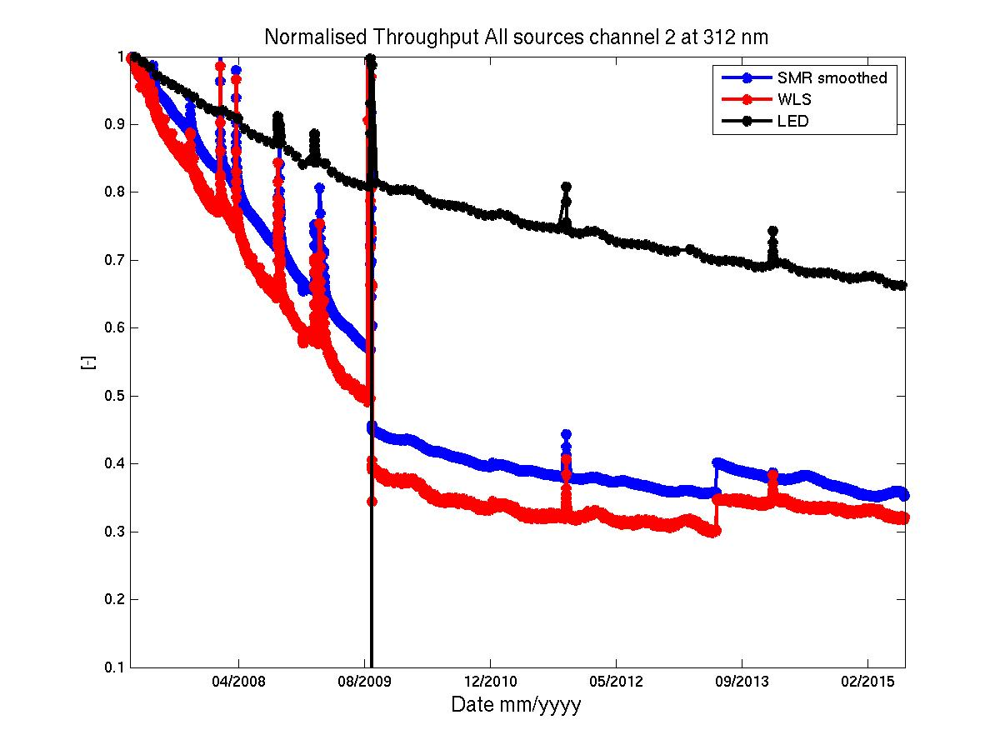
GOME-2 Metop-A Long-term throughput changes
All sources at 312 nm (FPA)
GOME-2 FM3 Metop-A

Slide 16
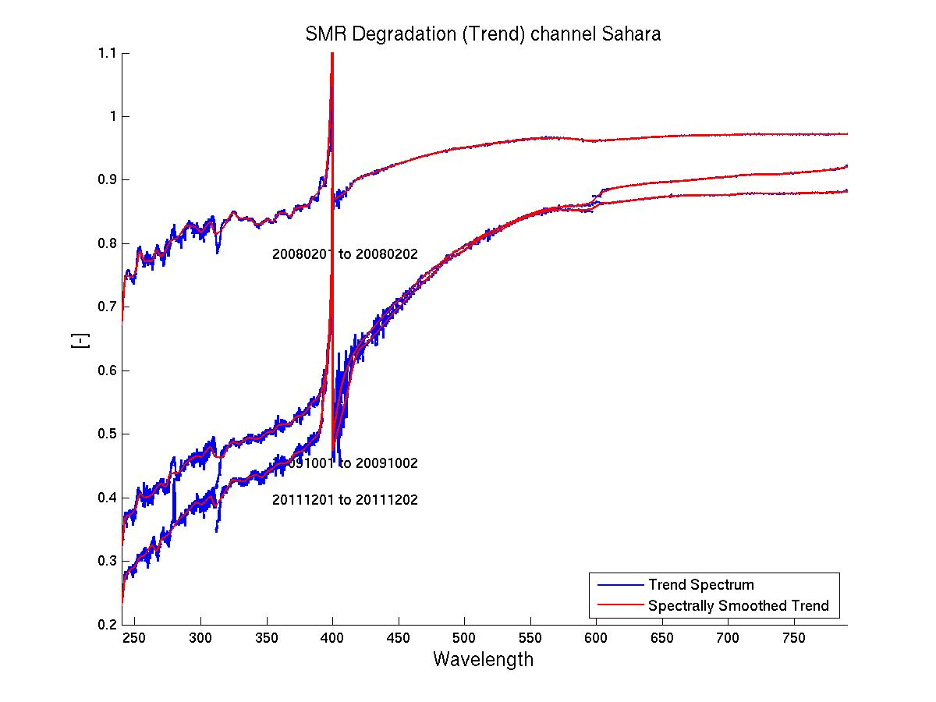
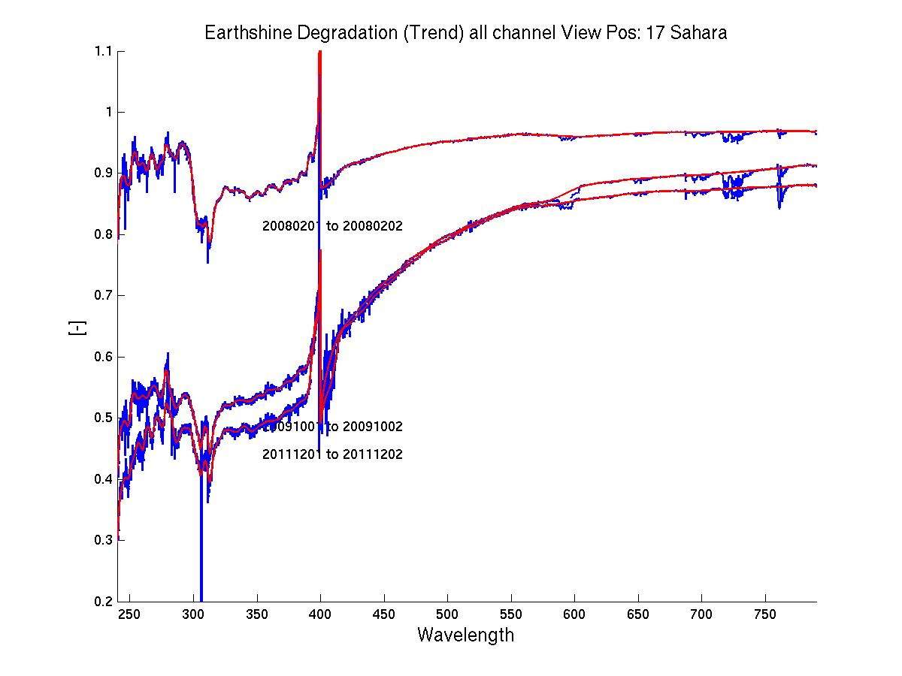
GOME-2 Metop-A Long-term throughput changes
Components of the observed signatures
GOME-2 FM3 Metop-A
Irradiance
(Solar Mean reference)
Radiance
(Earthshine at 10º West)
Differential Degradation between Solar and Earthshine path

Slide 17
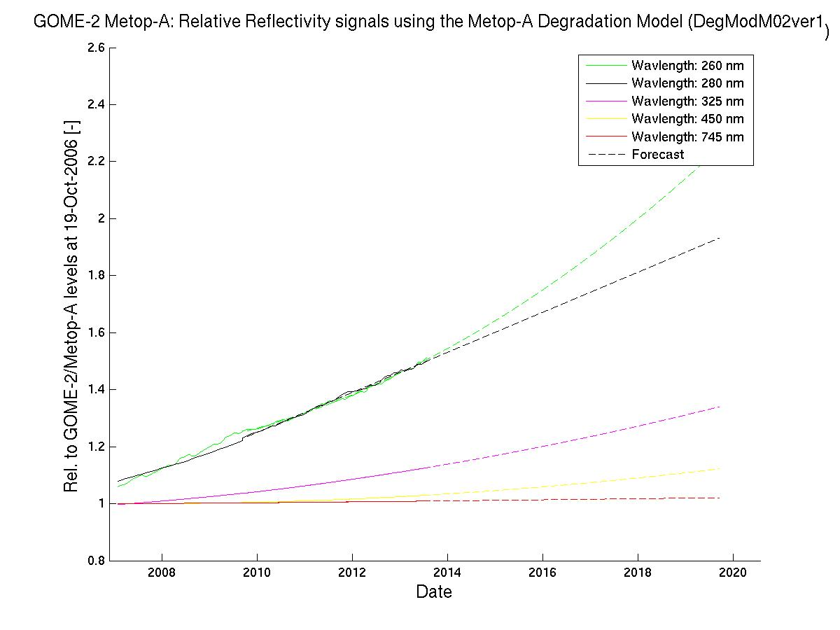
GOME-2 degradation component modelling
Reflectance signal level prediction due to differential degradation
GOME-2 FM3 Metop-A
Reflectivity
Trend/Forecast

Slide 18
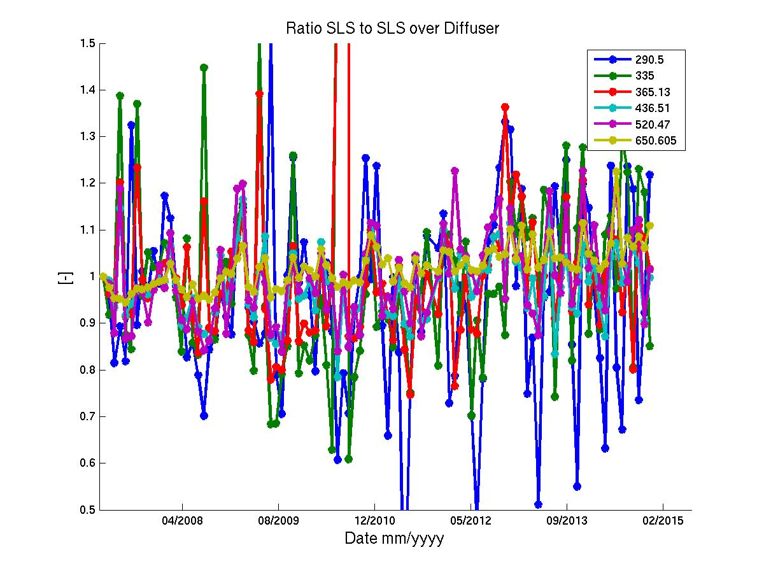
GOME-2 Metop-A Long-term throughput changes
Solar diffuser monitoring using the SLS
GOME-2 FM3 Metop-A

Slide 19
On-board calibration (daily)
Solar Diffuser (QVD) plus mirror
GOME-2 FM3 Metop-A
Differential degradation: Reflectivity increases overall
Potential sources:
Diffuser + Mirror to sun
Small diffuser degradation detected!
<10% in 9 Years
Probably significant contribution to differential degradation
by mirror to sun

Slide 20
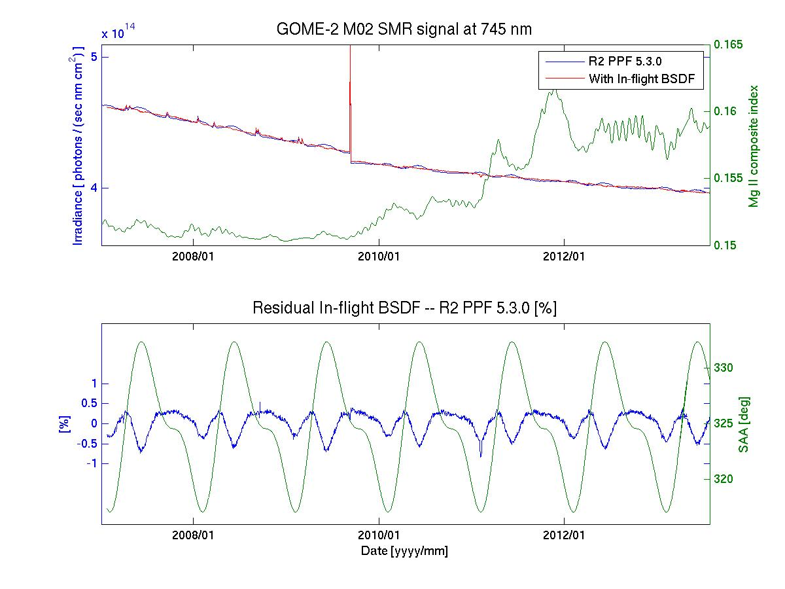
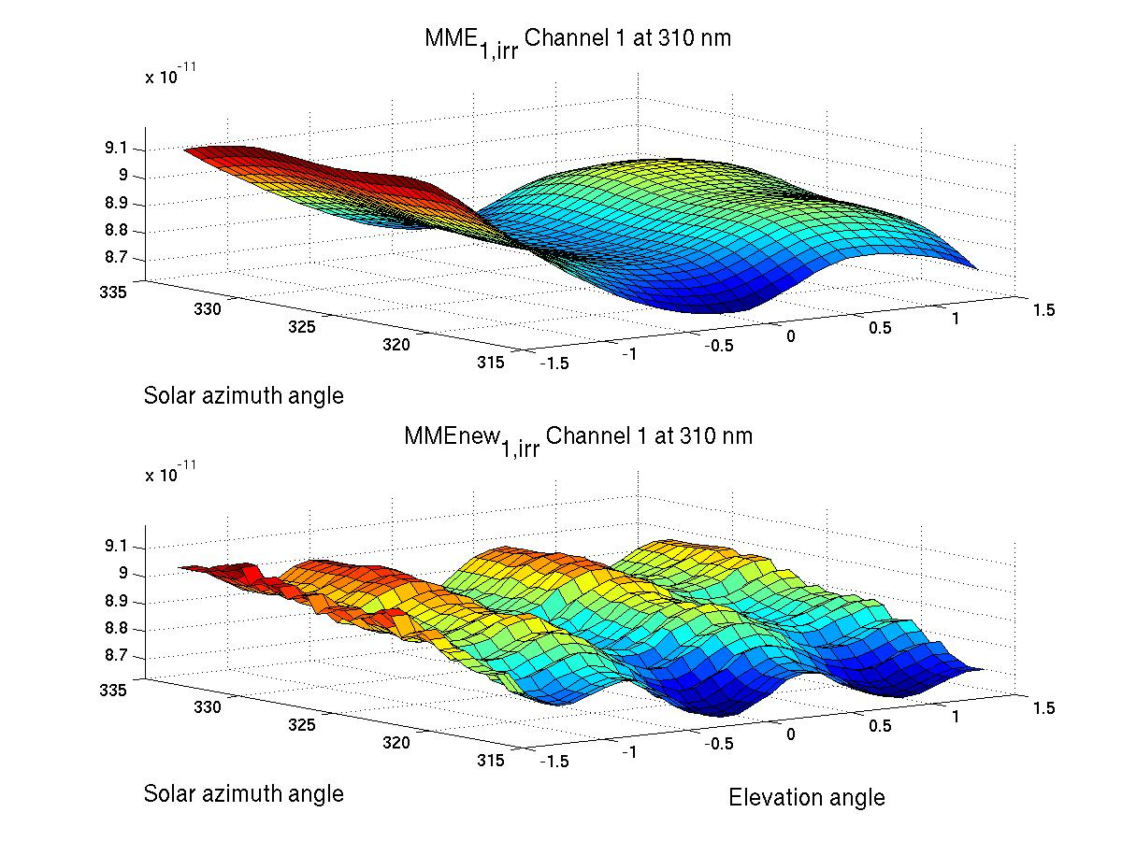
In-flight diffuser calibration
Diffuser goniometry – Improved solar irradiance accuracy
On-ground
In-flight
In-flight--On Ground

Slide 21
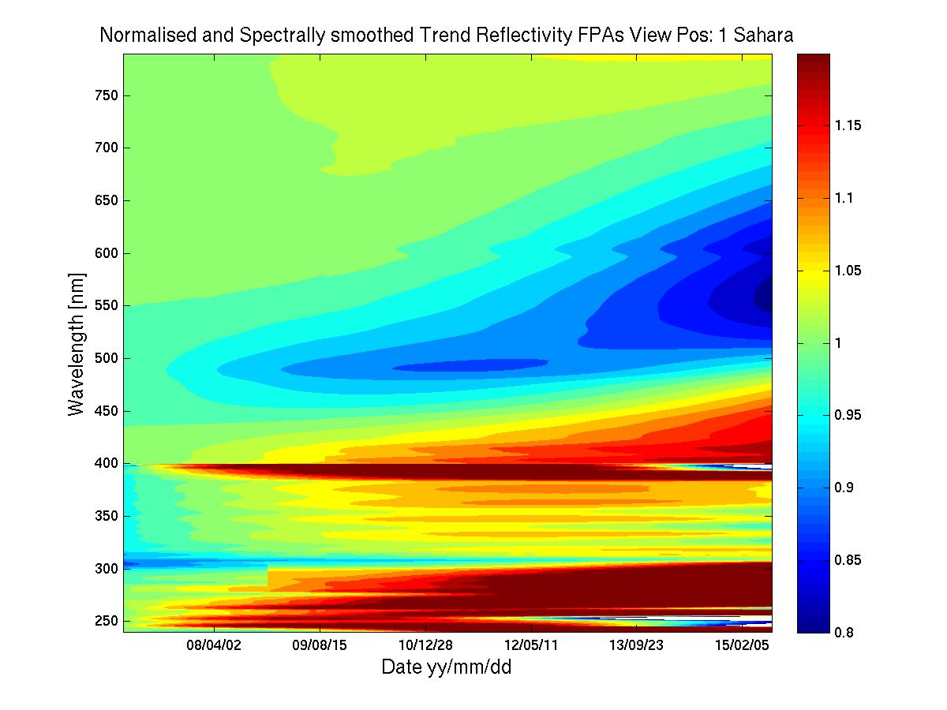
GOME-2 Metop-A degradation component modelling
Sahara reflectivity – spectral and temporal domain
GOME-2 FM3 Metop-A
800 nm
Jan 2007– Jun 2015
PPF 5.3
Reflectivity Trend
Strongest
Spectral features
In East looking
geometries
240 nm
Feb 2007
June 2015

Slide 22
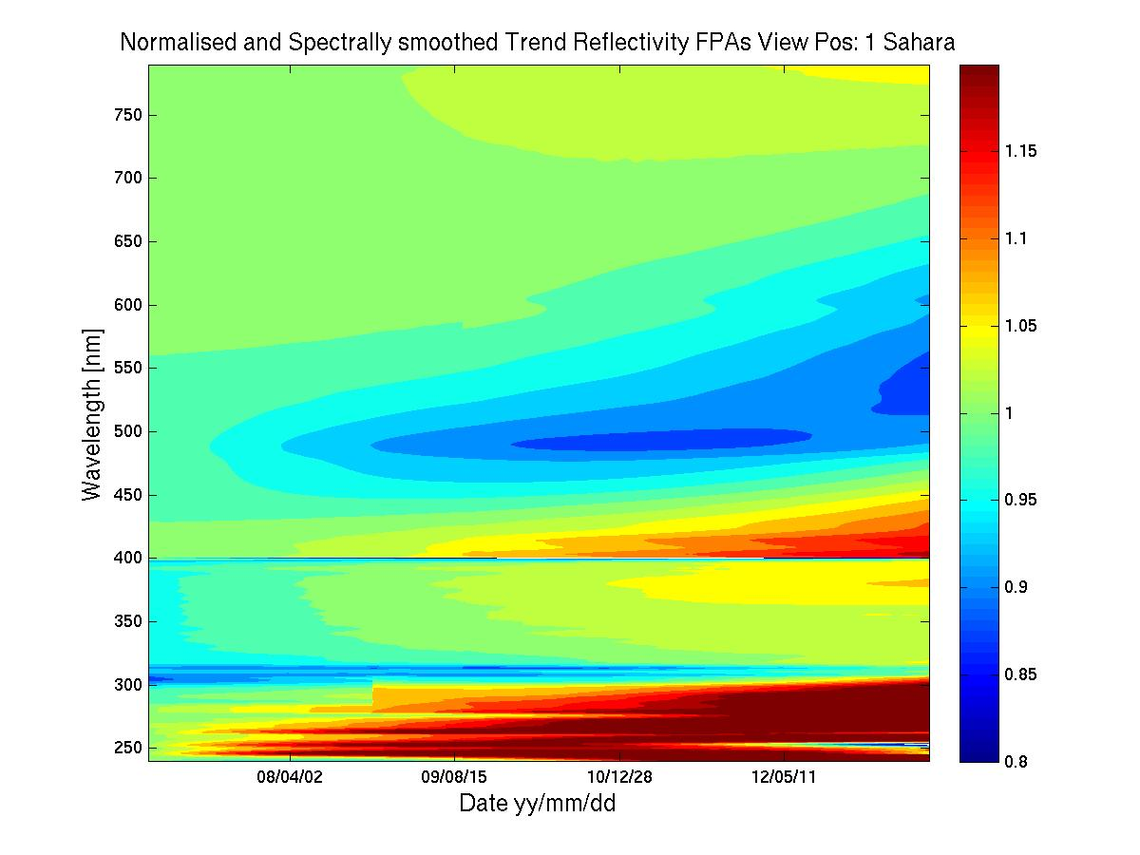
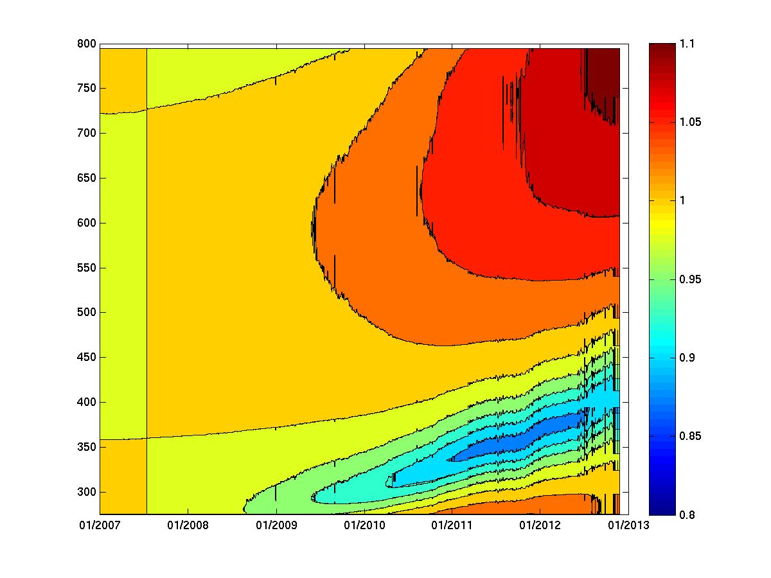
GOME-2 Metop-A degradation component modelling
Sahara reflectivity – spectral and temporal domain
GOME-2 FM3 Metop-A
R2 campaign
Jan 2007– Jan 2012
OPS phase (same PPF 5.3)
Jan 2012 – Oct 2013
Reflectivity Trend
800 nm
800 nm
300 nm
240 nm
GOME-1 Scan Mirror degradation
Feb 2007
June 2013
Strongest spectral features In East looking geometries potentially because of polarisation dependent scan mirror contamination signals!

Slide 23
Metop-A/B GOME-2 Radiometric accuracy and calibration
Earthshine measurement co-location FM2 to FM3 / Co-location criteria
GOME-2 FM3 Metop-A
GOME-2 FM2 Metop-B
Metop-A (M02): FM3
Metop-B (M01): FM2
Co-location criteria:
Area overlap > 80%
Geo. AMF diff < 2%
Relative O₂ A-Band residual (ROR) smaller than empirical threshold
Time difference:
49 min (half an orbit)

Slide 24
Metop-A/B GOME-2 Radiometric accuracy and calibration
Earthshine co-located Metop-A/B measurements – co-locations
GOME-2 FM3 Metop-A
GOME-2 FM2 Metop-B
26th December 2012
10th January 2013

Slide 25
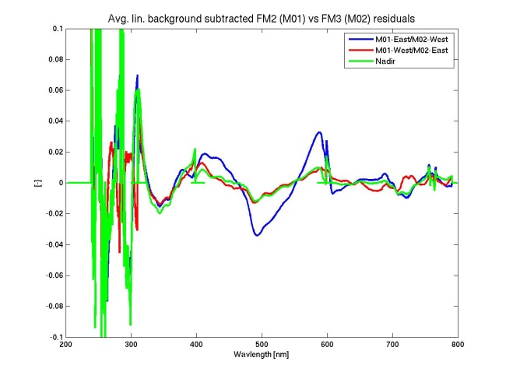
Metop-A/B GOME-2 inter-calibration
Earthshine co-located Metop-A/B residuals / Background subtracted
GOME-2 FM3 Metop-A
GOME-2 FM2 Metop-B
FM2-East/FM3-West
FM2-West/FM3-East
Nadir
Separation between East/West/Nadir at +- 20 degree viewing-angle

Slide 26
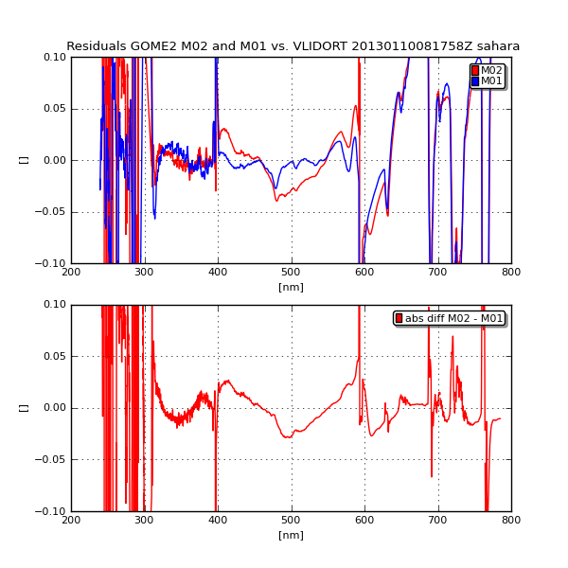
Metop-A/B GOME-2 inter-calibration
Earthshine co-located Metop-A/B residuals / V-LIDORT
GOME-2 FM3 Metop-A
GOME-2 FM2 Metop-B
Residual Metop-B with V-LIDORT
Residual Metop-A with V-LIDORT
Residuals between Metop-A and Metop-B
Broad-band structure in Metop-A channel 3
Small-scale structures in Metop-B channel 3

Slide 27
Metop-A/B GOME-2 inter-calibration
Earthshine co-located Metop-A/B residuals / Background-subtracted
GOME-2 FM3 Metop-A
Interpretation of residuals in channel 2 for Metop-A (M02)
Spectral structures in channel 3 are likely due to scan mirror polarisation (i.e. Scan angle dependent) degradation/contamination effects for both flight models
Metop-A (M02) Degradation Model for most East viewing direction with highest degree of polarization over Sahara (reference area)

Slide 28
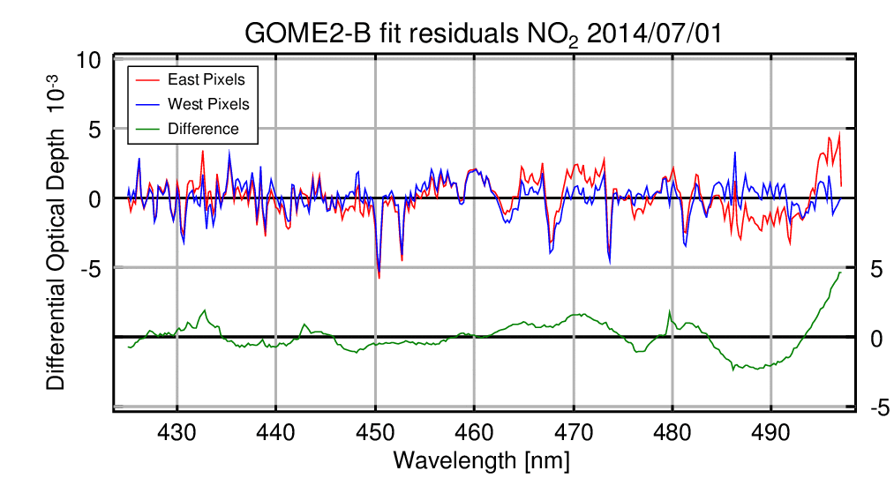
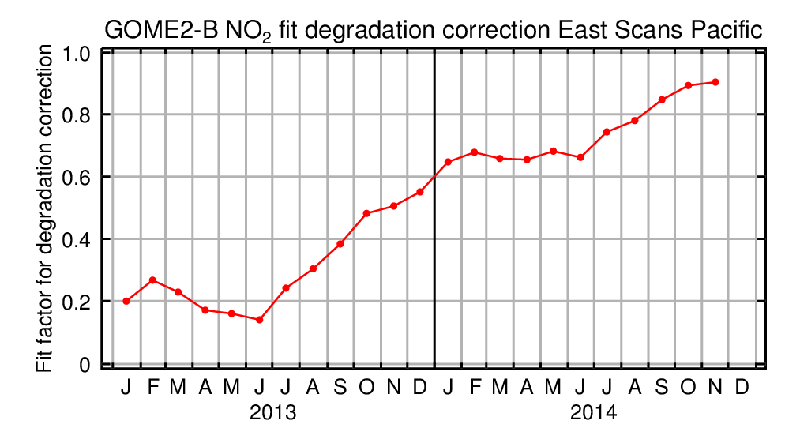
Metop-A/B GOME-2 inter-calibration
Earthshine co-located Metop-A/B residuals / Background-subtracted
GOME-2 FM3 Metop-A
GOME-2 FM2 Metop-B
Increasing contribution of a persistent scan-angle dependent spectral structure similar to an early scan mirror polarization contribution is observed by Richter et al. in NO2 retrievals.
Azam, Richter, 2014, IUP Bremen, Metop-B Degradation study

Slide 29
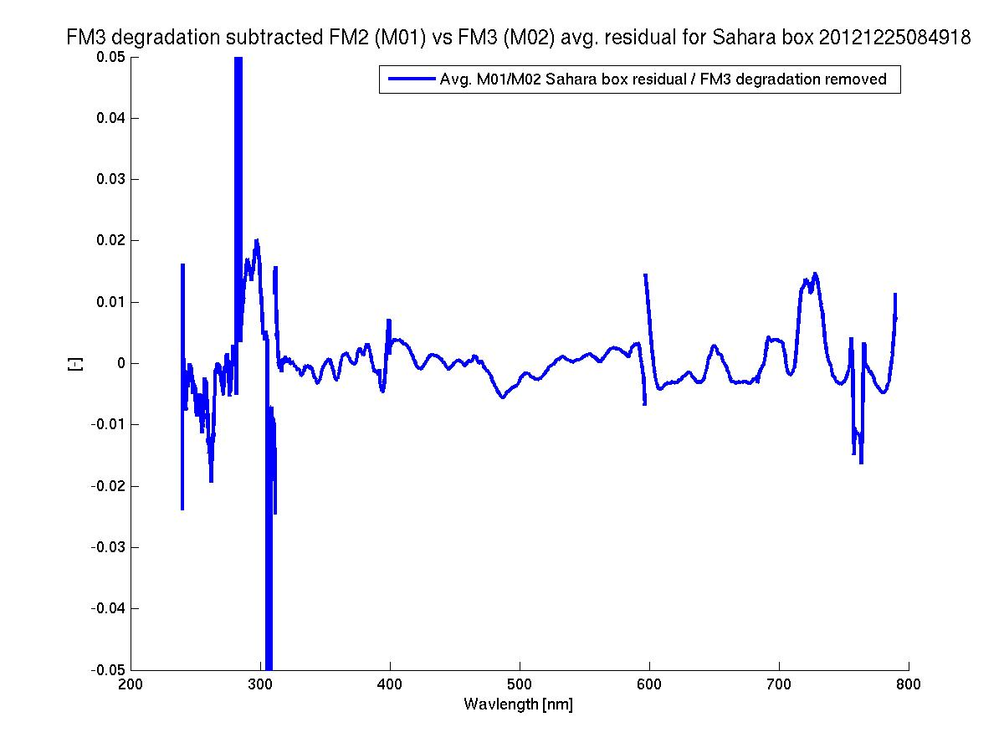
Metop-A/B GOME-2 inter-calibration
Earthshine co-located Metop-A/B residuals / Background-subtracted
GOME-2 FM3 Metop-A
GOME-2 FM2 Metop-B
Background subtracted co-located Metop-A/B residual
without the temporal degradation contribution of Metop-A

Slide 30
Metop-A/B GOME-2 inter-calibration
Earthshine co-located Metop-A/B residuals / Background-subtracted
GOME-2 FM3 Metop-A
GOME-2 FM2 Metop-B
After subtracing GOME-2 /MetopA long-term degradation residuals most of the remainder in the spectral structure can be associated to GOME-2 / Metop-B
Metop-B spectral structures are addressed in processor version 6.1.0 (June 2015)

Slide 31
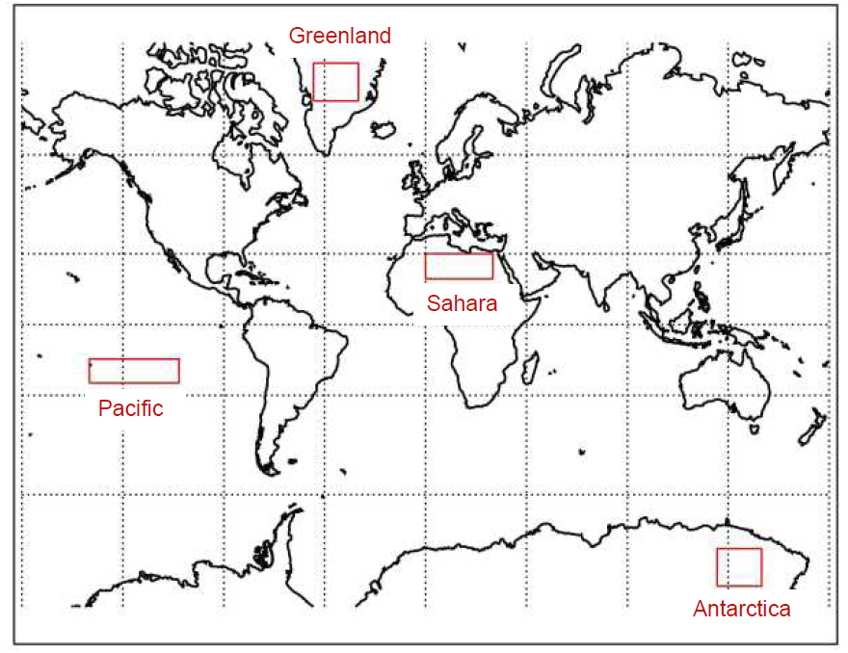
GOME-2 Metop-A degradation component modelling
Target domains
GOME-2 FM3 Metop-A

Slide 32
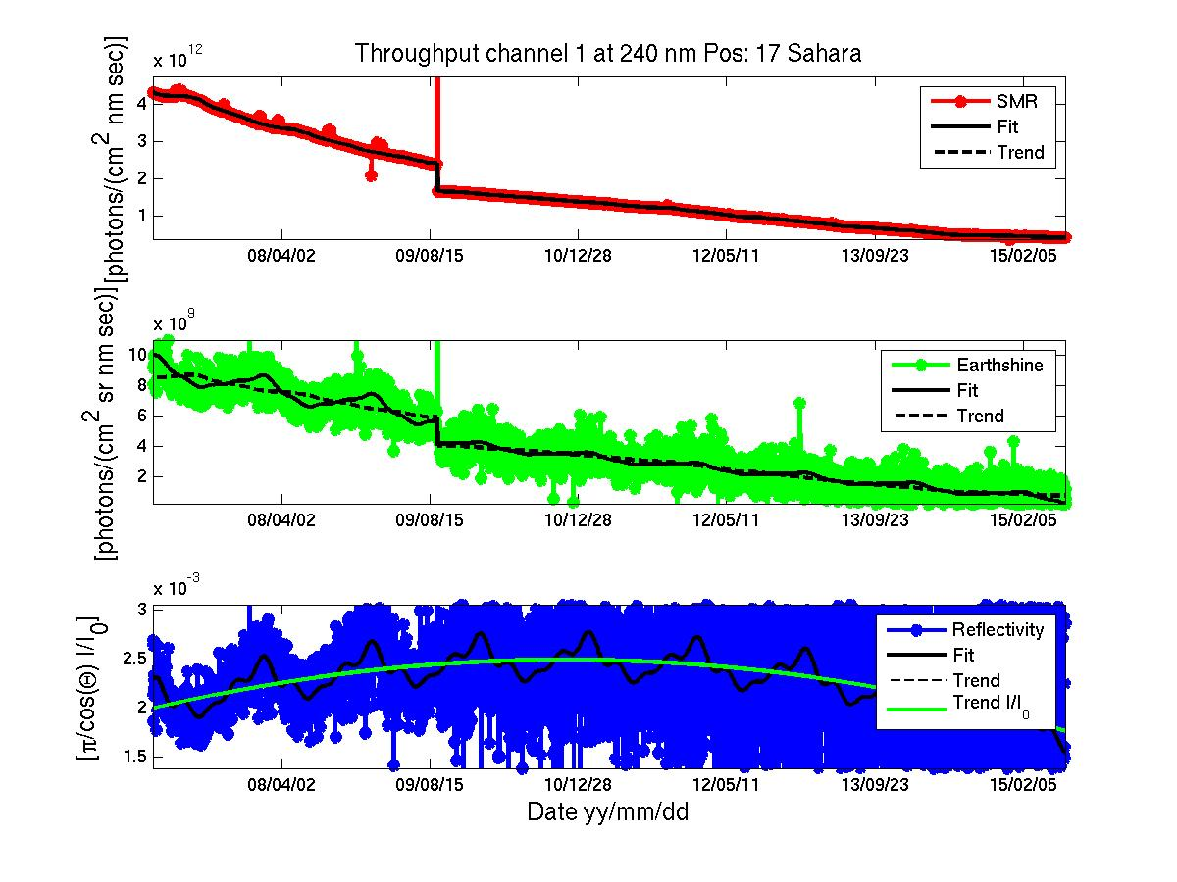
GOME-2 Metop-A degradation component modelling
Sahara – temporal domain
GOME-2 FM3 Metop-A
Jan 2007– Jun 2015
PPF 5.3
2nd Throughput Test
Solar Reference
Earthshine
Reflectivity
Model/Fit-Results
260 nm

Slide 33
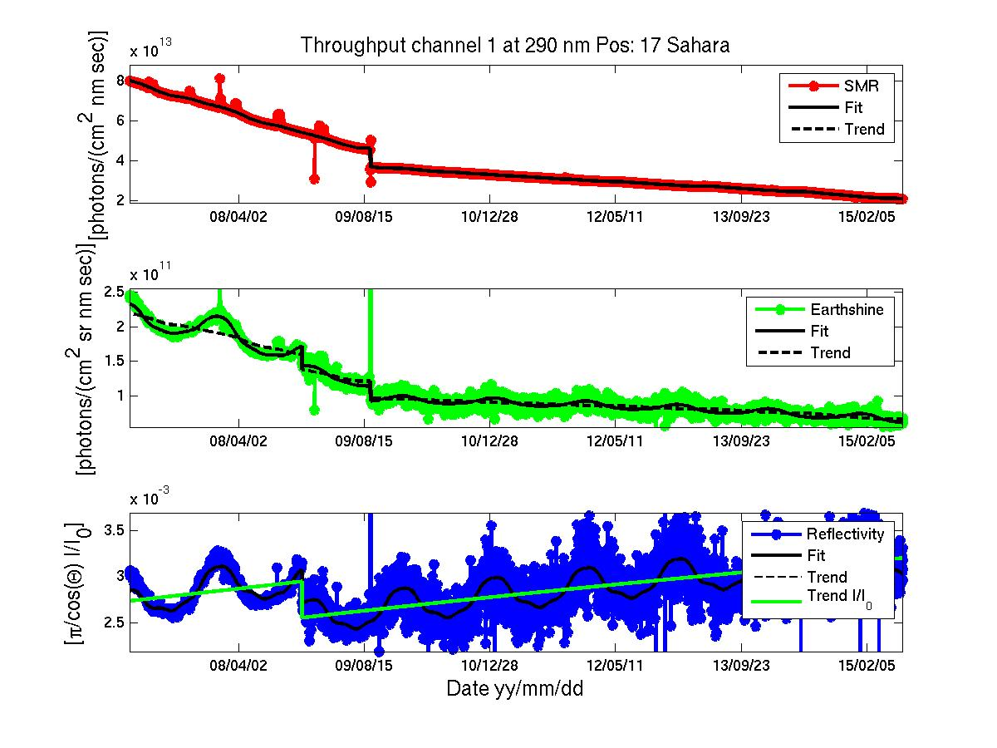
GOME-2 Metop-A degradation component modelling
Sahara – temporal domain
GOME-2 FM3 Metop-A
Band 1a/b separation shift
Jan 2007– Jun 2015
PPF 5.3
2nd Throughput Test
Solar Reference
Earthshine
Reflectivity
Model/Fit-Results
290 nm

Slide 34
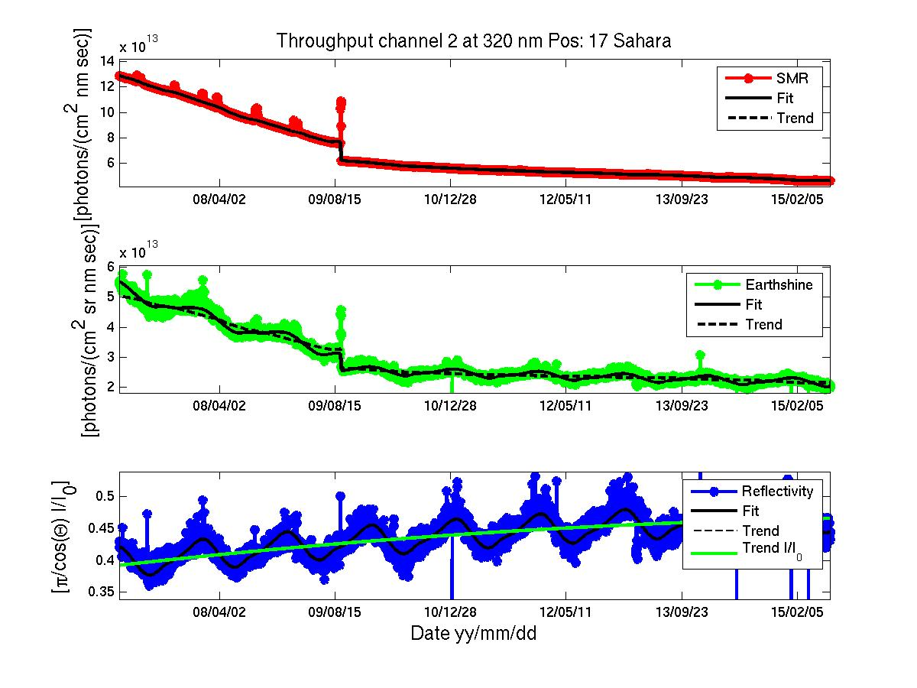
GOME-2 Metop-A degradation component modelling
Sahara – temporal domain
GOME-2 FM3 Metop-A
Jan 2007– Jun 2015
PPF 5.3
Solar Reference
Earthshine
Reflectivity
Model/Fit-Results
320 nm

Slide 35
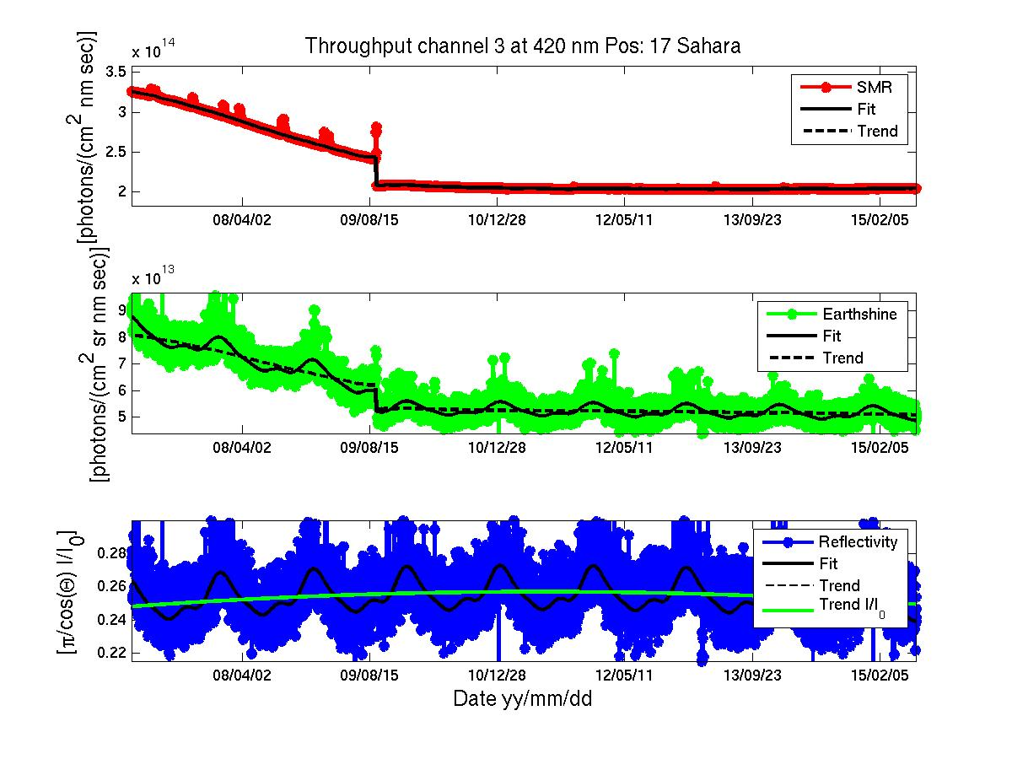
GOME-2 Metop-A degradation component modelling
Sahara – temporal domain
GOME-2 FM3 Metop-A
Jan 2007– Jun 2015
PPF 5.3
Solar Reference
Earthshine
Reflectivity
Model/Fit-Results
420 nm

Slide 36
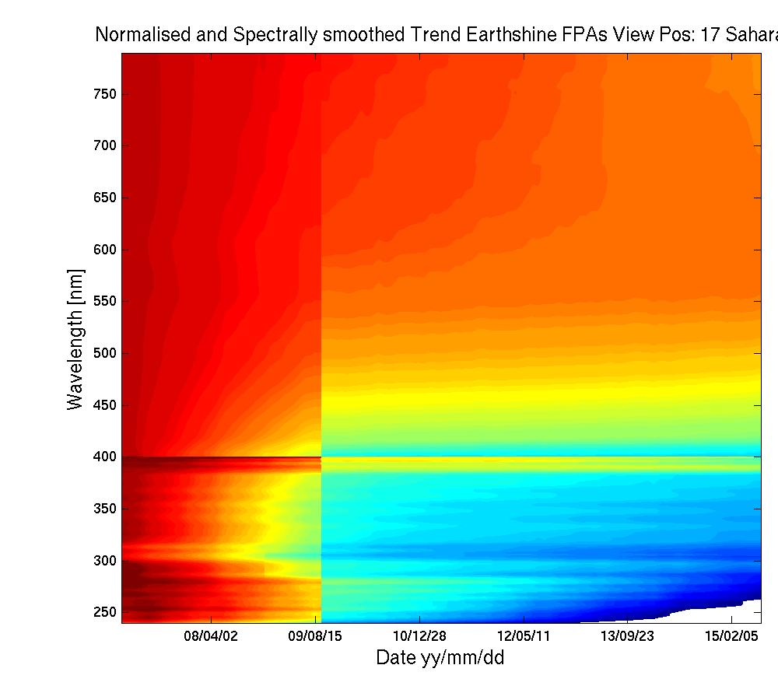
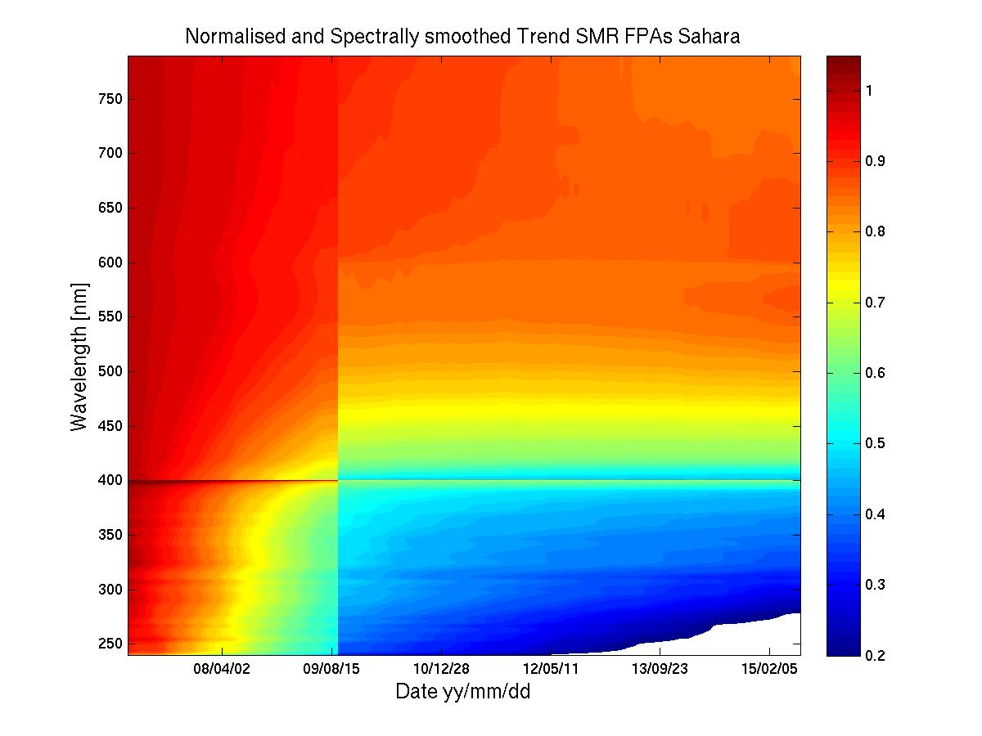
GOME-2 Metop-A degradation component modelling
Sahara – spectral and temporal domain
GOME-2 FM3 Metop-A
Modelled Earthshine degradation
Modelled Solar Path degradation
800 nm
240 nm
Feb 2007
June 2015
Feb 2007
June 2015
PPF 5.3.0 Jan 2007– Jun2015

Slide 37
PPF 6.0 and beyond
Preparing for reprocessing campaign R3 (2017/18)
Updated and cleaned key-data
Preliminary scope of R3
New diffuser BRDF (goniometric data)
New spectral calibration
algorithm
New solar mean reference data
Updated level-1B product
Degradation matrix for solar and earthshine data V1
New level-1C product
(degradation and stray-light corrected radiances)
Stray-light correction
RT reference
First version available/implemented
First version in development

Slide 38
The end

Slide 39
PPF 6.0 and beyond
Preparing for reprocessing campaign R3 (2017/18)
PPF 6.0: Adding cloud-information and radiances at sub-pixel resolution from AVHRR
PPF 6.1: Correction of on-ground key-data (source/instrument instability on-ground):
  Cleaning of differential spectral features in key-data
  Correction of diffuser goniometric calibration with in-flight data
PPF 6.x: Spectral calibration from solar measurements
  Addressing anomaly of on-board spectral line source (SLS)
  Lacking information content in some part of the spectrum form the SLS
  Thermal instability issue of spectral lamp and spectral calibration algorithm using the SLS signals
PPF 6.x: Improved solar mean reference spectrum
PPF 6.x: Stray-light correction in band 1
PPF 6.x: PMD and main channel cross-calibration
Plus degradation matrix for Earthshine and solar path.
Updated GOME-2 level-1B product PPF 6.x for R3, and
new GOME-2 level-1C product (degradation corrected)

Slide 40
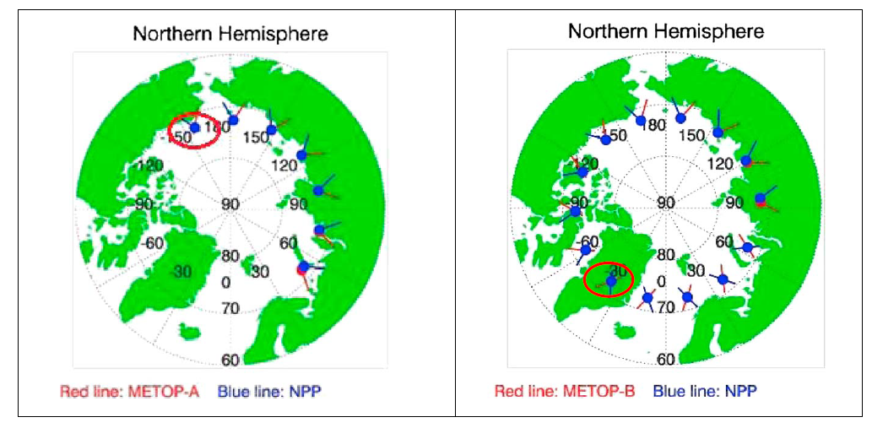
Metop-A/B GOME-2 / OMPS
Wu et al., JGR, 2014
GOME-2 FM3 Metop-A
GOME-2 FM2 Metop-B
NPP/Metop-A/B SNRs
Courtesy Wu et al., JGR, 2014, NOAA/NESDIS

Slide 41
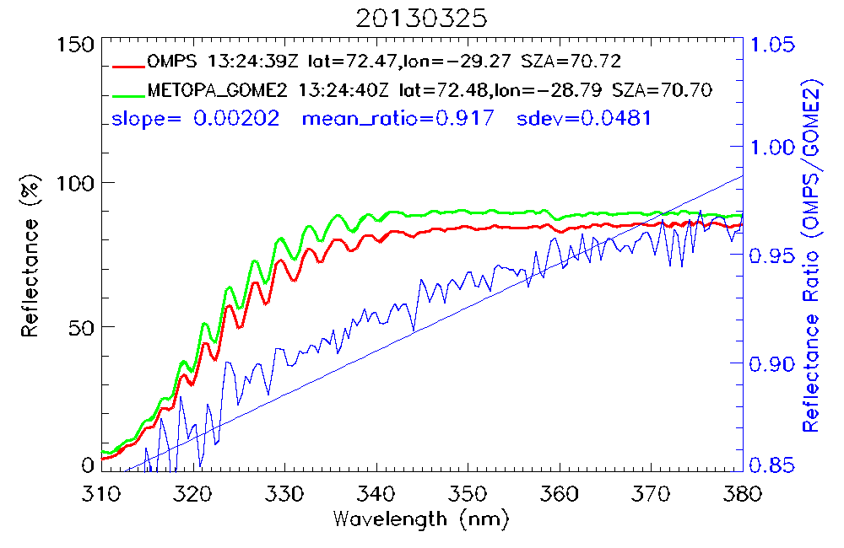
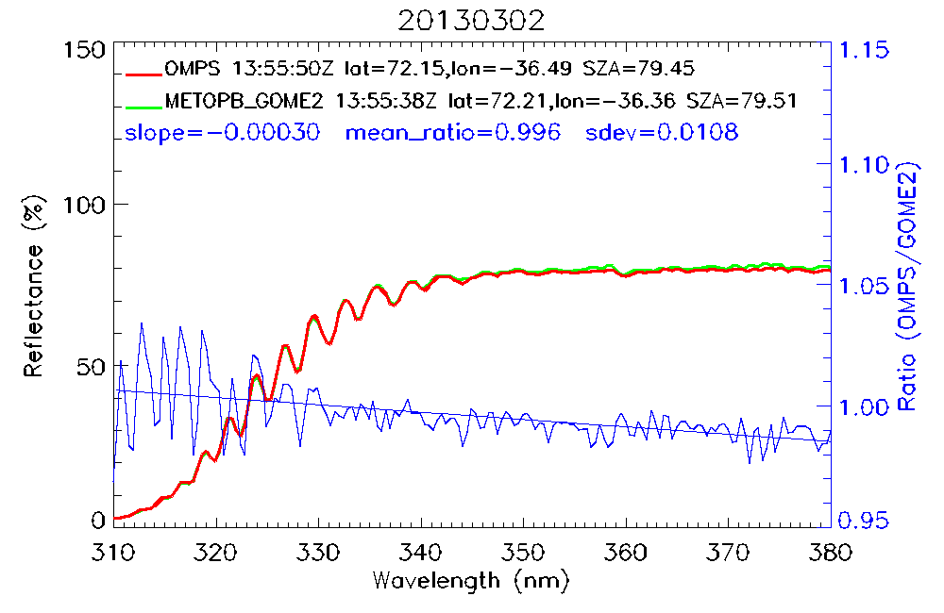
Metop-A/B GOME-2 / OMPS
Wu et al, JGR 2014
GOME-2 FM3 Metop-A
GOME-2 FM2 Metop-B
GOME-2 Metop-A
vs
OMPS
GOME-2 Metop-B
vs
OMPS
Courtesy Wu et al., JGR, 2014, NOAA/NESDIS
Data from March 2013

Slide 42
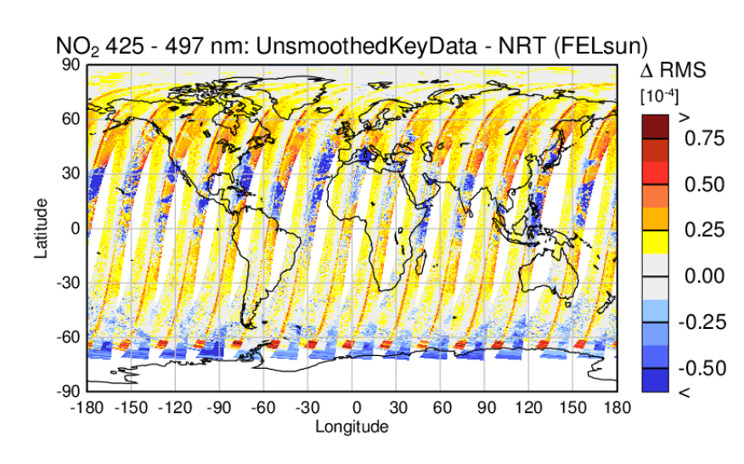
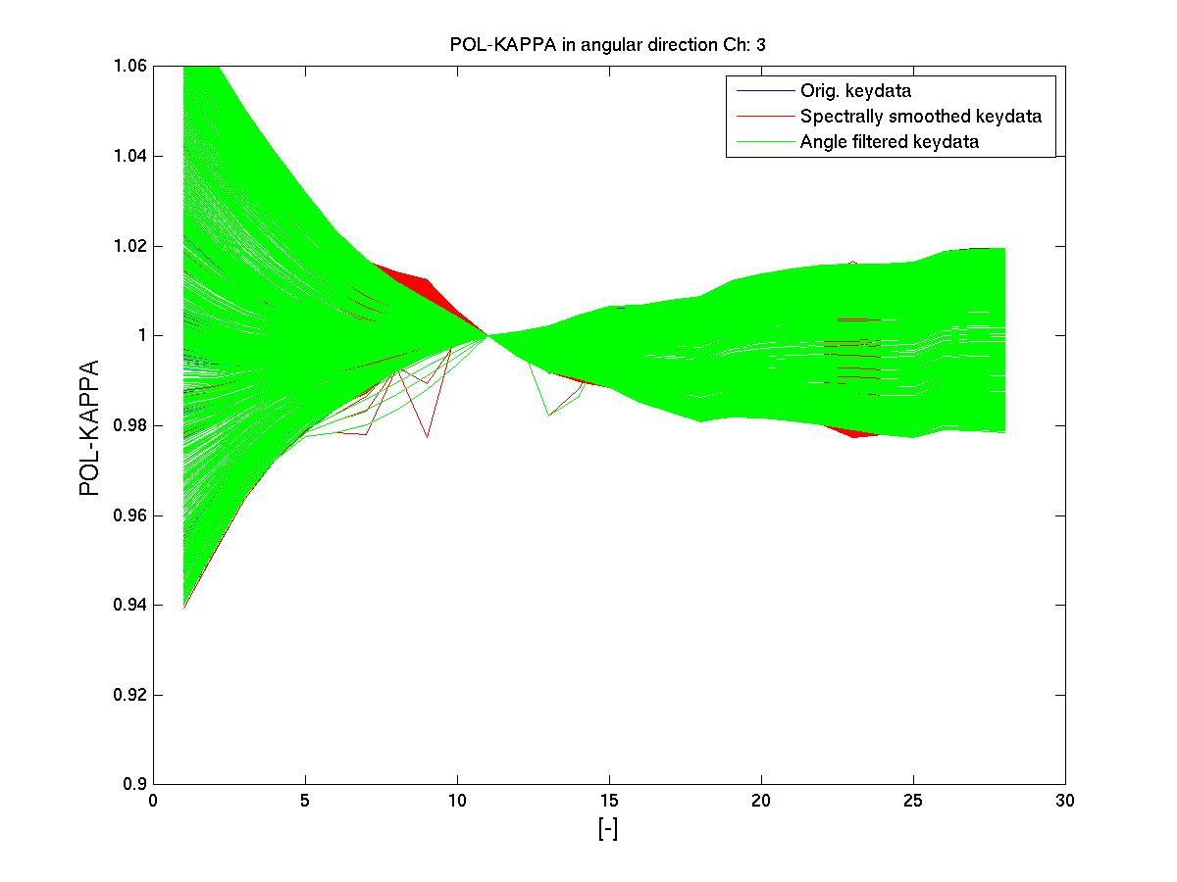
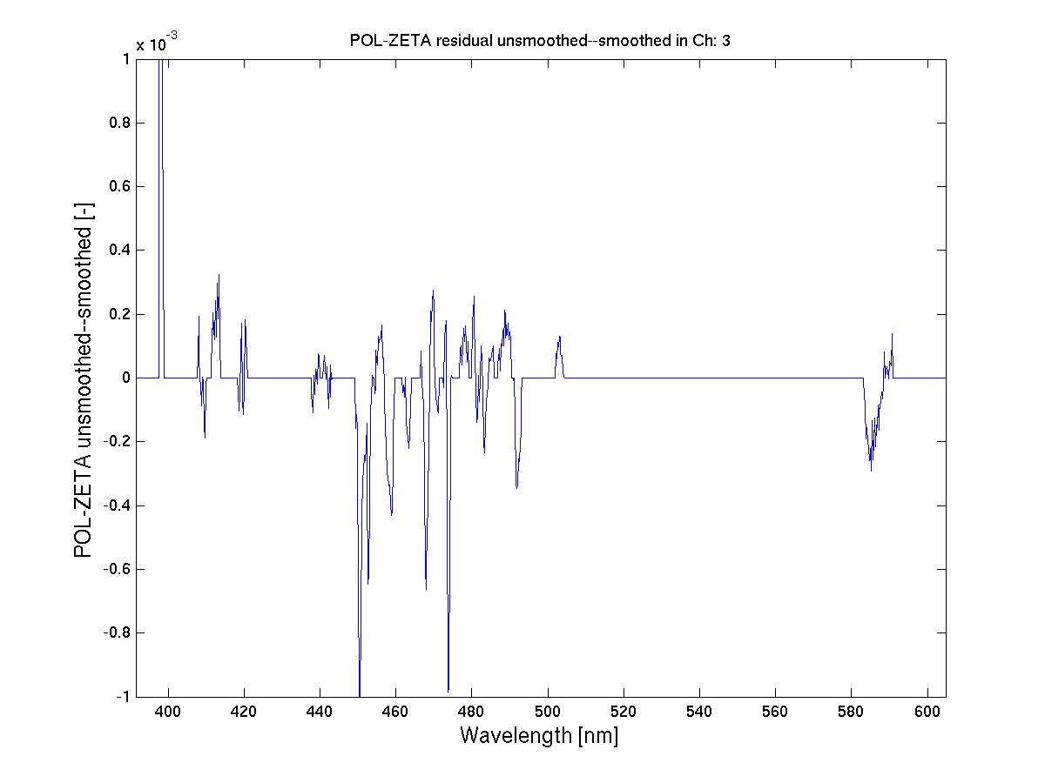

PPF 6.0 and beyond
Correction of on-ground instrument key-data
On-ground calibration data
in the viewing angle domain
On-ground calibration data
in the spectral domain
Corrected with PPF 6.1
June 2015
On-ground calibration setup instability
IUP Bremen – Azam & Richter

Slide 43



PPF 6.1 and beyond
Improved solar irradiance accuracy and long-term stability – Impact on level-2
From the
GOME-2
Degradation impact on level-2 study
by IUP Bremen
Azam & Richter

Slide 44



PPF 6.x and beyond
Stray-light correction in channel 1 below 295 nm
Stray-light modeling is done as part of the degradation modeling (v 0.9)
Inputs:
Band 1a/b simulated reflectance between 260 and 311 nm from OPERA
based on climatology O3 profiles scaled with measured O3MSAF-TO3 (KNMI, courtesy O. Tuinder)
Band 1a/b measured reflectance
Fit of two stray-light offset components min| std(1-(R(λ)-offset)/R_{sim} ) | [240,283] and [283,295]
West
Nadir
East

Slide 45

PPF 6.1 and beyond
Impact on reflectance

Slide 46

PPF 6.x and Degradation Correction
Towards a level-1c product
Corrected level-1B data
Spectral calibration
Diffuser goniometry
Instrument key-data
Updated solar mean reference
GOME-2 / M02 Degradation matrix V1
Earthshine degradation coefficients over all viewing angles
Solar degradation coefficients
Stray-light correction
Presentation on Friday
Session 7
11:45 –
On GOME-2 degradation model version 1
+
Spectral Level-1B-Level-1C residuals

Slide 47

On-board calibration (daily)
Spectral line source daily measurement
GOME-2 FM3 Metop-A
Polynomial fitting of SLS daily measurement results from spectral fitting w.r.t. on-ground measured key-data spectral calibration -
Operational method

Slide 48


GOME-2 Metop-A spectral accuracy
New Solar Spectrum Fraunhofer line fitting algorithm
Triggered by AR 15911 (sudden decrease in HCL lamp voltage 25/12/2014)
indication of lamp aging
introduction of “back-up” spectral calibration algorithm using the solar spectrum
Channel 2
Channel 3
Fitting to reference Solar spectrum using daily solar measurements – residual w.r.t. on-ground key-data spectral calibration

Slide 49


GOME-2 Metop-A spectral accuracy
New Solar Spectrum Fraunhofer line fitting algorithm
Triggered by AR 15911 (sudden decrease in HCL lamp voltage 25/12/2014)
indication of lamp aging
introduction of “back-up” spectral calibration algorithm using the solar spectrum
Channel 2
Channel 3
Operational spectral calibration from HCL lamp
New Solar spectrum Fraunhofer line fitting

Slide 50
Timelines for the Metop / GOME-2 level 1 products
Processor versions: Reprocessed and NRT data
R2
Metop-A
Metop-A / GOME-2 level 1 processor version 5.3.0/6.0.0
Future NRT versions
Metop-B
Metop-B / GOME-2 version 5.3.0/6.0.0
Future NRT versions
R3 version 6.x
Metop-C
Metop-C / GOME-2 Future NRT version
Jan 2012
Today
Oct 2018
Jan 2007
Sep 2012
TBD
Q1 2018

