Slide 1
Reference Measurements for the TEMPO Mission
Kelly Chance, Xiong Liu,
Raid M. Suleiman,
Smithsonian Astrophysical
Observatory
David Flittner, Jay Al-Saadi,
NASA LaRC
Scott Janz, NASA GSFC
Joint GSICS GRWG-UVSG &
CEOS WGCV-ACSG @ NCWCP
October 8, 2015

Slide 2
Introduction
Question 5. What external resources, if any, are regarded as reference measurements. Does your community have any common standards to which all retrieval algorithms are tied or compared? Are there solar spectra that your community regard as the reference?
Answer for TEMPO:
  Reference measurements for the spectral variation of parameters related to modeling solar UV-Vis backscatter (more to follow)
  There does not seem to unanimous use of standards.

Slide 3
TEMPO Reference Measurements
In general the approach is to use the best available ancillary data
  Spectral resolution finer than the instrument resolution
  Captures the important physics, e.g. variation with temperature
List includes:
  Solar Spectrum
  Molecular Scattering Coefficients
  Trace Gas Absorption Coefficients
  Surface Spectral Albedo
Notes:
In general the approach is to use the best available sources for solar input flux, scattering & absorption coefficients and

Slide 4
TEMPO Reference Solar Spectrum
Solar spectrum is SAO2010 (aka Chance & Kurucz 2010, doi:10.1016/j.jqsrt.2010.01.036)
  <300nm: Balloon based observations (Hall/Anderson)
  >305nm: Ground based FTS (Kurucz et al., 1984)
  Merged over 300nm to 305nm range
  Corrected for telluric lines
  FTS normalized to irradiance data of Thuillier et al. 2003
  Good for wavelength calibration (cross-correlation), determining instrument line shape (slit) function, Ring effect correction, and correction for spectral undersampling of atmospheric spectra

Slide 5
TEMPO Reference Absorption Cross-sections
Most relevant cross-sections for TEMPO Baseline Products (O₃, NO₂, H₂CO) are:
  Molecular scattering: Bodhaine et al., 1999
  O₃: Brion, Daumont, Malicet, et al. (aka BDM)
  NO₂: Vandaele, et al., 1998
  H₂CO: Cantrell et al., 1990
  O₄: Vandaele, et al., 2003

Slide 6
General Question
“Does your sensor use vicarious calibration methods? If so, what adjustments are derived?”
Anticipate performing radiance comparisons with LEO instruments such as TropOMI and VIIRS/JPSS to verify radiance calibration and possible transfer standard within the global Air Quality Constellation
Experience has shown that measurement/model residuals for cases with low model uncertainty can also provide fractional radiance adjustment.

Slide 7
Example: OMI Radiance Residuals
CROSS TRACK POSITION
Liu et al., 2010

Slide 8
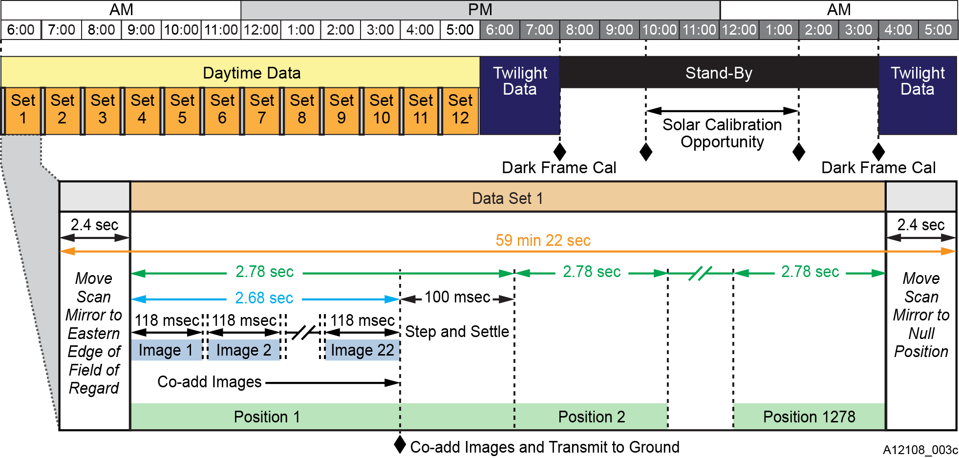
Nominal Daily Operations
22 co-adds per mirror position meet SNR and 60 minute scan duration requirements
8-12 scans acquired per day, seasonally varying, and twilight imaging periods
2 Dark calibrations/day
1 Solar calibration performed per day over the entire year
Note: Scan mirror parked at off-null position overnight for pointing stability
Courtesy of Ball Aerospace Technologies, 28-31 July 2014 TEMPO Instrument PDR

Slide 9
Radiometric Calibration Concept of Operations
Activity | Frequency | Activity | Frequency
Dark Imaging | Twice/day | Working Diffuser Linearity Observation | Every 3 months
Working Solar Diffuser Observation | Once/day | Reference Solar Diffuser Observation | Every 6 months
Solar Diffuser Calibrations CONOPS:
Performed at a constant obliquity of 30° (diffuser normal to solar angle)
Yields greatest calibration consistency
Yearly variation of calibration time illustrated at right
Currently baselining prior to local midnight but design does not preclude post-midnight calibrations
Linearity observation includes 20 (TBR) integration times and dark collects

Slide 11
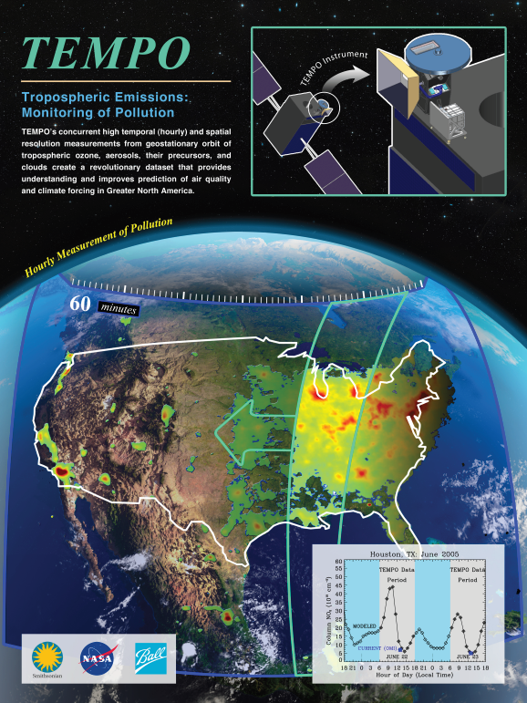
Hourly atmospheric pollution from geostationary Earth orbit
PI: Kelly Chance, Smithsonian Astrophysical Observatory
Instrument Development: Ball Aerospace
Project Management: NASA LaRC
Other Institutions: NASA GSFC, NOAA, EPA, NCAR, Harvard, UC Berkeley, St. Louis U, U Alabama Huntsville, U Nebraska, RT Solutions, Carr Astronautics
International collaboration: Korea, U.K., ESA, Canada, Mexico
Selected Nov. 2012 as NASA’s first Earth Venture Instrument
  Instrument being implemented, delivery May 2017
  NASA will arrange hosting on commercial geostationary communications satellite with launch expected NET 11/2018
Provides hourly daylight observations to capture rapidly varying emissions & chemistry important for air quality
  UV/visible grating spectrometer to measure key elements in tropospheric ozone and aerosol pollution
  Exploits extensive measurement heritage from LEO missions
  Distinguishes boundary layer from free tropospheric & stratospheric ozone
Aligned with Earth Science Decadal Survey recommendations
  Makes many of the GEO-CAPE atmosphere measurements
  Responds to the phased implementation recommendation of GEO-CAPE mission design team
  North American component of an international constellation for air quality observations

Slide 12
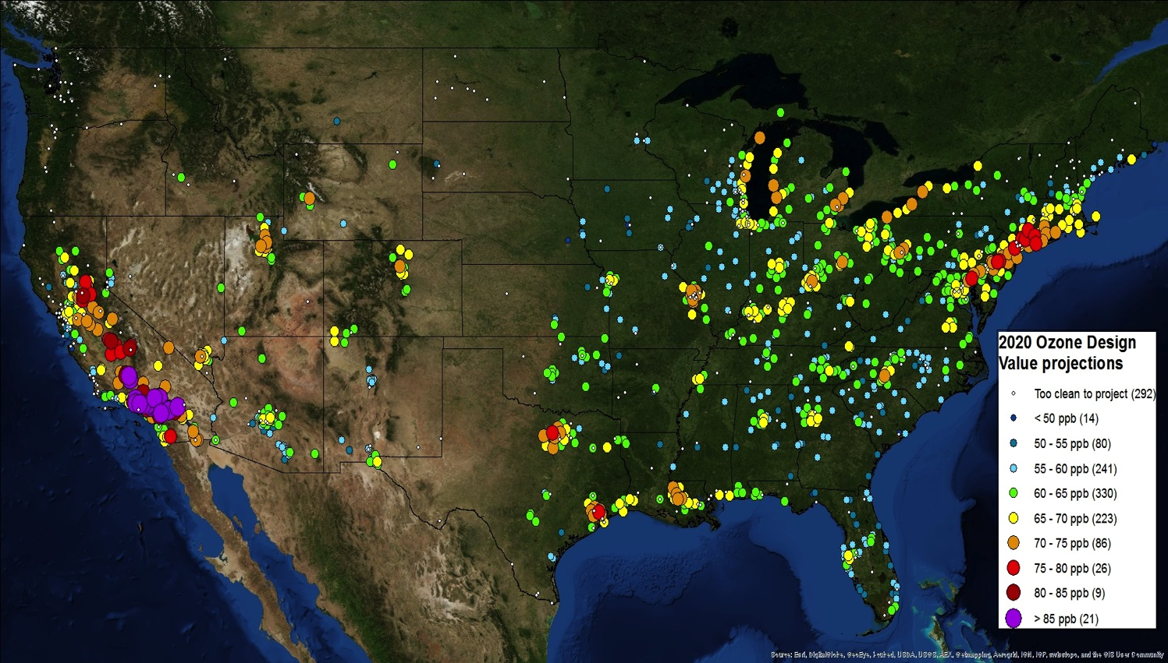
TEMPO science overview
US air quality standards continue to become more stringent to better protect human health
New and transient pollution sources (e.g., vehicular traffic, oil & gas development, trans-boundary pollution) are growing in importance yet are very difficult to monitor from ground networks
Many areas that are not currently monitored are expected to violate proposed ozone standards
TEMPO measurements will provide data to help solve this national challenge
US EPA ozone 8-hour design projections to 2020
TEMPO science questions
What are the temporal and spatial variations of emissions of gases and aerosols important for air quality and climate?
How do physical, chemical, and dynamical processes determine tropospheric composition and air quality over scales ranging from urban to continental, diurnally to seasonally?
How does air pollution drive climate forcing and how does climate change affect air quality on a continental scale?
How can observations from space improve air quality forecasts and assessments?
How does intercontinental transport affect air quality?
How do episodic events, such as wild fires, dust outbreaks, and volcanic eruptions, affect atmospheric composition and air quality?

Slide 13
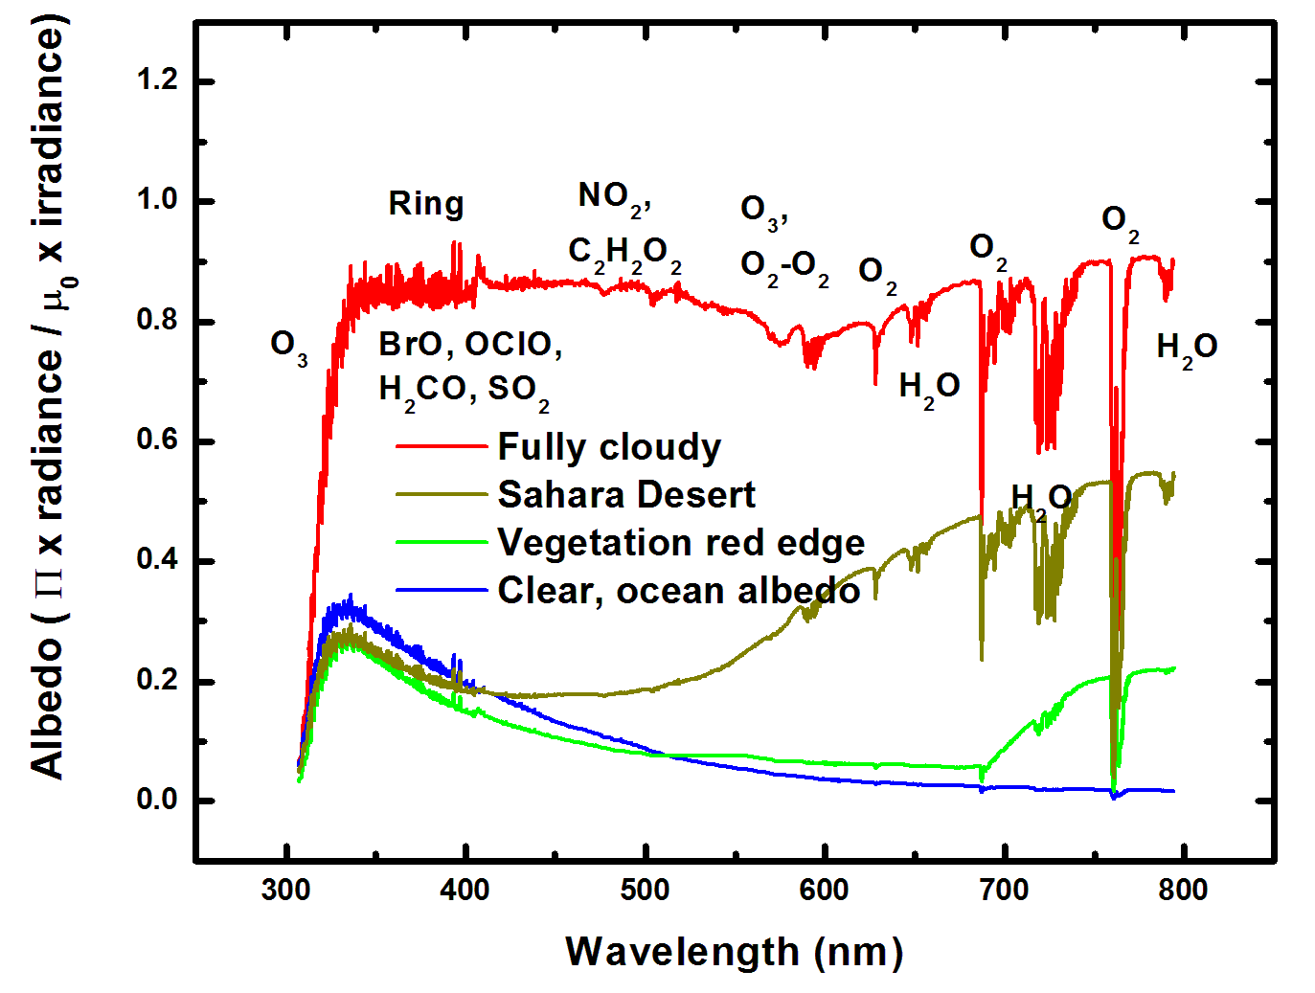
Typical TEMPO-range spectra (from ESA GOME-1)

Slide 14
Baseline and threshold data products
Species/Products | Required Precision | Temporal Revisit
0-2 km O₃ (Selected Scenes) Baseline only | 10 ppbv | 2 hour
Tropospheric O₃ | 10 ppbv | 1 hour
Total O₃ | 3% | 1 hour
Tropospheric NO₂ | 1.0 × 10¹⁵ molecules cm⁻² | 1 hour
Tropospheric H₂CO | 1.0 × 10¹⁶ molecules cm⁻² | 3 hour
Tropospheric SO₂ | 1.0 × 10¹⁶ molecules cm⁻² | 3 hour
Tropospheric C₂H₂O₂ | 4.0 × 10¹⁴ molecules cm⁻² | 3 hour
Aerosol Optical Depth | 0.10 | 1 hour
Minimal set of products sufficient for constraining air quality
Across Greater North America (GNA): 18°N to 58°N near 100°W, 67°W to 125°W near 42°N
Data products at urban-regional spatial scales
  Baseline ≤ 60 km² at center of Field Of Regard (FOR)
  Threshold ≤ 300 km² at center of FOR
Temporal scales to resolve diurnal changes in pollutant distributions
Collected in cloud-free scenes
Geolocation uncertainty of less than 4 km
Mission duration, subject to instrument availability
  Baseline 20 months
  Threshold 12 months

Slide 15
TEMPO instrument concept
Measurement technique
  Imaging grating spectrometer measuring solar backscattered Earth radiance
  Spectral band & resolution: 290-490 + 540-740 nm @ 0.6 nm FWHM, 0.2 nm sampling
  2 2-D, 2k×1k, detectors image the full spectral range for each geospatial scene
Field of Regard (FOR) and duty cycle
  Mexico City/Yucatan Peninsula to the Canadian tar/oil sands, Atlantic to Pacific
  Instrument slit aligned N/S and swept across the FOR in the E/W direction, producing a radiance map of Greater North America in one hour
Spatial resolution
  2.1 km N/S × 4.7 km E/W native pixel resolution (9.8 km²)
  Co-add/cloud clear as needed for specific data products
Standard data products and sampling rates
  Most sampled hourly, including eXceL O₃ (troposphere, PBL) for selected areas
  H₂CO, C₂H₂O₂, SO₂ sampled hourly (average results for ≥ 3/day if needed)
  Nominal spatial resolution 8.4 km N/S × 4.7 km E/W at center of domain (can often measure 2.1 km N/S × 4.7 km E/W)
  Measurement requirements met up to 50º for SO₂, 70º SZA for other products

Slide 16
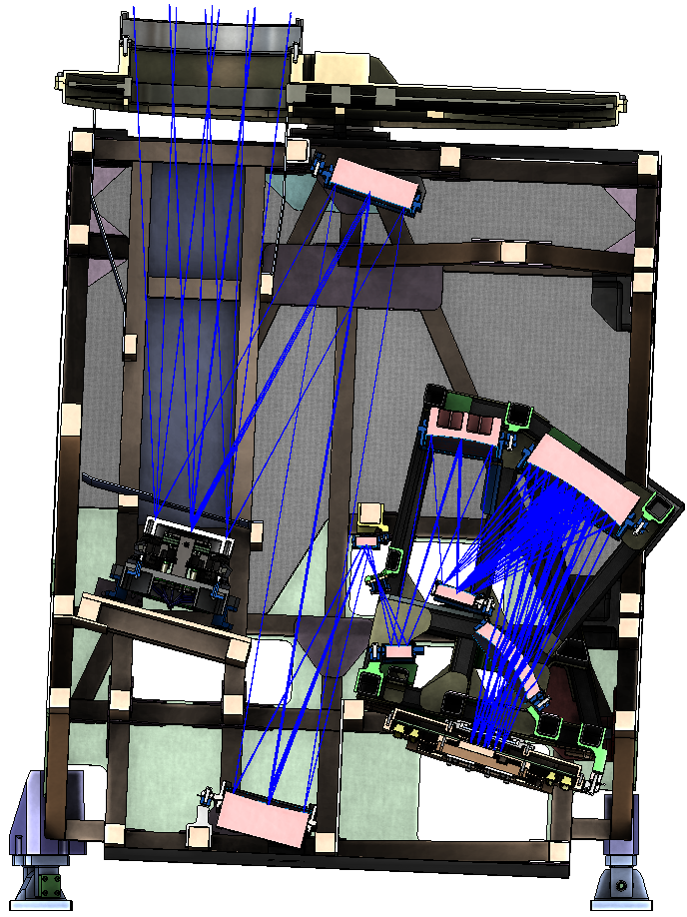
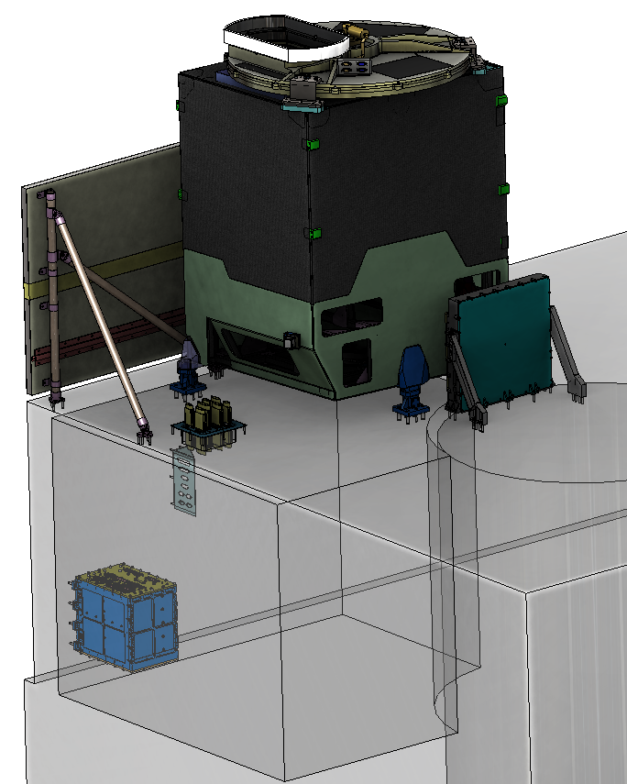

Instrument layout
Calibration Mechanism Assembly
Telescope Assembly
Scan Mechanism Assembly
Spectrometer Assembly
Radiator Assembly
Focal Plane Electronics
Focal Plane
Assembly
Instrument
Control Electronics
Instrument Support
Assembly
Notes:
Most of final drawings done; detectors in-house; grating ordered; optical bench ordered

Slide 18
Stratospheric Aerosol and Gas Experiment
SAGE III on ISS
An Earth Science Mission on the International Space Station
Example of SAGE Internal Data Consistency
Joe Zawodny, Larry Thomason,
Sharron Burton, Rob Damadeo
NASA Langley Research Center
October 8, 2015

Slide 19
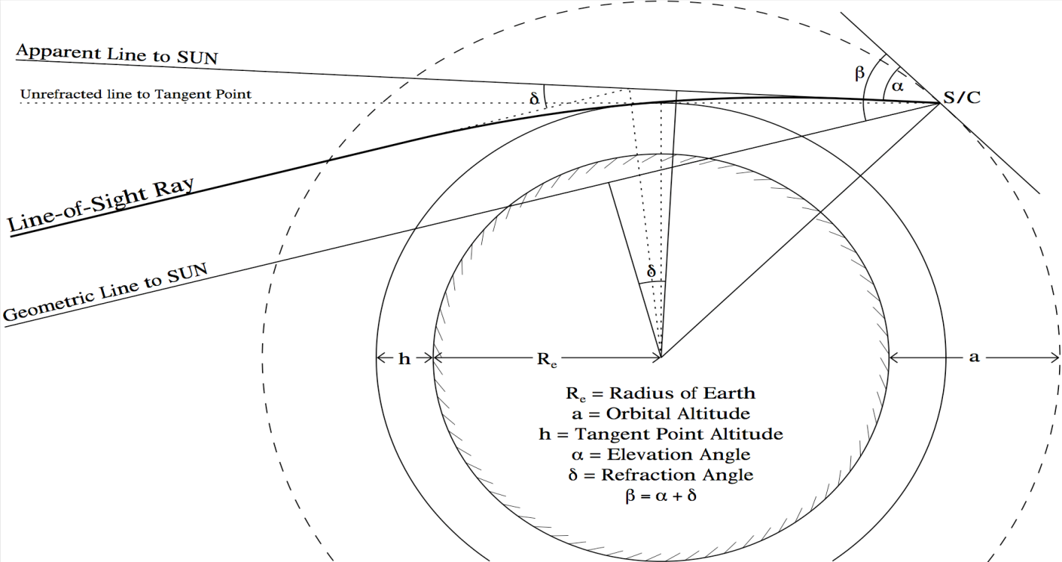
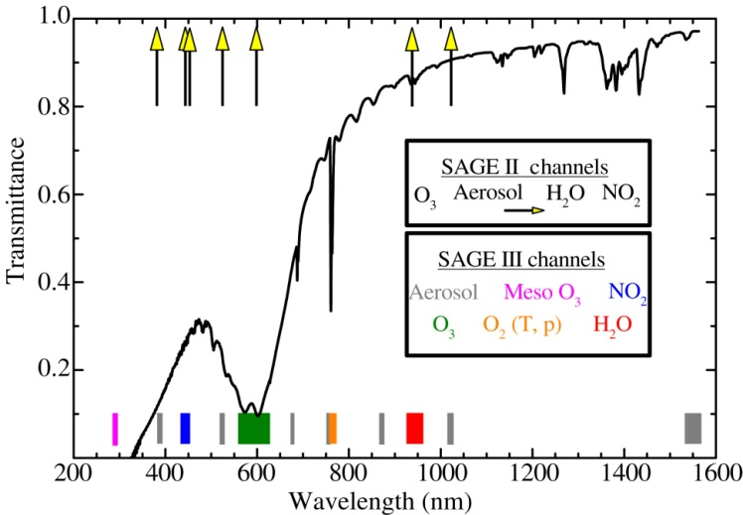
SAGE III Approach
Make accurate, high-vertical-resolution profiles of ozone, aerosol extinction, and other trace species using the heritage Occultation Technique
Utilize both the Sun and the Moon

Slide 20
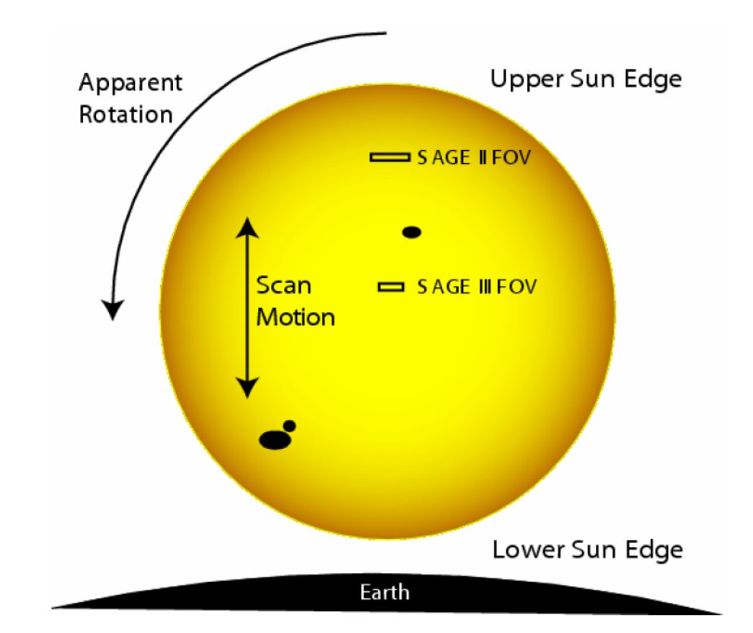
The Data to Work With
Reference exo-atmospheric scans across the sun characterize the Source and Instrument for each event
Scans across the sun looking through the atmosphere provide measure of atmospheric slant path transmission
Transmission = I /Io
Io
I

Slide 21
Effect of Source Variations
Spatial variations in source intensity can map into temporal variations due to:
  Apparent rotation into and out of scan plane
  Misplacement of Field of View (FOV) on the face of the sun
  Occurs for Io and I scans
Variations produce increased uncertainty in transmission & species concentration

Slide 22
Example of Effect on Io

Slide 23
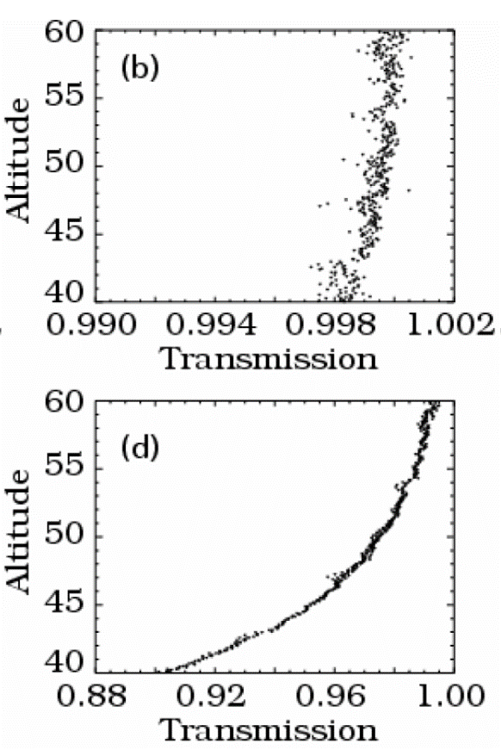
Correlations Allow for Corrections
Variations are correlated spectrally and spatially
Use correlations to:
  Modify the placement of FOV on face of source
  Account for rotation of source
Wavelength 1
Uncorrected
Corrected
Wavelength 2

Slide 24
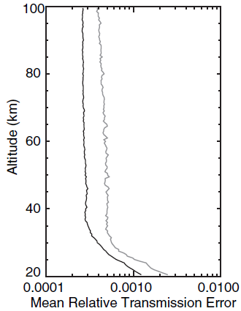
Improved SAGE Data Products
Corrections greatly reduces the variance in transmission, ~40%
Uncorrected
Corrected
[Burton, et al. 2010]

Slide 25
Backup

