Slide 1
OMPS Nadir Radiometric Calibration
Colin Seftor¹, Glen Jaross², Liang-Kang Huang¹, Michael Haken¹, Mark Kowitt¹, Grace Chen¹, Jason Li¹
¹Science Systems and Applications, Inc
²NASA Goddard Space Flight Center
NASA OMPS Science Team / SIPS

Slide 2
Both the NM and NP sensors are extremely stable
Working/Reference diffuser measurements are taken to monitor long-term stability
Question 1

Slide 3
Both the NM and NP sensors are extremely stable
Working/Reference diffuser measurements are taken to monitor long-term stability
Question 1

Slide 4
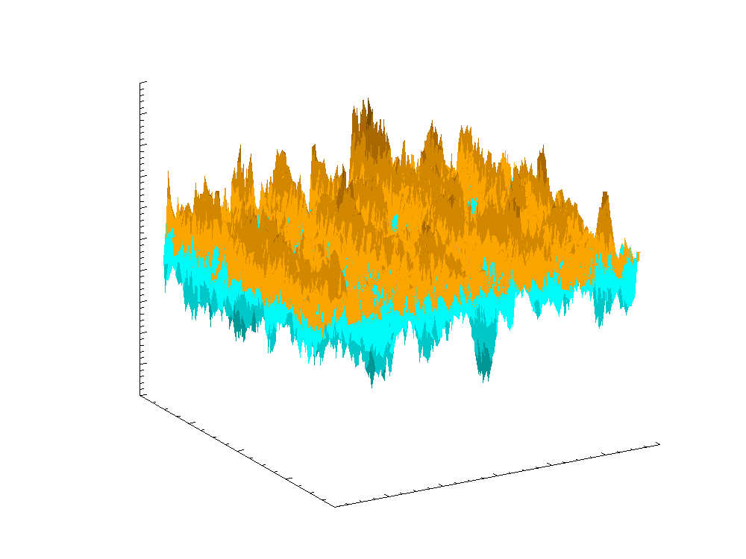
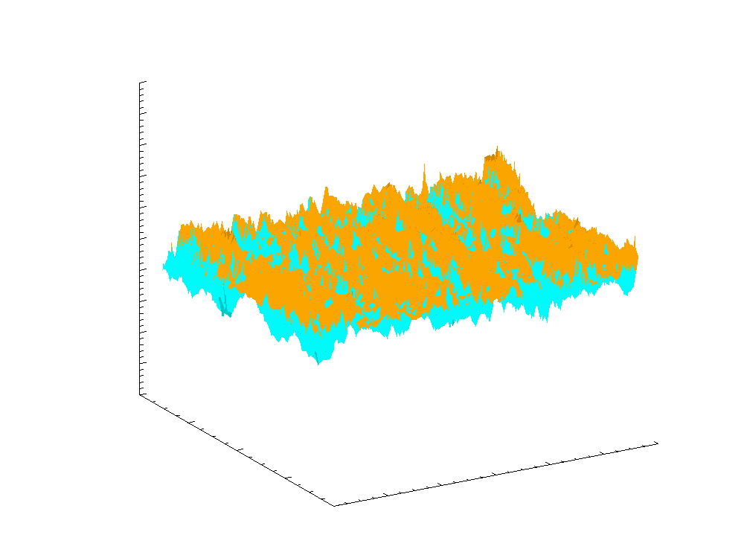
Aluminum diffuser interference features minimized
Calibration sequence changed so that sequence of solar measurements taken over solar incident angle of 6 deg (right) instead of 1 deg (left)
Quasi-volume diffusers to be used on JPSS 1 and JPSS 2
1.05
1.05
1.04
1.04
1.03
1.03
1.02
1.02
1.01
1.01
1.00
1.00
Solar Flux Ratio, 29 Feb / 27 Jan
Solar Flux Ratio, 7 March / 28 Jan
0.99
0.99
0.98
0.98
0.97
0.97
0.96
0.96
0.95
0.95
380
380
360
360
340
100
120
340
80
100
120
Wavelength (nm)
80
Wavelength (nm)
320
40
60
320
40
60
Spatial Position
300
Spatial Position
300
20
0
20
0
Question 1
0.95
0.96
0.97
0.98
0.99
1.00
1.01
1.02
1.03
1.04
1.05

Slide 5
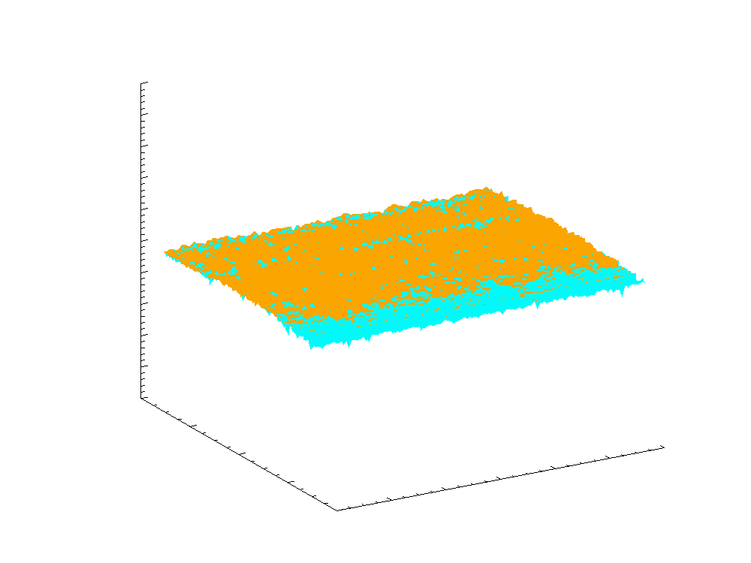
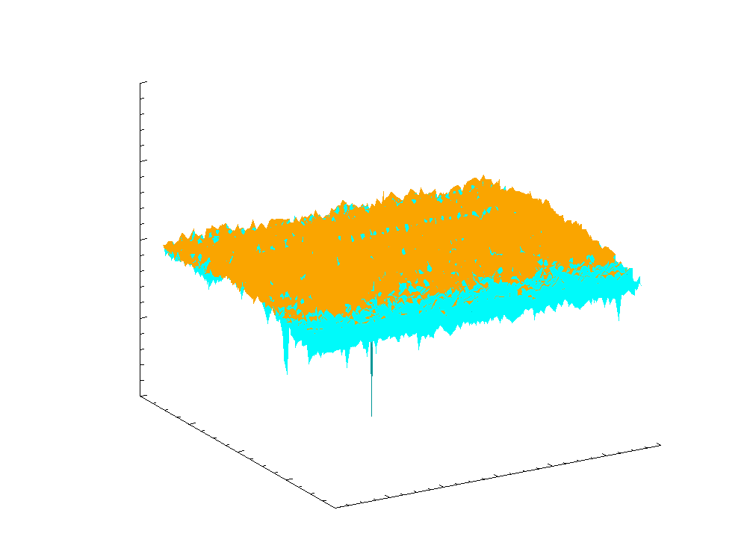
Comparison of two different reference measurements show little noise
Reference measurements taken at the same beta angle show no diffuser features
1.05
1.02
1.04
1.03
1.01
1.02
1.01
1.00
Solar Flux Ratio, 28 Aug 2013 / 31 Aug 2012
1.00
Solar Flux Ratio, 28 Aug 2013 / 31 Aug 2012
0.99
0.98
0.99
0.97
0.96
0.95
0.98
380
380
360
360
340
100
120
340
80
100
120
Wavelength (nm)
80
Wavelength (nm)
320
40
60
320
40
60
Spatial Position
300
Spatial Position
300
20
0
20
0
0.95
0.96
0.97
0.98
0.99
1.00
1.01
1.02
1.03
1.04
1.05
Question 1

Slide 6
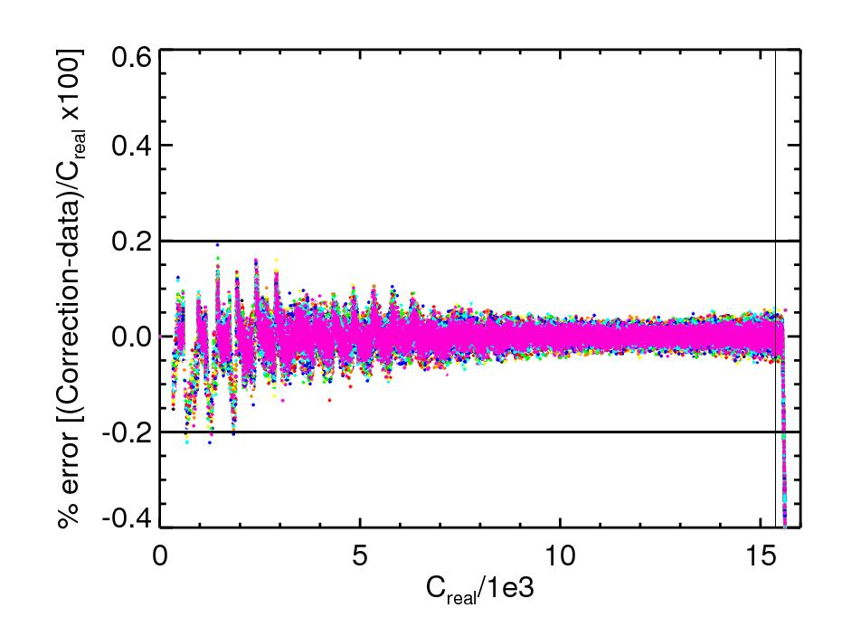
Signals for both the NM and NP sensors are extremely linear
Linearity correction determined using LED lamp exposures of CCD from 0 to 2.4 seconds in steps of 60 ms
Linearity correction applied to NP sensor
NM results are similar
Non-linearity knowledge of 0.2%
Question 1

Slide 7
“Seasonal” wavelength shifts seen in NP sensor
Comparison of measured to reference (synthetic) solar flux convolved with appropriate instrument spectral functions
On-orbit wavelength shift cal = 0.01 nm
Synthetic flux used:
Dobber, M., Q. Kleipook, R. Dirksen, P. Levelt, G. Jaross, S. Taylor, T. Kelly, L. Flynn, G. Leppelmeier, and N. Rozemeijer (2008), Validation of Ozone Monitoring Instrumentt level 1b data products, J. Geophys. Res., 113, D15506, doi: 10.1029/2007JD008665.
Question 2

Slide 8
Much smaller (.002 nm) seasonal dependence seen in NM sensor
Comparisons of reference solar flux measurements on 31 Aug 2012, 4 Apr 2013, and 28 Aug 2013 with 21 Mar 2012
  Left – No shift in wavelengths
  Right – 0.002 nm shift for 31 Aug 2012 and 28 Aug 2013
Question 2

Slide 9
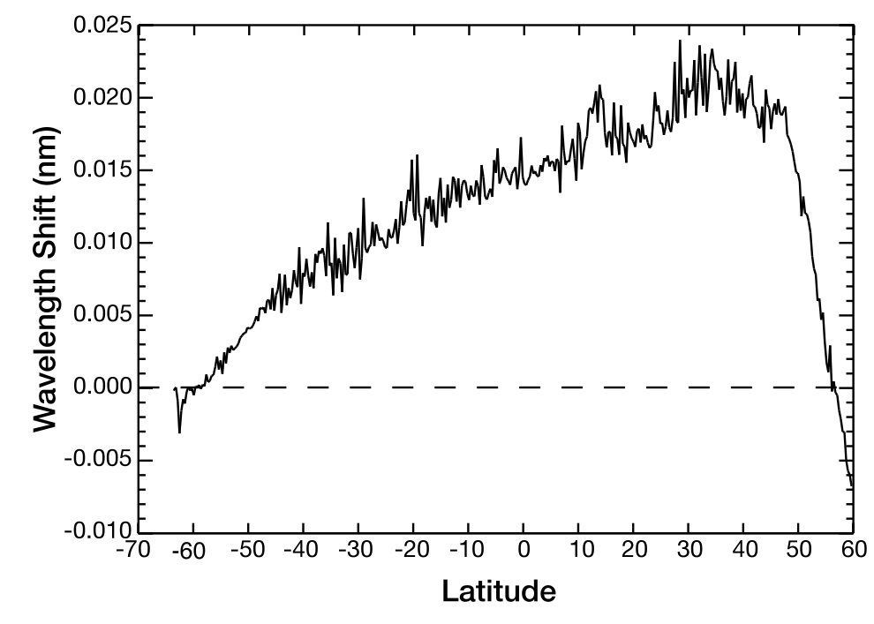
Intra-orbital dependence seen in NM sensor
Comparison of Earth measured radiances for non-ozone absorbing wavelengths compared to synthetic solar
Flux
On-orbit wavelength shift cal = 0.01 nm
Question 2

Slide 10
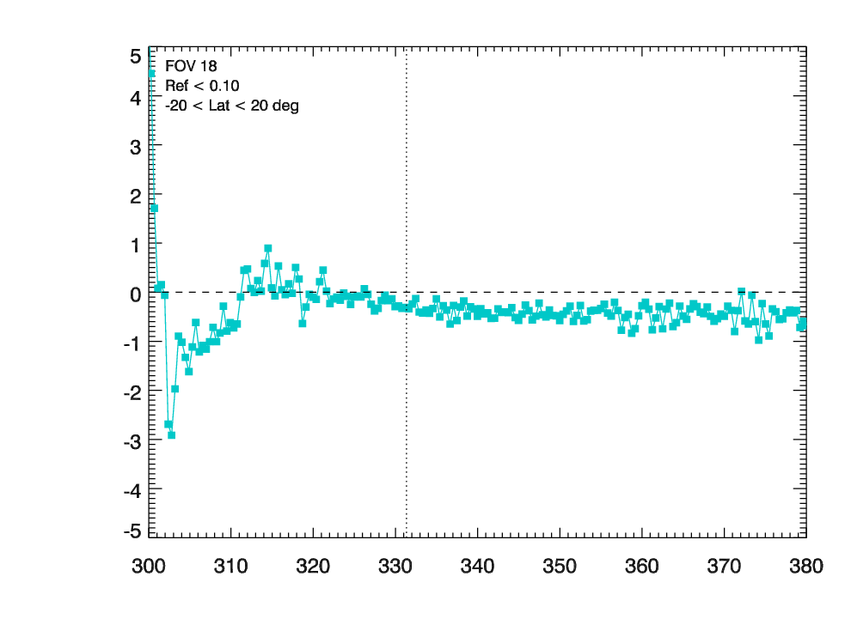
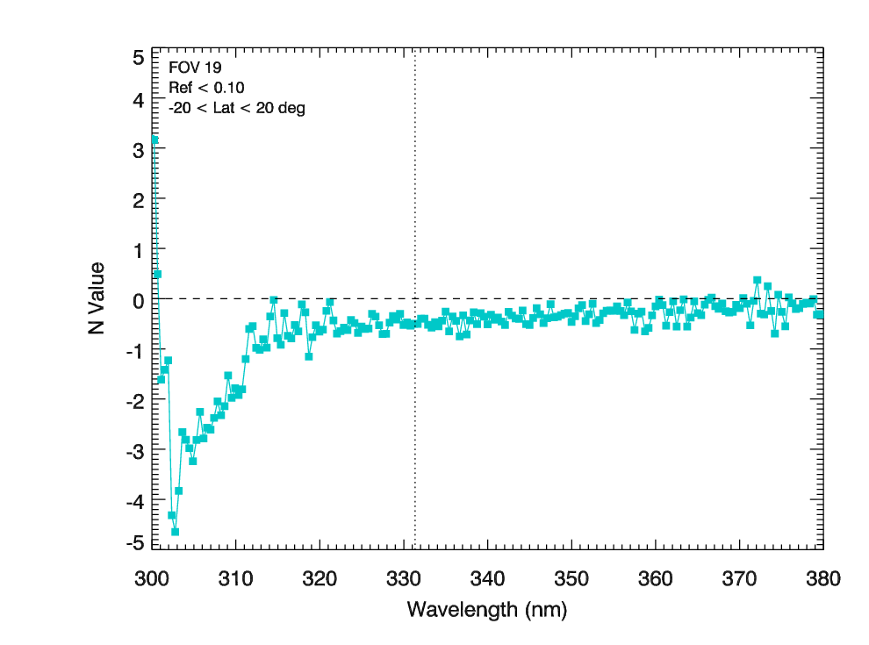
OMPS/MLS matchup comparison shows good performance for normalized radiances
Co-locate MLS temperature, ozone profiles to OMPS NM measurements
Calculate normalized radiances from NM viewing conditions, MLS profiles using RTMe
Compare measured OMPS NM NR with calculated NR
  Agreement seen to within 2% for wavelengths > 310 nm
  Stray light spec < 2%
Stray light seen for wavelengths < 310 nm
  Consistent with pre-launch sensor characterization
Normalized Radiance spec 2%
  Radiance spec 8%
  Irradiance (solar flux) spec 7%
N Value
Question 3/4

Slide 11
Adjustments needed to account for changes in throughput, particularly in dichroic region
Question 3/4

Slide 12
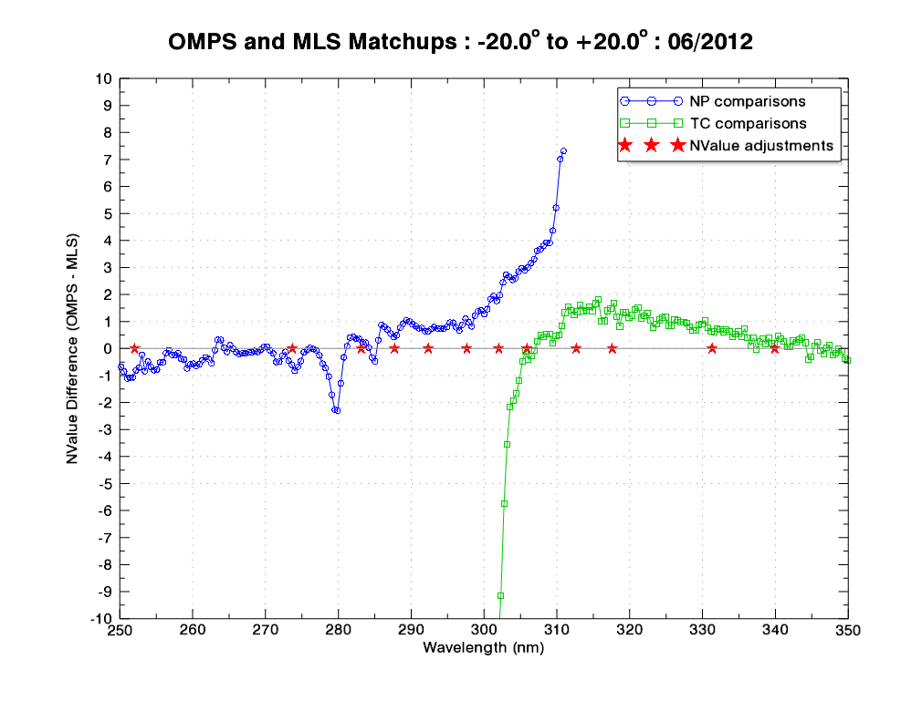
V1 OMPS/MLS matchup comparisons showed problems unrelated to dichroic adjustment
MLS ozone/temp profiles from matched up dataset used in radiative transfer calculations of normalized radiances
Calculated NR compared to OMPS measured NR
N values difference compared
  N = -100log₁₀(NR)
  ΔN = -2.3% radiance difference
Question 3/4

Slide 13
Adjustments needed to account for “unphysical” behavior of cal coefficients
Question 3/4

Slide 14
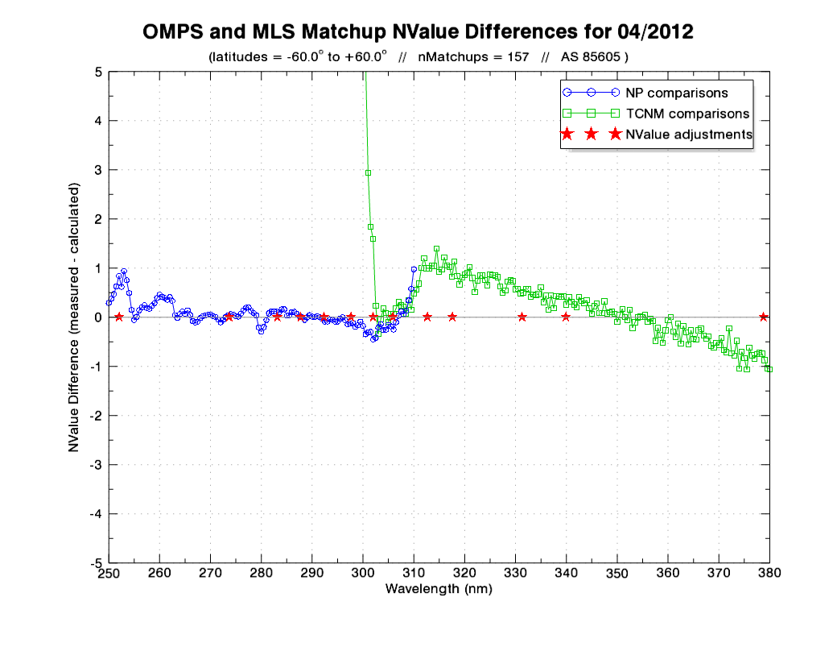
\
V2 OMPS/MLS Matchup Comparisons showed better performance with new coefficients
Includes corrections for dichroic region
Includes corrections for stray light
Question 3/4

Slide 15
J1 calibration coefficients show the same type of unphysical behavior
Question 3/4

Slide 16
Comparisons of OMPS NM total ozone to OMI shows no trend
OMPS (BDM) / OMI (Bass & Paur) / Difference
(Average total ozone from -60 to 60 degrees latitude)
Comparisons to Dobson, Brewer ground measurements also performed
Question 4

Slide 17
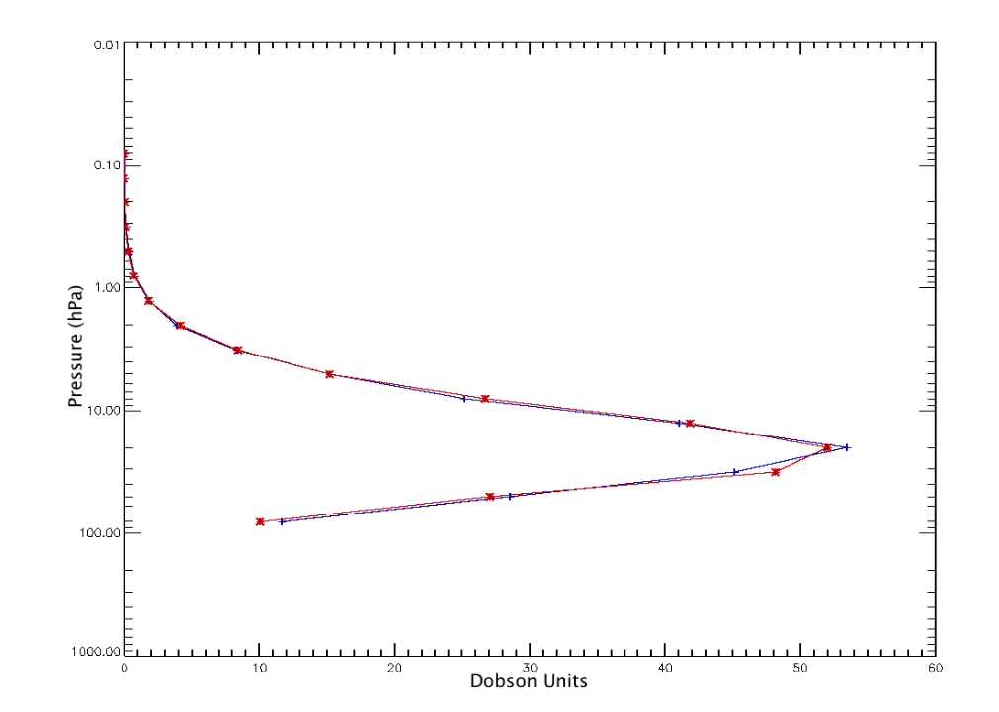
Comparisons of OMPS NP data to MLS show good agreement
Comparison of average MLS profile for 23 June 2012 with average NP profile.
-20 to 20 degrees latitude
Total ozone from MLS: 235.7 DU
Total ozone from
NP: 236.7 DU
Question 4

Slide 18
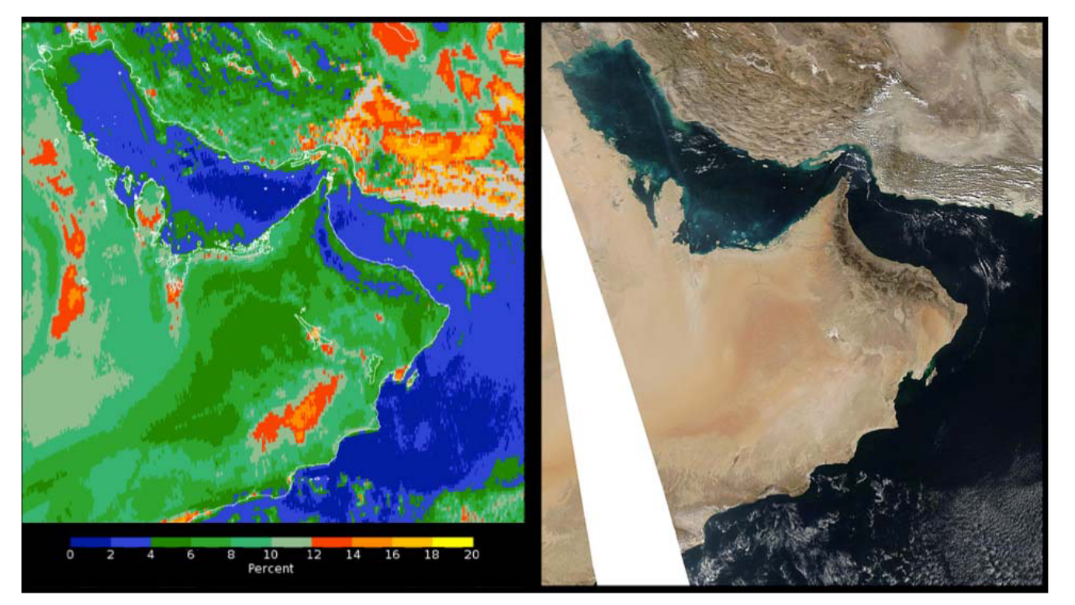
Geolocation of the NM sensor is excellent

Slide 19
Summary
OMPS nadir sensors met pre-launch specifications (for the most part)
  NM outside spec for the shortest wavelengths (< 310 nm)
  Correction for stray light now applied for both NM and NP sensors
OMPS nadir sensors performing well post-launch
  Diffuser interference features mitigated by change to calibration process
    Measurements taken over wider range of solar angles to “smooth out” features
  Wavelengths shifts understood, now corrected for
  Sensor performance is linear over the entire signal range
  Issues in dichroic “transition region” due to “unphysical” behavior of calibration coefficients, now minimized using coefficients corrected by assuming smooth behavior with wavelength
  Dark current is changing as expected
    Correction currently applied weekly, will move to daily correction
Both NM and NP sensors stable, with little to no long-term change

