Slide 1
Calibration Status for the GOME Instrument
D. Loyola, B. Aberle, M. Coldewey-Egbers, N. Hao, S. Slijkhuis
Joint GSICS GRWG-UVSG and CEOS WGCV-ACSG Meeting
NCWCP College Park, October 8th 2015

Slide 2
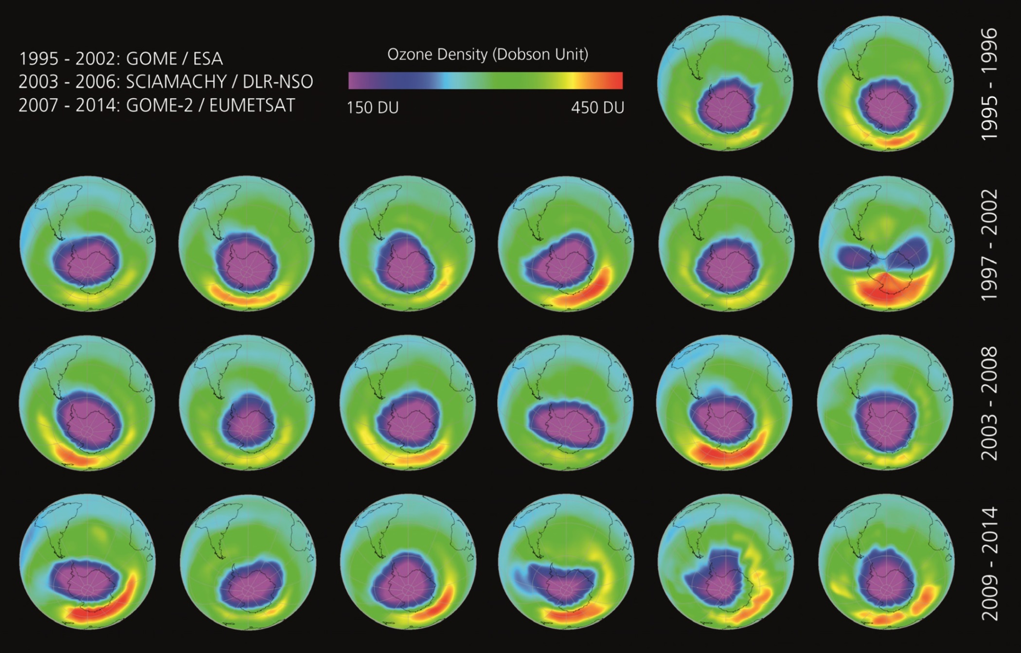
Evolution of the Ozon Hole over Antarctic

Slide 3
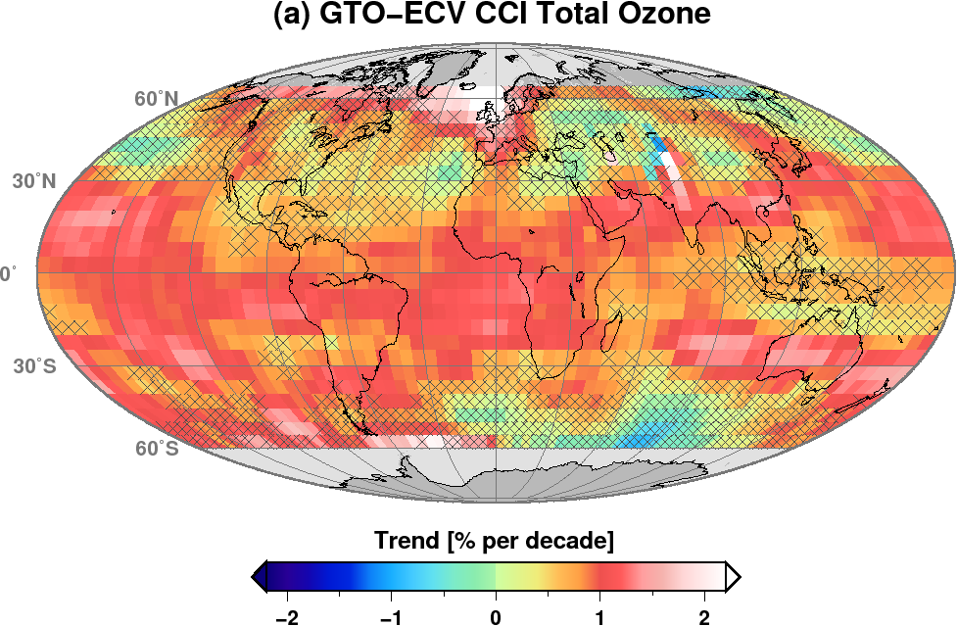
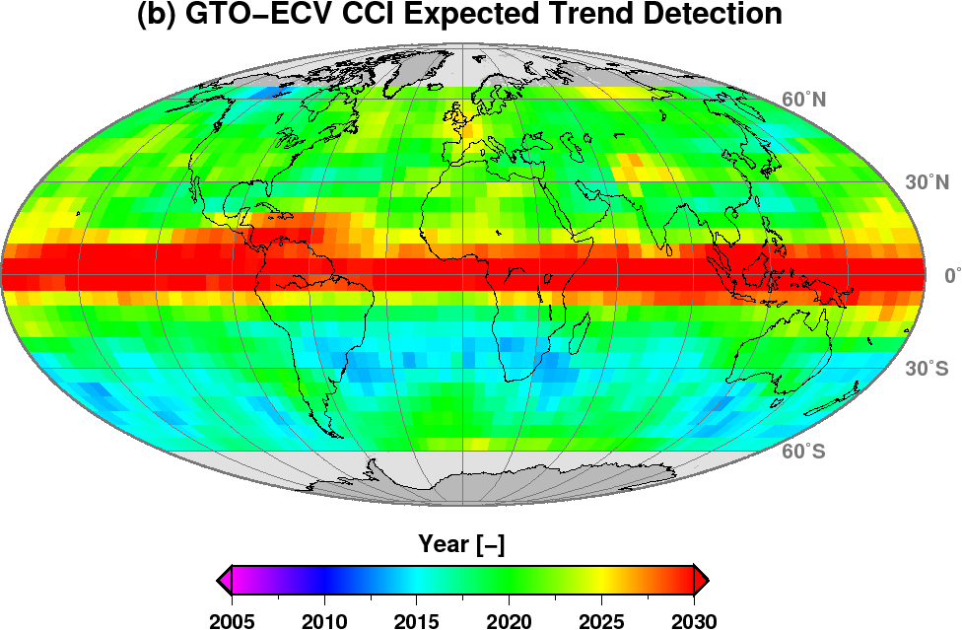

Slide 4
ESA Project GOME-Evolution
First reprocess the GOME L1b products for the complete mission
Analyze and optimize the in-flight calibration
Update the level 0-to-1 algorithms
Validate the L1b product
Products in netCDF CF compliant with the Sentinels
Water Vapour as operational GOME product
Outreach
WebGalery for atmospheric composition missions
School-lab experiment for secondary school

Slide 5
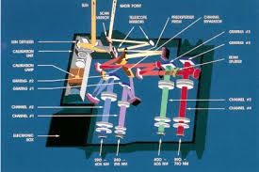
Global Ozone Monitoring Experiment
GOME/ERS-2 launched in April 1995 and decommissioned in July 2011
Nadir-viewing spectrometer that measures solar radiation reflected and/or scattered in the Earth‘s atmosphere or from its surface
4 Diode Arrays Detectors (1024 pixels)
Channel 1: 237-316nm
Channel 2: 311-405nm
Channel 3: 405-611nm
Channel 4: 595-793nm
3 Polarization Measurement Devices
PMD 1 : 295-397nm
PMD 2 : 397-580nm
PMD 3 : 580-745nm
GOME optical layout (courtesy of ESA)

Slide 6
GOME In-Flight Calibration
Spectral calibration
Instrument houses a platinum-chromium-neon (PtCrNe) emission lamp
Wavelength calibration using well-known spectral positions of these emission lines
Pixel-to-Pixel Gain (PPG) correction using LED measurements
Dark Current correction
Monitor thermal leakage and associated noise of 4 channels (4096 detector pixels) by periodically taken dark-side measurements
Correct PMDs for their zero offset and noise
Sun and Moon measurements

Slide 7
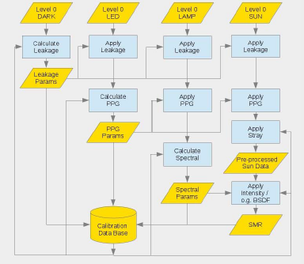
Processing flow for calibration parameters

Slide 8
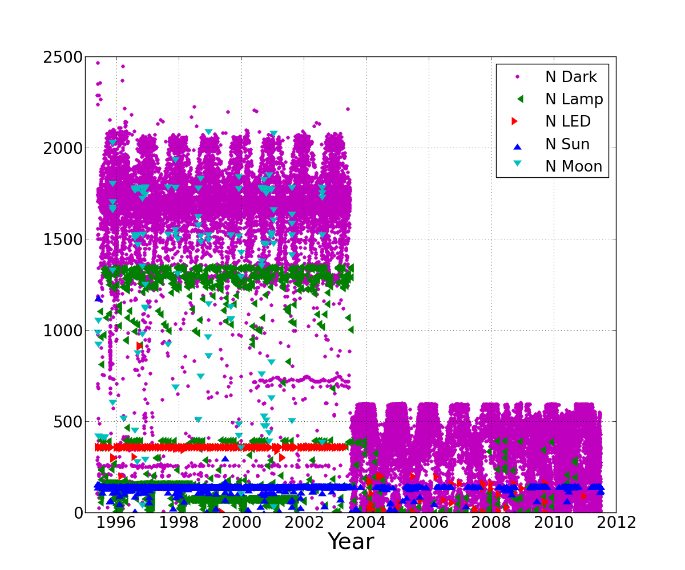
Number of In-Flight Calibration Measurements
Loss of global coverage in May 2003 due to failure of on-board tape recorder

Slide 9
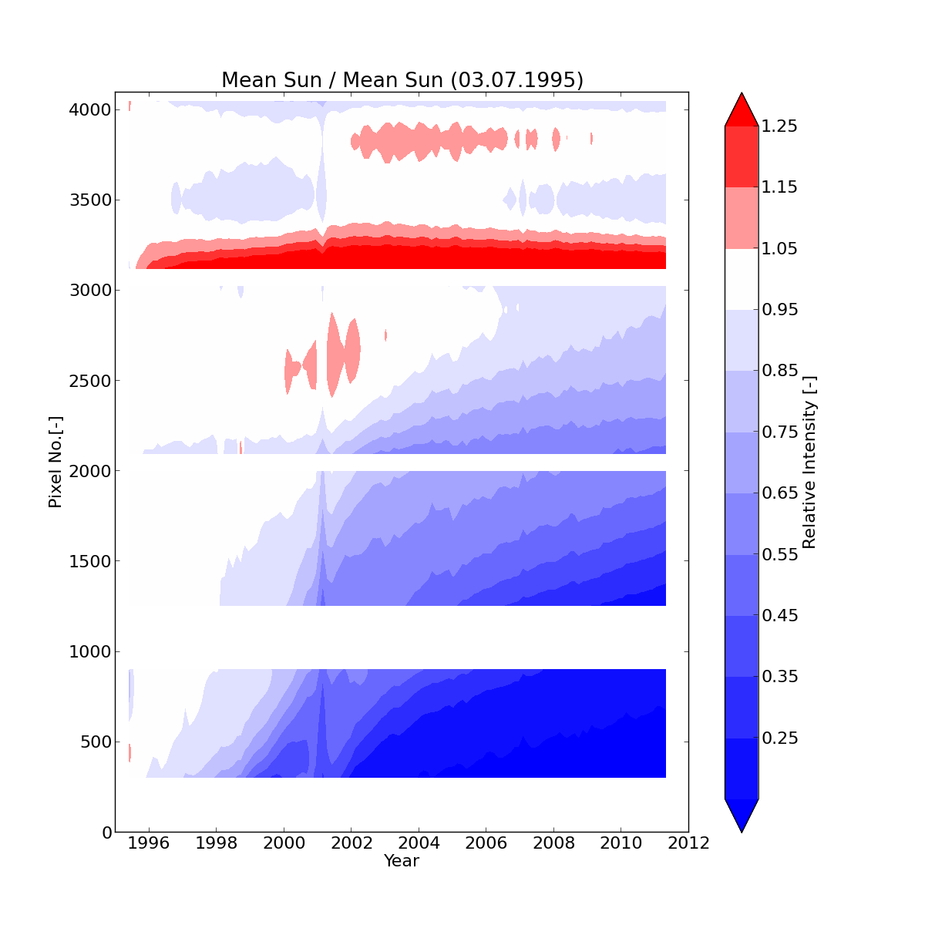
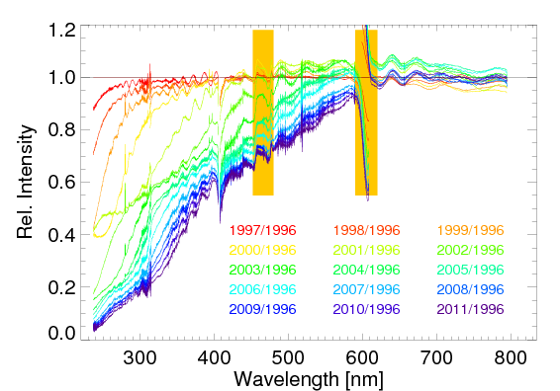
GOME Degradation Monitoring
Ch1 Ch2 Ch3 Ch4
Channel 4
Channel 3
Channel 2
Channel 1
Dichroic filter
Anomalies in 2001 due to gyroscope failure

Slide 10
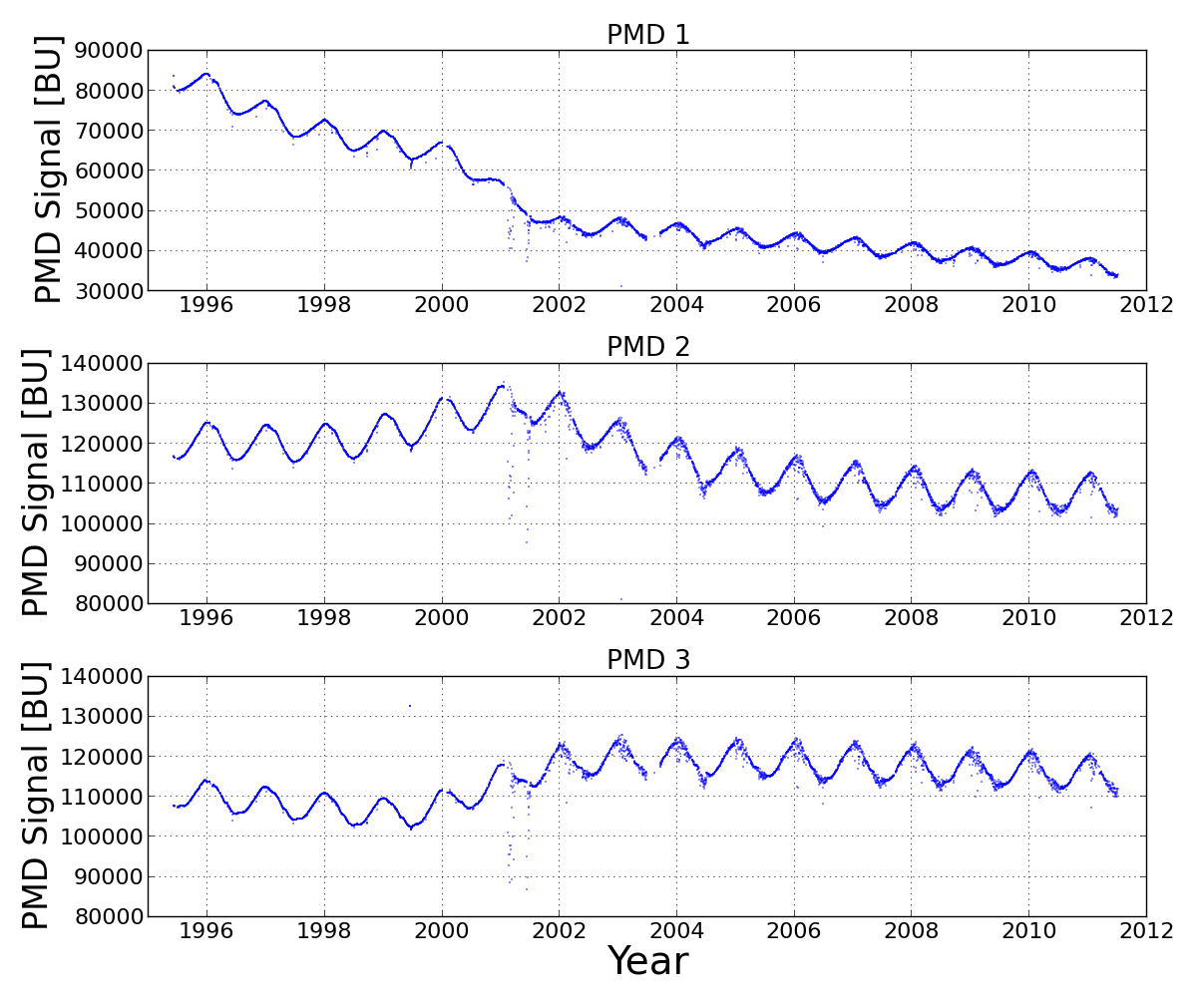
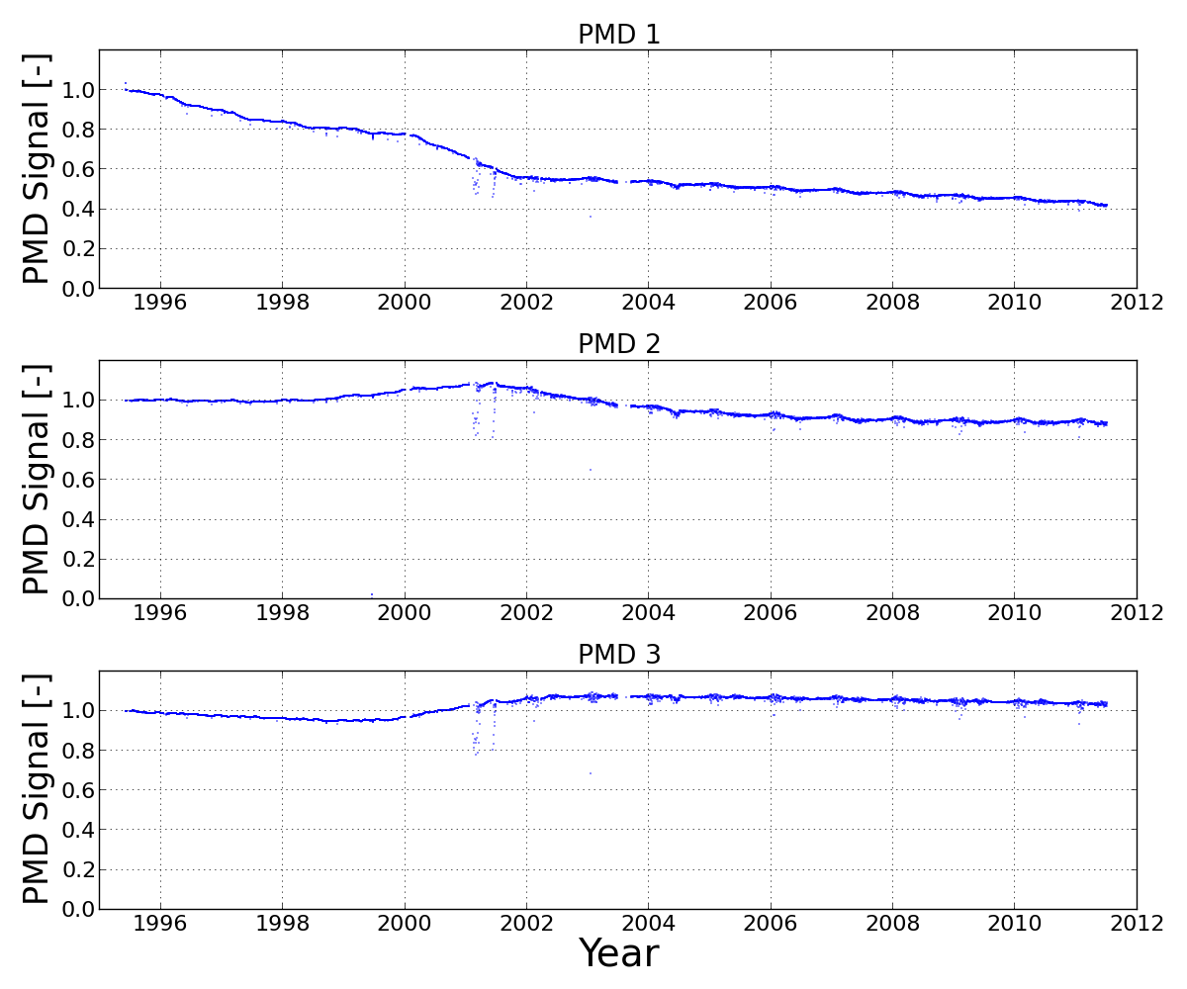
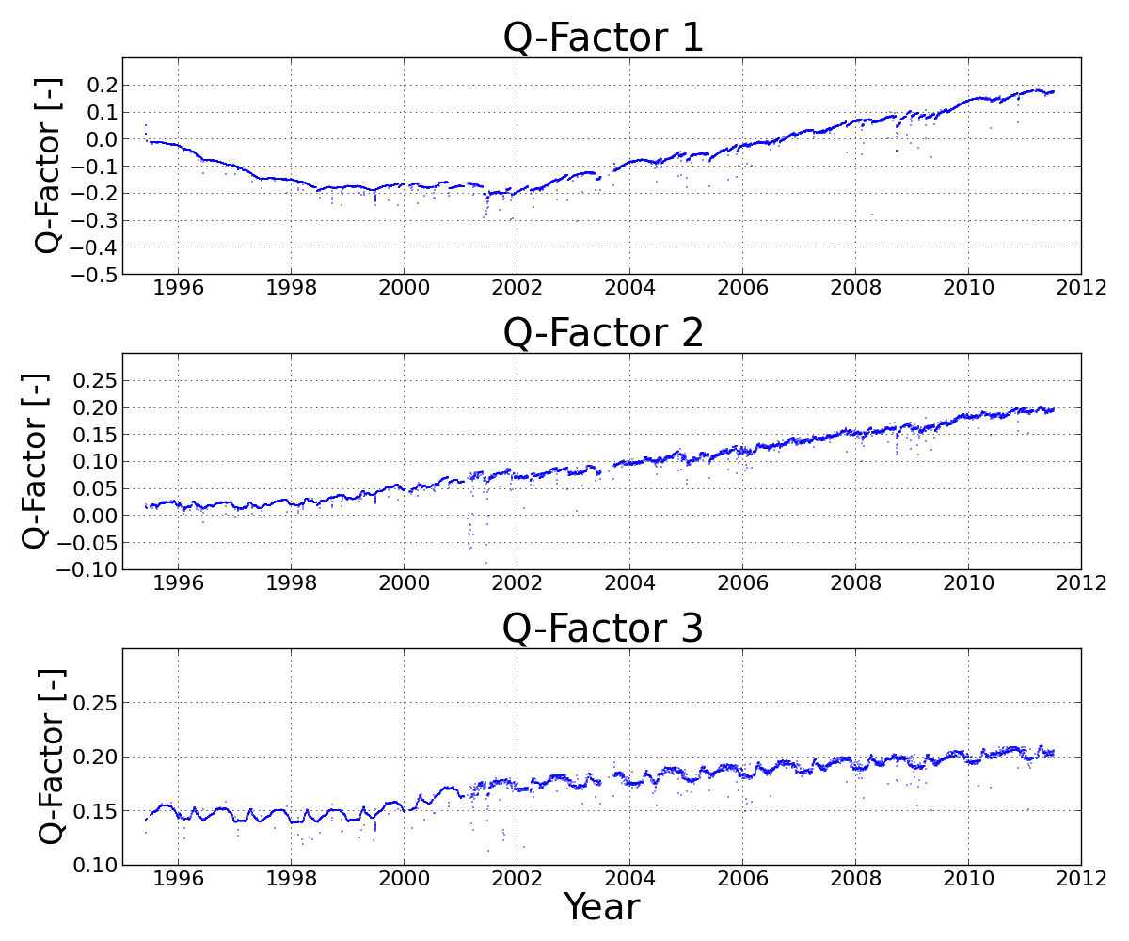
PMD Measurements and Q-Factors
PMD Signal
Change vs. 1995
Q-Factors

Slide 11
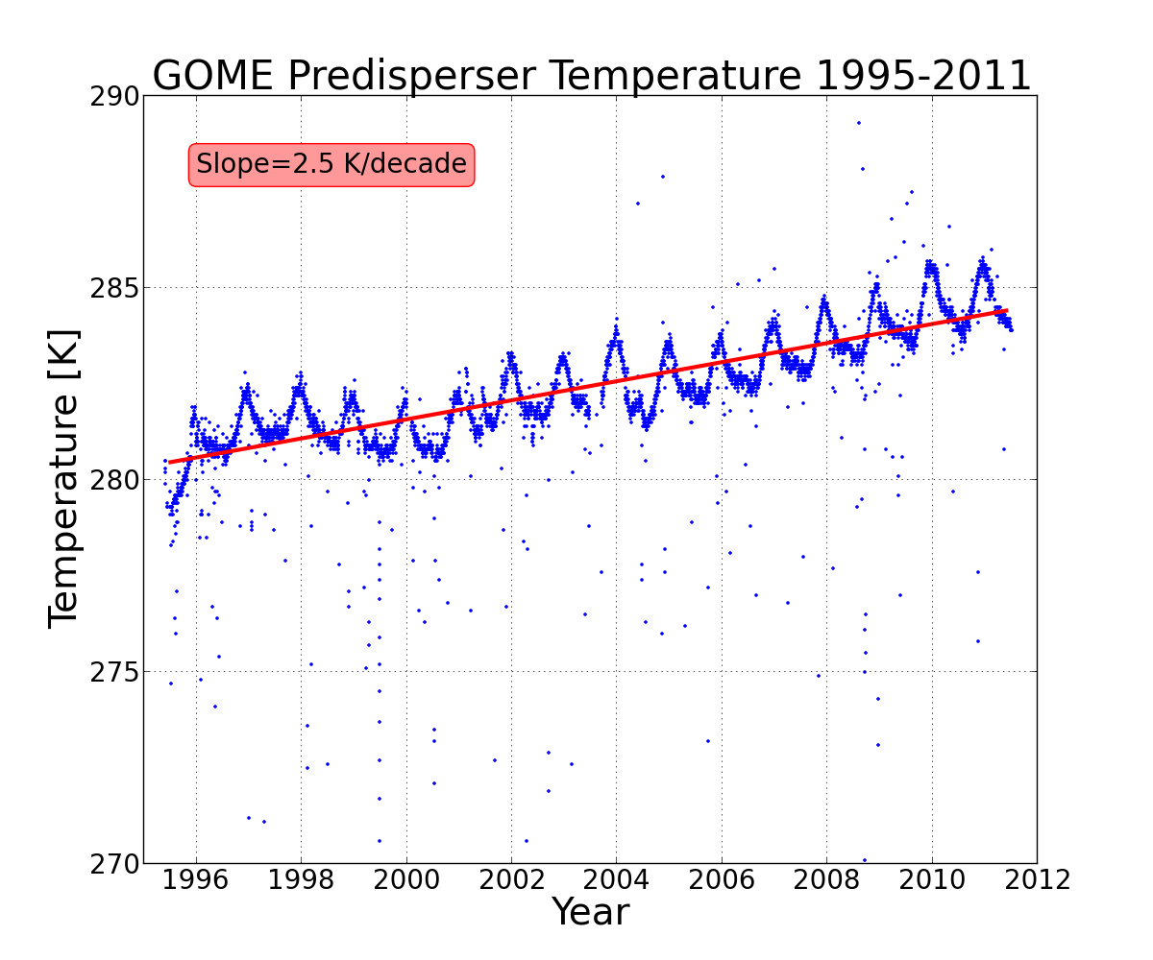
GOME Pre-disperser Temperature
Quartz pre-disperser prism is one of the key elements in the optical system
Refractive index depends on wavelength and temperature
Temperature increases along an orbit due to warming of the satellite by the sun and partly because light passes through the instrument
Temperature changes affect the wavelength calibration
Long-term increase is due to degradation of the thermal system
Outliers are connected to instrument and cooler switch-offs

Slide 12
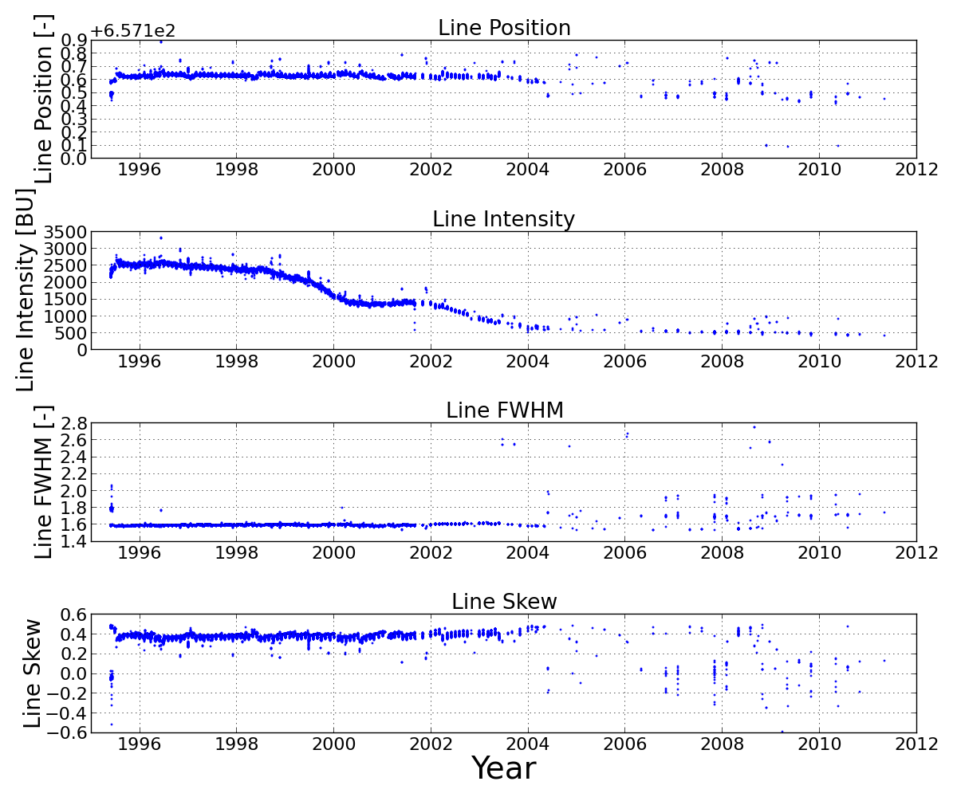
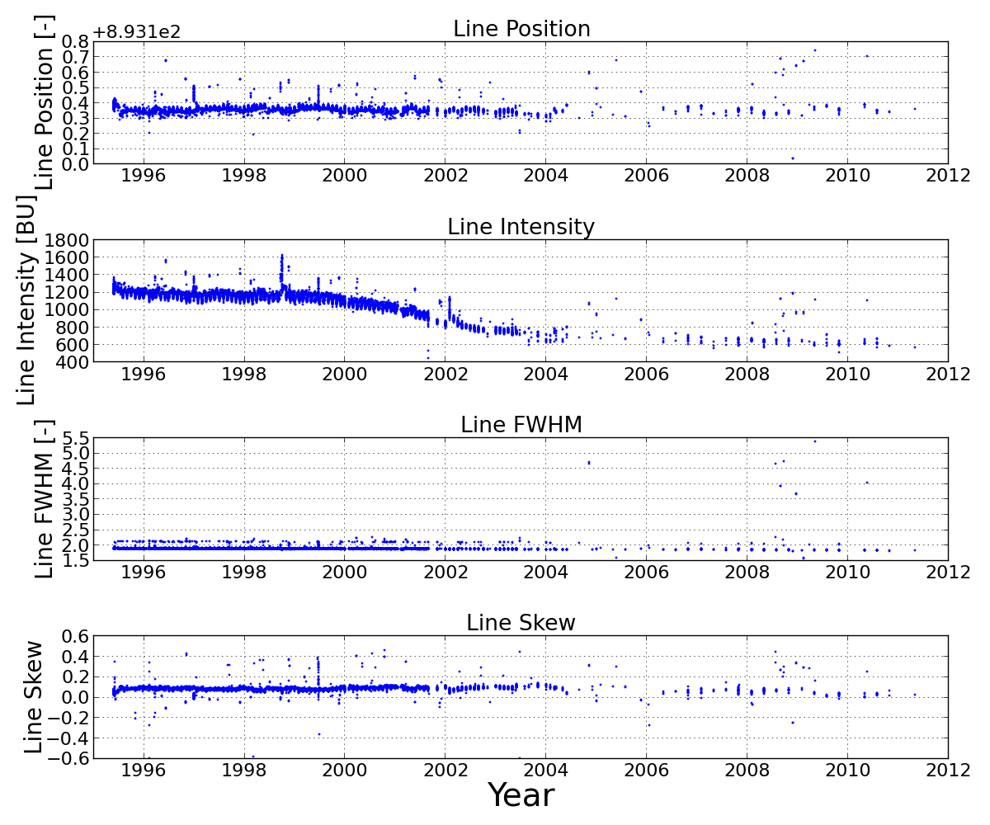
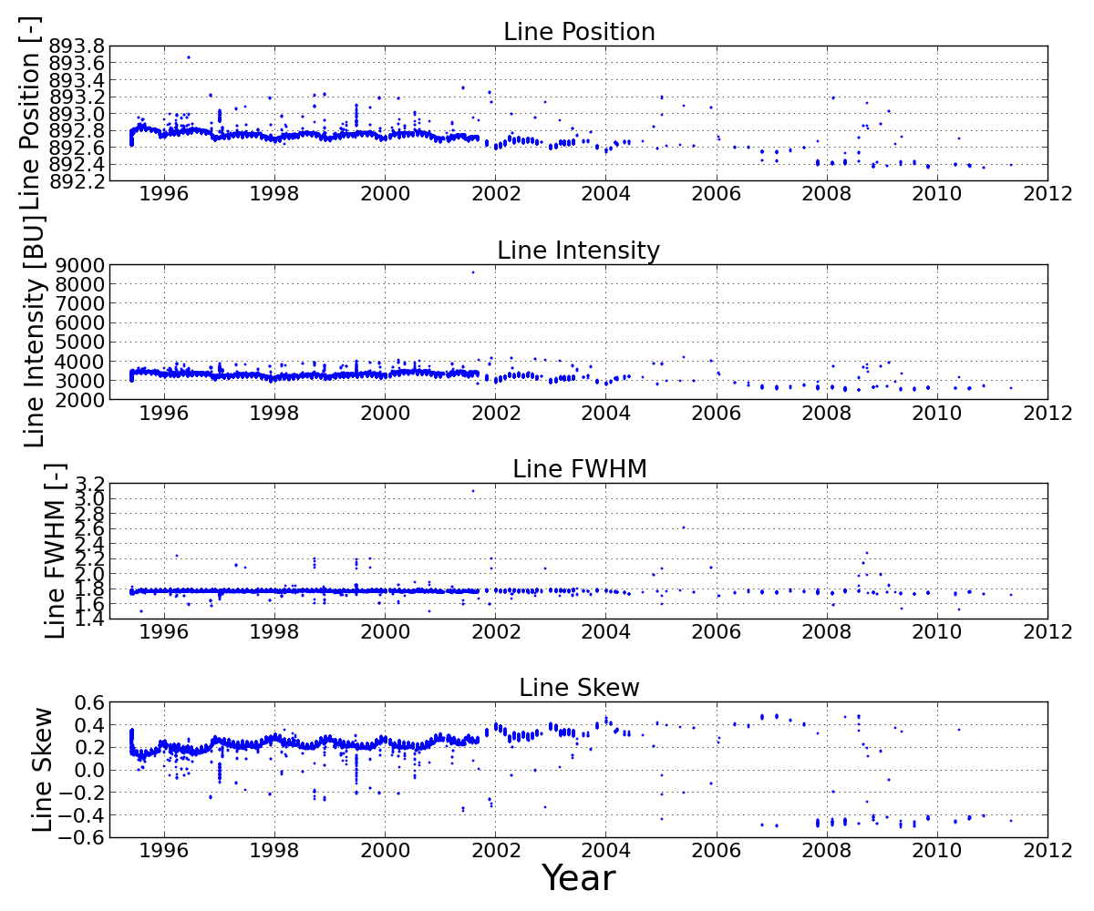
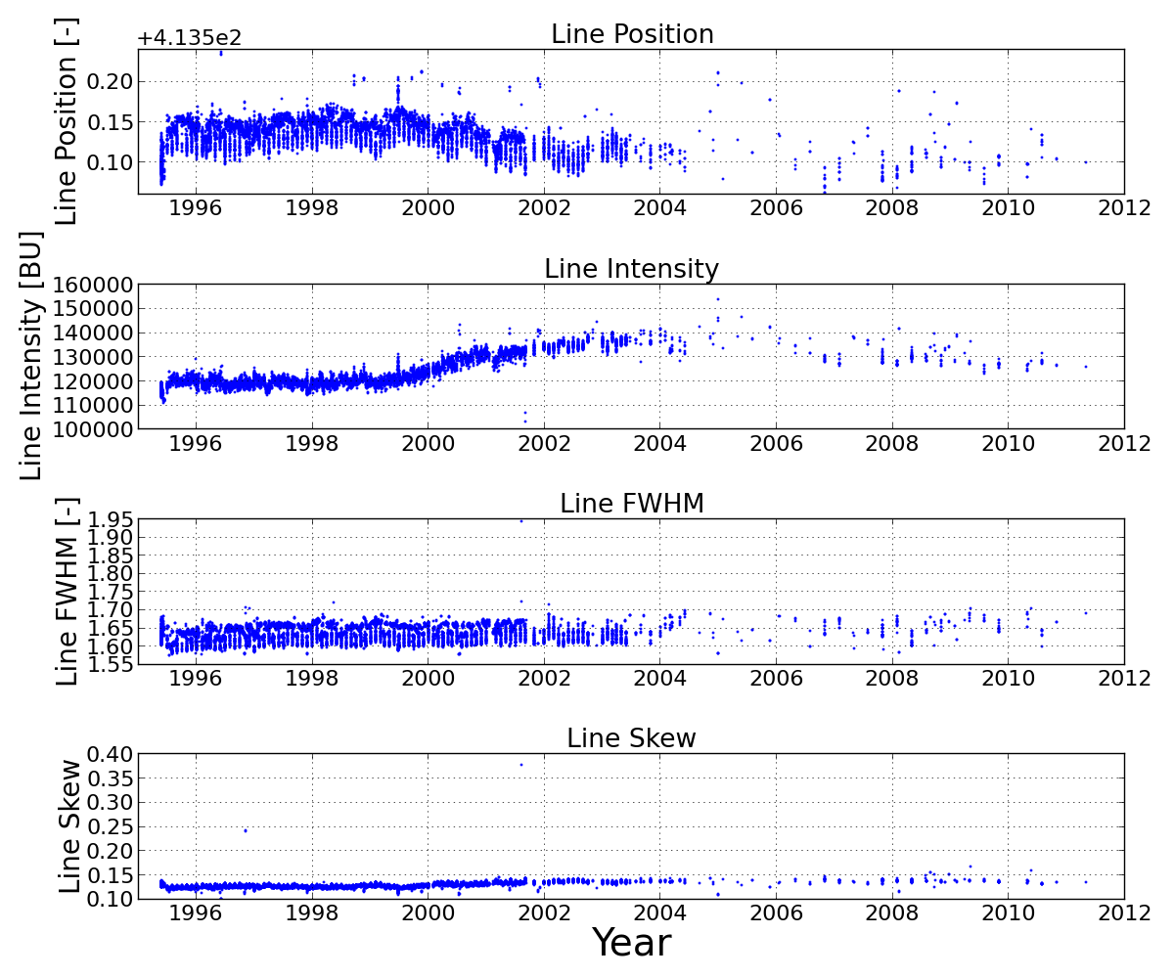
Spectral Lamp Measurements
Ch 1: 283nm
Ch 2: 391nm
Ch 3: 582nm
Ch 4: 668nm

Slide 13
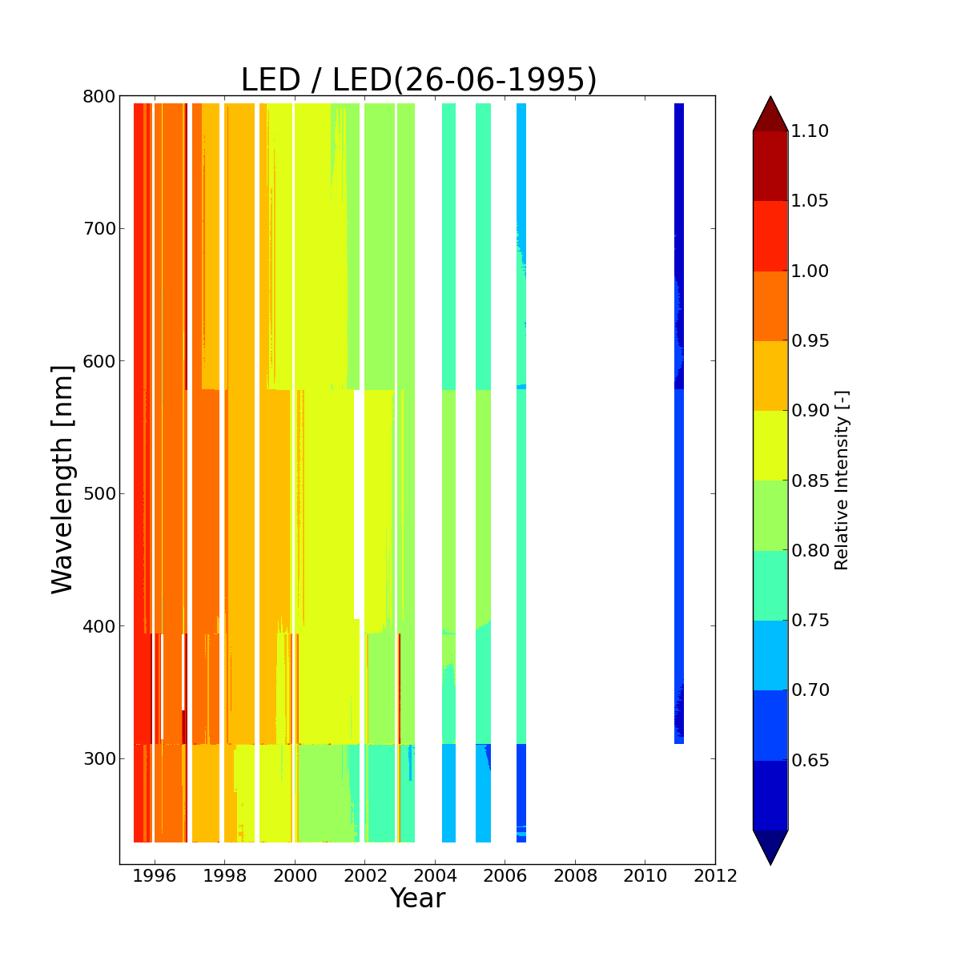
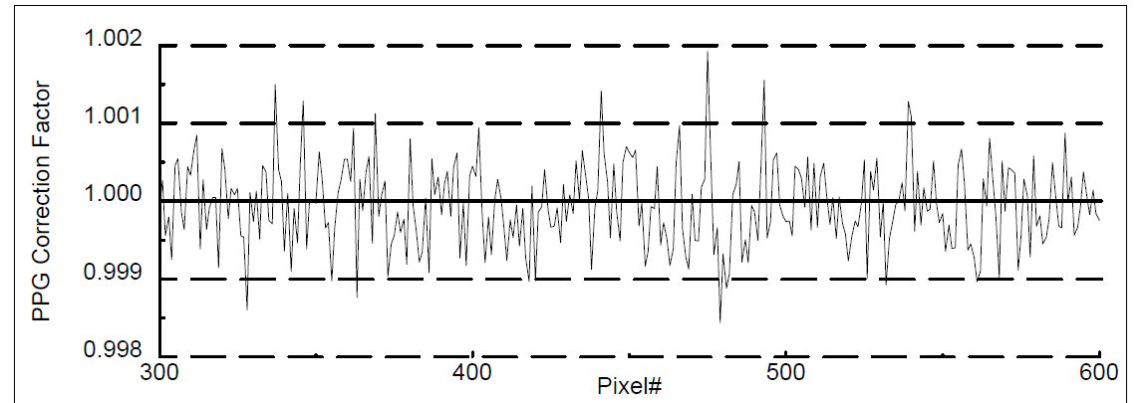
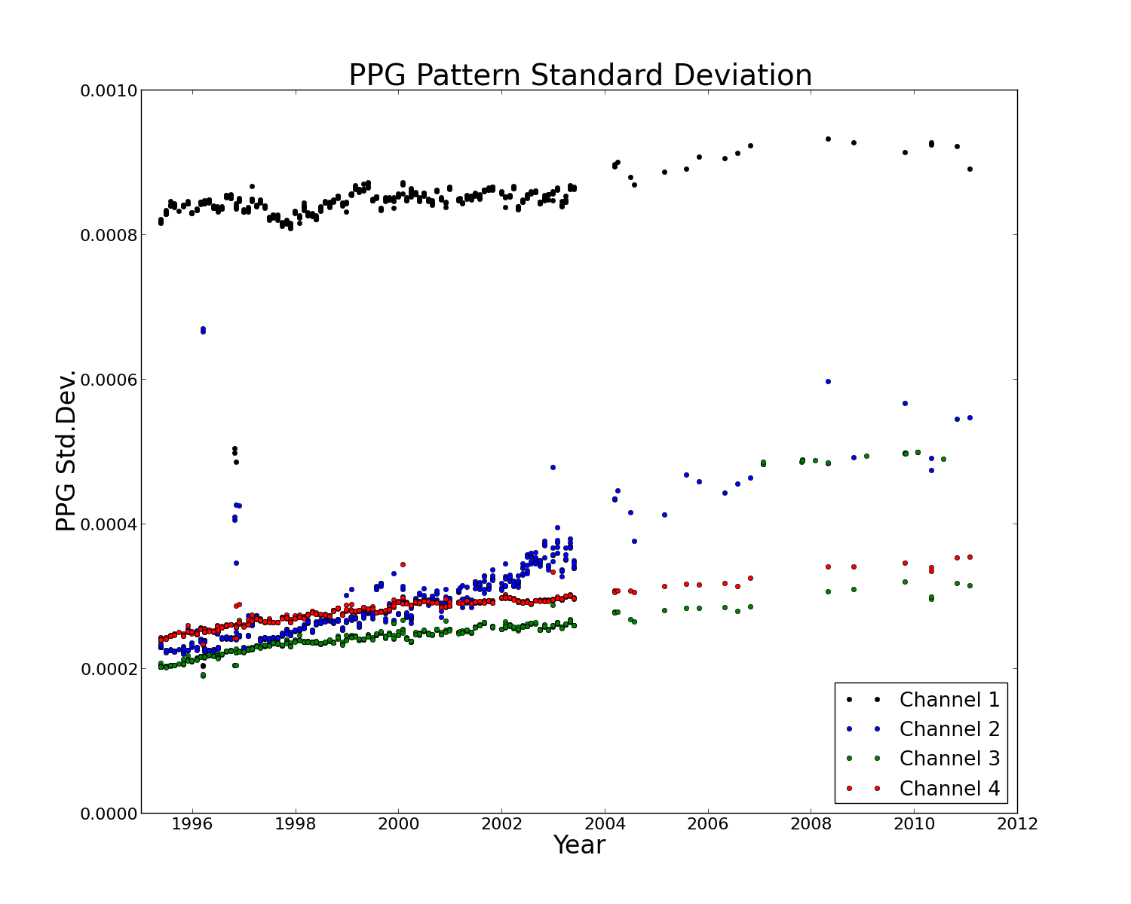
LED Measurements + Pixel-to-Pixel Gain Correction
Typical PPG correction factor
Ch 4
Ch 3
Ch 2
Ch 1

Slide 14
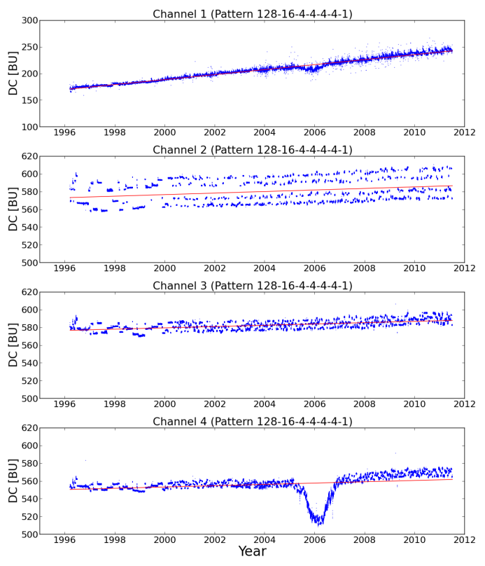
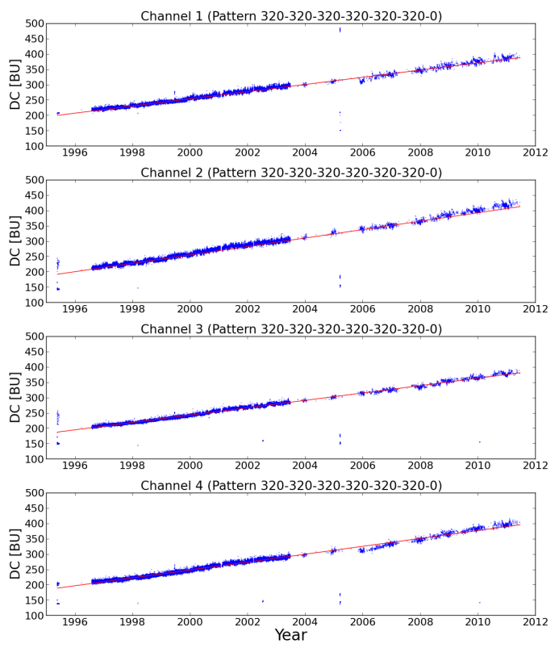
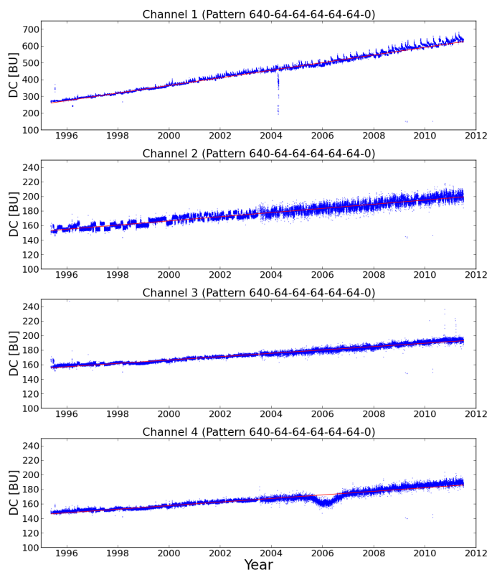
Dark Current Measurements vs. Integration Time (IT)
IT pattern: Scan
(Band 1a: 12s and Bands 2-4: 1.5s)
IT pattern: LED
(Bands 1-4: 30s)
IT pattern: Moon
(Band 1a: 60s and Bands 2-4: 6s)
→ Increase: 4-6 BU/s / 10 years

Slide 15
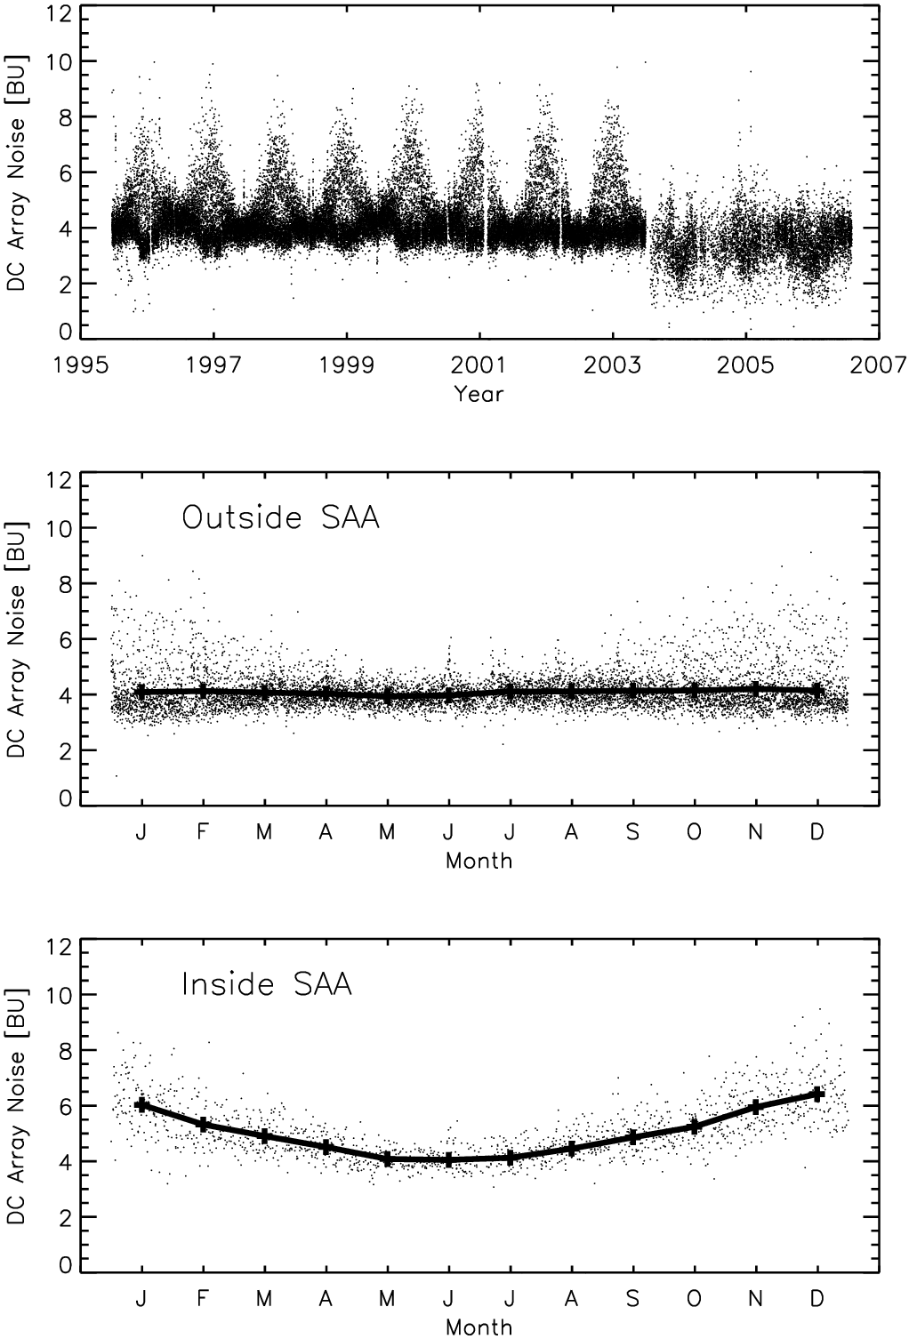
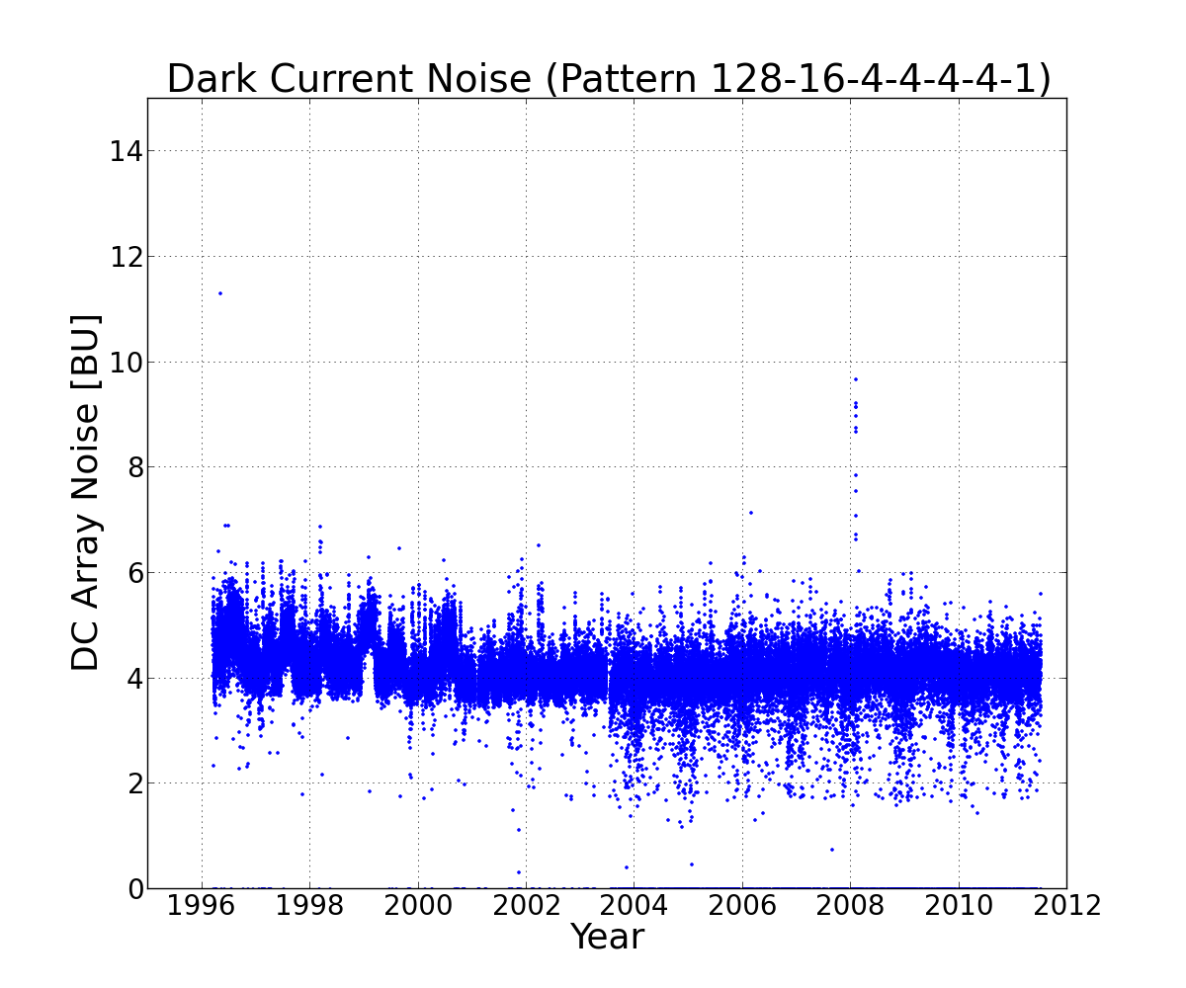
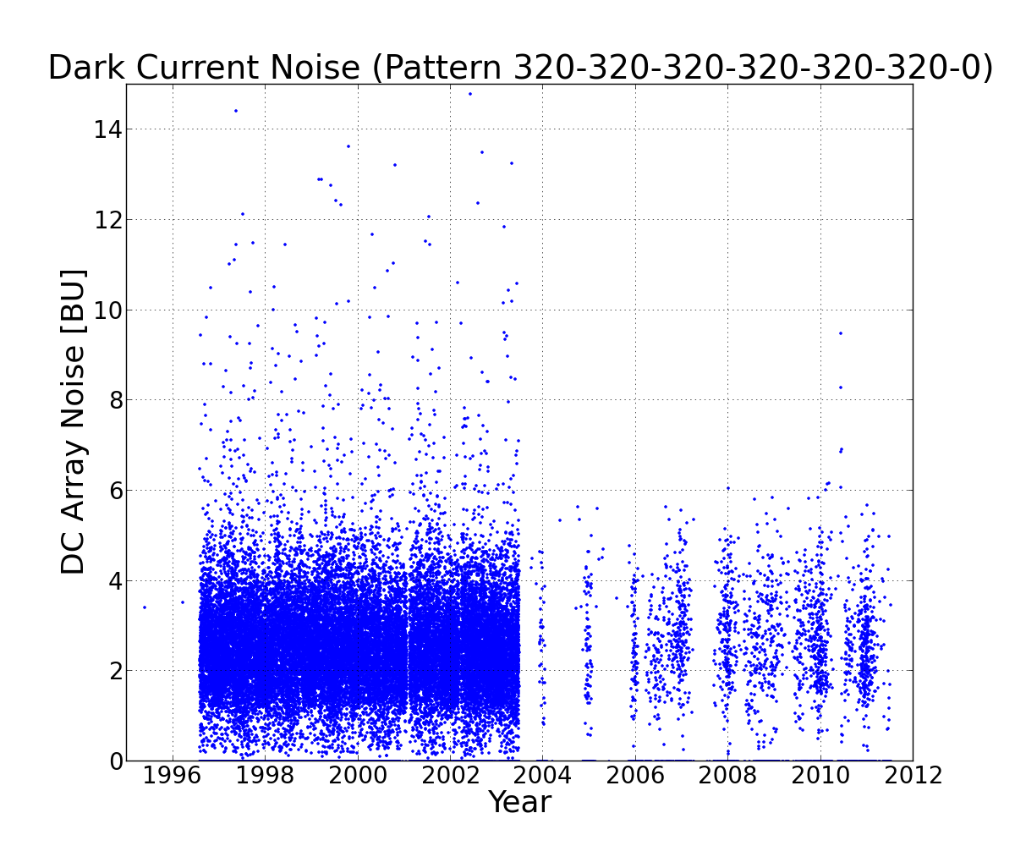
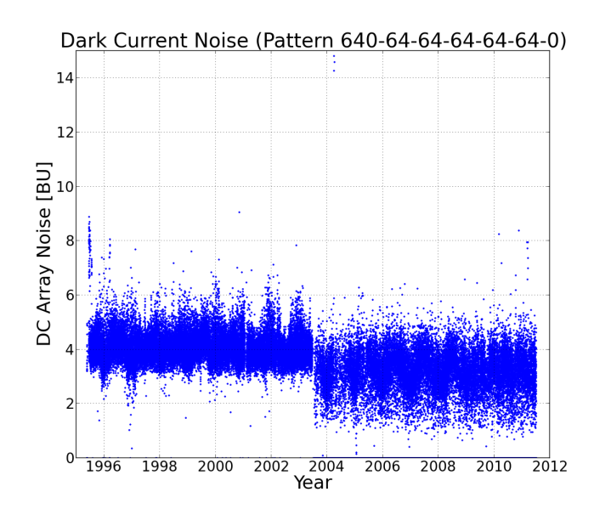
Dark Current Noise
Old
SAA
IT pattern: Scan IT pattern: LED IT pattern: Moon

Slide 16
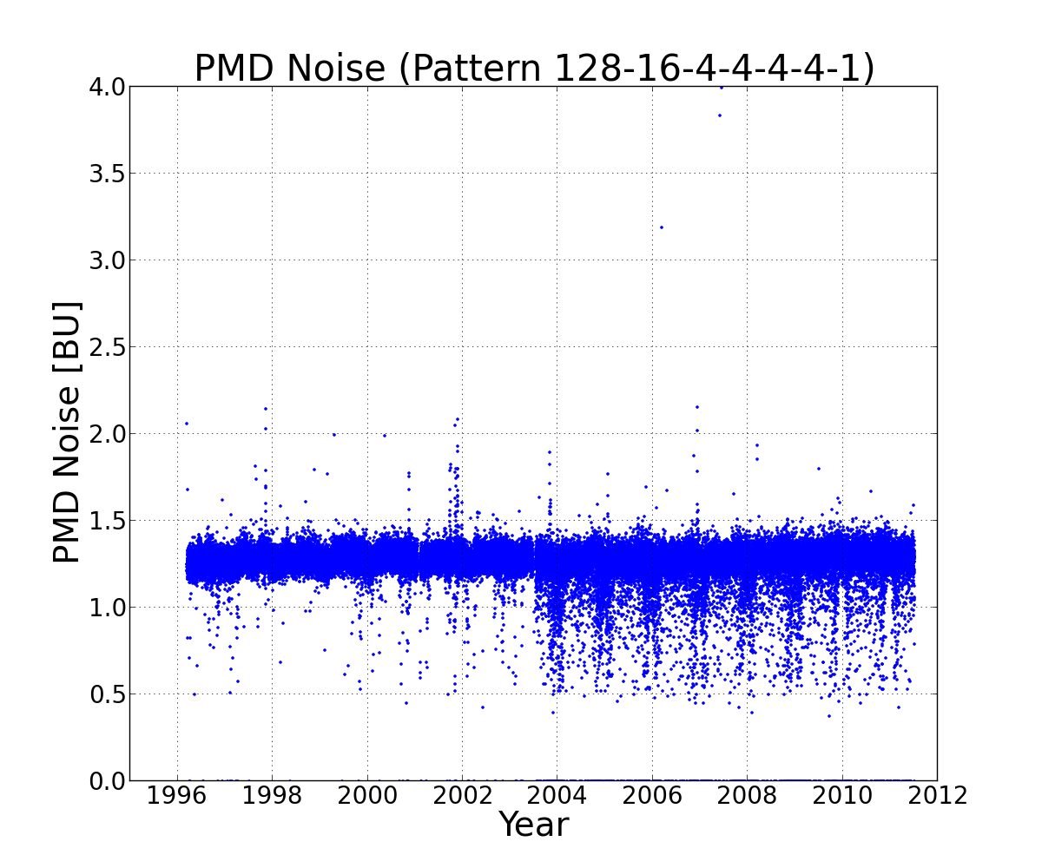
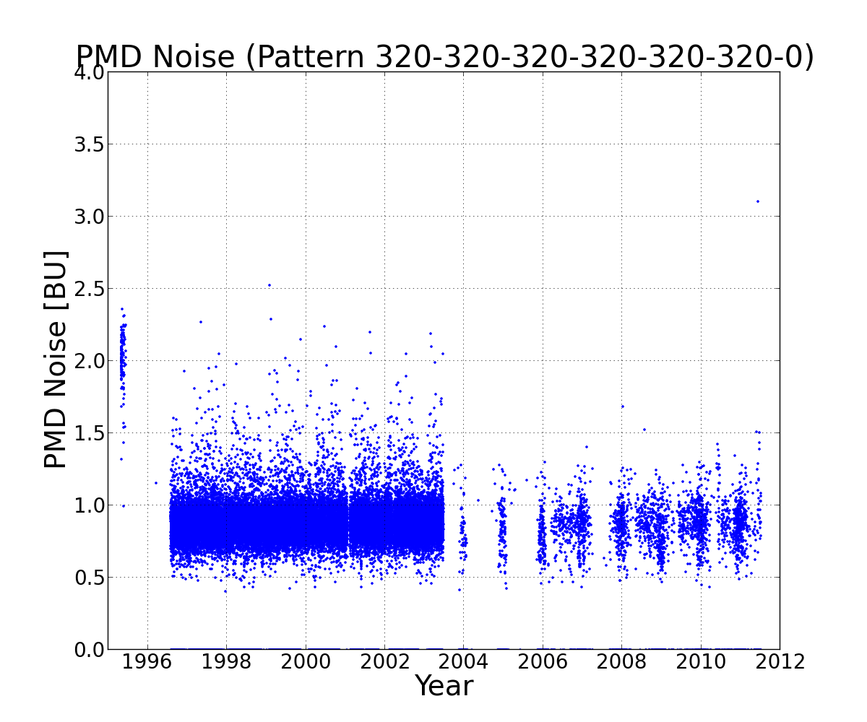
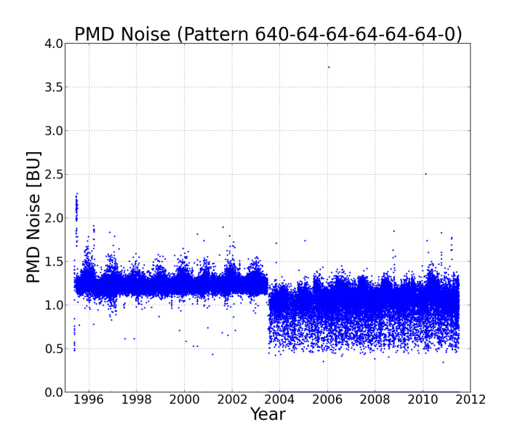
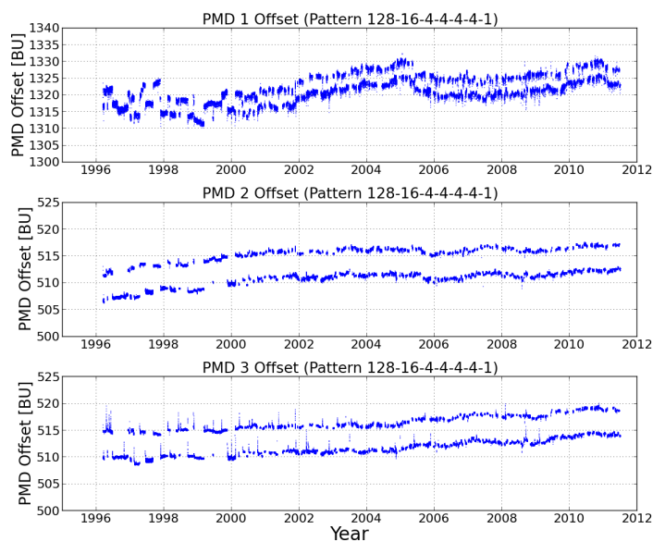
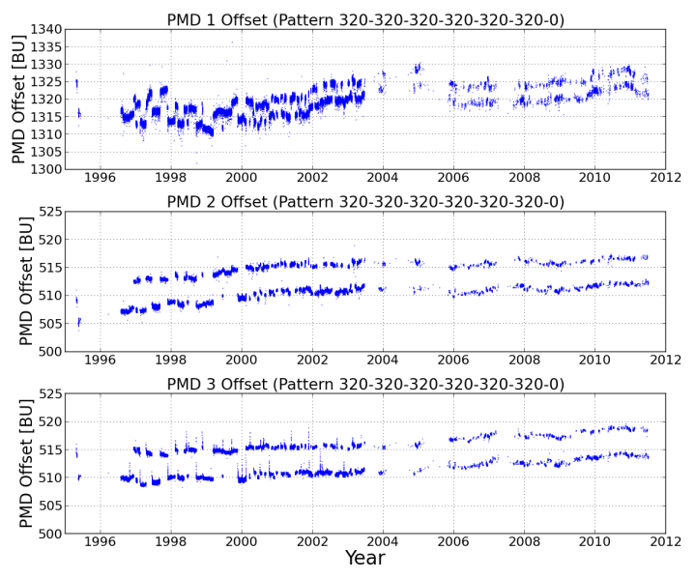
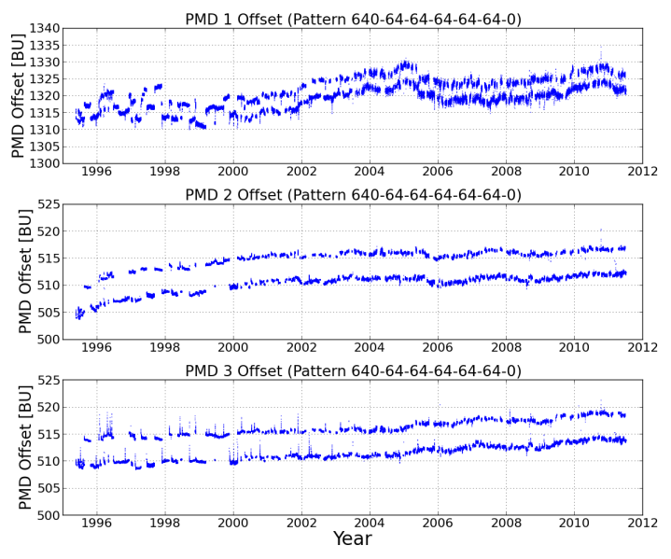
PMD Noise + Zero Offset
IT pattern: Scan IT pattern: LED IT pattern: Moon

Slide 17
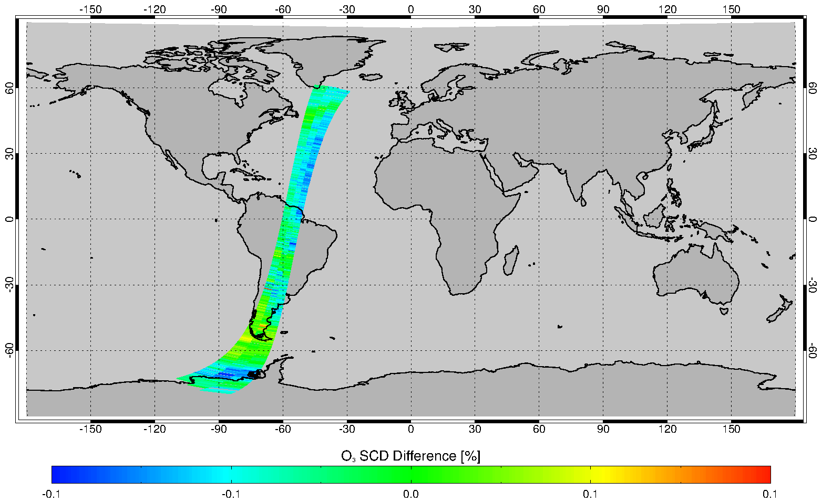
Assessing L1b via L2 Retrievals – DOAS
Oct. 01, 1997, orbit: 12804
GOME O₃ SCD difference
between new L1 and old L1 is very small (about -0.03%). DOAS fitting residual using new L1 improve at most situations (about 0.9%) compared to using old L1 data.
GOME NO₂ SCD difference between new L1 and old L1 is very small (about 0.07%). DOAS fitting residual using new L1 improve a little (about 1.0%) compared to using old L1 data.

Slide 18
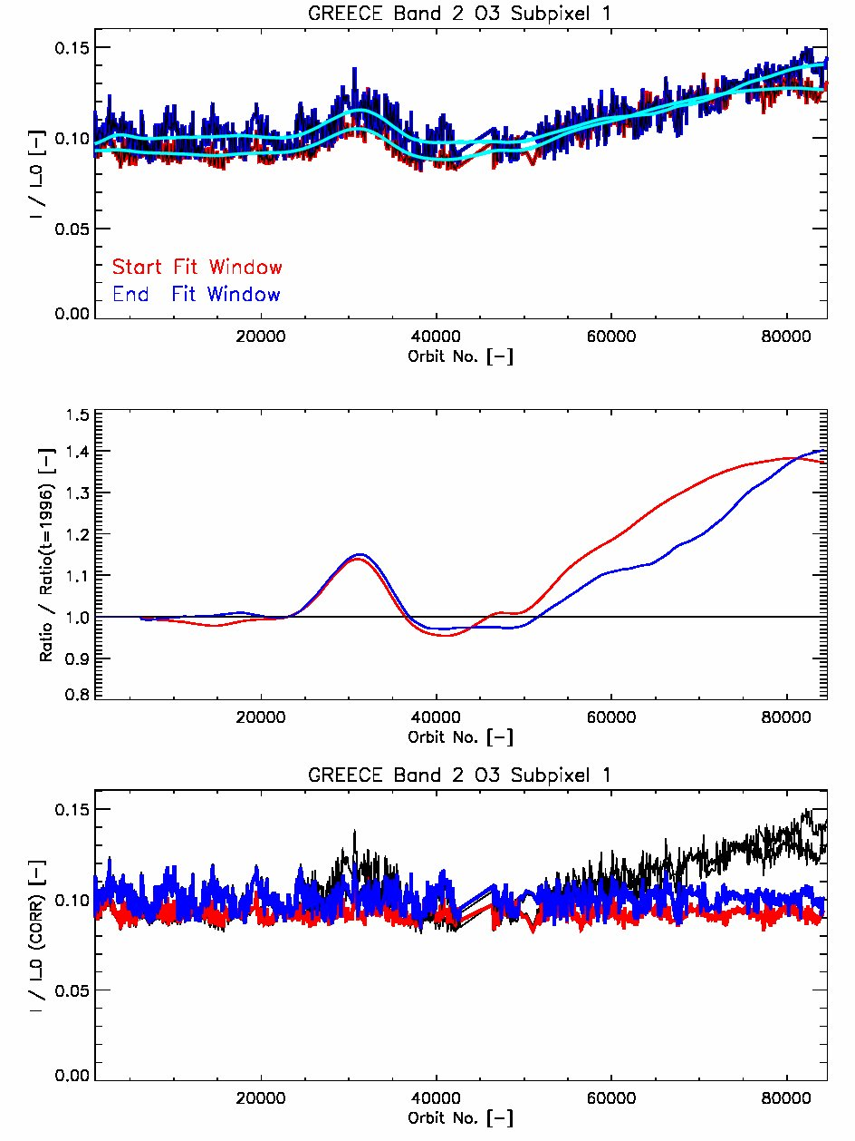
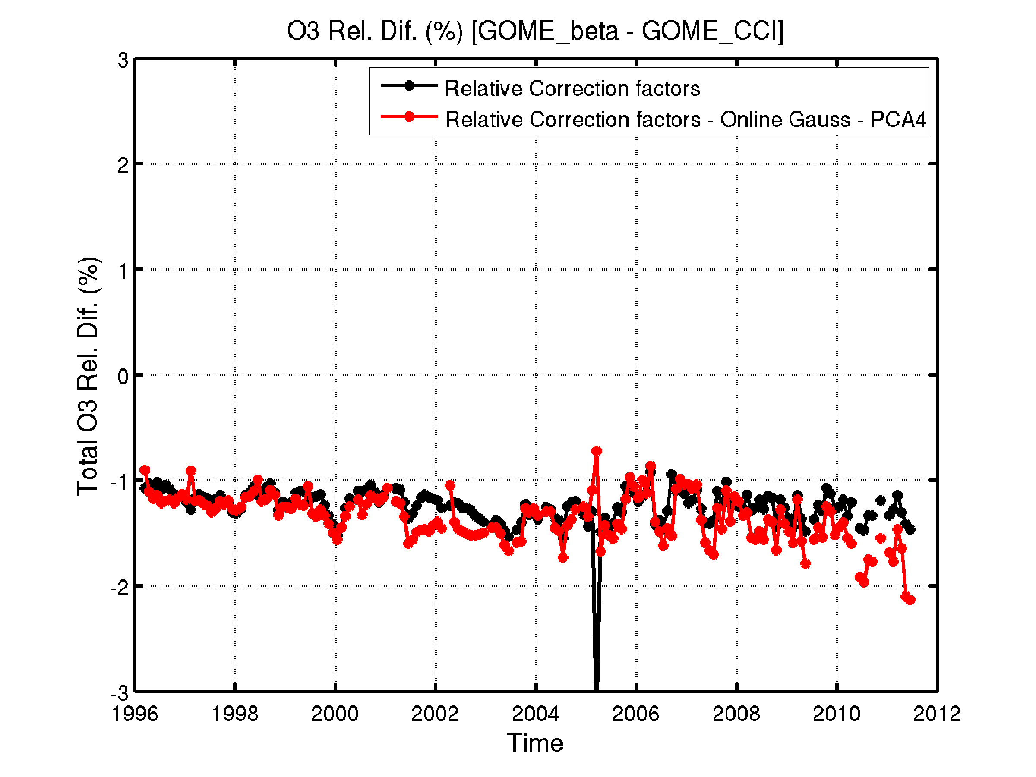
Assessing L1b via L2 Retrievals – GODFIT
Relative degradation 325-335nm
Courtesy C. Lerot (BIRA)
Reference sector: Mediterranean sea, clear sky

Slide 19
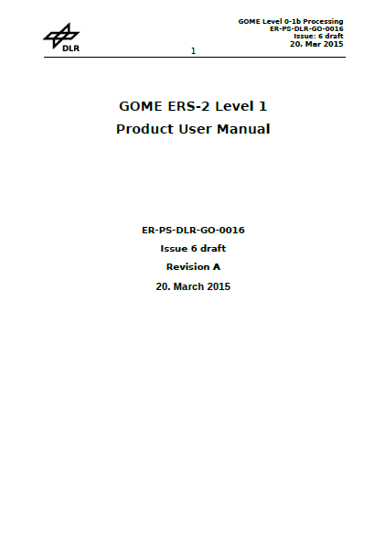
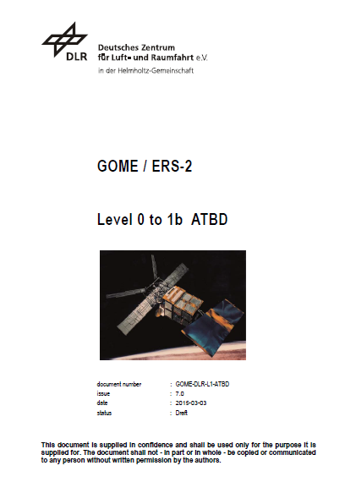
Product Harmonization – from GOME to Sentinels
Same netCDF CF format for all UVNS sensors
Nadir/Band-xy (Integration-time 1s or 0.5s)
Fillvalues
1s
1s
1s
0.5s
0.5s
0.5s
0.5s
0.5s
1s
1s
1s
4s

