Slide 1
Review of GPPA submission for Meteosat-MODIS VNIR GSICS products to enter Demo Phase
Special Issue of the IEEE TGRS on “Inter-Calibration of Satellite Instruments”:
Special Issue of the IEEE TGRS on “Inter-Calibration of Satellite Instruments”:
Tim Hewison
(EUMETSAT) (Outgoing GRWG Chair)

Slide 2
GPAF
Is fine
In fact, I think it’s all good to go to Demo status
All the following comments highlight areas that need to be resolved before promotion to Pre-Operational mode

Slide 3
GPPA General
For the sake of transparency and traceability:
Propose keeping GPAF and reviews online on Wiki
Could see who has reviewed which parts & when
Product names and documentation should include monitored instrument(s)
Sub-Group Chair should be involved in GPAT

Slide 4
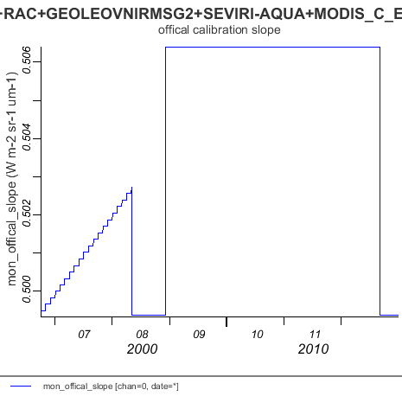
Sample netCDF product
Would like closer alignment with format of IR products – Masaya?
Should include uncertainty in mon_gain
Did mon_official_slope and mon_official_offset really change like this?

Slide 5
ATBD
Mostly minor comments
e.g.
“Target Instrument” = “Monitored Instrument”
Should be corrected to enter Demo mode
Applicability to Meteosat imagers not at 0E?
Should we force Seasonal Indices to be cyclic?
Make it clearer that mode of PDF is used (not mean)
Review Further Developments (Seb?):

Slide 6
Further Developments
Seasonal cycle observed with Meteosat-9 at 0E
currently removed by mathematical analysis the complete timeseries
better understanding needed to assess limitations of the method and its applicability to other reflective solar bands.
Sensitivity of the method to the BRDF model to correct to overhead sun should be assessed by implementing other BRDF models.
Finally, a complete uncertainty analysis still need to be performed prior to the release of operational GSICS inter-calibration products.
Method only applied to the channels around 0.6µm.
Applicability to other bands needs to be assessed.
Suomi NPP VIIRS will be considered instead of Aqua MODIS (for VIS0.8 band)
Blended GSICS products should be established.
Implies development of additional and complementary inter-calibration methods
And robust blending method to derive composite corrections with uncertainties

