Slide 1
Fast and Accurate Collocation of CrIS and VIIRS
Likun Wang^{1*}, Bin Zhang¹, Denis Tremblay², Yong Han³
1.* Univ. of Maryland, College Park, MD; Likun.Wang@noaa.gov
2. Science Data Processing Inc., Laurel, MD
3. NOAA/NESDIS/STAR, College Park, MD
2016 GSICS Annual Meeting, Japan

Slide 2
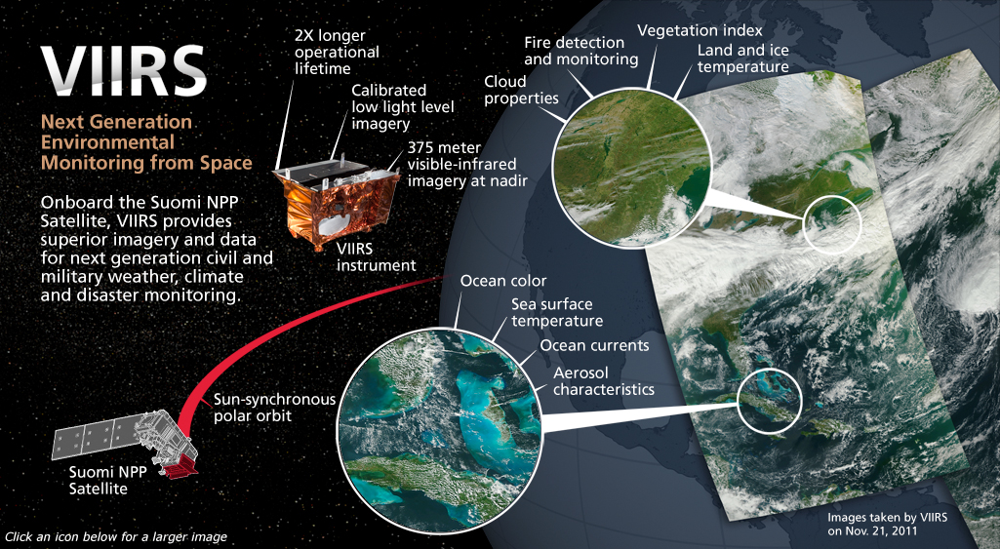
VIIRS Instrument
16 M-bands (750m); 5 I-Bands (375m); 1 DNB Band (750m)
Copied from Raytheon Website
Notes:
1) VIIRS provide imagery of the Earth Surface, it has very high resolution
1) 22 bands 3) all kinds of EDR, vegetation, land, cloud, ice, Aerosol

Slide 3
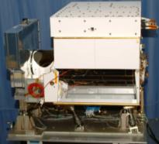
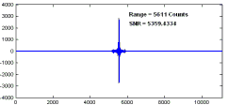
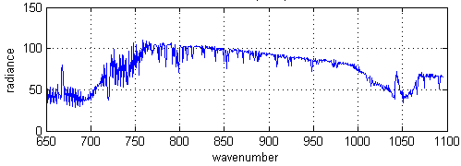
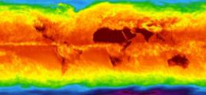
CrIS Operational Concept
CrIS on NPP
RDR = Raw Data Record
SDR = Sensor Data Record
EDR = Environmental Data Record
±50° Cross track Scans
Downlink
RDRs
RDRs
Decode Spacecraft Data
30 Earth Scenes
Interferograms
Ground Station
SDRs
2,200 km Swath
CrIS SDR Algorithm
Calibrated / Geolocated Spectra
3x3 Array of CrIS FOVs (Each at
14-km Diameter)
EDRs
Co-Located ATMS SDRs
NWP, EDR Applications
Global Temperature, Moisture, Pressure Profiles

Slide 4
Motivation
land surface
cloud properties
Combination of CrIS Spectra and VIIRS Products
NWP Data assimilations
Physical parameter retrievals
Inter-calibration
Providing sub-pixel information for CrIS observations using collocated high-spatial resolution VIIRS products

Slide 5
Outline
Using CrIS and VIIRS as an example to explore general issues on collocation of two satellite sensors
CrIS and VIIRS are two independent instruments, though on the same platform
Not like IASI and AVHRR on MetOp
No alignment requirements when design
Separate geolocation fields
Fast and accurate collocation algorithm suitable for operational use
Are CrIS and VIIRS perfect align together?
If not, collocated products can introduce errors and uncertainties, making data assimilation even worse.

Slide 6
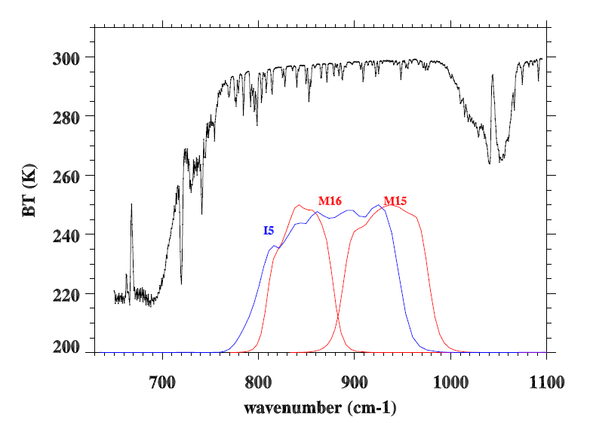
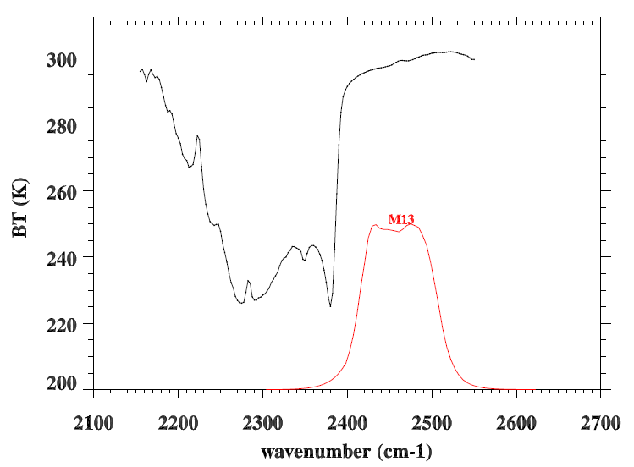
VIIRS vs. CrIS: Spectrally
CrIS spectra are overlapped with VIIRS SRFs for M13, M15, and M16, and I5
12.0 µm
10.8 µm
4.05 µm

Slide 7
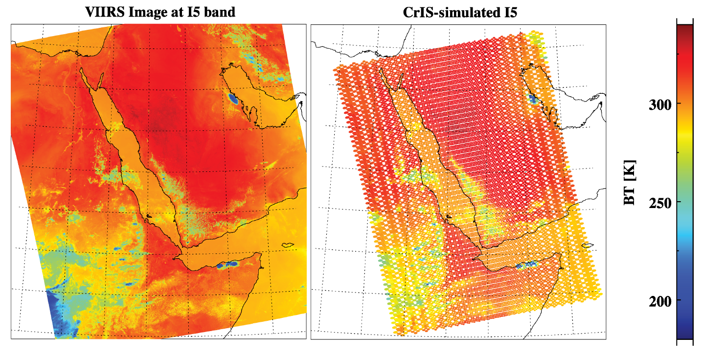
VIIRS vs. CrIS: Spatially
VIIRS I5 bands
CrIS at 900 cm⁻¹
Resolution: 375m (I) or 750m (M) 14.0km nadir
Scan Angle: 58.3° 48.3 °
Sampling: Continuous Sub-sample

Slide 8
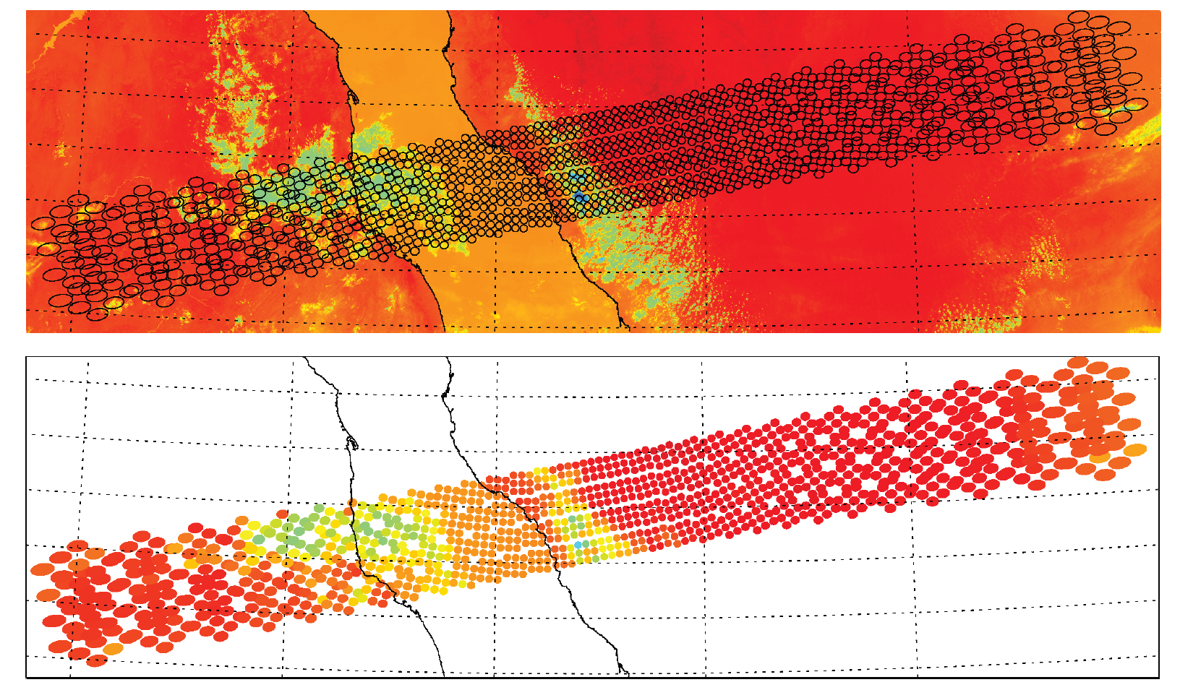
Collocation of CrIS with VIIRS
CrIS Footprints
Collocation of the measurements from two satellite sensors (either on the same satellite platform or not) involves pairing measurements from two sensors that observe the same location on the Earth but with different spatial resolutions.
CrIS Footprints
overlapped with
VIIRS image
It is challenging to do it on the Earth Surface using latitude and longitude.
1) Footprint rotation and distortion off nadir; 2) Searching! Searching! Searching!

Slide 9
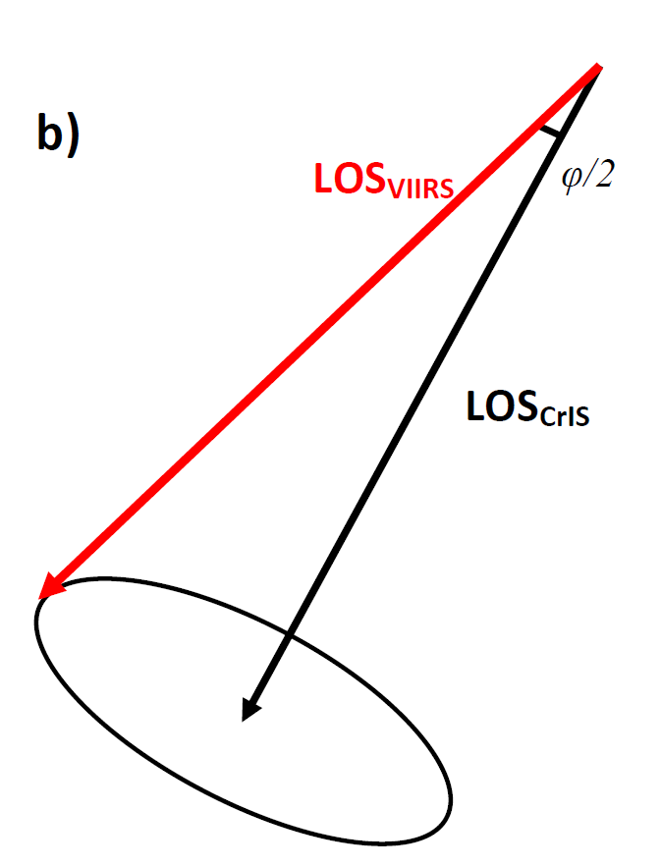
Collocation of CrIS with VIIRS Using line-of-sight vector
It is better to collocate CrIS and VIIRS in space instead of on the Earth Surface
If we can retrieve line-of-sight vector of CrIS and VIIRS
The collocation of VIIRS and CrIS can be simplified as examining the angles between two vectors.
No worry about FOV distortion

Slide 10
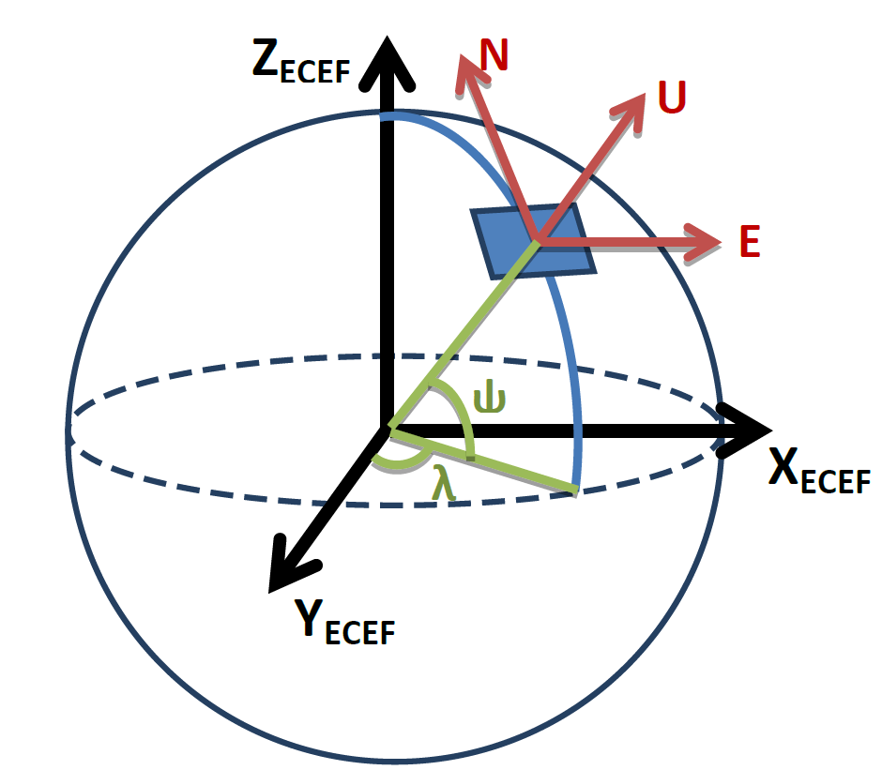
Retrieve LOS Vectors
Azimuth, Zenith, Range in Local Spherical Coordinate
(East, North, Up) in meter in Local East, North, Up (ENU) Coordinate
Geodetic Latitude, Longitude, and Altitude (LLA) Coordinate
Earth-centered, earth-fixed (ECEF) Coordinate

Slide 11
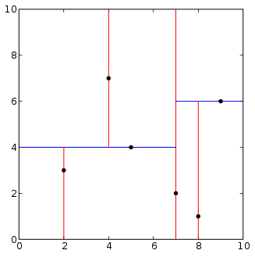
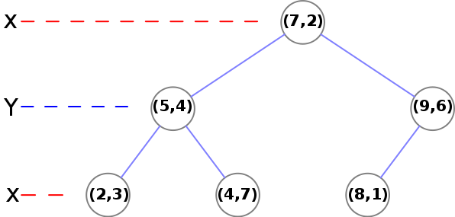
K-D Tree Search
In computer science, a k-d tree (short for k-dimensional tree) is a space-partitioning data structure for organizing points in a k-dimensional space.
 | Average | Worst case
Search | O(log n) | O(n)

Slide 12
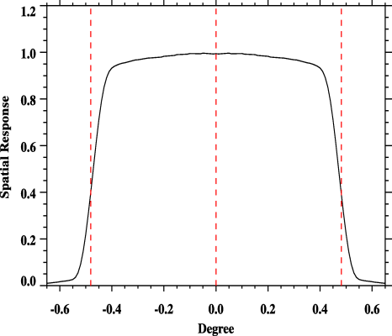
CrIS Spatial Response Function
Ideally, VIIRS images should be convolved with CrIS spatial response function.
CrIS detector response function: a cutoff value of ±0.963°/2 (14.0 km at nadir) is about 41.19% to its peak value but already collects 98% of total radiation falling on the detector.
The box-car spatial response is good enough to represent the real CrIS spatial response.
0.963° 14.0km
VIIRS (Box Car Average) - (Spatial Response Convolution): ~0.0023K

Slide 13
CrIS-VIIRS BT Diff. Map
Descending
Ascending
Large diff. can be seen at the end of scan

Slide 14
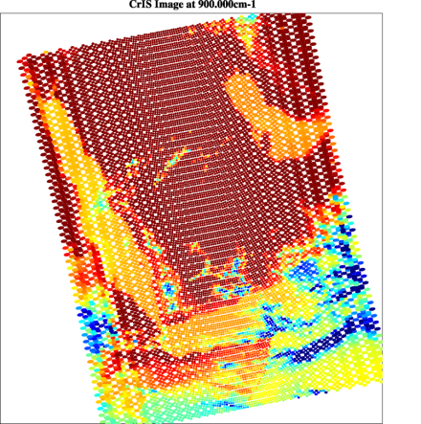
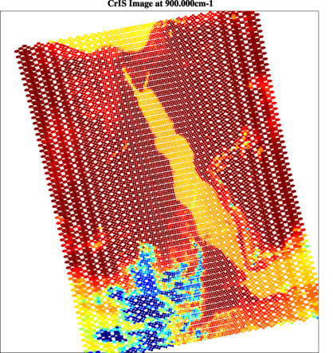
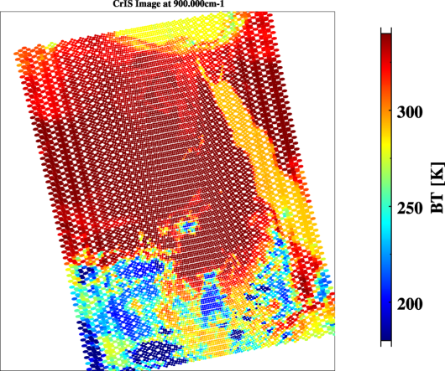
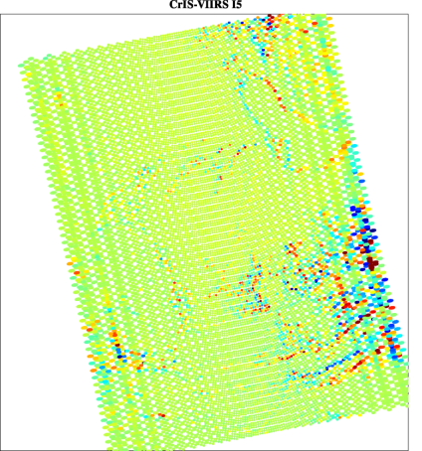
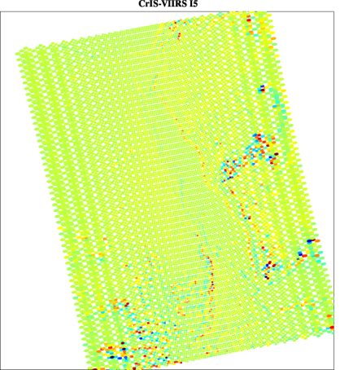
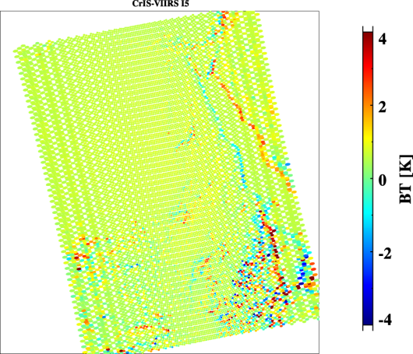
Misalignment between CrIS and VIIRS at the end of scan

Slide 15
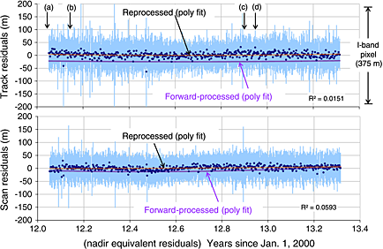
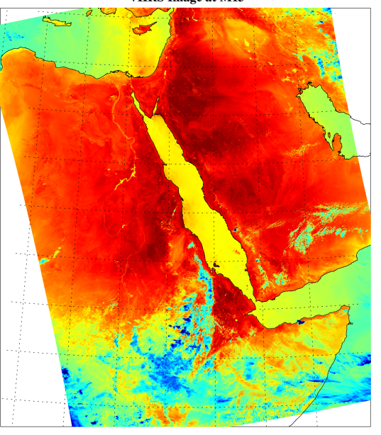
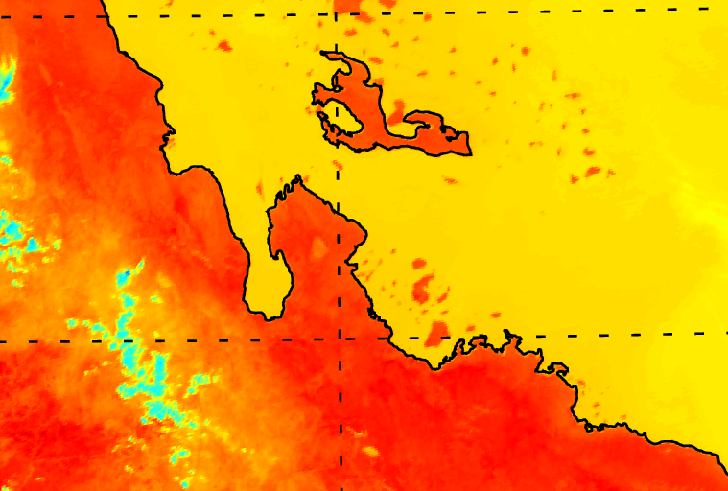
VIIRS Geolocation Very Accurate ! (I5 band: 375m resolution)
Wolf et al. 2013
from Wolf et al. 2013
Table 2. VIIRS Geolocation Accuracy
Residuals | First Update | Second Update
 | 23 February 2012 | 18 April 2013
Track mean | −24 m, −7% | 2 m, 1%
Scan mean | −8 m, −2% | 2 m, 1%
Track RMSE | 75 m, 20% | 70 m, 19%
Scan RMSE | 62 m, 17% | 60 m, 16%

Slide 16
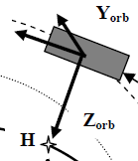
CrIS Geolocation Assessment Using VIIRS as a reference
The misalignment between CrIS and VIIRS can be caused by the CrIS geolocation error.
Can we use VIIRS as a reference to check CrIS geolocation accuracy?
The purpose is to identify the error characteristics of CrIS LOS pointing vector by comparing them with the truth.
Furthermore, if the systematic errors are found, a new set of co-alignment parameters should be retrieved based on assessment results to improve the geolocation accuracy.
Satellite
VIIRS (Truth)
CrIS
Earth Ellipsoid

Slide 17
Overview of NPP/JPSS
Geolocation Algorithms
CrIS (or other instrument)
JPSS or any satellite
Coordinate transformation
Common GEO
Interferometer
Spacecraft
SSM
Orbital
Sensor Isolation
system
Function call to common geo:
ellipIntersect(outPt,inst2SC,exitVec, dlat,lon,satazm,satzen,range)
ECI
ECEF(ECR)
Spacecraft
Geodetic
feedback
GEOLOCATION Assessment
ADCS
Geolocate each FOV
GCP/Maps/Ground truth
the other instrument measurements with enough geolocation accuracy
Comparing the truth and CrIS Geo fields
Pos/Vel/Quaternion (RPY)
Attitude Determination & Control System (ADCS)
SGP4
Modified from C. Cao

Slide 18
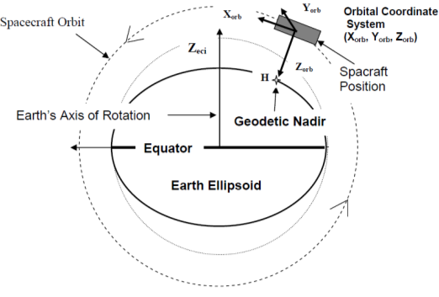
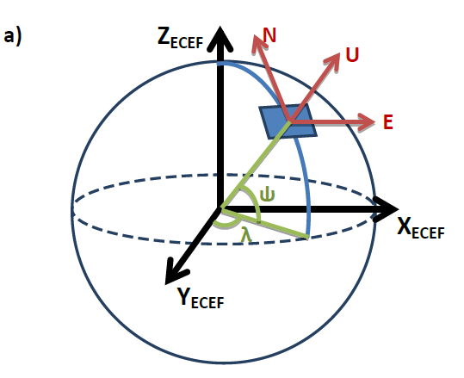
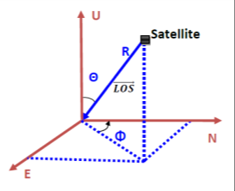
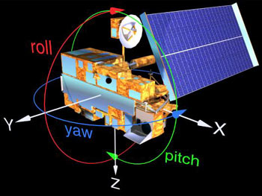
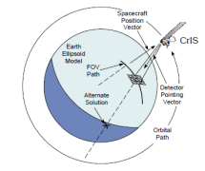
Retrieved the CrIS LOS vector relative to Spacecraft
LOS vector in S/C
(satellite Pitch, Roll, and Yaw angle)
Geolocation Fields
(satellite range, azimuth, and zenith angle)
LOS vector in ECEF or ECR
(lat , Lon)
LOS vector in orbit frame
(satellite velocity, geodetic nadir)
+
Triad Method
Satellite
the Earth

Slide 19
Defining α and β angles of CrIS LOS vector in Spacecraft Coordinate
Y: CrossTrack
X: InTrack
β = atan(y/z)
α = atan(x/z)
Z: from satellite Pointing Earth Surface
P: unit vector of LOS in SBF (x, y, z)
Notes:
1) Spacecraft coordinates forms two planes: satellite in-track planes and cross-track planes. 2) LOS vectors projected onto these two planes; 3) two angels can be defined: alpha and beta, which exactly corresponds to LOS; 4) When alpha and beta changes, LOS vector is also changed. 5) The whole idea is to change alpha and beta and find the true LOS relative to VIIRS.

Slide 20
α and β Angles varying with Scan Position (FOV5)
β
α
Noted that the yaw patterns of α angles are caused by the Earth Rotation
when retrieving them in ECEF.

Slide 21
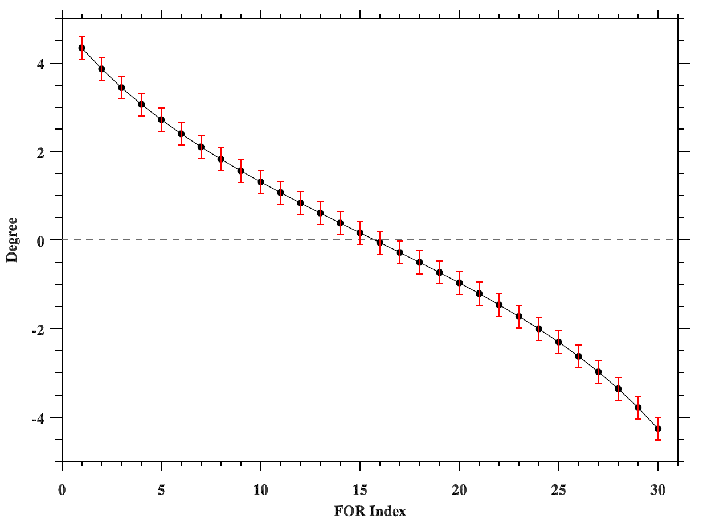
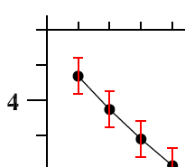
α and β angles are step-by-step perturbed by 21 steps with a angle of 375/833/1000.0
α

Slide 22
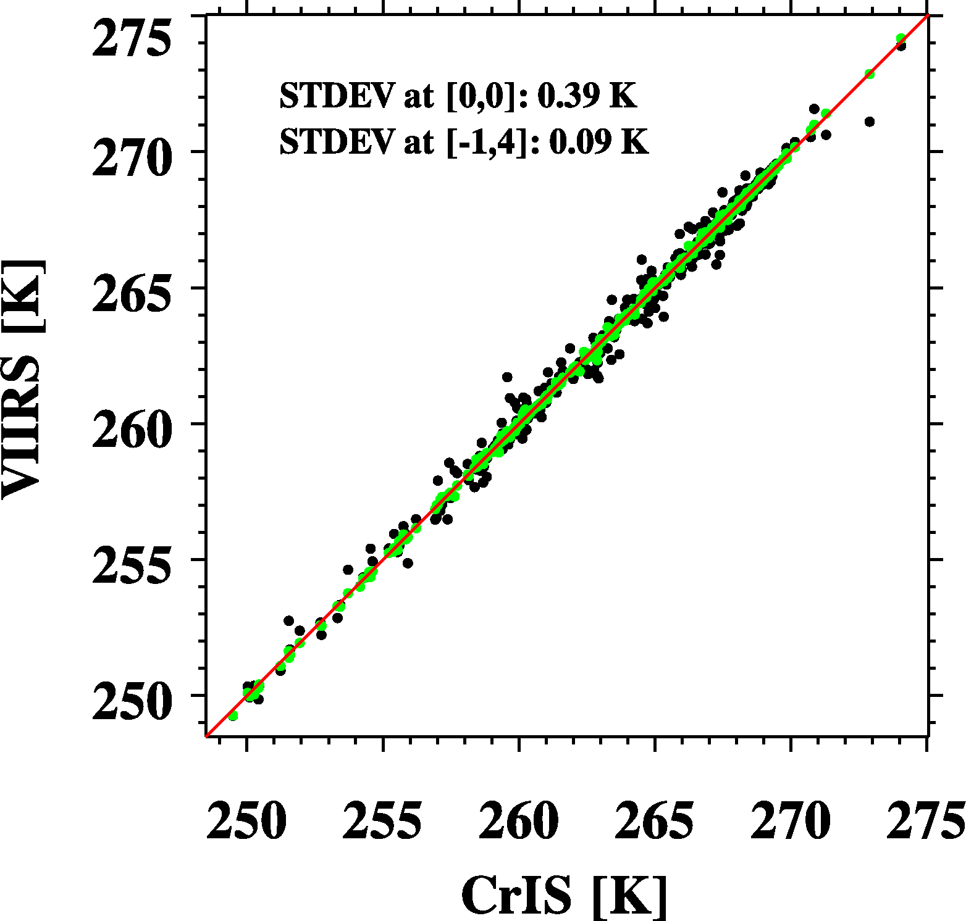
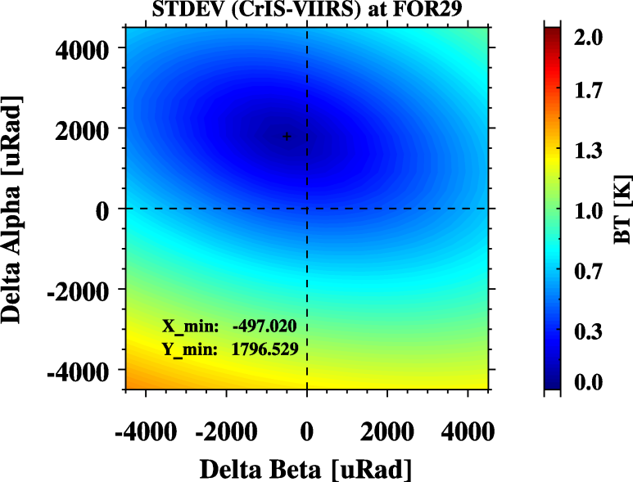
Using VIIRS to find best collocation position
FOR 30

Slide 23
Flowchart for VIIRS-CrIS Alignment Check
CrIS Geo. Field
CrIS LOS Vector in ECEF
Produce new CrIS LOS vector in SBF
Convert CrIS LOS vector into ECEF
Collocate VIIRS and CrIS
Output Collocated Results
Perturb α and β angles with small angles
CrIS Sat_P and V in ECEF
Loop by 21x21
steps
VIIRS Geo. Field
Compute LOS Vector in
Orbit Frame
VIIRS Vector in ECEF
Compute LOS Vector in S/C Frame

Slide 24
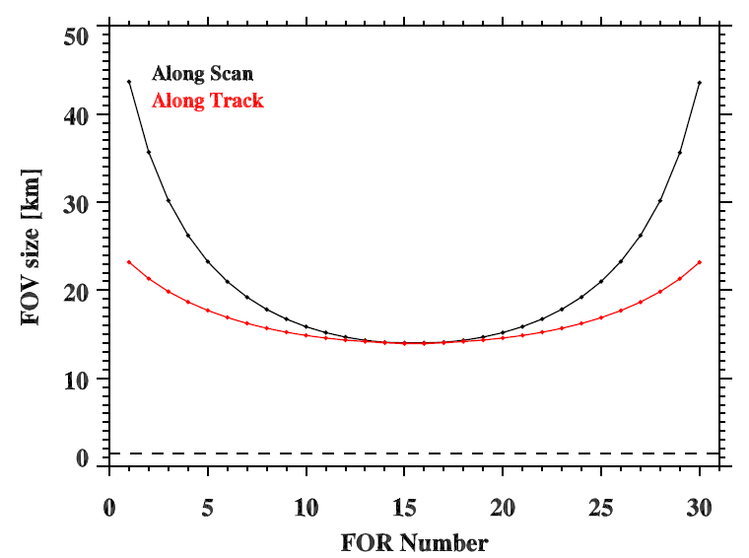
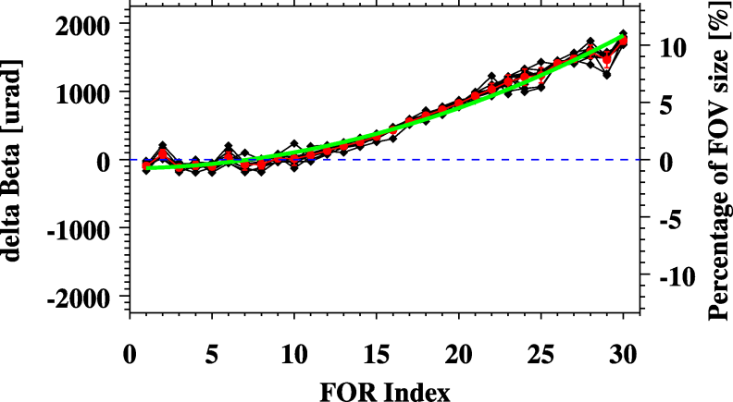
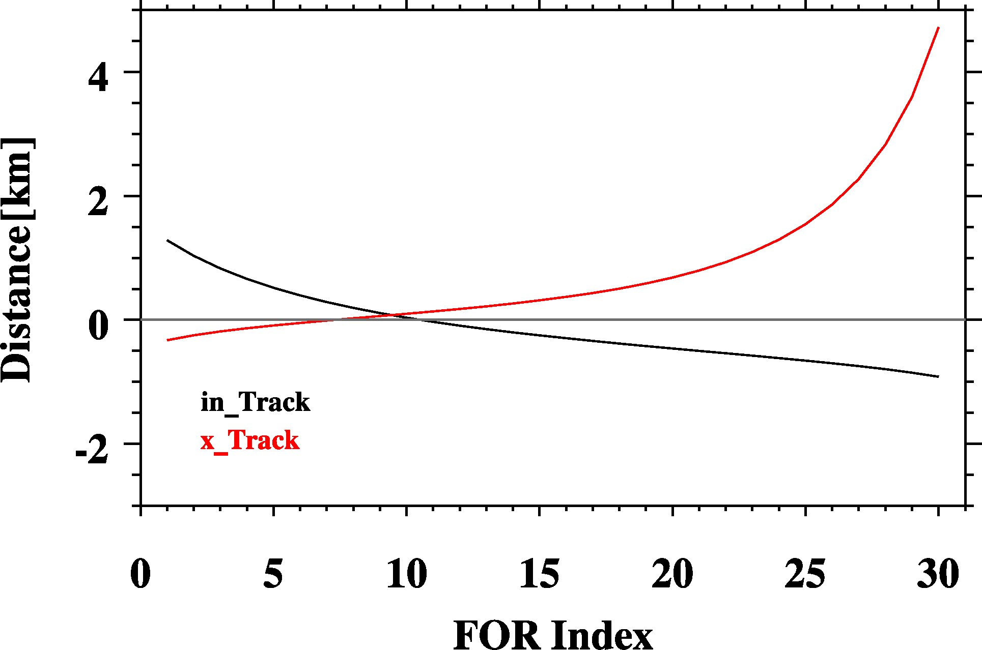
IDPS Data Geolocation Performance
CrIS FOV size in-track and cross-track direction
in-track direction
cross-track direction
This is root cause of misalignment between CrIS and VIIRS.
Notes:
Slow, point out the figures at left.

Slide 25
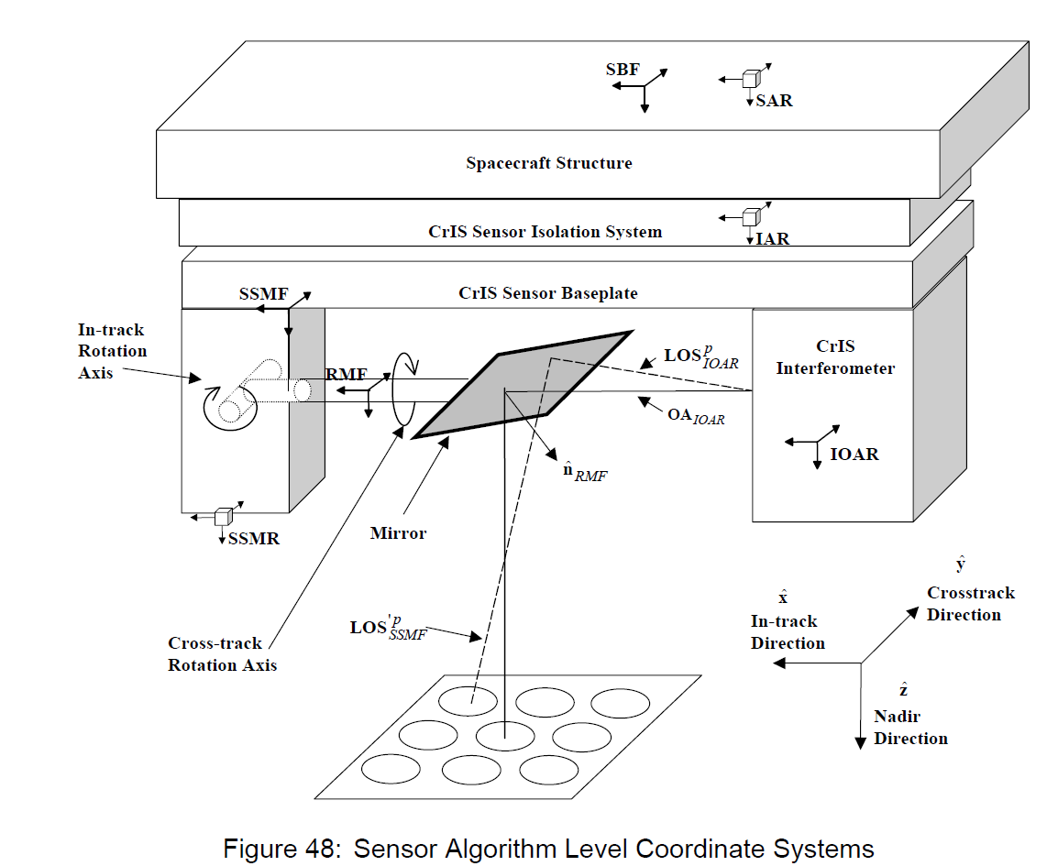
New Geometric Parameters
SDR Algorithm Process
LOS in IOAR coordinate = ILS parameters (3x3)
Convert from IOAR to SSMF coordinate (2 angles)
3) Compute normal to SSM mirror in SSMF (30 Scan Pos) (60 angles)
4) Apply SSM mirror rotation to get LOS in SSMF coordinate
5) Convert from SSMF to SSMR coordinate (3 angles)
6) Convert from SSMR to IAR coordinate (3 angles)
7) Convert from IAR to SAR (3 angles)
8) From SAR=> SBF coordinate (0 angels)
9) From SBF=> Spacecraft (3 angles)
Given the assessment results with 60 angles,
the best strategy is to retrieve 60 scan mirror
rotation angles.
Notes:
This part needs not to be detailed.

Slide 26
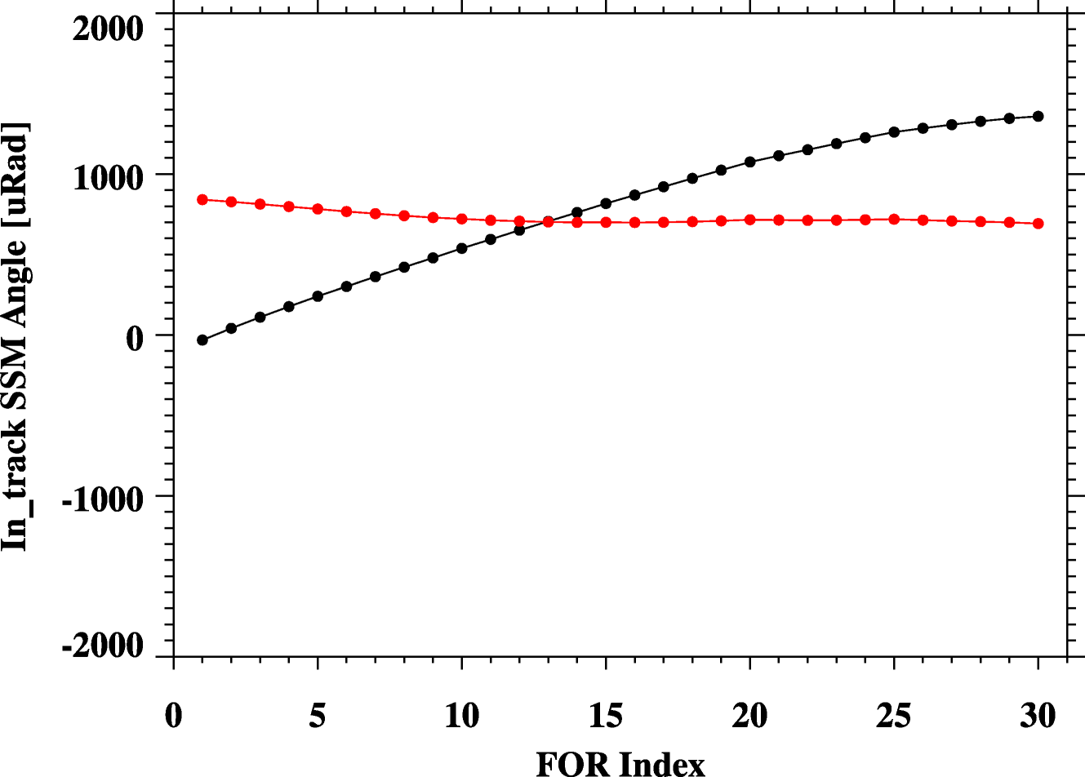
New SSMF In-track Angles
New Values
Values in EngPKT

Slide 27
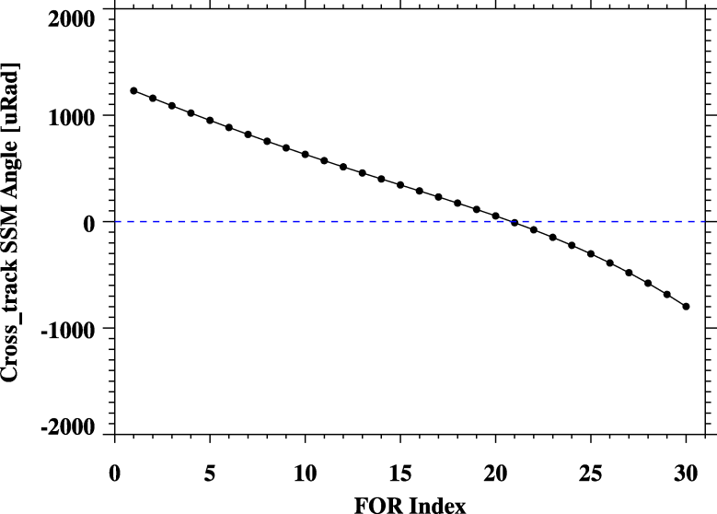
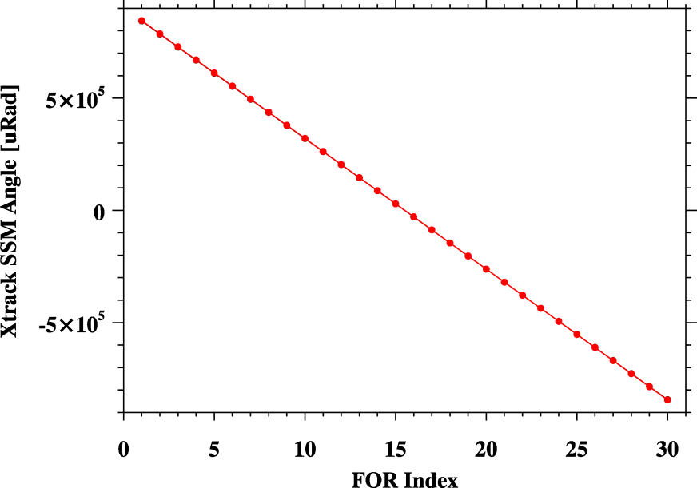
Retrieved SSMF Cross-track Angles
New -EngPKT
New Values
Values in EngPKT

Slide 28
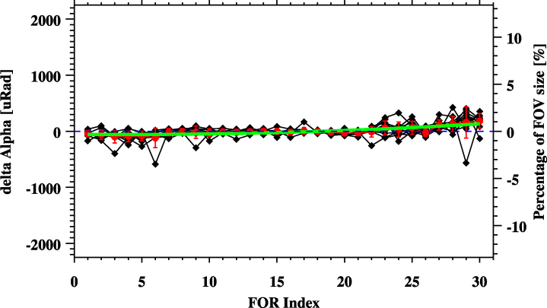
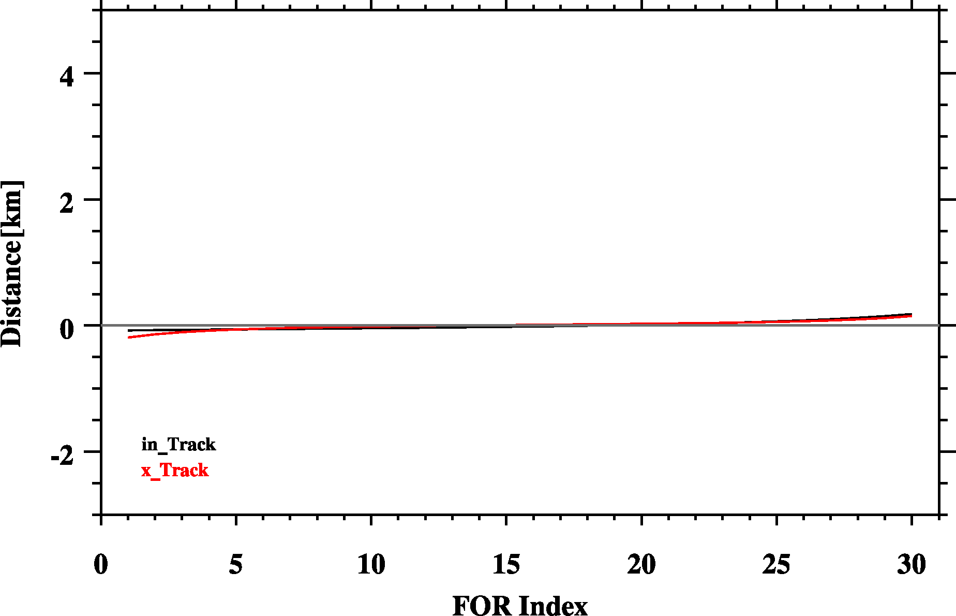
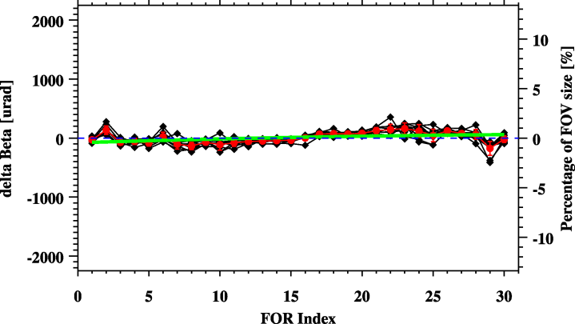
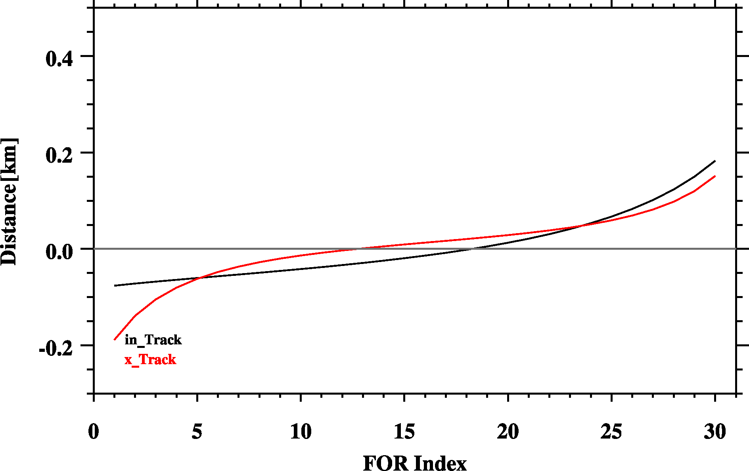
Geolocation Performance (New Parameters)
in-track direction
cross-track direction
Zoom in

Slide 29
Only correct cross-track direction

Slide 30
correct cross-track and in-track Direction

Slide 31
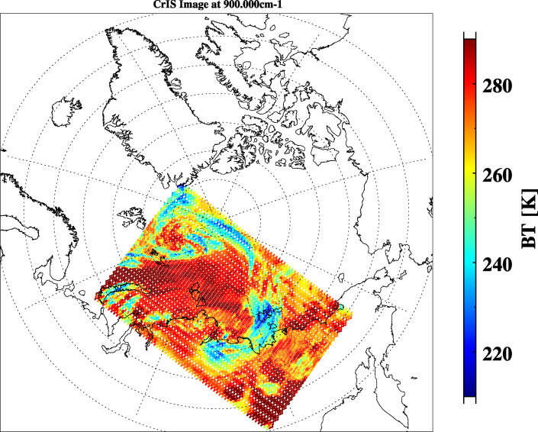
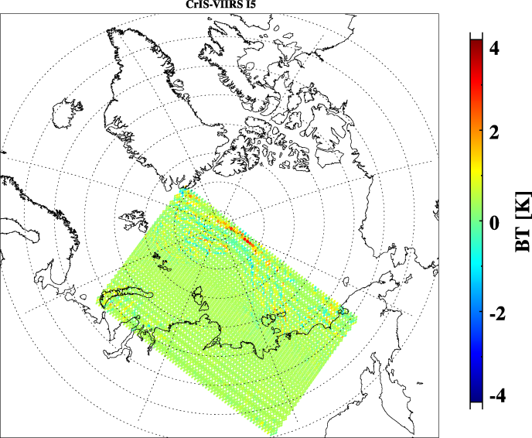
Another Validation Case
Polar Region
CrIS-VIIRS I5 image
IDPS
New Codes + New EngPkt

Slide 32
Conclusion
Line-of-sight based collocation to avoid FOV distortion
K-D tree based-search to speed up program
CrIS geolocation has been adjusted to perfectly align with VIIRS.
The method can work for other two sensors on different platform also.

