Slide 1
2016 GSICS Annual Meeting (29 Feb ~ 4 Mar 2016 )@ Tsukuba, Japan
KMA Agency Report
NMSC/KMA

Slide 2
Current Status of KMA
Visible channel
Operate vicarious calibration system using targets on the Earth
Keep studying the moon targets for vicarious calibration
Infrared channel
Operate GSICS GEO-LEO Inter-calibration system
→ using IASI-A, IASI-B, AIRS and CrIS
Investigate the cold bias correction in WV with SRF correction
Preparation for the Demonstration Phase
Prepare to enter the Demonstration Phase of the GSICS Procedure for Product Acceptance

Slide 3
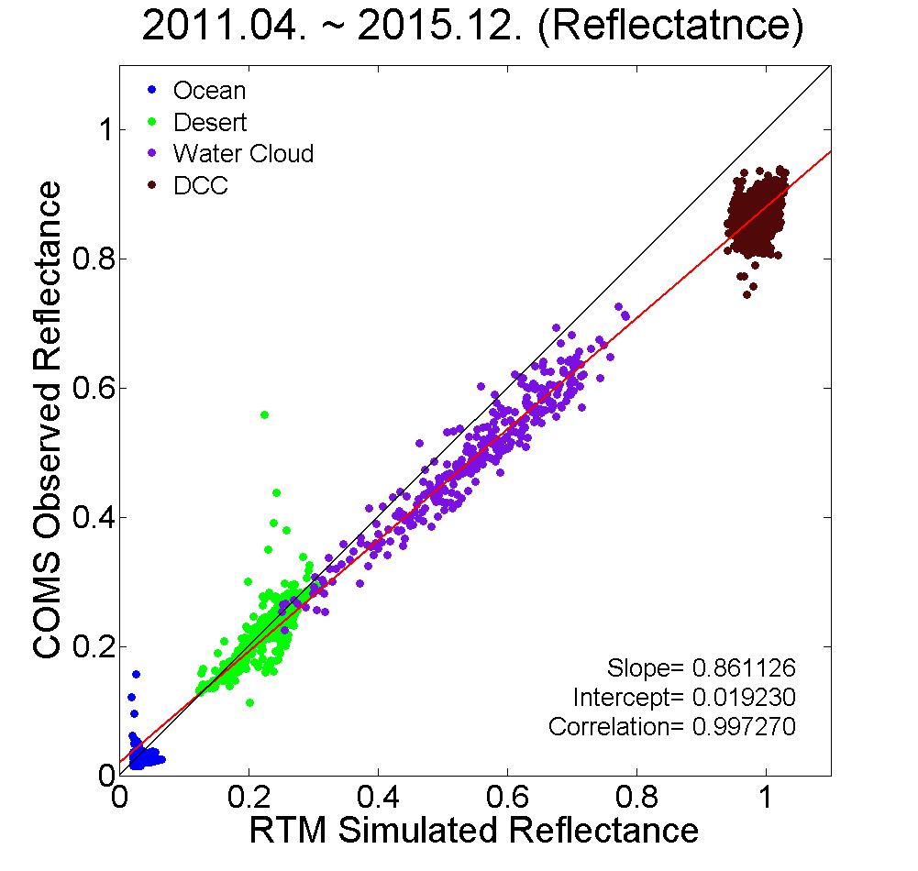
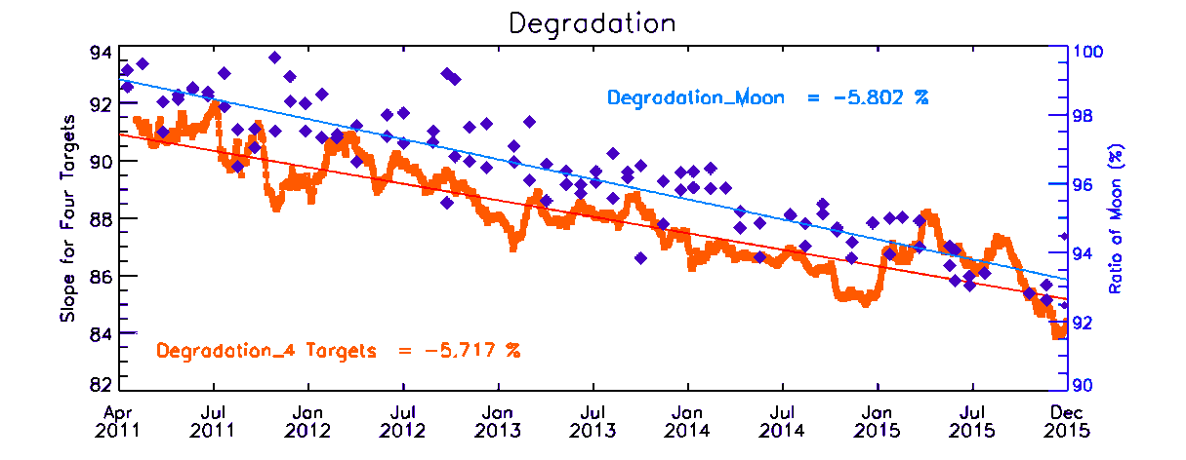
Visible Channel
a scatter plot for 30 days data
get a slope/intercept
trend of slope for long period
Scatter plot
using ocean/desert/WC/DCC
Time series of slopes and intercepts
Ocean
Desert
Water Cloud
DCC
DCC
Water Cloud
Results of Moon and DCC (RTM)
Desert
Ocean
Slope(moon)=-5.802%
for all data until now
slope= 0.861
intercept= 0.019
Slope(4 targets)=-5.717%

Slide 4
Visible Channel (DCC and Moon)
Visible Calibration by Lunar, DCC(RTM and NASA method)
In 102 cases of COMS lunar observation
Result from DCC target is consistent with other target data, making linear regression line with high correlation
Comparison with Lunar, DCC(RTM) and DCC(NASA method)
Results of Lunar, DCC(RTM) and DCC(NASA method)
Moon : 1.2318/year, DCC(RTM) : 1.1689/year from April 2011 ~ December 2015
DCC(NASA): 0.9757/year from April 2011 ~ December 2013
Need more investigation for the DCC result with NASA method

Slide 5
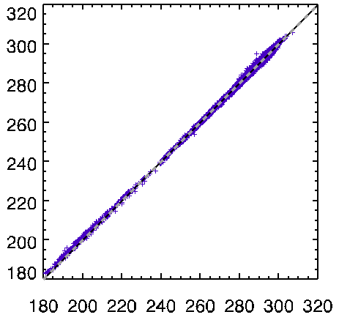
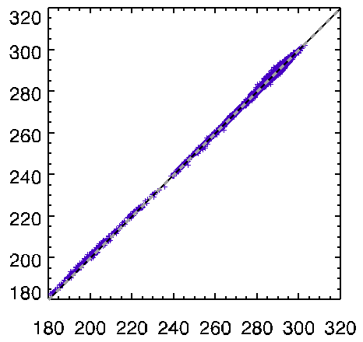
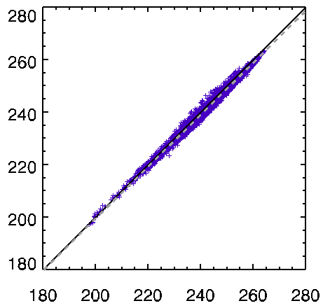
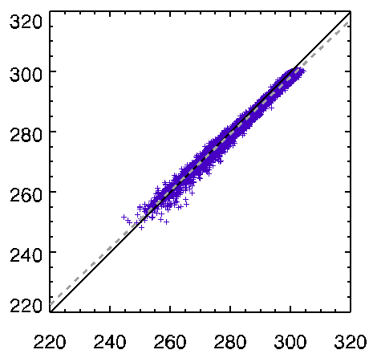
LEO(CrIS) TB vs. GEO TB
check the TB bias for each IR channels
period: CrIS(Jan. 2014 - Dec. 2015)
IR1(10.8μm)
IR2(12.0 μm)
COMS TB (K)
WV(6.8μm)
SWIR(3.8μm)
In SWIR of CrIS, large bias due to much shorter spectral coverage of MI broadband
COMS TB (K)
LEO TB (K)
LEO TB (K)

Slide 6
Monthly variation of TB Bias & RMSE
monthly variation of TB bias and RMSE
period: AIRS IASI-A (April 2011 - Dec. 2015) IASI-B (Aug. 2013 - Dec. 2015) CrIS(Jan. 2014 - Dec. 2015)
AIRS IASI-A IASI-B CrIS
TB Bias (COMS-LEO)
TB RMSE
Double Diff.(IASI/A TB bias- IASI/B TB bias)
Mean bias -0.0208
IR1
IR1
IR1
Mean bias -0.0283
IR2
IR2
IR2
WV
WV
Mean bias 0.0142
WV
SWIR
Mean bias 0.0088
SWIR
SWIR

Slide 7
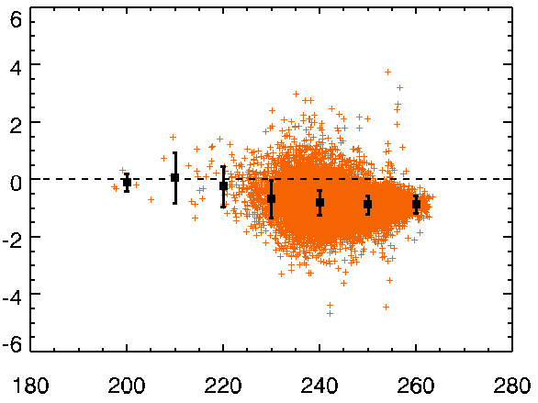
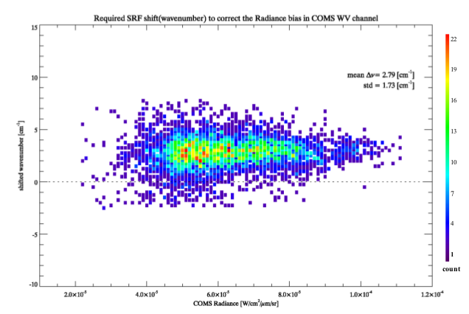
Infrared Channel(WV anomaly-1)
IASI WV SRF +2.8 cm⁻¹ shift
Currently, check the trend of TB bias for WV
Large negative bias for warm temperature
Period: Jan. 2014 - Dec. 2014
For estimated shift of the SRF center position, match the band averaged radiance from IASI and COMS/MI radiance
SRF shift : 2.79±1.73 cm⁻¹
Period: April. 2011 - Jan.2012 (16 different days including four seasons)
WV(6.7μm)
TB Bias(COMS-LEO) (K)
Bias=-0.8373
RMSE=0.4211
Shifted SRF [cm⁻¹]
COMS TB (K)
COMS Radiance [Wm⁻²sr⁻¹μm⁻¹]
< Two Methods>
1) Original MI + IASI(SRF shifted by +2.8cm⁻¹ shift)
2) (SRF) Corrected MI + IASI(SRF shifted by +3.4cm⁻¹ shift)
*Refrence: Myoung-Hwan Ahn, Su Jeong Lee, Dohyeong Kim “Estimation of uncertainties in the spectral response function of the water vapor channel of a meteorological imager”, Proc. SPIE, 2015

Slide 8
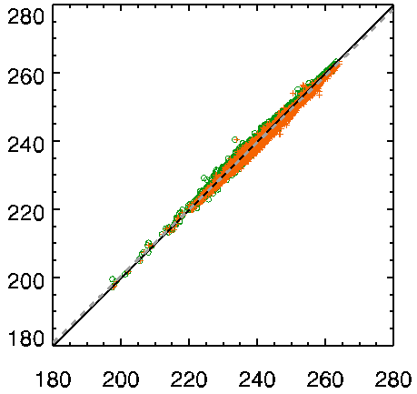
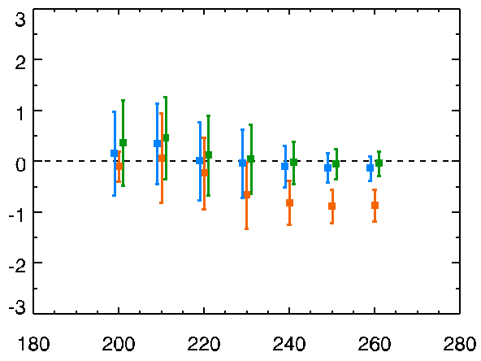
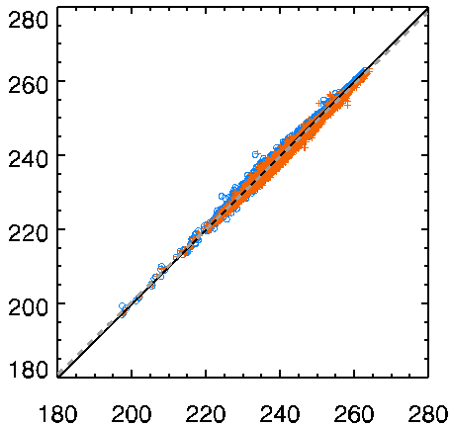
Infrared Channel(WV anomaly-2)
Result of IASI SRF shift and the trend of TB bias for WV
Period: Jan. 01.2014 - Dec.12.2014
Slop 0.9817 0.9837
Inter. 3.6385 3.9394
Original : Original MI + Original IASI
Method1 : Original MI + IASI SRF shifted by +2.8cm⁻¹
Method2 : Corrected MI + IASI SRF shifted by +3.4cm⁻¹
COMS TB (K)
WV(6.7μm)
+ IASI o IASI_2.8
Bias -0.8307 -0.0277
RMSE 0.4112 0.3905
Slop 0.9817 0.9846
Inter. 3.6385 3.6457
TB Bias(COMS-LEO) (K)
COMS TB (K)
IASI IASI_2.8 IASI_3.4
Bias -0.8307 -0.0277 -0.1051
RMSE 0.4112 0.3905 0.3882
+ IASI o IASI_3.4
Bias -0.8307 -0.1051
RMSE 0.4112 0.3882
COMS TB (K)
LEO TB (K)

Slide 9
Infrared Channel (summary)
GSICS GEO-LEO Inter-calibration for COMS IR channels
Period : AIRS, IASI-A(April 2011 - Dec. 2015), IASI-B(Aug. 2013 - Dec. 2015), CrIS(Jan. 2014 - Dec. 2015)
TB bias : IR1< 0.13K, IR2<0.02K and IR3<-1.0K(<0.1 after correction)
TB bias of CrIS show the smallest(0.03K, -0.01K) among four instruments for IR1 and IR2
SWIR of CrIS shows systematic uncertainties due to its much shorter spectral coverage of MI broadband
Investigate SRF shift (+2.8cm⁻¹) to correct the large negative bias of WV channel
Seasonal variation : the same pattern between AIRS and CrIS
TB bias has two peaks around March and Sep.-Oct.
Diurnal variation : At the local midnight, the biases of all four IR channels shows gradual increasing patterns which may be caused by midnight effect
Investigate MBCC effect on the IR channels
Results of GSICS are displayed on KMA’s homepage http://nmsc.kma.go.kr/html/homepage/en/gsics/gsicsMain.do

Slide 10
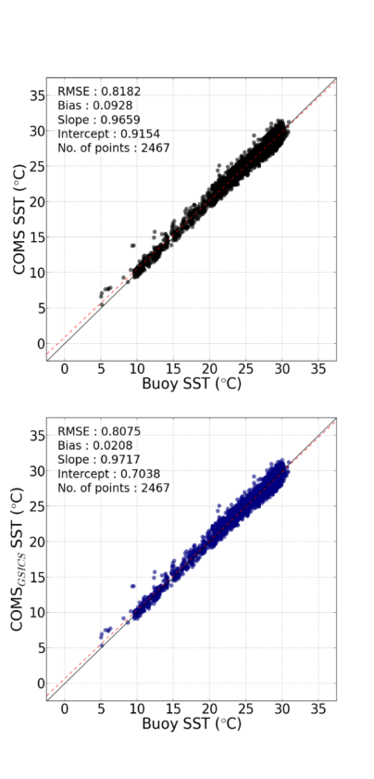
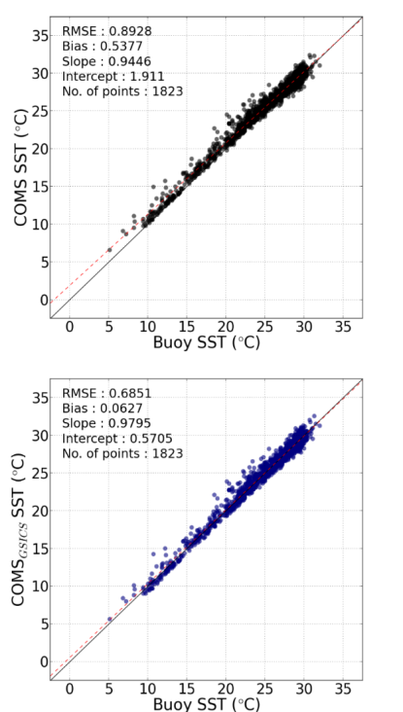
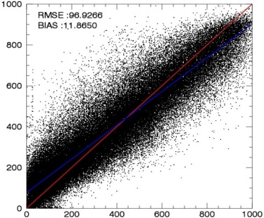
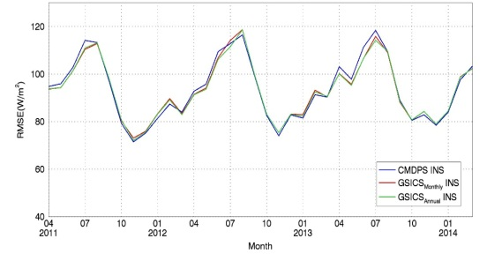
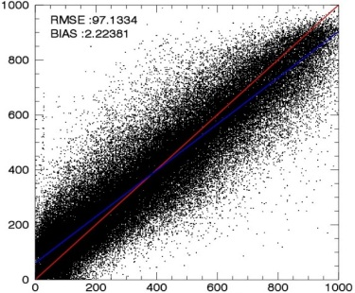
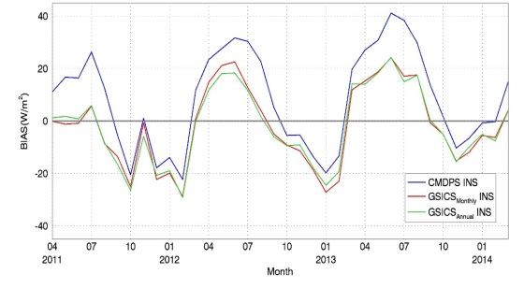
Application of GSICS correction
1. Sea Surface Temperature (SST)
2. Insolation (INS, Shortwave Radiation)
Area: 0-45°N, 105-160°E
Data: COMS/MI IR data, GTS buoy SST data
Study Area : 30-40°N, 120-130°E
Data : COMS/MI Vis data, Pyranometer(Ground station)
Daytime SST
Nighttime SST
(Variation Monthly RMSE)
Bias=0.5377
Before Correction
Bias=0.0928
Before Correction
Bias=11.88
Before Correction
(Variation Monthly Bias)
Bias=2.22
After Correction
Bias=0.0627
After Correction
Bias=0.0208
After Correction
Pyranometer

Slide 11
COMS IR for Demo phase
Preparation for COMS IR to enter the Demonstration Phase of the GSICS Procedure for Product Acceptance(GPPA)
Preliminary version of ATBD and sample data (Nov. 2014)
Checking sample data format

Slide 12
Thank you…

