Slide 1
3.m. GEO-LEO IR Progress at NOAA
Yuanzheng (Jordan) Yao
2016 GSICS Annual Meeting
Tsukuba, Japan
Feb 29-4 Mar, 2016
Acknowledgement: Fangfang Yu

Slide 2
Outline
Introduction
Issues and solutions
Current status
Near term goals
Summary

Slide 3
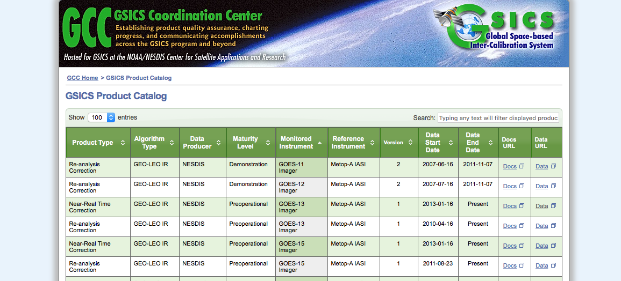
GEO-LEO IR Products from NOAA/NESDIS
Dis-continued
Dis-continued
Updated
Updated
Updated
Updated

Slide 4
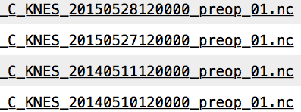
GEO-LEO IR Products from NOAA/NESDIS: Issues
Daily update was stopped because system hardware/software upgrade occurred during the transition from research to operation.
Incident 1: On May 2014, System Upgrade.
Products backed on line on May 2015 by updating codes and libraries
Incident2: On June 2015, Hardware and storage replacements.
Significant codes modifying needed!
….........

Slide 5
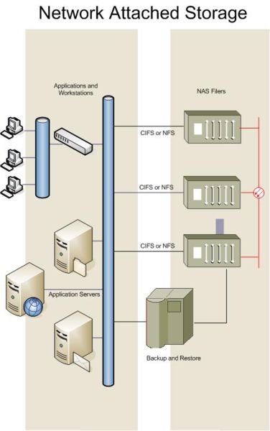
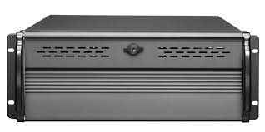
Issues Associated with Computer Servers for GEO-LEO IR Upgraded
GEO-LEO IR PreOperation
By – Fred Wu,
Fangfang Yu
…...
Old systems
Two major problems that make the programs difficult to be adapted quickly with systems upgrade/replacements:
Different developers used different ways to reference the hardware/software. The update has to be done individually on many programs. A user account change would cause problem as well.
Many steps are involved in the operation. A single error in one step would cause the whole operation disrupted.
New systems
Data downloading
The storage
Subset
Collocation
Generate Correct-coefficients
Update THREDDS server
Notes:
The storage

Slide 6
Bring GSICS GEO-LEO IR Pre-Operation Back Online
What we did are as follows:
Corrected all parts to resume the operation
Standardized the paths/libraries etc. in the whole package so that the operation will not rely on individual user’s environment. This will prevent an operation disruption from future software/hardware upgrade.
GOES-13 continental scan time in Mcidas is changed from 02/32 to 00/30 and GOSE-13 South Hemisphere scan time is changed from 09/39 to 08/38
The GSICS THREDDS server is replaced with a new URL as follows: http://www.star.nesdis.noaa.gov/thredds/gsics/catalog.html

Slide 7
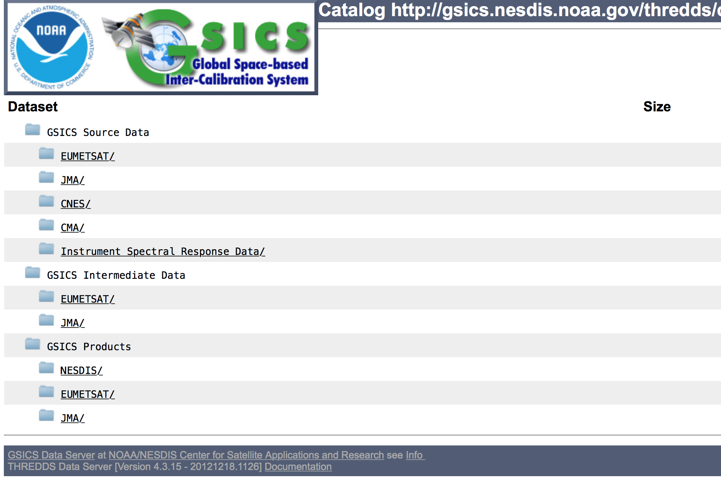
Migration of NOAA/NESDIS GSICS THREDDS Server
Current THREDDS: http://gsics.nesdis.noaa.gov/thredds/catalog.html
Problem: Remote access to other GSICS servers does not work.
System firmware is too old to be upgraded.

Slide 8
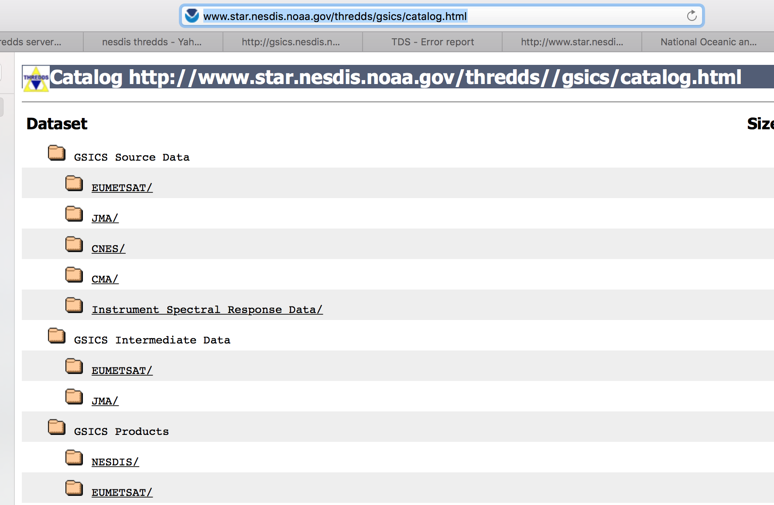
New NOAA/NESDIS THREDDS Server
New GSICS THREDD is on line: http://www.star.nesdis.noaa.gov/thredds/gsics/catalog.html
Still working on adding GSICS icons for GSICS pages.
GEOLEO IR products are back online.

Slide 9
NOAA/NESDIS GSICS GEOLEO-IR Is Back Online
Name convention discussed: MetopA or MetOpA?
MW_US-NESDIS-STAR,SATCAL+NRTC+GEOLEOIR,GOES13+Imager-MetOpA+IASI_C_KNES_2016_US-NESDIS-STAR,SATCAL+NRTC+GEOLEOIR,GOES13+Imager-MetOpA+IASI_C_KNES_2016 W_US-NESDIS-STAR,SATCAL+NRTC+GEOLEOIR,GOES13+Imager-MetOpA+IASI_C_KNES_2016

Slide 10
Near-term Goals
Refine the programs
Add missing GEOLEO IR back
Finalize the migration of THREDDS on the new server

Slide 11
Thank You

Slide 12
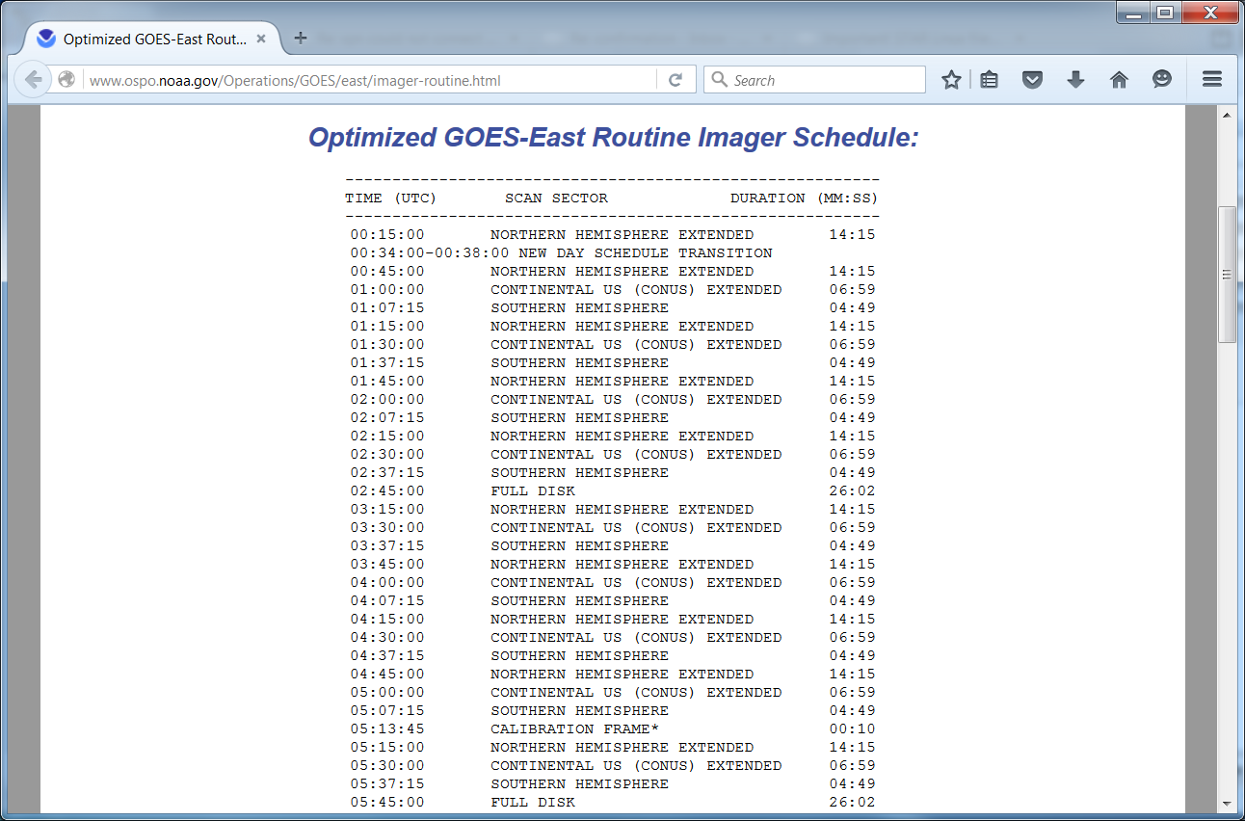
cid:part1.03010403.05020703@noaa.gov

