Slide 1
Operation Around Midnight for 3-Axis Stabilized Geo
X. Wu
Based on work by many people in many years
2016-03-02, Tsukuba, Japan

Slide 2
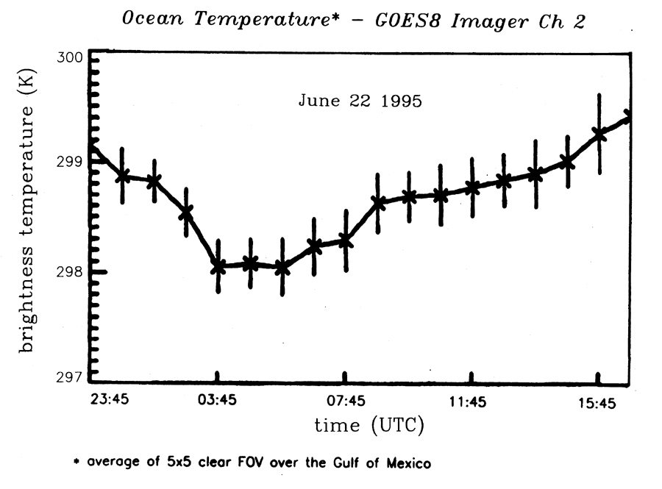
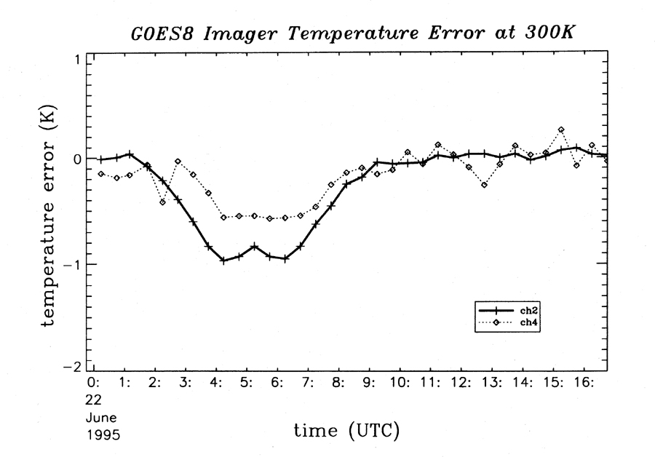
IR Calibration

Slide 3
Calibration Coefficients

Slide 4
Root Cause - Thermal Stress …
One Week
One Month
~60ºK some other days
~40ºK “now”
Complicated seasonal variations of diurnal heating
Long term trend
One Year
One Satellite
Goes-12 Scan Mirror Temperature

Slide 5
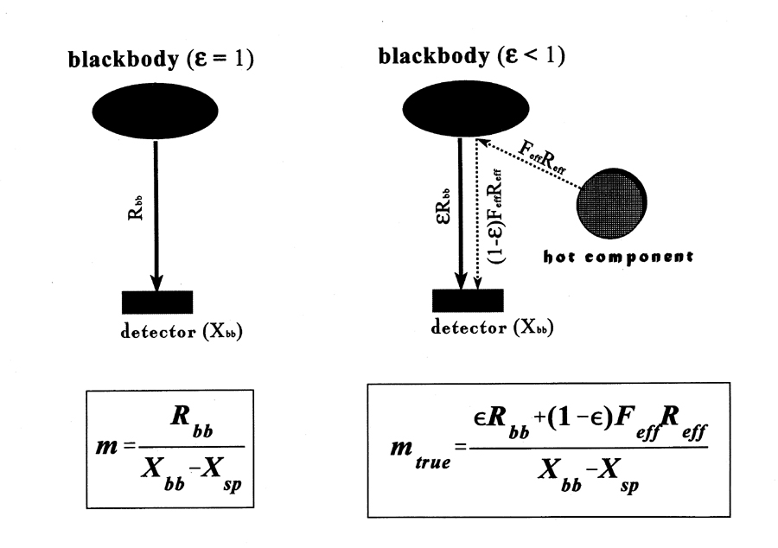
… coupled with blackbody …
T_{BB}
Not a problem without this varying radiator

Slide 6
… that is less than black
T_{BB}
T_{BB}
OK if ε=1 or T_{env}=T_{BB}
Less true for GOES
T_{env}

Slide 7
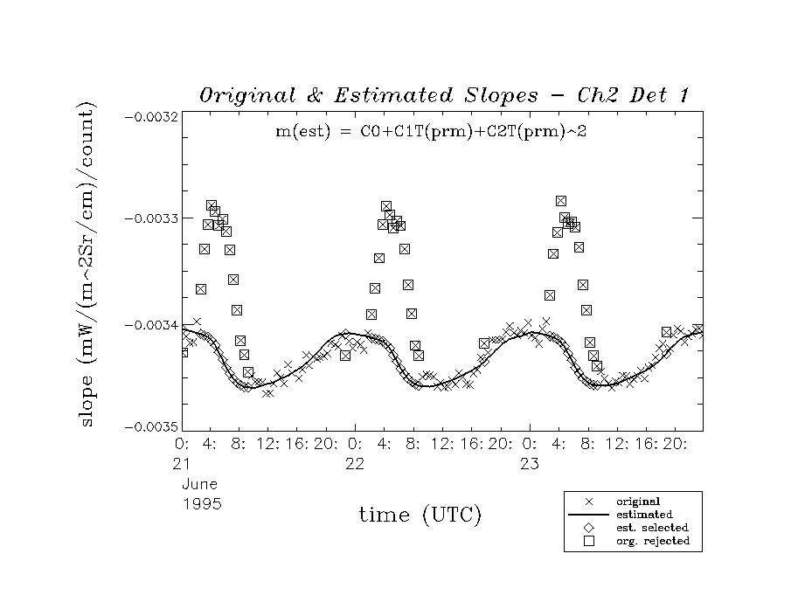
Correction (MBCC) …

Slide 8
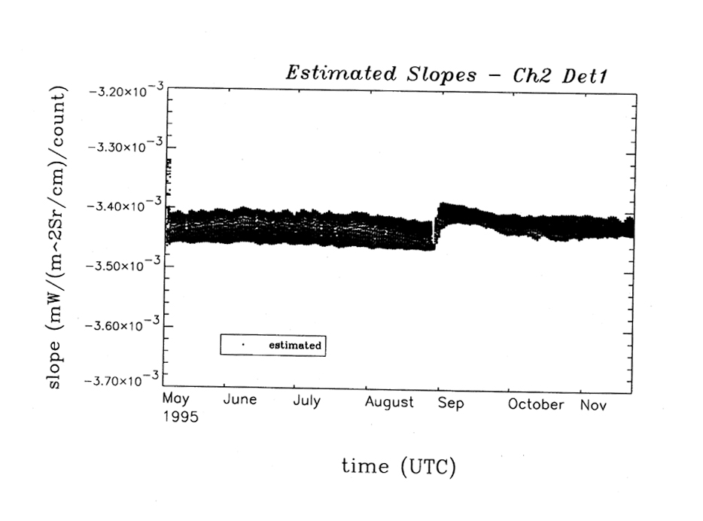
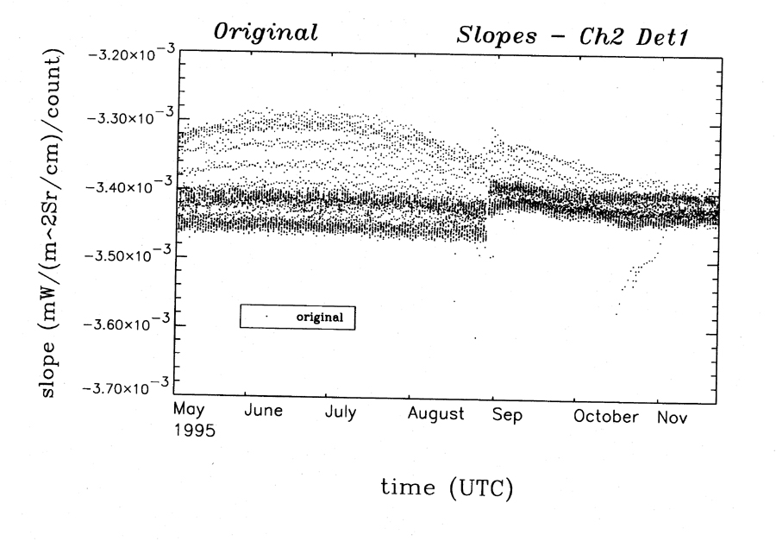
… and effects

Slide 9
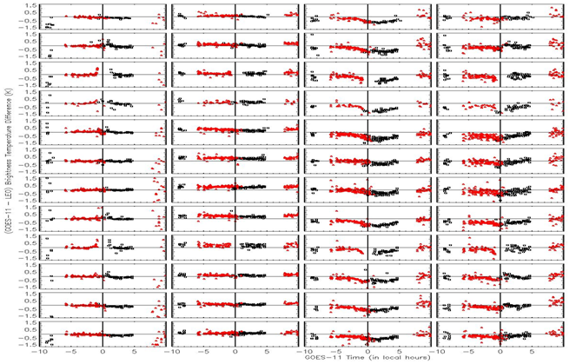
MBCC Performance Evaluation – GOES-11 Imager IR Channels
Ch2 Ch3 Ch4 Ch5
Jan
Feb
Mar
Apr
May
Jun
Jul
Aug
Sep
Oct
Nov
Dec
Jan
Feb
Mar
Apr
May
Jun
Jul
Aug
Sep
Oct
Nov
Dec
Diurnal variation varies at different channel and different season

Slide 10
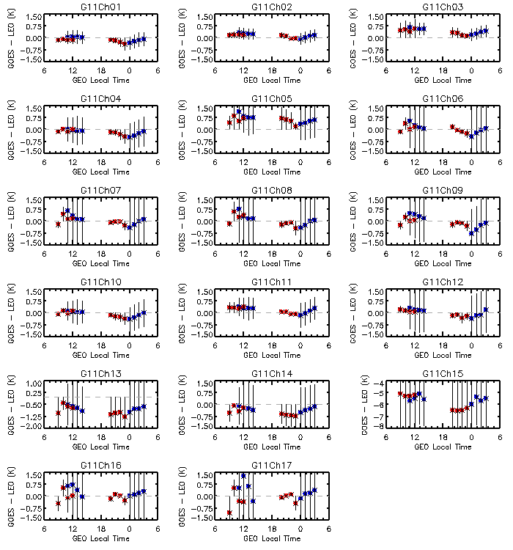
No MBCC applied to the Sounder IR channels
Impact of the midnight calibration anomaly for GOES-11 Sounder IR channel 1 through Ch17. ΔTb_{4:00am,0:00am} = ΔTb_{4:00am} - ΔTb_{0:00am}
Channel | ΔTb_{4:00am,0:00am} (K) | Channel | ΔTb_{4:00am,0:00am} (K) | Channel | ΔTb_{4:00am,0:00am} (K)
Ch1 | +0.25 | Ch7 | +0.54 | Ch13 | +0.33
Ch2 | +0.22 | Ch8 | +0.49 | Ch14 | +0.38
Ch3 | +0.25 | Ch9 | +0.67 | Ch15 | +0.61
Ch4 | +0.37 | Ch10 | +0.39 | Ch16 | +0.28
Ch5 | +0.24 | Ch11 | +0.44 | Ch17 | +0.51
Ch6 | +0.51 | Ch12 | +0.53
Yu and Wu, 2013 TGRS

Slide 11
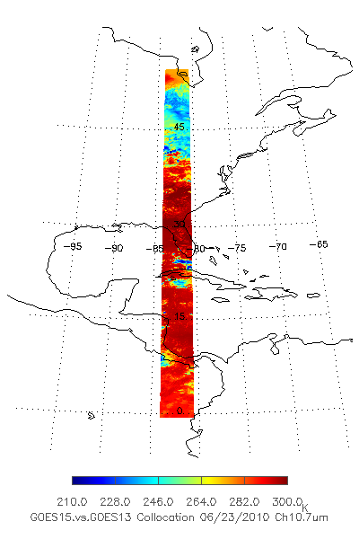
GEO-GEO Comparison During GOES-15 PLT Period
GEO-GEO collocation
Spatial collocation
Temporal difference: < 5 minutes
Geometric alignment: viewing zenith angle difference < 1%
GOES 13: -75º
GOES-15: -89.5º

Slide 12
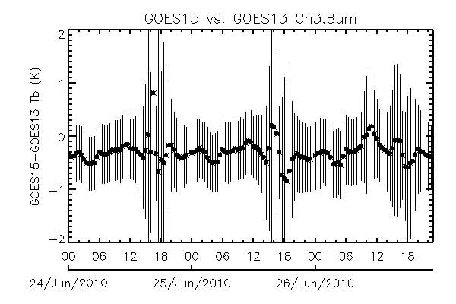
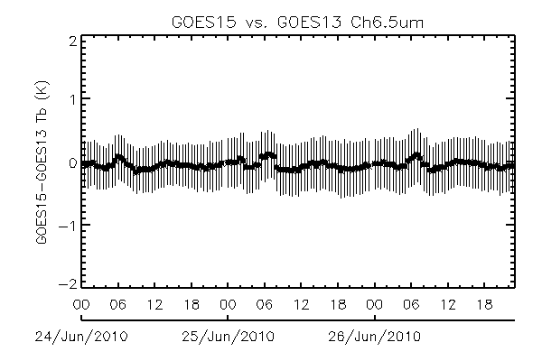
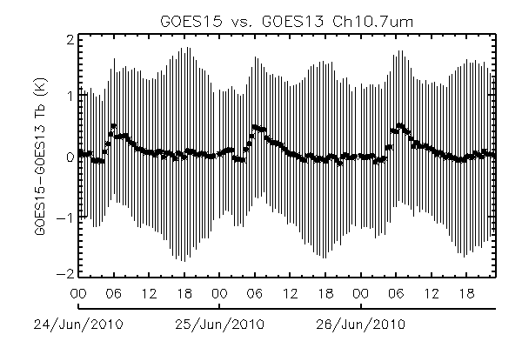
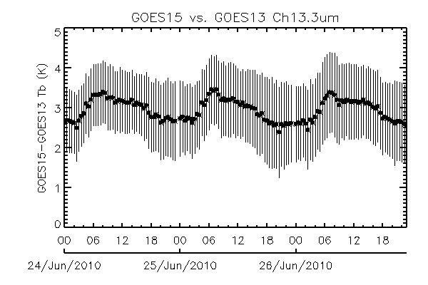
GEO-GEO Comparison
No correction was made for SRF difference
Midnight
Midnight
BRDF
Midnight
Midnight
Yu
Note: the GEO-GEO inter-comparison was conducted before the SRF shifts for G15 Ch3 and Ch6

Slide 13
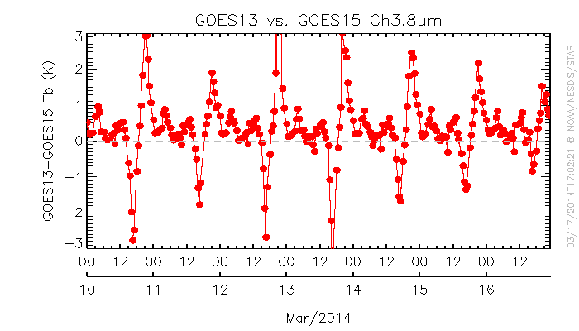
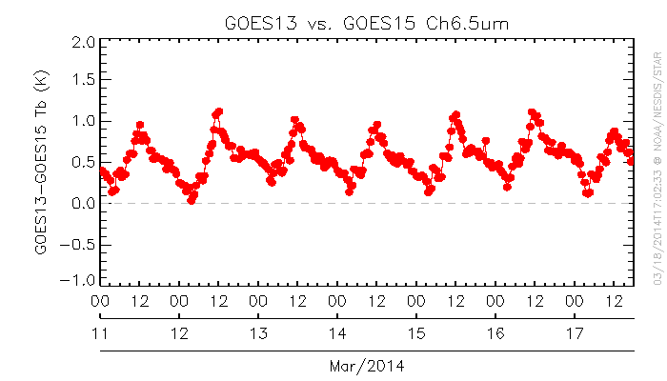
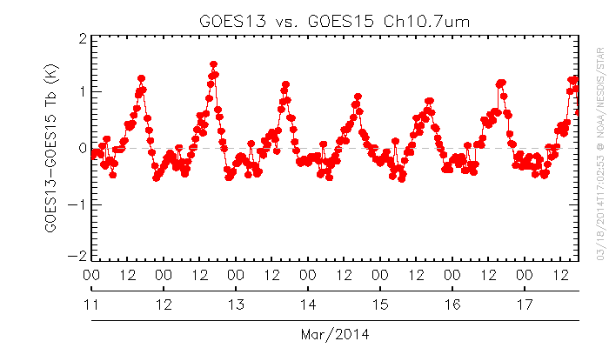
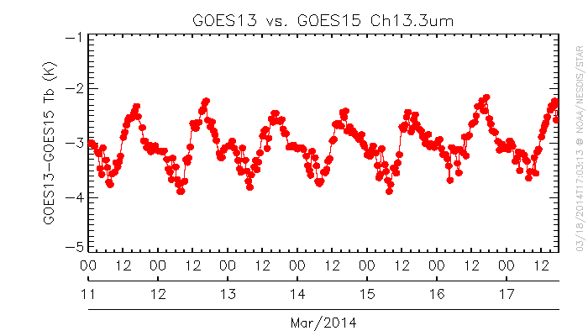
GEO-GEO Radiance Comparison
Yu

Slide 14
Improvements for AHI
Expected:
Optical design
Improved cooling
And Observed:
Temperature excursion
Radiance bias

Slide 15
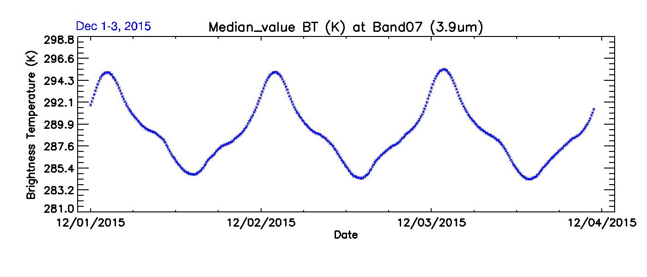

Slide 16
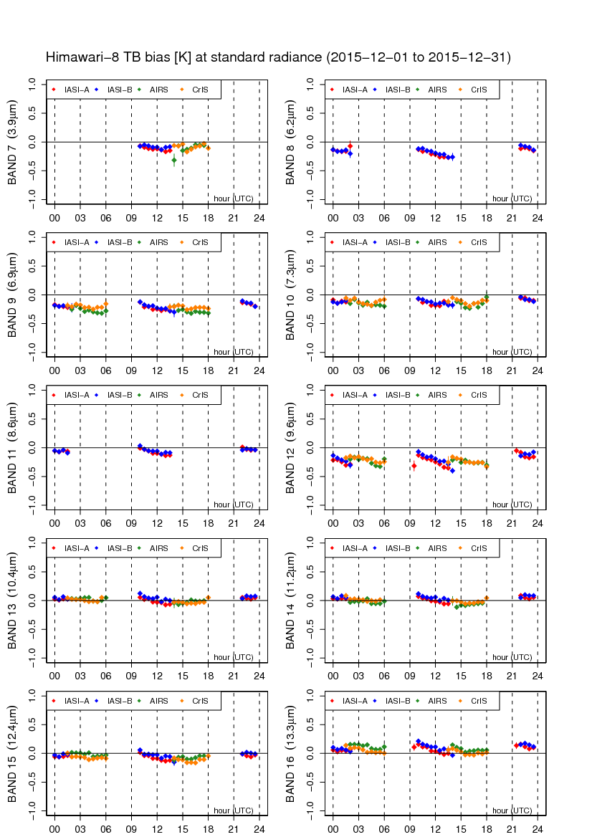
AHI data quality (Diurnal variation in IR)
will be reported in [3k]
Himawari-8/AHI
There is no significant diurnal variation seen in MTSAT-2
The biases at the standard radiance are shown.
Data period is December 2015.
Reference sensors are:
Metop-A/IASI
Metop-B/IASI
Aqua/AIRS
S-NPP/CrIS
MTSAT-2/Imager
Notes:
基準センサーが変わる時間帯に見られる不連続の原因については調査中。画像上では、異変は認められない。

Slide 17
Summary
3-axis stabilized geostationary platform is subject to tremendous thermal stress around satellite midnight, especially during the semi-annual eclipse season.
This has broad impacts.
For Imager (2nd generation):
KMA offered non-MBCC radiance for MI
Obtained support to strengthen support for Imager.
NOAA plan to investigate further with KMA.
For Advanced Imager (3rd generation): reduced effects are
… Expected, thanks to optical design and improved cooling
… And Observed, both temperature excursion and radiance bias
Within spec, but seems statistically significant.
NOAA plans to investigate further with JMA
Not discussed but also important: impact on navigation

