Slide 1
5.c. The New GSICS WIKI Server
Yuanzheng (Jordan) Yao
2016 GSICS Annual Meeting
Tsukuba, Japan
Feb 29-4 Mar, 2016

Slide 2
Outline
Introduction
Why the WIKI server needs to be changed?
How is it changed
Current status
Summary

Slide 3
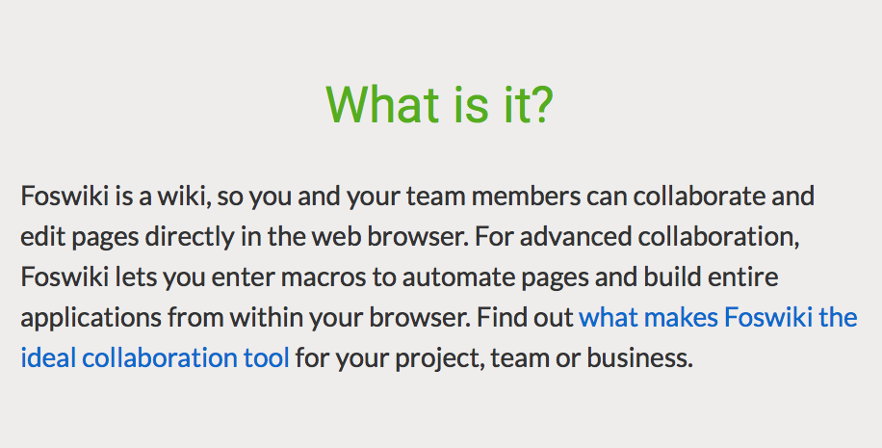

Slide 4
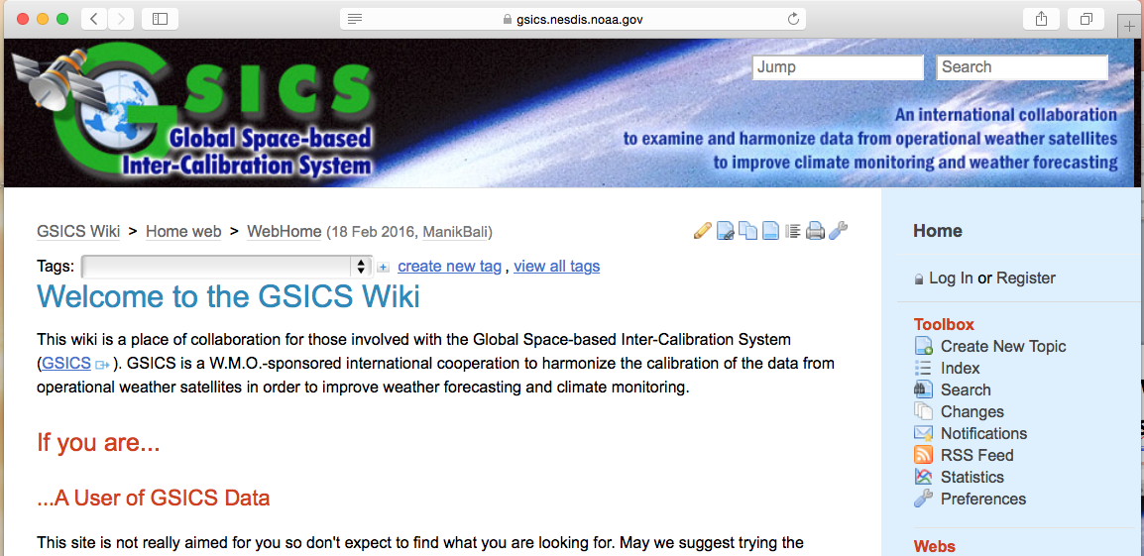
Current GSICS WIKI Server
http://gsics.nesdis.noaa.gov/wiki
Foswiki-1.1.3

Slide 5
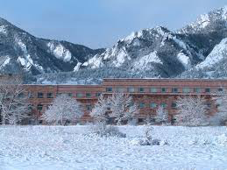
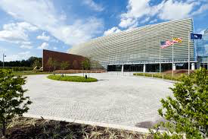
Wiki services will be stopped on NOAA.GOV
Reason: Vulnerability

Slide 6
Choices
Change wiki service to other type of service, such as Google Group
Advantage: more reliable
Disadvantage: inconvenient, file loss
Build a GSICS wiki server outside of NOAA
Advantage: keep everything the same as before for users
Disadvantage: remaining hack in risk

Slide 7
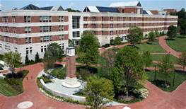
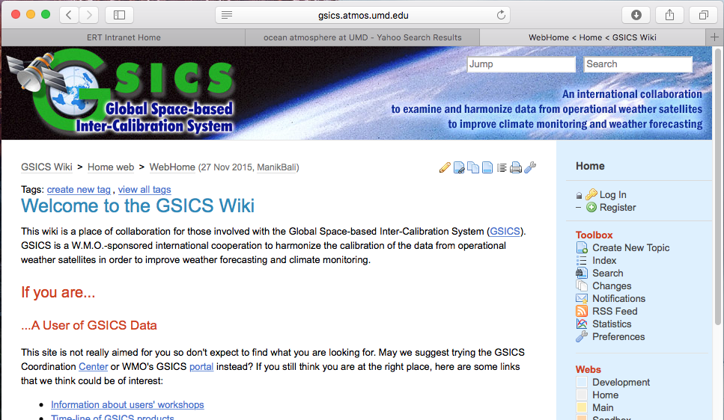
Our choice: Build a WIKI Server at UMD
http://gsics.atmos.umd.edu/wiki
Foswiki version v2.0.3
University of Maryland
Foswiki version v2.0.3
li-cick2.umd.edu

Slide 8
Technical Details
Install a decent server
Linux, 64 cores, 256GB memory,
li-cics2.umd.edu
Set HTTP and wiki service
FOSWIKI V-2.0.3
Configure the GSICS wiki on the
server
Meaningful URL name: gsics.atmos.umd.edu/wiki
Adding the required APPs at the
latest version
Move and covert all contents from old to new wiki

Slide 9
Can two wiki services be synchronized (mirrored)?
http://gsics.nesdis.noaa.gov/wiki
Foswiki-1.1.3
http://gsics.atmos.umd.edu/wiki
Foswiki-2.0.3
Because of version differences, the contents in two wiki services can not be simply copied or synchronized. Manual converting is required..

Slide 10
Concern: Security! Security!
A lot of hack attempting are detected.
Feb 21 15:09:19 li-cics2 sshd[47345]: Failed password for invalid user ubuntu from 177.55.88.2 port 37705 ssh2
Feb 21 15:09:21 li-cics2 sshd[47347]: Failed password for invalid user teamspeak from 177.55.88.2 port 38494 ssh2
user oracle from 177.55.88.2 port 39231 ssh2
Feb 21 15:44:38 li-cics2 sshd[48954]: Failed password for root from 104.152.208.38 port 1153 ssh2
Feb 21 15:44:40 li-cics2 sshd[48954]: Failed password for root from 104.152.208.38 port 1153 ssh2
Feb 22 05:00:03 li-cics2 sshd[26303]: Failed password for root from 113.195.145.12 port 23915 ssh2
Feb 22 21:12:51 li-cics2 sshd[14151]: Failed password for root from 58.218.211.198 port 11636 ssh2
Feb 23 19:16:14 li-cics2 sshd[24771]: Failed password for root from 59.47.5.230 port 35053 ssh2
Feb 23 19:16:23 li-cics2 sshd[24771]: Failed password for root from 59.47.5.230 port 35053 ssh2
Feb 24 09:01:18 li-cics2 sshd[7213]: Failed password for root from 182.100.67.59 port 4230 ssh2
Feb 24 09:01:21 li-cics2 sshd[7213]: Failed password for root from 182.100.67.59 port 4230 ssh2
Solutions:
Make it more secure
(Update software to the
latest versions. Watch
the logs closely etc.)
Backup contents frequently

Slide 11
Be Prepared for Occurrences of Bad Things
Backup on NOAA wiki server:
Ever day
Backup at UMD wiki Server
Everyday (overwrite)
Everyday Sunday (overwrite)
First day each month (keep)

Slide 12
When to Start Using the New Wiki Server?
Scheduled the time
Replace http://gsics.nesdis.noaa.gov/wiki with http://gsics.atmos.umd.edu/wiki on all related web pages

Slide 13
Summary
The new GSICS wiki service is set outside of NOAA
It is ready to be used
Frequent back up is set up
Need to schedule a day to switch from old wiki to new one
Keep the old wiki server running offline

Slide 14
Thank You

