Slide 1
GDWG Terms of Reference
Peter Miu (EUMETSAT)
CMA, CNES, EUMETSAT, ISRO, IMD, JMA, KMA, NASA, NIST, NOAA, ROSHYDROMET, USGS, WMO

Slide 2
Overview and Purpose
Being a GDWG member
Collaboration Problems
Collaboration Solutions
Proposed Way Forward for Effective Collaboration; proposed process & automation

Slide 3
Being a GDWG Member
Terms of Reference (ToR), GSICS-RD004-V1.0, June 2015
GDWG Members are expected to contribute 1 man month per year
Is this expectation being met?
GDWG Member | Days Contributed 15/16
CMA | 5 + ?
EUMETSAT | 5 + 40 = 45
IMD | 5 + ?
JAXA | 0 + ?
JMA | 5 + 30 = 35
KMA | 5 + ?
NOAA | 40 (on both WGs) + ?
ROSHYDROMET | 0
WMO | 5 + ?
Notes:
GSICS-RD004-v1.0

Slide 4
Being a GDWG Member
If members are not involved then:
Decisions are being made in with your name and GPRC
For your Organisation to stay a member, you must following international decision that can be against your local interest
Time is wasted by all members working with you.
Notes:
GSICS-RD004-v1.0

Slide 5
Collaboration Problems
Regular changes in members
Working in a foreign language
Use of foreign technologies
Out of sight, out of mind
No formal authority amongst the group

Slide 6
Proposed Collaboration Solutions
Regular changes in members
EP commits members
Working in a foreign language
Visit Scientist Programmes
Use of foreign technologies
Visit Scientist Programmes / Training
Out of sight, out of mind
Automate Progress Updates (6a)
No formal authority amongst the group
Automated Status Monitoring and Escalation (6a?)

Slide 7
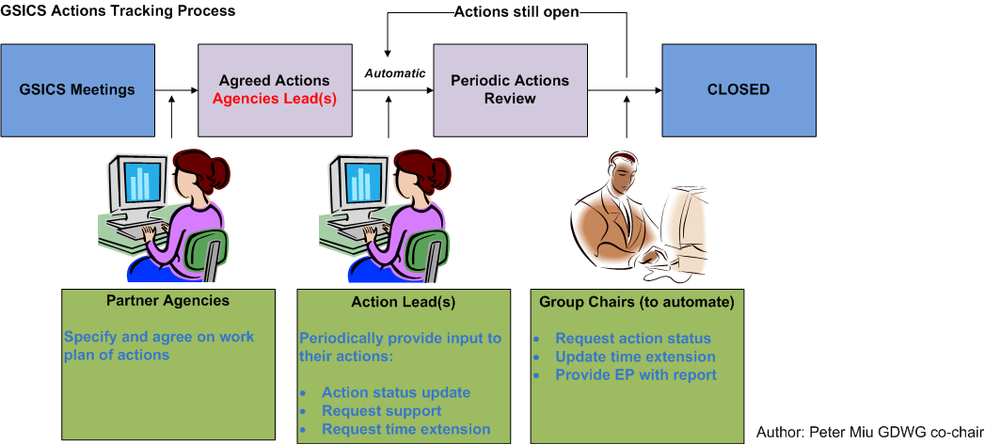
Proposed Way Forward
Action Tracking Process

Slide 8
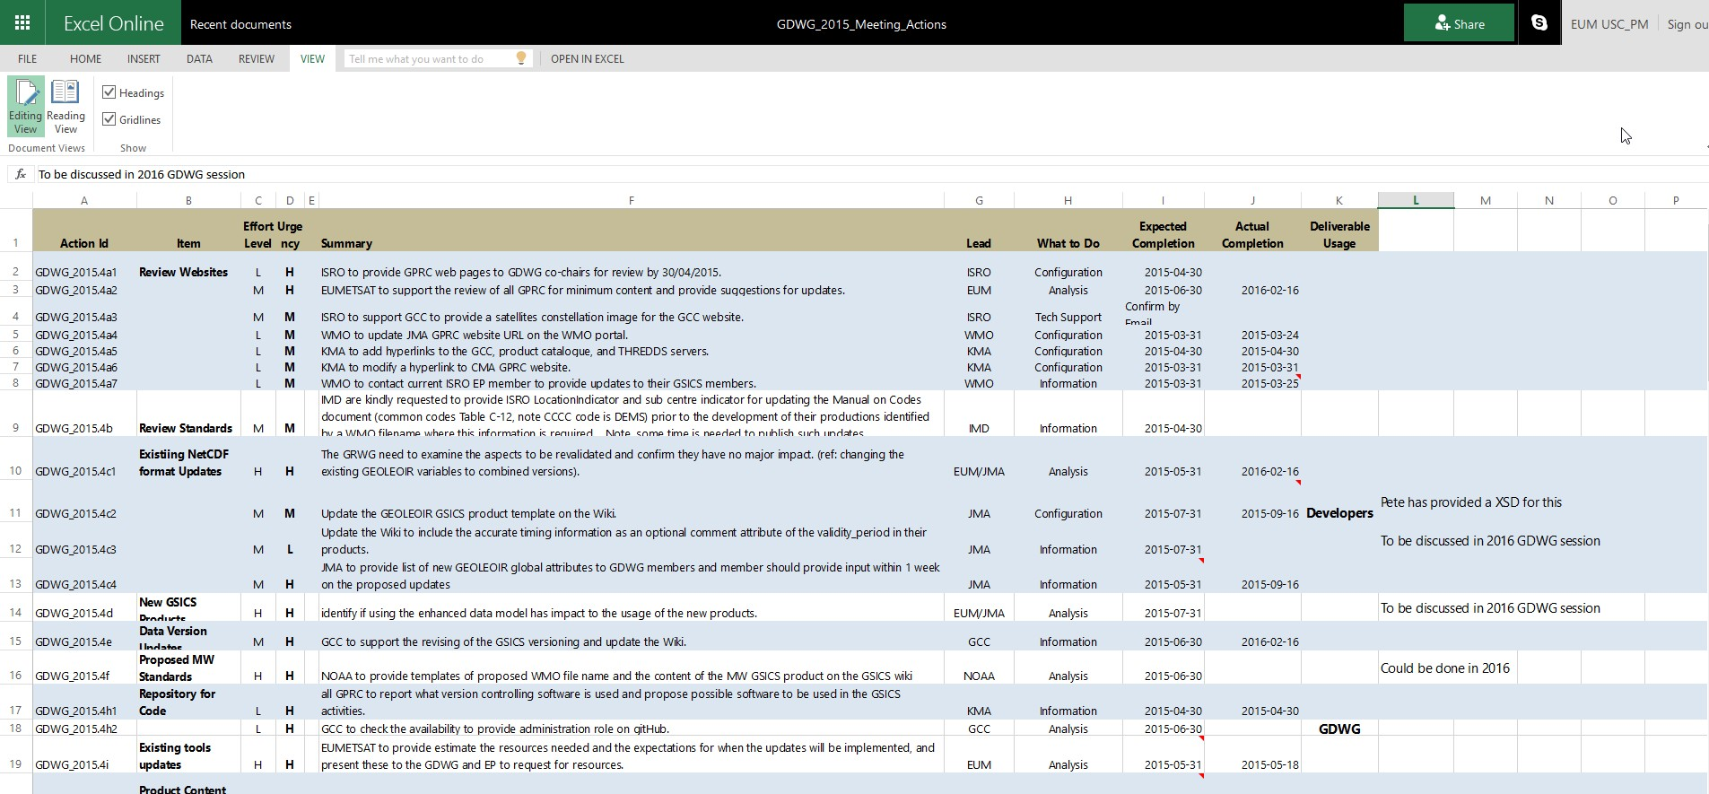
Actions Summary

Slide 9
Actions Alerter Design

Slide 10
Collaboration Measures
ToR – 1 man month, Resource Usage Example
Task | Lead | Resource 16/17 | Action Summary
Website Updates | CMA | 20 – 1 = 19 | Check min content
Collaboration Server updates | CMA | 20 – 10 = 9 | Update directories and configure services
Collaboration Server updates | EUM | 30 – 5 = 25 | Data preservation installation
Collaboration Server updates | NOAA | 20 – 10 = 10 | Update directories and configure services
GEOLEOIR metadata & format support | JMA | 30 – 10 = 20 | Specification
Etc.

Slide 11
Resource Usage Summary
GDWG Member | Resources Available 16/17
CMA | 19
EUMETSAT | 25
IMD | 30
JAXA | 30
JMA | 20
KMA | 30
NOAA | 25
ROSHYDROMET | 30
WMO | 30

Slide 12
Using Available Resources
GDWG actions from meetings will require support
These will be offered to the GDWG members to take a lead on
GDWG Chair may assign action to members with support from experts to improve membership collaboration

Slide 13
Discussion
Recommendations & Actions

Slide 14
End of Presentation: Thank you for your attention

