Slide 1
Effort toward Characterization of Selected Lunar Sites for the Radiometric Calibration of Solar Reflective Bands
Fangfang Yu¹, Xi Shao¹, Xiangqian Wu²
Masaya Takahashi³ and Arata Okuyama³
1: ERT, Inc@NOAA/NESDIS/STAR
2: NOAA/NESDIS/Center for Satellite Application and Research (STAR)
3: Japan Meteorological Agency (JMA)/meteorological Satellite Center (MSC)

Slide 2
Lunar Calibration
The moon is an extremely stable solar diffuser
  No atmospheric absorption/scattering
  No vegetation/water ….
  Relatively flat spectrum
  Yet with strong directional reflectance
Lunar irradiance calibration is currently widely used
  ROLO (GIRO) model is the most popular physical model to estimate the lunar irradiance
    Works very well for the instrument trending when the phase angle range is small, successful at some LEO instruments (e.g. SeaWIFS, MODIS, VIIRS…)
    Challenge for the GEO instruments as the moon can appear at the FOR at large range of phase angles due to its phase angle dependent relative calibration accuracy with possible libration correction residual
    Relatively large absolute calibration uncertainty
  Items in the satellite irradiance estimates
    Uncertainties in the oversampling factors, out-of-field energy (MTF, cross-talking, straylight, etc) and detector noise
Lunar radiance calibration can be an alternative method
  Use of relatively spectral/spatial uniform sites at the lunar surface
    Minimize the phase and libration effects on the physical model
    Minimize the effects of out-of-field radiance and oversampling factors on the satellite measurement
  Challenges:
    Accurate image-to-image registration
    Accurate BRDF model is still required

Slide 3
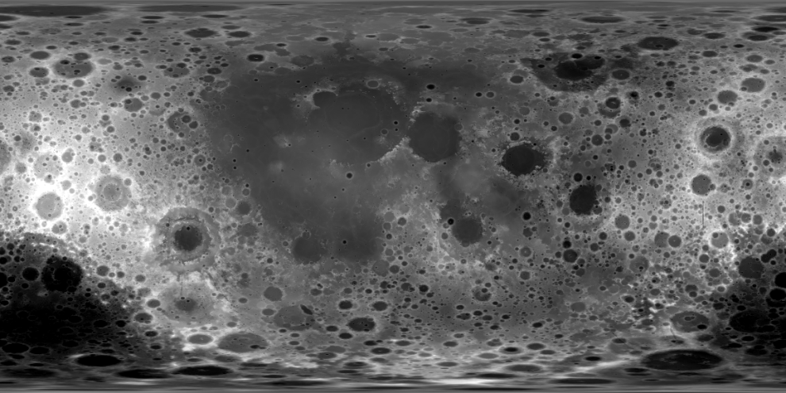
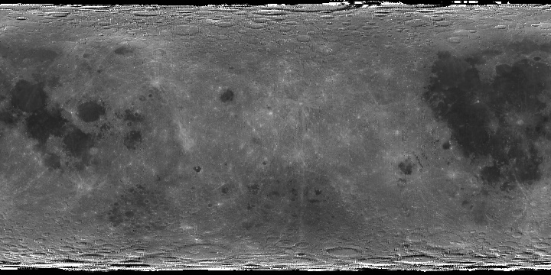
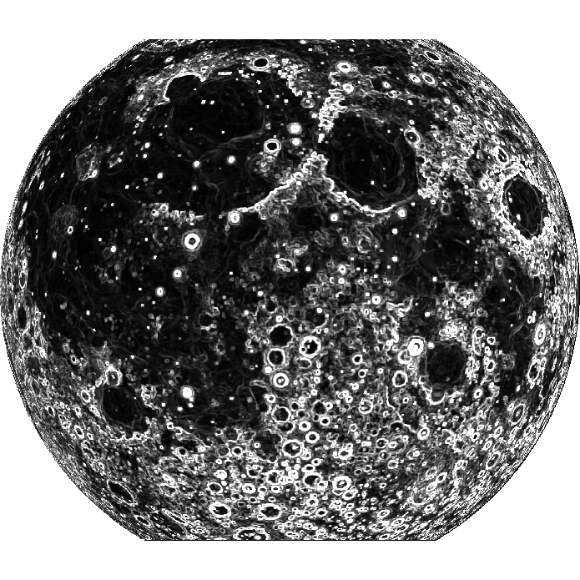
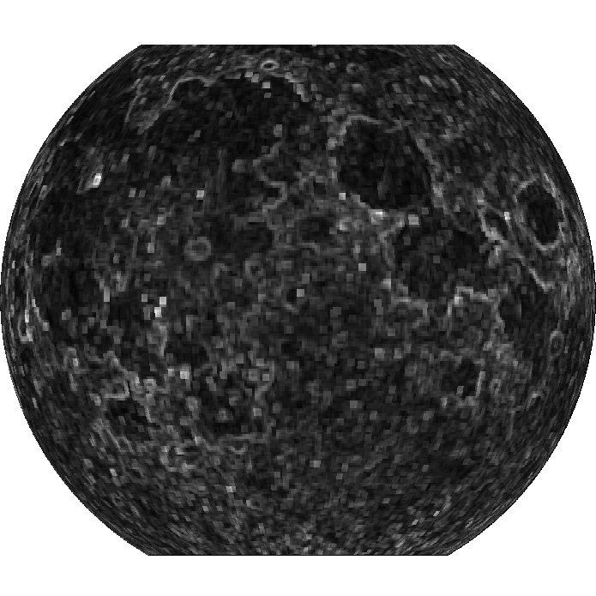
SELENE (Kaguya) Data to Select the Target Areas
SELENE/LALT
SELENE/SP
(-180, 90) (180, 90)
(-180,-90) (180, -90)
Re-project the near side of lunar surface products from cylindrical onto plane projection with selenographic coordinate at 5km/grid spatial resolution at Equator
Generate the Coefficient of Variation (CoV) of the topographic and radiometric products
Combine the CoV maps
60º
60º
60º
60º
-90º
90º
90º
-90º
Identify the Topographically and Spectrally Uniform Targets
-60º
-60º
-60º
-60º

Slide 4
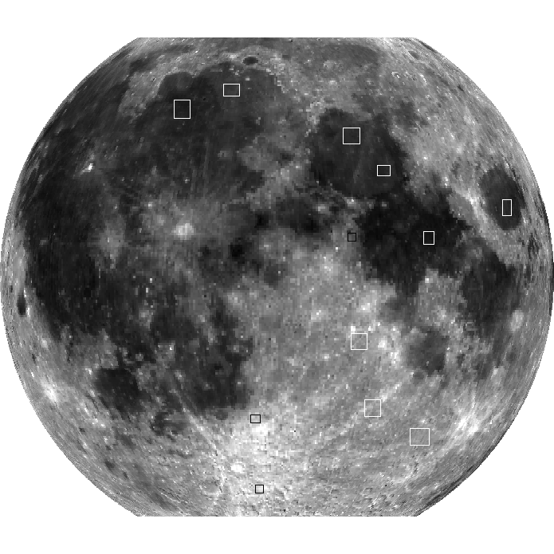
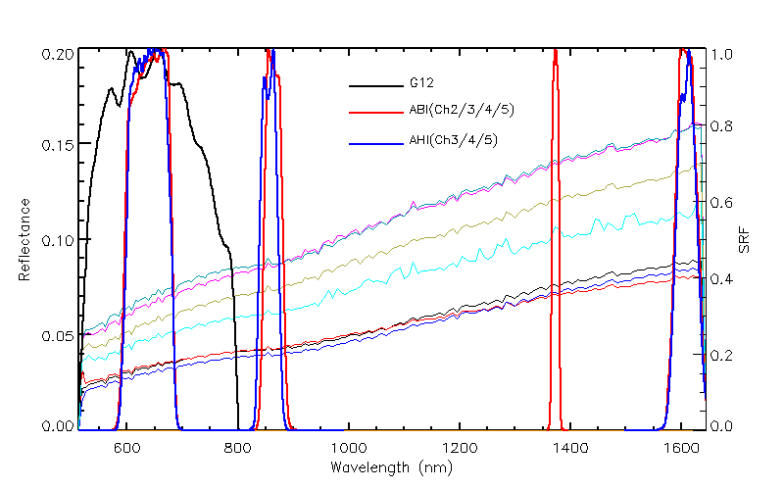
Combined CoV from SELENE Data
Favorable Conditions
Spatially Uniform – for flat moon surface. No impacts of vegetation and atmosphere
  SELENE/Laser Altimeter (LALT) for lunar global topography
Spectrally Uniform
  SELENE/SP for spectral variation
Sufficiently Large – tolerant to INR uncertainty
  Different spatial resolutions at different bands
Closer to the center
  More data opportunity for model development
Both dark (low elevation) and bright (high elevation) sites – bright sites to increase SNR
Apollo 16 site for absolute calibration
Weighting for these favorable conditions
o
o
60
60
SELENE SP spectra of lunar surface and the GOES-12, GOES-R ABI, H8 AHI spectral response functions
o
o
-60
-60

Slide 5
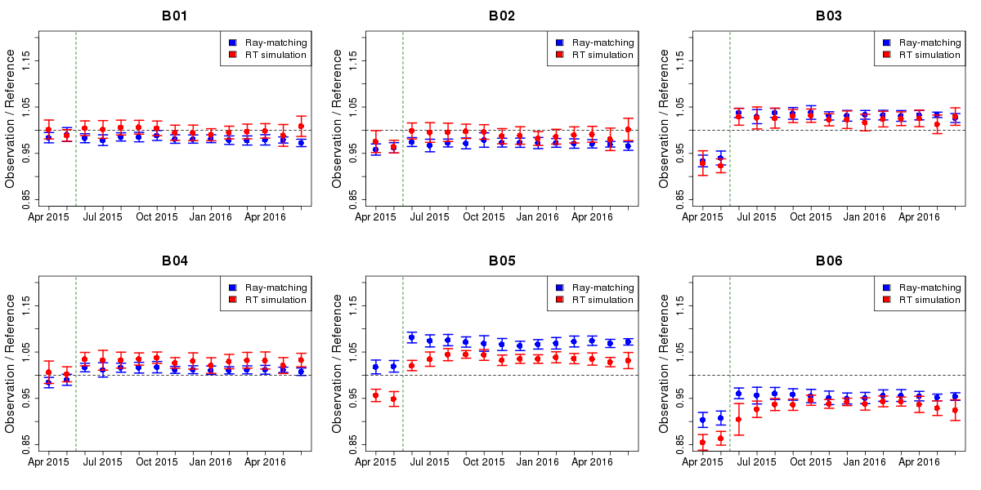
JMA’s AHI Earth Data Quality Monitoring
Band 1 (0.47μm) Band 2 (0.51μm)
Update of Cal. slope
No apparent trending of AHI earth observation data since June 2015
Band 3 (0.64μm) Band 4 (0.86μm)
Band 5 (1.6μm) Band 6 (2.3μm)
Courtesy of JMA

Slide 6
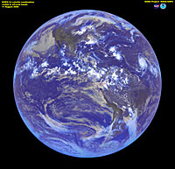
Lunar Appearance in ABI Field of Regard (FOR)
Meso-Scale Mode
ABI/AHI: Moon’s appearance within the annular ring between Earth’s limb margin and the outer boundary of the ABI/AHI’s field of regard

Slide 7
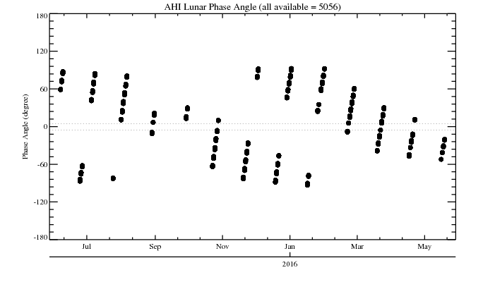
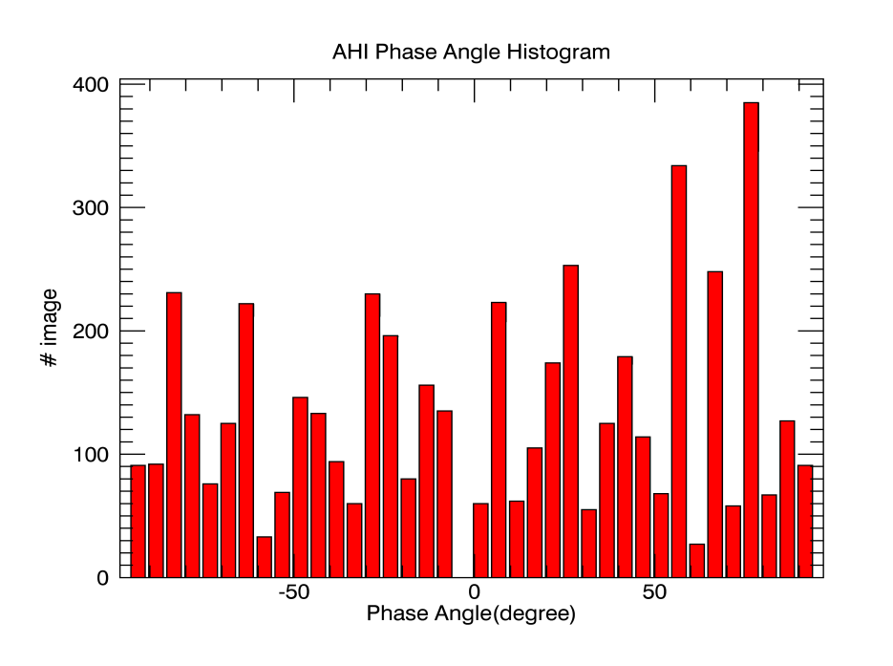
H8 AHI Lunar Data
Verify the sites with earth orbital satellite data
  AHI data
  June 2015 – May 2016
    >5, 000 images no-occulted images
Moon tracing event, each has +10 to +100 images

Slide 8
Image Registration
Not implemented yet!
Lunar L1A Data
Coherent noise correction
BDS map
Radiance to reflectance conversion
Subset lunar radiance images
Temporary Reference image
Source images
Auto Image Registration:
images obtained in the same day and adjacent days
Image enhancement
(convert to pgm format)
Image enhancement
(convert to pgm format)
Feature point extractions with SIFT
Feature point extractions with SIFT
Matched key-point features
Affine transformation
Image registration with near-neighbor point resample
Reference Image
(small phase angle)
Hybrid method: SIFT + Manual Control Point Selections
Band-to-band registration
Registration of All Images
Not implemented yet!

Slide 9
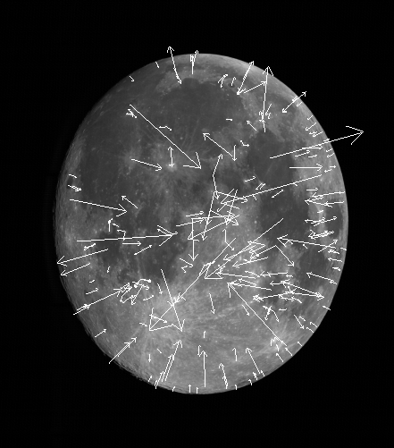
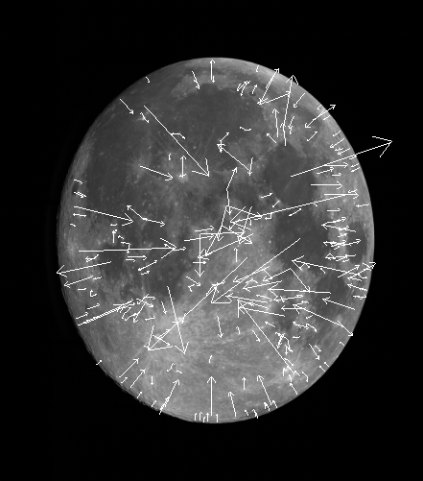
Keypoint Features - B1 as example
Scaled Invariant Feature Transform (SIFT)
Reference image
Source image
Lowe, D. 2004, International Journal of Computer Vision, 60, 91-110
Sub-pixel accuracy for the extracted key-point features

Slide 10
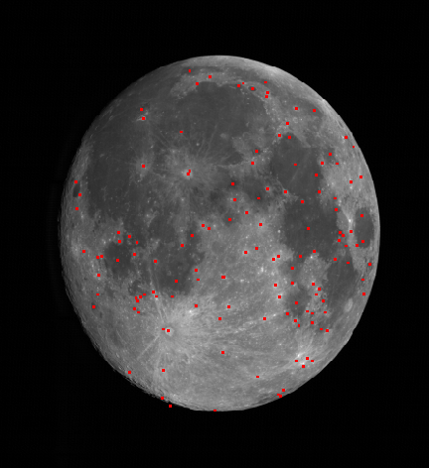
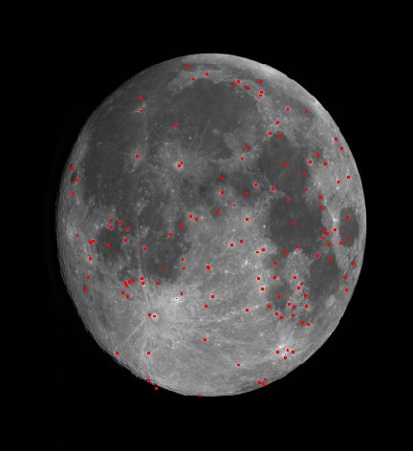
Extraction of Matched Key-points
Images in one moon tracing event
Reference image
Source image
Euclidean distance to select the matchups of key-points

Slide 11
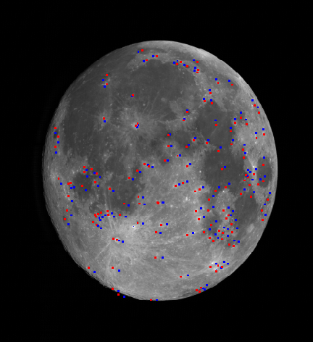
Matched Key-points (Example)
Distortion is not systematic!
- Linear affine transformation may not be sufficient to correct the image distortion
The number of matched key-points reduces and becomes clustered as absolute phase angle increases
Blue: source image Red: temporary reference image image: temporary reference image

Slide 12
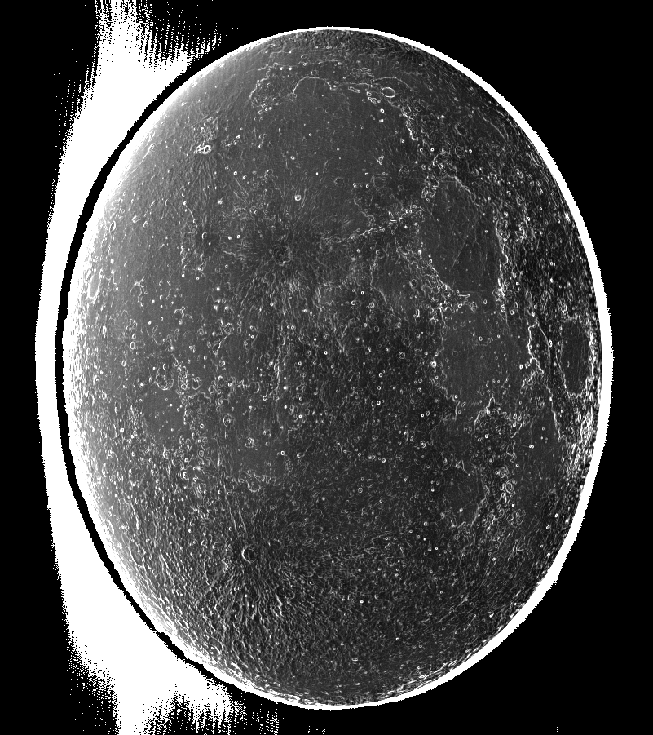
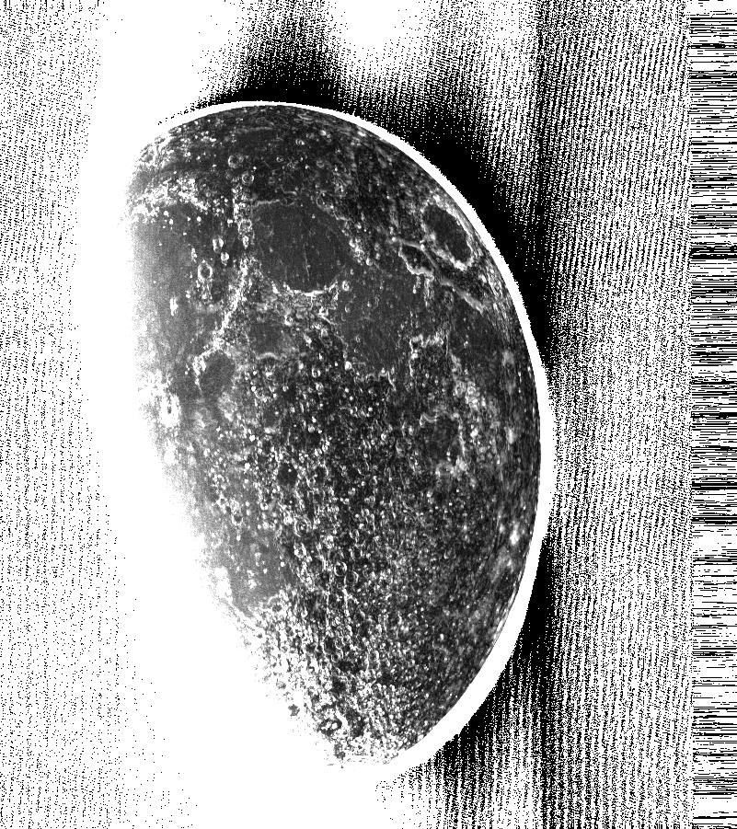
CoV of Radiance for Two Moon Tracing Events
Phase angle = ~-10. degree, ~100 images
Phase angle = ~-75. degree, ~60 images

Slide 13
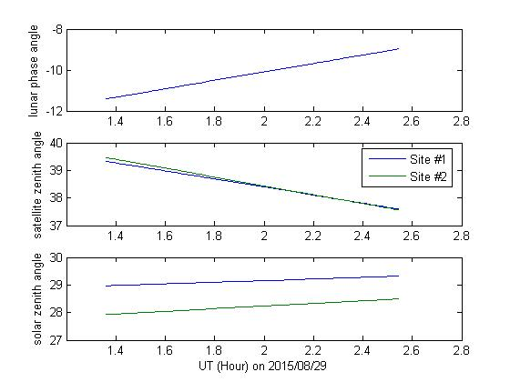
Viewing Geometry
Earth
1
29 August 2015
Phase angle: from -11.5 to -9.0 [deg]
100 observation / ~90 minutes
2
Lunar observations

Slide 14
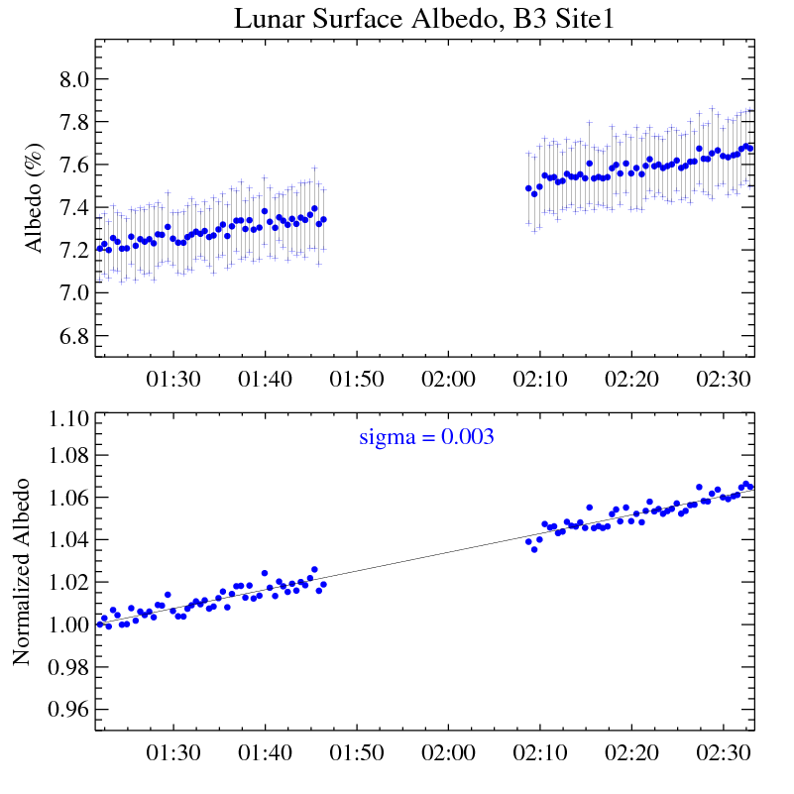
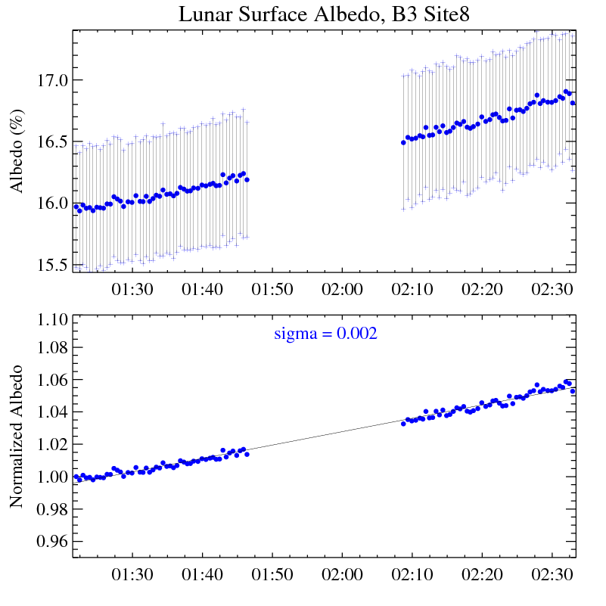
Site Radiance Extraction
1
8

Slide 15
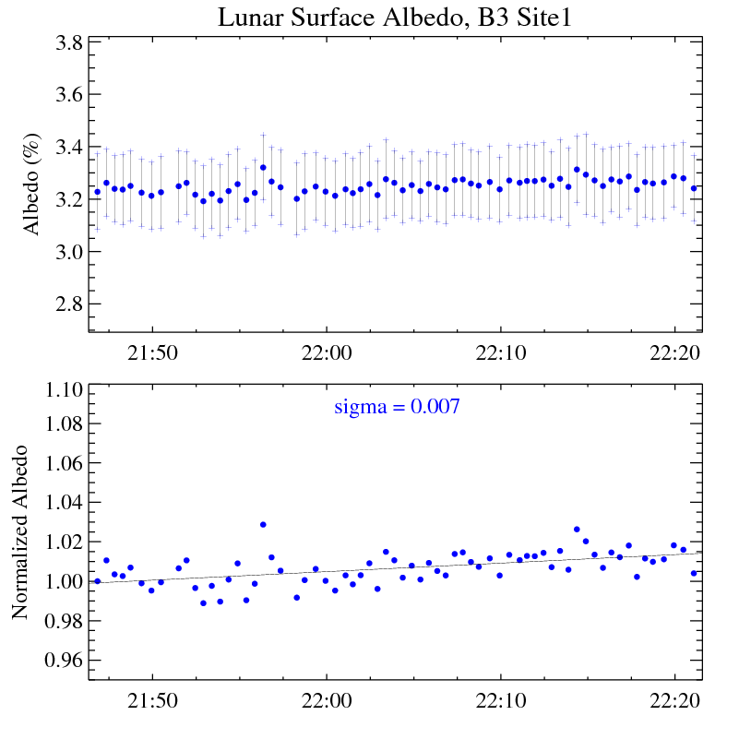
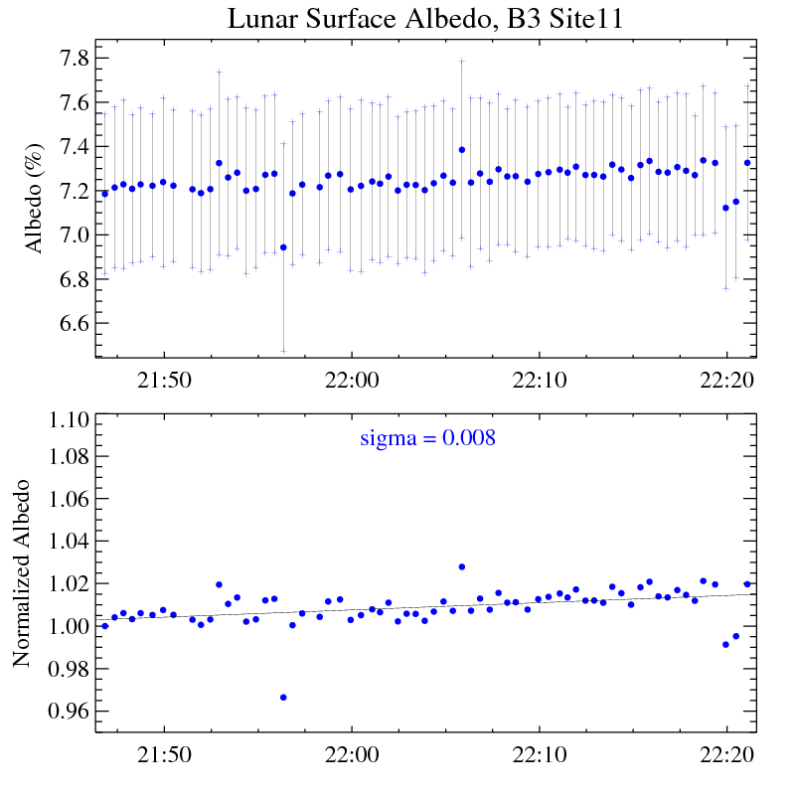
11x11 window size
1
11
Possible coherent noise
Image mis-registration error

Slide 16
Current Issues and Challenges
Reduced and Clustered distribution of the matched key-points
  Different phase angles/libration
Manually add the matched control points
  Result in relatively large registration error, especially for B5 and B6 (2km spatial resolution)
Image distortion is not linear

Slide 17
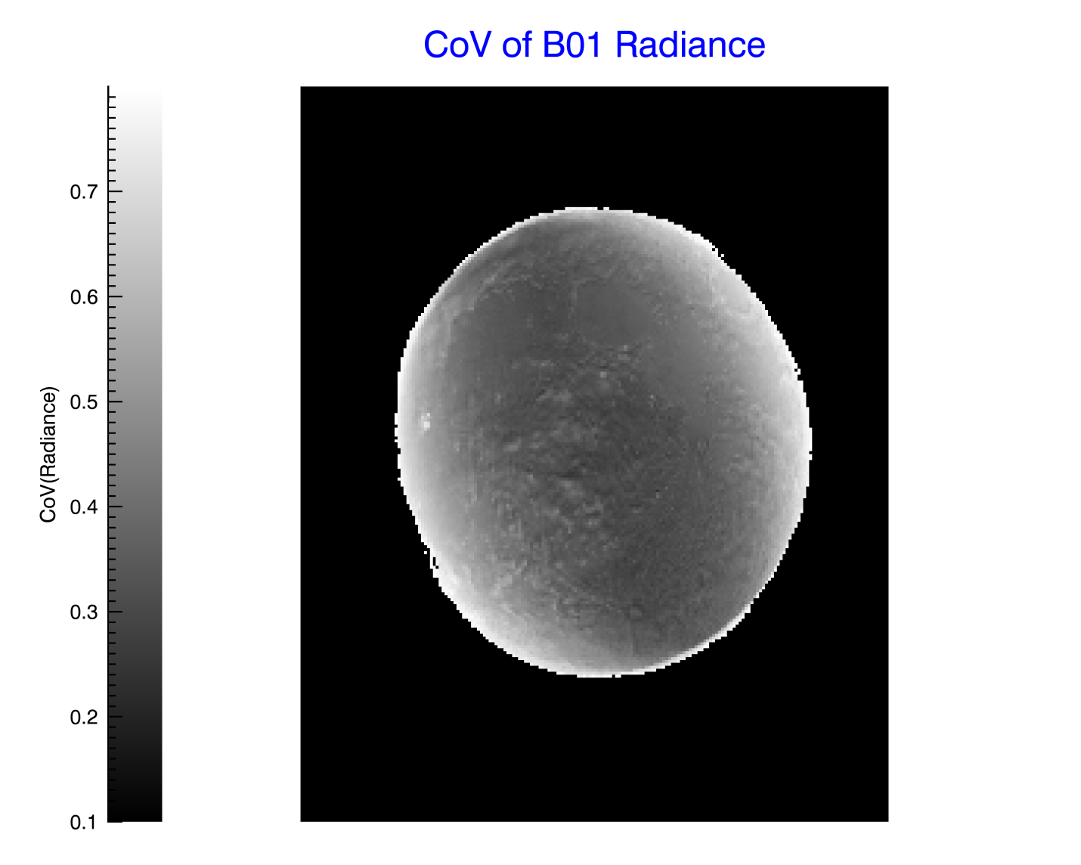
Preliminary Results – Uniformity
0.47um, 1Km
B1 (0.47um, 1km) data, at various phase angles

Slide 18
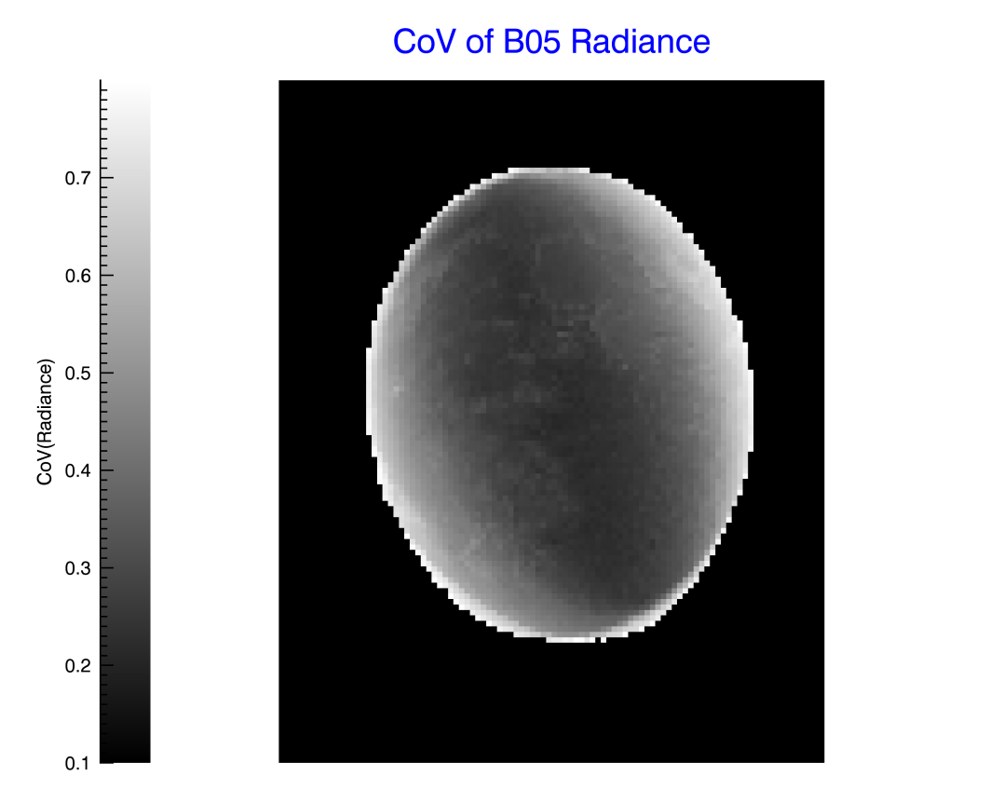
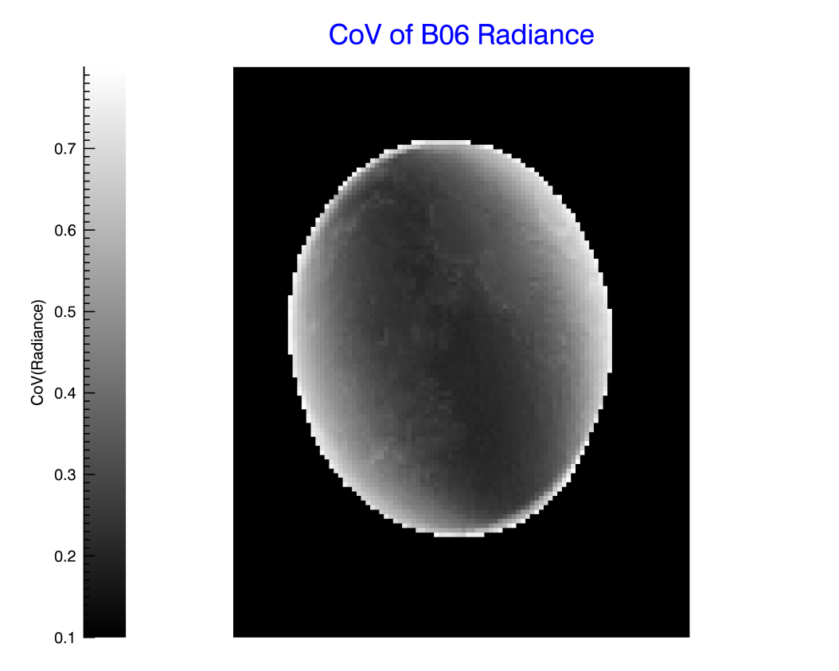
Uniformity for B5 and B6
1.6um, 2km
2.3um, 2km
B5 (1.6um, 2km), B6 (2.3um, 2km):
  Almost data: 5 < |Phase angle| < 45, July 2015 – May 2016

Slide 19
Summary
Both the lunar and earth orbital satellite data display large uniform area at low elevation region
  Potential targets for instrument-to-instrument inter-calibration and band-to-band degradation trending comparisons
The two moon tracing event images show encouraging early results to develop the BRDF model with H8 AHI data
  1-sigma of albedo variation < 1% at both low and high albedo sites
Accurate image-to-image registration is the key to the success of lunar radiance calibration
  Increase the matched key-points across the illuminated lunar surface
  May need to re-consider the ray trace method

Slide 20
Acknowledgements
NOAA/NESDIS and JMA ABI/AHI cal/val collaboration
JMA for the Himawari-8 AHI lunar observation data
JAXA, Japan NIES and AIST for the SELENE/LALT and SELENE/SP data

