Slide 1
GSICS MW products and a path forward.?
Manik Bali, Ralph Ferraro Larry Flynn, and Cheng-Zhi Zou
MW Subgroup Meeting
January 6, 2016

Slide 2
Outline
Outline
Introduction
Selection matrix of In-orbit reference for MW
Proposed in orbit reference for MW .
Summary

Slide 3
Introduction
Introduction
In orbit Microwave instruments are often compared to in-situ targets and GPS-RO measurements.
These comparisons get influenced by local weather conditions and usually require a forward model to compute the TOA (Top of Atmosphere) MW reference radiances from the in-situ and GPS-RO measurements.
Inter-comparisons do not reveal the full scale of instrument biases such as scan angle dependence of measurements, temporal trends and temperature dependence of bias
Need an in-orbit reference for MW
How do we select one

Slide 4
Proposed- Process to identify GSICS reference Instrument
The instrument and Channels agency wishes to monitor.
The method/s they would employ to monitor( eg. single or blended references, use transfer target , stability criterion).
May consider scoring proposed by Hewison and Reference Expectations gathered by GSICS Survey ( stated next slidse)
Demonstrated use of the instrument by member agencies and users for instrument monitoring.
Comparison of Instrument design specification ( Pre-launch testing) with In-orbit behavior.
May consider if in-orbit status of key parameters of Candidate Ref instrument are monitored and available to users ( such as . ICVS).
7. Take Info ( global coverage, eq. cross time etc) related to instrument available ( eg OSCAR) Phone: +1 301-683-3550
Reference Selection Matrix
1. Sensor Record performance stability 2. Field of view (FOV) consistency (ATMS has oversampling FOV and can be B-G to AMSU-A and MSU) 3. Error budgets (prelaunch characterization and postlaunch verification) 4. Geolocation accuracy 5. Data availability

Slide 5
In-orbit references
The AMSU/MSU L1B FCDR for O₂ bands resembles a typical in-orbit reference that is stable and accurate.
Has scan angle corrected radiances
Trends have been removed
Undergone stringent quality assurance test
Real time quality flags for each pixel come with the product

Slide 6
AMSU/MSU FCDR as a reference: Current progress
Coded and Setup an AMSU – ATMS inter-comparison SNO algorithm
NOAA-GDWG has helped AMSU FCDR resemble a typical MW orbit file – scan time stamps that can be used to generate SNO’s, uniformity of file format (NetCDF4) across time spans has been achieved.
Computed AMSU footprint size
Created a three month database of AMSU-FCDR – ATMS collocations.
Scan angle corrected BT included that resemble RVS corrected IASI/VIIRS radiances and are used as reference.
Next steps- analyze the collocations data set
Once we have an in-orbit reference we can generate in-orbit cross calibration products

Slide 7
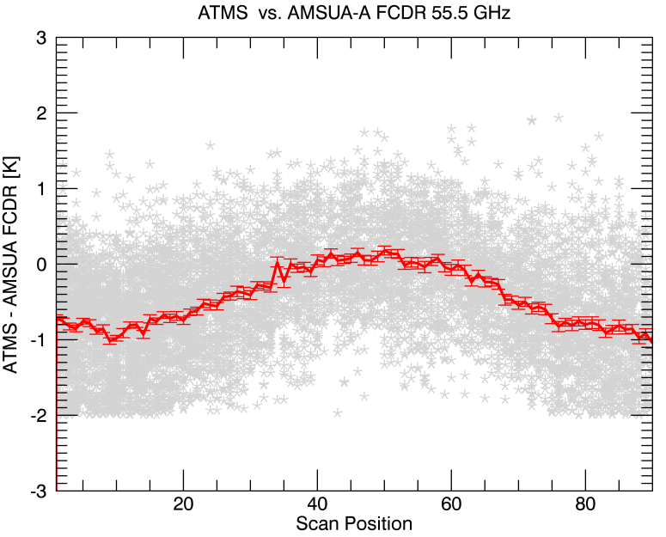
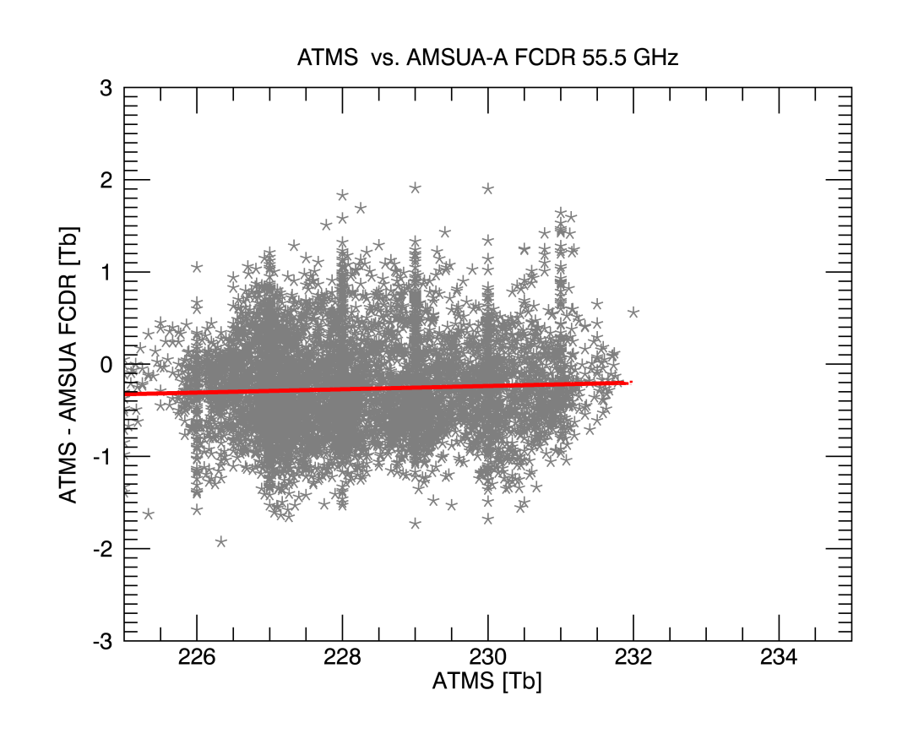
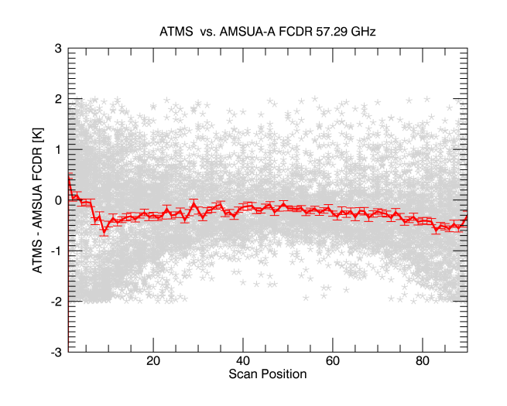
SATMS –AMSU-A 55.5 GhZ bias [NOAA-18]
Collocations extended to Oct 2016
Stable temperature dependent bias
Zenith angle dependence similar to model calculations
Offset = -0.29 K
Figure above shows pre-launch level of bias of SATMS
Figure right Shows the scan angle dependence of ATMS-SDR is within 1% of the Nadir view when compared with the limb corrected AMSU-MSU FCDR.

Slide 8
Summary
Rules of identifying in-orbit reference being formulated
We made progress with evaluating the AMSU/MSU FCDR as a in-orbit reference.
AMSU/MSU – SATMS Collocation data set extended to Oct 2016
AMSU/MSU – SATMS shows pre-launch level of temperature dependence and low scan angle dependence.
Further work underway to measure long time series.

Slide 9
THANK YOU

