Slide 1
MICROWAVE REMOTE-SENSING PROJECT UPDATE
David Walker
RF Electronics Division
NIST, Boulder, CO

Slide 2
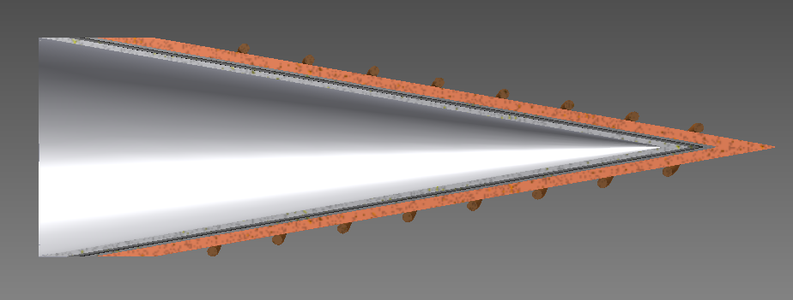
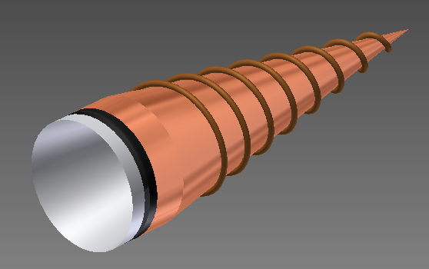
NIST BB Standard Target Design
Single open conical structure
Uniform emissivity $≈1$ over broad microwave frequency spectrum (18-220 GHz)
Minimal temperature gradients
Operating temperature range: 80 K to 350 K
Total U ≈ 0.1 K
foam insulation
conductive base
heat exchanger tubing
layered microwave absorber

Slide 3
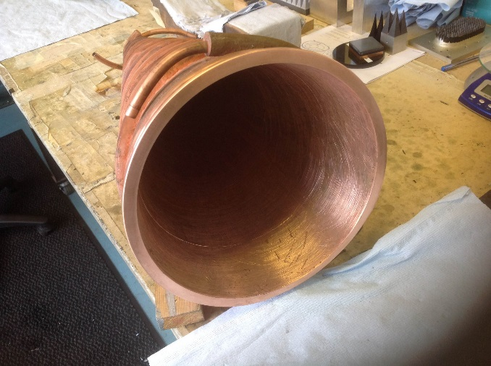
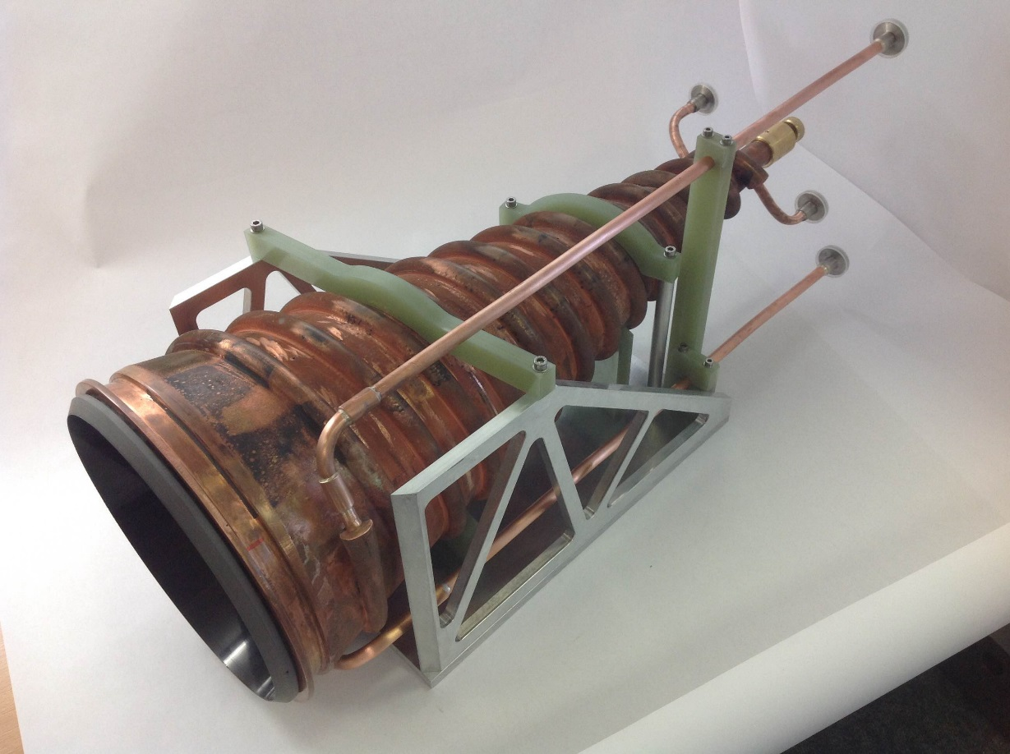
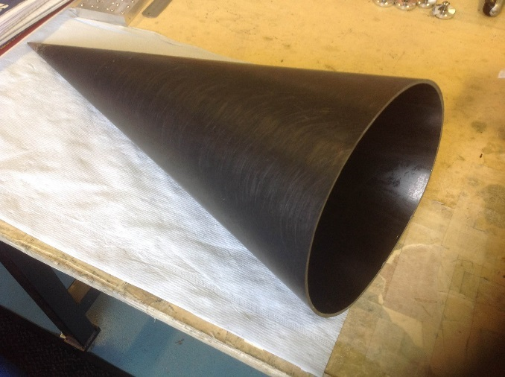
Primary Std Target
23 cm diameter aperture
Design frequency range 18 GHz to 220 GHz
Covers ATMS and MWS (MetOp SG sounder) bands
ANSYS 3D finite element solution
2D heat equation solution of cross section

Slide 4
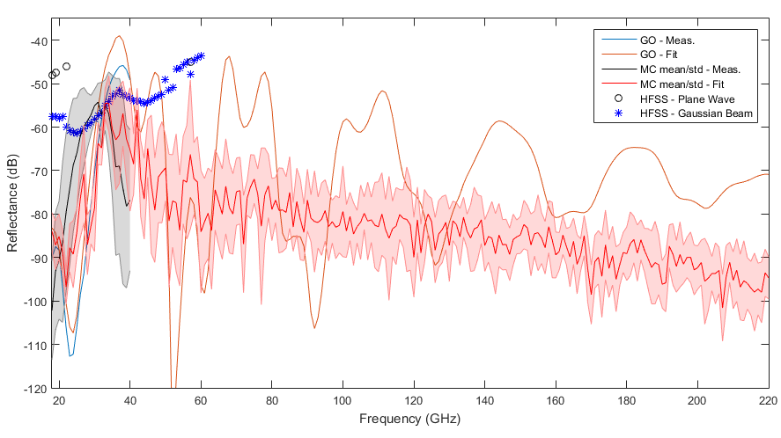
Performance Prediction

Slide 5
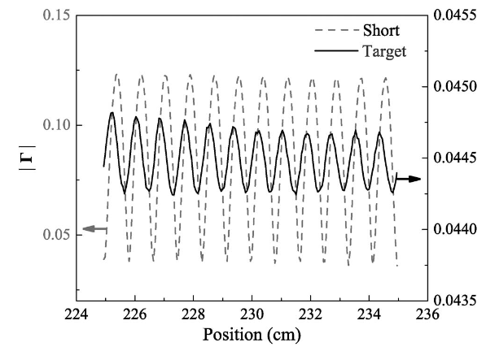
Emissivity Verification
Linear translation stage
2 μm repeatability (λ/680 at 220 GHz)
Allows characterization of emissivity (through reflectivity) by standing wave effect
Example data at 18 GHz:

Slide 6
Next Steps
Complete emissivity & thermal verifications
Smaller 13 cm dia. target under construction
(ATMS has two apertures; 23 cm & 13 cm)
MWS – ESA - Ville Kangas
Principal Instrument Engineer
ATMS – NASA (JPSS) - Ed Kim
Chief Instrument Scientist
~2019 calibration of both instruments
Near term: demonstrate cal xtr on smaller (ground-based) microwave radiometer

