Slide 1
Second Joint GSICS-IVOS
Lunar Calibration Workshop
China 2017

Slide 2
Some updates on GIRO + GLOD
At the last meeting, the following points were still on hold:
EUMETSAT’s internal procedure for Verification + Validation ➔by end September 2016 ➔ DONE
Code analysis to check license compliance ➔ by mid-October 2016 ➔ DONE
Preparation of a License Agreement to be agreed and signed by licensees = Condition for access to the GIRO + GLOD (following the policy presented at GSICS EP in May 2015) ➔ by end September 2016 ➔ DONE (almost ☺). Will be circulated soon for signature!
Set-up of an infrastructure for GIRO + GLOD on EUMETSAT’s website (web page with relevant information/documents + helpdesk service + link to GIRO + GLOD repositories) ➔ by end 2016 ➔ NOT DONE but on-going…

Slide 3
Some updates on GIRO + GLOD
Contains Moon observations from all instruments using GIRO ➔ please provide updates if required
Timeline for distribution = same as the GIRO
Distribution to GIRO source code and GLOD upon signature of the license agreement ➔ not blocked by the availability of the infrastructure

Slide 4
Some updates on GIRO + GLOD
Interaction with USGS to document the traceability of the GIRO to the ROLO:
Definition of the cases to be covered by the benchmark (benchmark purpose = testing systematically the GIRO against the ROLO + local implementations)
Documentation being written
Preparation of the cases – Not started (tentative GSICS annual meeting)
Will be part of the GLOD
Formalising the traceability
Preparation of a paper to be used as the reference to the GIRO for future publications
Mid-November = Final presentation of the study on the validation of SBAFs with lunar hyperspectral measurements by M. Krijger + R. Snel.
➔Identified potential follow-up projects. TBC how and when those projects would materialise…
Implementation of the inter-calibration scheme proposed at the GSICS annual meeting in 2016 ➔ prototype by end 2016. Need to liaise with NASA for MODIS + VIIRS data (NOAA?)

Slide 5
GSICS and GLOD usage policy
Please remember the policy…
So-far agreed by email but still, it is in place and shall be followed.
Link under the Lunar Calibration Algorithm Work Area (GSICS wiki): http://gsics.atmos.umd.edu/pub/Development/LunarWorkArea/GSICS-EP-16_Doc_13_GIRO-GLOD-policy.pdf

Slide 6
Second Lunar Calibration Workshop
Listing potential topics to be addressed…

Slide 7
From last web meeting
Co-organised and hosted by the Chinese Meteorological Administration
Where? China (place to be confirmed)
When? ➔ Q4 2017 but when in Q4: October / November / December?
Identified main topics with proposed chairmen:
Measurements and Moon observations (Scott Hu - CMA)
Using the ROLO/GIRO (Tom Stone - USGS)
Inter-calibration using the Moon (Seb Wagner or Tim Hewison - EUMETSAT)
Alternative methods and applications (Fred Wu - NOAA)

Slide 8
Measurements and Moon observations
Focus = measurement/observation campaigns + outcome of those campaigns (dataset, analysis, new model, better characterisation of existing model, etc.), with the purpose of improving the lunar calibration reference.
CMA to present the current status of its data analysis from the 2015-2016 activities.
Plans that CMA may have for future activities.
Use of CIMEL instruments for Moon irradiance measurement
Establish a comprehensive catalog / description / evaluation of existing data.
Scott ➔ invite NIST to present the status of their activities + update on the NASA ARCSTONE project
General discussion.

Slide 9
Using the ROLO/GIRO
Benchmarking tool and dataset
Benchmarking and traceability: has someone implemented its own version of the ROLO and would like to try the benchmark and report?
New development in the ROLO/GIRO
new spectral analysis and interpolation as a function of the phase, to replace the current mechanism that adjust the Apollo spectrum as a function of the phase.
new solar spectrum, that can accommodate hyperspectral instruments. This also will involve the outcome of GSICS/CEOS-IVOS discussions on a recommended solar spectrum.
Empirical phase angle dependence correction as interim measure
- and uncertainty
Based on AHI? PLEIADES? …
Spectral interpolation/fitting

Slide 10
Using the ROLO/GIRO
Uncertainties in lunar irradiance measurements from images:
Estimate the uncertainties on the oversampling factors
Polarisation sensitivity: impact of the polarisation on the results. Participants would assess the impact of the sensitivity of their instrument, either from pre-launch characterisation or derived from first principles.
Uncertainties on the evaluation of the deep space / dark current signal
Moon extraction method (histogram, thresholds, etc.)
The SCIAMACHY measurements as source of improvement for the ROLO/GIRO
New measurements processed by the ROLO/GIRO:
GOME-2 (aboard Metop-A and Metop-B)

Slide 11
Inter-calibration using the Moon
Focus = inter-calibration to a common reference + cross-calibration + inter-band calibration.
Inter-calibration: depending on the outcome of the work currently ongoing at EUMETSAT and JMA, could the participants implement the approach and report on the results?
Cross-calibration
Inter-band calibration:
Ensures spectral consistency in multi-channel instruments (Important for many L2 products)
when more bands are available, can the spectral consistency of the calibration results (inter-band calibration) bring more information about the ROLO/GIRO or about some limitations in its use?
If a channel is used as a reference channel (similarly to what is done in the Ocean Colour community for instance with MODIS and its 0.864micron band).
Some instruments have interband requirements: can we use the ROLO/GIRO to monitor the spectral consistency?
In case of departure from the expected behaviour, can inter-calibration correct the departing result(s)?

Slide 12
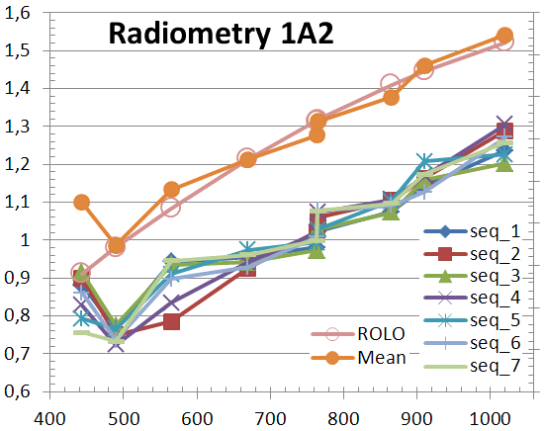
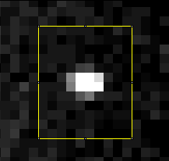
Inter-band calibration. Ex: PARASOL
CNES - B. Fougnie, Pers. Comm., 2014

Slide 13
Inter-calibration using the Moon
What about the VIIRS ocean colour calibration and its spectral consistency with respect to the ROLO?
Formulation of the inter-calibration method: irradiance differences/ratios/polynomials/…
Application of SBAF and propagation of uncertainties
Requires knowledge of GIRO uncertainty covariances

Slide 14
Alternative methods and applications
NOAA is developing a radiance model, based on AHI/ABI data. Update on using SELENE SP data or the radiance model developed by AIST?
Shall we issue an announcement to see what the current developments are in the astronomical (or other) community?
JAXA/AIST to present the current activities on the radiance map of the Moon?
Infrared band calibration/validation using the Moon (CMA has made some developments on this specific topic) - including MWIR (e.g. 3.9µm)

Slide 15
Additional topics?
Shall the Lunar Calibration Workshop address topics such as the characterisation post-launch of the MTFs and the characterisation of cross-talk?

