Slide 1
NOAA VIIRS Team
GIRO Implementation Updates
12/5/2016
Taeyoung (Jason) Choi, Xi Shao, Changyong Cao, Fuzhong Weng
For Lunar Calibration Web Meeting

Slide 2
Outline
Introduction
  About S-NPP VIIRS and on-board calibrators
Reflective Solar Band Calibration
  Solar Diffuser (SD) Calibration
  Lunar Calibration using GIRO
  Lunar Band Ratio (LBR)
Results
  About scheduled lunar collections
  Comparisons between SD and lunar F-factors
  Comparisons between SD and lunar band ratios
Summary

Slide 3
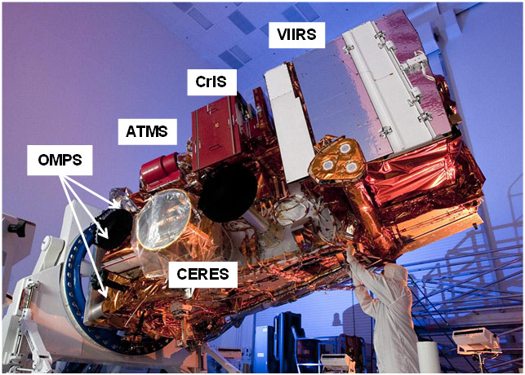
Introduction
The Suomi National Polar-orbiting Partnership (S-NPP)
Visible Infrared Imaging Radiometer Suite (VIIRS)
Descriptions of S-NPP VIIRS
  A whiskbroom scanning radiometer
  Sun synchronous orbit
  Field of view of 112.56⁰
  Nominal altitude of 829 km
  A large scan coverage of 3060 km
  Equator crossing local time of approximately 1:30 pm
  22 spectral bands covering a spectral range of 412nm to 12 μm.
From ICVS webpage http://www.star.nesdis.noaa.gov/icvs/index.php

Slide 4
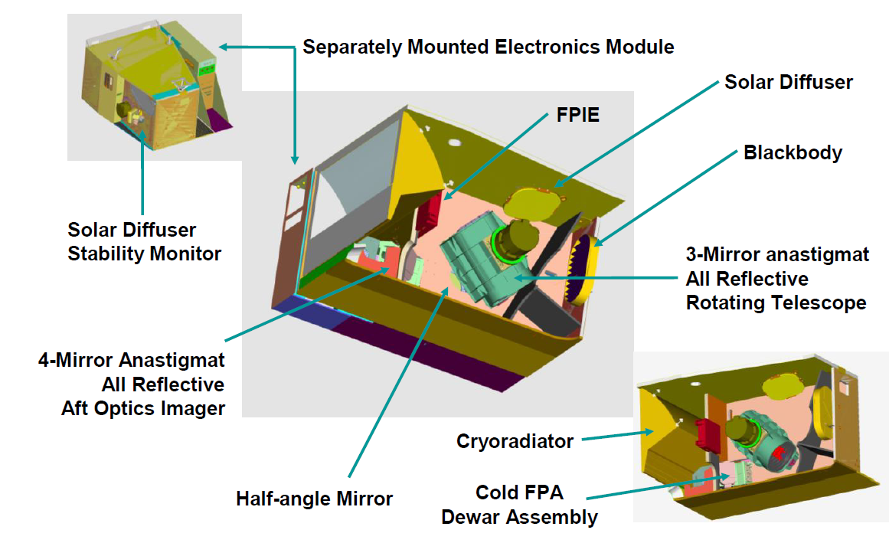
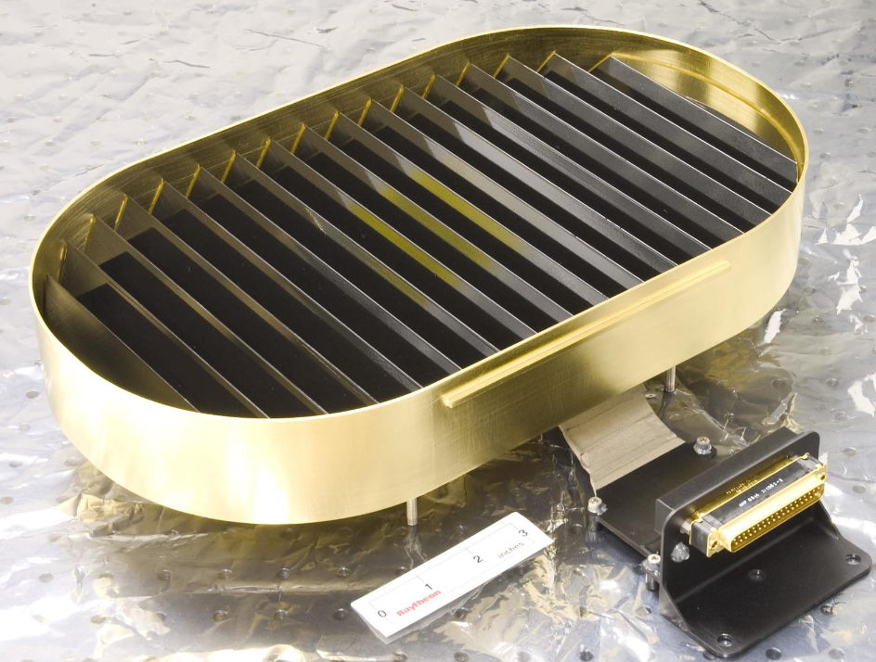
Introduction
Focal Plane Interface Electronics
Blackbody
From VIIRS Radiometric ATBD.

Slide 5
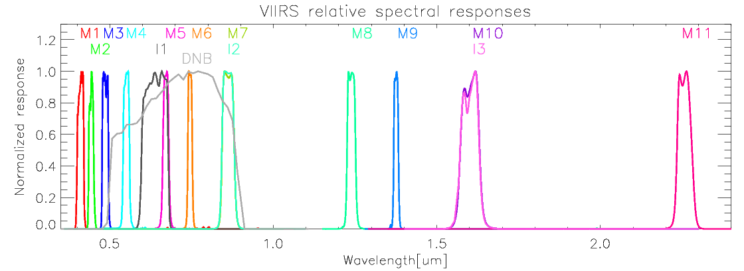
Introduction
Spectral Responses of the VIIRS RSB
  RSB cover a spectral range from 412nm to 2.25 μm.
  There are 14 RSB with 3 image bands (I1-I3) and 11 moderate bands (M1-M11).
  RSB band calibration is dependent on Solar Diffuser (SD) and Solar Diffuser Stability Monitor (SDSM) observations.
  The required RSB calibration uncertainty is 2 percent.

Slide 6
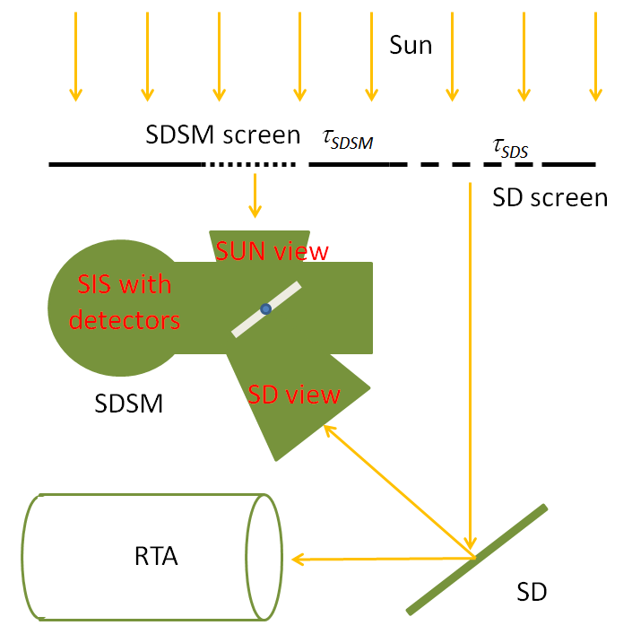
RSB Calibration: SD F-factor
The RSB F-factor is just a ratio of computed sun radiance from SD over observed SD radiance from the VIIRS detectors.
  dn_{SD} : offset corrected SD DN, RVS_{SD} : response versus scan function at the angle of SD, C_{0,1,2} : detectors and electronics temperature dependent calibration coefficients, θ_{inc}: solar incident angle to the SD screen, Esun :solar irradiance, τ_{sds} : screen transmittance function, BRDF: the BRDF function out of on-orbit yaw maneuvers, H(t): SD degradation over time

Slide 7
RSB Calibration: Lunar F-factor
Lunar F-factor: as the secondary calibration coefficient
The lunar F-factor is calculated as a ratio between the theoretical lunar irradiance and observed lunar irradiance.
  I_{GIRO} : band dependent lunar irradiance value from the the Global Space-based Inter-Calibration System (GSICS) Implementation of RObotic lunar observatory (GIRO v1.0.0) model (at https://gsics.nesdis.noaa.gov/wiki/Development/LunarWorkArea ), φ: moon phase angle, L_{Avg}: averaged radiance of the effective lunar pixels, R_{moon}: moon radius, Dist_{Sat_Moon}: distance between satellite and moon

Slide 8
RSB Calibration: Lunar Band Ratio (LBR)
Lunar Band Ratio (LBR)[1]
  Lunar data processing
    Lunar area is properly trimmed.
    Based on all the valid bias corrected lunar pixels.
    Bias is calculated from the background value.
  LBR is calculated using M11 as a reference band
LBR is compared to the SD F-factor ratios
  Using M11 as a reference band.
[1] Choi, T., Shao, X., Cao, C., Weng, F., Radiometric Stability Monitoring of the Suomi NPP Visible Infrared Imaging Radiometer Suite (VIIRS) Reflective Solar Bands Using the Moon. Remote Sens. 2016, 8, 15.

Slide 9
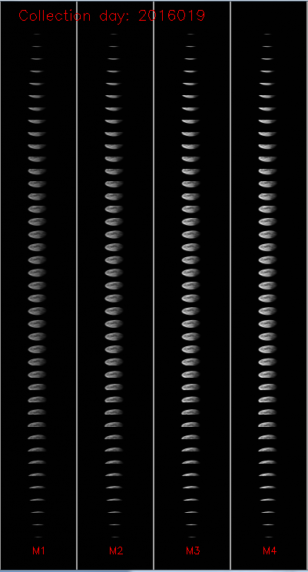
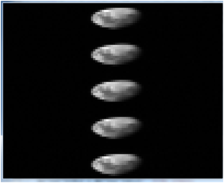
Results
Scheduled Lunar Collection
  Moon observation made through the Space View (SV) as shown the Figure.
  During the sector rotation, the VIIRS observations are set to be fixed High Gain (HG) mode.
  Spacecraft roll maneuvers are required.
  To avoid the complex oversampling factor calculation,
    Center 5 scans with full moon in the entire scan are used.
    Recently changed to 4 scans.
Scheduled lunar collection example image on Jan. 19th, 2016.

Slide 10
Results
Table 1. Dates and phase angles of the scheduled lunar collections.
Lunar phase angles are very consistent.
Date | Time | Phase Angle | Date | Time | Phase angle
04-02-2012 | 23:05:32 | -51.24 | 10-04-2014* | 17:29:33 | -50.80
05-02-2012 | 10:20:25 | -50.92 | 11-03-2014 | 01:08:00 | -50.52
10-25-2012 | 06:58:38 | -51.01 | 12-31-2014 | 19:38:32 | -50.73
11-23-2012 | 21:18:43 | -50.73 | 01-30-2015 | 08:22:39 | -51.16
12-23-2012 | 15:01:16 | -50.90 | 03-30-2015 | 16:49:30 | -51.29
02-21-2013 | 09:31:50 | -50.71 | 04-29-2015 | 12:29:48 | -50.43
03-23-2013 | 03:29:24 | -51.15 | 05-29-2015 | 04:47:30 | -51.07
04-21-2013 | 19:48:16 | -50.82 | 06-27-2015* | 14:17:10 | -54.42
10-14-2013 | 21:39:42 | -50.94 | 11-22-2015 | 04:20:49 | -50.76
11-13-2013 | 06:58:03 | -50.66 | 12-21-2015 | 13:36:09 | -50.30
12-12-2013 | 19:36:11 | -50.39 | 01-19-2016 | 22:55:10 | -50.41
01-11-2014 | 10:00:10 | -51.30 | 02-18-2016 | 08:18:40 | -51.09
02-10-2014 | 05:34:37 | -51.03 | 03-18-2016 | 21:08:48 | -50.82
03-12-2014 | 01:12:08 | -51.05 | 04-17-2016 | 11:43:36 | -50.62
04-10-2014 | 20:53:40 | -50.60 | 05-17-2016 | 04:01:21 | -50.47
05-10-2014 | 13:13:21 | -50.91 | 06-15-2016 | 18:36:33 | -51.58
06-09-2014* | 03:49:02 | -51.04

Slide 11
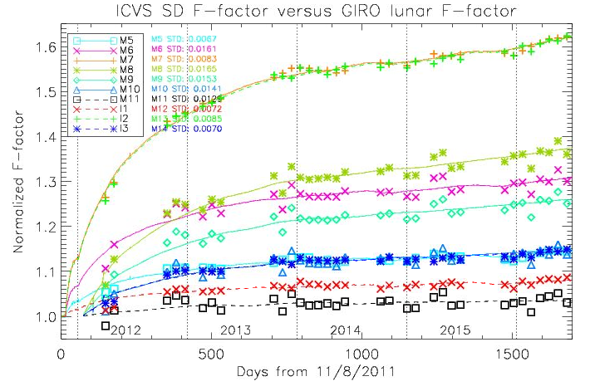
SD and Lunar F-factor comparisons
The two F-factors need to be normalized (or scaled) properly because of the different solar irradiance models.
  The SD F-factors (solid lines) are normalized
The best fitting scaling factors are calculated and applied for lunar F-factors (symbols).

Slide 12
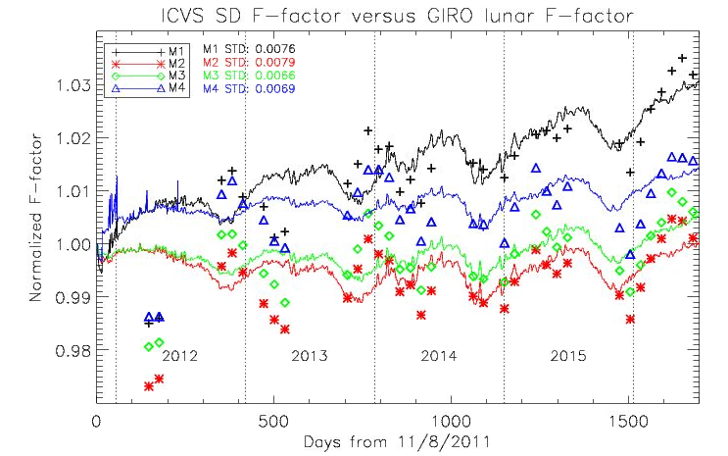
SD and Lunar F-factor comparisons
The lunar F-factors show excellent agreements in bands M1~M4 with 1-σ STD values < 1%.
  Including annual oscillation patterns.
The first two points are outliers
Oscillation patterns are matching from mid 2013.

Slide 13
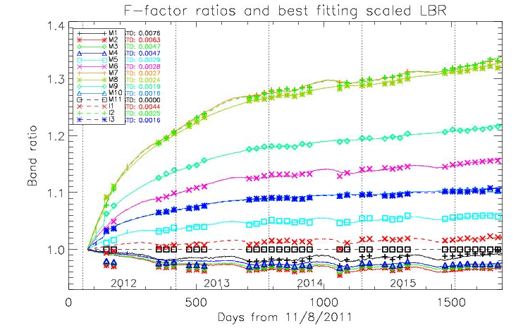
SD and Lunar Band Ratio (LBR)
1-σ STD values are less than 1% in all bands.

Slide 14
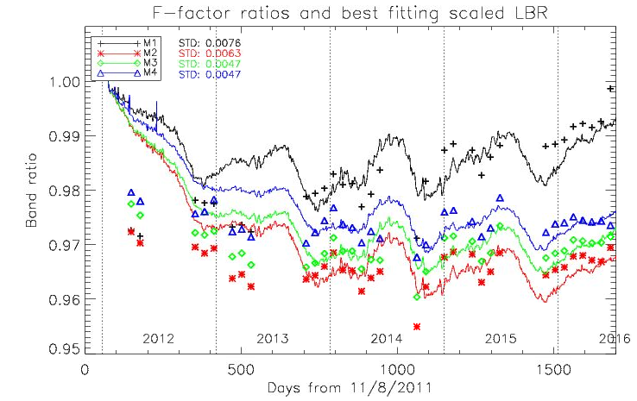
SD and Lunar Band Ratio (LBR)
Zoomed in for M1~M4
  LBR and F-factor ratios are very consistent except the first two points.
  Similar to F-factor comparison, annual oscillation patterns are also similar.
  The LBR plots are available in NOAA’s Integrated Calibration & Validation System (ICVS) webpage at http://www.star.nesdis.noaa.gov/icvs/status_NPP_VIIRS.php.
Not enough evince of long-term differences between SD and LBR

Slide 15
Summary
NOAA VIIRS team successfully implemented GIRO to monitor primary SD calibration.
The SD and lunar F-factors show very reasonable agreements mostly < 2% 1-σ STD.
  Possible early lifetime differences in the short wavelength bands from M1 to M4.
  Annual variation patterns are very similar.
  The SD F-factor correction using lunar trending needs more evidences.
    Such as DCC, pseudo invariant Cal. site trending, SNO x-calibration, etc.
The LBR also validated lunar F-factors with SD band ratios.
  The LBR results also showed calibration Diffs. in band M1 to M4.
  Annual variation patterns are very similar.
The moon is a very important source of independent radiometric calibration for any on-orbit imaging sensor in the visible and near inferred bands.

