Slide 1
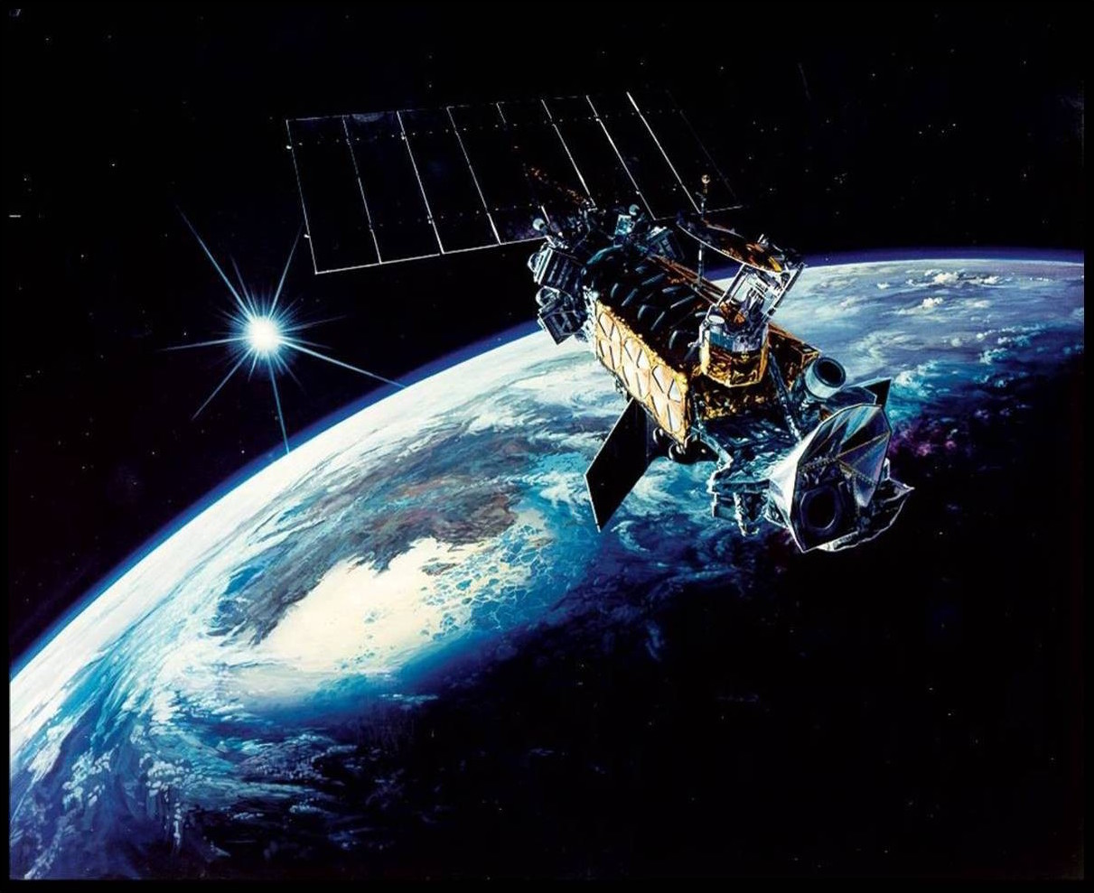
Inter-calibration of UTH-related radiances from SSM/T-2 and AMSU-B Johnny Luo¹, Jeyavinoth Jeyaratnam¹, Nazia Shah¹, William B. Rossow¹, and Ralph Ferraro² ¹City College of City University of New York ²NOAA/NESDIS/STAR

Slide 2
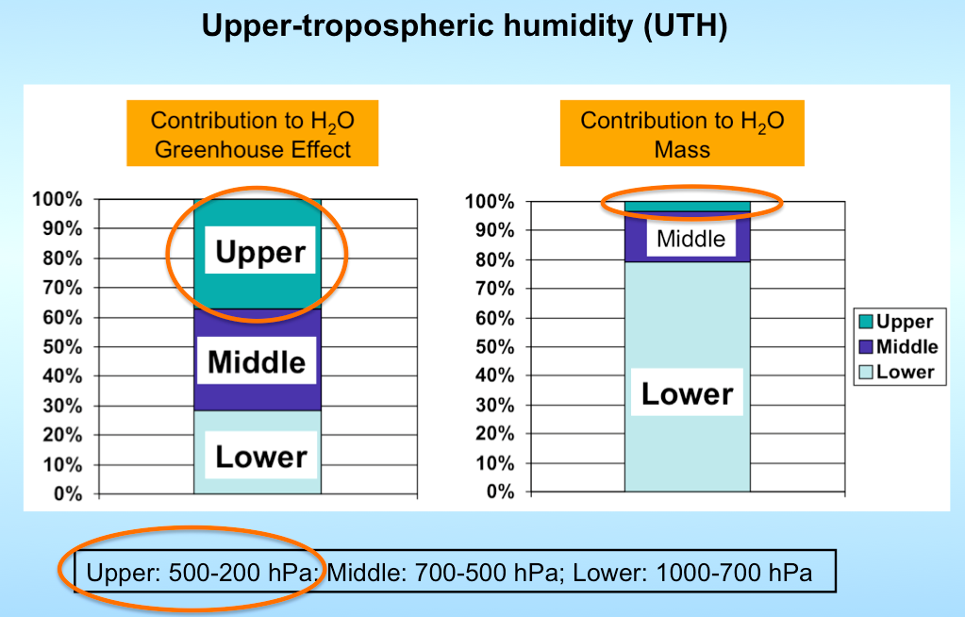
CDR (Climate Data Record) Project Description
Goal: “…bring together all the upper-tropospheric humidity (UTH)-related radiance data from multiple satellites and process them to establish a long-term, global, inter-calibrated radiance record from which UTH can be retrieved and UTH research can be conducted.”

Slide 3
CDR (Climate Data Record) Project Description
Goal: “…bring together all the upper-tropospheric humidity (UTH)-related radiance data from multiple satellites and process them to establish a long-term, global, inter-calibrated radiance record from which UTH can be retrieved and UTH research can be conducted.”

Slide 4
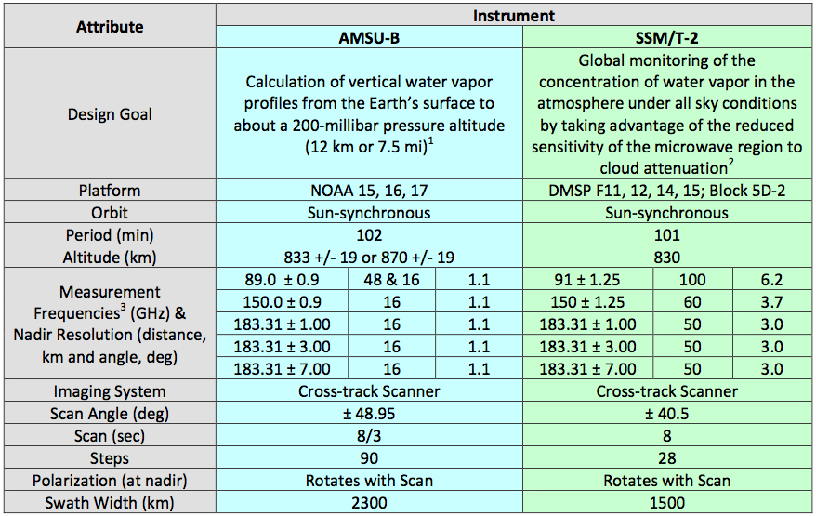
SSM/T-2 and AMSU-B

Slide 5
Datasets & Inter-calibration Methods
Datasets
SSM/T-2: F11, F12, F14 and F15 (1992-2008), obtained from Dan Kowal of NGDC and Hilawe Semunegus of NCDC (now NCEI)
AMSU-B: NOAA15 (so far), obtained from Ralph’s group (NESDIS/STAR), data range: 2000 onward
Methods
Zonal averages (all)
Zonal averages (tropical ocean)
Simultaneous nadir overpasses (SNOs)
Comparison with sounding (MOZAIC takeoff & landing) using RTM
Reference: John, V. O. et al. (2013), Assessment of intercalibration methods for satellite microwave humidity sounders, J. Geophys. Res. Atmos., 118, 4906–4918, doi:10.1002/jgrd.50358.

Slide 6
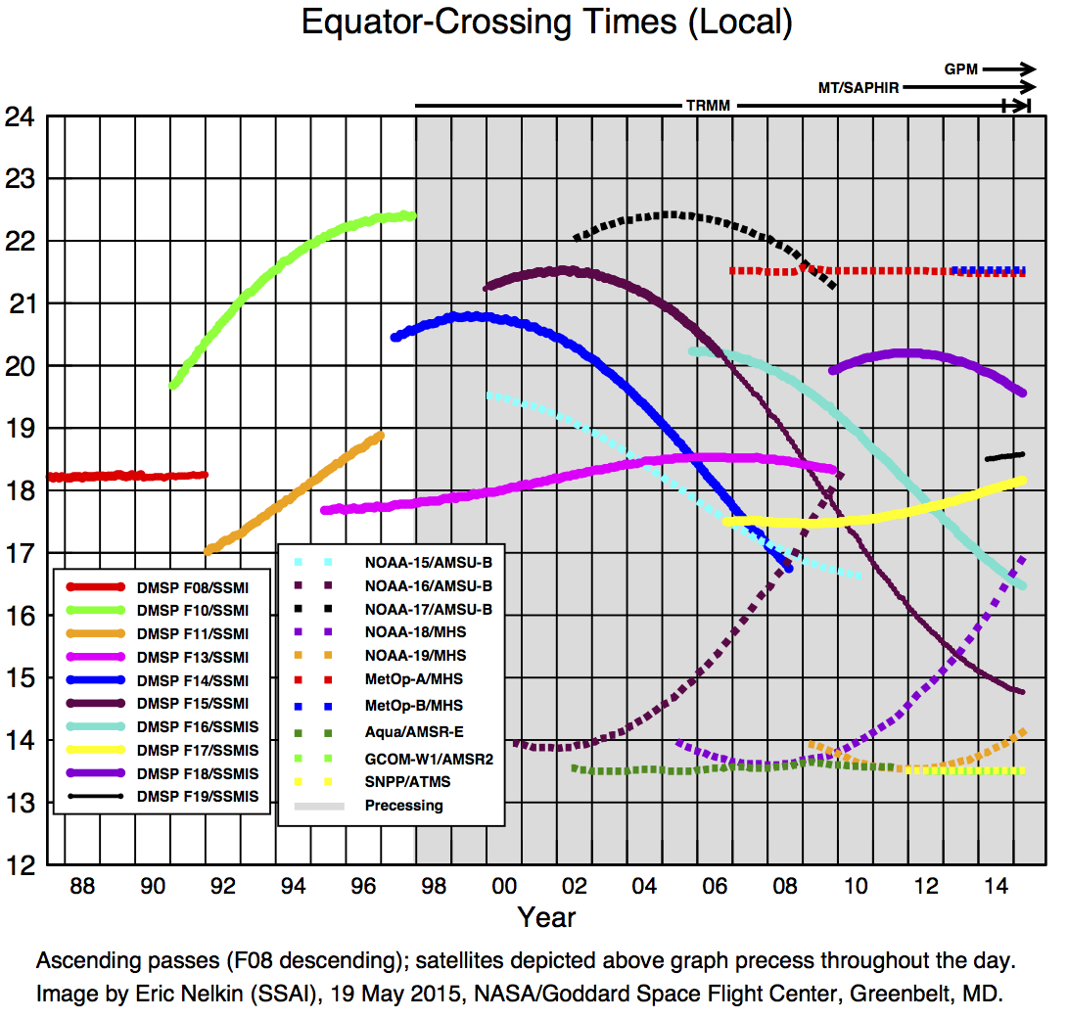
F15
F14
F11
F13

Slide 7
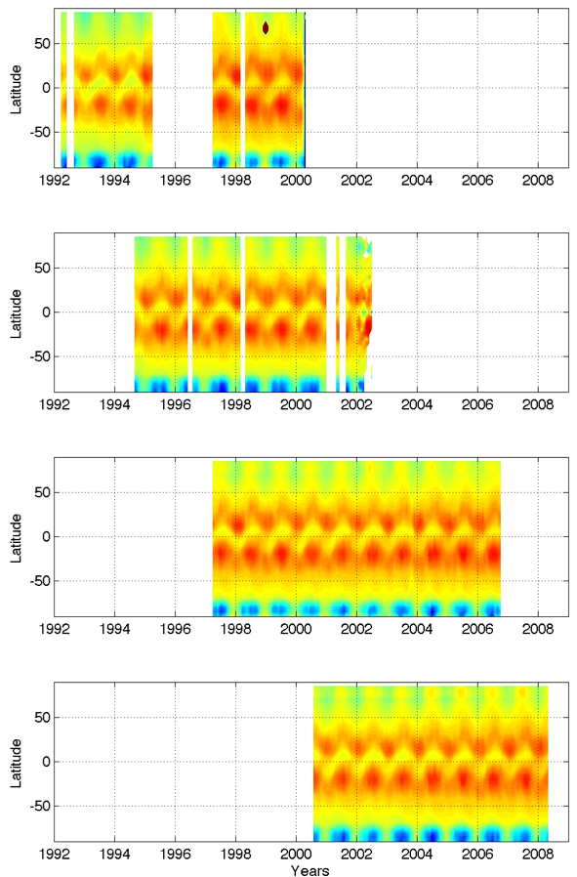
Production Approach
SSM/T2 TB(183±1 GHz), monthly, zonal means
(Use SSM/T2 as an example)
F-11
Uncalibrated, raw SSM/T2 data (Two versions: one from NESDIS and the other from NGDC)
F-12
Granularize and quality control
Apply various calibration methods
F-14
Append ISCCP cloud info
UTH FCDR
F-15

Slide 8
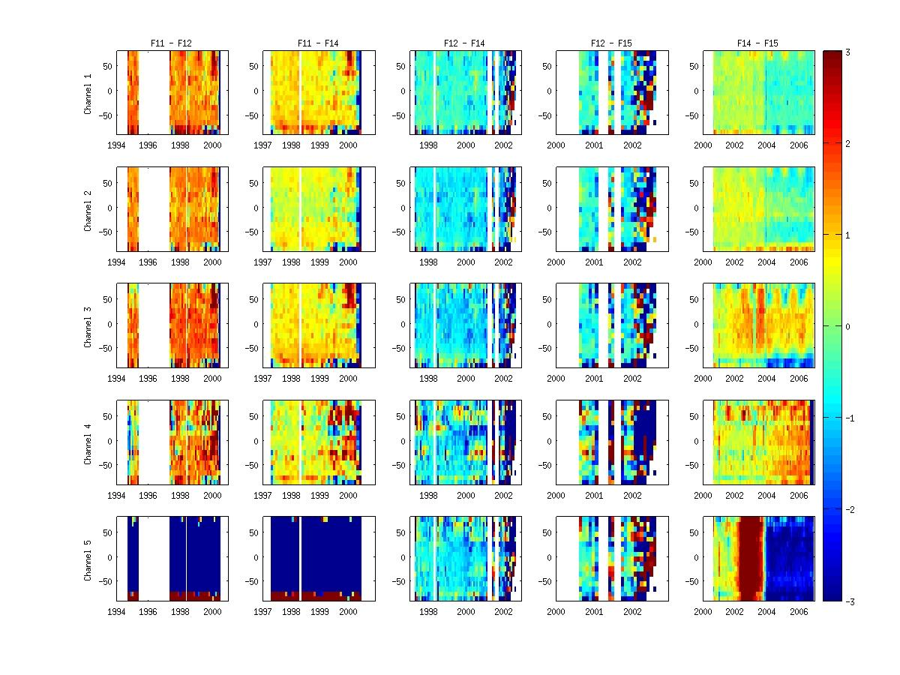
Zonal mean
F11 – F12
F11 – F14
F12 – F14
F12 – F15
F14 – F15
183±3
183±1
183±7
92
150

Slide 9
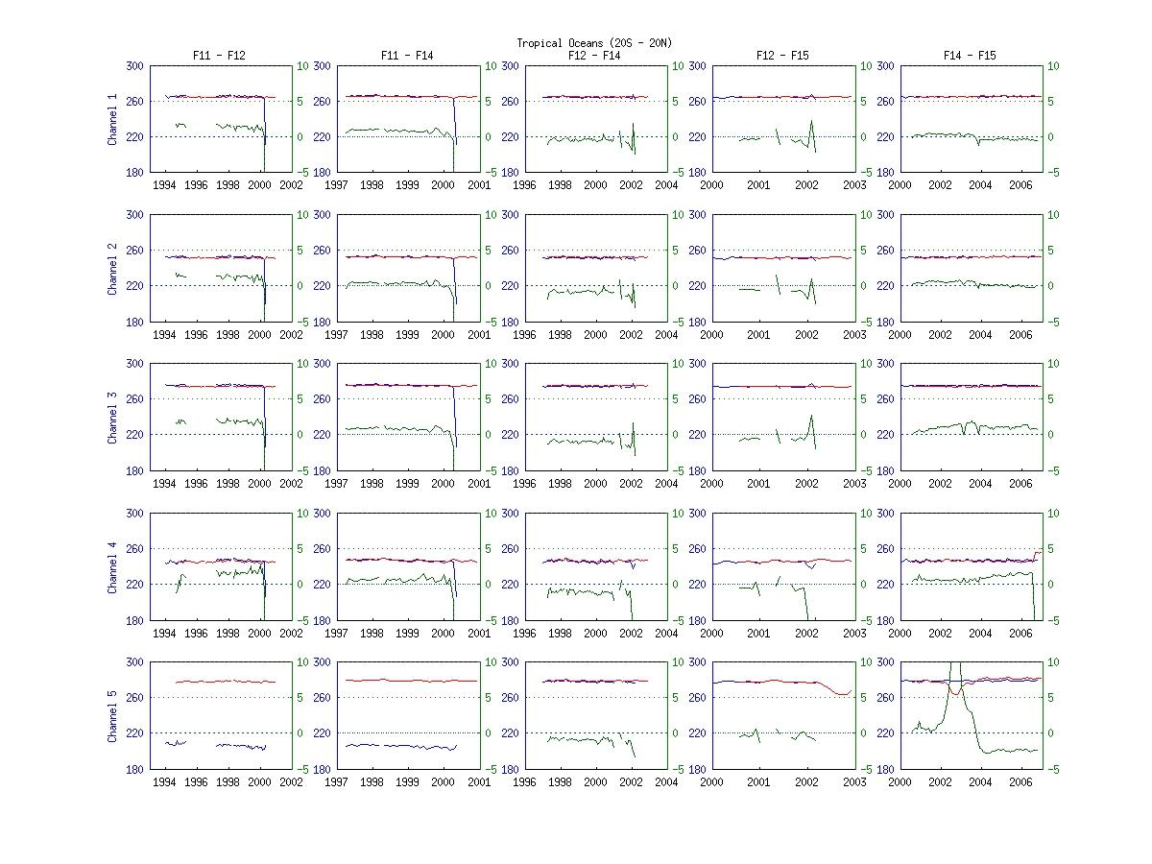
Tropical Oceans
F11 – F12
F11 – F14
F12 – F14
F12 – F15
F14 – F15
183±3
183±1
183±7
92
150

Slide 10
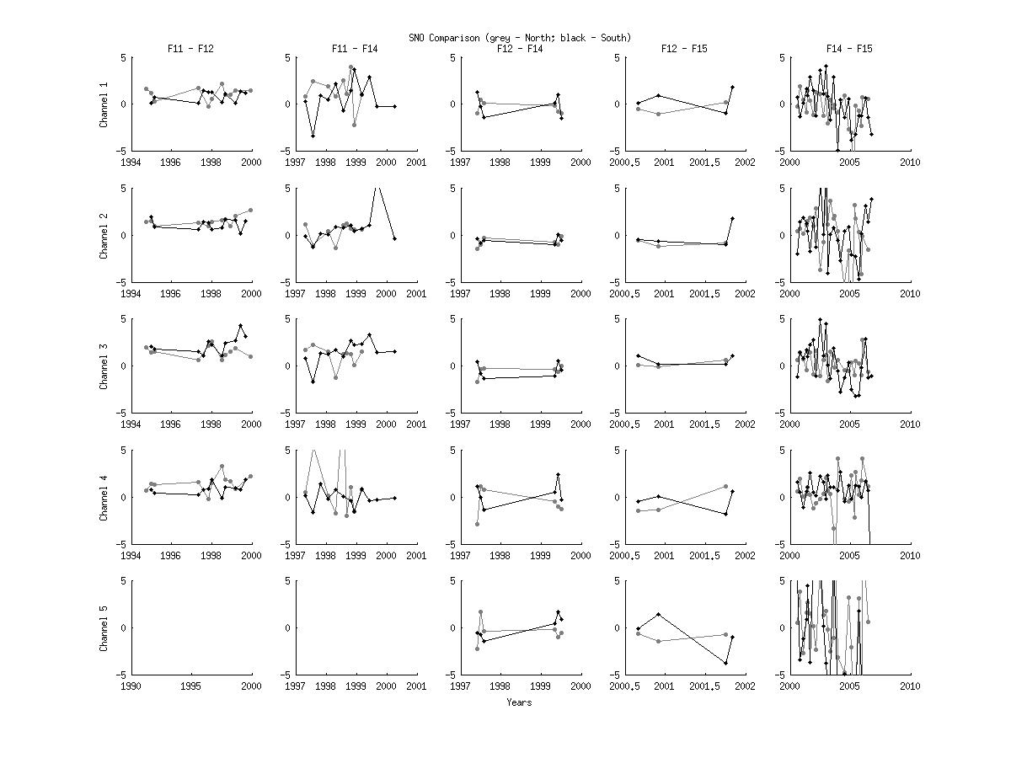
SNO
F11 – F12
F11 – F14
F12 – F14
F12 – F15
F14 – F15
183±3
183±1
183±7
92
150

Slide 11
Relative Calibration (on a broad brush):
F14 was used as the base;183±1 GHz as an example
F11 was warmer than F14 by ~0.5K
F12 was colder than F14 by ~1K
F15 was warmer than F14 by ~0.5K (before 2004; after that, bias decreases to close to 0K)
(Theses bias estimations do not include some sudden changes)

Slide 12
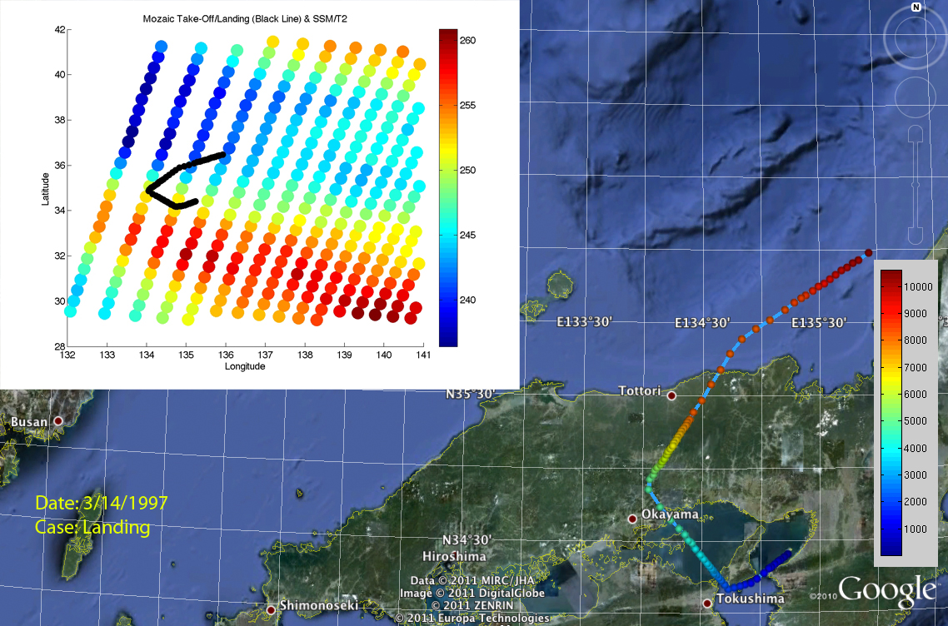
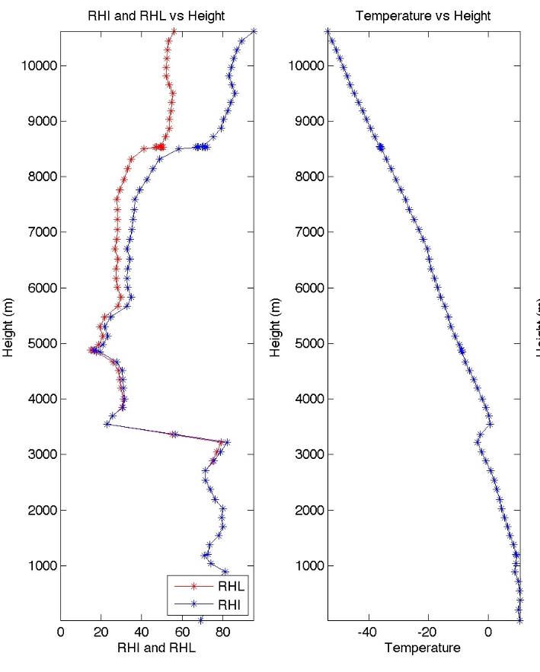
“Profiling” ability of MOZAIC.
~ 150 km

Slide 13
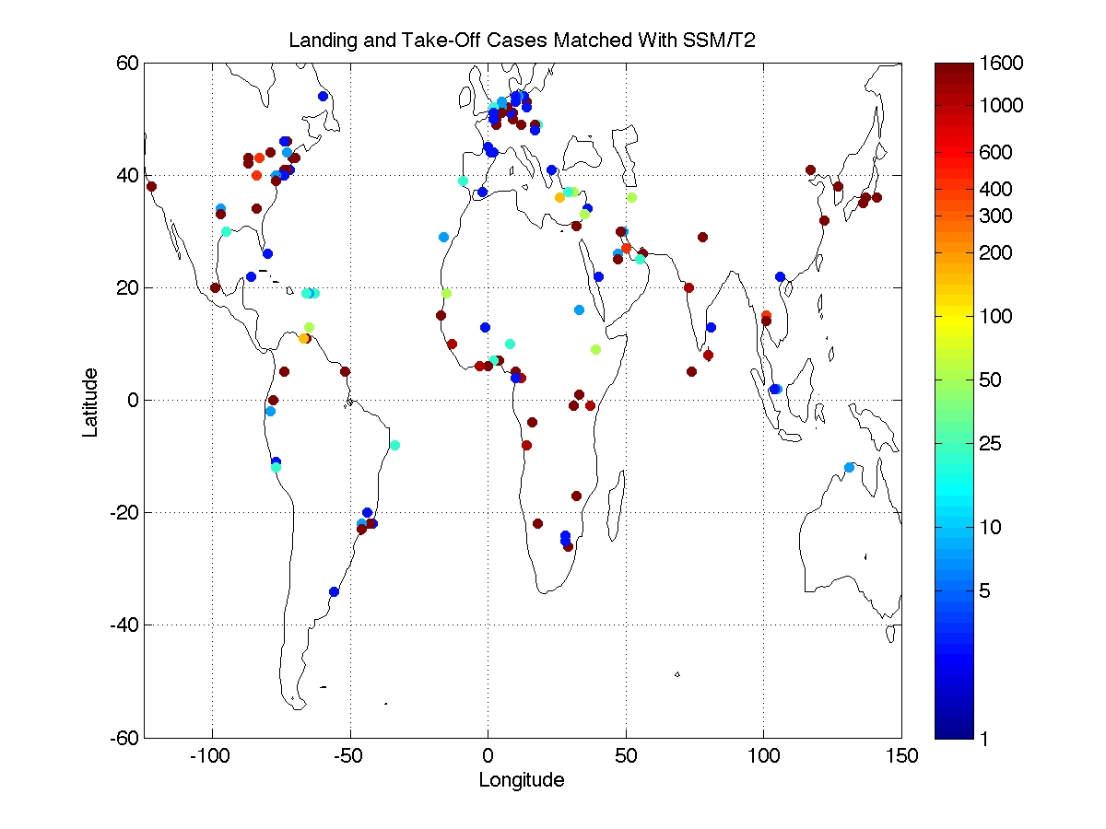
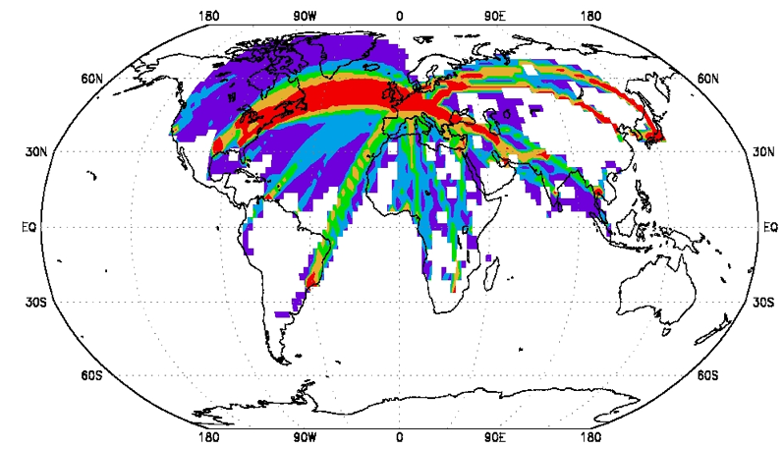
Number of MOZAIC ascent/descent matched with SSM/T2

Slide 14
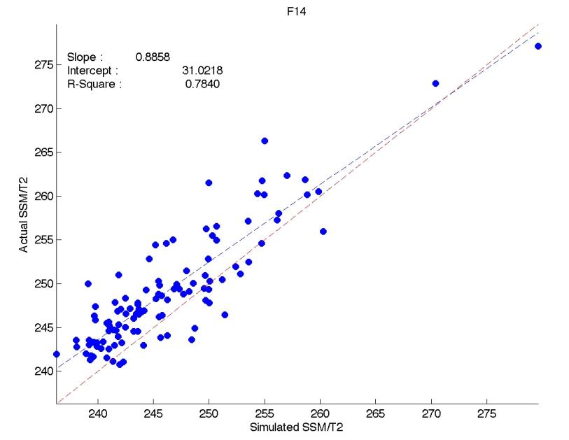
183±1 GHz

Slide 15
F14
NOAA-15

Slide 16
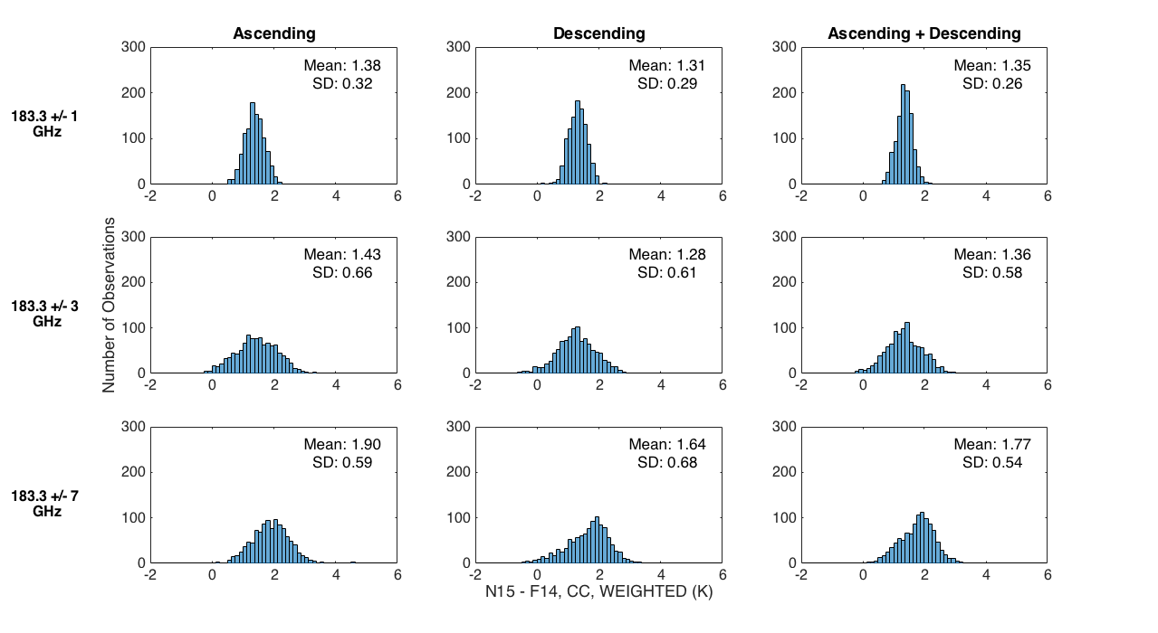
NOAA15 - F14

Slide 17
Zonal averages: AMSU-B is generally warmer than SSM/T-2 by
1.35 ± 0.26 K for 183.3 ± 1 GHz
1.36 ± 0.58 K for 183.3 ± 3 GHz
1.77 ± 0.54 K for 183.3 ± 7 GHz

Slide 18
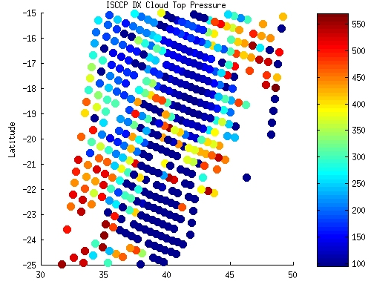
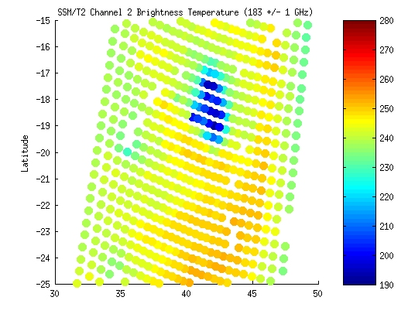
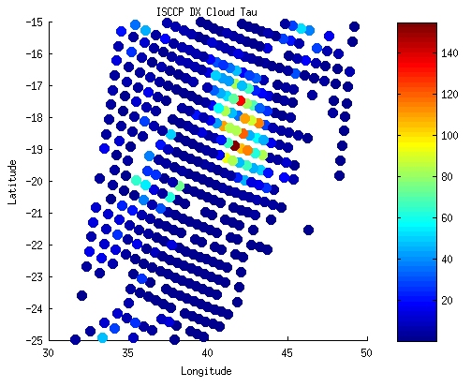
ISCCP Cloud-top pressure (hPa)
An important ancillary data for UTH CDR are clouds, because certain clouds (e.g. deep convection) can contaminate UTH radiances and need to be marked up.
SSM/T2 TB(183±1 GHz) swath data
An example of deep convection contamination
ISCCP cloud optical depth

