Slide 1
Reference Solar Spectrum Considerations
Greg Kopp
Univ. of Colorado / LASP &
Max-Planck-Institut für Sonnensystemforschung

Slide 2
Disclaimer
I have no bias and I’m not presenting my “favorite” spectrum
I’m presenting an approach to creating a reference spectrum for the community

Slide 3
What Does Community Need?
Creating a reference with broad applicability requires addressing diverse community needs
Applications include
Solar physics (high time cadence; UV spectra)
Climate research (long-term variations with solar-cycle stability; accuracy)
Atmospheric modeling (UV spectra; seasonal stability)
What do users want? Everything!
Good spectral resolution
Broad spectral range
Different solar-activity types

Slide 4
Suggested Approach
Use a composite: Reference will require a composite with inputs from several instruments
No single instrument provides full spectral range with narrowest spectral resolution
Enhance with solar-atmospheric models: NLTE solar-atmospheric models can provide spectral resolution and range not achieved by accurate, space-based instruments
But these rely on space-based instruments for absolute accuracy
Time-extend with solar-irradiance models: Solar-irradiance models can relate spectra under different temporal and activity conditions
Can extend to times when observations were unavailable

Slide 5
Get Beyond Individual(’s) Spectra
Dataset | Wavelength |  | Resolution | Time Range |  | Accuracy | Stability |  | Dataset Summary & Reference
 | Minimum [nm] | Maximum [nm] | [nm] | Minimum | Maximum | [%] | Solar-Cycle [%] | 27-Day [%]
ATLAS 1 | 0.5 | 2,400.0 |  | 1992 |  | 3.0% |  |  | Observationally-based composite spectrum of high solar activity
ATLAS 3 | 0.5 | 2,400.0 |  | 1994 |  | 3.0% |  |  | Observationally-based composite spectrum of low solar activity; used as "standard" spectrum
Whole Heliosphere Interval (WHI) | 0.1 | 2,400.0 | 0.1 | 10-Apr-2008 | 16-Apr-2008 |  |  |  | Space-based observational composite spectrum of quiet Sun at solar minimum; Woods et al., GRL, 2008
SAO2010 | 200.0 | 1,001.0 | 0.04 |  |  | 5.0% |  |  | Observationally-based composite; Chance, K. & Kurucz, R. L., J. of Quantitative Spectroscopy and Radiative Transfer, 111, #9
Solar Radiation Physical Model (SRPM) | 200.0 | 100,000.0 |  |  |  |  |  |  | Computationally-based NLTE spectrum of quiet Sun; Fontenla et al., ApJ, 707, 2009, doi: 10.1088/0004-637X/707/1/482
SOLSPEC SOLAR 2 | 200.0 | 2,400.0 |  | 2008 |  | 3.0% |  |  | SOLSPEC instrument on ISS at solar minimum; Gerard Thuillier et al., Solar Physics, 2015, 290 (6), doi:10.1007/s11207-015-0704-1
SATIRE | 115.0 | 160,000.0 | 1.0 | 1610 | present |  |  |  | Semi-empirical physical model-based spectrum of Sun; daily values; Krivova et al., 2010, JGR doi:10.1029/2010JA015431
NRLSSI | 120.0 | 100,000.0 | 1.0 | 1610 | present |  |  |  | Empirical model-based spectrum of Sun; daily values since 1882; Coddington et al., BAMS, 2016, doi:10.1175/BAMS-D-14-00265.1
Code for Solar Irradiance (COSI) |  |  |  |  |  |  |  |  | Computationally-based NLTE spectrum; Shapiro et al., A&A, 517, 2010, doi:10.1051/0004-6361/200913987
Kurucz Model Spectrum |  |  | 0.02 |  |  |  |  |  | Computationally-based NLTE spectrum based on KPNO FTS
Need to fill in a table of possible inputs rather than focus on each individually
Speakers should provide perspective on their presented spectra for it to be beneficial to group

Slide 6
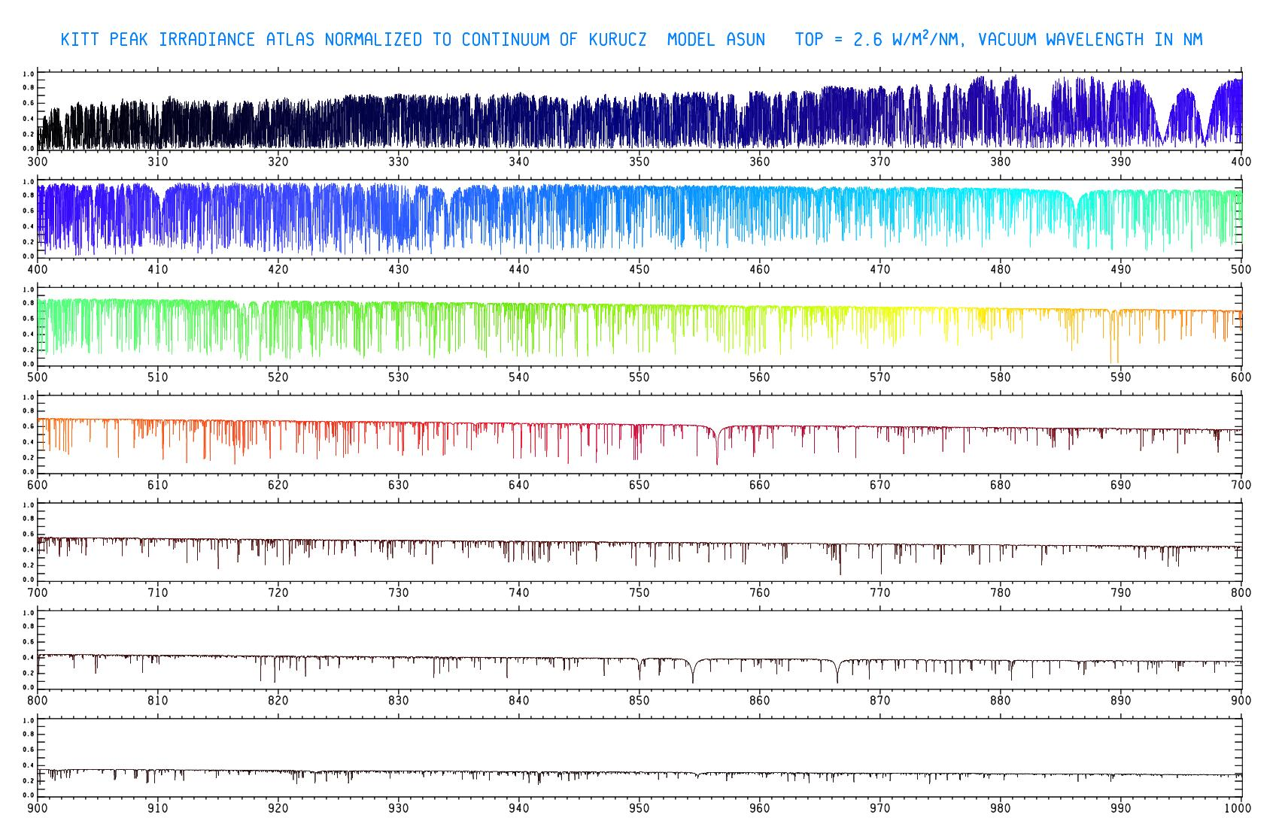
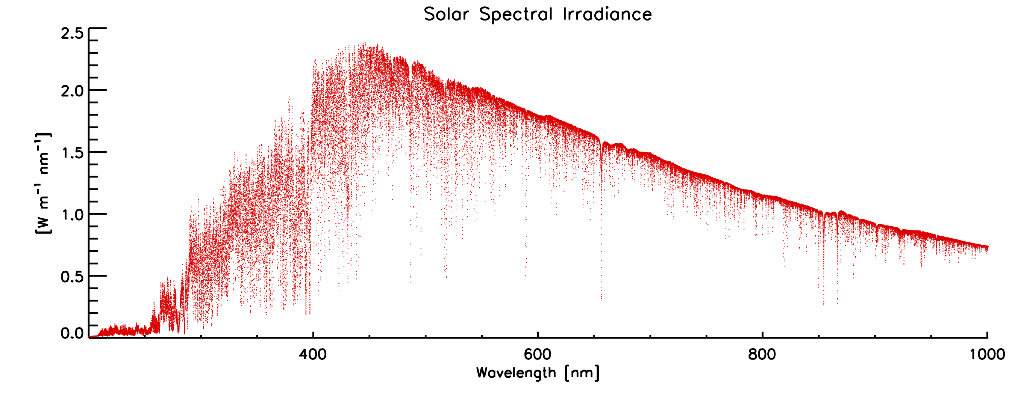
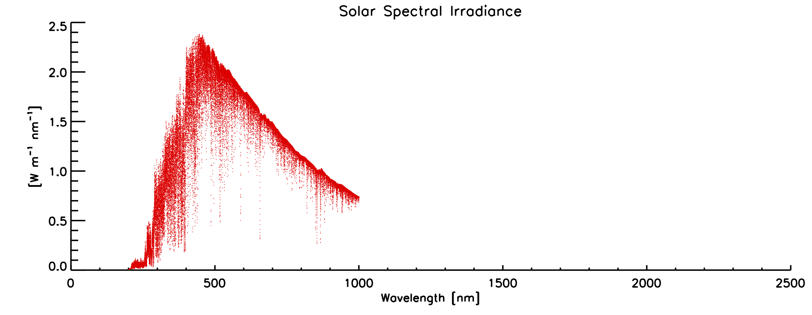
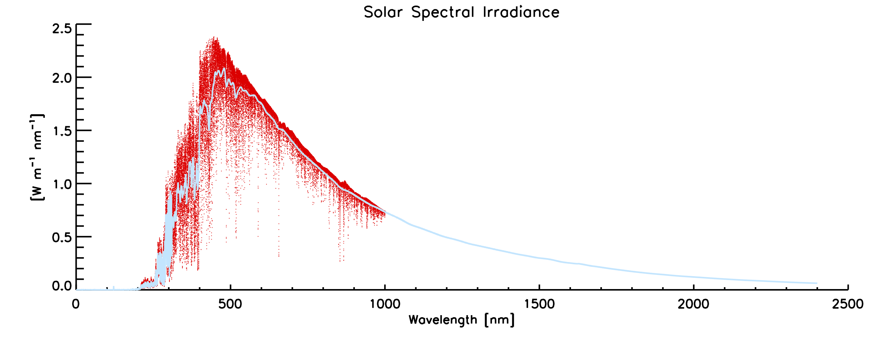
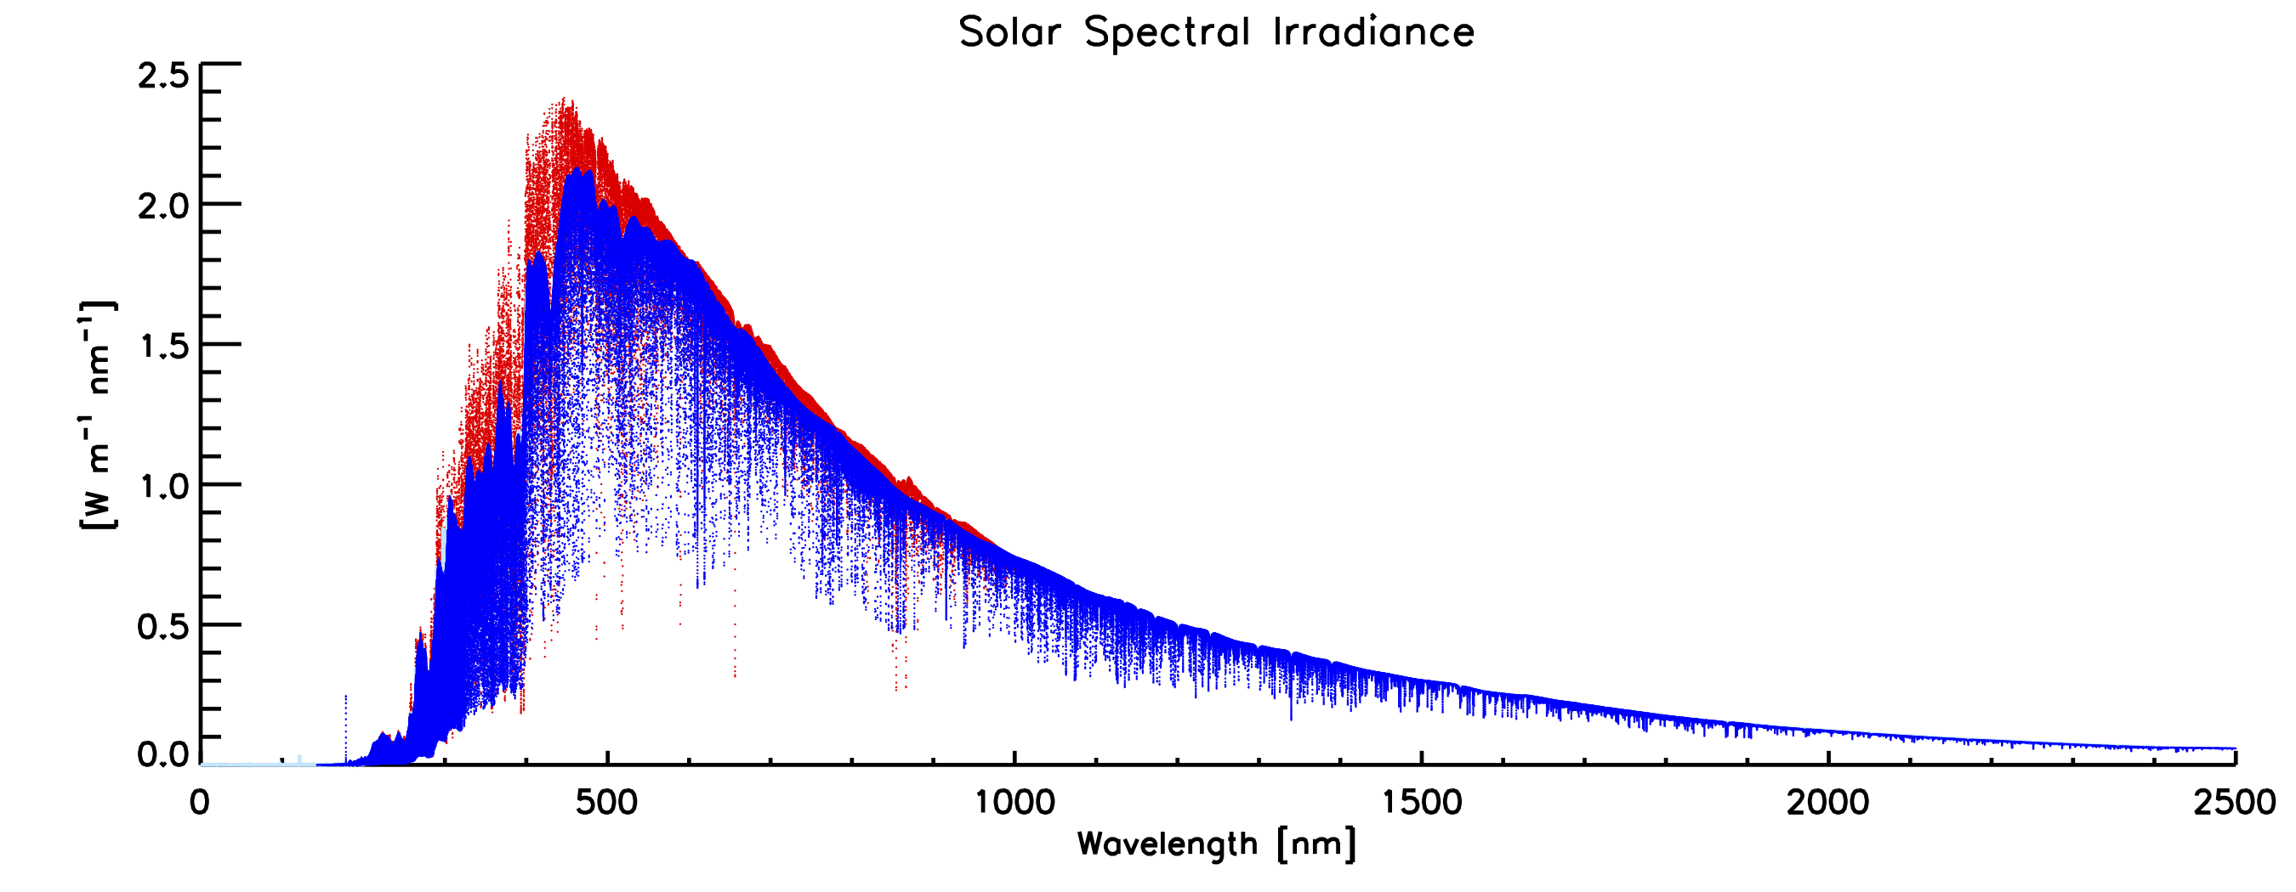
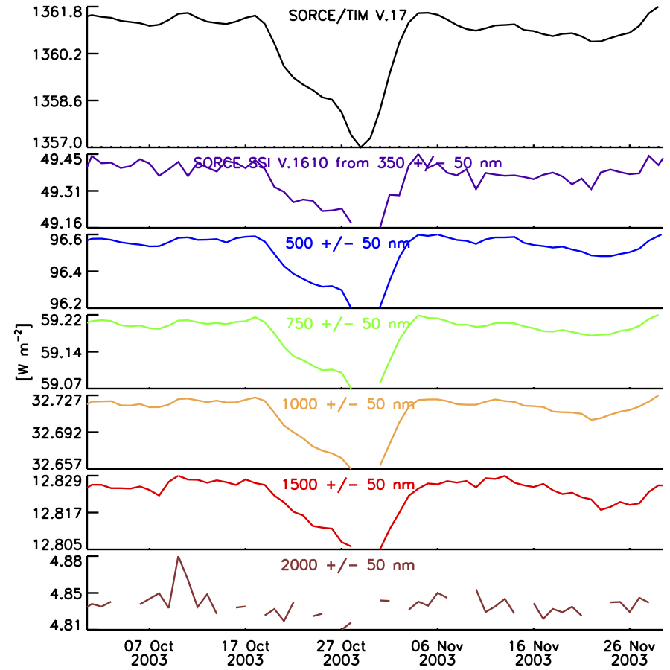
Example
Dataset | Wavelength |  | Resolution | Time Range |  | Accuracy | Stability |  | Dataset Summary & Reference
 | Minimum [nm] | Maximum [nm] | [nm] | Minimum | Maximum | [%] | Solar-Cycle [%] | 27-Day [%]
ATLAS 1 | 0.5 | 2,400.0 |  | 1992 |  | 3.0% |  |  | Observationally-based composite spectrum of high solar activity
ATLAS 3 | 0.5 | 2,400.0 |  | 1994 |  | 3.0% |  |  | Observationally-based composite spectrum of low solar activity; used as "standard" spectrum
Whole Heliosphere Interval (WHI) | 0.1 | 2,400.0 | 0.1 | 10-Apr-2008 | 16-Apr-2008 |  |  |  | Space-based observational composite spectrum of quiet Sun at solar minimum; Woods et al., GRL, 2008
SAO2010 | 200.0 | 1,001.0 | 0.04 |  |  | 5.0% |  |  | Observationally-based composite; Chance, K. & Kurucz, R. L., J. of Quantitative Spectroscopy and Radiative Transfer, 111, #9
Solar Radiation Physical Model (SRPM) | 200.0 | 100,000.0 |  |  |  |  |  |  | Computationally-based NLTE spectrum of quiet Sun; Fontenla et al., ApJ, 707, 2009, doi: 10.1088/0004-637X/707/1/482
SOLSPEC SOLAR 2 | 200.0 | 2,400.0 |  | 2008 |  | 3.0% |  |  | SOLSPEC instrument on ISS at solar minimum; Gerard Thuillier et al., Solar Physics, 2015, 290 (6), doi:10.1007/s11207-015-0704-1
SATIRE | 115.0 | 160,000.0 | 1.0 | 1610 | present |  |  |  | Semi-empirical physical model-based spectrum of Sun; daily values; Krivova et al., 2010, JGR doi:10.1029/2010JA015431
NRLSSI | 120.0 | 100,000.0 | 1.0 | 1610 | present |  |  |  | Empirical model-based spectrum of Sun; daily values since 1882; Coddington et al., BAMS, 2016, doi:10.1175/BAMS-D-14-00265.1
Code for Solar Irradiance (COSI) |  |  |  |  |  |  |  |  | Computationally-based NLTE spectrum; Shapiro et al., A&A, 517, 2010, doi:10.1051/0004-6361/200913987
Kurucz Model Spectrum |  |  | 0.02 |  |  |  |  |  | Computationally-based NLTE spectrum based on KPNO FTS
Start with SAO2010
Measurement-based high spectral resolution
Scale absolute value and spectrally extend with WHI
Includes broad community inputs and represents multiple instruments
Improve spectral resolution with physics-based model
Scale model values to spectrum over instrumental spectral profiles
Extend to alternate time domains with solar-irradiance model

Slide 7
Creating a Reference Spectrum – Summary
Get a high-level overview of possible input spectra
Consolidate summary of spectral range, resolutions, accuracies, times, etc.
Identify which spectra provide the best qualities
i.e. absolute accuracy, spectral resolution, etc.
Combine into a composite spectrum
Emphasize accurate absolute value over spectral resolution or range
Space-based data have best absolute accuracy
Add spectral resolution from physics-based model
Physics-based models have best spectral resolution
Scale to absolute value from most accurate measurement-based spectra
Allow for temporal variations via irradiance models
Needed for climate and solar-physics research

